Slide 1
Design of Very Lightweight Agents for Reactive Embedded Systems
Jae C. Oh
Madhura S. Tamhankar
Syracuse University
Daniel Mosse
University of Pittsburgh
April 8, 2003
ECBS 2003
Huntsville, Alabama

Slide 2
Overview
Very Lightweight Agent Definition
Motivating Application
VLA Design Criteria
Subsumption Architecture and Modified Subsumption
Architecture
VLA Hierarchy and Rule Example
Virtual Sensor Idea
When to run VLAs?
Conclusion

Slide 3
Very Lightweight Agents(VLAs)
Simple software entities, implemented in a few dozen lines of code, taking advantage of the exception-signaling and interrupt-handling mechanisms present in most DSP kernels
Subsumption Architecture[Brook’s Architecture] as the basis.
Widely used in Robot control applications. It is a good fit for RTES too!

Slide 4
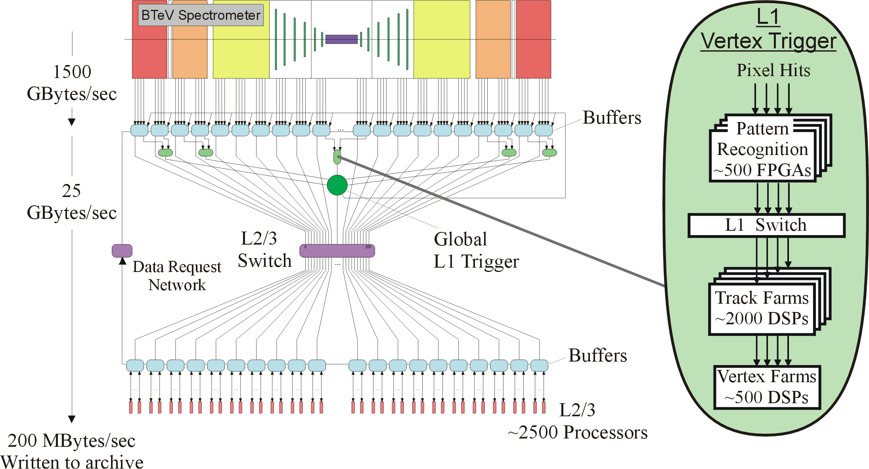
Motivating Application
Large scale Data Acquisition system for BTeV, a particle accelerator based physics
experiment to study matter – antimatter asymmetries in the decays of particle containing bottom quarks.

Slide 5
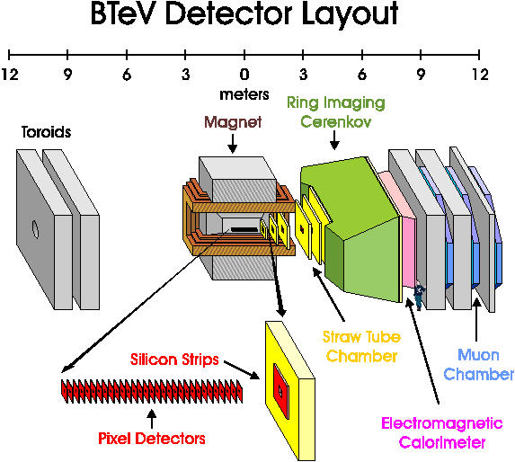

Slide 6
RunTime System Requirements
Must support real time scheduling and fault tolerance of L1 trigger
Soft real time support at L2 and L3 levels
Ability to store large amount of event data
Adaptive to changing load conditions
Adaptive to changes in operating(environmental) conditions
Should be able to actively monitor hardware, detect errors,
carry out/start recovery procedures, send reports

Slide 7
“Agents” Vs “Daemons”
VLAs are proactive as well as reactive in nature.
They exhibit agent properties like
Rationality
Ability to learn
Autonomy.
In traditional AI, agents are known to be “heavyweight” and slow
processes and were seldom used in systems where guaranteed
response time is desired.

Slide 8
Design Criteria for Very Lightweight Agents
Should have small footprint (to fit in the DSP memory).This
requirement is more stringent at L1 level compared to L2/3.
Should be able to be accommodated in the spare cycles left
over by the HEP application
Should be scalable
Fast error detection

Slide 9
Design Criteria for Very Lightweight Agents
Should be adaptive(should be able to change rules in real time)
Monitor Hardware
Monitor Software
Platform Independence
Error Reporting
(Efficient)Communication with higher level software entity

Slide 10
Possible Hardware Checks by VLA
CPU temperature monitoring (lm_Sensors package under Linux)
Network interface testing
Motherboards will be tested not only during POST (Pre Operation Self Test), but also batteries that supply energy to the CMOS clock and ROM.
Memory checking will be carried out in addition to error
correction through rules in higher layers.
Sensor Failure (dealt with Virtual Sensor)

Slide 11
Possible Software checks by VLA
CPU load monitoring.
Not-so-critical error conditions can prompt checking for more
critical symptoms more often.
Correlation and aggregation of data and errors detected.

Slide 12
Subsumption Architecture
Level 3
Level 2
Level 1
Level 0
Sensors
Actuators

Slide 13
Why Subsumption Architecture for VLAs?
Salient Features :
No explicit knowledge representation
Layered reactive architecture consisting of finite state machines implemented as a very simple Condition->Action rule
Many rules can fire at the same time
Rules in the higher layer can inhibit rules in lower layer
Steels’ Hierarchy :
Rules in higher layers can represent less urgent and abstract behaviors
Rules in lower layers can represent more urgent and concrete behaviors

Slide 14
Weakness of Subsumption Architecture
Higher-level layers always “subsumes" control lower-level layers.
But Lower layers are closer to the hardware and have more accurate information.
Higher level may be unaware of those problems.

Slide 15
Modification to Subsumption Architecture
Make the division between layers more flexible.
Blackboard architecture for VLA communication
Introduce proactivness in the subsumption architecture.

Slide 16
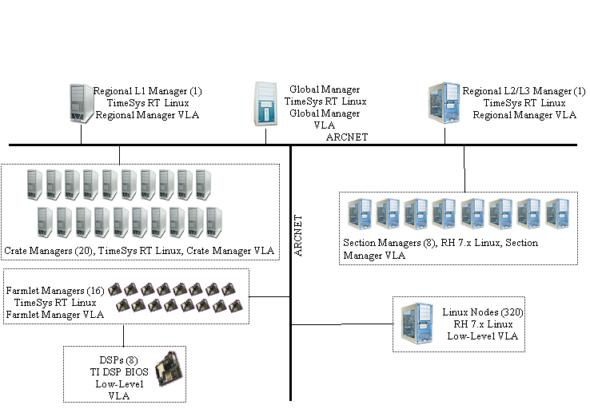
VLA Hierarchy in RTES

Slide 17
L1 Low Level VLA Rules
Rule # | Condition | Action
L1R1 | Event data are corrupted (noticed from the physics application). | Report to the Farmlet manager. Investigate if it is a hardware problem.
L1R2 | Too much event data. (noticed from the physics application.) | Report to Farmlet manager.
L1R3 | Too little data. (noticed from the physics application.) | Report to Farmlet manager.Note that the Farmlet manager may activate corresponding virtual sensor.
L1R4 | No input from sensors (noticed from the physics application.) | Report to the Farmlet manager. Test hardware integrity.

Slide 18
Rule # | Condition | Action
L1R5 | Overloaded DSP | Report to the Farmlet manager
L1R6 | Timer interrupt for periodic testing task has been received. | Perform the test.
L1R7 | Certain additional CPU cycles can be spared for the VLA | Run additional diagnostic procedure, communicate with other VLAs, perform preventive actions, check not-so-critical conditions, etc
L1R8 | None. | Check DSP CPU load.
The subsumption hierarchy for the L1-level VLAs is:
L1R4 < L1R5 < L1R1 < (L1R3 = L1R2) < L1R6 < L1R7 <L1R8.
L1R2 and L1R3 are mutually exclusive

Slide 19
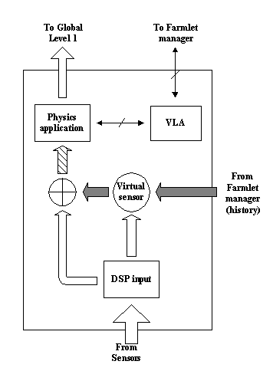
Virtual Sensor in RTES
Can be part of VLA in actual implementation.
Block arrows represent data paths.
Line arrows represent control paths.
Shaded arrows not activated in normal operation.
Shaded data paths are enabled when there is a need for extrapolating data.

Slide 20
When to run VLAs?
CPU time is distributed to HEP, kernel and VLAs
  Priority based scheduling, kernel>HEP>VLAs
  In terms of clock cycles, HEP>VLAs>Kernel
Scheduling should be adaptable to change in operating/
environmental conditions.
Working on a new scheduling algorithm to effectively schedule
Proactive VLA component, by exploiting a data pattern noticed in
BTeV. Paper to be submitted to EMSOFT.

Slide 21
Conclusion
Described an agent-based architecture for fault-tolerant, adaptive, very large-scale, real time, embedded computer systems.
Software agents based on Subsumption architecture with modifications suitable for the BTeV environment.
An individual VLA is simple. Multiple VLAs interact, we expect to see more complicated and sophisticated intelligent behaviors to emerge.

Slide 22
Conclusion Cont..
Modified subsumption architecture seems to be a good theoretical basis for designing VLAs as they directly deal with hardware.

Slide 23
Acknowledgements
John Gross – University of Pittsburgh
Supported through an NSF-ITR medium grant,
award number 0121658.

