Slide 1
Enriching and Designing Metaschemas for the UMLS Semantic Network
Yehoshua Perl
James Geller
Department of Computer Science
New Jersey Institute of Technology

Slide 2
Problem 1
Problem 1: the SN’s tree structure is restrictive since it does not allow multiple parents because each semantic type has at most one parent in the current SN.
Example:Gene or Genome
  Current parent: Fully Formed Anatomical Structure
  Fact: Gene or genome is also a kind of Molecular Sequence.
  Result: this subsumption knowledge is omitted.

Slide 3
Problem 1 (cont’d)
  Disadvantages:
    We have no direct access to the subsumption knowledge.
    We have difficulties in reasoning and decision making.
    The relationship modeling for Gene or Genome is limited, because it cannot inherit valid relationships from Molecular Sequence.

Slide 4
Problem 2
The SN is very complex, due to many relationships, making it difficult for user orientation.
  135 semantic types
  133 IS-A relationships
  About 7,000 semantic relationship occurrences
  It is difficult to gain knowledge from the picture of the SN.
  The following page shows about 1/4 of the SN with many relationships abbreviated by numbers.

Slide 5
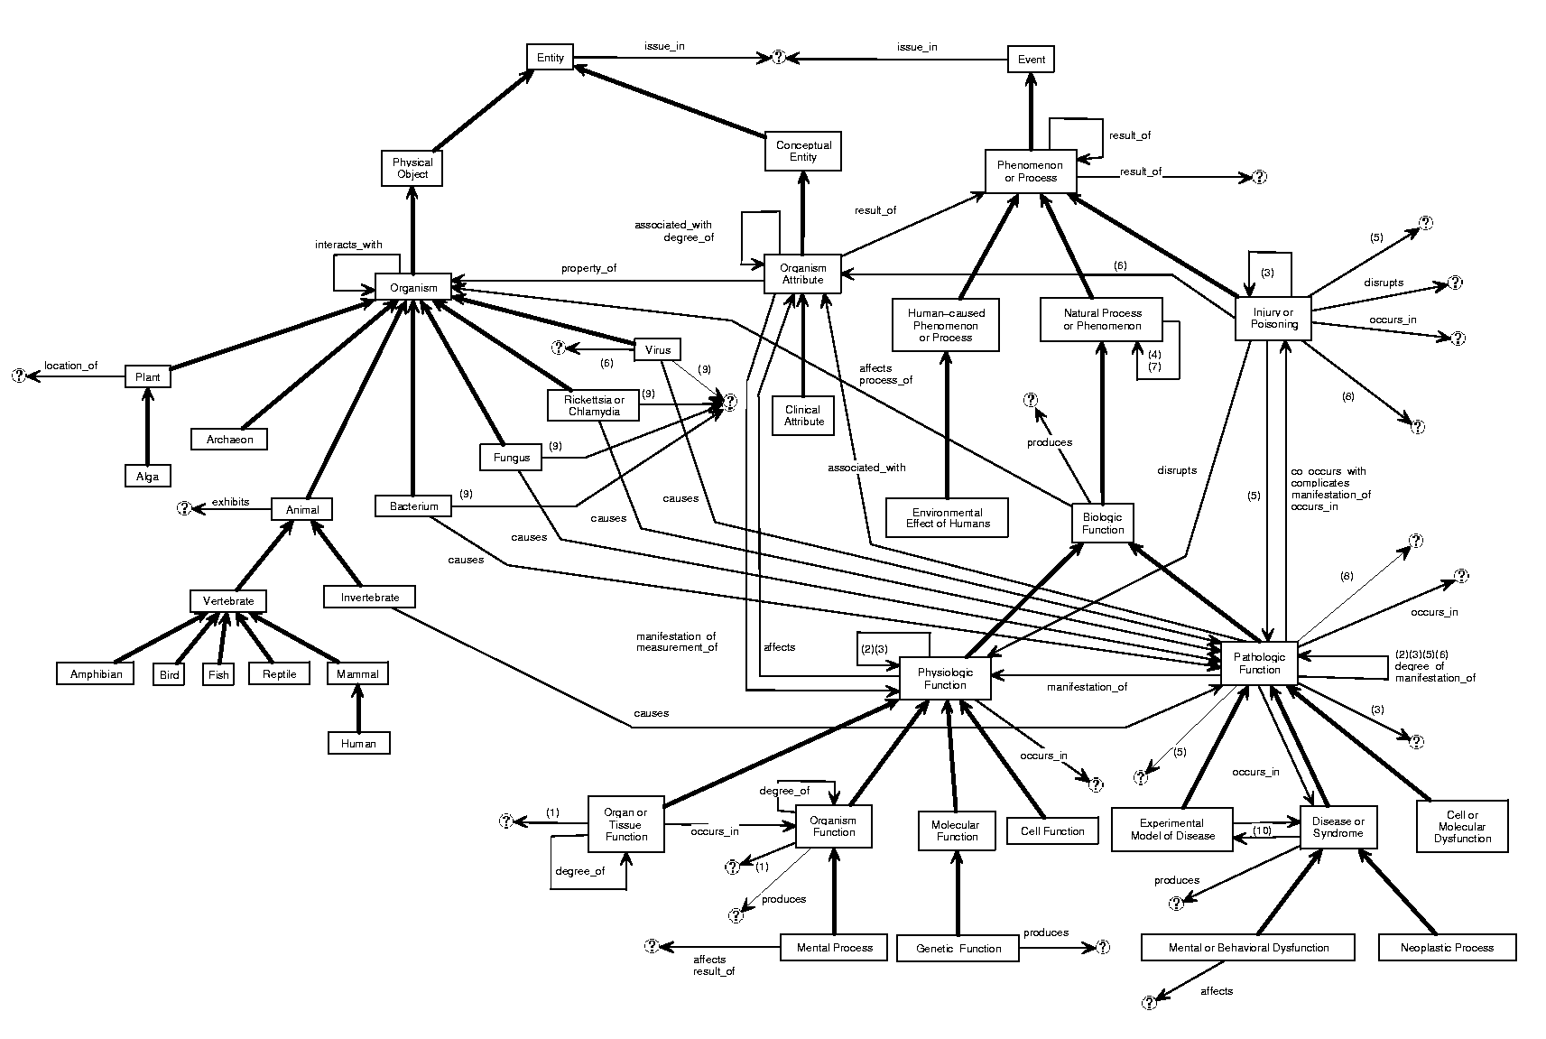
Notes:
Part of Event, Part of Entity, about ¼ of SN
Show interactions between the two parts.

Slide 6
Proposed Solutions
For the problem of SN’s restrictive structure
  Expand the SN into a multiple subsumption structure with a Directed Acyclic Graph (DAG) hierarchy.
  Called the Enriched Semantic Network (ESN)
  Accommodates multiple inheritance of semantic relationships.
For the problem of SN’s (ESN’s) comprehension
  Create a Metaschema as a higher-level abstraction of SN (do the same thing for ESN).
  The role of the Metaschema for the SN is similar to the role of the SN for the underlying META.

Slide 7


Problem1: Expand the SN to the ESN
Objective: Expand the SN from two trees to a DAG
Methods:
  Identify viable IS-A links by imposing connectivity on a partition of the SN [McCray, Burgun, Bodenreider, MedInfo’01]
  Identify viable IS-A links by string matching between semantic types’ names and definitions.

Slide 8
Method 1: Imposing Connectivity
[McCray, Burgun, Bodenreider, MedInfo’01] presented a partition of the SN consisting of 15 groups of semantic types.
The partition is based on a semantic approach:
  externally identify subject areas
  place semantic types in areas
Six principles for a partition are presented:
  One of them is Semantic Validity: the groups must be semantically coherent.
Notes:
Semantic Validity: Groups must be semantically coherent
Parsimony: the number of groups should be as small as possible
Completeness: The groups must cover the full domain
Exclusivity: each concept in the domain must belong to only one group
Naturalness: the groups must characterize the domain in a way that is acceptable to a domain expert
Utility: the groups must be useful for some purpose

Slide 9
Semantic Validity
Judging semantic validity:
  We check whether the types in a group are hierarchically related to each other (by IS-A links) to form a connected subgraph of the SN (“Connectivity Property”).
  Because the SN’s IS-A hierarchy consists of two trees, such a connected subgraph in the current SN must form a tree with a unique root.

Slide 10
Semantic Validity (cont’d)
Some groups are disconnected.
They have multiple roots so that not all semantic types in the groups are subsumed under one category.
E.g.: Genes and Molecular Sequences group
T085
Molecular Sequence
T088
Carbohydrate Sequence
T087
Amino Acid Sequence
T086
Nucleotide Sequence
T028
Gene or Genome

Slide 11
Identify IS-A based on Imposing Connectivity
Step 1: Analyze disconnected groups in the partition.
Step 2:
  Convert each disconnected group into a new connected group (sometimes several connected groups).
  Identify viable IS-A links during the conversion procedure.
  Present 4 kinds of transformations: IS-A addition, Root-addition, Split, and Root-moving.
Notes:
Based on the analysis, can we identify potentially additional IS-A links if we enforce connectivity property to those disconnected groups?

Slide 12
Four Transformations
(1) “IS-A Addition” Transformation
  Identify and add IS-A links to transform a disconnected group into a connected one.
(2) “Root-addition” Transformation
  Create a new semantic type that will be an ancestor of all roots in the group.
    Disconnected group must have multiple roots, so we need to make these roots subsumed under one common category.
  Make the new semantic type a root of the new group by adding additional IS-A links to it from all roots in the group.

Slide 13
Four Transformations (cont’d)
(3) “Split” Transformation
  Split a group into several smaller connected groups.
  Each of the smaller groups is either a tree or can be transformed into a tree by using other transformations.
(4) “Root-moving” Transformation
  Find the lowest common ancestor of all roots of the disconnected group.
  Make this lowest common ancestor the root of the new group.

Slide 14
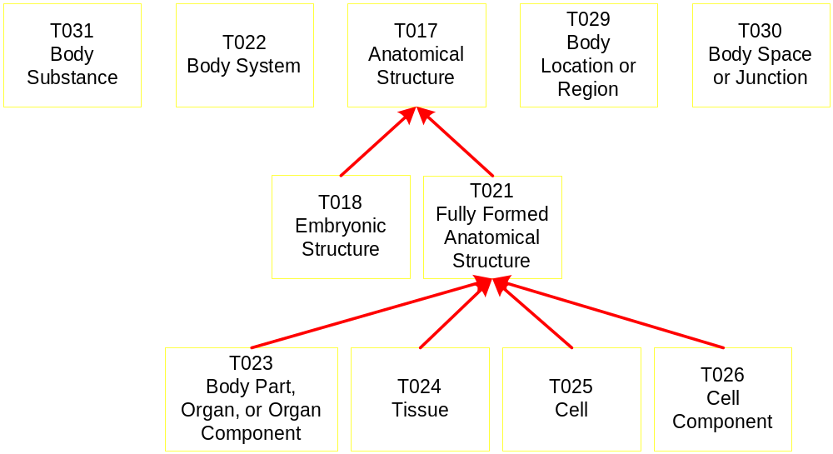
Root-addition Transformation Example
Notes:
Body Location or Region, Body Space or Junction, Body System are in conceptual entity branch;
Body Substance, Anatomical Structure are in Physical Object branch.

Slide 15
Root-addition Transformation Example
We utilized the analysis of anatomy concepts of the Digital Anatomist Foundational Model (DAFM).
DAFM was developed at the U. of Washington [C. Rosse, et al. Amia ‘95, Jamia ‘98]

Slide 16
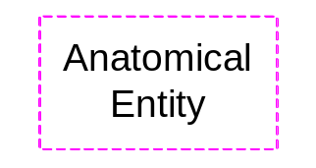
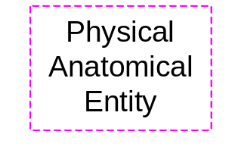
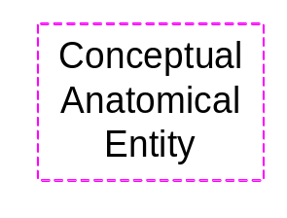
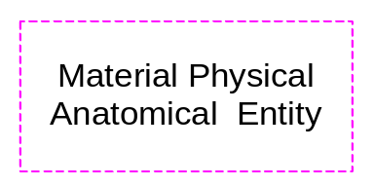
Anatomical Entity Group
T030
T017
T031
T022
T029
Body Space
Anatomical
Body
Body System
Body Location
or Junction
Structure
Substance
or Region
T018
T021
Embryonic
Fully Formed
Structure
Anatomical
Structure
T023
T026
Body Part,
T024
T025
Cell
Organ, or Organ
Tissue
Cell
Component
Component
Notes:
Using the analysis of anatomical concepts in [Rosse01] , we found:
Body Location or Region and Body System have neither mass nor spatial dimension;
Body Space or Junction has spatial dimension but no mass
Body substance has mass but no spatial dimension
Add following IS-A links:
Body Location or Region IS-A Conceptual Anatomical Entity
Body System IS-A Conceptual Anatomical Entity
Body Space or Junction IS-A Physical Anatomical Entity
Body Substance IS-A Material Physical Anatomical Entity
Anatomical Structure IS-A Material Physical Anatomical Entity
Material Physical Anatomical Entity IS-A Physical Anatomical Entity
Physical Anatomical Entity IS-A Physical Object
Physical Anatomical Entity IS-A Anatomical Entity
Conceptual Anatomical Entity IS-A Anatomical Entity
Anatomical Entity IS-A Entity
Body Location or Region, Body Space or Junction are in Conceptual Entity tree, while Body System and Anatomical Structure are in Physical Object tree. Can not connect them under one semantic type in current tree structure.

Slide 17
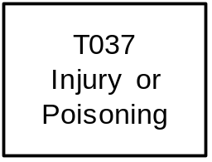
IS-A addition and Split Transformation Example
T046
T190
T033
Pathologic
Anatomical
Finding
Function
Abnormality
T050
T047
T049
T019
T020
T184
Experimental
Disease or
Cell or
Congenital
Acquired
Sign or
Model or
Syndrome
Molecular
Abnormality
Abnormality
Symptom
Disease
Dysfunction
T048
T191
Mental or
Neoplastic
Behavioral
Process
Dysfunction
Pathologic Function
Anatomical Abnormality
Finding
Notes:
Action:
Split the group into three small groups:
Pathologic Function group;
Anatomical Abnormality group;
Finding Group
All three groups are trees, satisfying the connectivity property
Injury or Poisoning emphasizes more on the disorder result than on the process producing this disorder result.
Here, we identified a missing IS-A link from Injury or Poisoning to Disease or Syndrome by transformation 1

Slide 18
Method 2: String Matching
Definition (CP-pair): a pair (T₁; T₂) is a CP-pair if T₁ is a child of T₂
Definition (String match): A string match from a semantic type T₁ to another semantic type T₂ is a triple (T₁; T₂; S) such that S is a string appearing both in the definition of T₁ and in the name of T₂. S is called the common string.
In the definition, lexical normalization is used to convert adjectives and other formats to noun format.

Slide 19
Observation
Observation: among the 133 CP-pairs of semantic types, 88 have matches from children to their respective parents.
If there is a match from one semantic type to another not connected by IS-A path, then it may imply an IS-A relationship between them.
Method: Find string matches between any two semantic types having no IS-A path between them.

Slide 20

Example
Enzyme: a complex chemical, usually a protein, that is produced by living cells and which catalyzes specific biochemical reactions
Three matches:
  (Enzyme; Amino Acid, Peptide, or Protein; “protein”)
  (Enzyme; Cell; “cell”)
  (Enzyme; Cell Component; “cell”)
  The match between Enzyme and Chemical is not considered, because Chemical is an ancestor of Enzyme in the SN.
Viable IS-A: Enzyme IS-A Amino Acid, Peptide, or Protein

Slide 21
Matching Results
All matches were reviewed by a domain expert
There are only a few valid matches that indicate new viable IS-A links (5):
  Enzyme IS-A Amino Acid, Peptide, or Protein
  Receptor IS-A Cell Component
  Vitamin IS-A Pharmacologic Substance
  Vitamin IS-A Organic Chemical
  Gene or Genome IS-A Molecular Sequence

Slide 22
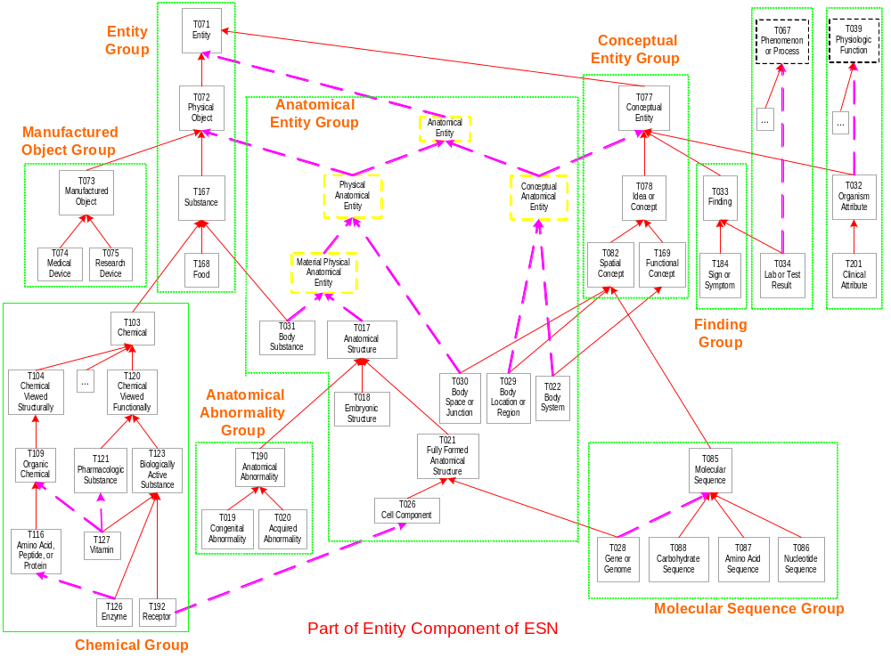

Slide 23
ESN’s Relationship Structure
ESN is different from SN:
  Allows semantic type to inherit more relationships from its new parent (“multiple inheritance”).
  Has 21 semantic types having multiple parents/ancestors
  Expands the relationship model of these 21 types
ESN’s relationship structure:
  Preserves existing relationships in the SN (6,977)
  Includes new relationships inherited from new parents/ancestors

Slide 24
Validity of Newly Inherited Relationships
Observations: New relationships come from the four new semantic types or semantic types having multiple parents or ancestors.
  4 new semantic types, 12 new relationships for them
  414 newly inherited relationships involving the 21 semantic types having multiple parents/ancestors.
  Question: are all the 414 relationships valid?
  For each of the 21 semantic types, we checked the validity of the new relationships inherited from its new parent/ancestor.

Slide 25
Validity Check Example
For example:
  Injury or Poisoning has new parent Disease or Syndrome.
  It has 112 new relationships inherited from Disease or Syndrome.
  After review, 92 are valid and retained in the ESN, 20 are invalid and blocked in the ESN.

Slide 26
ESN relationship Structure Summary
Among the 414 newly inherited relationships, 314 are valid and inherited by 12 semantic types, 100 are invalid.
Only seven blockings suffice to prevent 100 invalid relationships.
The ESN has 7,303 (6,977+12+314) relationship occurrences.
Among the 139 semantic types in the ESN, 16 (12+4 new) have different relationship structures.

Slide 27
ESN Summary
ESN’s IS-A hierarchy:
  139 semantic types, 150 IS-A links
  21 semantic types have multiple parents/ancestors
ESN’s relationship structure:
  7,303 semantic relationship occurrences (5% more)

Slide 28
Problem 2: SN/ESN’s comprehension
The SN is still too hard to understand.
  There are 135 semantic types, 133 IS-A links
  About 7,000 semantic relationships (6977)
Solution:
  Build a higher-level abstraction for the SN/ESN.
  Referred to as a Metaschema

Slide 29
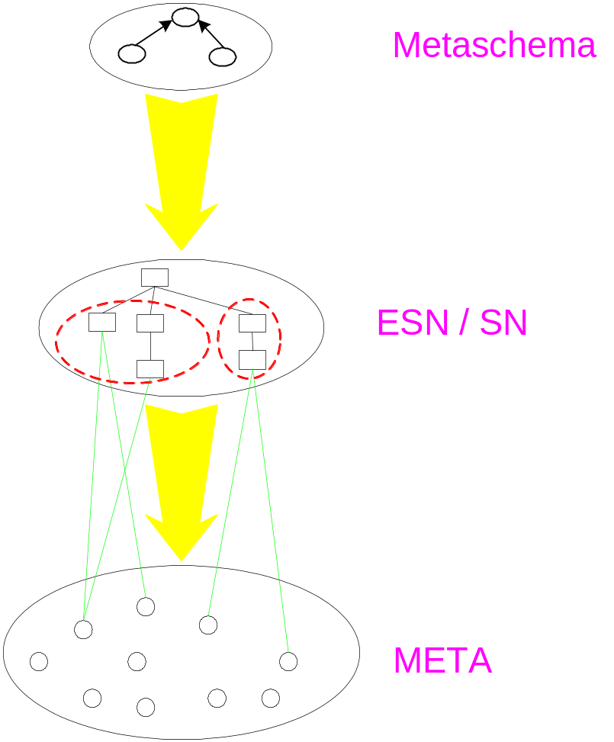
Metaschema

Slide 30
Metaschema Requirements and Derivation
Metaschema:
  A set of meta-semantic types (MSTs)
  Hierarchical meta-child-of relationships between MSTs
  Meta-relationships between MSTs
A Metaschema of the SN (ESN) will represent a partition of the SN (ESN).

Slide 31
Metaschema Requirements and Derivation (cont’d)
Procedure to build metaschema:
  Step 1: Partition the SN (ESN) into disjoint semantic-type groups.
  Step 2: Define a meta-semantic type (MST) to represent each semantic-type group.
  Step 3: Derive hierarchical meta-child-of relationships between meta-semantic types.
  Step 4: Derive meta-relationships between meta-semantic types.

Slide 32
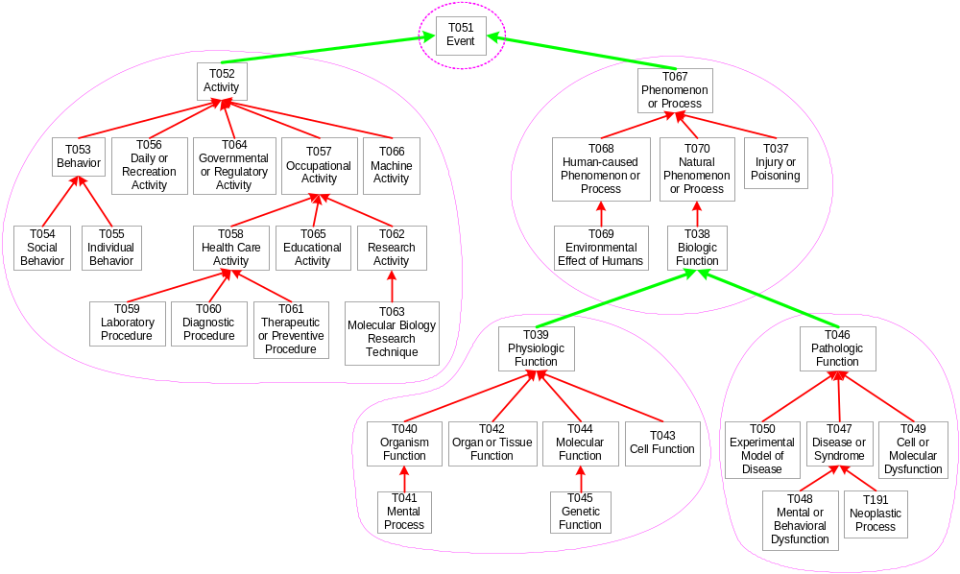
Partition Example

Slide 33
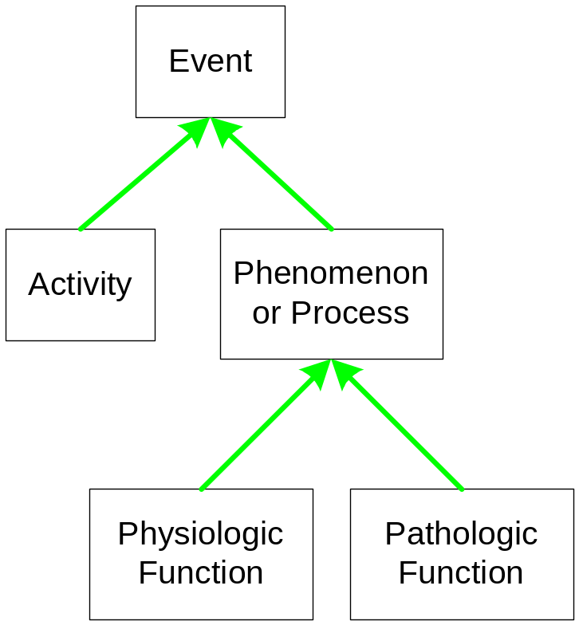
Metaschema example

Slide 34
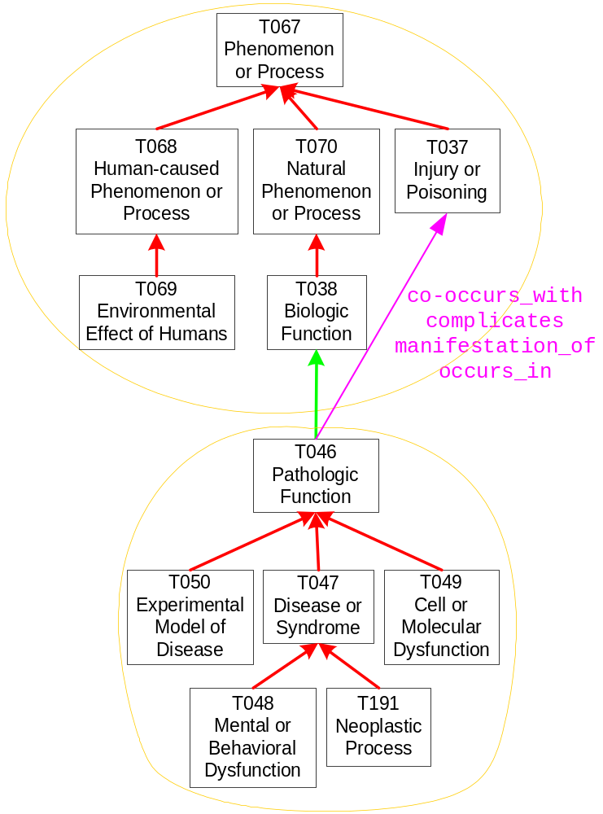
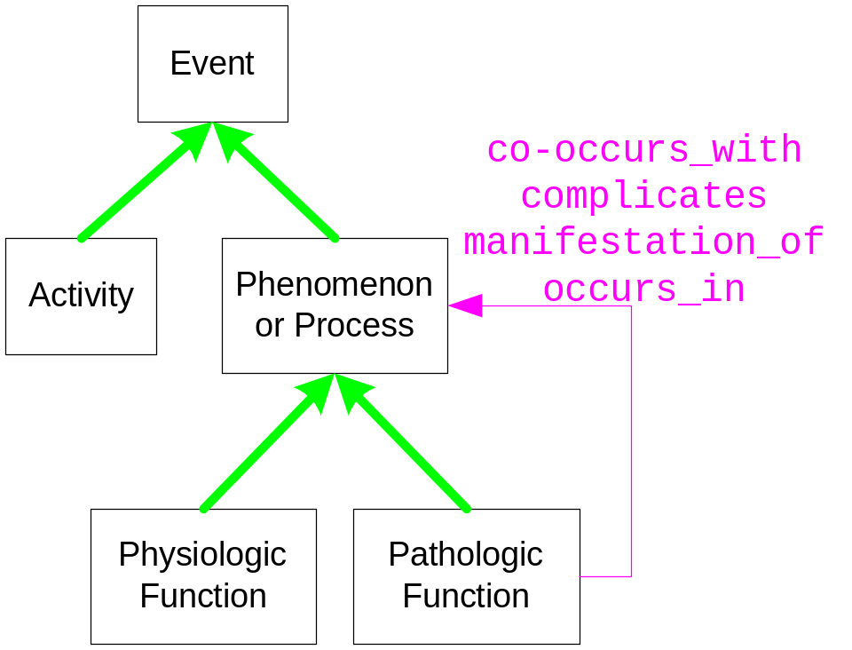
Meta-relationship Example
meta-relationship example

Slide 35
ESN’s two metaschemas
Q-metaschema (Qualified Metaschema)
  Basis: the partition of 19 disjoint semantic-type groups obtained when we expanded the SN to the ESN [Zhang, JBI 2003]
C-metaschema (Cohesive Metaschema)
  Basis: cohesive partition which partitioned all semantic types exhibiting the same relationship set into one semantic type group [M. Halper, et al. Amia 2001][Perl JBI 2003]

Slide 36
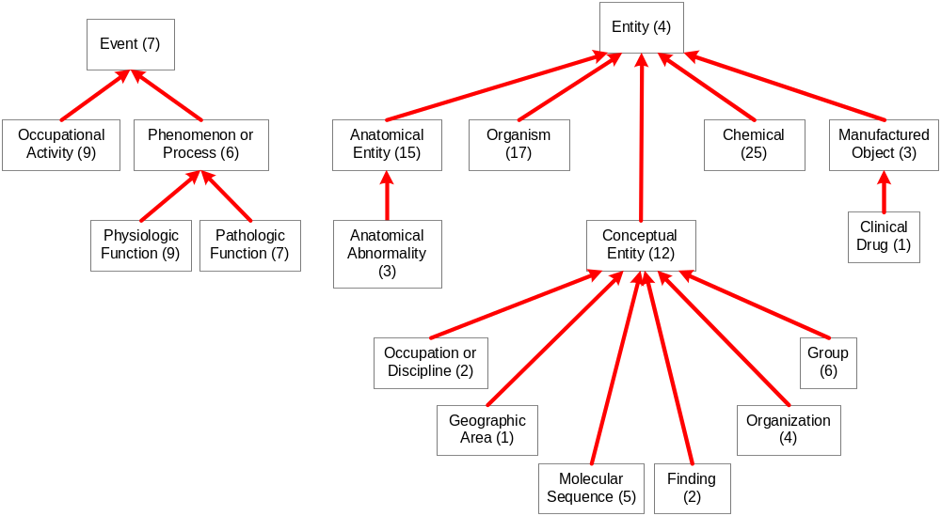
Q-metaschema hierarchy

Slide 37
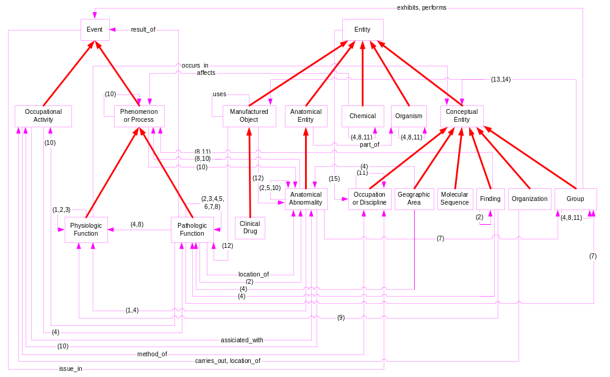
Q-metaschema including meta-relationships

Slide 38
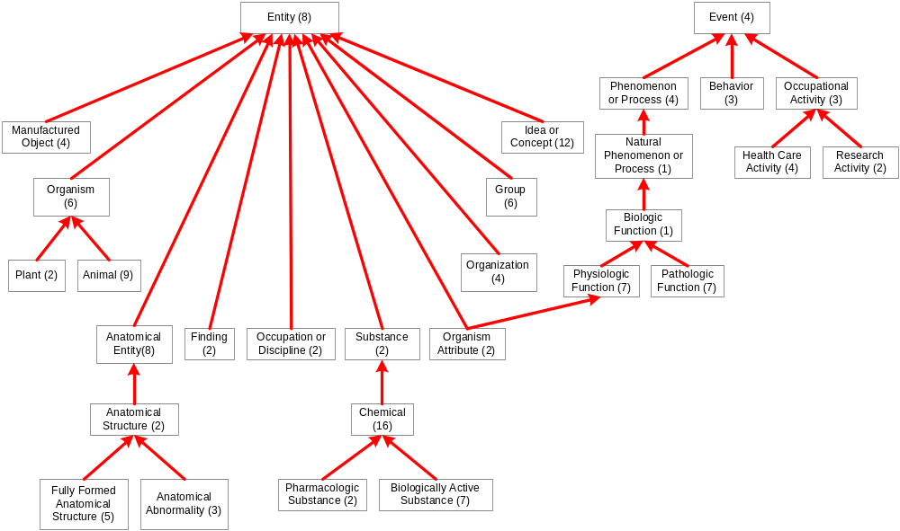
C-metaschema hierarchy

