Slide 1
Symbolic Execution and
Model Checking for Testing
Corina Păsăreanu and Willem Visser
Perot Systems/NASA Ames Research Center and SEVEN Networks

Slide 2
Thanks
Saswat Anand (Georgia Institute of Technology)
Sarfraz Khurshid (University of Texas, Austin)
Radek Pelánek (Masaryk University, Czech Republic)
Suzette Person (University of Nebraska, Lincoln)
Aaron Tomb (University of California, Santa Cruz)
David Bushnell, Peter Mehlitz, Guillaume Brat (NASA Ames)

Slide 3
Introduction
Goal:
  Detect errors in complex software
  Data structures, arrays, concurrency
Solutions:
  Software model checking with (predicate) abstraction
    Automatic, exhaustive
    Scalability issues – Explicit state model checking can not handle large, complex input domains
    Reported errors may be spurious
  Static analysis
    Automatic, scalable, exhaustive
    Reported errors may be spurious
  Testing
    Reported errors are real
    May miss errors
    Well accepted technique: state of practice for NASA projects
Our approach:
  Combine model checking and symbolic execution for test case generation

Slide 4
Model Checking vs Testing/Simulation
OK
FSM
Simulation/
Testing
Model individual state machines for subsystems / features
Simulation/Testing:
  Checks only some of the system executions
  May miss errors
Model Checking:
  Automatically combines behavior of state machines
  Exhaustively explores all executions in a systematic way
  Handles millions of combinations – hard to perform by humans
  Reports errors as traces and simulates them on system models
error
FSM
OK
Model Checking
error trace
specification
Line 5: …
Line 12: …
…
Line 41:…
Line 47:…

Slide 5
Java PathFinder (JPF)
Explicit state model checker for Java bytecode
  Built on top of custom made Java virtual machine
Focus is on finding bugs
  Concurrency related: deadlocks, (races), missed signals etc.
  Java runtime related: unhandled exceptions, heap usage, (cycle budgets)
  Application specific assertions
JPF uses a variety of scalability enhancing mechanisms
  user extensible state abstraction & matching
  on-the-fly partial order reduction
  configurable search strategies
  user definable heuristics (searches, choice generators)
Recipient of NASA “Turning Goals into Reality” Award, 2003.
Open sourced:
  <javapathfinder.sourceforge.net>
  ~14000 downloads since publication
Largest application:
  Fujitsu (one million lines of code)

Slide 6
Symbolic Execution
JPF– SE [TACAS’03,’07]
  Extension to JPF that enables automated test case generation
  Symbolic execution with model checking and constraint solving
  Applies to (executable) models and to code
  Handles dynamic data structures, arrays, loops, recursion, multi-threading
  Generates an optimized test suite that satisfy (customizable) coverage criteria
  Reports coverage
  During test generation process, checks for errors

Slide 7
Symbolic Execution
Systematic Path Exploration
Generation and Solving of Numeric Constraints
[pres = 460; pres_min = 640; pres_max = 960]
if( (pres < pres_min) || (pres > pres_max)) {
…
} else {
…
}
[pres = Sym₁; pres_min = MIN; pres_max = MAX] [path condition PC: TRUE]
if ((pres < pres_min) ||
(pres > pres_max)) {
…
} else {
…
}
if ((pres < pres_min)) ||
(pres > pres_max)) {
…
} else {
…
}
if ((pres < pres_min) ||
(pres > pres_max)) {
…
} else {
…
}
[PC₁: Sym₁< MIN]
[PC₂: Sym₁ > MAX]
[PC₃: Sym₁ >= MIN &&
Sym₁ <= MAX
Solve path conditions PC₁, PC₂, PC₃ → test inputs

Slide 8
Applications
NASA control software
  Manual testing: time consuming (~1 week)
  Guided random testing could not obtain full coverage
  JPF-SE
    Generated ~200 tests to obtain full coverage
    Total execution time is < 1 min
    Found major bug in new version
K9 Rover Executive
  Executive developed at NASA Ames
  Automated plan generation based on CRL grammar + symbolic constraints
  Generated hundreds of plans to test Exec engine
  Combining Test Case Generation and Runtime Verification [journal TCS, 2005]
Test input generation for Java classes:
  Black box, white box [ISSTA’04, ISSTA’06]

Slide 9
Symbolic Execution
King [Comm. ACM 1976]
Analysis of programs with unspecified inputs
  Execute a program on symbolic inputs
Symbolic states represent sets of concrete states
For each path, build a path condition
  Condition on inputs – for the execution to follow that path
  Check path condition satisfiability – explore only feasible paths
Symbolic state
  Symbolic values/expressions for variables
  Path condition
  Program counter
Notes:
Say we use Omega lib

Slide 10
Example – Standard Execution
Code that swaps 2 integers
Concrete Execution Path
int x, y;
if (x > y) {
x = x + y;
y = x – y;
x = x – y;
if (x > y)
assert false;
}
x = 1, y = 0
1 > 0 ? true
x = 1 + 0 = 1
y = 1 – 0 = 1
x = 1 – 1 = 0
0 > 1 ? false

Slide 11
Example – Symbolic Execution
Code that swaps 2 integers
Symbolic Execution Tree
path condition
int x, y;
if (x > y) {
x = x + y;
y = x – y;
x = x – y;
if (x > y)
assert false;
}
[PC:true]x = X,y = Y
[PC:true] X > Y ?
false
true
[PC:X≤Y]END
[PC:X>Y]x= X+Y
[PC:X>Y]y = X+Y–Y = X
[PC:X>Y]x = X+Y–X = Y
[PC:X>Y]Y>X ?
false
true
[PC:X>Y∧Y≤X]END
[PC:X>Y∧Y>X]END
False!
Notes:
Say what PC represents: precondition for the inputs to follow a particular path

Slide 12
Generalized Symbolic Execution
JPF – SE handles
  Dynamically allocated data structures
  Arrays
  Numeric constraints
  Preconditions
  Recursion, concurrency, etc.
Lazy initialization for arrays and structures [TACAS’03, SPIN’05]
Java PathFinder (JPF) used
  To generate and explore the symbolic execution tree
  Non-determinism handles aliasing
    Explore different heap configurations explicitly
  Off-the-shelf decision procedures check path conditions
    Model checker backtracks if path condition becomes infeasible
Subsumption checking and abstraction for symbolic states
Notes:
Say we use omega library

Slide 13
Example
NullPointerException
class Node {
int elem;
Node next;
Node swapNode() {
if (next != null)
if (elem > next.elem) {
Node t = next;
next = t.next;
t.next = this;
return t;
}
return this;
}
}
Input list +
Constraint
Output list
?
null
none
?
null
E0
none
E0
E0
E1
E0 <= E1
E0
E1
E0
E1
null
E0 > E1
E1
E0
null
E0
E1
E0 > E1
E1
E0
E0
E1
E0 > E1
E1
E0
E0
E1
?
E0 > E1
E1
E0
?

Slide 14
Lazy Initialization (illustration)
consider executing
next = t.next;
next
next
E0
E1
t
Precondition: acyclic list
next
next
next
next
next
next
next
E0
E1
null
E0
E1
?
E0
E1
E0
next
E1
t
t
t
next
t
next
next
next
next
next
E0
E1
null
E0
E1
?
t
t

Slide 15
Implementation
Initial implementation
  Done via instrumentation
  Programs instrumented to enable JPF to perform symbolic execution
  General: could use/leverage any model checker
Decision procedures used to check satisfiability of path conditions
  Omega library for integer linear constraints
  CVCLite, STP (Stanford), Yices (SRI)

Slide 16
Implementation via Instrumentation
    OmegaLib,
    CVCLite, STP,
    Yices
decision
procedure
continue/
backtrack
state:
program
instrumentation
instrumented program
path condition (data)
original program
model
checking
heap configuration
thread scheduling
correctness specification/
coverage criterion
counterexample(s)/test suite
[heap+constraint+thread scheduling]

Slide 17
State Matching: Subsumption Checking
Performing symbolic execution on looping programs
  May result in an infinite execution tree
Perform search with limited depth
State matching – subsumption checking
  [SPIN’06, J. STTT to appear]
  Obtained through DFS traversal of “rooted” heap configurations
    Roots are program variables pointing to the heap
  Unique labeling for “matched” nodes
  Check logical implication between numeric constraints
Notes:
Same program counter

Slide 18
State Matching: Subsumption Checking
Stored state:
1:
E₁
E₁ > E₂ ∧
E₂ > E₃ ∧
E₂ ≤ E₄ ∧
E₁ > E₄
Set of concrete
states represented
by stored state
2:
E₂
3:
E₃
4:
E₄
⊆
⇒
⊆
1:
E₁
E₁ > E₂ ∧
E₂ > E₃ ∧
E₂ < E₄ ∧
E₁ > E₄
New state:
Set of concrete
states represented
by new state
2:
E₂
3:
E₃
4:
E₄
Normalized using existential quantifier elimination
Notes:
We handle only integer constraints

Slide 19
Abstract Subsumption
Symbolic execution with subsumption checking
  Not enough to ensure termination
  An infinite number of symbolic states
Our solution
  Abstraction
    Store abstract versions of explored symbolic states
    Subsumption checking to determine if an abstract state is re-visited
    Decide if the search should continue or backtrack
  Enables analysis of under-approximation of program behavior
  Preserves errors to safety properties/ useful for testing
Automated support for two abstractions:
  Shape abstraction for singly linked lists
  Shape abstraction for arrays
  Inspired by work on shape analysis (e.g. [TVLA])
No refinement!

Slide 20
Abstractions for Lists and Arrays
Shape abstraction for singly linked lists
  Summarize contiguous list elements not pointed to by program variables into summary nodes
  Valuation of a summary node
    Union of valuations of summarized nodes
  Subsumption checking between abstracted states
    Same algorithm as subsumption checking for symbolic states
    Treat summary node as an “ordinary” node
Abstraction for arrays
  Represent array as a singly linked list
  Abstraction similar to shape abstraction for linked lists

Slide 21
Abstraction for Lists
Symbolic states
Abstracted states
1:
2:
3:
this
V₀
next
V₁
next
V₂
next
this
V₀
next
V₁
next
V₂
next
n
n
E₁ = V₀ ∧ E₂ = V₁ ∧ E₃ = V₂
PC: V₀ ≤ v ∧ V₁ ≤ v
PC: V₀ ≤ v ∧ V₁ ≤ v
Unmatched!
⊆
1:
2:
3:
this
V₀
next
V₁
next
V₂
next
V₃
next
this
V₀
next
{ V₁
, V₂ }
next
V₃
next
n
n
E₁ = V₀ ∧ (E₂ = V₁ ∨ E₂ = V₂) ∧ E₃ = V₃
PC: V₀ ≤ v ∧ V₁ ≤ v ∧ V₂ ≤ v
PC: V₀ ≤ v ∧ V₁ ≤ v ∧ V₂ ≤ v
Notes:
From the list example that I showed before

Slide 22
Applications of JPF-SE
Test input generation for Java classes [ISSTA’04,’06]
  Black box
    Run symbolic execution on Java representation of class invariant
  White box
    Run symbolic execution on Java methods
    Use class invariant as pre-condition
  Test sequence generation
Proving program correctness with generation of loop invariants [SPIN’04]
Error detection in concurrent software
Test input generation for NASA flight control software

Slide 23
Test Sequence Generation for Java Containers
Containers – available with JPF distribution
  Binary Tree
  Fibonacci Heap
  Binomial Heap
  Tree Map
Explore method call sequences
  Match states between calls to avoid generation of redundant states
  Abstract matching on the shape of the containers
Test input – sequence of method calls
  BinTree t = new BinTree();
  t.add(1);
  t.add(2);
  t.remove(1);

Slide 24
Testing Java Containers
Comparison
  Explicit State Model Checking (w/ Symmetry Reductions)
  Symbolic Execution
  Symbolic/Concrete Execution w/ Abstract Matching
  Random Testing
Testing coverage
  Statement, Predicate
Results
  Symbolic execution worked better than explicit model checking
  Model checking with shape abstraction
    Good coverage with short sequences
    Shape abstraction provides an accurate representation of containers
  Random testing
    Requires longer sequences to achieve good coverage

Slide 25
Test Input Generation for NASA Software
Abort logic (~600 LOC)
  Checks flight rules, if violated issues abort
  Symbolic execution generated 200 test cases
    Covered all flight rules/aborts in a few seconds, discovered errors
  Random testing covered only a few flight rules (no aborts)
  Manual test case generation took ~20 hours
Integration of Automated Test Generation with End-to-end Simulation
  JPF—SE: essentially applied at unit level
  Input data is constrained by environment/physical laws
    Example: inertial velocity can not be 24000 ft/s when the geodetic altitude is 0 ft
  Need to encode these constraints explicitly
  Use simulation runs to get data correlations
  As a result, we eliminated some test cases that were impossible due to physical laws, for example

Slide 26
Related Approaches
Korat: black box test generation [Boyapati et al. ISSTA’02]
Concolic execution [Godefroid et al. PLDI’05, Sen et al. ESEC/FSE’05]
  DART/CUTE/jCUTE/…
Concrete model checking with abstract matching and refinement [CAV’05]
Symstra [Xie et al. TACAS’05]
Execution Generated Test Cases [Cadar & Engler SPIN’05]
Testing, abstraction, theorem proving: better together! [Yorsh et al. ISSTA’06]
SYNERGY: a new algorithm for property checking [Gulavi et al. FSE’06]
Feedback directed random testing [Pacheco et al. ICSE’07]
…

Slide 27
Variably Inter-procedural Program Analysis for Runtime Error Detection
[ISSTA’07] Willem Visser, Aaron Tomb, and Guillaume Brat
Dedicated tool to perform symbolic execution for Java programs
  Does not use JPF
  Can customize
    Procedure call depth
    Max size of path condition
    Max number of times a specific instruction can be revisited during the analysis
Unsound and incomplete
  Generated test cases are run in concrete execution mode to see if they correspond to real errors
  “Symbolic execution drives the concrete execution”

Slide 28
Variably Inter-procedural Program Analysis for Runtime Error Detection
Applied to 6 small programs and 5 larger programs (including JPF 38538 LOC, 382 Classes, 2458 Methods)
Varied:
  Inter-procedural depth: 0, 1 and 2
  Path Condition size: 5, 10, 15, 20 and 25
  Instruction revisits: 3, 5, and 10
Results:
  Found known bugs
  Increasing the call depth does not necessarily expose errors, but decreases the number of false warnings
Checking feasibility of path conditions
  Takes a lot of time (up to 40% in some of the larger applications)
  Greatly helps in pruning infeasible paths/eliminating false warnings
More interesting results – see the paper

Slide 29
Current and Future Work
New symbolic execution framework
  Moved inside JPF
  Non-standard interpretation of bytecodes
  Symbolic information propagated via attributes associated with program variables, operands, etc.
  Uses Choco (pure Java, from <sourceforge>) – for linear/non-linear integer/real constraints
  Available from <javapathfinder.sourceforge.net>
Start symbolic execution from any point in the program
Compositional analysis
  Use symbolic execution to compute procedure summaries
Integration with system level simulation
  Use system level Monte Carlo simulation to obtain ranges for inputs
Test input generation for UML Statecharts
  Recent JPF extension
Use symbolic execution to aid regression testing
Apply to NASA software …

Slide 30
Thank you!

Slide 31
JPF – SE
JPF
formula
satisfiable/unsatisfiable
Generic Decision Procedure Interface
Omega
Maryland
CVCLite
Stanford
STP
Stanford
Yices
SRI

Slide 32
Communication Methods
JPF and the Interface code is in Java
  Decision procedures are not in Java, mainly C/C++ code
Various different ways of communication
  Native: using JNI to call the code directly
  Pipe: start a process and pipe the formulas and results back and forth
  Files: same as Pipe but now use files as communication method
Optimizations:
  Some decision procedures support running in a incremental mode where you do not have to send the whole formula at a time but just what was added and/or removed.
  CVCLite, Yices

Slide 33
Decision Procedure Options
+symbolic.dp=
  omega.file
  omega.pipe
  omega.native
  omega.native.inc
    …inc - with table optimization
  yices.native
  yices.native.inc
  yices.native.incsolve
    …incsolve - Table optimization and incremental solving
  cvcl.file
  cvcl.pipe
  cvcl.native
  cvcl.native.inc
  cvcl.native.incsolve
  stp.native
If using File or Pipe one must also set
  Symbolic.<name>.exe to the executable binary for the DP
For the rest one must set LD_LIBRARY_PATH to where the DP libraries are stored
  Extensions/symbolic/CSRC
Currently everything works under Linux and only CVCLite under Windows
  Symbolic.cvclite.exe = cvclite.exe must be set with CVClite.exe in the Path

Slide 34
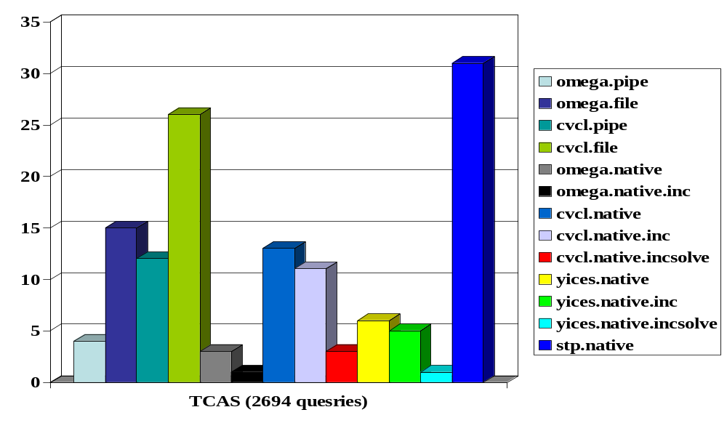
Results TCAS

Slide 35
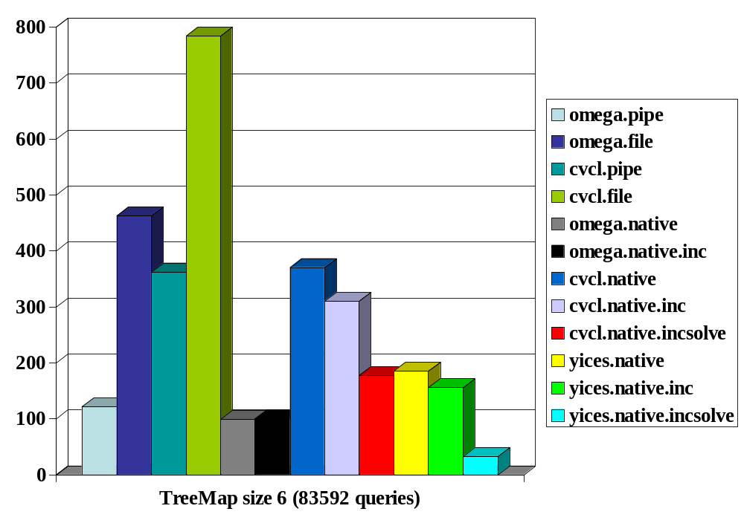
Results TreeMap
STP took > 1 hour

