Slide 1
Livestock Evaluation “MUST” Haves
3 body tissue – fat, muscle, bone
  Nutritional priorities
finish, Finish, FINISH (fat, Fat, FAT)
  The basics of fat deposition
  The “kinds” of fat
  Fat and muscle “thickness”
Learn as much as you can about how the livestock were handled, fed, cared for, etc.

Slide 2
Nutritional Priorities
Nervous
Bone
Tendon
Muscle
Fat

Slide 3
Fat Deposition Priorities
Internal Fat –
Kidney, Pelvic & Heart (KPH)
Seam Fat
External Fat
Marbling

Slide 4
Jorgenson’s Muscling Theory
(Thickness)

Slide 5

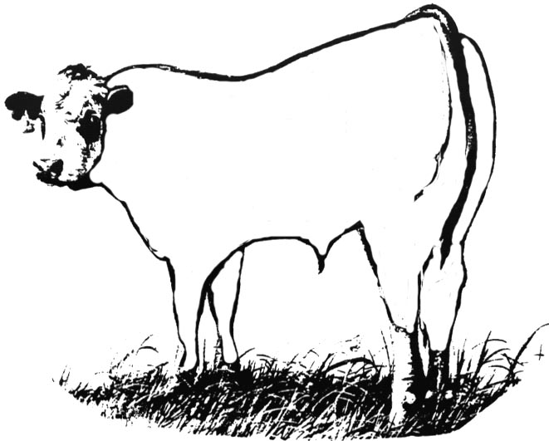
Adopted from: Mulvaney, D.R. 1991. How Growth Affects Composition. Pages 55-92 in Proc. 21st Century Concepts Important to Meat-Animal Eval. University of Wisconsin. Madison, WI.

Slide 6
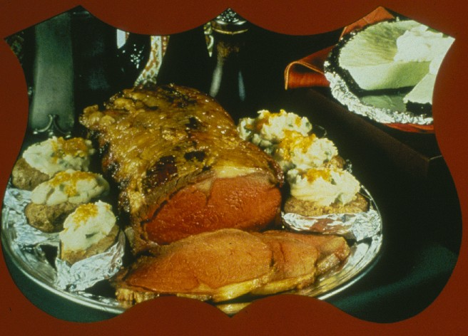

Slide 7


USDA Quality Grades
Prime
Choice
Select
Standard
Commercial
Utility
Cutter
Canner

Slide 8
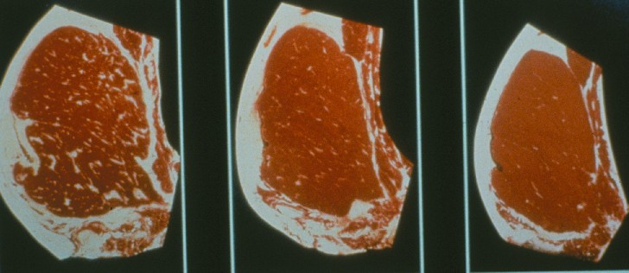
Quality Grade Basics
Marbling
Maturity

Slide 9
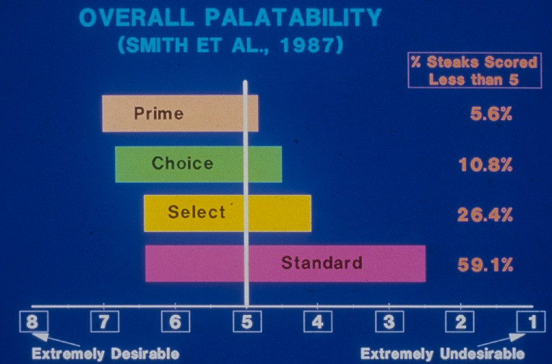

Slide 10
Odds of an Unpleasant Eating Experience
USDA Quality Grade | Odds of Having an Unpleasant Eating Experience | % Steers/Heifers in National Consist (NBQA, 2000)
Prime | 3% (1 in 33) | 2%
Upper 2/3 Choice | 10% (1 in 10) | 17%
Low Choice | 16% (1 in 6) | 32%
Select | 27% (1 in 4) | 42%
Standard | 50% (1 in 2) | 7%

Slide 11
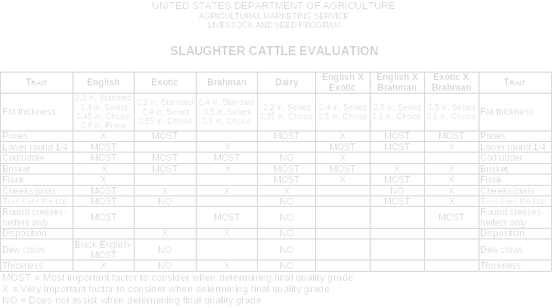

Slide 12
What’s in your
QUALITY GRADING BASKET?
Turn to the top
Cod/Udder
Lower Round 1/4
Pones
Fat Thickness
Prime
Choice
Select
Standard

Slide 13
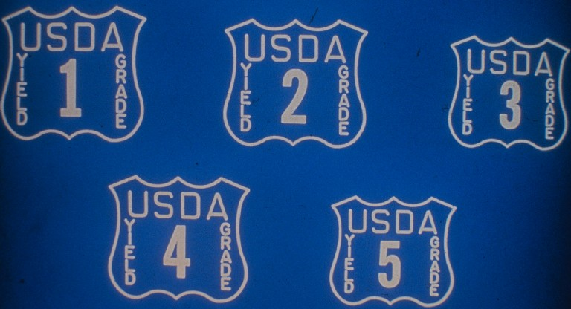
USDA Yield Grades

Slide 14
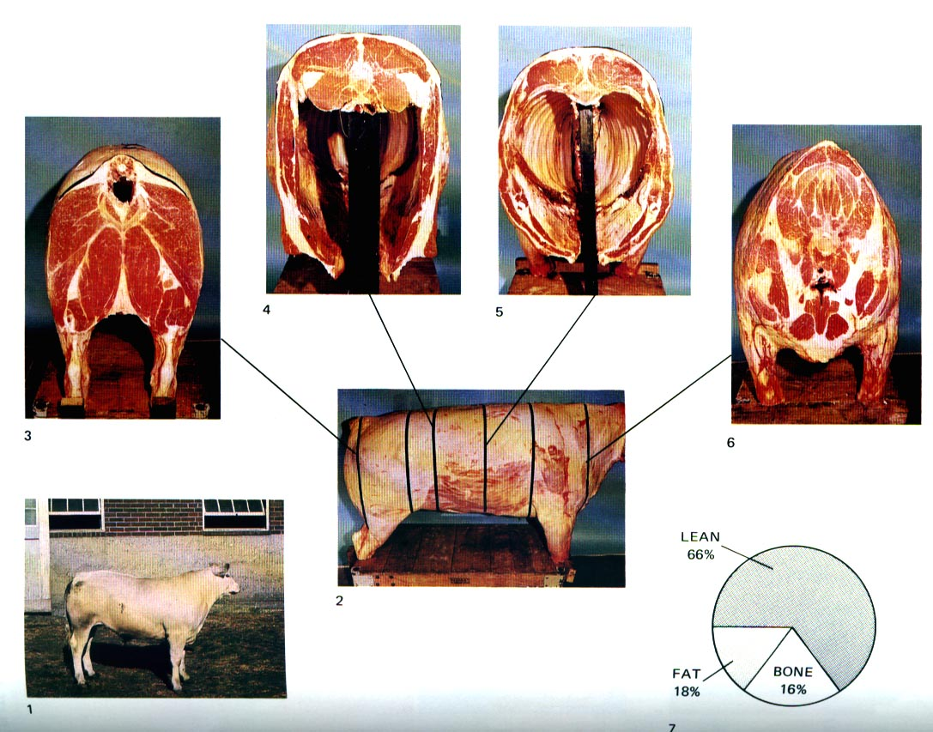
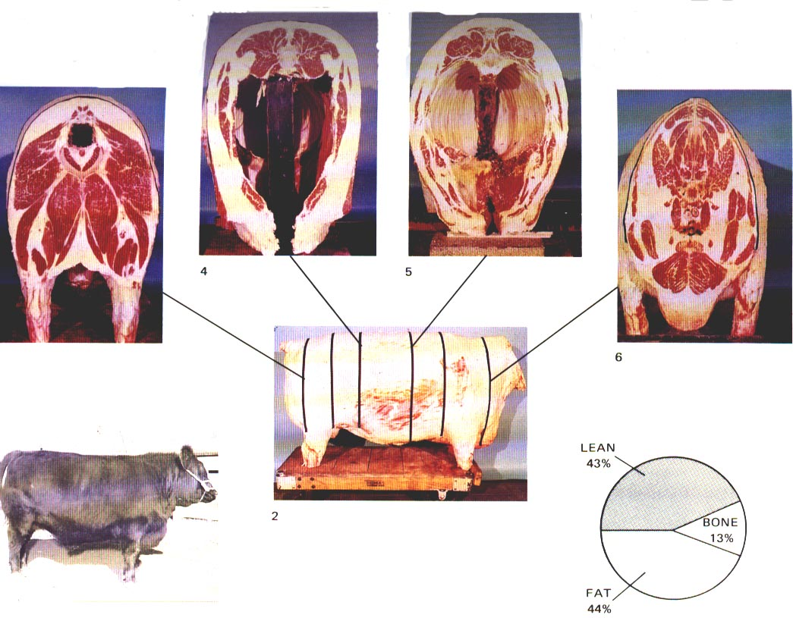
Yield Grade 2
Yield Grade 5

Slide 15
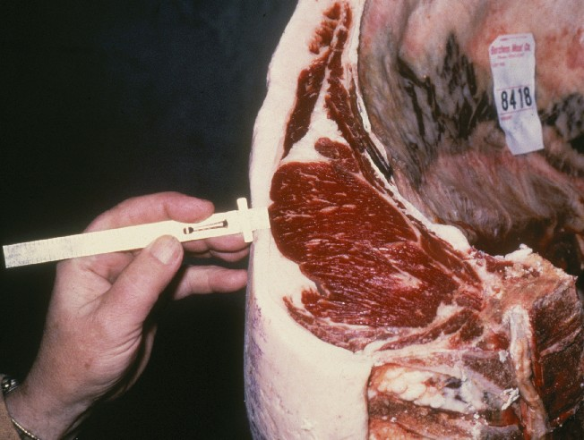
Yield Grade Basics
Fat Thickness – 12th Rib Preliminary Yield Grade
Rib Eye Area
Hot Carcass Weight
Kidney, Pelvic & Heart Fat

Slide 16
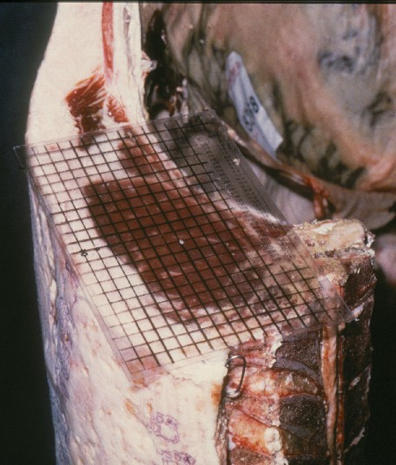
Yield Grade Basics
Fat Thickness – 12th Rib Preliminary Yield Grade
Rib Eye Area
Hot Carcass Weight
Kidney, Pelvic & Heart Fat

Slide 17
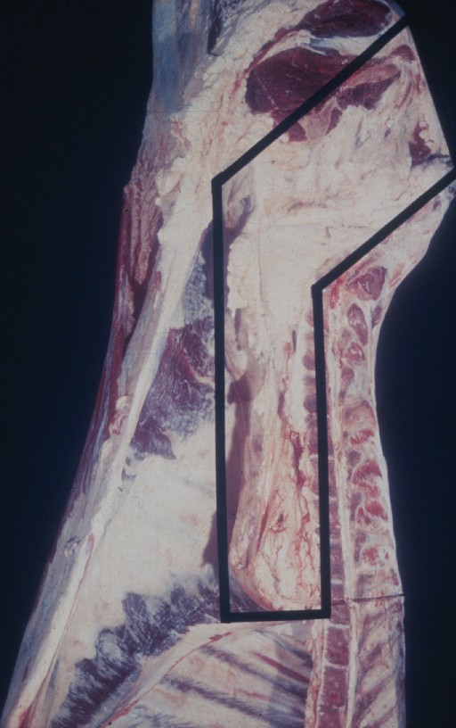
Yield Grade Basics
Fat Thickness – 12th Rib Preliminary Yield Grade
Rib Eye Area
Hot Carcass Weight
Kidney, Pelvic & Heart Fat

Slide 18
Yield Grade 2
Adopted from: R.E. Taylor. Scientific Farm Animal Production. 4th Ed. 1992.

Slide 19
Calculating Yield Grade
Fat Thickness – 12th Rib (0.4 inches) Preliminary Yield Grade | 3.0
Rib Eye Area (approximately 2.0 inches more than required) | -0.6
Kidney, Pelvic & Heart Fat (2.0% or -0.3) | -0.3
Final Yield Grade | 2.1

Slide 20
Yield Grade 5
Adopted from: R.E. Taylor. Scientific Farm Animal Production. 4th Ed. 1992.

Slide 21
Calculating Yield Grade
Fat Thickness – 12th Rib (1.1 inches) Preliminary Yield Grade | 4.75
Rib Eye Area (Inferior muscling, approximately 2.0 inches less than required) | +0.6
Kidney, Pelvic & Heart Fat (3.5% or 0.0) | +0.0
Final Yield Grade | 5.35

Slide 22
Yield Grade 2
Yield Grade 5

Slide 23
Yield Grade 2
Yield Grade 5

Slide 24
Yield Grade 2
Yield Grade 5

Slide 25
Yield Grade 2
Yield Grade 5

Slide 26
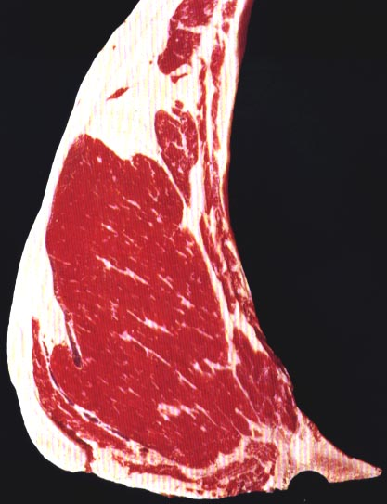
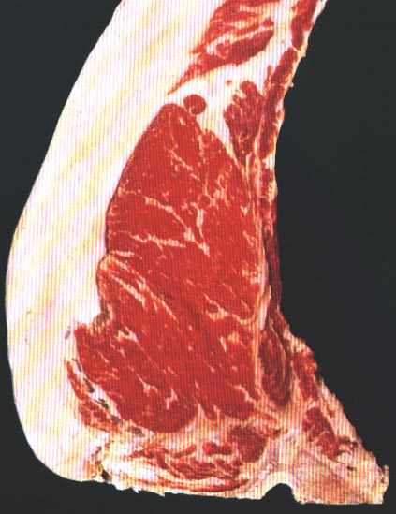
YG 1 vs YG 5 Ribeye
Adopted from: Meat Evaluation Handbook. 1997. Amer. Meat Sci. Assoc., Savoy, IL.

