Slide 1
Wess-Zumino term in high energy QCD
Yoshitaka Hatta
(RIKEN BNL)
Ref. Nucl. Phys. A768, (2006) 222.

Slide 2
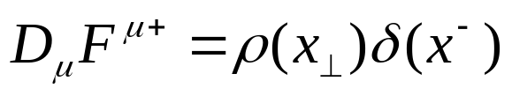


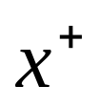
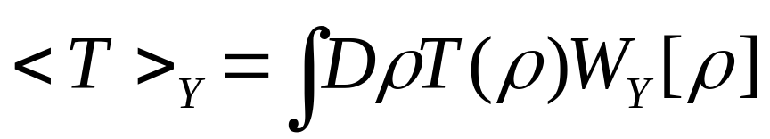



Introduction
Classical description of high energy QCD
McLerran & Venugopalan ‘93
high energy hadron random color charges + WW fields
~
Observable
is effectively static (independent of )

Slide 3



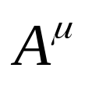

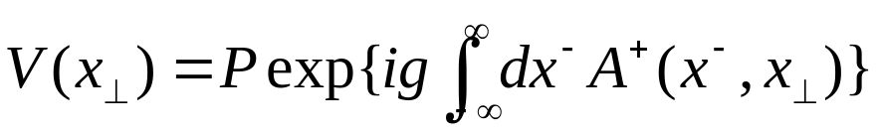

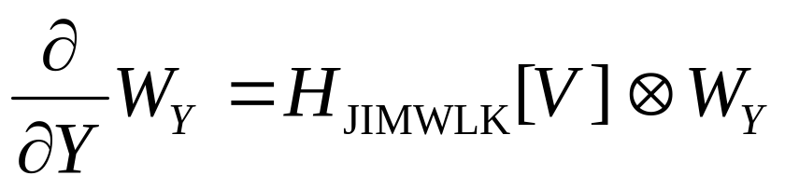
Gluon saturation
All order effect of can be
summed in the form of a Wilson line
JIMWLK equation

Slide 4
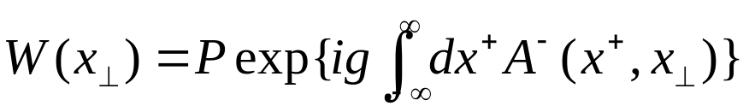

Beyond B-JIMWLK
Gluon Bremsstrahlung
Missing in B-JIMWLK !
must be time ( ) dependent

Slide 5
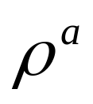
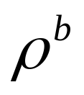
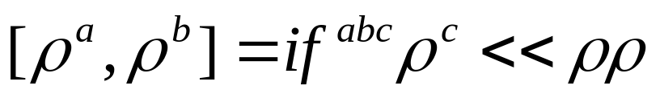
Non-commutativity strikes back
Color charges are non-commutative.
This property is lost when they are replaced by c-number charges…
In the dilute regime where a hadron develops gluon number fluctuation,
non-commutativity of charges should be taken into account.

Slide 6
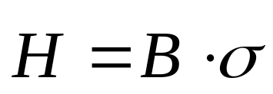
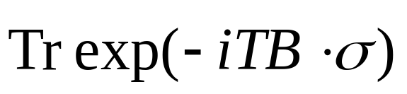
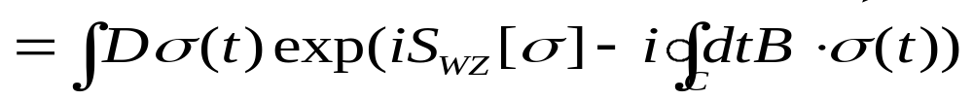

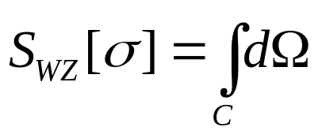

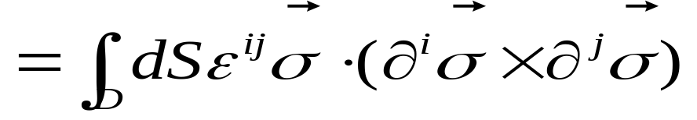
Path integral of a spin
“…path integrals suffer most grievously from a serious defect. They do not permit
a discussion of spin operators…in a simple and lucid way. Nevertheless, spin is
a simple and vital part of real quantum mechanical systems.”
R. Feynman
spin-magnetic interaction
Wess-Zumino term, Kirillov form, Polyakov’s spin factor, Berry’s phase, symplectic form…

Slide 7
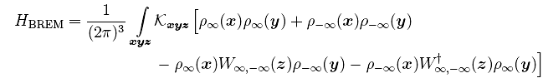
Generalized weight function in CGC
“In pursuit of Pomeron loops:
The JIMWLK equation and the Wess-Zumino term”
Kovner & Lublinsky ‘05
Evolution kernel in the dilute regime
Kovner, Lublinsky,
Y.H., Iancu, McLerran, Stasto, Triantafyllopoulos

Slide 8
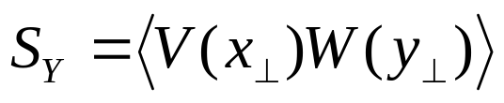
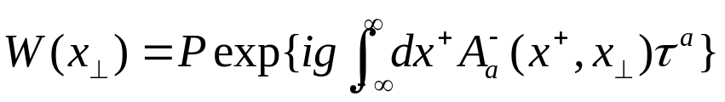
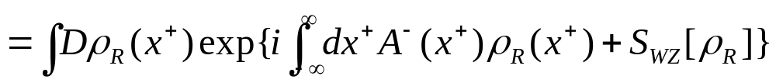


Wess-Zumino term in high energy scattering
Eikonal formula for the quark-quark scattering
Nachtmann, ‘91
Use the path integral representation of the Wilson line
where,
for SU(2)

Slide 9
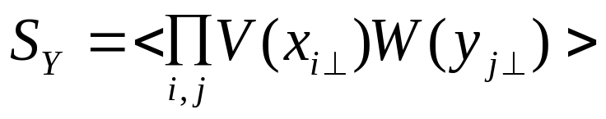
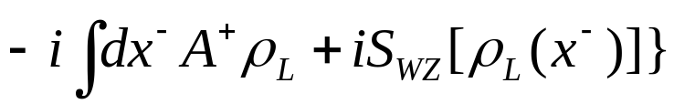


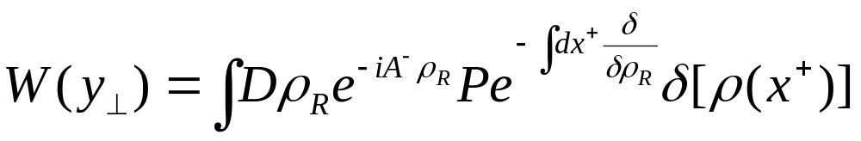
A model for hadron (nucleus) collisions
Gauge invariant source terms
Note: one can also write

Slide 10

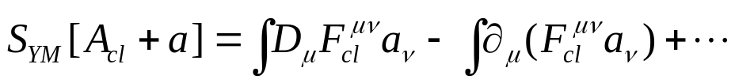

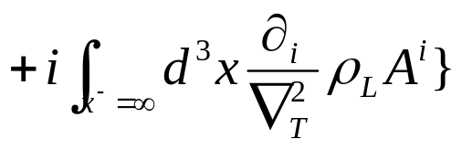
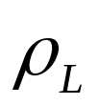
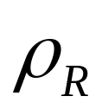
The case of the light-cone gauge
Sources sit at time infinity
Balitsky ‘98
Use the residual gauge freedom to relegate
interactions to only at the initial or final time.
Kovchegov & Mueller, ‘98
Iancu, Leonidov & McLerran, ‘00
Belitsky, Ji & Yuan, ‘02

Slide 11



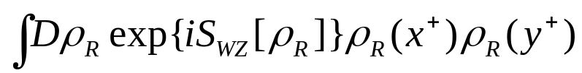

Application (1)
Gluon production in pp collision
Sources are weak, ~
Expand the exponential, contract with the external field
Use the property of the WZ term

Slide 12

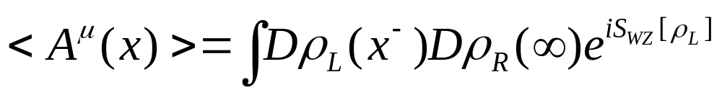
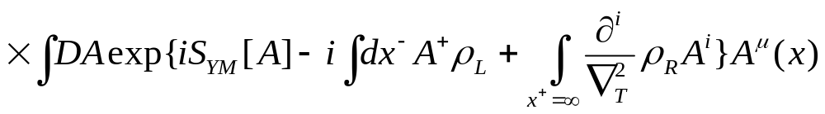
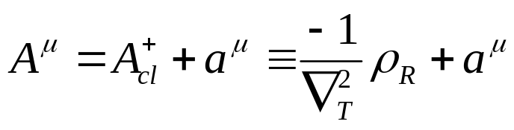
Application (2)
Gluon production in pA collision
Light-cone gauge of the left-moving proton
Shift the integration variable

Slide 13
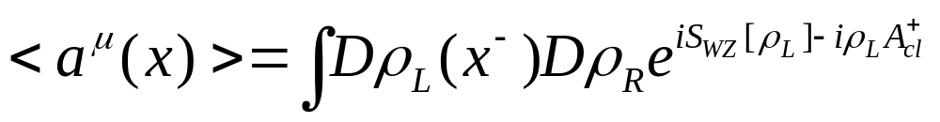
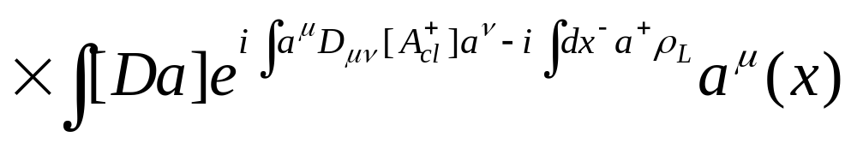
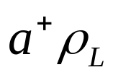
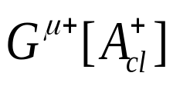




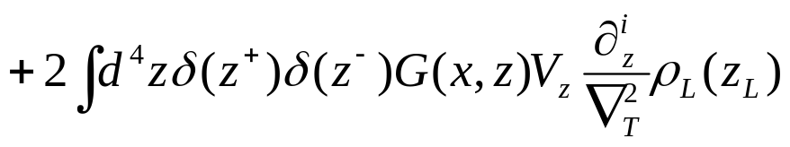
Gluon production in pA collision (cont’d)
Expand to linear order, contract with the external field.
Use the background field propagator
is large, ~ . Do the saddle point in integral.
c.f., Gelis & Mehtar-Tani, ‘06

Slide 14
Conclusion
We formulated the two-source problem using the method of spin path integral. The source term is gauge invariant, and ensures non-commutativity.
Modifications needed in the light—cone gauge are discussed.
Setup for the classical and quantum description of the AA collision.

