Slide 1
Risk Assessments for
Salmonella Enteritidis in Shell Eggs and
Salmonella spp. in Liquid Egg Products (Part I)
October 22, 2004

Slide 2
Contributors
Margaret Coleman
Eric Ebel
Neal Golden
Allan Hogue
Abdel Kadry
Janell Kause
Heejeong Latimer
Harry Marks
Nathan Quiring
Wayne Schlosser
Carl Schroeder

Slide 3
Peer Reviewers
Scott Ferson
Applied Biomathematics
United States of America
Tom Humphrey
University of Bristol
United Kingdom
Christine Little
Health Protection Agency
United Kingdom
John Maurer
University of Georgia
United States of America
Maarten Nauta
National Institute for Public Health
and the Environment
The Netherlands

Slide 4
Colleagues from the Risk Assessment Division
William James
Uday Dessai
Terry Disney
David Goldblatt
Chuanfa Guo
Michael Kasnia
David LaBarre
Silvia Kreindel
Heather Quesenberry

Slide 5
Other Colleagues
Ken Anderson
Tristan Cogan
Victor Cook
Edmund Crouch
Philip Derfler
Daniel Engeljohn
Richard Gast
Roger Glasshoff
Elke Jensen
Suzanne Hasiak
Arshad Hussein
Dolores Hill
Walt Hill
Peter Holt
Karen Hulebak
Stan Kaplan
Lynn Larsen
Priscilla Levine
Victoria Levine
Carol Maczka
Ronald Meekhof
Celine Nadon
Alecia Naugle
Bharat Patel
Merle Pierson
Louise Ryan
Patricia Schwartz
Amelia Sharar

Slide 6
Additional thanks to
FDA, Center for Food Safety and Applied Nutrition
  Provided comments for consideration. Revision ongoing
Centers for Disease Control and Prevention
  Plans to review

Slide 7
Outline
Background
Microbiology of Salmonella
Epidemiology of Human Salmonellosis
Conclusion

Slide 8
Background

Slide 9
Background
In 1996, FSIS, in collaboration with FDA, initiated a risk assessment to characterize the public health effects associated with consumption of S. Enteritidis-contaminated eggs
Results indicated multiple interventions along the farm-to-table chain were necessary to reduce significantly the risk of illness from S. Enteritidis in eggs
Results were useful in developing the Egg Safety Action Plan, etc. but were not deemed sufficient for evaluating FSIS risk management options for developing performance standards for eggs

Slide 10
Background
Since then, however, additional data have become available
  FSIS has conducted a national baseline survey to measure Salmonella levels in liquid egg products produced in the U.S
  Experimental studies have clarified scientific issues associated with SE contamination in egg yolk
  The American Egg Board sponsored studies on lethality kinetics of Salmonella spp. in liquid egg products
  A dose-response model for Salmonella spp. has been developed by FAO/WHO

Slide 11
Microbiology of Salmonella

Slide 12
Nomenclature
Salmonella Enteritidis
Salmonella species and subspecies | No. of Serovars
S. enterica subsp. enterica (I) | 1,454
S. enterica subsp. salamae (II) | 489
S. enterica subsp. arizonae (IIIa) | 94
S. enterica subsp. diarizonae (IIIb) | 324
S. enterica subsp. houtenae (IV) | 70
S. enterica subsp. indica (VI) | 12
S. bongori (V) | 20
TOTAL | 2,463
Bailey JS, Maurer JJ. 2001. Salmonella species. In: Food Microbiology: Fundamentals and Frontiers (Doyle MP, Beuchat LR, Montville TJ, eds.), pp 141-170. ASM Press, Washington DC.

Slide 13
The Salmonellae
Gram-negative, rod-shaped bacteria
Facultatively anaerobic
Motile by means of flagella

Slide 14
Affect of Temperature and pH on Growth of Salmonella
Condition | Minimum | Optimum | Maximum
Temperature (ºC) | 5.2 | 35–43 | 46.2
pH | 3.8 | 7–7.5 | 9.5

Slide 15
Contamination of Shell Eggs
S. Enteritidis is transmitted to eggs through two routes
  Trans-ovarian (vertical) transmission
    SE is introduced into the egg from infected ovaries or oviduct tissue before egg is laid
    Primary route of contamination
  Trans-shell (horizontal) transmission
    Can result from fecal contamination of the eggshell

Slide 16
Epidemiology of Human Salmonellosis

Slide 17
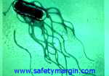
Salmonellosis
Foodborne salmonellosis in the U.S.
  ~1.3 million illnesses
  ~15,600 hospitalizations
  ~550 deaths
Mead PS, Slutsker L, Dietz V, McCaig LF, Bresee JS, Shapiro C, et al. Food-related illness and death in the United States. Emerg Infect Dis 1999 Sep-1999 Oct;5(5):607-25.
Notes:
Based on work by colleagues at the CDC, it is estimated that foodborne salmonellae cause approximately 1.3 million illnesses, 15,600 hospitalizations, and 550 deaths per year in the United States. The basis on which these estimated are based may be found in the seminal article “Foodborne Illness and Death in the United States” by Paul Mead and colleagues. You see the full reference here.

Slide 18

Salmonellosis
Salmonellosis case costs:
  ~$440 (no physician visit)
  ~$950 (physician visit)
  ~$10,700 (hospitalization)
  ~$455,000 (death)
http://www.ers.usda.gov/data/foodborneillness/
Notes:
The economic costs of salmonellosis have also been estimated.

Slide 19
Disease Characteristics
Symptoms include diarrhea, fever, abdominal pain or cramps, vomiting, headache, and nausea
Incubation period ranges from 8 to 72 hours with symptoms lasting up to a week
Severity of infection varies. While most are self-limiting, some are fatal

Slide 20
Sequellae
Reactive arthritis
  Symptoms develop 7 to 30 days after intestinal illness
  Develops in about 2 to 3% of persons with salmonellosis
Urethritis
Conjunctivitis
Weight loss of over 5 kg
Oral ulcers
Pneumonia
Maki-Ikola O, Granfors K. Salmonella-triggered reactive arthritis. Scand J Rheumatol 1992;21(6):265-70.

Slide 21
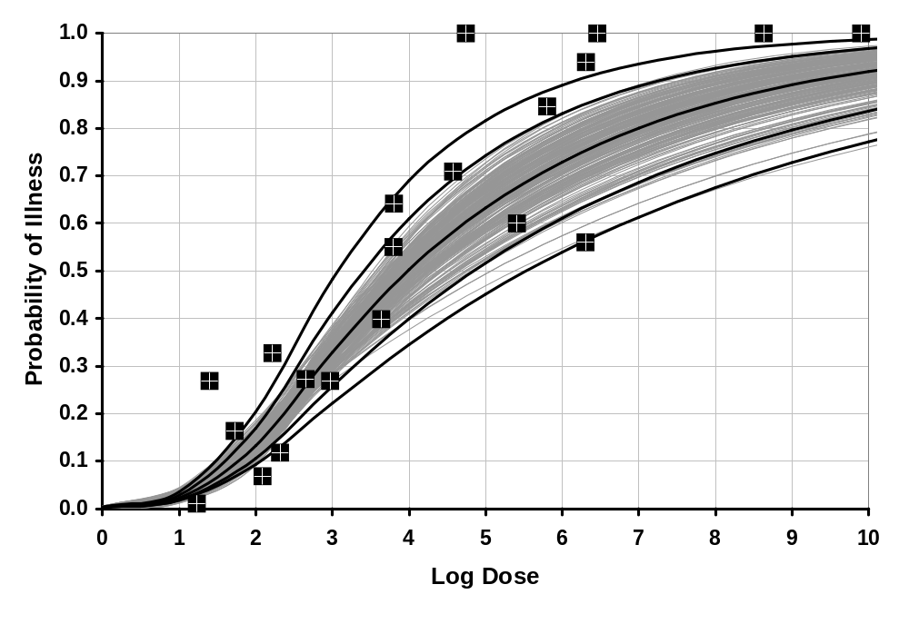
Dose-response and Outbreaks
FAO/WHO. 2002. Risk assessments of Salmonella in eggs and broiler chickens. Rome: FAO/WHO.

Slide 22
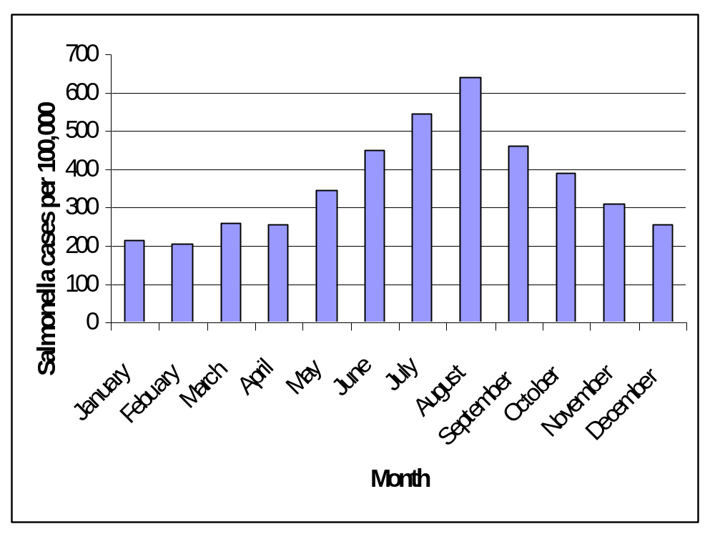
Salmonella Cases Per 100,000 Population, 2000
Centers for Disease Control and Prevention. Salmonella surveillance: Annual summary, 2000.
Centers for Disease Control and Prevention. Morb Mortal Wkly Rep 2001 Apr;50(13):241-6.
Notes:
Infection from Salmonella appears to occur most frequently in the summer. Similar seasonal patterns have been documented for outbreaks of infection caused by S. Enteritidis and for Salmonella-positive spent hens at slaughter. Warm temperatures provide an environment in which Salmonella can grow during the processes of production, transport, and storage. The data presented in this figure may also reflect, in part, picnics, cookouts, and other similar group functions that commonly take place in the summer.

Slide 23
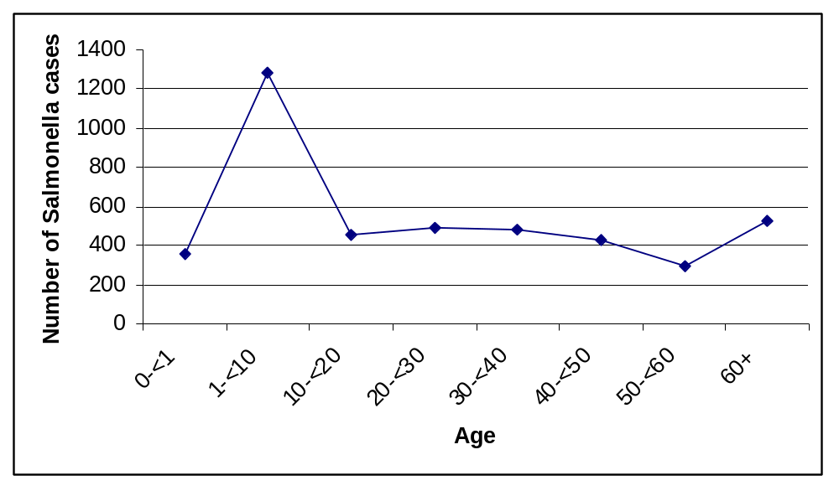
Incidence of Salmonella Infections by Age Group (Yrs), 2000
Centers for Disease Control and Prevention. Salmonella surveillance: Annual summary, 2000.
Centers for Disease Control and Prevention. Morb Mortal Wkly Rep 2001 Apr;50(13):241-6.

Slide 24
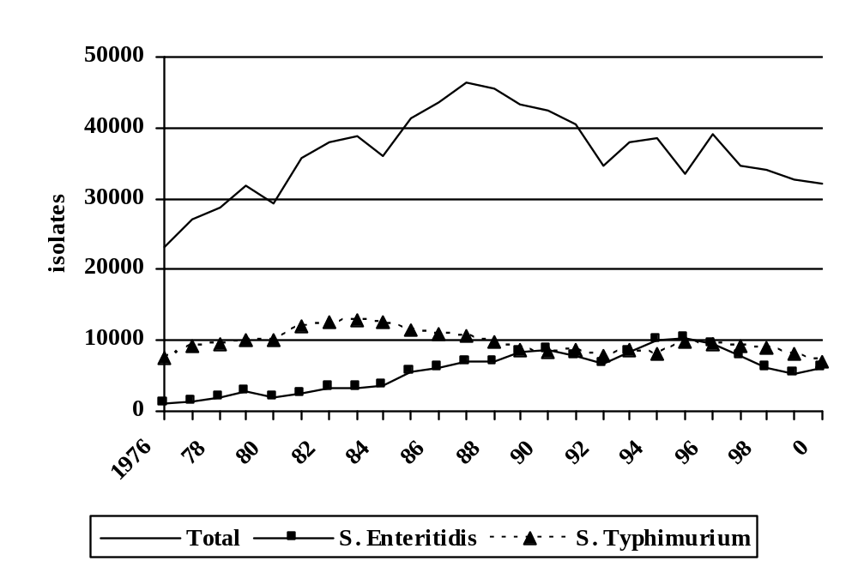
Salmonella Isolates from Human Sources by Serotype and Year, 1976-2000
Centers for Disease Control and Prevention. Salmonella surveillance: Annual summaries, 1977-2000.
Notes:
5,116 S. Enteritidis isolates reported for 2002 (comprising 15% of all Salmonella isolates). Second only to S. Typhimurium (7,062 isolates; 21.9%)

Slide 25
S. Enteritidis and Eggs
The period 1976 to 1995 saw an 8-fold increase in infections with S. Enteritidis reported to the CDC
  Greater than 75% of the infections were associated with foods containing undercooked eggs
Angulo FJ, Swerdlow DL. 1999. Epidemiology of human Salmonella enterica serovar Enteritidis infections in the United States. In: Salmonella enterica serovar Enteritidis in Humans and Animals (Saeed AM, Gast RK, Potter ME, Wall PG, eds.), pp33-42. Iowa State University Press, Ames.

Slide 26
S. Enteritidis and Eggs
From 1985 through 1998, 794 SE outbreaks were reported to CDC
  Involved 28,644 illnesses, 2,839 hospitalizations, and 79 deaths
  Greater than 75 percent were associated with foods containing undercooked eggs
Centers for Disease Control and Prevention. Salmonella surveillance: Annual summari, 1985-1998. U.S. Department of Health and Human Services. Atlanta.

Slide 27
Illness Estimates from Surveillance Data
Surveillance Step | Estimate
1. Salmonella illnesses ascertained by FoodNet | 4,330
2. Isolates serotyped | 3,964
3. Serotyped isolates that were SE | 585
4. Ratio of serotyped isolates that were SE | 0.15
5. Estimated number of illnesses from Salmonella attributable to SE | 639
6. Population of catchment area | 30,500,000
7. Incidence of SE in catchment area | 2.1/100,000
8. U.S. population | 281,400,000
9. Estimated cases of SE in U.S. | 5,896
10. Illness underreporting multiplier | 37
11. Illness from SE | 254,688
12. Proportion of SE illnesses from eggs | 0.80
13. Estimated annual illnesses from SE in eggs | 174,356

Slide 28
Conclusions

Slide 29
Conclusions
Based on surveillance data, shell eggs have been identified as an important vehicle of infection from S. Enteritidis
  >75% of S. Enteritidis outbreaks have been egg-associated
  We know of no outbreaks from Salmonella in liquid egg products
New data and modeling techniques have enabled us to conduct robust risk assessments for S. Enteritidis in shell eggs and Salmonella spp. in liquid egg products

