Slide 1
Thermal Validation Challenge Problem
Kevin Dowding and Martin Pilch
Validation and Uncertainty Quantification, 1533
Sandia National Laboratories
Richard Hills
Dept of Mechanical Engineering
New Mexico State University
Validation Challenge Workshop
Albuquerque, MM
May 22-23, 2006
Sandia is a multiprogram laboratory operated by Sandia Corporation, a Lockheed Martin Company,
for the United States Department of Energy under contract DE-AC04-94AL85000.

Slide 2
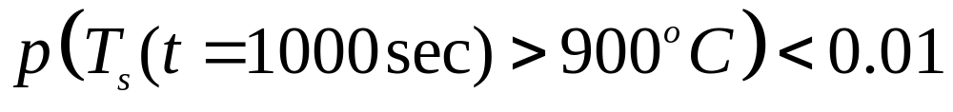
High-Consequence Regulatory Decision For an Intended Application
Safety critical devices that demonstrate unit-to-unit variability
The intended application of the devices are exposed to environments that are well characterized, q=3500 W/m² and thickness L=1.90 cm, neither having uncertainty
Regulatory Requirement
L
-k dT/dx = q
dT/dx = 0
T_{s}
x
Participants are asked to 1)assess whether the device meets
the regulatory requirement using the model and 2)quantify
their confidence in the assessment.

Slide 3
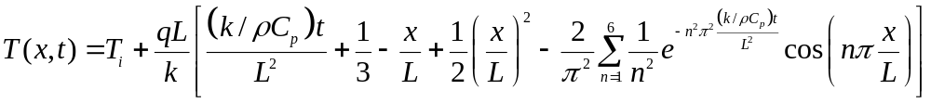



Model to assess is (linear) transient heat conduction
Model:
Ground rules:
  Model form is fixed
  All inputs precisely known except (k, ρC_{P})
  Thermal properties (k, ρC_{P}), and possibly other parameters, can be “adjusted”
Same model form is used in the hierarchy of validation exps
  Magnitudes of heat flux (q) and thickness (L) are different in the various validation exps
L
x
x=L

Slide 4
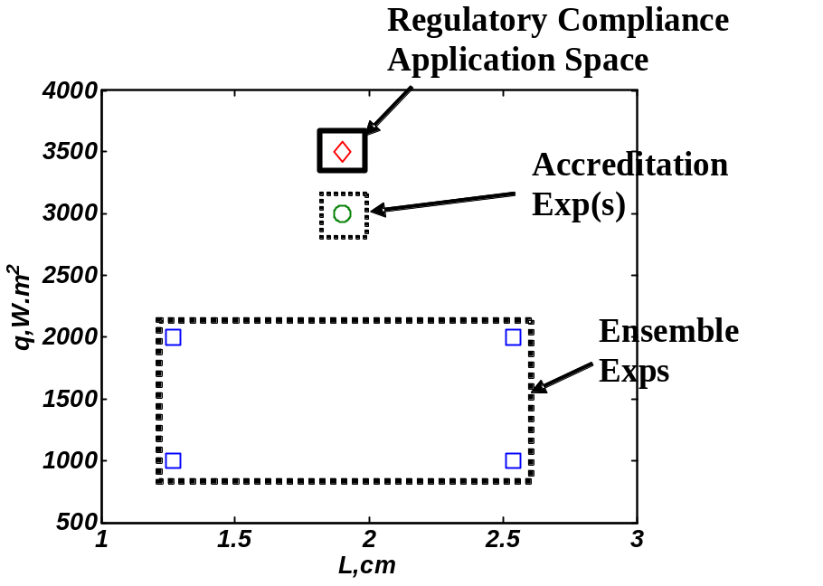
Overview of the
Hierarchal Validation Experiments
Material Characterization (not shown Fig)
  Estimate (measure) values for k and ρC_{P} over a range of temperatures
Ensemble Validation
  Explore a range of (q,L) combinations (configurations)
  Sensitivity to L and ability to extrapolate on q are studied
  Limited replicates are available
Accreditation
  More relevant to application, but outside previous database of exps (ensemble)
  Very limited number of exps (usually a single exp)

Slide 5
Study sensitivity to the number of exps at each level of the hierarchy
Exp runs | Material Characterization (N_{c}) | Ensemble Validation (N_{v}) | Accreditation (N_{a})
Low | 6 | 1 per Config./ 4 total | 1
Medium | 20 | 2 per Config./ 8 total | 1
High | 30 | 4 per Config./ 16 total | 2
Different number of exps at each level in the hierarchy
  Low, Medium, and High number of exps
Goal is to understand how analyses (and conclusions) are impacted by the number of exps
Look at comparable number of exps for each level in the hierarchy

Slide 6
Material Characterization

Slide 7
Material Characterization
Estimate (measure) values for k and ρC_{P} over a range of temperatures and samples
  Did not involve model considered in validation
Nominal dimensions of specimens tested are representative of the intended application
Manufactured with the same processes used in the intended application
Reasonable assumptions:
  diagnostic variability or uncertainty is negligible compared to specimen-to-specimen variability
  estimates of thermal conductivity and volumetric heat capacity are independent
  estimates for a given property at different temperatures are independent (i.e., from characterizing a different sample).

Slide 8
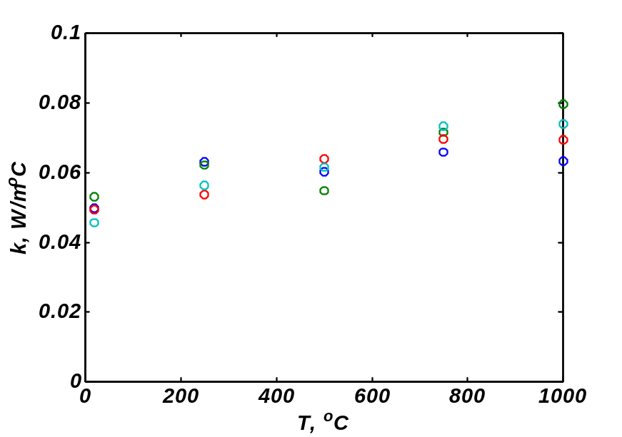
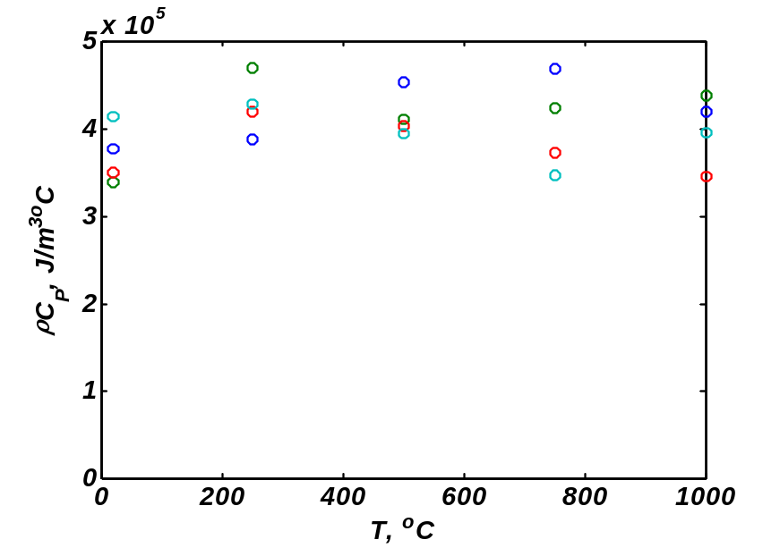
Material Characterization data
(N_{c} = 20)

Slide 9
Ensemble Validation Experiments

Slide 10
Ensemble validation conducted over four configurations
Exp Configuration | Heat Flux, q (W/m²) | Thickness, L (cm)
1 | 1000 | 1.27
2 | 1000 | 2.54
3 | 2000 | 1.27
4 | 2000 | 2.54
Exps conducted at lower heat flux values (q), and values of L that bound that specified in the regulatory requirement
Each exp conducted on a different (randomly selected) sample
Replicates at each configuration (for medium/high levels of exp data)

Slide 11
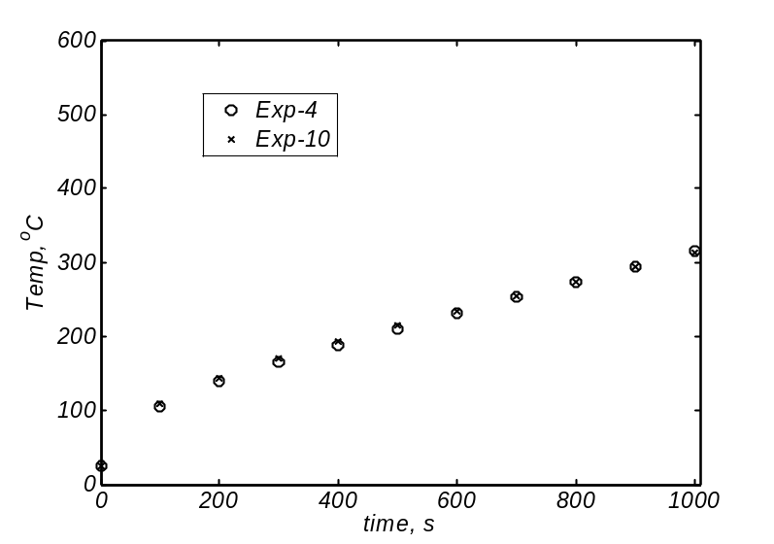
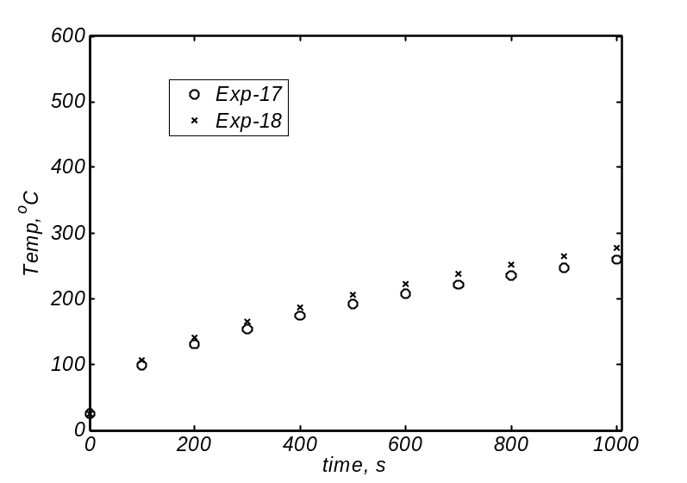
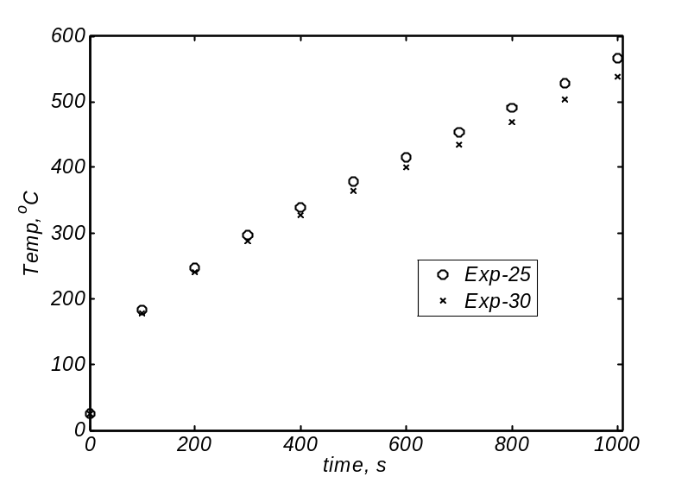
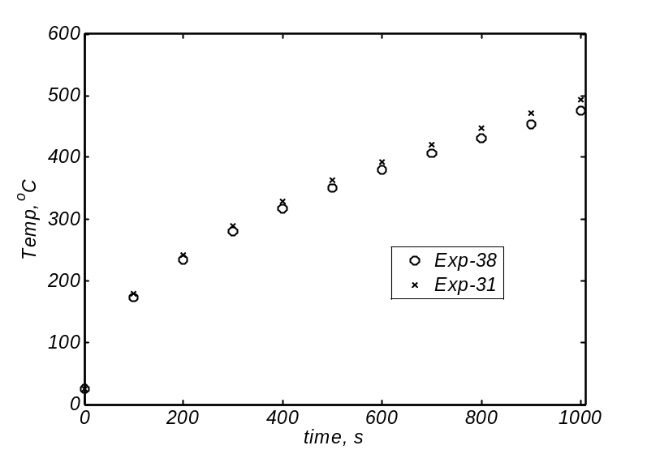
Ensemble Validation Data
(N_{v}=8, 2 exps/configuration)
Config 1
(1000W/m²,1.27cm)
Config 2
(1000W/m²,2.54cm)
Config 3
(2000W/m²,1.27cm)
Config 4
(2000W/m²,2.54cm)

Slide 12
Accreditation Validation Experiment

Slide 13
Accreditation Experiment
Exp Configuration | Heat Flux, q (W/m²) | Thickness, L (cm)
5 | 3000 | 1.90
Conditions more relevant to the regulatory requirement, still at a lower heat flux
Each experiment conducted on a different sample (when applicable)
Measure temperatures at x=0 and x=L/2

Slide 14
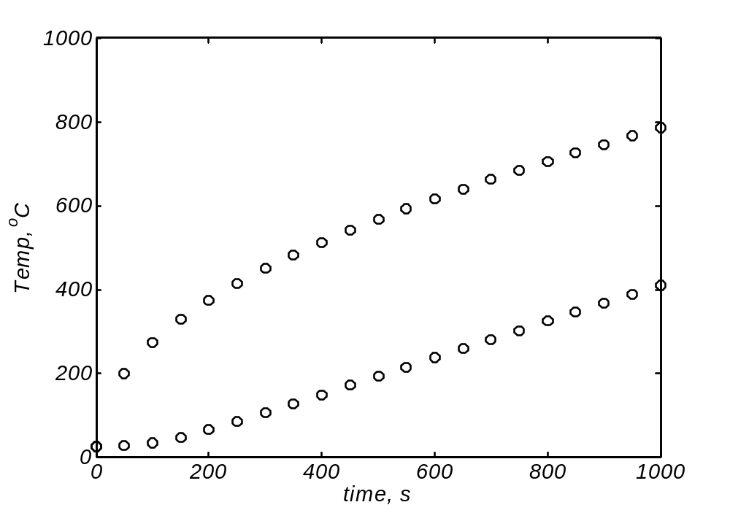


Accreditation Experiment
(N_{a}=1)

Slide 15
Summary
Asking participants to assess the model accuracy and model adequacy at each level in the validation hierarchy
  Model accuracy/adequacy defined by the participants
  Model updating (calibration) is permitted
(Option to) use all the information available to assess the regulatory requirement and the confidence in the assessment
More interested in understanding the assessment methodology and relating validation at various levels (hierarchy) than the outcome for this problem

Slide 16
Thermal Problem Speakers
9:00 am to 9:45 am | Model Validation Metrics for the Thermal Challenge Problem Sankaran Mahadevan, J. McFarland, and X. Jiang Vanderbilt University
9:45 am to 10:30 am | Model Validation, Calibration and Predictive Capability Scott Ferson, Applied Biomathematics William L. Oberkampf, Sandia National Laboratories
10:30 am to 11:00 am | Break
11:00 am to 11:45 am | A Bayesian Analysis of the Thermal Challenge Problem F. Liu and J. Berger, Duke University M. J. Bayarri, Valencia R. Paulo, Bristol J. Sacks, National Institute of Statistical Sciences (NISS)
11:45 am to 12:30 pm | Another Bayesian Analysis of the Thermal Challenge Problem Dave Higdon, and Charlie Nakhleh Los Alamos National Laboratory
12:30 pm to 1:45 pm | Lunch (provided), Alvarado F
1:45 pm to 2:30 pm | Thermal Problem Discussion

Slide 17
Topics
What is the role of calibration in validation??
How should a bias term (kludge, patch discrepancy) be incorporated into the model?
What metrics should we use?
  Hypothesis test
  Discrepancy model
How do we formulate the model adequacy?

Slide 18
Structural Dynamics-Driven Topics
Language:
  Calibration/Validation
  Identification of analysis approach all relevant models
    Physical processes
    Uncertainty models
Validation criteria (e.g. relevance to reg req’t)
Validation metrics
Communication

