Slide 1
Building Energy Code Education Projects At Iowa Central Community College
Bill McAnally
Iowa Central Community College
Fort Dodge, Iowa
July 18, 2002

Slide 2
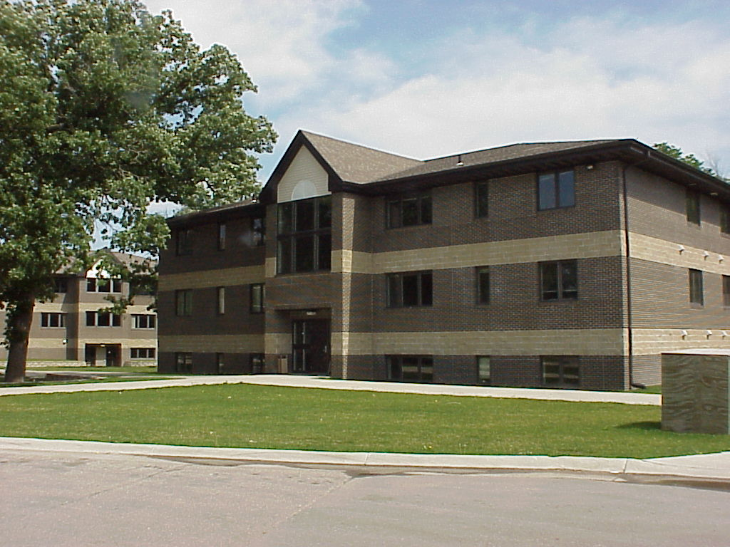

Slide 3
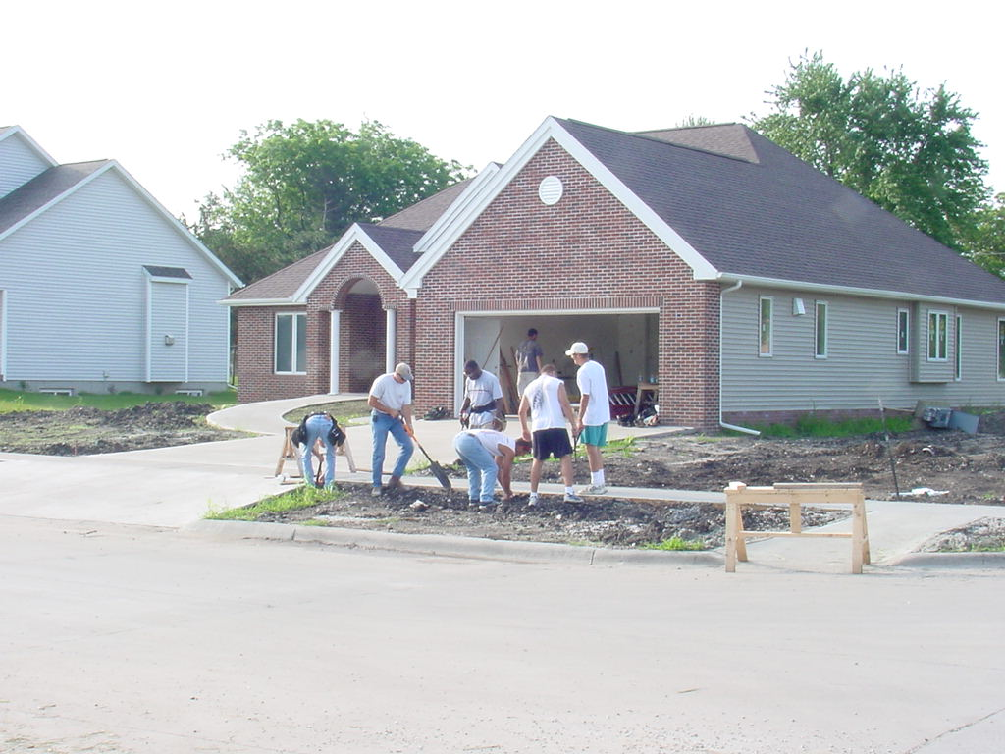

Slide 4
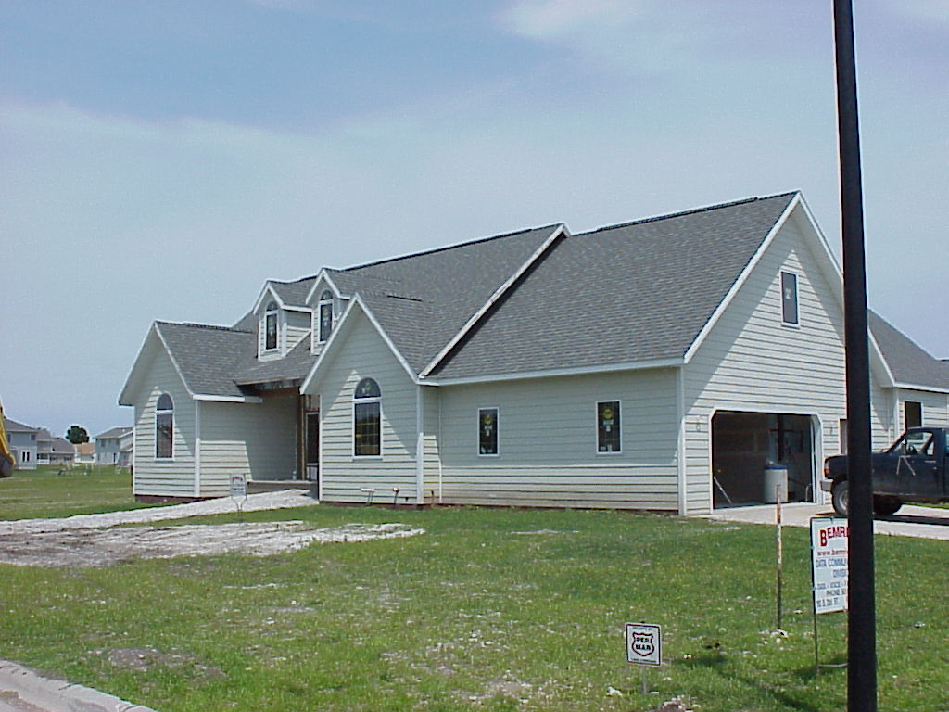

Slide 5
Project Driven Education
Contracted with the Department of Natural Resources
Two project homes
One residence hall
Groundbreakings
Open house – formal and informal
Presentations at conferences and seminars
Partnerships

Slide 6
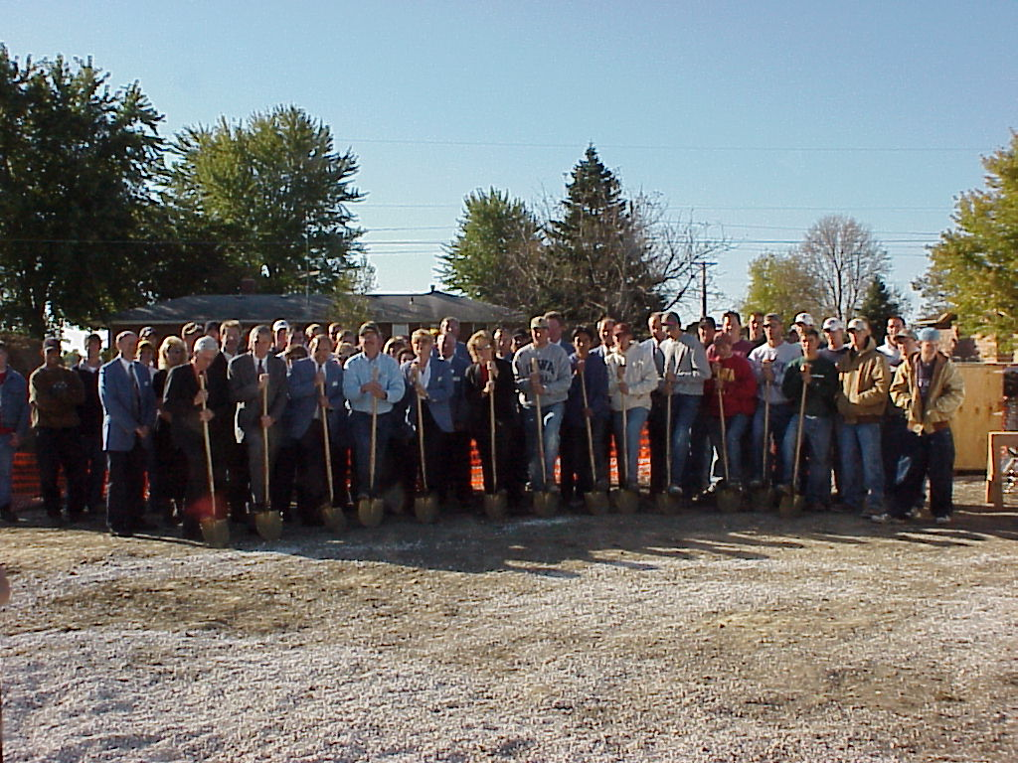

Slide 7
Why Do We Need The BECE Program In Iowa?
First thought is saving energy. Right?
Update the building industry on methods and materials
Housing longevity
Create new jobs
The best benefit is homeowner health and comfort!!!!

Slide 8
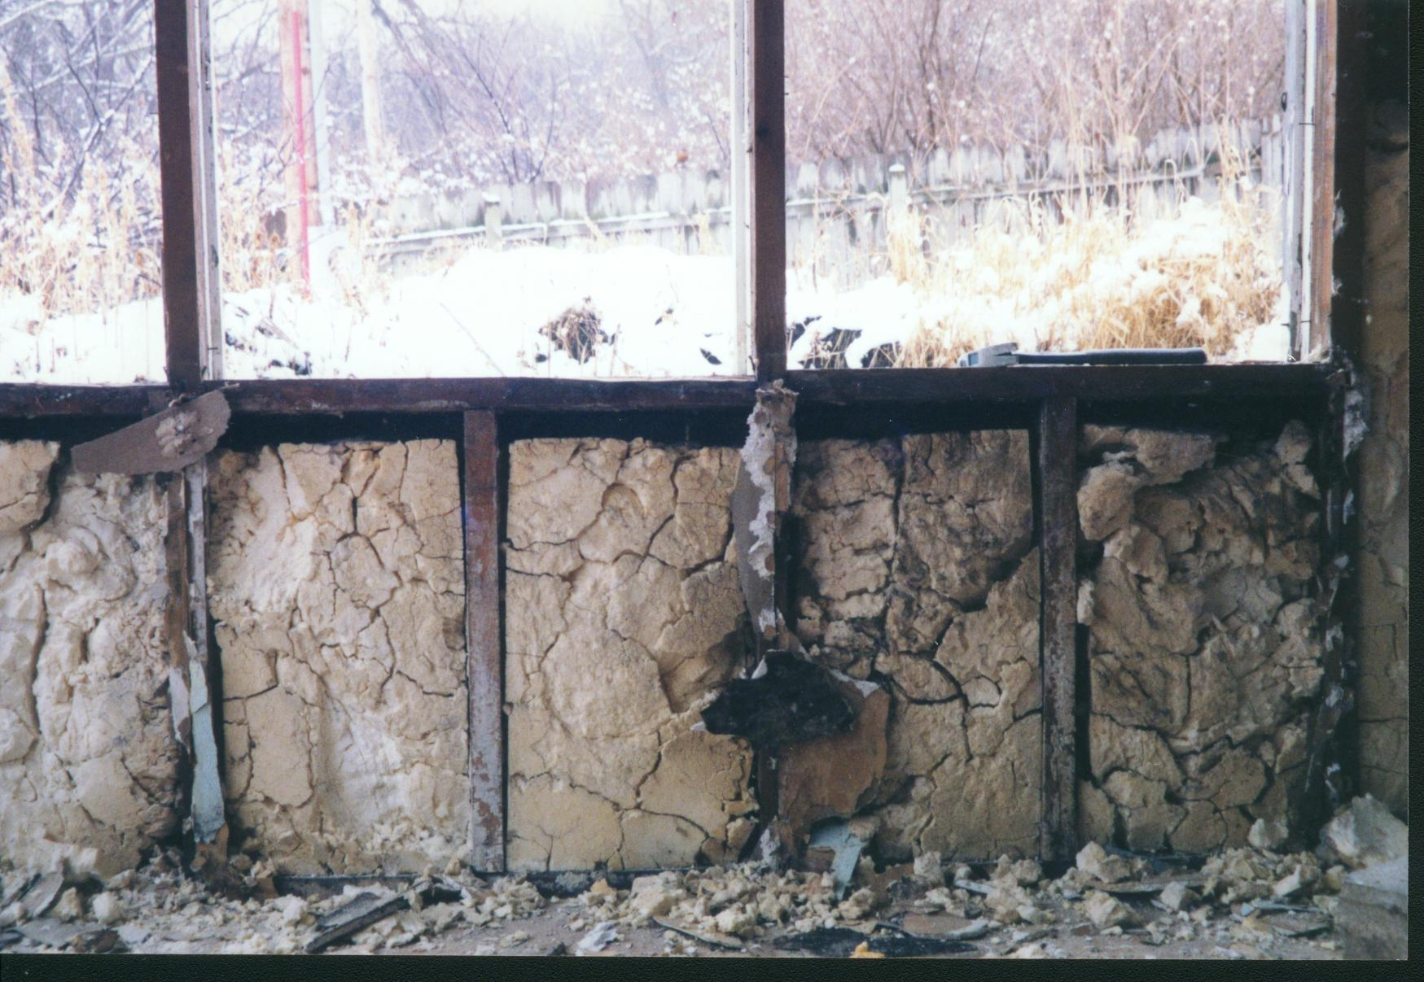

Slide 9
Foundations
Drainage
Waterproofing
Insulation – interior or exterior
Superior Walls
Wood
Insulated Concrete Forms

Slide 10
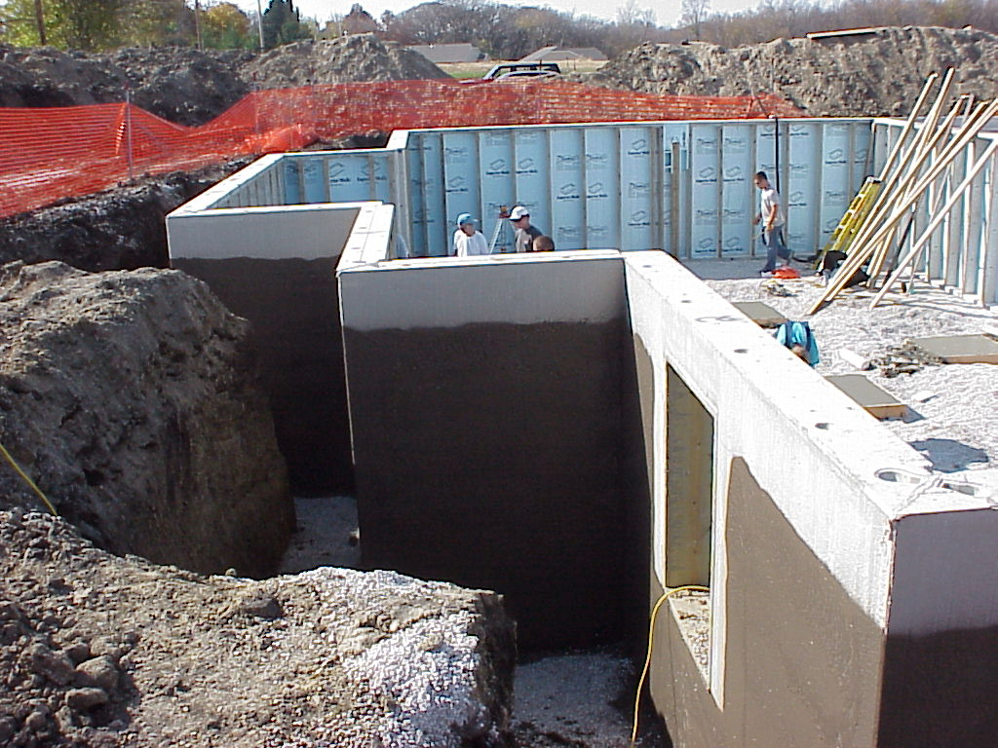

Slide 11
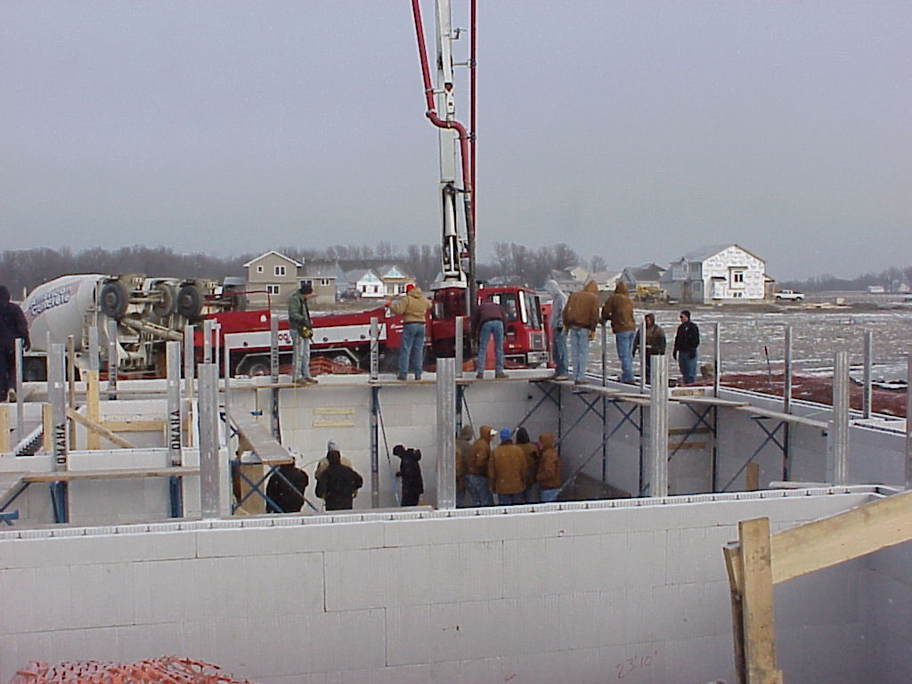

Slide 12
Walls And Roof
OVE framing
Vapor retarders and air barriers
Band joist area
Sealing details and products
Insulation demonstrations
Infra-red testing of the envelope

Slide 13
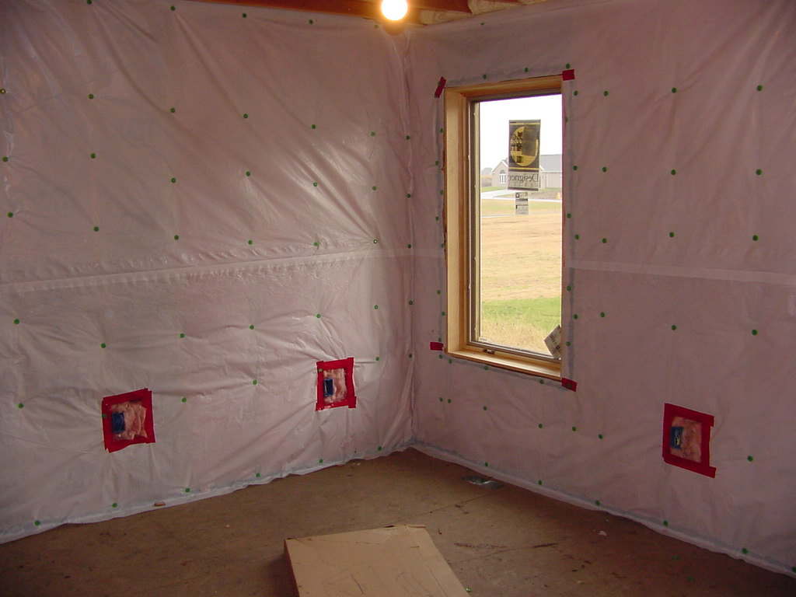

Slide 14
Wall And Roof Exterior
Homewrap and competitors
Drainage plane
Ventilated cladding
Ice dam explanations
Doors and windows

Slide 15
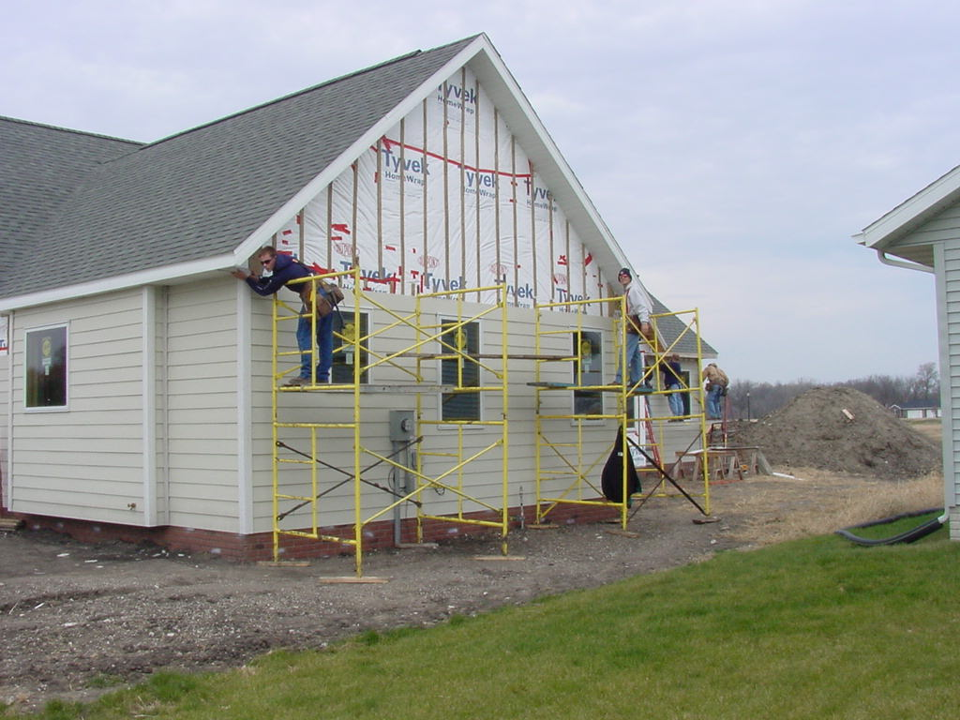

Slide 16
Mechanicals
Geo-thermal
High efficiency sealed combustion gas
Energy recovery ventilators
Radon, VOC’s, paints, and CO
Mold

Slide 17
Are We Reaching People?
Conferences, seminars, and training sessions
Radio talk shows
Parade Of Homes
Open houses
Newspaper articles
Happy Customers
Word of mouth!

Slide 18
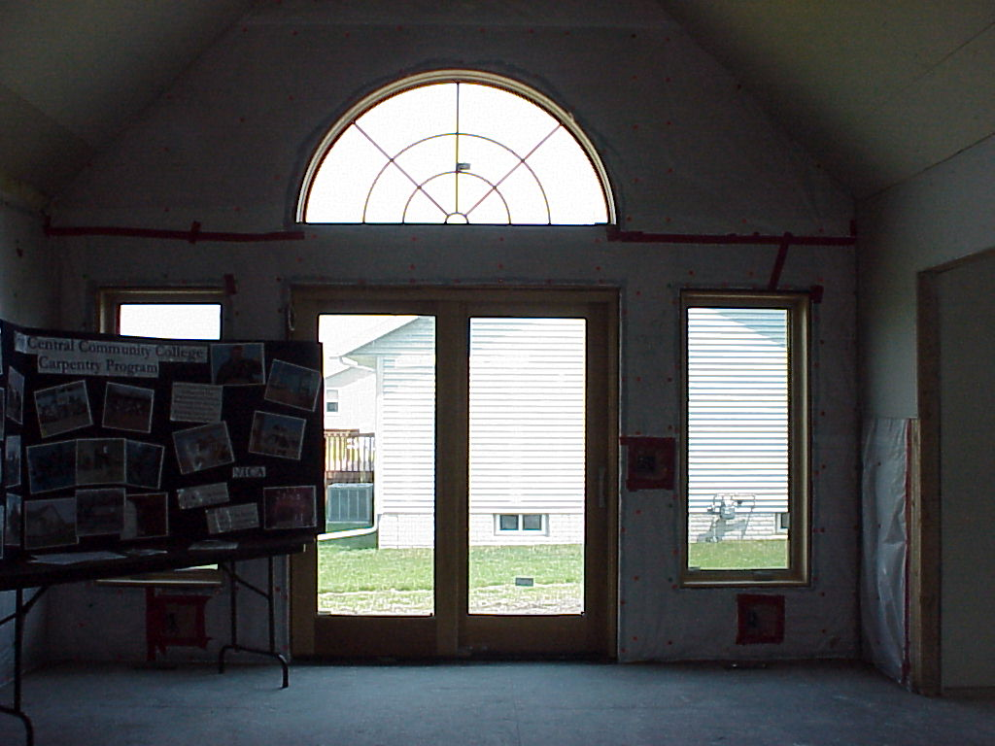

Slide 19
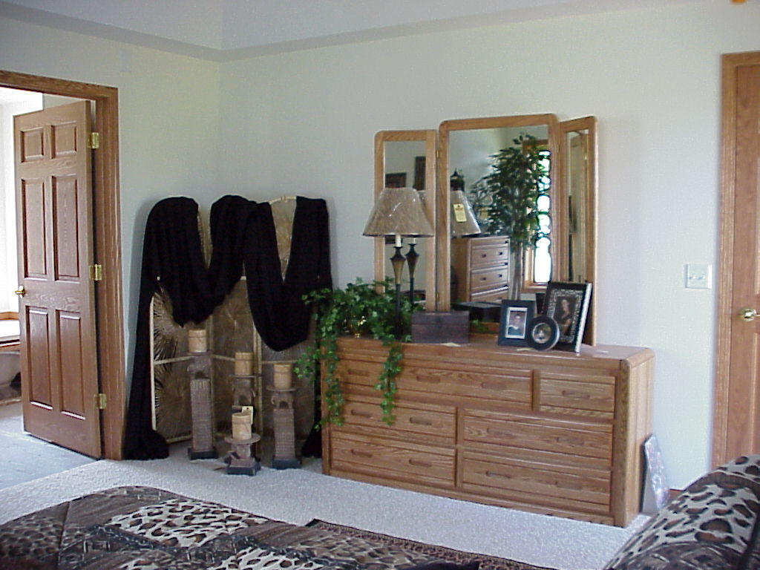

Slide 20
