Slide 1


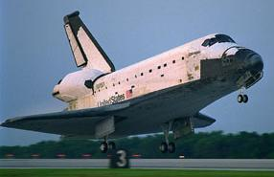
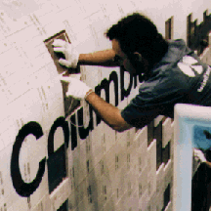
The Cost of Maintaining Thermal Protection Systems
Frank E. Jones
NASA-KSC
July 1999

Slide 2
Agenda
Background
  Design Overview
  Maintenance Drivers
Factors Affecting Cost
  Materials
  Access
  Touch Time Labor
  Costs per TPS Type
  Off Line Support
Improvements To Reduce Cost
  Presently In-work
  Future Necessities
Beyond Shuttle

Slide 3
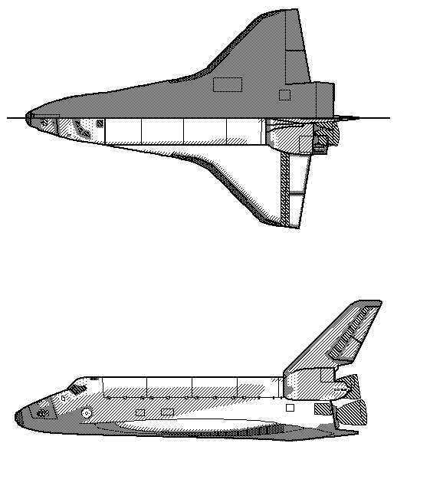

TPS Surfaces
Lower Surface
Upper Surface
TPS Legend
HRSI (Black) Tiles
LRSI (White) Tiles
AFRSI Blankets
FRSI
RCC
Glass
Exposed Metallic Surfaces

Slide 4
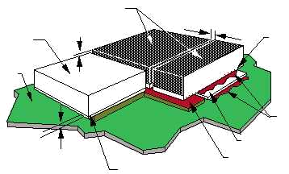
Tile Configuration
HRSI Tiles - Black RCG Coating
Gap
LRSI Tile White
Glass Coating
Step
Densified IML Surface
Koropon-Primed
Structure
Silicone RTV Adhesive
Uncoated Tile
SIP
Filler Bar
Coating Terminator

Slide 5
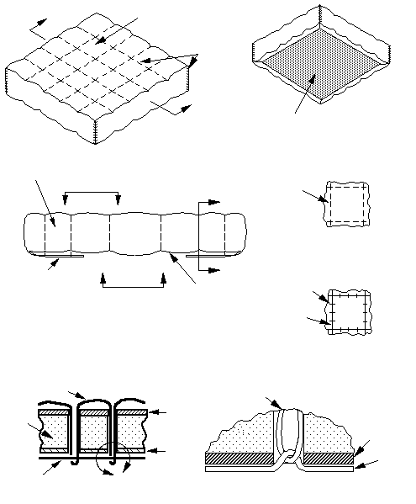
Fibrous Insulation Blankets
A
Quartz
OML Fabric
Quartz
OML
Thread
A
RTV Transfer Coated
Surface on IML
Quartz Batting
OML
Thread
B
B
D
View B-B
OML Fabric
Folded Over
To IML and
Stitched
Through
Thickness
C
C
D
OML
Thread
Section A-A
Glass IML
Fabric
IML
Thread
View C-C
OML Thread
OML Thread
OML
Fabric
Batting
IML Fabric
IML
fabric
Glass IML
Thread
IML Thread
E
Section D-D
Detail E

Slide 6
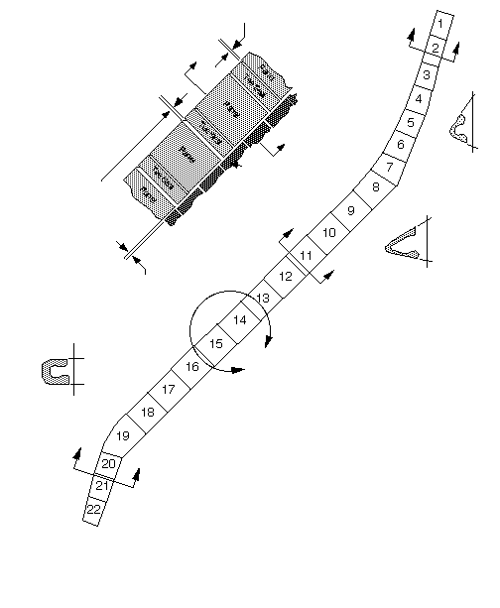
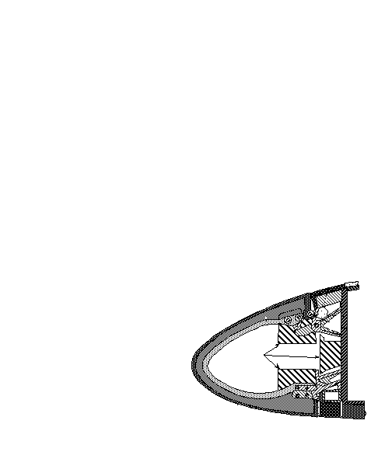
Leading Edge RCC
Fixed Upstream Gap Between
Panel and Tee Seal
A
E
A
E
HRSI Tiles
Section A-A
Variable Downstream Gap
Between Panel and Tee
Seal For Thermal Expansion
Allowance
Upper Wing
B
Detail D
B
Interface Gap
Between
RCC and
HRSI Tiles
Section B-B
Upper LESS
Access Panel
HRSI Tiles
D
Upper Wing AFRSI
RCC
Tee Seal Web
(In Background)
Thermal Barrier
Section C-C
I nconel
Attachments
C
ACSS Hardware
C
I nconel
Insulators
Upper
Left
Wing
RCC Panel
(In Foreground)
Wing Spar
Horsecollar
Peripheral Gap Filler
Lower Wing HRSI Tile
Lower LESS Access
Panel HRSI Tile
Section E-E

Slide 7
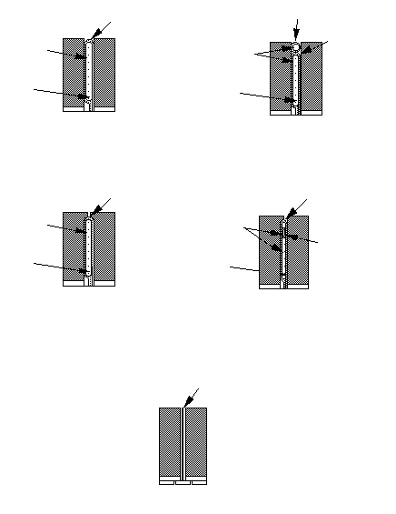
Gap Fillers
Nextel Ceramic Fabric
Nextel Sleeving
Saffil Alumina Batting
Nextel Ceramic Fabric
Saffil Alumina
Batting
Inconel Foil
Inconel Foil
Pillow or Pad Type
Pillow With Sleeving
Nextel Ceramic
Fabric
Nextel Ceramic Fabric
Saffil Alumina Batting
Saffil Alumina
Batting
Nextel Ceramic Sleeving
Inconel Foil
Inconel Foil
Pillow Captive Type
(Double Lip)
Pillow Captive Type
(Single Lip)
RTV or Ceramic Coated Nextel Fabric
Ames Type

Slide 8
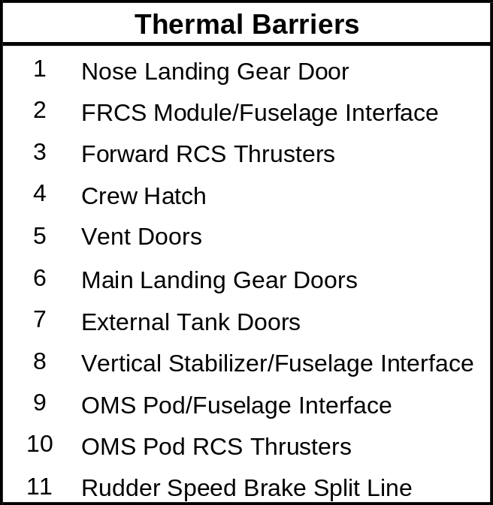
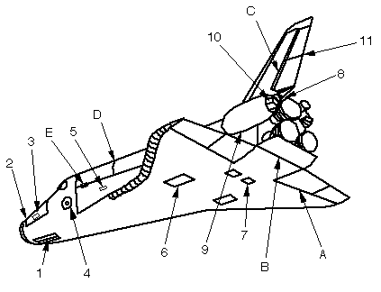
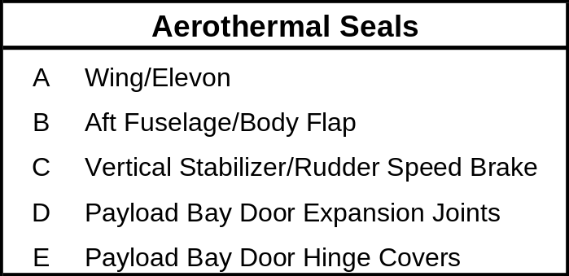
Thermal Barrier & Seal Locations

Slide 9
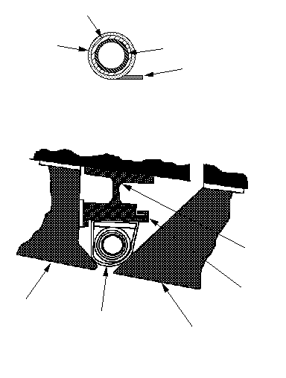
Typical Thermal Barrier
Nextel Sleeving
Nextel Fabric
Inconel Spring Tube
RTV-Stiffened Fabric Tail
Typical Thermal Barrier Detail
Thermal Barrier Support
Structure Side Tile
Thermal Barrier Carrier Plate
Thermal Barrier
Main landing Gear Door Side Tile
Main Landing Gear Door Thermal Barrier

Slide 10
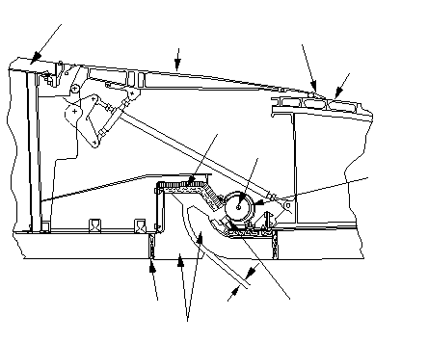
Elevon Cove Seal
Upper Wing TPS
Flipper
Door
Flipper Door Seal
Elevon Rub Panel
Uncoated AFRSI
Blankets
Hinge
Pins
Elevon Rub Tube
Lower Wing TPS
Lower Elevon
TPS
Pillow Gap Filler
Spanwise Polyimide
Primary Seal
0.5”
Gap
HRSI
Tiles

Slide 11
Orbiter TPS
Average tiles damaged from flight requiring replacement ~20
Average tiles replaced per flow ~75
HRSI tiles on the Orbiter ~19,700 (9 lb), 525 (22 lb)
TUFI tiles on the Orbiter 306 (8 lb)
FRCI tiles on the Orbiter 2,950 (12 lb)
LRSI tiles on the Orbiter 725 (9 lb), 77 (12 lb)
FIB blanket area on the Orbiter 2,123 sq ft
FRSI sheet area on the Orbiter 2,024 sq ft

Slide 12
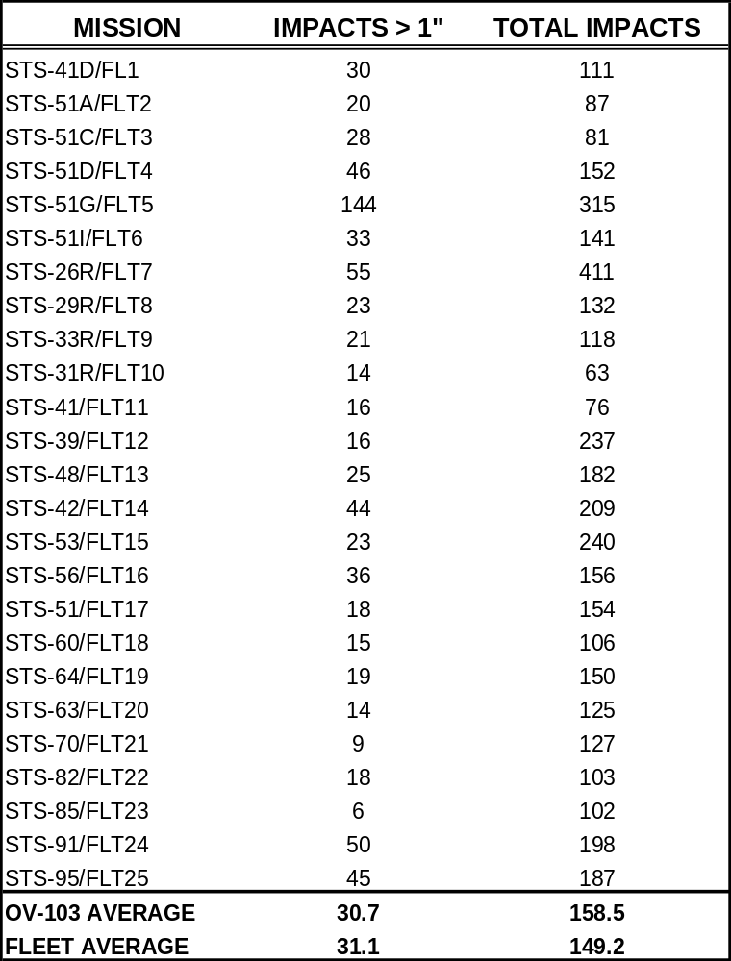
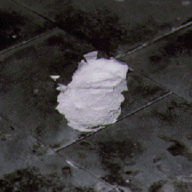
Flight Damage History

Slide 13


Materials Cost
Raw Materials* $200k / Flight
Tile PU’s $137k / Flight
Consumables $ 10k / Flight
Total $347k / Flight
* TPSF = RTV’S, Threads, Fabrics, Coatings, etc.

Slide 14
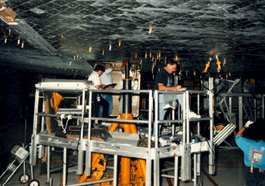
Work Access

Slide 15
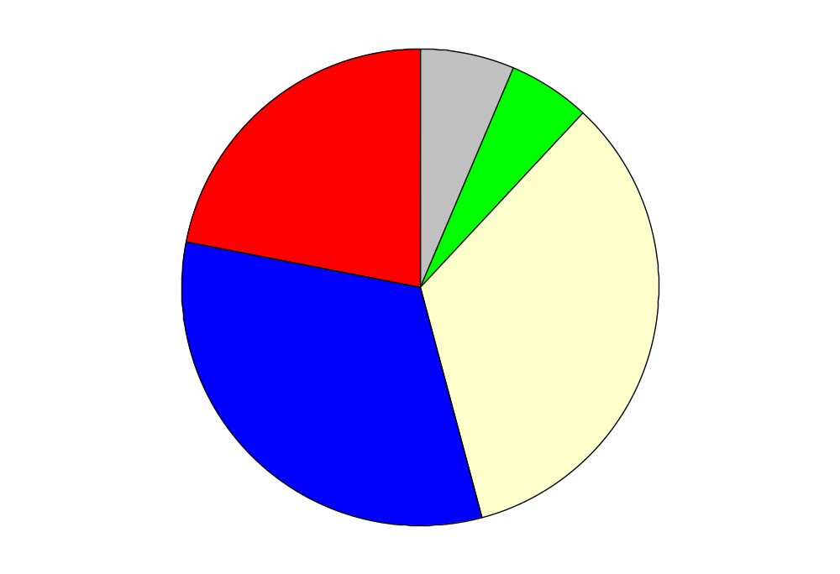
Causes for R&R
Out-of-Tolerance
6.34%
Access
21.83%
Ground Handling
5.63%
Flight
33.80%
Modification
32.39%

Slide 16
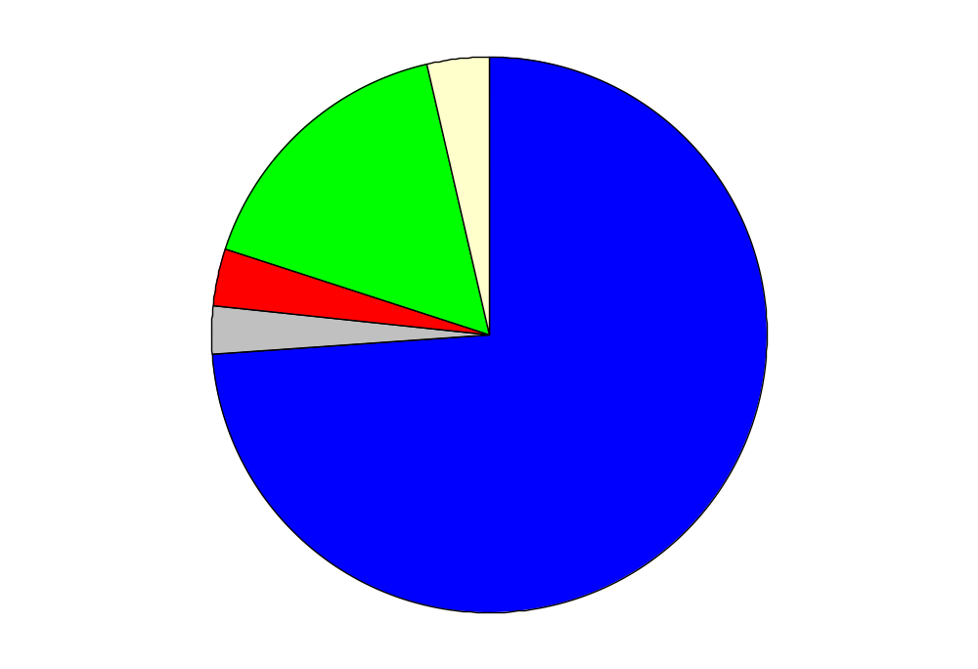
TPS Discrepancies
FRSI, Filler Bar,
and All Others
3.56%
Gap Fillers,
Thermal Barriers,
and O/T Conditions
16.30%
FI Blankets 3.50%
Re Water
Proofing
2.88%
RSI Tiles
73.75%

Slide 17
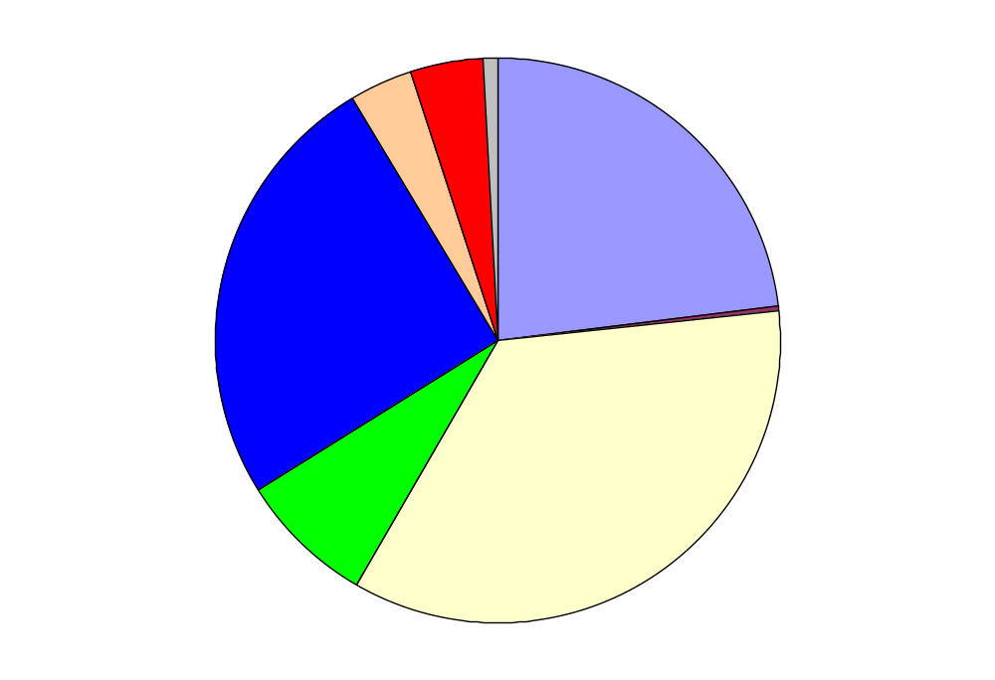
Work Load for Component R&R
Tile Reinstallation 4.18%
Complex AFRSI 0.72%
Simple AFRSI 3.85%
Simple Splash
Tile
22.96%
Complex NC
25.29%
FRSI 0.20%
Complex Splash
Tile 7.79%
Simple NC
Tile
35.02%

Slide 18
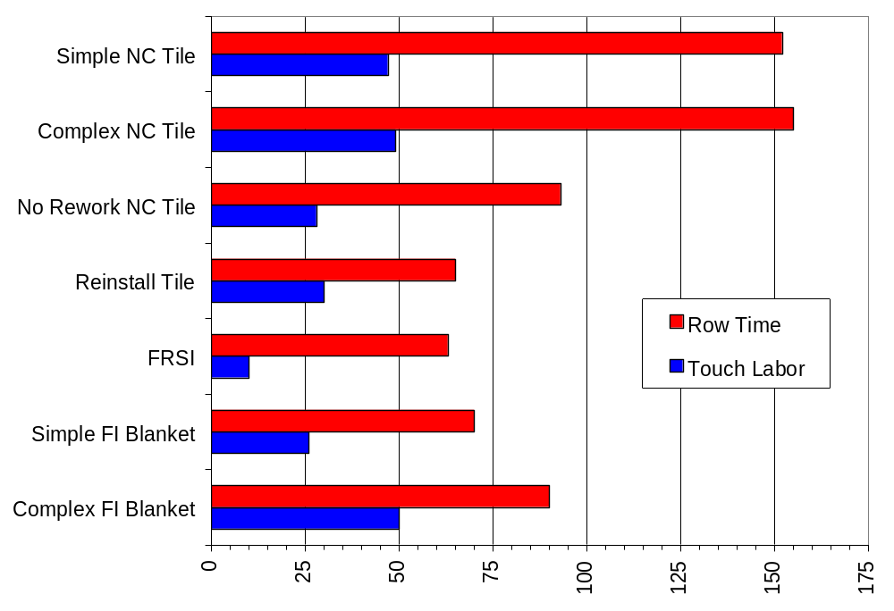
Labor Hours per Type

Slide 19
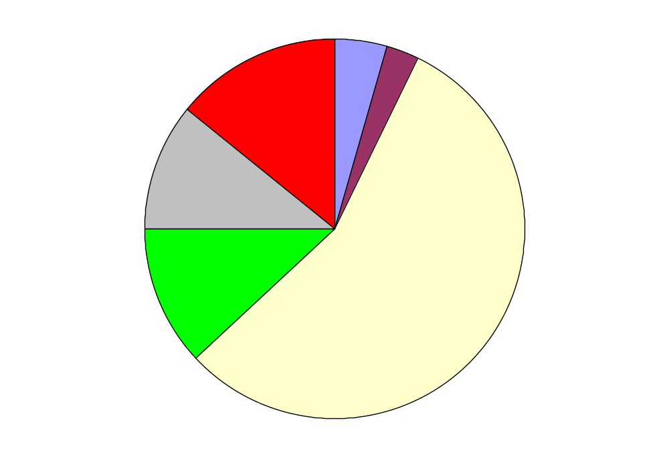
Tech Labor Breakdown
ML0601-9024 Rework 4.41%
MDR Repairs
14.27%
Re water Proofing 2.88%
ML0601
Repairs
10.71%
ML0601-9025
Repairs
12.03%
Removals &
Replacements
55.70%

Slide 20
Labor Touch Time per TPS Type
Tile = 2.27 hours/sq.ft.
FIB = 0.16 hours/sq.ft.
FRSI = 0.02 hours/sq.ft.
ET SOFI = 0.70 hours/sq.ft.

Slide 21
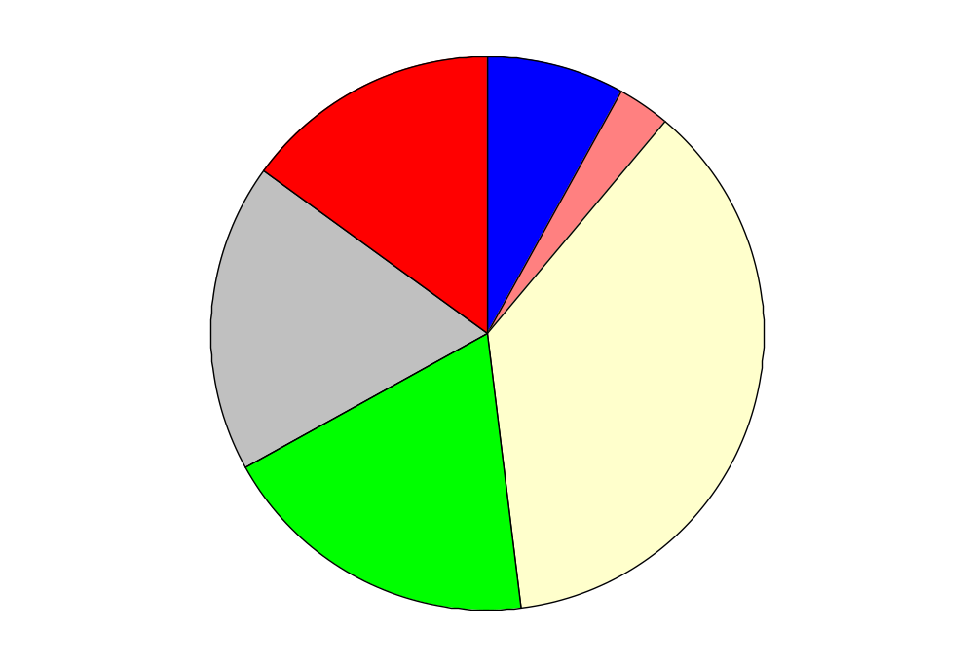
Discipline Comparison
Operations 8%
Quality Assurance
15%
Logistics 3%
Engineering
18%
Maintenance
Technicians
37%
Manufacturing
Technicians
19%

Slide 22
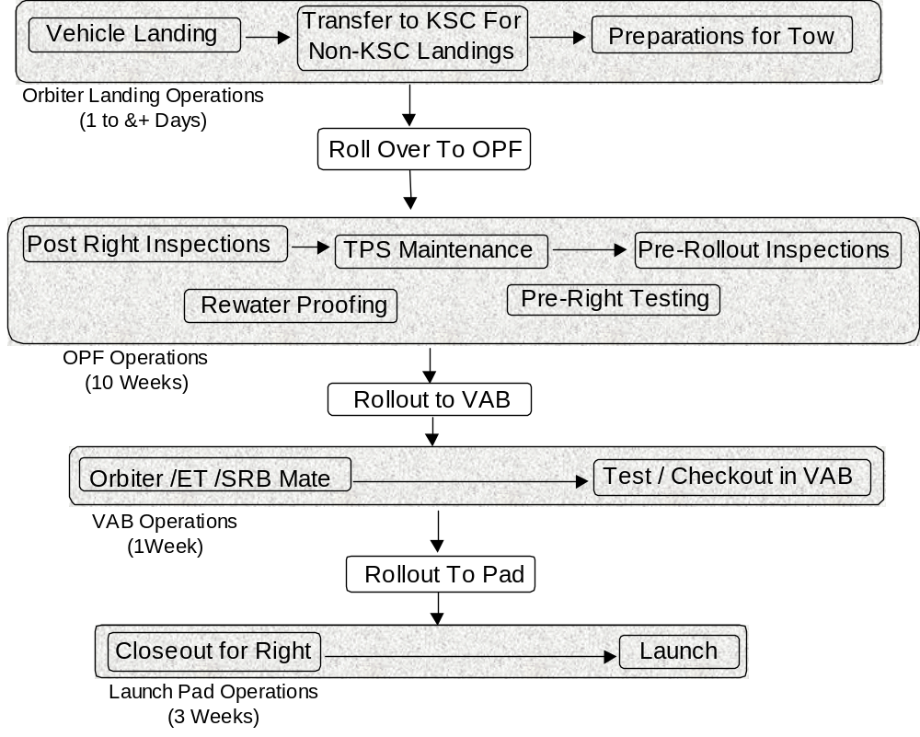
Orbiter Processing at KSC

Slide 23
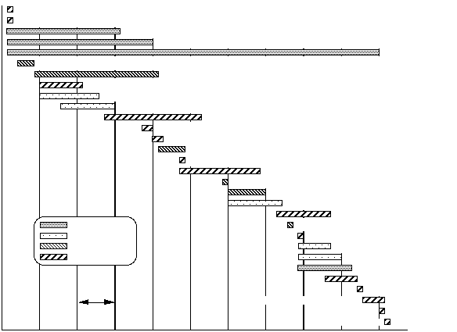
OPF Processing
Orbiter Landing at KSC, Tow to OPF, Jack and Level
PLBD Strong back Installation, PLBD Open Up
TPS Post Flight Inspection
TPS Waterproofing
TPS Processing
Payload Removal
Payload Bay Reconfiguration
FRCS Functional
SSME Heat Shield Removal
SSME Removal
OMS Pod Functional
Hydraulic System Fill and Bleed Removal Aerosurfaces
Fuel Cell Voltage Test
Payload Premate Testing
Drag Chute Installation
APU Servicing and Checkout
Payload Bay Cleaning
Payload Installation
SSME Installation
All Closeouts
TPS Operations
Final Payload Bay Cleaning
SSME/MPS Ops
ET Door Functional
Payload Ops
SSME Heat Shield Installation
Vehicle Ops
MPS/ SSME Integration
TPS Rollout Inspection
Landing Gear Door Functional
1 Week
PLBD Closure
Orbiter Jack Down, WT & cg, OTV OPS
Orbiter Power Down
Roll Out VAB

Slide 24
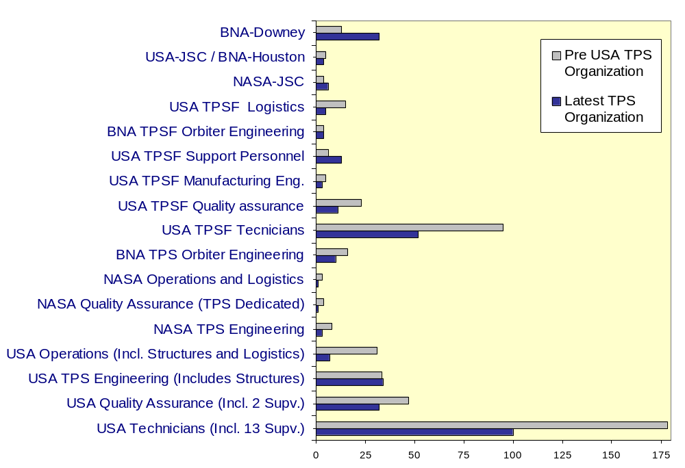
TPS Workforce

Slide 25
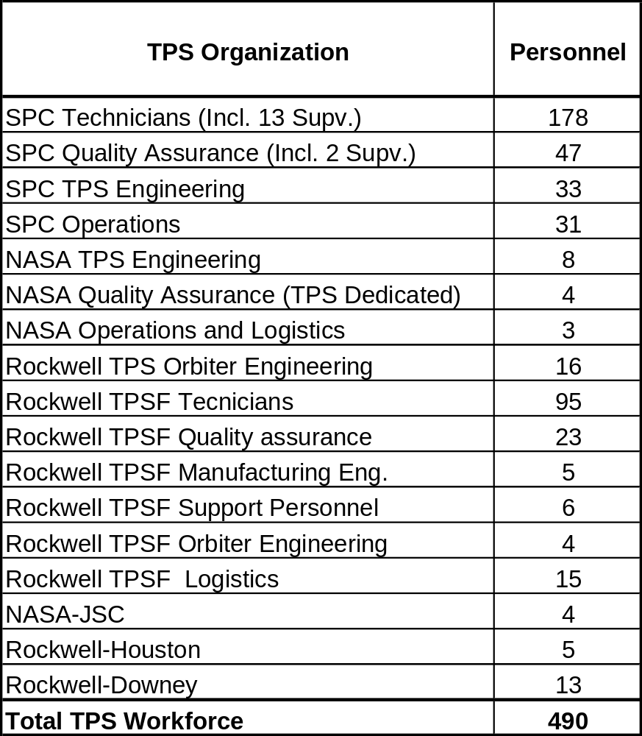
Past TPS Organization

Slide 26
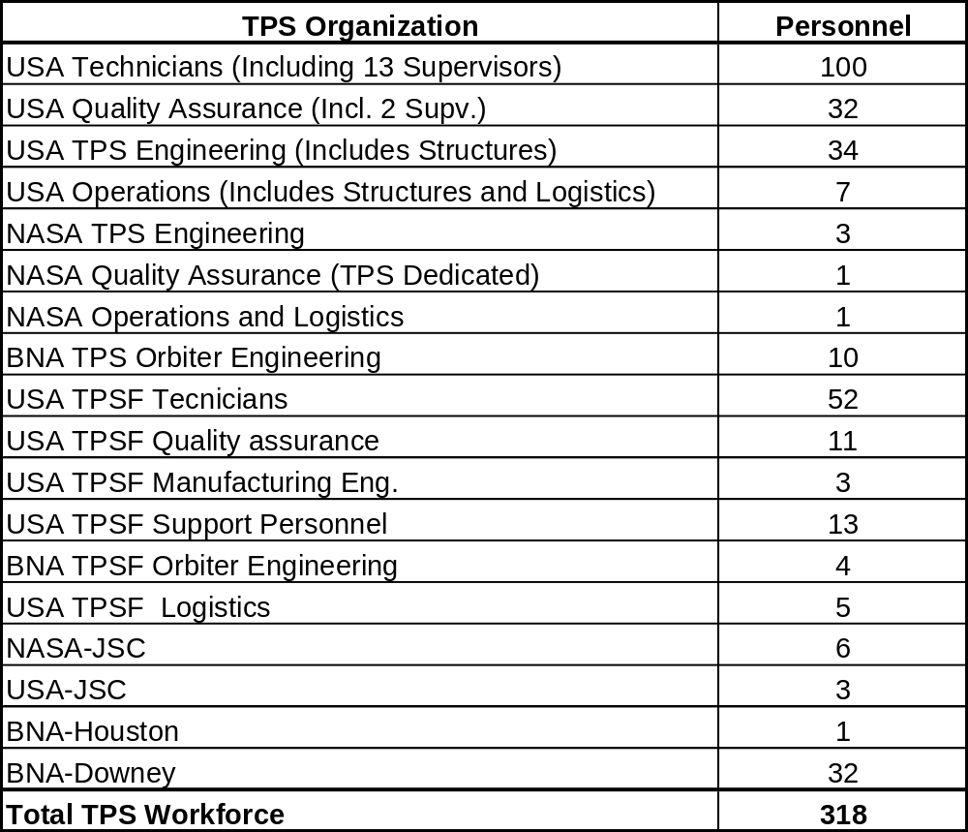
Present TPS Organization

Slide 27
Improvements To Reduce Cost
Presently In-work
      Processing Reductions
      Less Toxic Re-Waterproofing
      Surface Defect Analyzer
Future Improvements
      White TUFI
      Ceramic Captive G/F
      Thermal Barrier Improvements

Slide 28
Beyond Shuttle
Internal Vehicle Health Monitoring
RF replaces Ground Connections
No Penetrations
No Windows
Self Healing TPS

