Slide 1



The Federal Green Construction Guide for Specifiers
Implementing Your Green Building
Goals and Mandates
Alison Kinn Bennett
US EPA Environmentally Preferable Purchasing Program
OFEE Environmental Symposium
May 3, 2006
Notes:
I’d like to get a sense of who’s in the audience:
-designers/architects?
-spec writers
-contractors
-NGO
-Fed? Local govt?
-product reps or trades

Slide 2
Today’s Discussion. . .
Federal Green Building Mandates
EPA Guidelines and best practices
Voluntary Standards
The Tool Bringing it All Together:
Federal Green Construction Guide for Specifiers
Expansion Plans and Opportunities

Slide 3
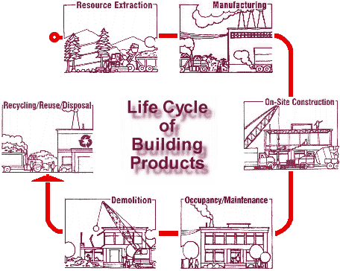
The Federal EPP Mandate
Agencies shall:
  procure and use environmentally preferable products and services and
  implement cost-effective procurement preference programs
EP products and services:
  have a lesser or reduced effect on human health and the environment...
  considers impacts throughout the lifecycle
—Executive Order 13101,
September 16, 1998
Notes:
Federal Executive Order 13101 strengthens and expands the Federal government's commitment to recycling and buying recycled-content and environmentally preferable products.
Among other things, it:
* Defines key terms;
* Elevates implementation of waste prevention and recycling activities to a new, White House-level Steering committee;
* Discontinues all government purchases of printing and writing paper not containing 30 percent postconsumer fiber by the end of 1998;
* Provides new ways for the Federal government to build markets
for environmentally preferable products and services;
*Increases government purchases of bio-based products to develop markets for these items;
* Requires all Federal facilities to comply with recycling and
recycled content purchasing requirements under the Federal Facility Compliance Act;
*Requires agencies to establish long-term goals both for waste prevention and recycling and for buying recycled and environmentally preferable products
*Directs federal agencies to track and measure results and to
report progress.

Slide 4
Federal Green Building Goals and Mandates
Greening of Government Executive Orders
EPA’s Comprehensive Procurement Guidelines
ENERGY STAR & DOE Federal Energy Management Program (FEMP) Product Efficiency Recommendations
EPACT 2005
USDA Biobased Purchasing Program
Federal Leadership in High Performance and Sustainable Buildings MOU
Notes:
Greening of Government Executive Orders
(13101-Environmentally Preferable Purchasing;
13123-Energy Efficiency,
13134-Biobased,
13148-Environmental Management);
CPG - the Federal Buy Recycled Program
including recovered content requirements for insulation, paint, carpet, tiles, fiberboard, etc.
The NTTAA and its implementing guidance, Office of Management and Budget Circular A-119, direct federal agencies to use standards for regulatory and procurement activities, and to participate in the development of these standards. OMB Circular A-119 directs agencies to use third party, non-governmental standards in lieu of government-unique standards where possible. EPA is encouraging the development of standards which reflect environmental considerations across the life cycle of a product or service.

Slide 5



EPA’s Green Building ‘Best Practices’ www.epa.gov/greenbuilding
Media-Focused
  Energy
  Water
  Waste
  Materials
  Indoor Environments
Sector-Based
  Homes
  Offices
  Schools
  Laboratories
  Federal Facilities
Notes:
EPA has a long and successful history of addressing environmental and health impacts related
to buildings.
Designing and operating buildings to use energy efficiently and to use renewable sources of
energy, including solar, wind, and biomass.
Designing and operating buildings to use water efficiently.
Using building materials that, in comparison to competing brands, have a reduced effect on the
environment throughout their life cycle (e.g. recycled content, low toxicity, energy efficiency,
biodegradability, and/or durability).
Reducing the waste from construction, remodeling, and demolition.
Designing and operating buildings that are healthy for their occupants.
EPA GB Work Group
Discuss Charter and first meeting
Goals/Objectives
Potential projects
coordinated input into USGBC LEED development
EPA as a Model Facility/Test bed

Slide 6
The Power of Standards
ASTM E6.71
  General Principles of Sustainability
  Data Collection for Assessing Sustainability of Building Products
  Green Roof Systems, Earthen Materials
  Reporting Sustainability of Buildings (draft)
  Labeling Environmentally Preferable Products (draft)
  Symposium April 2007
Product Specific
  GreenSeal, SCS, FSC, NSF, BIFMA
Whole Building Rating Systems
  State and Local, USGBC LEED, GBI Green Globes
Notes:
The Power of Standards
E2114-05 Standard *Terminology for Sustainability*
E2432 -- Standard Guide for General Principles of Sustainability Relative to Buildings
It is expected that the Guide will be referenced and used by local governments, architects, and others seeking to solidify and/or justify the tripartite---environmental, economic, and social---approach to building design, operations, maintenance, and end-of-life issues.
Key contributions of this document include:
-Recognizing the "three legs of the stool" concept -- environmental, economic, social
-Recognizing that sustainability is an ideal and that, when applying the principles of sustainability in the real world, balancing trade-offs and continual improvement are necessary
-Providing credibility to the sustainability movement within the building industry
-Providing a foundation for the development of other ASTM standards, such as sustainable building assessment and reporting
E2129-03 Standard Practice for Data Collection for Sustainability Assessment of Building Products; A survey to be used by arhcitects to gather information from manufacturers on the ‘greeness’ of building products.
E2392-05 Standard Guide for Design of Earthen Wall Building Systems;Provides design guidance for earthen building systems (adobe, rammed earth, cob, cast earth and other earth technologies).
E1991-05 Standard Guide for Environmental Life Cycle Assessment of Building Materials/ Products;This guide describes a framework for life cycle inventory analysis, and describes various options and aspects of Impact Assessment and Interpretation.
Future:
Standard Practice for Reporting of Sustainability in Building; Sets minimum requirements for reporting: assumptions, boundary sets, metrics, data, information, decisions, evaluations and assessments for the sustainability of a building.;in committee *draft*
Standard Practice for Labeling Environmentally Preferable Products;Details the recommended format and minimal content of information to be included on labels for environmentally preferable products.;in committee *draft*
USGBC LEED & GBI Green Globes --encouraging leadership, consensus process, and sound science in rating system development

Slide 7
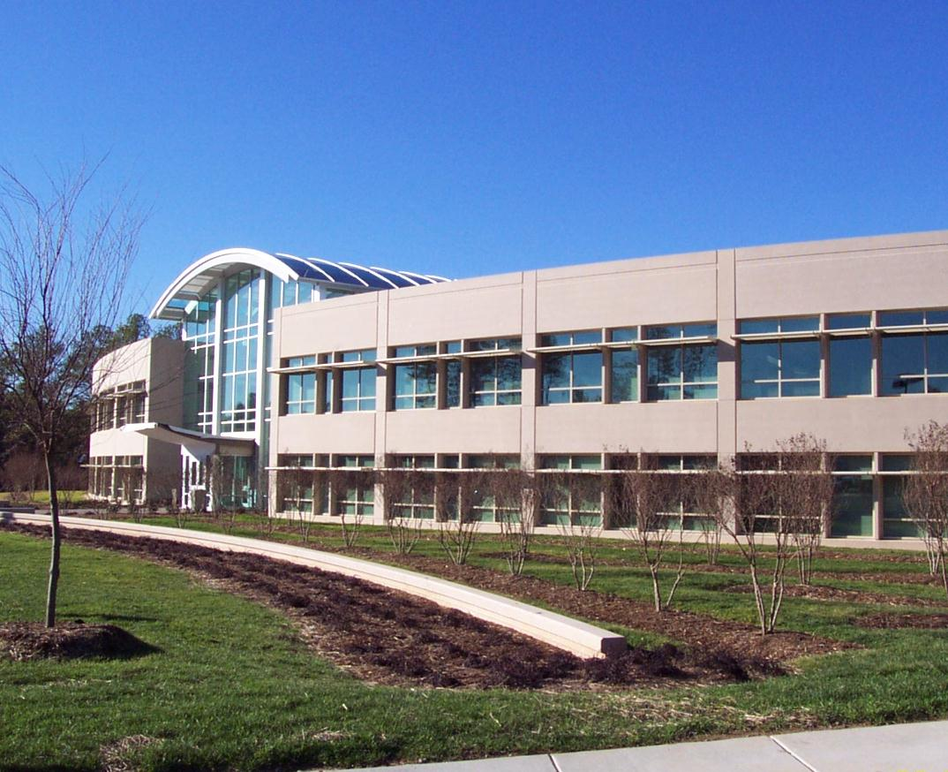
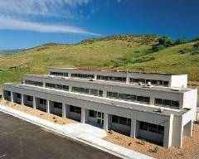
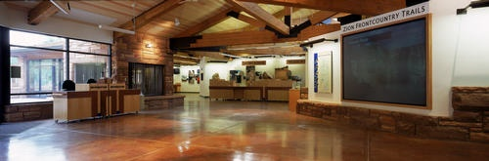
The Federal Green Construction Guide for Specifiers
Brought to you by…
  EPA
  Office of the Federal Environmental Executive
  Interagency Sustainability Working Group
  National Inst of Building Sciences --
  Whole Building Design Guide - www.wbdg.org
  http://fedgreenspecs.wbdg.org

Slide 8
CSI MasterFormatTM (1995)
Update to v2004 – 50 Division format coming soon!
1 - General Requirements
2 - Site Construction
3 - Concrete
4 - Masonry
5 - Metals
6 - Wood and Plastics
7 - Thermal and Moisture Protection
8 - Doors and Windows
9 - Finishes
10 - Specialties
11 - Equipment
12 - Furnishings
13 - Special Construction
14 - Conveying Systems
15 - Mechanical
16 - Electrical
Notes:
Please excuse this cursory approach to Specs 101, but I know as I was getting into this it was helpful.
The working drawings and specifications are the essential pieces to bid and build a project.
Building specifications describe the materials as well as the installation methods.
They also prescribe quality standards of construction procedures executed on the project.
Because it’s the standard language of our audience, and throughout the Construction Industry, we’re organizing our tool according to
Const Spec Inst MasterFormat Divisions 1-16
Division 1 is where general administrative and procedural requirements are found as they apply to the entire project.
Often Division 1 is where all the green requirements go. This might be appropriate for Volume builds in which the same situation
& same players are involved over and over again. Or, for Design/Build in which all the players are from the same company.
The problem with that approach is that, although all parties are supposed to see all the specs and drawing, in reality, on the job site,
a subcontractor will probably only be handed the pertinent Division/Section for their piece of the project,
potentially missing all the environmental requirements.
And so, rather than stating the “green” in just one place,
we’ve integrated environmental language throughout all the Divisions, as appropriate.
This approach has been reviewed and endorsed by the Construction Specifications Institute.
So, I’m proud to say that we could be influencing how specs will incorporate green in the future.
Specifications 2-16 accomplish two major functions:
First, they describe the unique product qualities of green building materials and products. In our tool, the user can pick and choose those specs
with the environmental attributes that support the project-specific environmental goals, such as low toxicity, minimal chemical emissions,
recycled content, recyclability, durability, moisture resistance, and environmental and ecological installation procedures.
Another application of environmental specifications includes addressing the installation, protection, handling and cleanup of
specific building materials. They ensure that work is performed in a manner consistent with the environmental goals of the project.
The incorporation of a green material alone may not contribute to "greening" the project if it does not function as intended due to
improper installation or if it becomes contaminated as the result of careless handling.
Our model language is intended to supplement, not replace full specifications. It’s only the green stuff!
They are designed to be edited, adapted and incorporated into the standard specifications of a building project.

Slide 9
CSI Principles for Green Specifications
August 2003
Integrate green attributes
The environment is like all other “health, safety and welfare” issues
Rely on consensus standards to define green

Slide 10
SECTION 17010 – Gizmo
SPECIFIER NOTE:
resource management: Mining raw materials for gizmos produces soil erosion, pollutant runoff, and habitat loss. Adhesives for gizmos are typically derived from petrochemicals. Manufacturing of gizmos is considered energy intensive; however, there have been some energy efficiency improvements in recent years. Gizmos containing recycled glass are available.
toxicity/IEQ: VOCs may be emitted from gizmo adhesives during the curing process.
performance: Gizmos are extremely durable and require little maintenance. Performance is comparable for green methods and standard methods.
Notes:
Before I tell you the construction activities and materials for which we are developing model language,
I thought it would be best to run through one section so you could begin to grasp the look, feel, and purpose
of this resource.
Now, I went back and forth on whetehr I should cover out drat sections on widgets, trinkets or gizmos.
However, since we are familiar with the environmental impacts of gizmos,
I decided to illustrate this section as an example.
We begin here as we are doing in all sections, with a note to the specifier about
resource management
toxicity and
performance issues associated with gizmos
to help he or she make environmentally preferable decisions.

Slide 11
SECTION 17010 – Gizmos
PART 1 -- GENERAL
1.2 Submittals
Biobased / Recycled / Local Material / Sustainable Forestry / Energy-Efficiency/ O&M Manuals
  a. Indicate type of biobased material in product and biobased content.
  b. Indicate relative dollar value of biobased content product to total dollar value of product included in project.
1.3 Quality Assurance
1. ASTM standards for formaldehyde and
VOC emissions
2. Third-party Certification programs
Notes:
Under Part 1
We have included possible submittal requirements, depending upon the project specific goals.
Again we notify the specifier of relevant Federal mandates and/or goals
For gizmos, we discuss
Farm Bill Sec 9002 - Federal Procurement of Biobased Products
and flag that there is a LEED credit for rapidly renewable materials.
The specification asks the contractor to submit
the type of biobased material in and biobased content of the gizmo.

Slide 12
SECTION 17010 – Gizmos
PART 2 – PRODUCTS
2.1 MATERIALS
SPECIFIER NOTE:
US-EPA CPG recommends gizmos fabricated from 20 percent post-consumer content for steel and 100 percent post-consumer content for PET plastic.
LEED v2.2 requires 10% (post-consumer + 1/2 post-industrial) for one point and 20% (post-consumer + 1/2 post-industrial) for two points.
Green Globes US also provides points for reused building materials and components and for building materials with recycled content.
Verify with manufacturer for product availability and recycled content.
1. Recycled Content:
  a. steel: Minimum [20] [xxxx] percent post-consumer content.
Notes:
In Part 2,
we address material specifications.
For gizmos, we have pointed out in the Specifier Note
the CPG of 10% post-consumer content for gizmos
and the LEED credits for recycled content.
In the model specification, we left it up to the user to decide which minimums meet their agency’s
project specific needs and goals.

Slide 13
SECTION 17010 – Gizmos
PART 3 – EXECUTION
3.1 SITE ENVIRONMENTAL PROCEDURES
A. Indoor Air Quality:
  1. Temporary ventilation: Ventilate gizmos prior to installation. Remove from packaging and ventilate in a secure, dry, well-ventilated space free from strong contaminant sources and residues. Provide a temperature range of 60 degrees F minimum to 90 degree F maximum continuously for minimum 72 hours.
B. Resource Management:
  1. Verify gizmo is properly installed, connected, and adjusted. Verify that gizmo is operating as specified.
  2. Coordinate with manufacturer for [maintenance agreement] [take-back program] [green lease] of gizmo.
Notes:
In part 3 of section 17010 for gizmos,
we address site environmental procedures.
Specifically, we’ve included model language to:
-ventilate the gizmos prior to installation;
-verify that the gizmo is properly installed
-and, to coordinate for either
-a maintenance agreement
-a take-back program
-or the green lease of the gizmo
Again, depending on the agency’s project-specific goals

Slide 14
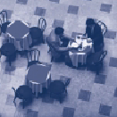
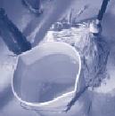
Division 1 -
General Requirements
01100 - Summary
01300 - Administrative Requirements
01351 - Waste Management
01353 - Noise & Acoustics Management
01354 – Environmental Management
01400 - Quality Control
01411 – Environmental Regulatory Requirements
01421 – Environmental References
01500 – Construction Facilities & Temporary Controls
01611 - Environmental Requirements for Products
01740 - Cleaning
01780 – Project Closeout
01810 - Commissioning
01821 – Environmental Demonstration & Training
01830 - Operation & Maintenance
Notes:
I’ll run through the sections we currently have in draft stage:
In Divison 1, the sections for which we’ve found ample precedent and supporting data
to develop model language, include . . .

Slide 15
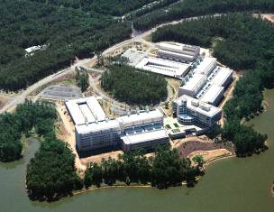
Division 2 -
Site Construction
02220 - Site Demolition
02230 - Site Clearing
02360 - Soil Treatment
02700 - Bases, Ballasts, Pavements
02795 - Porous Paving
02872 - Bat Houses
02900 - Landscaping
Notes:
For Division 2,
addressing:
polluted run-off
groundwater recharge
disturbance to existing vegetation
native, climate appropriate plants
even bat houses!

Slide 16
Divisions 3, 4, and 5
03300 - Cast-in-Place Concrete
03400 - Precast Concrete
04200 - Masonry
05050 - Basic Metal Materials & Methods
Notes:
Recycled content
Toxics
embodied energy

Slide 17
Division 6 - Wood and Plastics
06070 - Wood Treatment
06100 - Rough Carpentry
06160 - Sheathing
06200 - Finish Carpentry
06600 - Plastic Fabrications
06700 - Alternative Agricultural Products
Notes:
Sustainable forestry practices
toxics in wood preservatives
recycled content
locally harvested
biobased content

Slide 18
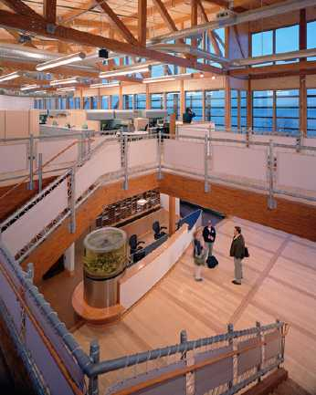
Divisions 7 & 8
7 Thermal and Moisture Protection
  07100 - Dampproofing & Waterproofing
  07200 - Thermal Protection
  07300 - Shingles & Tiles
  07500 - Membrane Roofing
  07900 - Joint Sealers
8 Doors and Windows
  08210 - Wood Doors
  08500 - Windows
Notes:
Coordinating with FEMP
addressing:
energy efficiency
recycled content

Slide 19
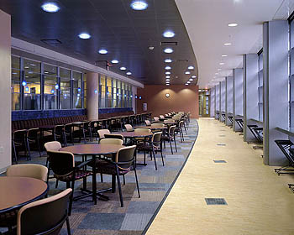
Division 9 - Finishes
09250 - Gypsum Board
09300 - Tile
09510 - Acoustical Ceilings
09650 - Resilient Flooring
09654 - Linoleum
09680 - Carpet
09720 - Wallcovering
09900 - Paints & Coatings
Notes:
IAQ
recycled content
toxics
durability

Slide 20
Divisions 10, 11, 12, 13 and 14
10 Specialties
  10170 - Plastic Toilet Compartments
  10400 - Signage
11 Equipment
  11160 - Loading Dock Equipment
  11450 - Residential Equipment
  11680 - Office Equipment
12 Furnishings
  12100 - Artwork
  12482 - Floor Mats
  12700 - Systems Furniture
13 Special Construction
  13600 – Renewable Energy Systems
14 Conveying Systems
  14200 - Elevators
Notes:
Renewable energy systems
energy efficient equipment
flexible furniture systems

Slide 21
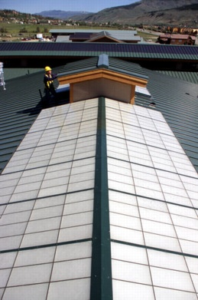
Divisions 15 & 16
Division 15 - Mechanical
  15400 - Plumbing Fixtures & Equipment
  15700 - Heating, Ventilating, & Air Conditioning Equipment
  15800 - Air Distribution
Division 16 - Electrical
  16500 - Lighting
Notes:
Water efficient fixtures
energy efficient HVAC and lighting

Slide 22
Next Steps
Implementation of Federal MOU
WBDG Sustainability Subcommittee – Advisory Group
Greening UFGS and MasterSpec
Continual Improvement & Expansion!

Slide 23
Expansion Plans - Phase I
Model Green Bid Specification (SFO, RFP)
IEQ Management - Moisture Control
FEMP-sponsored sections
New technical sections:
  Stormwater Management with Compost
  Rainwater Harvest
  Vegetative Roof Systems (vegetation, membranes)
  Constructed Wetlands
  Integrated Pest Management
  Structural Steel
Notes:
Likely sections, chosen by FEMP because these products do not have ENERGY STAR labels, include:
11420 - Gas Griddles (and maybe other commercial kitchen equipment)
11435 - Ice Machines
11440 - Pre-Rinse Spray Valves
16220 - Electric Motors
-The Contractor shall develop a model green building bid specification.
This document shall build on other groups’ model bid specs (e.g., AIA COTE guidance attached)
and past successful green solicitations (e.g, EPA Denver green SFO attached) in order to
assist Federal agencies in meeting their environmental building goals and mandates.
In addition, the model language should be compatible with use of the Unified Facilities Guide Spec

Slide 24
Expansion Plans - Phase II
Division 2-16 options
Integrated Pest Management
Landscape Maintenance
Irrigation Systems
Retaining Walls
Adobe
Rammed Earth
Strawbale
Glazing
Waterproofing
Thermal Protection
Shingles and Tiles
Curtain Walls
Terrazzo
Packaged Cooling Towers
Structural Plastics
Sitework Concrete
Other options
Guidance for DBOM contracts
Guidance for Environmental Management Systems and ISO 14001 registration
Contractor’s roles and responsibilities
Guidance for environmentally sensitive sites
Notes:
-Our long-term strategy for continual improvement of the model language, is to call on the
expertise within EPA and throughout the federal government;
comments from any interested party will always be welcome
and we’ll do our best to reflect them in the tool.

Slide 25
Questions for you...
Priorities?
Interest in co-sponsoring?
Will you use these Guide Specs?
Suggestions for measurement and assessment?

Slide 26
Contact Information
Alison Kinn Bennett
USEPA
202-564-8859
kinn.alison@epa.gov
<www.epa.gov/greenbuilding>
<fedgreenspecs.wbdg.org>

