Slide 1
MODULE III - LEAD SAFETY: MATERIALS AND WORK PRACTICES
Learning Objectives
Discuss the need to notify and protect residents.
Recognize materials, equipment and personal protective clothing.
Recognize proper work practices that minimize dust.
List five prohibited work practices.
List five unsafe work practices.
State the importance of thorough cleaning.
Notes:
Change bullets to Squares

Slide 2
WHY USE LEAD SAFE WORK PRACTICES?
Protect residents of the dwelling unit
Protect yourself
Protect fellow workers
Protect your family
Notes:
Change bullets to Squares

Slide 3
BEFORE THE JOB: COORDINATE WITH RESIDENTS
All residents should be out of the immediate work area
Only maintenance personnel in the unit
Management should:
  Notify residents of upcoming maintenance or other work
  Ask them to move their belongings as needed
  Relocate residents when necessary
Notes:
Change bullets to Squares

Slide 4
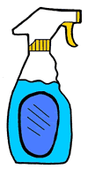
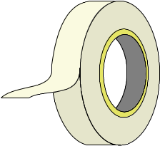

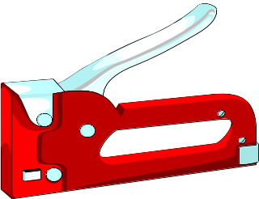
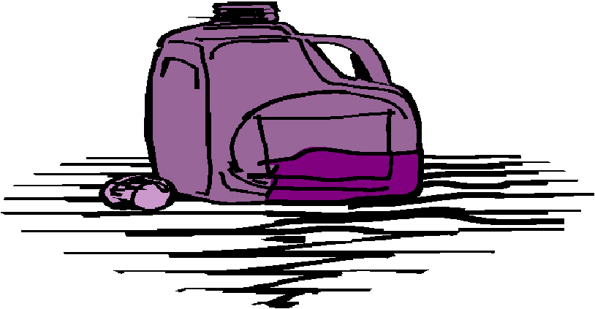
MATERIALS AND EQUIPMENT
Common Items:
Spray Bottle
Tape
Towels/Rags
Stapler
All Purpose Cleaner

Slide 5
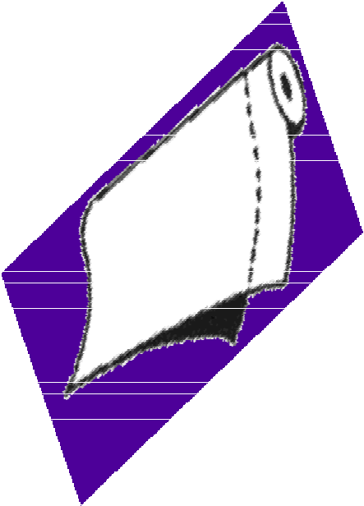

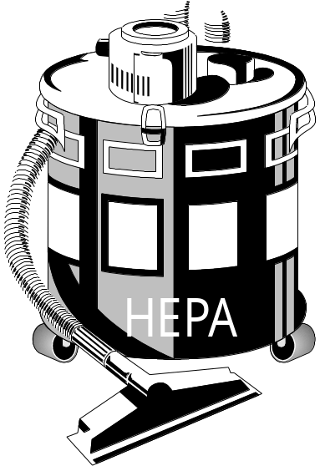
MATERIALS AND EQUIPMENT
Specialty Items:
Plastic Sheeting
Heavy-Duty Poly Bags
High-Efficiency Particulate Air Filtering (HEPA) Vacuum
Heavy Duty Plastic Sheeting
Notes:
Rotate Plastic sheeting and add label. Rotate so the roll is laying flat on the ground.

Slide 6
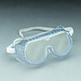

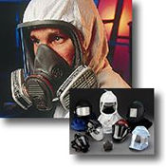

PROTECTIVE CLOTHING
Safety Eyewear
Body Protection
Hand Protection
Respiratory Protection
Notes:
Add Labels (Safety Glasses/Goggles;Work Gloves; Protective clothing; Respiratory Protection).

Slide 7
DURING THE JOB: HYGIENE
No smoking
No eating, drinking, chewing gum or tobacco
No applying cosmetics
Wash hands and face with soap (or towelettes) before eating, drinking or smoking
Notes:
Change bullets to Squares

Slide 8



LEAD SAFE WORK PRACTICES: AN INTRODUCTION
  Work Smart
  Work Wet
  Work Clean
Notes:
These three principles drive all LSWP. The prohibited practices are prohibited because they preventing working clean, wet and smart. They create huge amounts of dust or create unsafe situations.

Slide 9



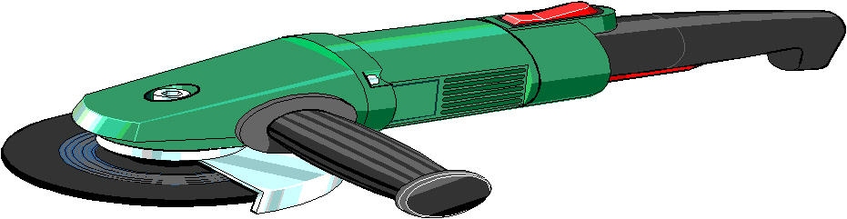
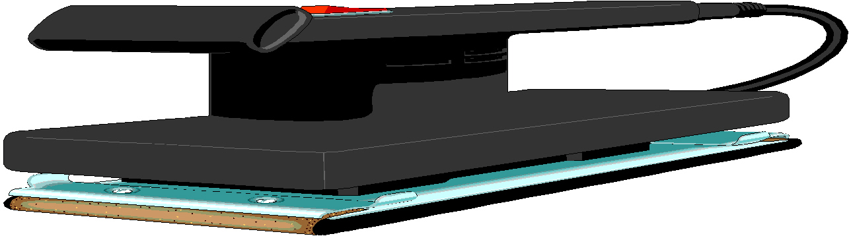
DURING THE JOB:
PROHIBITED PRACTICES
No open flame burning, heat gun hotter than 1,100º f, or welding/flame cutting
No mechanical grinding/sanding without HEPA attachments
No abrasive blasting, or sandblasting
No methylene chloride based strippers in poorly ventilated spaces.
No extensive dry sanding or scraping above de minimus levels
Methylene Chloride Stripper
Notes:
Add graphics for water or abrasive blasting; Add Torch

Slide 10

CLEAN-UP: GOOD PRACTICES
DO’S
DON’T’S
Use a HEPA-Filtered vacuum
Wash in buckets
Dispose of waste water in toilet or offsite
Keep water away from electrical outlets/fixtures
Dispose of waste at appropriate facilities
No vacuuming with household vacuum
No washing in resident’s sink
No disposal in resident’s sink, bathtub, or yard
No water near electric outlets/fixtures
No disposal of waste in resident trash

Slide 11
AFTER THE JOB:
DECONTAMINATION
Wash hands and face with soap and water
Remove dust from clothes with HEPA-filtered vacuum
Shower immediately after leaving job, before leaving the facility, or upon arriving home
Notes:
Arial Font

Slide 12
SUMMARY
Use protective clothing, equipment, and procedures when doing lead-based paint maintenance.
Work smart, wet, and clean to protect you, residents, and your family.
Avoid practices that are prohibited and unsafe.
Notes:
Arial Font

