Slide 1
MedlinePlus Go Local
National Library of Medicine
National Institutes of Health
Health and Human Services
May 24, 2004

Slide 2
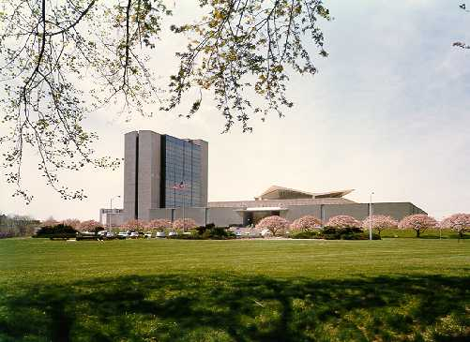
Welcome
Eve-Marie Lacroix, Chief, Public Services Division

Slide 3
Background
"Go Local" links on MedlinePlus health topic pages take you to information about health services in local geographic areas.
  Links include Web sites from hospitals, physicians, nursing homes, support groups, health screening providers and many others.
  Some facilities and services just have directory information listed, without links.
Users link directly from each MedlinePlus health topic to services related to that particular topic.
  "Go Local" from the MedlinePlus Breast Cancer page to Cancer Clinics, Oncologists, Support Groups, etc. on the local state site.
Notes:
The Go Local services pages also link back to the appropriate MedlinePlus health topics.

Slide 4
Health information + local services
Example Breast Cancer
Go Local Review
MEDLINEplus
NIH consumer literature
News
Symptoms
Treatment
Coping
MEDLINE search
ClinicalTrials.gov
Genetics Home Reference links
NC Health Info
Health screening services
Cancer care facilities
Support groups
Exercise and yoga classes
Providers of wigs and prostheses
Oncologists
Notes:
This is from the original concept a few years ago – including the capitalization of the time. The basic idea of what should be where remains the same, with reliable health and disease information being pointed to from Medlineplus (On the left) and this supplemented by local sources for facilities, supplies and services in the Go Local area (on the right).

Slide 5
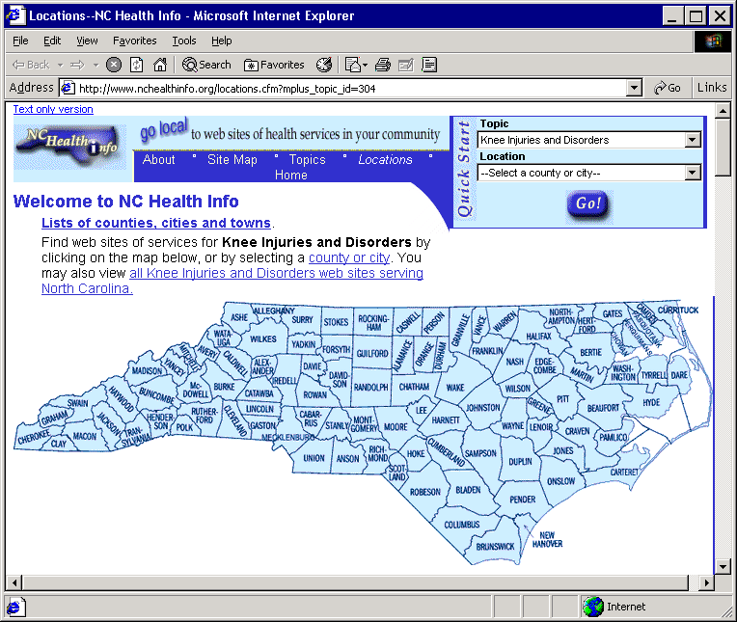
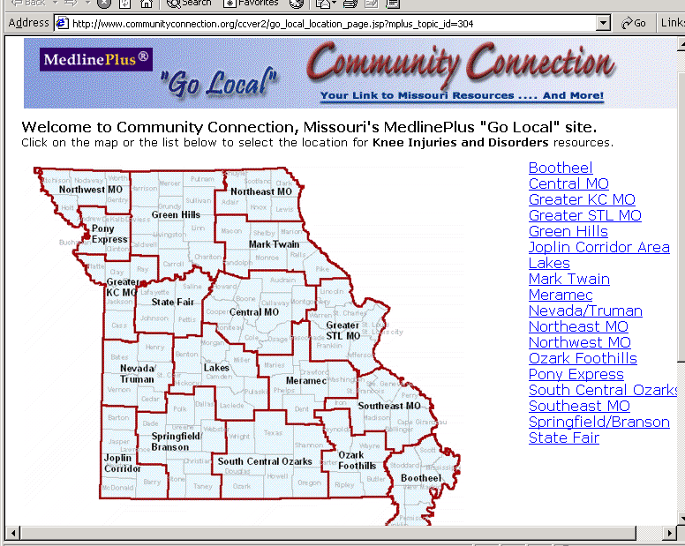
MedlinePlus Go Local Today
NCHealthInfo
  2000/01 feasibility study
  2002 system development, resource collection, outreach
  Feb 2003 – release
  200,000 pages month
  2,500 sites
Missouri Community Connection
  Began in 1998
  Summer 2003 –vocabulary mapping, record review, and system changes
  March 2004 – linked to MedlinePlus
  4,000 health services sites
Notes:
As you know, NCHealthInfo was the pilot. As of this spring, they are not alone.
In case any of you are concerned that the need to provide customer support is a burden, North Carolina received 80 reference questions last year through NCHealthInfo. I’ll let the people involved with making these Web sights happen tell you more in a few minutes.

Slide 6
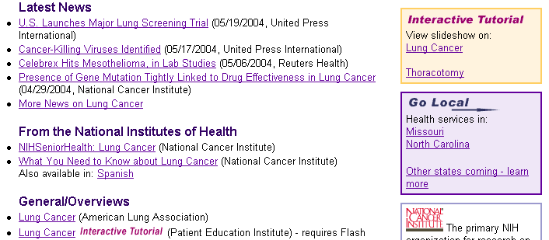
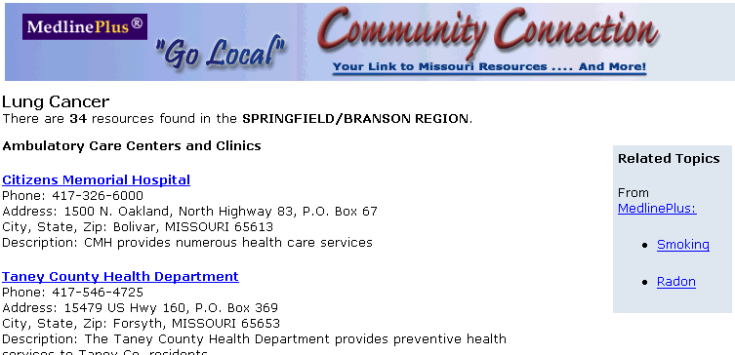
Notes:
Here clicking on the Go Local link for Missouri from the MedlinePlus topic page on Lung Cancer takes me to the Missouri’s Community Connection site, which knows I am looking for information on Lung Cancer. Once I choose my county, I am directed to clinics, oncologists, support groups, and so on.

Slide 7
Go Local Expansion
NLM plans to host sites across the country
Projected release date: Spring 2005
Currently 13 new participants
Notes:
The “go local” model is that the state provide health services information and map it to MedlinePlus health information topics
Users can link between the sites through the vocabulary mappings. We closed a first round of Go Local proposals in April, from which we have 13 new participants

Slide 8
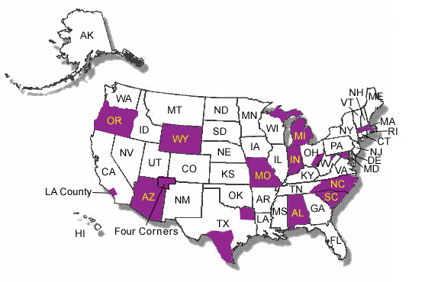
Notes:
This is what we hope to look like this time next year.
A few of these sites are planning to follow North Carolina and Missouri in creating and supporting their own linked systems, and that is still an option.

Slide 9
Keys to success
Institutional/organizational commitment
Dedicated staff
Services, not health information
Vigilance
Community outreach and partnerships
Feedback, evaluation and improvements
Notes:
Based on the proposals we reviewed, the experience gained by working with the North Carolina and Missouri go local sites and our experience with web sites through MedlinePlus, here are some best practices, keys to success for a viable go local site. First, they must have …

Slide 10
Presentations by Participants
NCHealthInfo: Christie Silbajorie
Community Connection: Cindy Martin
NexCare Collaborative: Pejman Salimpour, M.D.
Notes:
Now I will let you here from some of the Go Local sites, and then we will tell you more about the new NLM-hosted option.

Slide 11
Next Steps
NLM-supported Go Local system
NLM licensed directories and zip code lookup utility

Slide 12
NLM-Supported
Go Local System
Ease the technical load
  Centralized database and input system, supported and hosted at NLM
  Participants enter records using web-based form
  NLM systems will build the local pages based on the records

Slide 13
NLM-Supported
Go Local Input System
Hosted system “lives” at NLM
Pages built based on records local participants have entered

Slide 14
Other services provided by NLM
Vocabulary and mappings
Link checker
Site map
Search engine

Slide 15
Locally- vs. NLM-supported
Local Responsibilities
  Project manager
  Collect, index and maintain services links
  Outreach and promotion
  Customer service
  Quarterly reports
  Web server, mgt system, hardware, software
  Local vocabulary
  Map M+ and local vocabulary
  Geography and map links Report statistics
  Site accessibility, usability
  Search engine
Local Responsibilities
  Project manager
  Collect, index and maintain services links
  Outreach and promotion
  Customer service
  Quarterly reports
NLM responsibilities
  Web server, mgt system, hardware, software
  Local vocabulary
  Map M+ and local vocabulary
  Geography and map links Report statistics
  Site accessibility, usability
  Search engine

Slide 16
Local areas supply
Records for services in their areas
Customization for their local areas
  Logos
  About Us page
  Home page feature

Slide 17
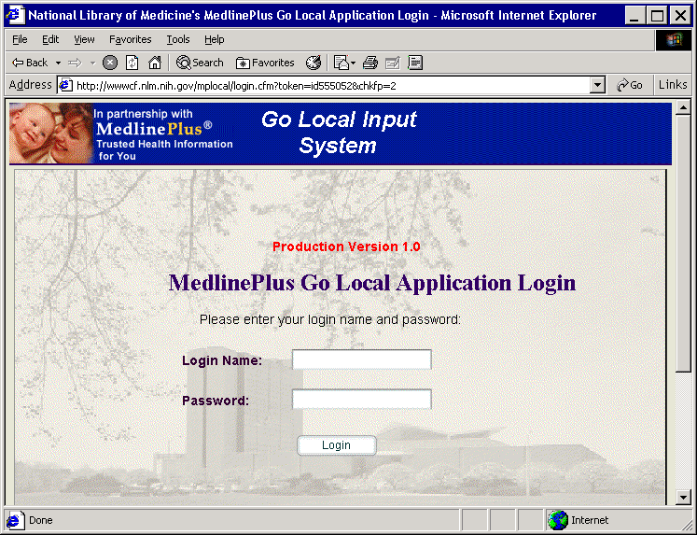
We have built it…
Complete Go Local management system is now available
Version 1 in name only
Based on experience with
  MedlinePlus system
    Since 1998
    Now in Version 16
  NCHealthInfo system
    Since 2002
Notes:
The NLM-hosted system is labeled version 1, but it has a really strong heritage in usable system. The medlineplus system is currently in version 16 and the NCHealthInfo system has been revised by UNC several times. NLM built this latest system based on years of experience.

Slide 18
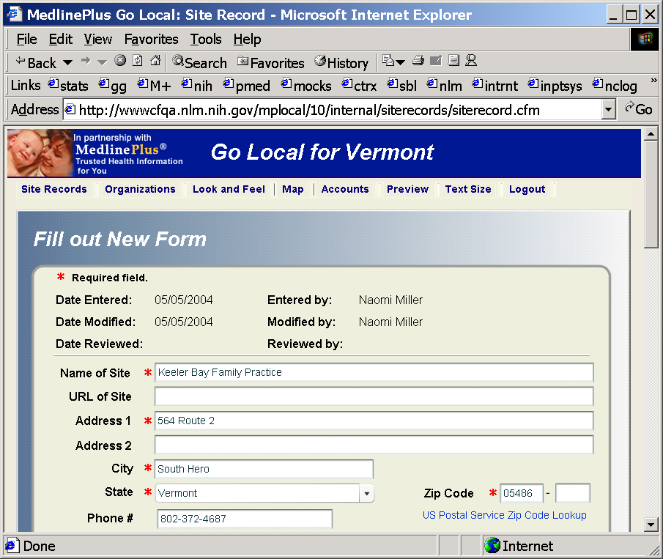
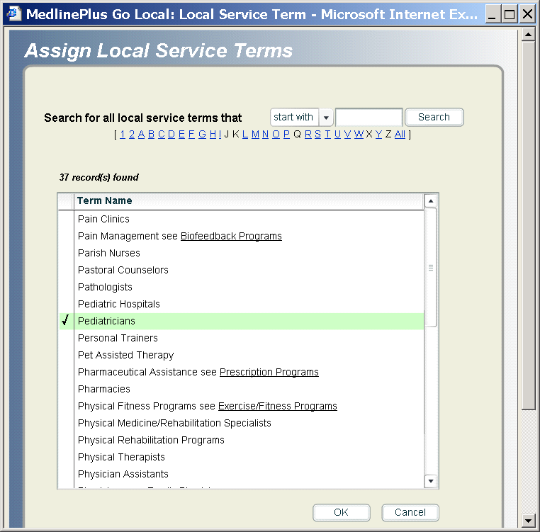
Local staff enter services…

Slide 19
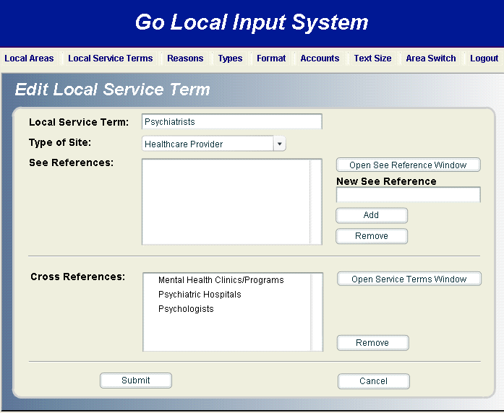
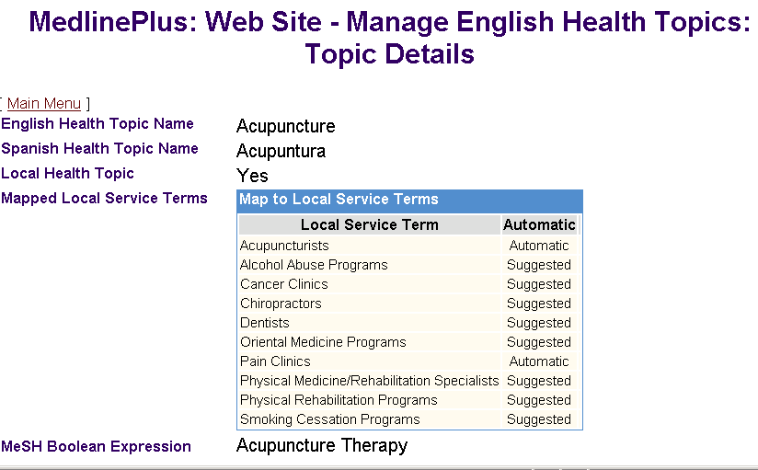
NLM maintains vocabulary & links

Slide 20
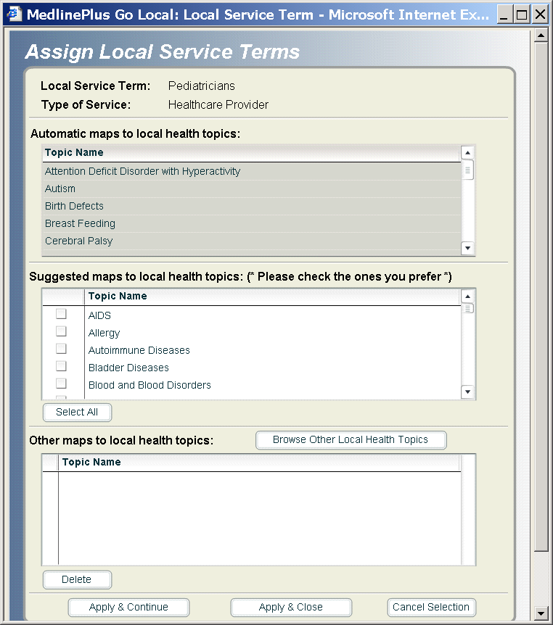
Automatic and suggested mappings

Slide 21
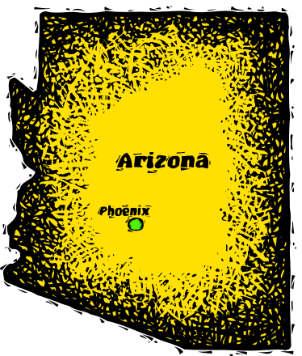


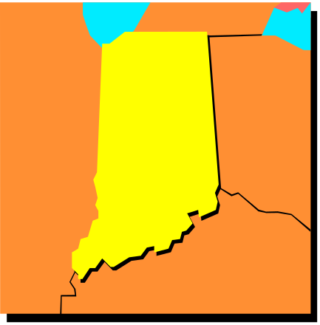
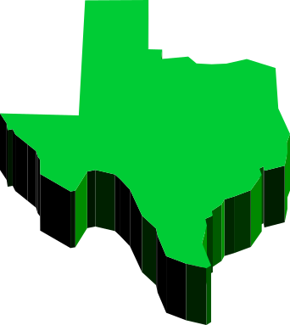
What will NLM-Supported
Go Local areas look like?

Slide 22
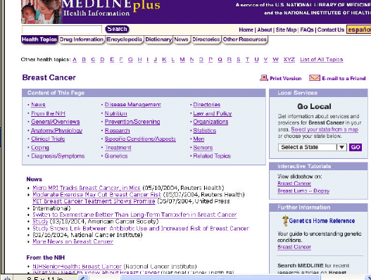

From MedlinePlus
Wireframe Draft

Slide 23
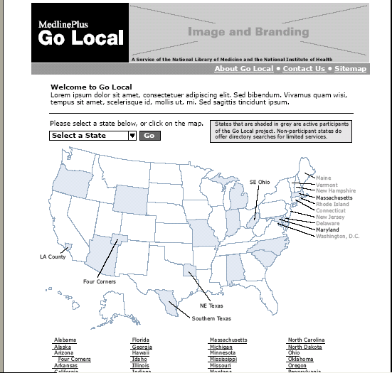
Wireframe Draft

Slide 24
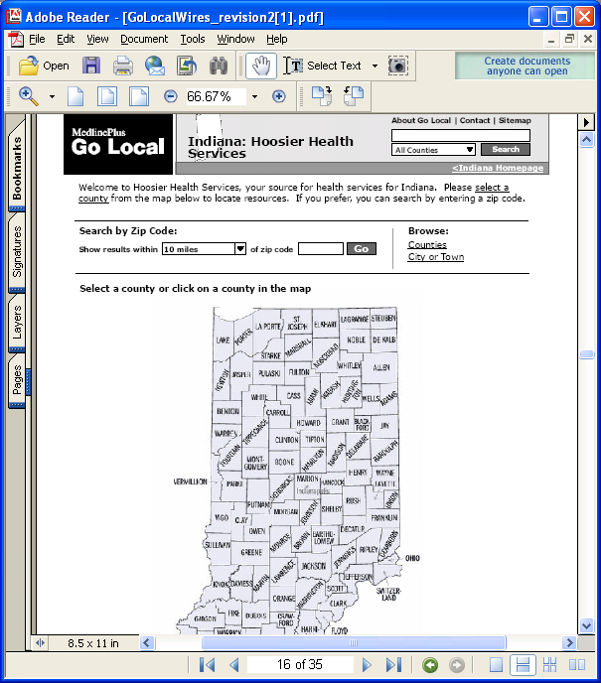
Wireframe Draft

Slide 25
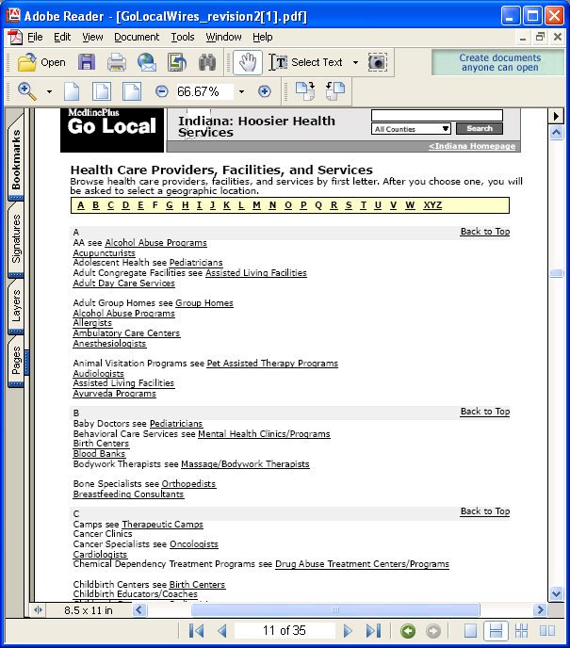
Wireframe Draft

Slide 26
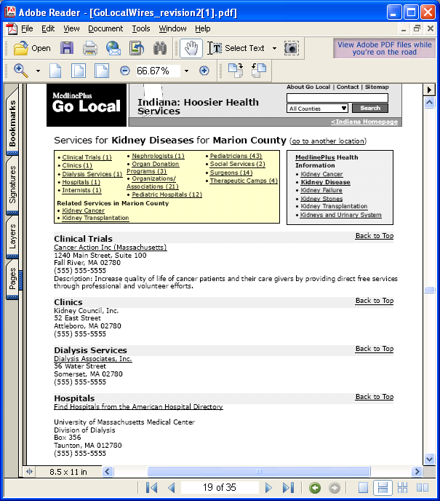
Wireframe Draft

Slide 27
Directories
This summer - American Hospital Association
From MedlinePlus – select directories
From Go Local - select state, then hospitals
Maps and directions - Mapquest

Slide 28
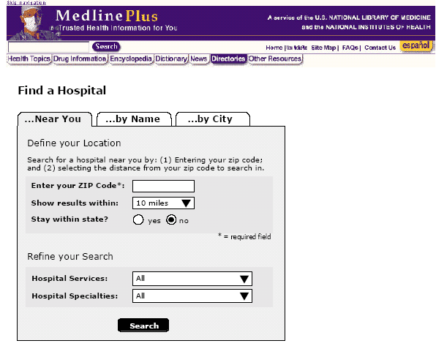
American Hospital Directory on MedlinePlus
Wireframe Draft

Slide 29
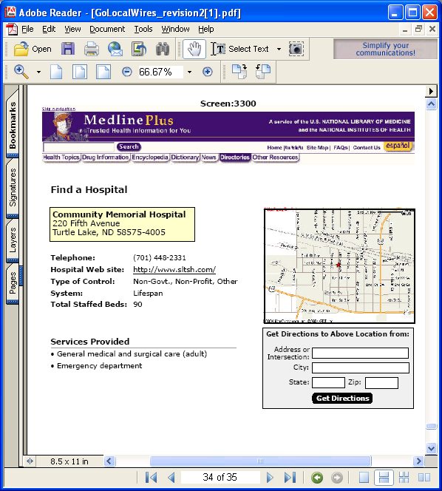
Hospital Page
Wireframe Draft

Slide 30
How can I get involved?
Follow the links to the Go Local information and requirements within MedlinePlus at http://www.nlm.nih.gov/medlineplus/golocal.html
Submit a proposal for your state or region. Proposals should be e-mailed to the Associate Director for your Regional Medical Library.
Join the new discussion list from http://list.nih.gov/archives/mplus-golocal.html
Notes:
The presentations you have seen today will also be available from the Go Local page.

Slide 31
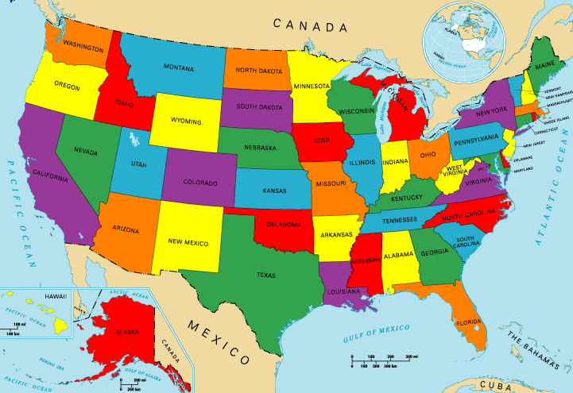
Go Local in the future....
Notes:
I’d really like to work with many of you to make this service available to more people.

