Slide 1
Development of Home Care Quality Indicators Based on the MDS-HC
Brant E. Fries, Ph.D.
University of Michigan
May 7, 2002
Notes:
Development of Home Care Quality Indicators Based on the MDS-HC, a presentation by Brant Fries of the University of Michigan. Presented at the AHRQ-NGA meeting, State Long Term Care Systems: Reducing Cost, Quality and Access, held in Indianapolis, IN May 6-8, 2002.

Slide 2
Agenda
RAI-HC as the basis for Quality Indicators
Home Care Quality Indicators (HCQIs)
  Development
  Summarizing HCQIs
Use of HCQIs in evaluating the MI Choice Programs
Notes:
I will discuss the use of quality indicators for the Michigan MIChoice Program.

Slide 3
Agenda
RAI-HC as the basis for Quality Indicators
Home Care Quality Indicators (HCQIs)
  Development
  Summarizing HCQIs
Use of HCQIs in evaluating the MI Choice Programs
Notes:
The RAI home care assessment tool was developed by clinicians.

Slide 4
RAI-Home Care Assessment System
Developed by interRAI, a multi-nation group of clinicians, researchers and policymakers
Community analogue to the RAI, mandated in U.S. nursing homes
Notes:
The RAI-HC was developed by a multi-national groups of clinicians, researchers and policymakers to measure program improvements.

Slide 5
Improvements in the RAI
Primary purpose:
  Improve care plans through improved assessment
Notes:
Everything should be designed around improving care plans through assessment.

Slide 6
Improvements in the RAI
Three parts of the RAI-HC
  Minimum Data Set (MDS-HC)
  Triggers
  Client Assessment Protocols (CAPs)
    (Care planning guidelines)
Notes:
Differentiate between RAI and MDS. The three parts include the MDS for home care. There are care planning guidelines around clinical problems (environment, ADLs, and others). Both components are linked by algorithms called triggers that indicate whether a person has a problem. We like think we “put assessors at risk of doing the right thing.”

Slide 7
Improving Assessment Process
Items clearly defined, including:
  full definitions
  examples and exclusions
  time delimiters
Cover all relevant domains
  individuals’ strengths and weaknesses
  tradeoff of breadth/depth and length
Notes:
Items have to clearly identified and have clear definitions for terms. We give examples of terms and situations and their place in the system such as when a person is dependent or independent. You have got to have clear questions so two interviewers get the same answers to the same questions. You need specific time delimiters - is it in the last day, last 7 days, last month? You also need to cover all domains, strengths as well as weaknesses. They is always a trade off breadth and depth. If everything is done right, everyone is mad at us because one area can’t be covered in enough detail to satisfy professionals in that area. This is never the end of an assessment, only the beginning, core items to do an assessment.

Slide 8
Improving Assessment Process
Use all possible sources of information
  individual, formal/informal caregivers, MD, medical record, etc.
  self-reporting may be inaccurate
  assessor decides when sources are inconsistent
Notes:
This process uses all sources of information. We need to triangulate multiple sources of information to determine the right answer given disparate information.

Slide 9
Improving Assessment Process
Careful testing of psychometric properties
Training manual
Ongoing refinement - RAI-HC Version 2
Notes:
We need to carefully test psychometric properties such as sensitivity, inter-rater reliability. A training manual is there to answer questions and improve reliability. Any instrument lives, breathes, and changes over time.

Slide 10
Applications of MDS-HC Data
Care Plan (CAP)
Case-Mix Algorithm
(RUG-III/HC)
ASSESSMENT
Eligibility Systems
(MI Choice)
Quality Measures
(HCQI)
Notes:
Remember we are doing this to better care planning and to provide care for specific clients, not to collect blind data. We can use the data collected blindly later. Other applications may be feasible after the primary use of the assessment information - providing care plans.

Slide 11
RAI Family of Instruments
Chronic care/nursing homes RAI 2.0
Home Care RAI-HC 2.0
Mental Health RAI-MH
Acute Care RAI-AC
Post-Acute Care-Rehabilitation RAI-PAC
Assisted Living RAI-AL
Palliative Care RAI-PC
Notes:
This is the family of survey instruments.

Slide 12
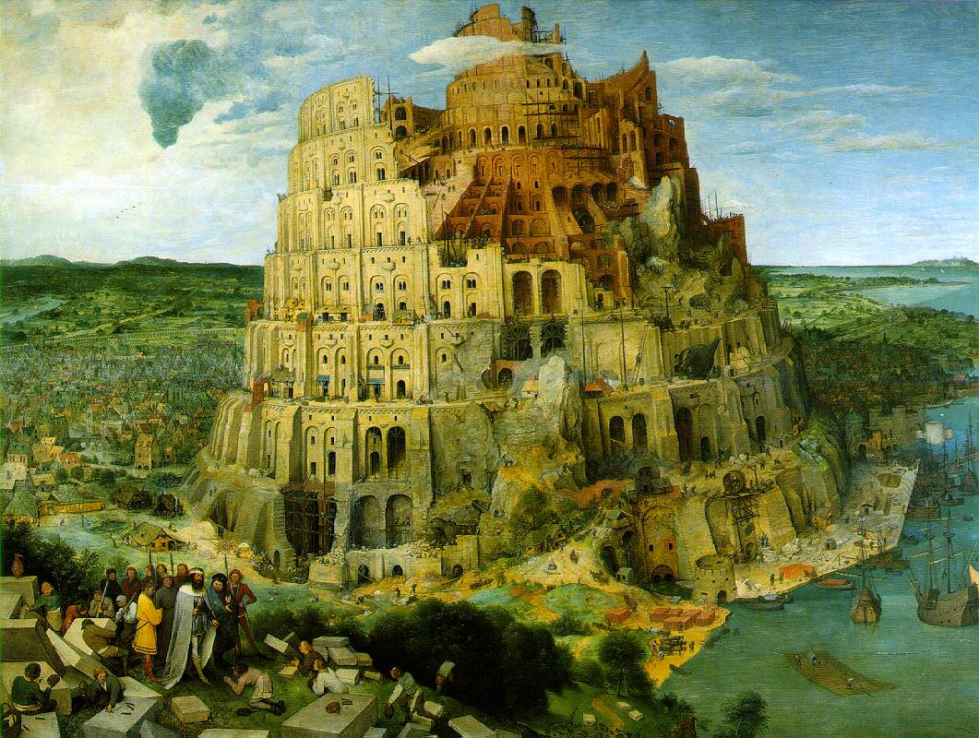
Notes:
These instruments were designed to deal with the Tower of Babel effect -- everyone with different ideas. We must find a common basis for applications.

Slide 13
Common Basis
All interRAI instruments have common basis of care planning
Major items in common
Possible to link across time and setting
Start of a “language” to describe long-term care users
Notes:
We start with a common basis for care planning, ensuring that each tool has major items in common with other tools so that items are measured the same way on different instruments and follows care across instruments, without developing a measurement effect.

Slide 14
Implementation of RAI-HC
InterRAI grants royalty-free license to governments
Adopted by 10 states, Department of Veterans Affairs
International adoptions
Used in fee-for-service and managed care programs
Notes:
InterRAI grants a royalty-free license to governments and technical support groups. It has been adopted by 10 States, and the U.S. Department of Veterans Affairs. RAI has international applications (developed and used in Canada, Japan, and Switzerland). It has also been used for fee for service and managed care organizations - the tools are independent of a financing modality.

Slide 15
Agenda
RAI-HC as the basis for Quality Indicators
Home Care Quality Indicators (HCQIs)
  Development
  Summarizing HCQIs
Use of HCQIs in evaluating the MI Choice Programs
Notes:
RAI has helped with development of home care quality indicators.

Slide 16
Uses of MDS-HC Data for Quality Measurement
User Profiles
  Whom are we serving?
Performance Benchmarks
  Are we serving the “right” people?
Outcome Measures
  What happens to the people we serve?
Quality Indicators
  How do care strategies affect the people we serve?
Notes:
MDS-HC data is used for a variety of quality which is a secondary use of data and helps answer: who are we serving, are we serving the right people? The tool utilizes user profiles and benchmarks from the data. We can look at outcome measures, what happens to the people served over time.

Slide 17
Why HCQIs Are Important
HCQI= Home Care Quality Indicators
Citizens, legislators, administrators want “proof” that programs work
Notes:
Quality indicators are important tools for helping the public, legislators and managers understand how the programs are working and who they serve.

Slide 18
Uses of HCQIs
Regulation
  Who is doing a substandard job?
Management
  How well am I doing? Compared with last year?
Consumers
  Where should I get care?
Best practices
  Who is doing an outstanding job?
Benchmarking
  How do I compare with others?
Notes:
Home Care Quality Indicators (HCQIs). There are a variety of reasons why people want to know whether what they do is working. Which providers are good or substandard, which are the best providers to use, who has outstanding best practices? Who is doing a good job and how do I compare to others? It is only by comparison to others that you see how you are doing.

Slide 19
HCQI Authors
John P. Hirdes Ph.D.
Brant E. Fries Ph.D.
John N. Morris Ph.D.
David Zimmerman Ph.D.
Naoki Ikegami M.D., Ph.D.
Dawn Dalby M.Sc.
Suzanne Hammer M.Sc.
Pablo Aliaga M.Sc.
Rich Jones, Ph.D.
Notes:
The authors of the instrument you can see here on the slide. Not on list is Mary James.

Slide 20
Considerations in Developing HCQIs
Reliability and validity of data items
Points of comparison
  Prevalence, incidence
Validity of indicators
Application – when agency is responsible
  Prevalence: follow-up data only
  Incidence: intake to follow-up
Notes:
During development, we picked only reliable and valid indicators. If we depend on other items that are not reliable or valid, the instrument is not useful. We found 2 points of comparison – prevalence and incidence. Prevalence shows whether a person has a problem. Incidence is more sensitive (did someone gain a problem under your care) and therefore is a more important measure. The validity of indicators is also essential. Prevalence is only follow up data not admission data, which represents what happened before. Incidence covers intake to follow up time under your control (three month period).

Slide 21
HCQI Research in a Nutshell
Two year effort in Canada, USA, Japan
Involved many stakeholders
Started with QIs from other sectors
Workgroups in Canada and Michigan
Identification of exclusions
Analysis with data from Canada, US, Italy
HCQIs with reasonable prevalence
Adjustments
Notes:
Development was a 2 year effort that included Canada, Japan and the US, as well as many stakeholders and multiple governments. We started thinking about what QIs we already have to see what is useful in health care. Work groups then went through the list and discovered other QI measures that might also be useful. We also consider who might be excluded from the population being evaluated. Weight loss evaluation for terminally ill is not a useful indicator. We insisted on analysis of data that worked in multiple populations. If data didn’t work in at least two populations, it was not considered a stable indicator. Technical adjustments such as these are critical in developing useful QIs for practice.

Slide 22
Prevalence HC Quality Indicators
Psychosocial function
  Social Isolation with Distress
  Delirium
  Negative mood
Medication
  No medication review
Safety/Environment
  Falls
  Any injuries
  Neglect/Abuse
Other
  No Influenza Vaccination
  Hospitalization
Nutrition
  Inadequate Meals
  Weight Loss
  Dehydration
Pain
  Disruptive/Intense Pain
  Unmanaged Pain
Physical function
  No Assistive Device for Clients with Difficulty in Locomotion
  ADL/Rehabilitation Potential and No Therapies
Notes:
Here are lists of the quality indicators we developed.

Slide 23
Incidence HC Quality Indicators
Psychosocial function
  Failure to improve/ incidence of cognitive decline
  Failure to improve/ incidence of difficulty in communication
Other
  Increased health instability
Incontinence
  Failure to improve/ incidence of bladder continence
Ulcers
  Failure to improve/ incidence of skin ulcers
Physical function
  Failure to improve/ incidence of decline in ADL
  Failure to improve/ incidence of impaired locomotion in the home
Notes:
Incidence quality indicators measure changes that occur after a person enters a program and include incontinence, ulcers, physical functioning and psycho-social function.

Slide 24
Adjusting HCQIs
Risk adjustment
  Should we adjust?
  Team identified candidate risk adjusters
  Analyze Ontario, Michigan and Italian data:
    Adjustment in same direction/ magnitude in 2 out of 3 countries
Notes:
Risk adjustment is controversial. If your population is higher risk, should you be adjusted for additional risk or should you put programs in place to adjust for your heavier risk population? But it may help you explain away things you could be addressing. We do risk adjustment for things that are not under control of the agency.

Slide 25
Example: Two Nutrition HCQIs
Notes:
Here is an example of two HCQI’s with risk adjusters.

Slide 26
Adjusting HCQIs
Selection/Ascertainment adjustment
  Should we adjust?
  Use intake rates to derive agency-level measure of bias
  Analysis of Ontario and Michigan data
Notes:
Selection or ascertainment bias is also controversial. If your staff are well trained, the agency is likely to pick up issues that an agency with less trained staff miss. The agency doing a good job looks worse and the agency doing the poorer job will not be identified as such. We can use intake data to give a baseline for further comparisons. Selection means you take or avoid people with conditions you identify. Ascertainment bias covers conditions you should have noted during an assessment.

Slide 27
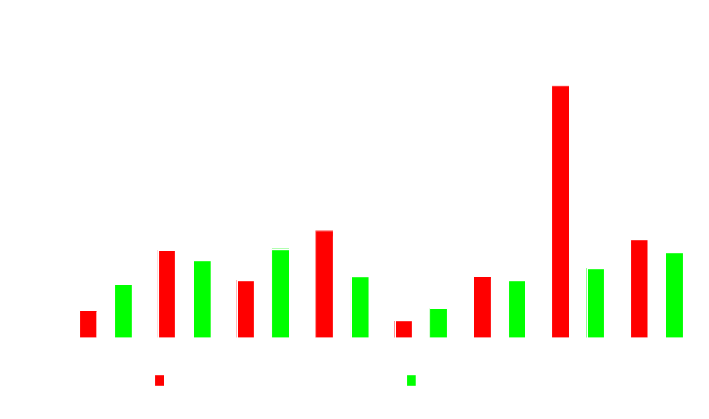
Risk/Ascertainment Adjustments for Mood, 8 Michigan Agencies
Notes:
This slide shows mood unadjusted illustrated against mood adjusted. There is not a lot of difference with risk adjustment but ascertainment adjustment shows great difference in risk. We believe these two adjustments are important to make.The highest agency did a very good job in identifying people with mood problems. Without an ascertainment adjustment, they look far worse than other agencies.

Slide 28
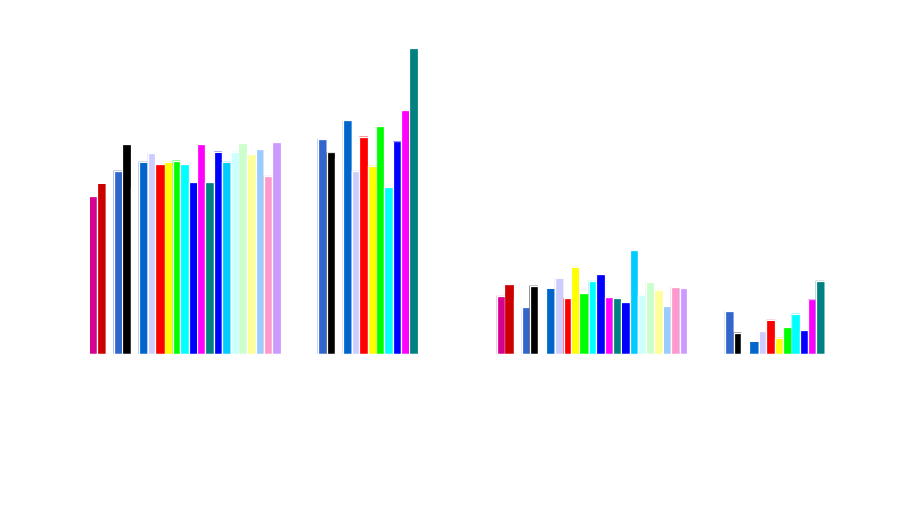
Two HCQIs, by Agency
Disruptive/intense daily pain
Delirium
Notes:
This shows adjustment for 2 HCQI’s by agency. Most of Canada seems to be doing better on some measures. Every country does some things well, some things bad, and the rest in the middle. Every country has something to bring to the table.This process helps establish benchmarks that agencies can use to determine their progress and compare to others.

Slide 29

All HCQI – Agency “A”
Notes:
Summary of HCQI using a radar plot as one visual representation. Risks are clumped and any point shows an agency peaking somewhere. The red area is the average incidence and the yellow the actual for each indicator. The more red, the better job the agency is doing.

Slide 30

All HCQI – Agency “B”
Notes:
This is another radar summary of HCQI as visual representation It shows a different pattern in terms of what the agency does well.

Slide 31

People want simple quality measures
Good Housekeeping Seal
Consumer Report Circles
Olympic Medals
Michelin Stars
Notes:
People want simple measures, and we are struggling with how to do that.

Slide 32

Average Relative QIHC, by Michigan Agency
Notes:
One way to do it is by averaging. But one agency that shows close to one as an average has mostly average scores, while the next averages out some exceptionally good and exceptionally bad indicators. Averages lose important information for evaluation.

Slide 33
Single Measure of Home Care Quality
People want simple, but…
  We lose critical information
  May not be feasible
When we present multiple measures…
  Difficult to interpret
  Still seeking good “views”
Notes:
One measure leaves a lot out and loses critical information but too many measures becomes difficult to interpret.

Slide 34
Agenda
RAI-HC as the basis for Quality Indicators
Home Care Quality Indicators (HCQIs)
  Development
  Summarizing HCQIs
Use of HCQIs in evaluating the MI Choice Programs
Notes:
In Michigan we have evaluated the use of RAI for home care, training, and CAPS for care planning planning. Early data has just collected information. The grant allowed us evaluate the data.

Slide 35
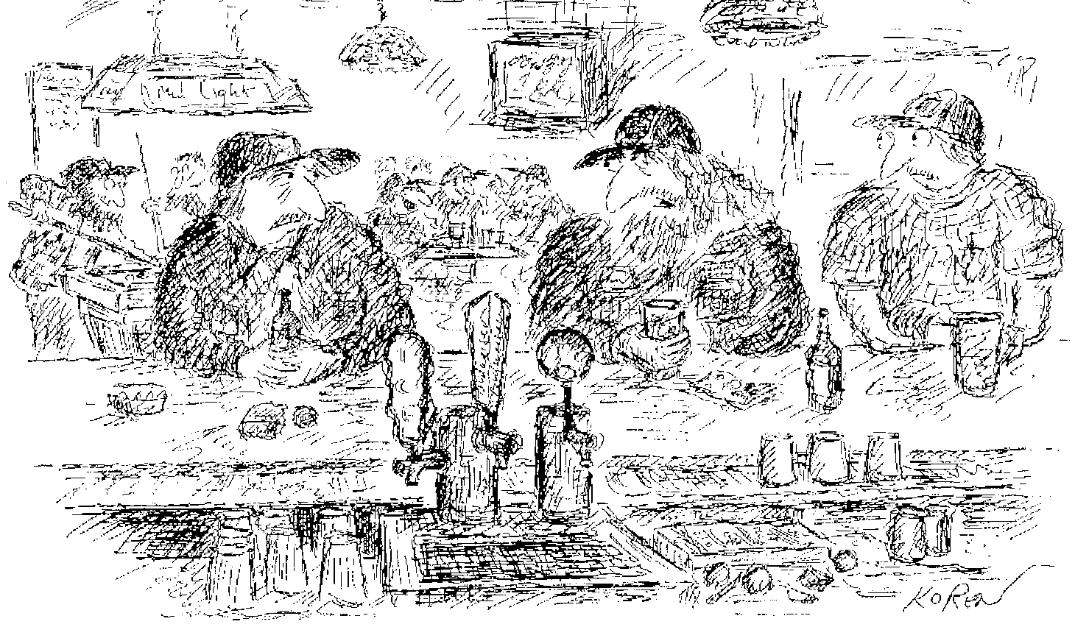
Are you just pissing and moaning, or can you verify what you’re saying with data?
Notes:
This cartoon captures a lot of what I’m talking about.

Slide 36
Methods
Used adjusted HCQIs
23 agencies
Over 8 quarters, from Jan 99 to Dec 01
  Training and computerization in 2nd quarter
Notes:
We adjusted the indicators for risk and ascertainment selection bias for 23 agencies and looked at data over eight quarters.

Slide 37
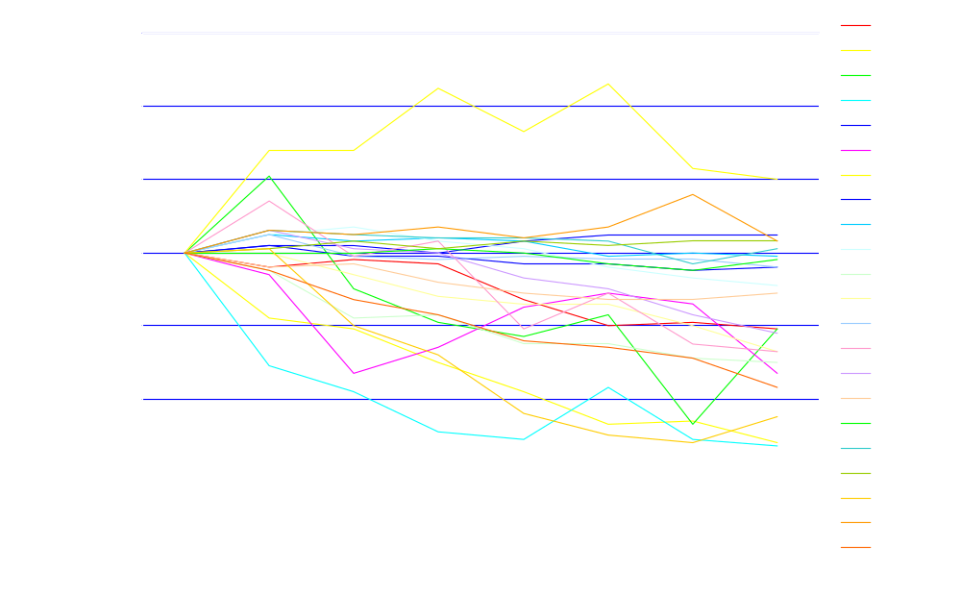
Change in Agency Average HCQI Score, by Period
Worse
Notes:
This graph shows changes in an agency’s average performance. These show the major results. We looked at each QI and standardized all of them to one for the first quarter. Then we measured indicators over time. Indicators that grew worse appear above the 100% line. Improvement is presented by a line dropping below 100% which shows a reduction in incidence. A couple are higher, some the same, and there are a bunch that are much lower (better) two years later.

Slide 38
Results
Over 8 periods (2 years) – (p<.005)
16 HCQIs improved (e.g., mood, falls, hospitalizations, weight loss, social isolation, decubiti)
4 HCQIs remained the same (e.g., pain, disruptive pain, injuries, no assistive dev.)
2 HCQIs worsened (intense pain, rehab potential without therapies)
Notes:
This slide shows the results of our study. We saw significant changes over a two year period. Sixteen of the indicators improved, four stayed the same and two got worse.

Slide 39
Defining Good /Poor Quality
GOOD
POOR
Notes:
This is how one indicator would look along a bell curve – good and poor tail. You can charting this curve for each indicator and add up all the good versus poor tails to get a sense of agency performance. .

Slide 40
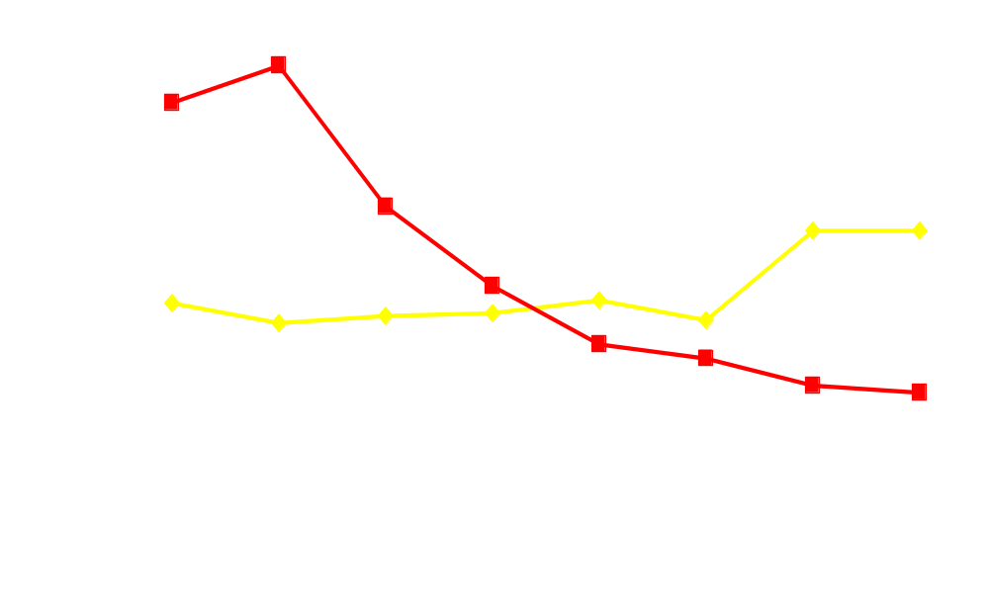
Average “Good”/ “Bad” HCQIs, by Quarter
Bad
Good
RAI
Training
Notes:
This shows average of good and bad indicators from all agencies. Bad declined, but good indicators improved marginally. More people moved to the middle. This was not a surprising result.

Slide 41
Distribution of a HCQI
GOOD
BAD
Notes:
This slide shows indicators shifted from bad to the middle, but did not show more indicators falling in the good area. When this shift is seen in sectors, it indicates a good movement away from bad.

Slide 42
Next Steps
Further validation of HCQIs
Develop archives for benchmarking
Applicability to subpopulations
Quality of Life?
Notes:
Our next steps include a further validation of the indicators, and we want to build benchmarking archives. We will also examine their applicability to sub-populations as some indicators make sense and some do not when a larger population is divided into other groupings. Quality of life issues are not addressed by these quality of care indicators.

Slide 43
Conclusions
RAI-HC has potential to improve care directly, through improved care planning
MDS-HC has multiple uses, including measuring quality of care
HCQIs can be used to monitor care
  Directly computed from MDS-HC
  Useful for comparisons, benchmarking
Notes:
RAI-HC is a very useful tool for these purposes.

