Slide 1

Language Assistance Planning and Self Assessment Tool
Analysis Summary

Slide 2
Background
September 29, 2006 distributed the Language Assistance and Self-Assessment Planning Tool for Recipients of Federal Financial Assistance
Requested responses by January 31, 2007
Received responses from 85 recipients

Slide 3
Existence of a Written Language Assistance Policy
65% of responding recipients have a written policy for the Limited English Proficient (LEP)
35% do not have such a policy
Notes:
35%(30) of all participants do not have a written policy. This is a high percentage. There are definitely very easy steps with which to improve on this situation.
One area of resource is the Civic Right Center. We can provide guidelines on how to generate such a written policy. In addition, there are 65% who have generated a written policy on the provision of services to LEP individuals. So this conference is an excellent place and time for accessing both of these resources.

Slide 4
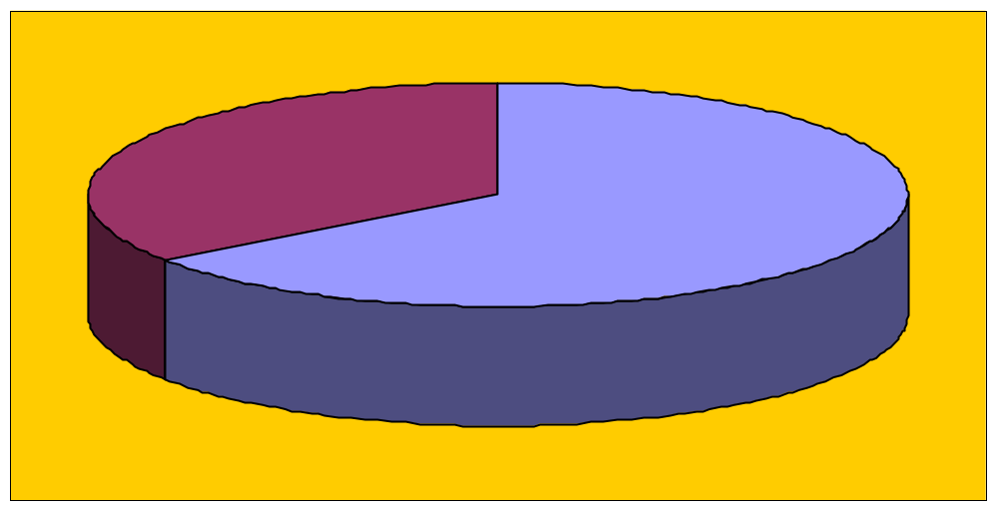
Existence of a Written Language Assistance Policy
35% Have NO Written Policy
65%
Have a Written Policy
Notes:
Having a written policy is just the starting point. With a written document, it is possible to standardize rules, procedures and processes. It is a reference point to which the members of the organization can know that they are obliged to provide meaningful access to information and services for Limited English Proficient(LEP) individuals.

Slide 5
Distribution of Written Language Assistance Policy
73% of responding recipients that have a written language access policy, distributed the written policy
27% do not distribute such a policy
Notes:
There may be various reasons for not distributing the written policy. Maybe there may not be a schedule or a plan to distribute such a written policy. Again, I will like to reiterate that this conference is a place for networking and exchanging best practices.
Some questions you can ask your contemporaries is whether they have a written policy and if they do, how do they go about distributing it. Do they do it monthly? Do they use their new employee orientation as their starting point?
How do they move from distributing the written policy to their employees to distributing it to the contractor and the general public?

Slide 6
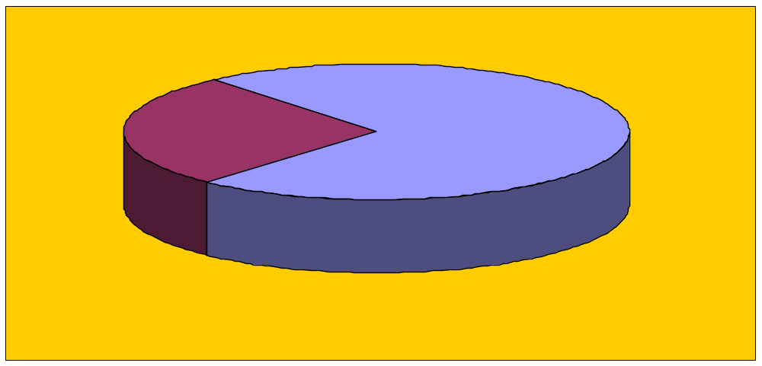
Distribution of Written Language Assistance Policy
27% Did not distribute
written policy
73% Distribute
written policy
Notes:
We see that out of the 55(65%) which have a written policy, only 73%(40) of them distributed the written policy. This is counterproductive. Today there are more tools to distribute a written policy:
By hand
By mail
By fax
By email
With these means of distribution, distributing it should be easy. Hence 35% of those, who have a written policy, not distributing it is an unacceptable percentage.

Slide 7
Recipients with a Comprehensive Language Assistance Plan
58% of responding recipients have a comprehensive plan
42% do not have a comprehensive plan
Notes:
36 or 42% not having a comprehensive plan may be a cause for great concern. It still may be possible to meet needs but there may be delays and additional costs. The immigrant population is always increasing and becoming more diverse. The needs will continue to grow and increase in diversity and complexity. The increase in population and diversity will leads to the need for more resources and the need to allocate resources more efficiently.

Slide 8
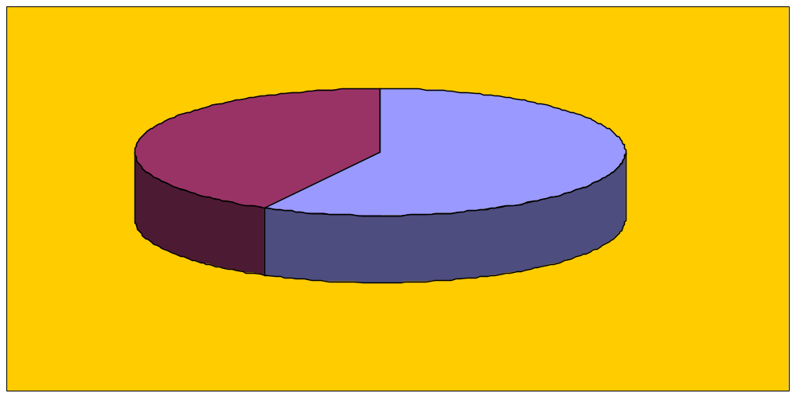
Recipients with a Comprehensive Language Assistance Plan
No comprehensive plan
42%
Have a comprehensive plan
58%
Notes:
With no comprehensive plan in place, can services be provided efficiently?
We believe that it is extremely difficult without a plan that integrate these different elements. The resources for this year or this quarter may not meet the resources of next year. There may be a need for Portuguese translator and literature this quarter but there may be an influx of immigrants from Cambodia. The education level may be lower. They may use a different alphabet or may not have an alphabet like our.
How do we switch gears from catering to Portuguese speakers who understand Spanish in some degree and use a similar alphabet to Cambodian whose language and culture is extremely different from the European language and culture? After a year? After a quarter?

Slide 9
Communication of Language Assistance Policy to Employees
16% of responding recipients do not communicate their language access policy to their staff
84% of responding recipients do communicate the policy to the staff

Slide 10
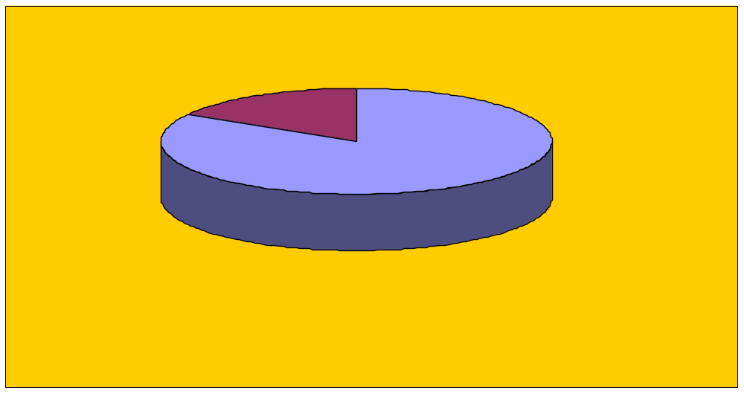
Communication of Language Assistance Policy to Employees
16% Do NOT communicate
policy to staff
84% Communicate
policy to staff
Notes:
The starting point for communicating the policy is within the recipient’s organization.
It is comforting to know that 81% of the organizations do communicate to your employees of this obligation to provide meaningful access to services and information for LEP persons.
We look forward to this percentage of 81% being increased to 100% which is highly feasible.

Slide 11
Advise Contractors of Language Assistance Policy
28% of all responding recipients do not inform contractors of their language assistance policy
72% do inform contractors
Notes:
What hindrances are faced in providing such information? Would a written policy be useful in such situation? Can the written policy used for the employees be employed for the subcontractors, as well? Can this be attached along with other informational material to be discussed with subcontractors?

Slide 12
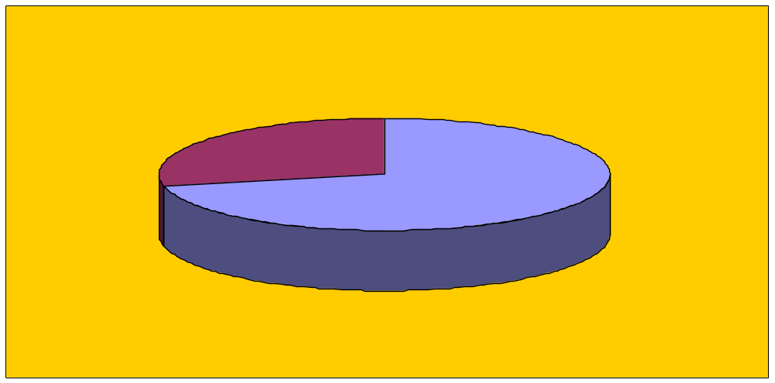
Advise Contractors of Language Assistance Policy
28% Do NOT inform
contractors of policy
72% Inform contractors
of policy
Notes:
28% do not inform their subcontractors of the policies regarding LEP persons. We are getting shortchanged here. 28% are essentially allowing the subcontractors an excuse for not fully fulfilling their contracts if LEP constitute a percentage of the end users of their services.

Slide 13
Inform customers of the right to free language services
72% of responding recipients inform customers that language services are available at no cost
28% do not inform customers
Notes:
28% of beneficiaries are not informed that they will be provided with interpreting services at no cost.
This is compounding the distribution problem with a problem in communication. If we are using subcontractors, we are putting ourselves in a position where we underutilize services we have already paid for.

Slide 14
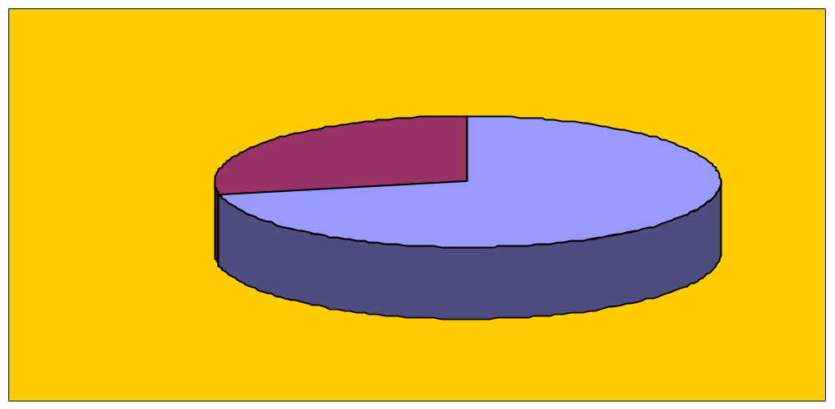
Inform customers of the right to free language services
28% Of customers NOT
informed of right to free service
72% Of customers informed
of right to free services

Slide 15
Ensure sufficient qualifications of bilingual staff
53% of responding recipients ensure that bilingual staff is qualified to provide services in another language
47% of responding recipients do not ensure that bilingual staff is qualified to provide services in another language
Notes:
One of the most basic areas to ensure is that of the personnel. Almost half(47%) of the participants ensure that their bilingual staff are qualified to provide services in another language.

Slide 16
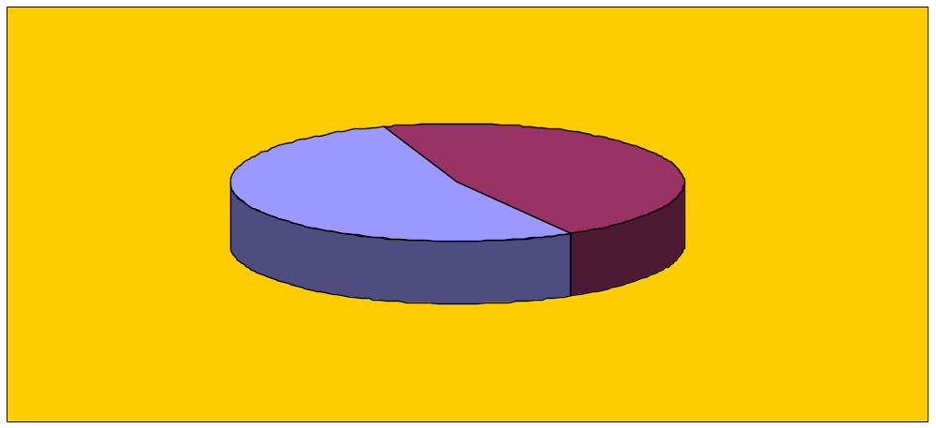
Ensure sufficient qualifications of bilingual staff
53% Ensure staff is qualified
to provide language services
47% Do NOT ensure staff is qualified
to provide language services
Notes:
We start with evaluating within the organization. The starting point is always communication. With LEP individuals, this would means communicating in another languages.
There is a difference in being able to speak a language from being able to translate or being able to interpret. In addition, there are terminology specific to certain areas such as the medical or insurance field which the typical layman may not know.

Slide 17
Developed a demographic profile of the population served by funded programs
87% of responding recipients have developed a demographic profile of the overall population served or likely to be served by US DOL funded programs and activities
13% have not developed such a profile
Notes:
So it goes without saying that developing a demographic profile is essential to knowing whom you need to serve.
87% having developed such a profile is good. Since we know the importance of this, we want to move a step ahead and ask the question of how we can sketch this profile more accurately and more promptly since we know that changes occur quickly.

Slide 18
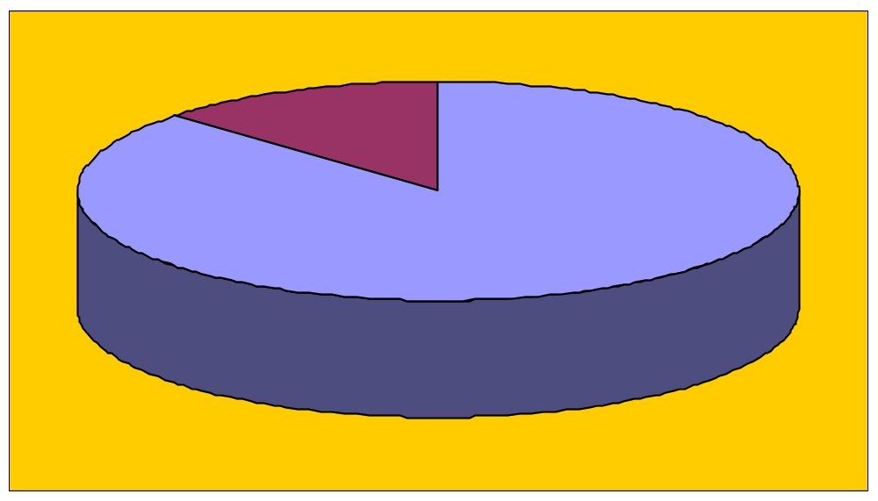
Developed a demographic profile of the population served by funded programs
13% Do NOT develop a demographic profile
87% Developed a demographic profile

Slide 19
Demographic profile developed for each labor market or local area
In service areas covering multiple labor markets, 79% have developed demographic profiles for each labor market or local area
21% did not develop demographic profile for each labor market area
Notes:
With the same AP excerpt in mind, we also want to think about demographic profiles that fit each labor market or local area. Consider Detroit in the AP excerpt. Its demographic make up will be drastically changed due to the influx of Iraq refugees and it will be different from the rest of Michigan. If we use an outdated census for Michigan, we would be misled in our planning within Detroit.

Slide 20
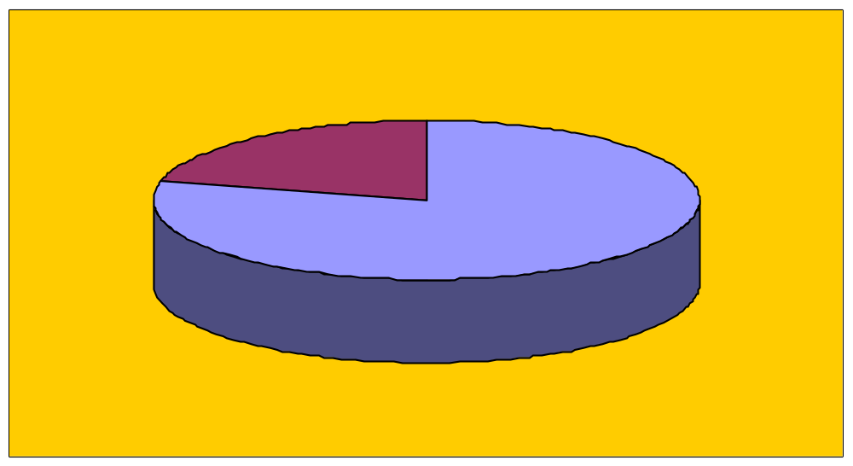
Demographic profile developed for each labor market or local area
21% Did NOT develop profile
for each labor market
79% Developed profile
for each labor market

Slide 21
Developed a profile of the primary languages spoken by the population served
84% of the responding recipients have developed a profile of the primary languages spoken by the population served or likely to be served by their Federally funded programs and activities
16% Did not develop a profile of the primary languages spoken by the population served
Notes:
Knowing what are the primary languages being spoken enable an organization to allocate resources more accurately. Hence 81% would be better able to allocate their resources such as interpreting services for the appropriate language groups. It will be interesting to know how the other 19% allocate such resources and whether they have to be making adjustments and how drastic are the adjustments.

Slide 22
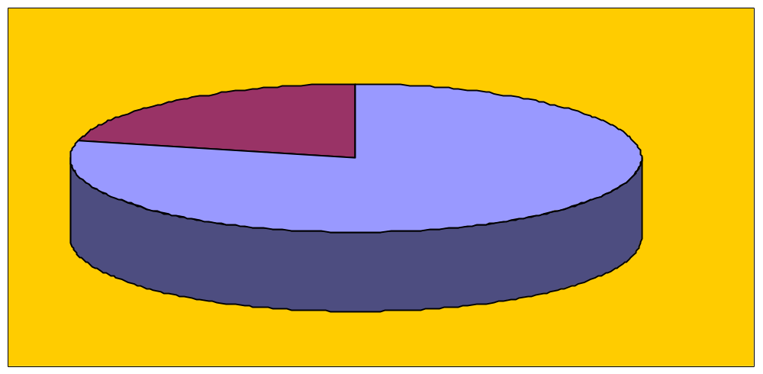
Developed a profile of the primary languages spoken by the population served
16% Did NOT develop profile by language
84% Developed profile by language

Slide 23
Process for surveying, collecting and recording primary language data
69% of responding recipients have a process for surveying, collecting and recording primary language data for individuals served
31% have no process in place for surveying, collecting and recording primary language data
Notes:
To determine such frequency, we must first establish a process for surveying, collecting and recording primary language data for individuals that participate in these programs and activities.
Again, we want to consider the possibility of exchanging ideas at this conference of how each state or LWIA has used such a process.

Slide 24
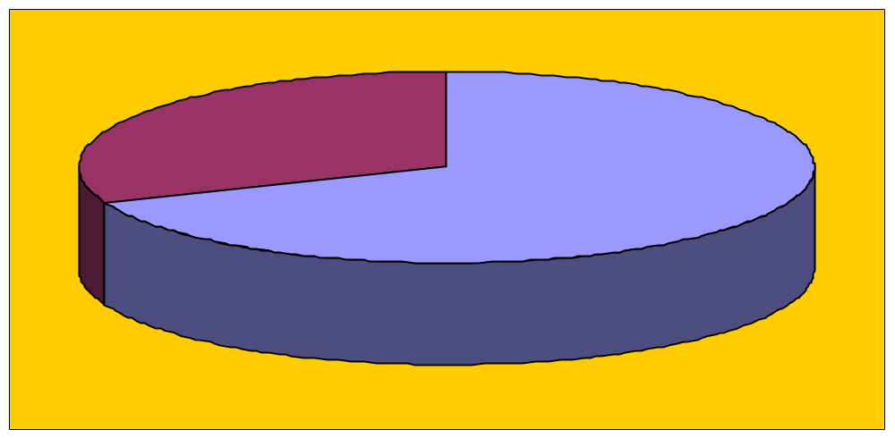
Process for surveying, collecting and recording primary language data
31% Have NO collection process
69% Have collection process
Notes:
.

Slide 25
Translate vital documents into languages other than English for LEP customers/beneficiaries
78% of responding recipients translated vital documents into languages other than English for LEP customers or beneficiaries
22% did not translate vital documents into languages other than English
Notes:
For those programs or activities with serious consequences, 78% have translated vital documents into various languages other than English for LEP customers or beneficiaries, for the purpose of reducing the negative impact of potential delays in the provisions of services or participation in your programs and/or activities.

Slide 26
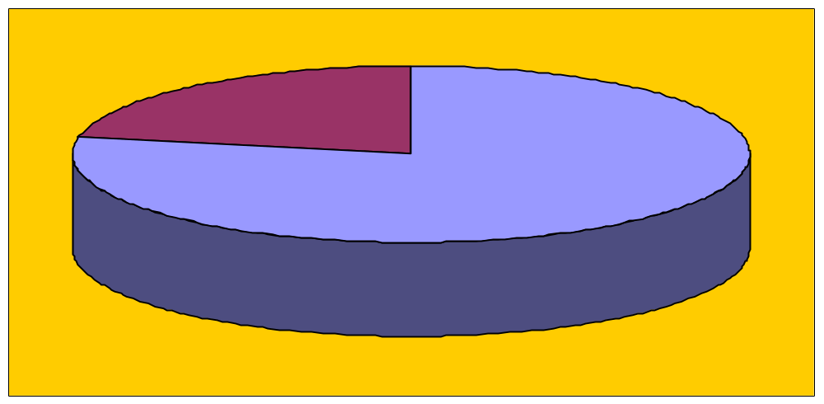
Translate vital documents into languages other than English for LEP customers/beneficiaries
22% Did NOT translate vital documents
78% Translated vital documents

Slide 27
Identified the resources needed to provide meaningful access for LEP persons
74% of responding recipients have identified the resources needed to provide meaningful access for LEP persons
26% did not identify the resources needed to provide meaningful access for LEP persons
Notes:
What do we want to consider when looking at resources needed:
Type of assistance necessary and resources available;
the possible sources of assistance;
the associated costs, and
the language groups assisted.

Slide 28
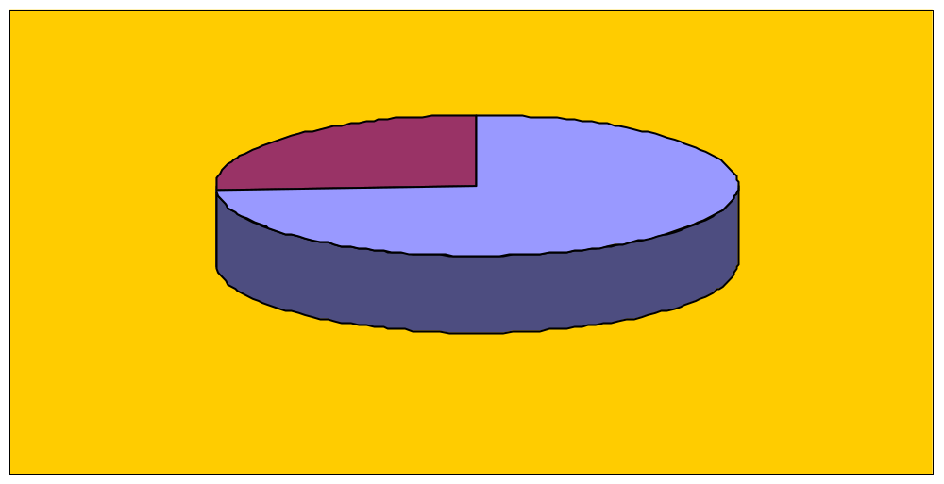
Identified the resources needed to provide meaningful access for LEP persons
26% Did NOT identify resources needed
to provide meaningful access for LEP
74% Identified resources needed to provide
meaningful access for LEP
Notes:
22 % have not identified the resources needed to provide meaningful access for LEP persons. If this is representative, it is worrisome. This is because when you encounter a resource-deficient situation, the provision of such access would be curtailed or even worse, neglected altogether.

Slide 29
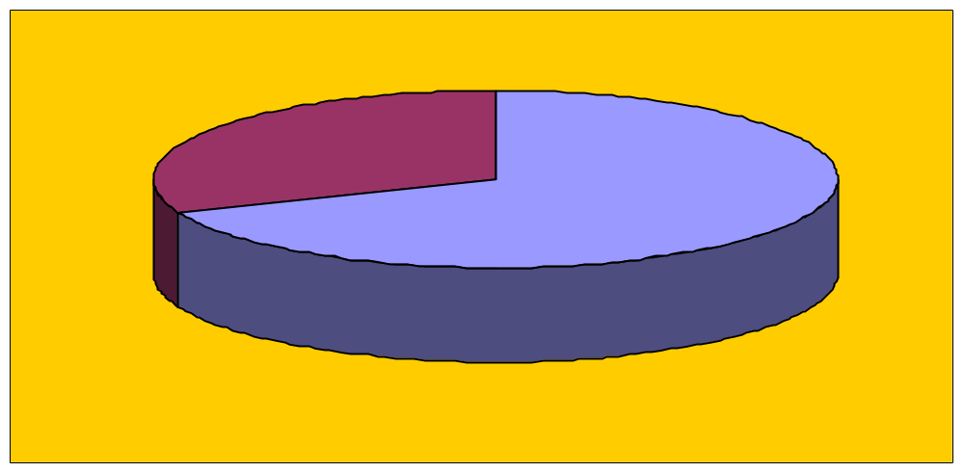
Staff person designated to coordinate language access activities
31% Do NOT have staff coordinator
69% Have staff coordinator
Notes:
This is a useful resource to have. It may be a necessity for everyone to have a person only dedicated to coordinating language access activities. It could be part of a staff member’s duties in addition to other responsibilities. This is an evolving area. It is up to management’s decision as to what proportion of a staff time this would take up. It should be assessed regularly, at least on an annual basis as to the proportion.

Slide 30
Staff person designated to coordinate language access activities
69% of responding recipients use at least one staff member assigned to coordinate language access activities
31% have no staff member assigned to coordinate language access activities
Notes:
It is not easy to describe such a staff member…whether it will be a person who is primarily assigned to LEP services or who has other duties or a contractor. What skills are needed? Only through doing a self assessment which include the demography of the people served and the demands, can we answer this question?

Slide 31
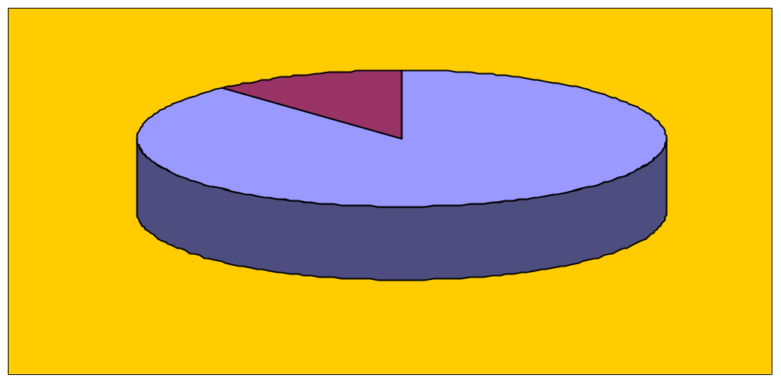
Identified the points of contact where LEP persons interact with the organization
12% Did NOT identify each point of interaction
88% Identified each point of interaction
Notes:
At an agency office, via telephone, via internet?
Are there signage and posters strategically positioned so as to catch the customer’s eyes easily?

Slide 32
Identified the points of contact where LEP persons interact with the organization
88% of responding recipients identify each point of contact at which LEP persons interact with the organization
12% do not identify each point of contact
Notes:
The use of each of these may depends on other resources as well. It will also depends on what level of interaction is needed with the LEP individual.
Can they read?
Do they have access to a computer?

Slide 33
Provide language assistance at each possible point of contact
78% of responding recipients make language assistance available at each point of contact
22% do not make language assistance available at each point of contact
Notes:
Efficiency of use of language services can be accomplished by such options such as the use of technology (such as through the internet, telephonic language lines); the sharing of language assistance materials, and services among and between recipients, advocacy groups and Federal grant agencies ; and through reasonable business practices.

Slide 34
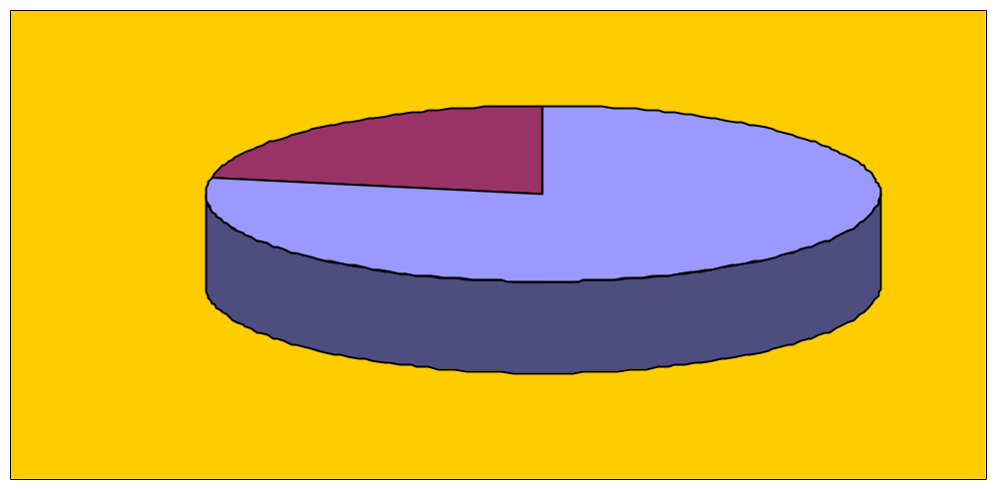
Provide language assistance at each possible point of contact
22% Do NOT provide language assistance
at each point of contact
78% Provide language assistance
at each point of contact
Notes:
Efficiency of use of language services can be accomplished by such options such as the use of technology (such as through the internet, telephonic language lines); the sharing of language assistance materials, and services among and between recipients, advocacy groups and Federal grant agencies ; and through reasonable business practices.

Slide 35
Utilize employees in the organization as interpreters
80% of responding recipients utilize employees within the organization as interpreters
20% do not utilize employees within the organization as interpreters
Notes:
Interpreting is a different skill than being bilingual and being able to communicate monolingually in more than one language. Interpretation requires particular skills.
http://www.dol.gov/oasam/regs/fedreg/notices/2003013125.pdf
Ability to communicate accurately in both English and the other language
Know specialized terms for the recipient’s program or activity in both languages.
Understand and follow confidentiality and impartiality rules
Understand and adhere to their roles as interpreters.
Interesting question here: Can the interpreter and the counselor both be the same person? We do not have time to delve into this now but this is also probably a case by case judgment.

Slide 36
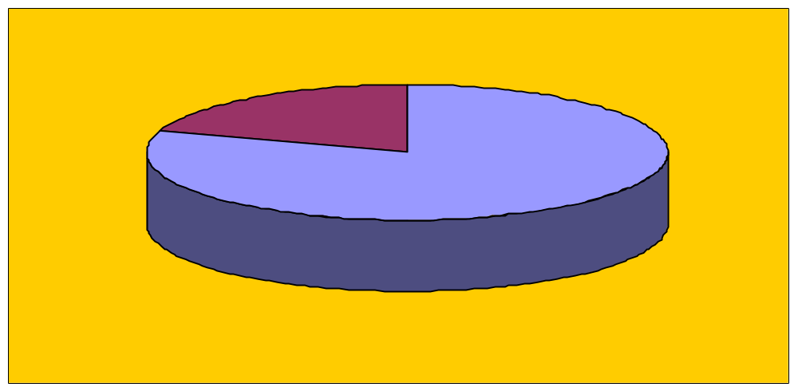
Utilize employees in the organization as interpreters
20% Do NOT utilize staff to interpret
80% Utilize staff to interpret

Slide 37
Utilize customer’s friends or family members as interpreters
79% of responding recipients utilize friends or family members of the customer as informal interpreters
21% do not utilize family members or friends to interpret

Slide 38
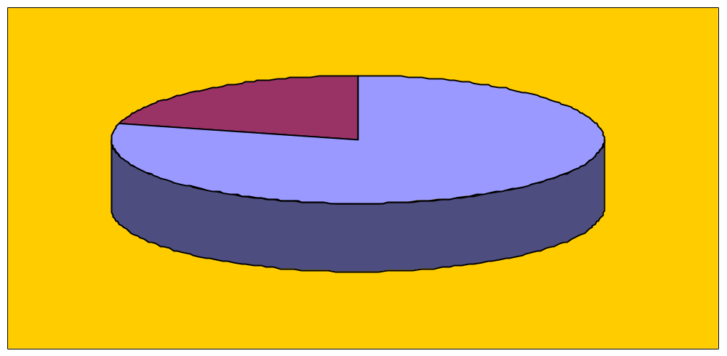
Utilize customer’s friends or family members as interpreters
21% Do NOT utilize friends & family to interpret
79% Utilize friends & family to interpret
Notes:
Some of the disadvantages here are obvious. Some are not.
The interpreter may be emotionally involved. There may be technical words which the interpreter may not be familiar with. There may be a conflict of interest.

Slide 39
Utilize minors as interpreters
15% of responding recipients utilize minors as informal interpreters (i.e. customer’s English speaking children)
85% do not utilize minors as informal interpreters

Slide 40
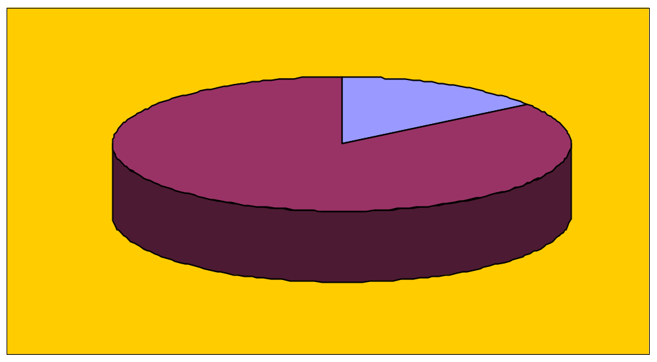
Utilize minors as interpreters
15% Utilize minors as interpreters
85% Do NOT utilize minors as interpreters
Notes:
As a policy, this should not be the case. Minors are usually emotionally fragile. Unfortunately sometimes the minors help the elders not only with interpreting but also with their physical needs.

