Slide 1

Census 2000 Special EEO Tabulation and Census 2000 EEO Data Tool Demonstration
Speakers:
Renee Jefferson-Copeland
Program Administrator
State and Governmental Programs
Customer Liaison Office and
Tim Braam
Information Technology Specialist
Systems Support Division
March 2004 SDC/BIDC Mid-Year Meeting
Notes:
Who uses the file?
All sorts of people: researchers, teachers, lawyers, professors, business people, state and local governments to name a few. The file is not only used for the purposes of the consortium, but is used by others for other reasons. This file has the most detailed occupation by race and sex data available.
How should the Bureau advise users as to what they should be using to develop Affirmation Action plans or fill out some kind of form; and, if the user should be using residence or worksite data?
We are the Bureau should not be advising users as to how to develop plans or fill out forms. That is the responsibility of the agency requiring the plan or the form – we provide the data, we are not experts on developing the plans or on the forms. Because we are not the experts, we are providing you with a list of “Websites for guidance and assistance in developing plans…” Keep this handout close by and refer to it.
Quickly explain handouts

Slide 2
Census 2000
Special EEO File
Notes:
Slide #2 - I am going to introduce you to the Census 2000 Special EEO Tabulation. The most important thing about this file is that it is not a standard Census product as it has been in the past. The 2000 EEO file is a Special Tabulation contracted for and paid for by a consortium of four Federal Agencies.
Background
The idea of a data product designed to measure the effects of anti-discrimination laws and regulations in the workplace and to encourage employers’ compliance goes back to the early 1970s.
The CB created the first EEO tabulation as a special tabulation after the 1970 Census. The product of got the name the “ORC Tapes” after it’s sponsor the Organization of Resources Council.
The Census Bureau made the EEO tabulation a standard data product for the 1980 and 1990 Censuses rather than a special tabulation.
For Census 2000, because of budget considerations, the Census 2000 Special EEO tabulation became a special tabulation funded entirely by a consortium of outside sources…

Slide 3




Census 2000 Special EEO Tabulation
Prepared for:
Equal Employment Opportunity Commission
Department of Justice
Department of Labor
Office of Personnel Management
Notes:
Slide #3 – The consortium is made up of:
1.Equal Employment Opportunity Commission – They took the lead in the project
2.Civil Rights Division of the Department of Justice
3. Office of Federal Contract Compliance Programs of the Department of Labor
4. Office of Personnel Management

Slide 4
Purpose
To monitor employment practices and enforce civil rights laws and regulations in the workplace and to assist employers in measuring their compliance to the laws.
The Census 2000 Special EEO File will serve as the primary external benchmark for comparing the race, ethnicity, and sex composition of an organizations’ internal workforce and analogous external labor market, with a specified geography and job category
Notes:
Slide #4 – The file is used to monitor employment practices.
It is used in litigation for enforcement of civil rights laws and regulations – it can be used on both sides of the litigation. It is used by EEOC to prosecute companies, but the file has also been used in the defense of companies being sued
The file helps employers with Affirmative Action Plans and helps them measure compliance to the laws.
The File also serves as a benchmark:
* for EEO complaints
* for comparing race data within a specific geography for a specific occupation
* for recruiting purposes.

Slide 5
Special Tabulation
2000 Census Special EEO File
Provides essentially the same data as earlier files but emphasis is on place of work and residence to worksite computer flows.
Major Changes Required
Impact of OMB’s revised standards on collection and publication of data on race
Emphasis on avoiding disclosure risk.
Notes:
Slide #5 – As I mentioned earlier, the EEO file is a special tabulation. All the specifications and variables are those requested by the consortium. The file provides the same data as in 1990, but the emphasis has shifted from residential data to worksite data and to commuting flows from residence to worksite.
One major change concerns the race groups. OMB required the EEO file to show 12 race groups including some dual-race combinations instead of the 6 race groups previously shown.
The other major change is the emphasis on maintaining confidentiality and avoiding disclosure risk.

Slide 6
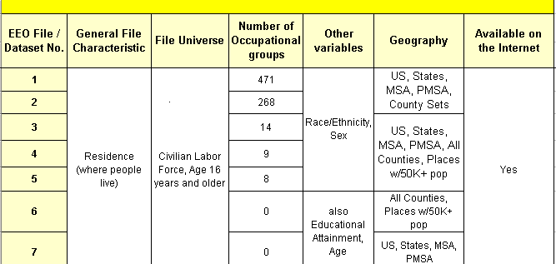
Census 2000 Special EEO Tabulation
Notes:
Slide #6 – If you will follow the 7-column chart in your handouts, these next two slides will help you assist users as to where to go to look for what variable.
The first column (EEO File/Dataset No.) shows the data set numbers 1-24. Numbers 1-7 show residence data only. Numbers 8 – 19 show residence to worksite flow data, and numbers 20 – 24 show worksite only data.
The type of data for each data set is listed in the second column (General File Characteristic).
The third column (File Universe) shows the universe. Residence data are for the entire civilian labor force, 16 years and older – this includes unemployed. Worksite data are for civilian employed at work, 16 years and older – this does not include the unemployed.
The fourth column show the number of occupation groups on each file.
The fifth column shows the variables that are available on the file.
The sixth column (Geography) shows the different types of geography available for each data set. The geography depends on the level of detail.
Column 7 indicates if the data set is available on the internet.

Slide 7
2000 Census EEO Tab
Race and Ethnic Categories
Race and Ethnicity for Hawaii (15)
Race and Ethnicity for Geographies Other than in Hawaii (12)
White alone not Hispanic or Latino
White alone Hispanic or Latino
Black or African American alone not Hispanic or Latino
American Indian and Alaska Native alone not Hispanic or Latino
Asian alone not Hispanic or Latino
Native Hawaiian and Other Pacific Islander alone not Hispanic or Latino
Black or African American and White not Hispanic or Latino
American Indian and Alaska Native and White not Hispanic or Latino
American Indian and Alaska Native and Black or African American not Hispanic or Latino
Asian and White not Hispanic or Latino
Native Hawaiian and Other Pacific Islander and White not Hispanic or Latino
Asian and Native Hawaiian and Other Pacific Islander not Hispanic or Latino
Asian and Native Hawaiian and Other Pacific Islander and White not Hispanic or Latino
Balance of individuals reporting more than one race not Hispanic or Latino plus individuals reporting some other race not Hispanic or Latino
Other Hispanic or Latino
White alone not Hispanic or Latino
White alone Hispanic or Latino
Black or African American alone not Hispanic or Latino
American Indian and Alaska Native alone not Hispanic or Latino
Asian alone not Hispanic or Latino
Native Hawaiian and Other Pacific Islander alone not Hispanic or Latino
Black or African American and White not Hispanic or Latino
American Indian and Alaska Native and White not Hispanic or Latino
American Indian and Alaska Native and Black or African American not Hispanic or Latino
Asian and White not Hispanic or Latino
Balance of individuals reporting more than one race not Hispanic or Latino plus individuals reporting some other race not Hispanic or Latino
Other Hispanic or Latino
Notes:
Slide #7 – This slide shows the race/ethnicity categories. (These are included in your handout that shows the subject matter variables.
The difference between the 12 race groups and the 15 Hawaiian race groups is:
Native Hawaiian and Other Pacific Islander (NHOPI) and White
NHOPI and Asian
NHOPI and Asian and White

Slide 8
2000 Census Special EEO File Geographical Definitions
Residence Geography –
Provides data for where people live.
Provides data for where people work
and the counties or places from which they
commute. (Workflow)
Residence/Worksite
Flows –
Workplace Geography
Provides data for where people work.
Notes:
Slide #8 –
Residence geography is available at the Total US level, the state level, MSA/PMSA level, county sets, all counties, and places of 50,000+ depending on the numbers of occupations shown in the data sets.
Residence/Worksite commuter flow data are only available for counties or places of 50,000 or more.
Worksite only data are only available for US Total and counties and places of 100,000 or more. These data are for larger geography because the data sets provide 471 detailed occupations by some other variable: Educational Attainment
Older Age Groups
Industry
Earnings
There is no residence geography in these worksite data sets because the consortium did not ask for it. This goes back to the file being a special tabulation, we provided what we were asked to provide and nothing more.

Slide 9
2000 Census Special EEO File Special Geographical Definitions
County Sets -
Were developed specifically for the residence data sets.
Provides data for counties of 50,000 or more.
Counties 50,000 or less were merged with other counties.
Specific guidelines used to create and name areas.
Notes:
SLIDE #9-County Sets are used for the two most detailed occupation data sets for Residence only – Census 471 and OPM 268.
At this level of detail we were not allowed to show counties of less than 50,000.
A committee made up of people from Census and from EEOC met over several months to create the county sets by combining counties of less than 50,000.
We followed very strict guideline. The most important factor in the creation of these county sets was 1990 data establishing commuter flow between counties – workflow patterns.
If there were no strong commuter flows, we would follow major highways or use some other geographic factor. Or if there was a large lake or mountain range between two counties, we did not combine them.
In addition, the counties had to be within the same state and had to be contiguous.
For more information about the creating and naming of the county sets please go to the main EEO web page and click on “Geographic Classifications – County Sets.” The URL for the EEO web page is at the bottom of the handout with the chart.
Because of the guidelines the user may find small counties combined with counties over 50,000 that could stand-alone. However, if that was the best combination based on commuter flows the two counties were combined.

Slide 10
MSAs, Places and MCDs
Because of confidentiality concerns, the following areas do not show in the EEO file:
5 MSAs and 2 PMSAs
60 Places with a population of 50,000 or more
34 Places with a population of 100,000 or more
In New England only, the county subdivision shown is the minor civil division (MCD) instead of Places
Notes:
Slide #10 – Due to the possibility of disclosing information about small geographic areas, we had to exclude some areas. The file does not show:
5 MSAs
2 PMSAs
(We could have revised the way we combined some of the county sets to show these MSA/PMSAs, but the consortium wanted to eliminate the MSAs/PMSAs and keep more individual counties.)
60 places of 50,000+
34 places of 50,000+
The complete list is on the “Things to know…” section of the mail EEO web page. The URL for the EEO web page is at the bottom of the chart on the first handout.
In New England we show minor civil divisions (MCDs) instead of places. Again, this was a consortium decision based on past concerns.

Slide 11
Disclosure Rules
All special tabulations are reviewed by the Census Bureau Disclosure Review Board (DRB).
All numbers rounded according to DRB rules.
No occupation with <10,000 workers nationwide shown. (combined with similar occupations)
Detailed occupational categories not shown for areas <50,000 (70% of counties combined into county sets)
No geographic overlap with slivers
No flow data for area with fewer than 50 unweighted cases
No flow data for a specific occupation with fewer than 3 unweighted cases
Notes:
Slide #11 - In 1995 the Census Bureau set up the Disclosure Review Board (DRB) to review specifications of all census data products and to ensure products have no disclosure risk. All specifications for all special tabs also had to be approved by the DRB.
Per the DRB: The EEO file could not show any occupations with less than 10,000 workers nationwide. Of the original 507 census occupations, 35 met the less than 10,000 criteria. These 35 were aggregated with similar occupations – no data were lost.
We could not show any detailed occupations for areas with less than 50,000 people – 70% of the counties in the US have less than 50,000 people.
We could not show any commuter flows for any areas with less than 50 unweighted cases and could not show any occupation within a commuter flow with less than 3 unweighted cases.
There could not be any geographic overlap that would leave slivers. That is why we had to exclude the MSA/PMSAs and places previously discussed.
All numbers had to be rounded to the DRB rules. Therefore on the Residence data sets in the Data Dissemination Tool, the totals will not be the sum of what the user is adding. The cells in the data set are not additive after rounding. The total is the unrounded total rounded.
See the note on rounding in your handouts.

Slide 12
Census 2000 EEO Data Tool: Features
Ability to select multiple geographies
Ability to select multiple occupations
Search for geography or occupation
Sort alphabetic or numeric
Customized race groupings
Totals dynamically generated
Ability to download
Section 508 compliant
Notes:
Slide #12 – The Census Bureau and Consortium members felt that the data on the EEO file must be available in a user-friendly format for the general public. (One of the people from EEOC was very concerned about a 7th grade social science teacher who had contacted him about obtaining the data from the EEO file for her class.)
Tim Braam in Systems Support Division created a prototype of the EEO Data Dissemination Tool. He demonstrated the EEO Data Dissemination Tool to the Consortium members and the Bureau personnel working on the file during several meetings. In addition, the members of the Consortium came out to the Bureau to “play” with the EEO Tool at other times.
As a result of these meetings, Tim Braam, the Consortium and EEO File Group from the Bureau came up with the following features:
(These features will be demonstrated in a few minutes)
The ability to select individual and/or multiple geographies, occupations, and industries – the industry feature is new, Tim just added it within the last couple of weeks
The user should be able to “search” for geographic areas and occupations
The user should be able to “sort” the occupations either numerically by occupation code or alphabetically by code title
The user should be able to customize race groups
The data tool tables should have totals – the totals are dynamically generated
The user can create a file to download
File is Section 508 compliant – (This makes web content accessible to people with disabilities.)

Slide 13
Census 2000 EEO Data Tool: Dissemination
18 tabulations released December 29, 2003
6 additional tabulations released February 9, 2004
All agencies agreed to phased release
All tabulations available through EEO Data Tool with the exception of workflow data
Entire EEO tab including workflow data is available on CD-ROM or for download at www.eeoc.gov
Hits:
  5000 1st day – average job time <2 seconds
  Over 100,000 since December 29, 2003
Notes:
Slide #13 – The Census 2000 Special EEO Tabulation was released to the Consortium on a flow basis.
18 data sets released on December 29 – At the same time the first version of the EEO Data Dissemination Tool was put up on the web site. I think we had six tables available on the Data Dissemination Tool at that time.
The six data sets not included in the original release were those with EEO Occupational Groups and EEO-1 Job Categories. They were delayed because EEOC changed their specifications at the last moment.
The final six data sets were released to the Consortium on February 9. When those 6 data sets went up on the Data Dissemination Tool, we had 22 of the 24 data sets available. Since then all 24 data sets have been made available on the Data Dissemination Tool, except for the commuter flow data. The commuter flow data are available only on the CD-ROM.
On the 1st day, the Data Tool received 5000 hits. The average job takes about 2 seconds.

Slide 14
The complete set of Census 2000 Special EEO Tabulation files are available on CD-ROM.
To purchase the EEO CD-ROM:
Call 301-763-INFO (4636) or go to: www.census.gov/mp/www/Tempcat/Catalog.html.
The CD-ROM contains the raw data files only; no software is included.

Slide 15
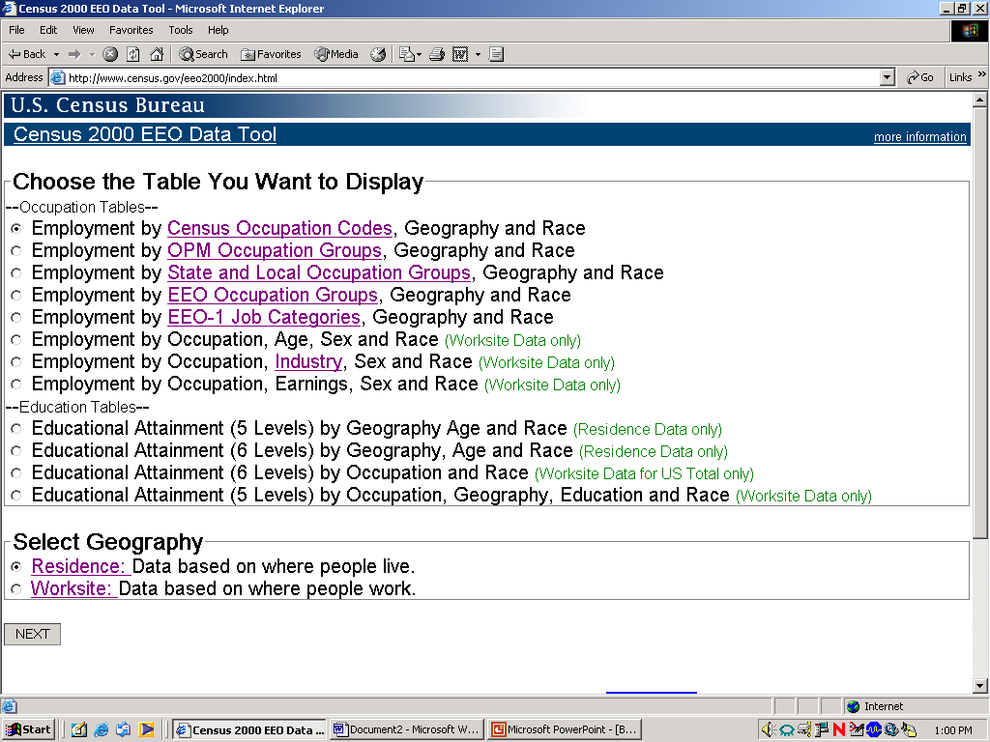
Census 2000 EEO Data Web Tool

