Slide 1
Do TANF Policies Move Work Participation Rates?
Caroline Danielson
Public Policy Institute of California
ACF Welfare Research and Evaluation Conference
June 4, 2007

Slide 2
Work Participation: FY 2007 and Forwards
Denominator
  Literature on the effects of welfare reform on the TANF caseload (only rough approximation of denominator)
  Finds negative effects of more stringent time limits and sanctions, and positive effects of financial incentives to combine work and welfare
Numerator
  No research; rather, research on employment and earnings among those “at risk” of welfare receipt
With the Deficit Reduction Act (2006), changes to work participation are reason to focus research more precisely on the numerator and denominator

Slide 3
Outline
Our Approach
Data
Results
Conclusions

Slide 4
Outline
Our Approach
Data
Results
Conclusions

Slide 5
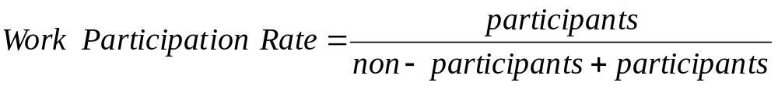
The Work Participation Rate
How do policies move the pieces: participation and non-participation?
What is their overall effect on the rate?
Caution: We do not observe shifting between participation and non-participation, and we do not observe motivation (unable vs. unwilling to comply).
Participants | Non-participants | Rate
↑ | ↑ | ?
↓ | ↓ | ?
↑ | ↓ | ↑
↓ | ↑ | ↓
NOTE: Of non-participants in FY 2005, approximately 60% had no hours and
were not exempted. Approximately 20% were exempted, and the same fraction had
some, but not enough, hours of participation.

Slide 6
Outline
Our Approach
Data
Results
Conclusions

Slide 7
Data: Strengths
We use the Data Reports states have been submitting in evidence of their work participation rates.
Span FY 1998-2005
Include the full range of allowable activities
Cover both TANF and SSP cases
Approximately 3,000 cases per state for each FY. Sample doubled for states with both TANF and SSP caseloads.

Slide 8
Data: Weaknesses
Cover only the post-reform period (FY 1998-2005)
  We include a rich set of controls for state background characteristics that may influence work and welfare receipt
States implemented varying work participation policies and regulations
  We include detailed controls to adjust for these differences

Slide 9
Data: Aligning the Past with the Future
Include both the TANF and SSP caseloads
  MOE-funded cases must be counted in the rate
Exclude sanctioned cases where adult removed
  BUT these contain a work eligible adult
  Closest substitute: “Grant reduction” sanction
Exclude timed-out cases where adult removed
  BUT these contain a work eligible adult
  Closest substitute: “All extended” time limit
States now act differently
  Include controls for the year of observation
  Compare differences between states that do / do not have a particular policy

Slide 10
Outline
Our Approach
Data
Results
Conclusions

Slide 11
Overview of States’ Policies
Policy |  | FY 2005
Financial Incentives | Maximum benefit | $379*
 | Maximum earnings at application | $700*
 | Earnings at $0 benefit, month 1 | $1,143*
 | Earnings at $0 benefit, month 13 | $806*
Work-related sanctions | Adult removed | 5
 | Grant reduction | 3
 | Gradual full-family | 24
 | Immediate full-family | 19
Time limits | None | 2
 | Adult | 4
 | Full-family | 39
 | All extended (+ adult or ff time limit) | 4
Diversion | Program | 27
 | No program | 24
*50th percentile
Source: Urban Institute, Welfare Rules Database

Slide 12
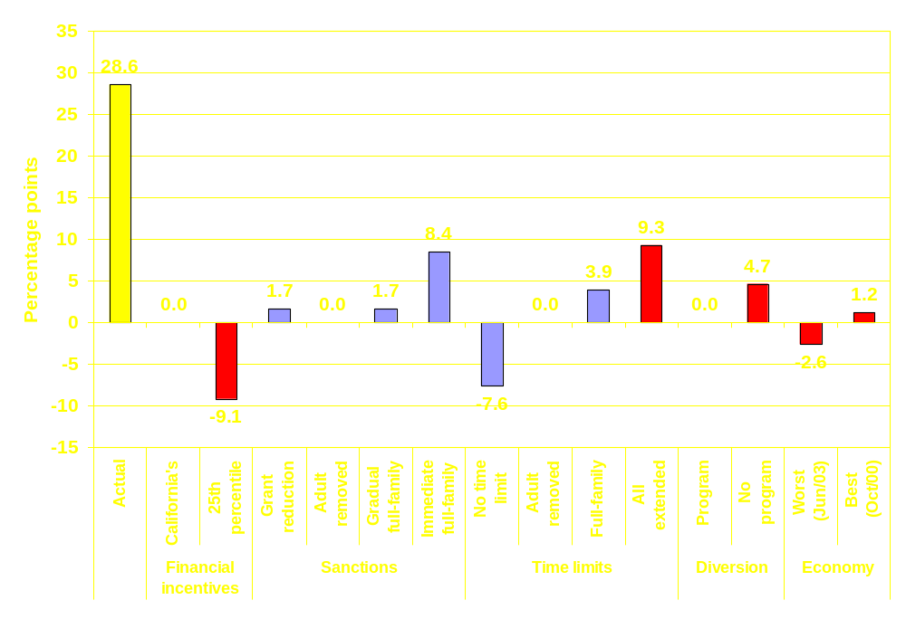
California
Actual WPR (FY 2005)
Change (significant)
Change (not significant)
Notes:
The implied change in the work participation rate if California had, in turn, each of the policies listed in the chart.

Slide 13
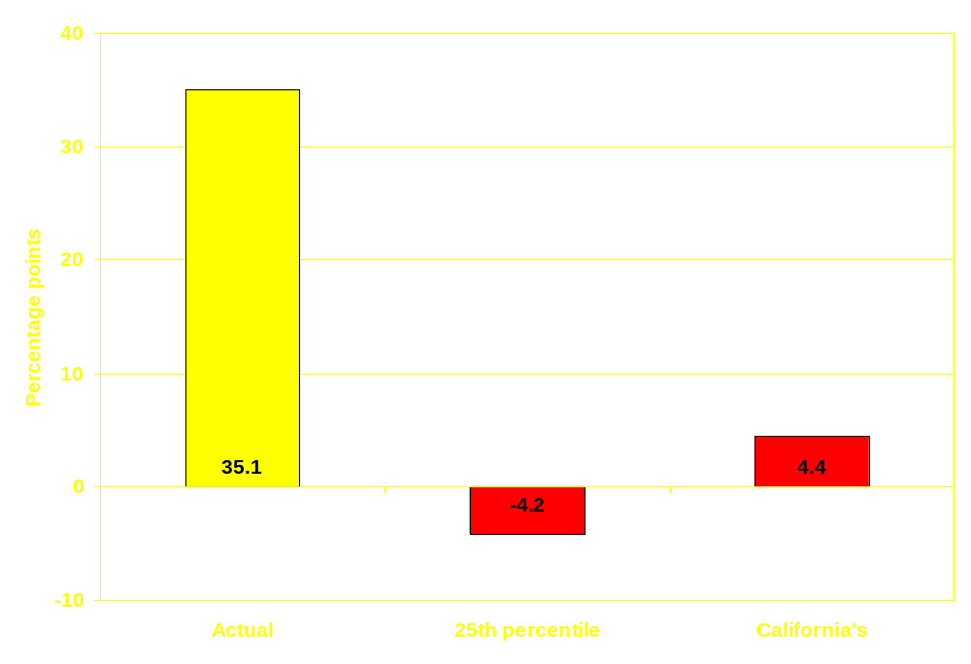
US: Financial incentives simulations
Actual WPR (FY 2005)
Change (significant)
Change (not significant)
Participation | +
Non-participation | +
Notes:
The implied change in the work participation rate if all states had, in turn, each of the policies listed in the chart.
C : comparison category
0 : statistically insignificant change
+ : significant, positive change
- : significant, negative change

Slide 14
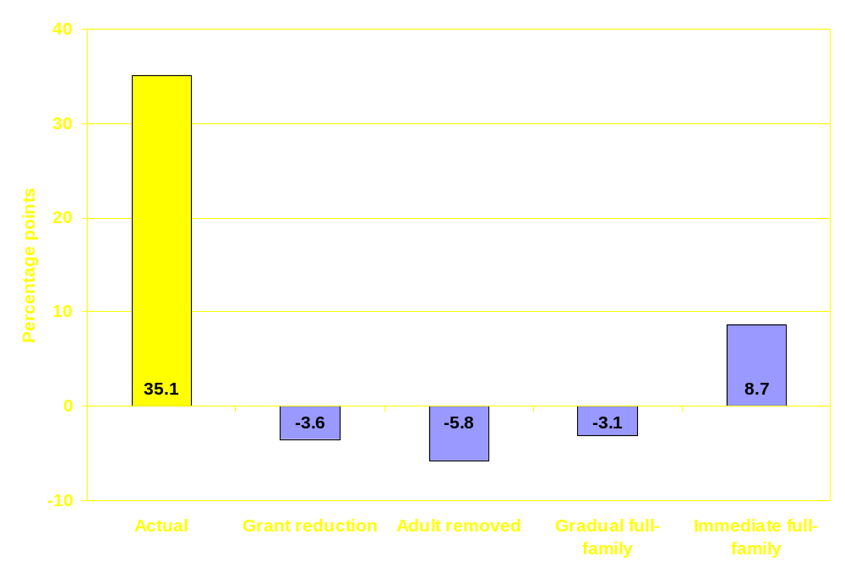
US: Sanctions simulations
Actual WPR (FY 2005)
Change (significant)
Change (not significant)
Participation | + | 0 | C | 0
Non-participation | + | 0 | C | -
Notes:
The implied change in the work participation rate if all states had, in turn, each of the policies listed in the chart.
C : comparison category (significance of other sanction policies compared to gradual full-family)
0 : statistically insignificant change
+ : significant, positive change
- : significant, negative change

Slide 15
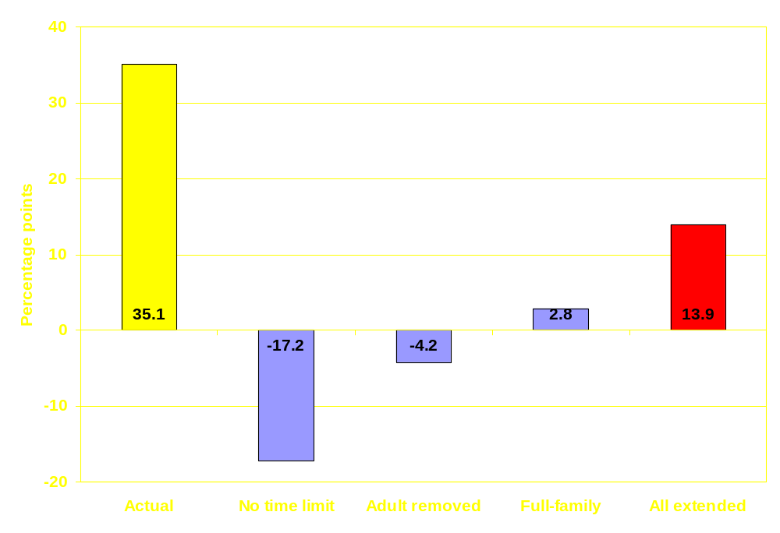
US: Time limits simulations
Actual WPR (FY 2005)
Change (significant)
Change (not significant)
Participation | C | 0 | 0 | +
Non-participation | C | 0 | - | 0
Notes:
The implied change in the work participation rate if all states had, in turn, each of the policies listed in the chart.
C : comparison category (significance of other time limit policies compared to no time limit)
0 : statistically insignificant change
+ : significant, positive change
- : significant, negative change

Slide 16
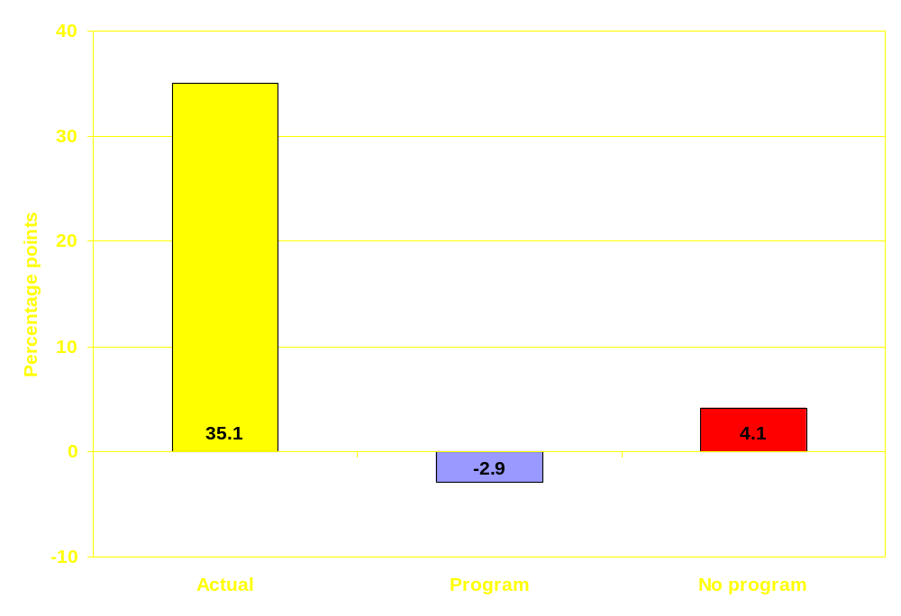
US: Diversion simulations
Actual WPR (FY 2005)
Change (significant)
Change (not significant)
Participation | C | -
Non-participation | C | -
Notes:
The implied change in the work participation rate if all states had, in turn, each of the policies listed in the chart.
C : comparison category
0 : statistically insignificant change
+ : significant, positive change
- : significant, negative change

Slide 17
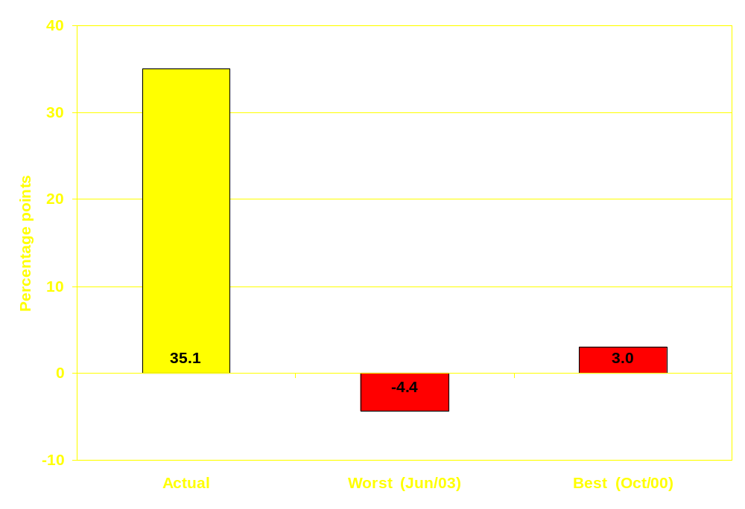
US: Economy simulations
Actual WPR (FY 2005)
Change (significant)
Change (not significant)
Participation | +
Non-participation | -
Notes:
The implied change in the work participation rate if all states had the best and worst economy of the FY 98-05 period.
C : comparison category
0 : statistically insignificant change
+ : significant, positive change
- : significant, negative change

Slide 18
Outline
Our Approach
Data
Results
Conclusions

Slide 19
Conclusions
Some evidence that more stringent time limits and sanctions increase rates by reducing the non-participating caseload
Time limit extensions appear to increase the participating caseload, raising the rate
Diversion reduces both caseloads, lowering the rate
Financial incentives increase both, raising the rate
A good economy increases the participating caseload and reduces the non-participating caseload, raising the rate

Slide 20
Contact Information
Public Policy Institute of California
www.ppic.org
Caroline Danielson
415 291-4462
danielson@ppic.org

