Slide 1
Assessment of the NCEP data assimilation systems during the NAME04 EOP period
Marco Carrera, Kingtse Mo,
and Wayne Higgins
CPC/NCEP/NWS/NOAA

Slide 2
Objectives
a) Inter-compare the NCEP data assimilation systems;
b) Compare the NCEP assimilation systems with soundings;
c) During EOP, other NAME04 data including aircraft P3, ship , radar and PIBAL data did not get into the NCEP system in time, but the soundings did. This gives an unique opportunity to examine the impact of soundings.

Slide 3
The NCEP data assimilation systems
Two Global systems:
CDAS Climate data assimilation system ( resolution T62L28; approx 250 km)
GDAS: Global data assimilation system( resolution T254L64; approx 50km)
Two regional systems
EDAS: Eta model 3D-Var Data assimilation system (resolution 12kmL64)
RCDAS: Regional climate data assimilation system
(resolution 32kmL45)

Slide 4
Table 1 Input data differences among the NCEP data assimilation systems
 | GFS | Eta operational | Regional CDAS | comments
GMS, METEOSAT,GOES cloud drift IR and visible winds | u, v | u, vT | u, v
GOES water vapor cloud top winds | u, v | u, v | not used
Surface land observations | u, v, T , Ps, q | Ps | Ps 10m winds,2m q
Surface ship and buoy observations | u, v, T, Ps, q | u, v, T, Ps, q | U ,v T, s and q From the COADS
SSM/I wind speeds | Used directly | Assigns direction from guess | Not used
Quickscat wind speed and direction | Not used | Used | Not used
SSM/I precipitable water | Used | Not used | Not used
SSM/I precipitation estimates | Not used | Used | Not used | Precipitation included through variational scheme and model physics
TRMM TMI precipitation estimates | Not used | Used | Not used | Precipitation included through variational scheme and model physics
GOES precipitable water | Used over land | Not used | Not used
NOAA-15, NOAA-16 AMSU-A 1b radiances | Used | Used | Not used
NOAA-15 –16 and –17 AMSU-B 1b radiance s | Used | Used | Not used

Slide 5
Precipitation assimilation
GDAS does not assimilate precipitation;
CDAS2 uses the CMAP pentad P data to adjust soil moisture, but does not assimilate P directly;
EDAS assimilates P over land;
RCDAS assimilates P over land and oceans

Slide 6
NAME EOP soundings
P. Penasco 31.18N, 113.33W Las Vegas 36.62N,116.02W
Kino Bay 28.8N,111.9W San Diego 36.62N,116.02W
Los Mochis 25.4N, 109.05W Flagstaff 32.85N,117.12W
Loreto 26.01N, 111.21W Albuquerque 35.05N,106.62W
Empalme 27.95N,110.77W El Paso 31.87N,106.7W
Mazatlan 23.20N,106.42 W Amarillo 35.23N,101.7W
Chihuahua 28.63N,106.08W Midland 31.95N,102.18W
Torreon 25.53N,103.45W Del Rio 29.37N, 100.92W
Monterrey 25.87N,100.23W Yuma 32.51N,114W
La Paz 24.17N,110.3W Phoenix 33.45N,111.95W
Guadalupe 22.75N, 102.5W Belize city 17.53N,88.3W
Tucson 32.12N,110.92W San Jose (Costa Rica) 10N,84.2W

Slide 7
Moisture transport from data assimilation systems
( Summary from the next 4 slides)
Two regional analyses have the NLDAS component and assimilate P so P, and E are similar and should be more reliable;
The GDAS does not assimilate P so the differences between the GDAS and the gauge P data are larger;
All systems show similar low level jet from the Great Plains (GPLLJ), and the easterly zonal low level jet in the Caribbean (CALLJ).
The LLJs from the Gulf of California (GCLLJ) from the EDAS and the GDAS are similar, the RCDAS overestimates the strength of the jet.

Slide 8
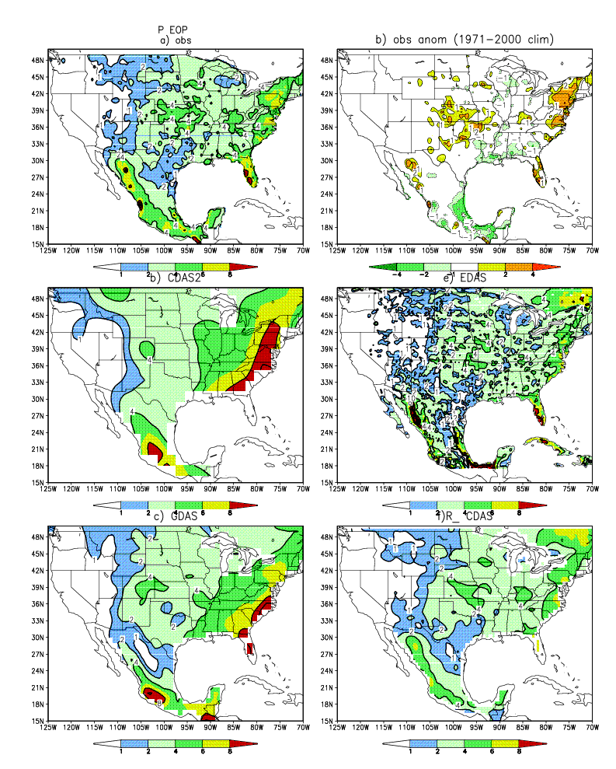
P mean over the EOP:
During this period, there are positive P anomalies over the central United States and northern Mexico, but drier over southern Mexico
The EDAS and the RCDAS assimilate P, so P is closer to the observations, both the GDAS and CDAS miss the center of P maximum over the central US and too much rainfall over southern Mexico

Slide 9
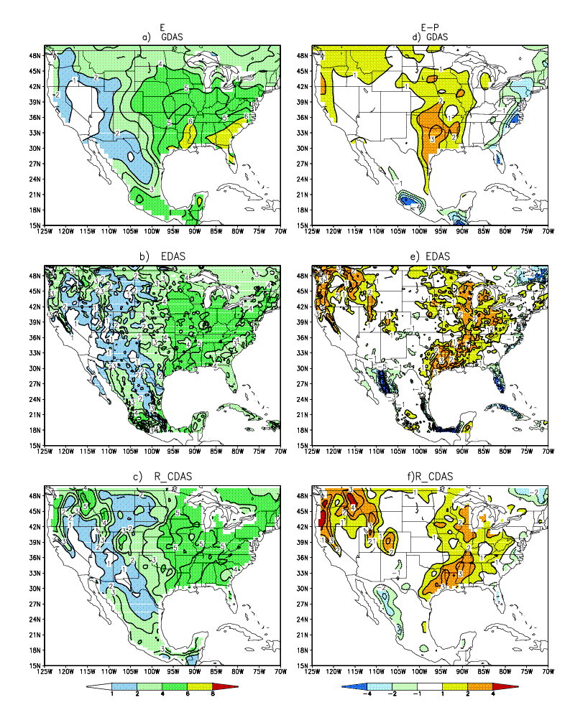
E
E-P
All data assimilation systems show E>P over the central United States.
Both EDAS and RCDAS have the NLDAS subsystem so they are similar, and more reliable,
while the GDAS
shows a shifted center of E-P.

Slide 10
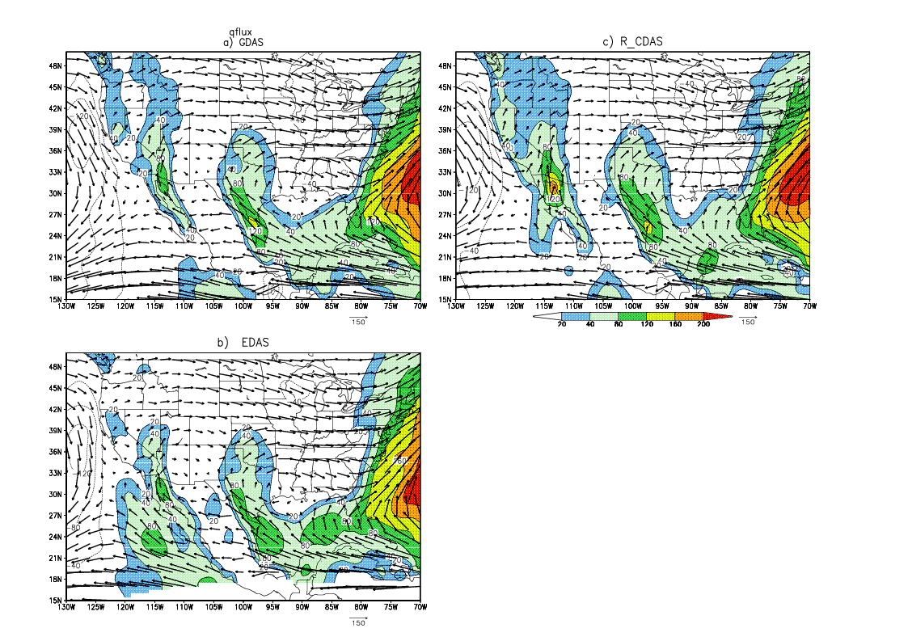
Vertically integrated meridional moisture flux [qv] ( contoured) and flux( Vector)
Units:kg/(ms)
The GPLLJ from 3 systems are similar;
The GCLLJ from the GDAS and EDAS are similar , while the RCDAS depicts a very strong jet with a center over the Gulf of California

Slide 11
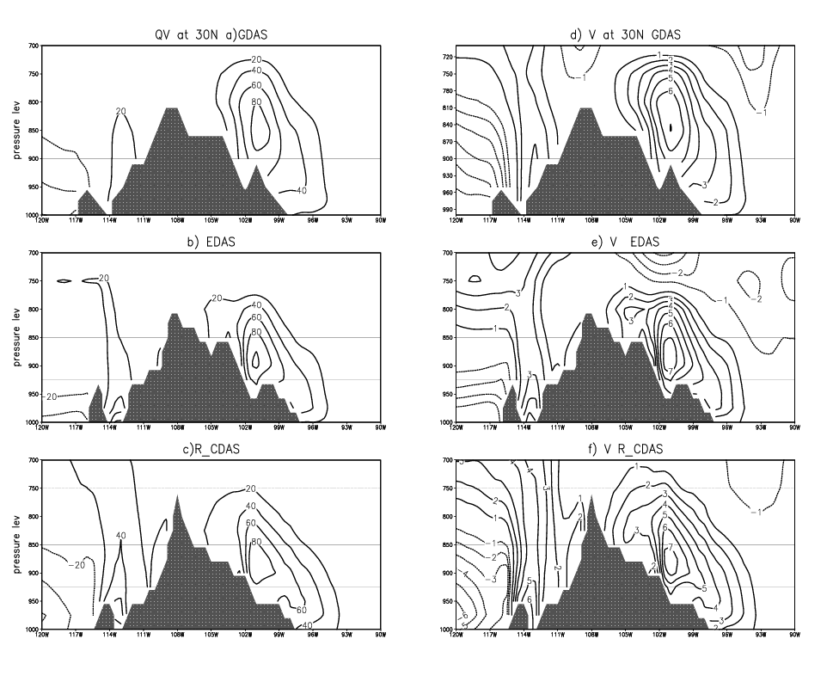
Vertically integrated meridional moisture flux and v at 30N
Both GDAS and EDAS show
a) similar vertical profiles of the GPLLJ, and GCLLJ.
b) the GCLLJ is confined in the boundary layer.
The RCDAS shows a similar GPLLJ, and a much stronger GCLLJ extending to 700 hPa
Units: m/s
Units: kg/(ms)

Slide 12
Comparison with soundings & satellite data
The next 5 slides
The model generated T, V, U and q outputs are interpolated to the observed sounding sites from 4 nearest grid points;
Both model and observed soundings are archived at the mandatory levels;
For mean vertical profiles, the mean is taken over the period that the observed soundings are available (9July- 10 August).

Slide 13
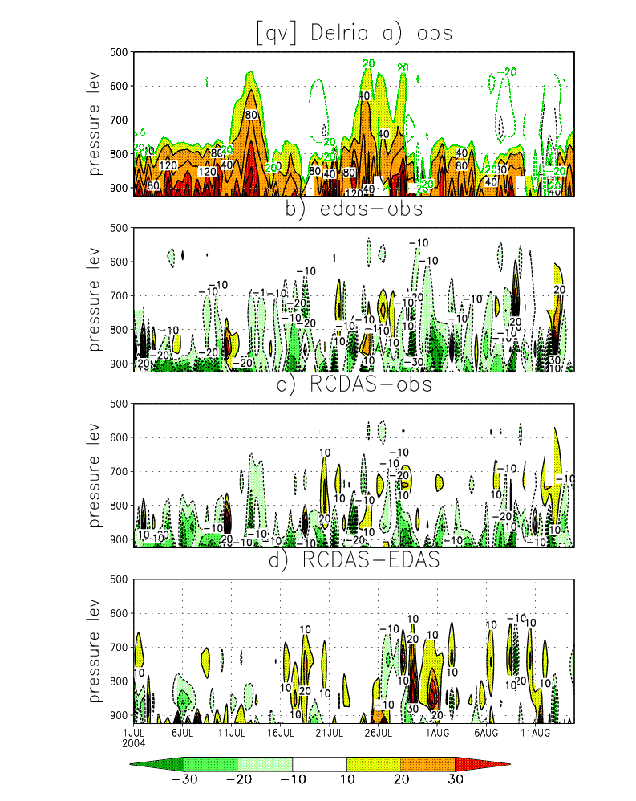
Del Rio (29.37N,100.92W) is located near the Maximum of the GPLLJ.
The comparison shows :
Little difference between the RCDAS and EDAS;
They both underestimate the strength of the (qv). The RCDAS errors are smaller

Slide 14
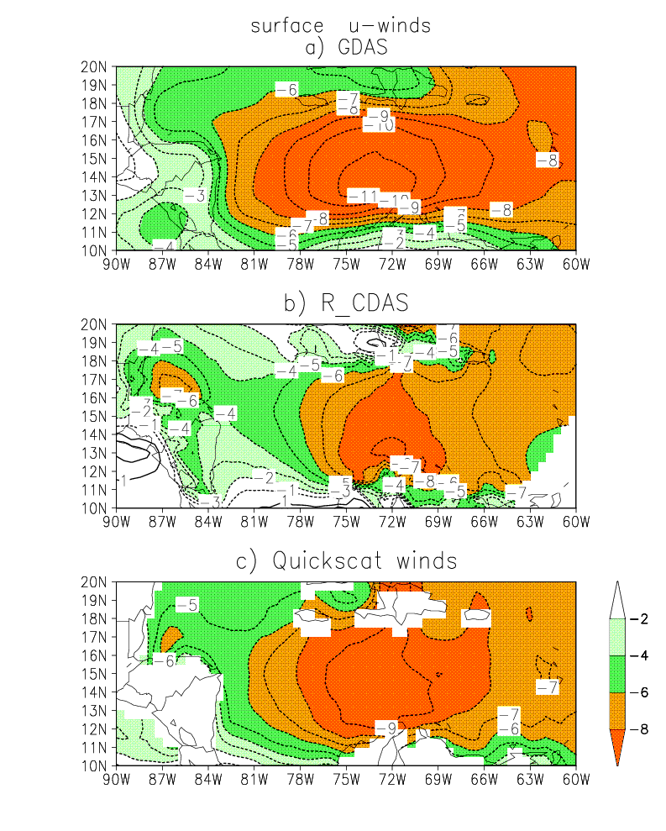
In comparison with the satellite Quickscat surface winds , all systems capture the location of the easterly LLJ maximum. The magnitude differs less than 2 m/s
All systems capture the CALLJ and they compare favorably with the satellite estimates.

Slide 15
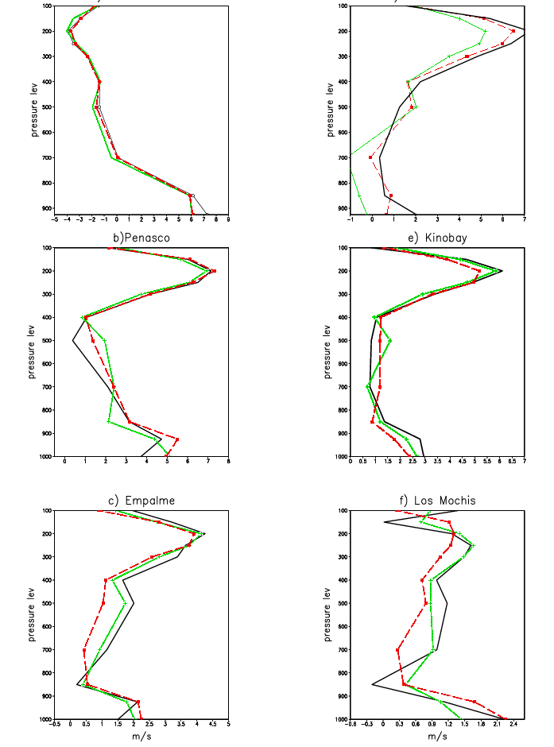
Compare v-wind profile with soundings
a) Del Rio
d)Tucson
ISS & GLASS Soundings over the NAME Tier I region
Penasco, Kinobay,Loreto & Losmuchis
The largest differences along the Gulf of California are located over the northern Gulf, where the large GCLLJ is located. At Puerto Penasco , the RCDAS v-winds are more than 1 m/s too strong.
At Tucson, both RCDAS and EDAS have weaker winds at the lower levels.
Red RCDAS, Green: EDAS, black (sounding)

Slide 16
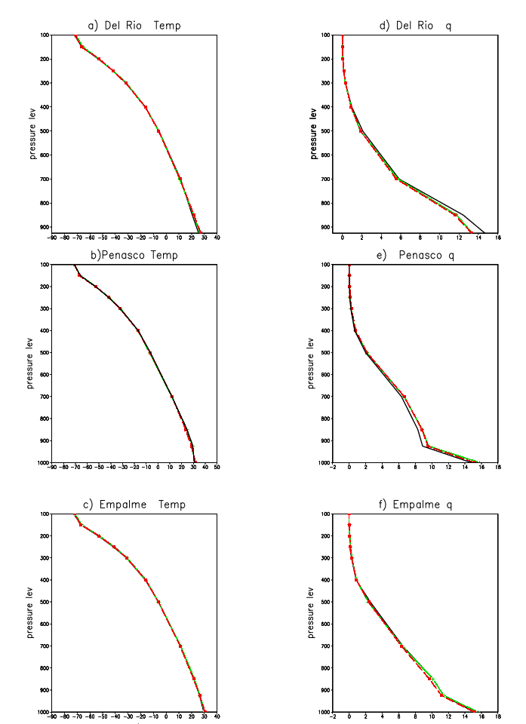
Compare T and q with soundings
Both T and q from the EDAS and the RCDAS compare favorably with the soundings
Red RCDAS, Green EDAS & dark soundings

Slide 17
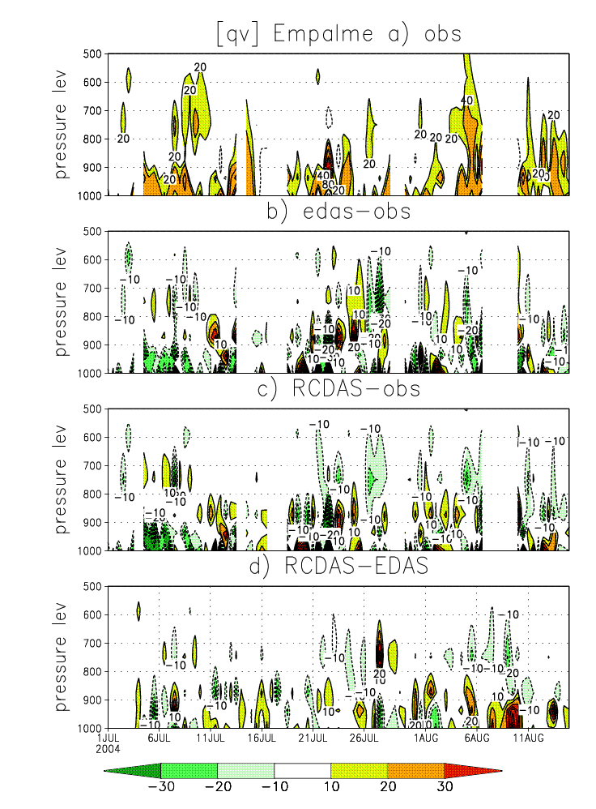
The comparison with the sounding at Empalme is good.
The differences between the RCDAS and the observations are concentrated over the northern Gulf of California (e.g. near Penasco), where the difference of [qv] flux is

Slide 18
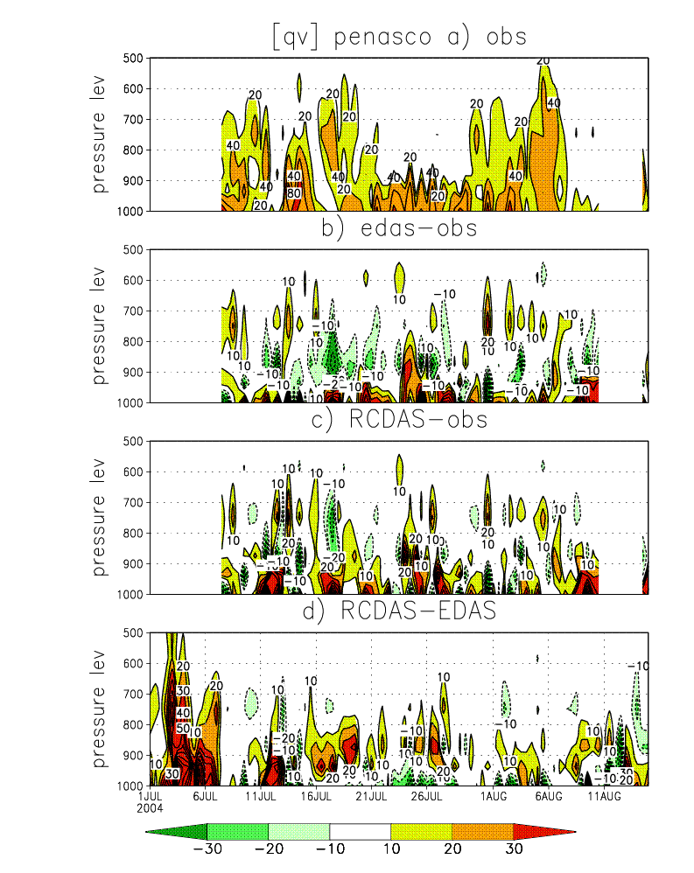
Comparison with sounding at P. Penasco both the EDAS and the RCDAS over estimate [qv] at lower level, but the differences for the RCDAS are larger.
The differences between the ECDAS and RCDAS extend to 700 hPa consistent with vertical profile of qv at 30N (slide 10)
The largest differences are from 1-7July when the sounding was not in operation. This suggests that the soundings have impact on the analyses.
This point is clear from the next 2 slides

Slide 19
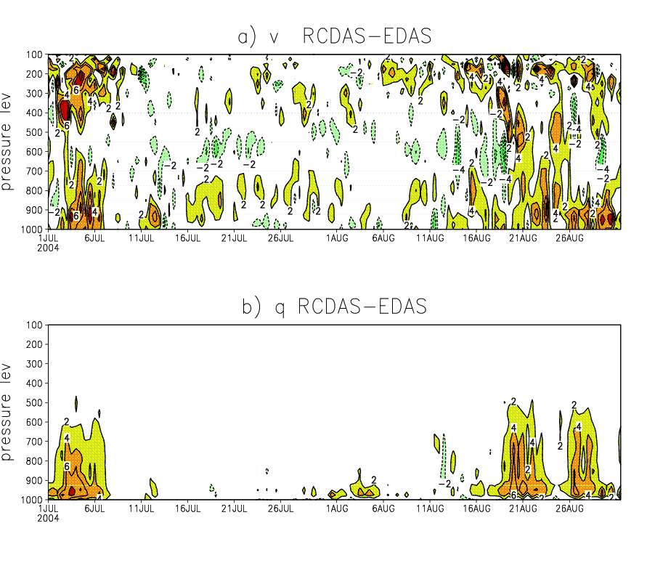
Difference between RCDAS and EDAS at Penasco site. There are total 29 vertical levels
Penasco data were available from July 8 to 11August 2004.
The differences between the two analyses are large when the sounding data were not available.

Slide 20
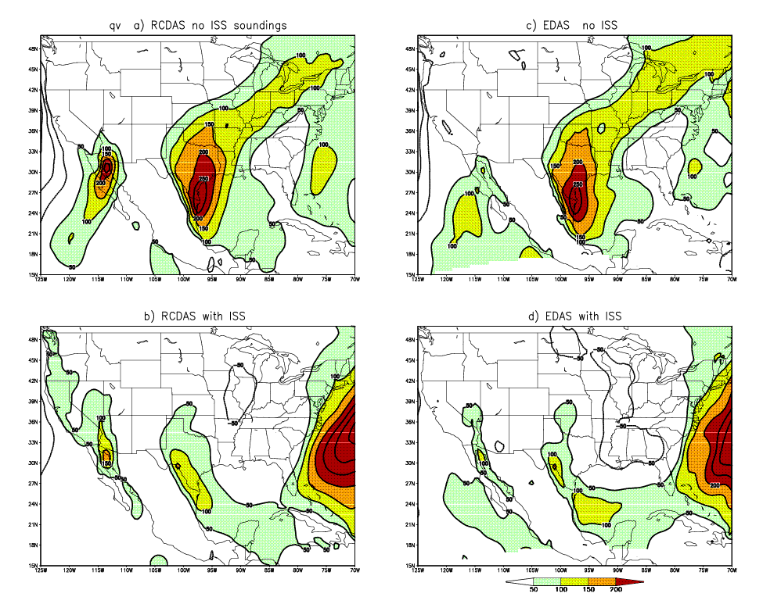
Vertically integrated moisture flux [qv] from RCDAS and EDAS for the periods with & without the ISS & GLASS soundings
RCDAS
EDAS
The GCLLJ from the RCDAS is 200 kg/(ms) strong in comparison with the EDAS without soundings.
With the ISS soundings, the difference reduces to 50 kg/(ms)
The period with soundings: July 11-August 11
Period with no soundings:
1-10 July and
16-31 August

Slide 21
Conclusions
During the EOP periods, most soundings entered the NCEP buffer files and were accepted by the assimilation systems;
The comparison shows:
a) the RCDAS overestimates the [qv] from the Gulf of California with a maximum located over the northern Gulf, while the EDAS compares more favorably with soundings;
b) All systems have similar CALLJ and GPLLJ and compare well with soundings;
c) The soundings are effective in correcting model biases

