Slide 1
SAMHSA Call Routing Technology Read-out
January 31, 2007 – initial readout
February 28, 2007 – follow up

Slide 2
Agenda
Background and Summary Information (Feb 28 new material)
Project Overview
  Project Scope and Methodology
  Participation
  Timeline
  Goals, Responsibilities and Issues
Current State
Call Routing Options
  Business Model Comparison
  Next Steps
Interview Findings
  Results
  Opportunities

Slide 3
Background and Summary Information

Slide 4
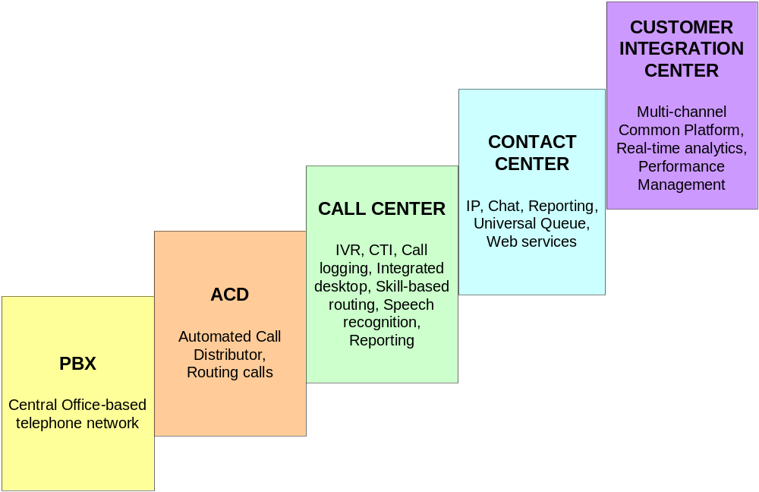
Technology Evolution in Contact Centers
The new breed of contact centers offers multiple methods of contact or communication
SAMHSA’s current technology offers limited advanced call center capabilities and relies on Sprint’s 800 number routing management

Slide 5
Components of a Contact Center Technology Model
Transport Services
800 / Long Distance Services
Level of service currently being provided by Sprint to Lifeline
Call Routing Services
IVR and Call Routing Logic
Disaster Recovery Services
Services and Advanced Infrastructure
SAMHSA’s current environment enables limited access to these advanced services and functionality
Desktop Integration
Higher Level Functionality
Speech Recognition
Quality Monitoring
CTI
Custom Reporting

Slide 6
Standard Technology
Functionality / Technology | Definition | Uses | Application for SAMHSA?
ACD – Automatic Call Distributor | A telephone facility that manages incoming calls and handles them based on the number called and an associated database handling instructions | Allows capturing of incoming calls, routing based on criteria, gathering of usage statistics, balances the assignment of calls to agents / centers | Yes, Routing of calls Reporting needs
IVR – Interactive Voice Response system | An automated answering device which routes calls to the appropriate place, based on user defined steps and responses to prompts | The IVRs that use prompts are "smart" attendants which ask questions and ask the caller to respond by pressing a number for routing. An IVR is commonly found in businesses to direct callers to the appropriate department | May not be appropriate for crisis calls to centers, however could consider for non-crisis uses, e.g., general information
Monitoring and Recording | Monitoring and recording capabilities as a contact center application allows callers’ interactions to be recorded as a means to evaluate the interface between the agent and the caller | Initial goal is typically to improve caller-facing processes by evaluating agents' interactions with callers based on specific criteria. Systems exist that can record both parties’ conversation as well as capture the screens accessed by the agents | Yes, particularly for training purposes, however, privacy issues need to be considered
Reporting | Real-time and historical data gathering from the ACD and all other systems within the call center. Standard and custom reporting features are available | Offers information regarding volumes of transactions, where transactions are originating and terminating from, and transaction disposition (busy, completed, no answer) | Yes, Standard and custom reports
800# Management | Activation and management of a toll-free number, which could include features such as music on hold, call routing by date, time and caller ID, among other features | Provides 3rd party management of phone number, routing options, features and reporting | Yes

Slide 7
Advanced Functionality & Applications
Functionality | Use | Application for SAMHSA?
Desktop Integration | A unified desktop for agents that provides a single point of access to all the mission-critical applications and tools required by the agent to effectively complete a customer interaction. Integrating the applications at the desktop oftentimes dramatically improves productivity | Yes, Could offer consistent tools to crisis center staff for gathering caller information and consistent reporting
Speech Recognition | Technology by which a computer recognizes/identifies spoken words, allowing a caller to speak commands which control the computer to perform the desired function | May not be appropriate for crisis calls, however could consider for non-crisis uses, e.g., general information
Quality Monitoring | Allows the silent monitoring and/or recording of agent’s interactions with callers for training, security and quality purposes | Yes
CTI (Computer-Telephony Integration) | A system that is based on the integration of computer, telephony and networks as a means to enhance telephone service. Examples include the delivery of Caller ID information via a PC, and the ability to access voice mail via the PC | May be useful for caller identification, and making available information from previous calls to crisis center
Custom Reporting | Tools that offer capability to design specific reports or analysis services when out-of-the-box reports are not sufficient | Yes, Allows for own design of reports based on needs

Slide 8
Technology Upgrade Considerations
The relationship of SAMHSA, the Lifeline administrator and the individual crisis centers must factor into consideration for any technology upgrades:
  The crisis centers manage their own technology infrastructure and they handle Lifeline calls as a subset of their overall responsibilities.
    Any new technology decisions must be able to be implemented without impacting the crisis centers current operations
  The Lifeline administrator is not a permanent assignment, so any technology decisions / investments must be transferable should the administrator change.
    Hosted services provide for an easier transfer than an “own and operate” business model (see pages 31 through 36)
  Government entities purchase telecom services and equipment under government contracts. However, the current telecom services provided by Sprint to support SAMHSA are purchased and paid for by the administrator, a non-government entity.
    Potential cost improvements via the FTS Networx contracts should be explored (see pages 15 – 16)

Slide 9
Call Routing – Current & Future
Current
Future
Call Routing via a Carrier
Call Routing via SAMHSA and/or Lifeline
Sprint performs the call routing function today and delivers the calls to the crisis centers based on defined network routing rules
Can be traditional circuit-switched or IP-based
See pages 24, 25 and 30
Requires an ACD
  An IP-enabled ACD handles both IP and circuit-switched calls, which allows for a phased implementation
Multiple business models can be considered
  Hosted
  Own and Operate
  See pages 31 - 36

Slide 10
Four Specific Questions
Are there more efficient and cost effective technologies available for routing calls to independent centers within the network?
IP-based platforms offer key quality and reporting benefits. From a pure technology view, IP-based platforms make multi-site routing more flexible, more cost-effective, and practical to manage and maintain.
From a call routing and handling perspective, reasons to move to IP include:
  Reduced access costs / more efficient use of bandwidth
  Ability to support work-at-home agents and multiple sites without site-specific routing rules (i.e., calls can route to the next available agent across multiple sites)
  Less physical infrastructure to support multiple sites
Most of the mainstream switch vendors offer hybrid platforms, which support both traditional voice routing as well as IP-based routing. This makes it more effective for organizations that are currently using circuit-switched routing to move towards an IP-based offering.

Slide 11
Four Specific Questions
Are there technologies that the Government should be considering in order to be able to respond to VoIP calls, instant messaging, or other emerging communication technologies?
For inbound VoIP calls, the Government can respond today through its current infrastructure. The issue of geographic identification is not solved with IP technology.
Geographic identification of the caller is also an issue with instant messaging because it functions on presence of an IP address, without an identifier, unless the user is asked to provide the information.
In the broadest sense, an IP-centric network of crisis centers could create an environment where all contacts – voice, email, web chat – are routed over the public Internet and handled via a single universal queue. It offers a way to manage web-based interactions alongside voice, resulting in a unified queuing, routing and reporting environment. This may be a compelling reason for SAMHSA to consider moving in that direction. Hosted providers typically use mainstream, proven IP vendors. A hosted solution gives the flexibility to introduce in a phased-approach some of the advanced call center capabilities based on individual crisis center drivers.
Hosted providers typically use mainstream, proven IP vendors. A hosted solution gives the flexibility to introduce in a phased-approach some of the advanced call center capabilities based on individual crisis center drivers.

Slide 12
Communication Methods and Scenarios
Interaction Type | Scenario | Crisis Center Requirements | SAMHSA TDM ACD Requirements | SAMHSA IP ACD Requirements | Limitations
Wireline phone | Caller from home, work | Answer end-point | DID Route Point with remote or local ACD agents | IP Route Point with universal IP Agents
Cellular phone | Traveler or someone away from home | Answer end-point | DID Route Point with remote or local ACD agents | IP Route Point with universal IP Agents | Geographic location of caller may not be available
Voice call from network VoIP phone | Caller from home/work | Answer end-point | DID Route Point with remote or local ACD agents | IP Route Point with universal IP Agents | Voice quality issues
Voice call from VoIP solution provider, e.g., Skype | Caller from home/work, using PC rather than telephone | Answer end-point | DID Route Point with remote or local ACD agents | IP Route Point with universal IP Agents | Caller identification or geographic location may not be available
Instant Message / Text Chat | Teen using PC to contact crisis center, using text as the means to communicate; User with hearing loss may use IM as communication method | IM client required on desktops | IM Server Architecture blended with multi-media CTI platform (for integrated message delivery and reporting) | IM Server Architecture with blended universal IP based access. Presence capability to know agents status. | Geographic location of user may not be available Interoperability issues across providers No emotion indications
Email | User sends email requesting information or request; User with hearing loss may use email as communication method | Email client required on desktops; Management of emails in a timely manner | Unified Messaging Architecture with multi-media CTI platform (for integrated delivery and reporting) | Unified Messaging with blended queuing. Presence capability to know agents status. | Geographic location of user may not be available Real-time conversation is lost No emotion indications

Slide 13
Four Specific Questions
What equipment would be necessary to establish a uniform technology system across all crisis centers?
As long as SAMHSA selects an IP-enabled ACD (hybrid which allows both IP and traditional circuit-switched calls), the individual crisis centers do not need to make any equipment investment immediately.
If SAMHSA were to choose a “own and operate” business model instead of a hosted solution, equipment placement becomes an important consideration.
  Routing centers could be set up as:
    A national center that routes to all crisis centers
    Regional centers based on traffic volumes and routings
    Localized distribution centers that could be by state or by urban areas
Given that the crisis centers are independent and that some have their own in-house ACDs to route calls throughout their centers, SAMHSA will not have full visibility to the call detail / disposition. If uniformity of call detail is desired, a substantial overall strategy involving center changes in process and / or technology would be required.
  The basic requirements for a uniform technology based on IP architecture include:
    Multimedia Platform sized for the number of simultaneous agents required for the number of channels (i.e. Voice, Chat, etc).
    Carrier Terminations to support inbound and outbound connectivity to support the Multimedia Platform.
    Licensing to support the platform and crisis center agents.

Slide 14
Four Specific Questions
If the Government were to implement an ACD system, what would it take to implement such a system and could it be phased in over time?
If SAMHSA decides to implement an IP-enabled ACD, either as a hosted solution or an “own and operate”
  The first step would be to convert the call routing functionality currently performed by Sprint to the ACD. This would be an “as is” conversion, that is routing calls in the same manner but using SAMHSA’s ACD rather than Sprint’s 800 routing service
  Once this change is stabilized, the newly-available feature / functionalities can be phased in
    Improved routing based on performance and call overflows
    Universal queue for voice, email, web chat
    Custom reporting
    Quality monitoring

Slide 15
FTS Networx Background
Networx is designed to replace the current GSA schedule for telecommunication services -- FTS 2001. The FTS 2001 contract expired in December, 2006 and is targeted for elimination by mid 2008. Currently, the Federal Government is operating through a bridge agreement with the carriers approved under the FTS 2001 contract.
There are two Networx GWACs (Government Wide Acquisition Contract) that will be awarded. The first is Networx Universal which will require carriers to provide 29 services virtually nationwide. The second is Networx Enterprise, which requires carriers to offer at least 6 services in limited geographic scopes.
The awards will be issued in Spring, 2007. It is likely that several carriers will be issued awards under each contract. Once the awards are issued and the time for appeal has passed, all approved carriers will be allowed to “market” their services to individual government agencies. Agencies are required to give all carriers a “Fair Opportunity” review which allows all participating carriers a fair chance to win agency business.

Slide 16
FTS Networx Background
Required Agency Activities
  Inventory all products and services currently purchased under the FTS 2001 contract vehicle. GSA has developed a database with what they believe is the current FTS 2001 inventory for each Agency. At a minimum each Agency is required to validate the GSA inventory.
  Gather user requirements to be used for Networx vendor evaluation.
  Determine which of the two contract vehicles the Agency will utilize for their communication vendor selection – Universal or Enterprise. Each Agency has the option of breaking this decision into “Logical Groupings” and spreading their requirements between Enterprise and Universal and even separate carriers within each vehicle. For example it may decide to break their requirements down by geography, application, or department. From these logical groupings the Agency may choose to use the Universal schedules for its international traffic, Enterprise schedule for its domestic traffic, and further break-down these groupings by location to increase the number of carriers and schedules.
  Select a single vendor for each logical grouping of services. Unlike FTS 2001, once the Agency determines how it will group its requirements; these “logical groupings” are awarded to a single vendor. Under FTS 2001, the Agency could choose among several contract holders for these services.
  Implementation. There are credits available to each Agency for transition costs but only if the Agency adheres to the GSA timeline.

Slide 17
Project Overview

Slide 18
Project Scope and Methodology
Project Scope
As defined in the SAMHSA RFP, the project will address the following:
  Evaluate the efficiency of the current technology systems employed by the Network Administrator and the individual local crisis centers
  Provide recommendations on how to improve technology and reduce costs as the network expands and grows
  Specific questions to be addressed:
    Are there more efficient and cost-effective technologies available for routing calls to independent centers within the network?
    Are there technologies that the Government should be considering in order to be able to respond to VoIP calls, instant message, or other emerging communication technologies?
    What equipment would be necessary to establish a uniform technology system across all crisis centers?
    If the Government were to implement an ACD system, what would it take to implement such a system and could it be phased in over time?
Methodology
Visit Lifeline and interview key stakeholders
Conduct site visits to two crisis center
  LifeNet Crisis Center, New York
  Suicide Prevention Services, Batavia, IL
Conduct telephone interviews of eight crisis center directors
Analyze call data
Analyze Sprint invoice
Define business models from an operational perspective
Review options with a focus on gaining efficiencies in call routing and call handling functions
Address organizational structures and constraints

Slide 19
Participation
Contact | Role | Location | Interview | Site Visit
Robert Kessler | Lifeline – MIS Director | National Suicide Prevention Lifeline | ✓ | ✓
Cathleen Kelly | Lifeline - Director of Network Development | National Suicide Prevention Lifeline | ✓ | ✓
Heather Stokes | Lifeline – Director of Certification and Training | National Suicide Prevention Lifeline | ✓ | ✓
Christopher Le | Lifeline – Resource and Information Manager | National Suicide Prevention Lifeline | ✓ | ✓
Natasha Clay | Crisis Center Director | Centerstone Crisis and Referral Services, Tennessee | ✓
Pam Cross | Crisis Center Director | Contact Heartline, Oklahoma | ✓
Jan Glick | Crisis Center Director | Contact Pittsburgh, Pennsylvania | ✓
David Therkelsen | Crisis Center Director | Crisis Connection, Minnesota | ✓
Jack Clifton | Crisis Center Director | Crisis Intervention of Houston, Texas | ✓
Ginny Gohr | Crisis Center Director | Girls and Boys Town, Nebraska | ✓
David Covington | Crisis Center Director | Integrated Health Resources / Behavioral Health Link, Georgia | ✓
Libby Donoghue | Crisis Center Director | 211 Brevard, Florida | ✓
Gillian Murphy | Crisis Center Director | LifeNet Crisis Center, New York | ✓ | ✓
Stephanie Weber | Crisis Center Director | Suicide Prevention Services, Inc., Illinois | ✓ | ✓

Slide 20
Timeline
Week 0:
10-25
Week 1:
11-3
Week 2:
11-10
Week 3:
11-17
Week 4:
11-24
Week 5:
12-1
Week 6:
12-8
Week 7:
12-15
Week 8:
12-22
Week 9:
12-29
Week 10:
1-5
Week 11:
1-12
Week 12: 1-19
Week 13: 1-26
Kick-Off Meeting
Review project scope and process
Data gathering
Conduct Site Visit to Lifeline and LifeNet
Interview key staff members of Lifeline
Interview Director of LifeNet
Complete interview process
Conduct site visit to Batavia Crisis Center
Conduct telephone interviews with 8 Crisis Center Directors
Read-Out:
Review analysis
Perform Analysis
Billing and Call Data
Assess Key Applications Approaches
Summarize Findings & Recommendations
Project Plan, Weekly Status Calls, Weekly Status Reports, On-going Communication, Issues Management

Slide 21
Goals
Goals of SAMHSA and Lifeline
  Facilitate a network of crisis centers committed to serving those in crisis and reducing suicide rates
    Provide caller support via a local crisis center
      Every call to be answered within the state that it originated
      Regional backup for overflow conditions
    Expand network of participating crisis centers to provide full coverage for every state
      Five states currently without any crisis centers: Arkansas, Hawaii, Idaho, Utah, Vermont
      There are coverage gaps in other states where not all areas are being served
    Insure callers are receiving the highest level of service available by establishing standards for handling crisis calls
      All centers on the Lifeline network accredited by AAS, JCAHO or other agencies
      Uniform Lethality assessment to be conducted on each Lifeline call
      Common training materials documenting best practices available to centers
  Administer and support the National Suicide Prevention Lifeline, insuring 7x24 availability to those in need

Slide 22
Responsibilities and Issues
Lifeline Responsibilities
  Insure network reliability, capacity and support are provided to all centers in the NSPL network
  Insure calls are routed to the correct center in the most efficient manner
  Explore/support alternative input methods for users to communicate to crisis centers (e.g., instant messaging, chat)
  Identify and reach out to population segments in need (e.g., Native Americans, GLBT, elderly, adolescents)
  Access to the technology required to monitor calls to NSPL Crisis Centers
Lifeline Issues
  Minimal call data or statistics available through current carrier by center, by number of calls answered, not answered, busy
  Inability to monitor call progression from those centers that have ACDs
    Currently must rely on the crisis centers for the appropriate reports
  Performance of current remote call monitoring
    Quality issues with VoIP calls
    Inability for recording

Slide 23
Current State

Slide 24
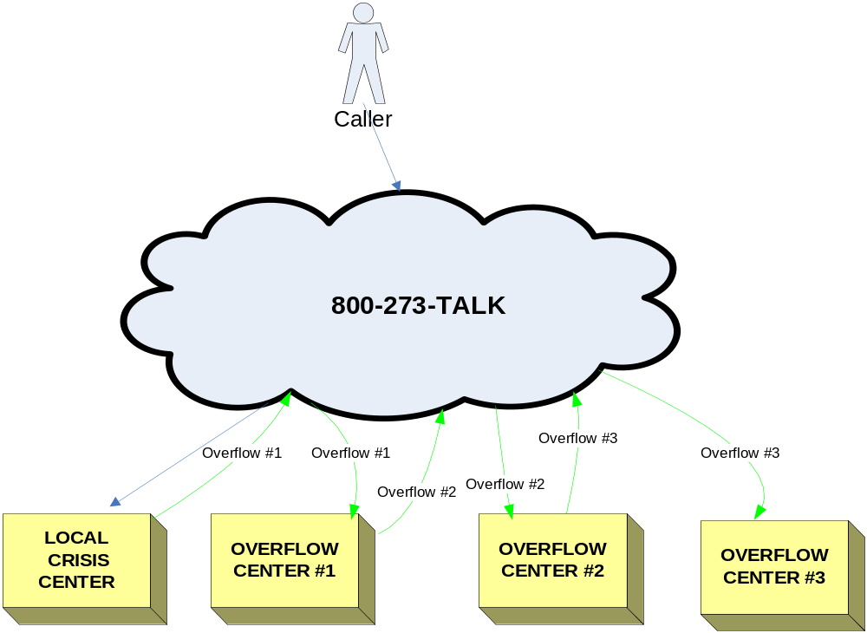
Call Routing Example
Current State
A caller to 273-TALK can be re-routed to up to 3 overflow centers before ultimately being answered
  This example assumes that Girls and Boys Town, as the final overflow center, answers the majority of the overflow calls
Estimated wait time for the caller may be upwards of 90 seconds before being answered
  Estimating 6 rings at each center equals approximately 30 seconds

Slide 25
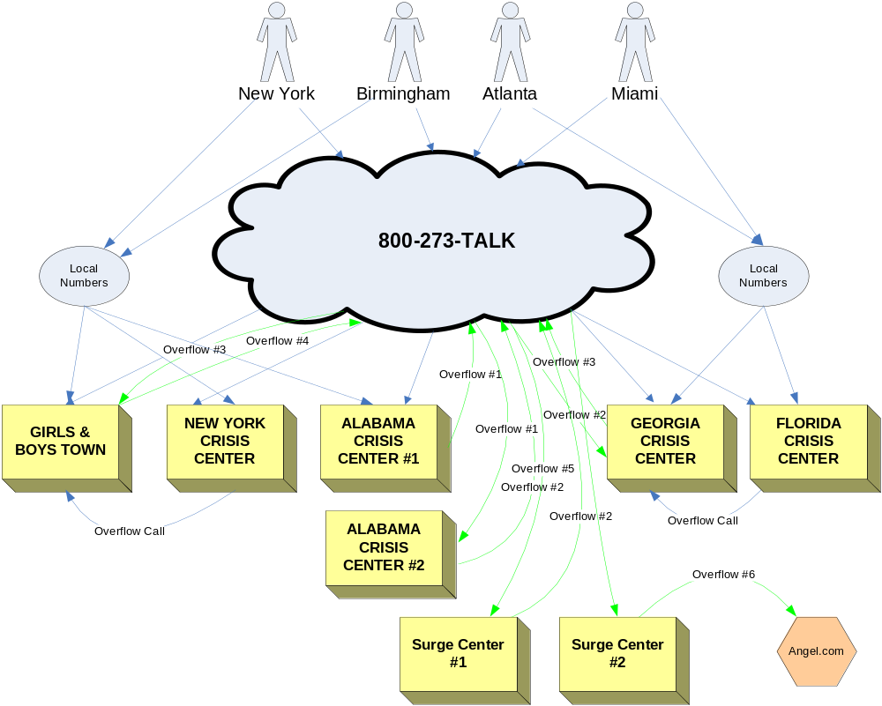
Call Routing Example
Current State
Callers reach crisis centers via NSPL 800 number, other 800 numbers and local numbers
  NSPL Administrator has no control over service level at any crisis center
  Some centers do not receive identification that calls originate from Lifeline’s 800 number
  Some centers combine 273-TALK and 800-SUICIDE to the same termination number for identification purposes
  Goal is to have a dedicated line in the crisis centers for Lifeline calls

Slide 26
Who Is Receiving the 273-TALK Calls?
Top 10 States Based on Percent of Total Calls Answered
States Answering Less than 1% of All Total Calls
State | % Total Calls Answered
Georgia | 8.4%
Nebraska | 7.9%
California | 7.5%
Texas | 6.6%
Virginia | 5.5%
Florida | 5.3%
New York | 5.1%
Louisiana | 4.4%
Illinois | 3.7%
Connecticut | 3.5%
State | % Total Calls Answered
Iowa | 0.9%
Kentucky | 0.9%
Tennessee | 0.9%
West Virginia | 0.9%
Nevada | 0.8%
New Hampshire | 0.6%
Delaware | 0.6%
Kansas | 0.5%
North Carolina | 0.4%
South Dakota | 0.4%
Alaska | 0.3%
Montana | 0.3%
Rhode Island | 0.2%
North Dakota | 0.2%
Wyoming | 0.1%
Mississippi | 0.0%
Based on NSPL September 2006 Call Data

Slide 27
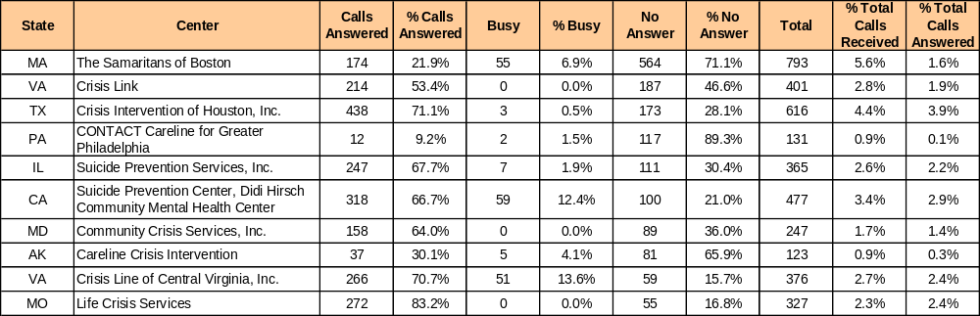
Operational Analysis
September 2006 data
By analyzing “No Answer” and “Busy” statistics on a regular basis, call routing decisions can be modified to minimize wait times for callers
Engage centers with below average answer rates to understand staffing and internal routing procedures
A typical measurement for an enterprise support center is how long it takes for a call to be answered
  A common metric is 80% of all calls are answered within 20 seconds (Service Level 80/20)

Slide 28
Call Routing Options

Slide 29
Call Routing Options
Continue with carrier-based routing and reporting
  Logic and approach in place
  Little or no management required
  Limited reporting, but could investigate options for additional reporting
Expand capabilities through additional hosted solutions
  More robust functionality
  Potential for customized reporting
  Minimal capital may required
  Little or no management required, except for vendor interface
  Can test or implement variety of technologies, at different stages and scale
Expand capabilities through owning and operating technology solution
  Most robust functionality
  Most options for configuration
  Technology decisions required
  Capital and location for equipment required
  Management and technical resources required

Slide 30
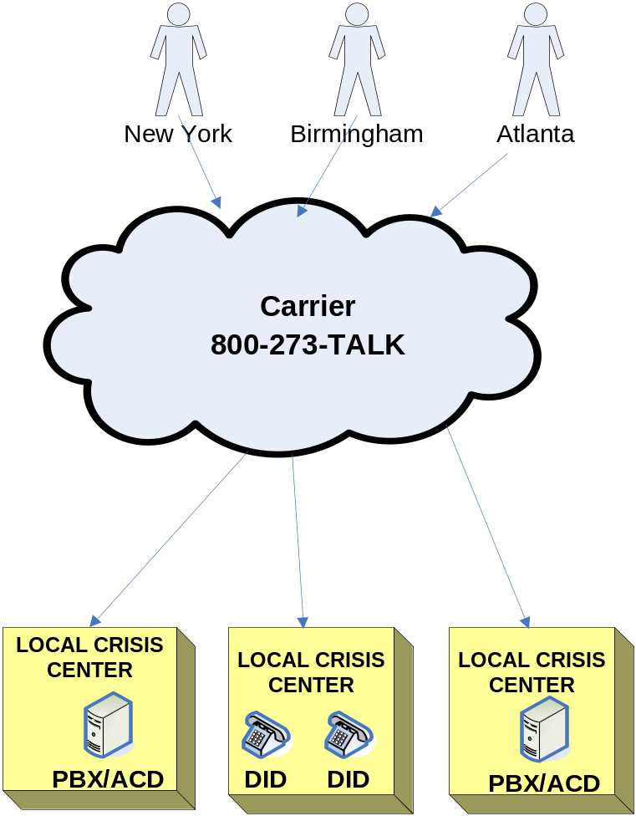
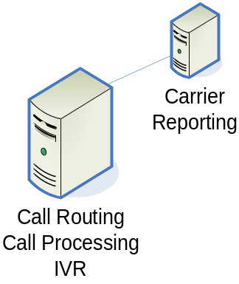
Carrier-Based Routing
Equipment owned and managed by carrier
Delivery of calls to ACDs or answer points at crisis centers requires cooperation
  Crisis Centers must allow routing to agent direct extensions
  Call statistics end with connection to Crisis Center ACD
No ability to monitor call after delivery to answer points

Slide 31
Business Model Options
Along with understanding available technology, business model options and deployment approaches for call routing and call handling must be factored into decision making process.
Business Model | Description
Own and Operate | Equipment that is owned or leased which is physically located at a designated location(s) and operated by its own staff
Hosted Services | Systems and applications that are operated at a service provider’s location, but which link to the client location (and is a shared/partitioned resource). Feature and functionality varies by provider (e.g., transport services, call routing services, advanced services)
Managed Services | Equipment that is owned or leased and is physically located at the owner’s location but is operated (managed) and monitored remotely by the vendor or outside staff
Outsourced Services | Delegating some portion of a company’s in-house operations/processing (oftentimes IT and telecom) to a third party, with the third party gaining full control over that operation or process

Slide 32
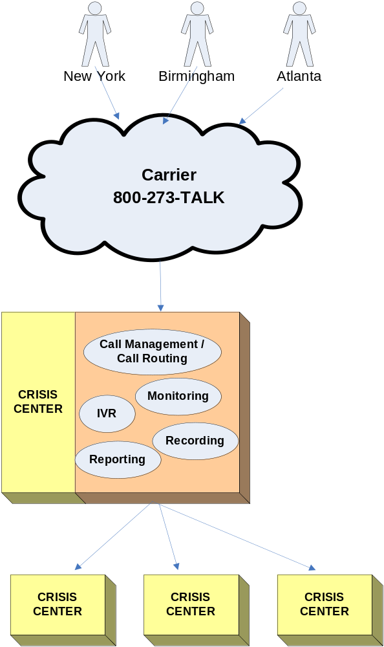
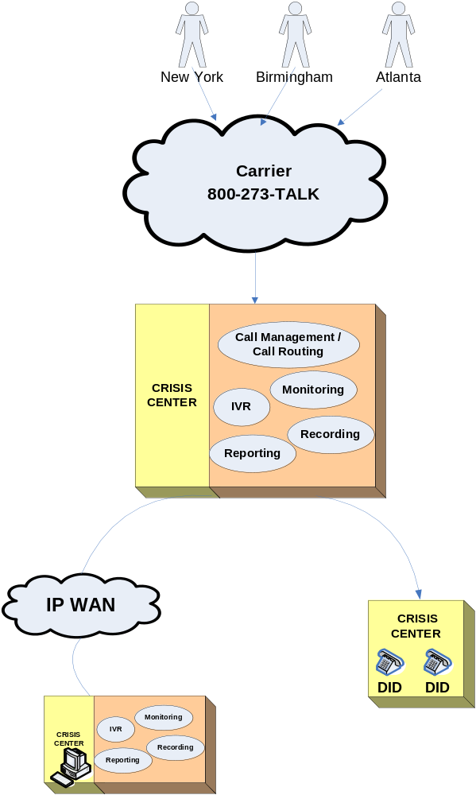
Own and Operate
Options
Voice Only
Voice and Data
Placement and management could be regionalized or localized
Installed at a central location, likely one of the largest centers
VoIP

Slide 33
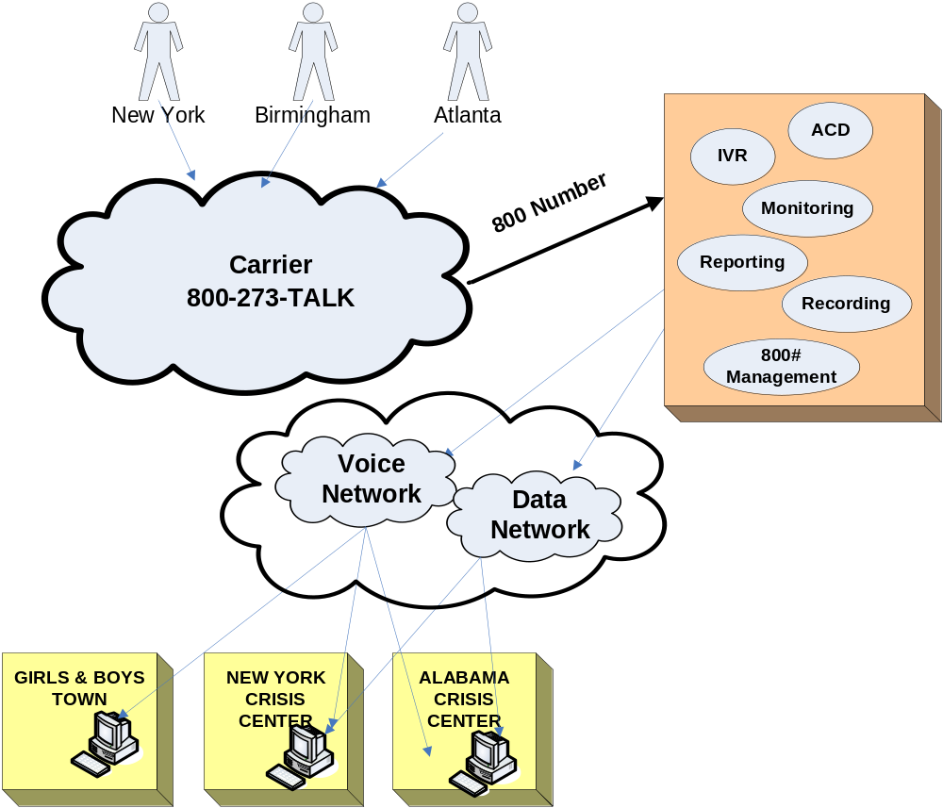
Hosted Solution
Hosted Provider
Equipment owned and managed by hosted provider
Scalable, as needed
  Can handle unplanned call spikes
All or some of the telecom infrastructure can be supported
Redundancy provides for disaster recovery

Slide 34
Components of Hosted Model
Transport Services
800 / Long Distance Services
Level of service currently being provided by Sprint to Lifeline
Call Routing Services
Disaster Recovery Services
IVR and Call Routing Logic
Services and Advanced Infrastructure
Desktop Integration
Higher Level Functionality
Speech Recognition
Quality Monitoring
CTI
Custom Reporting
Higher level functionality are available from carrier and other hosting vendors, such as Sprint and angel.com, as well as others
Functionality can be customized for Crisis Centers based on their system infrastructure
Recommend engaging current vendors in discussion regarding functionality offered

Slide 35
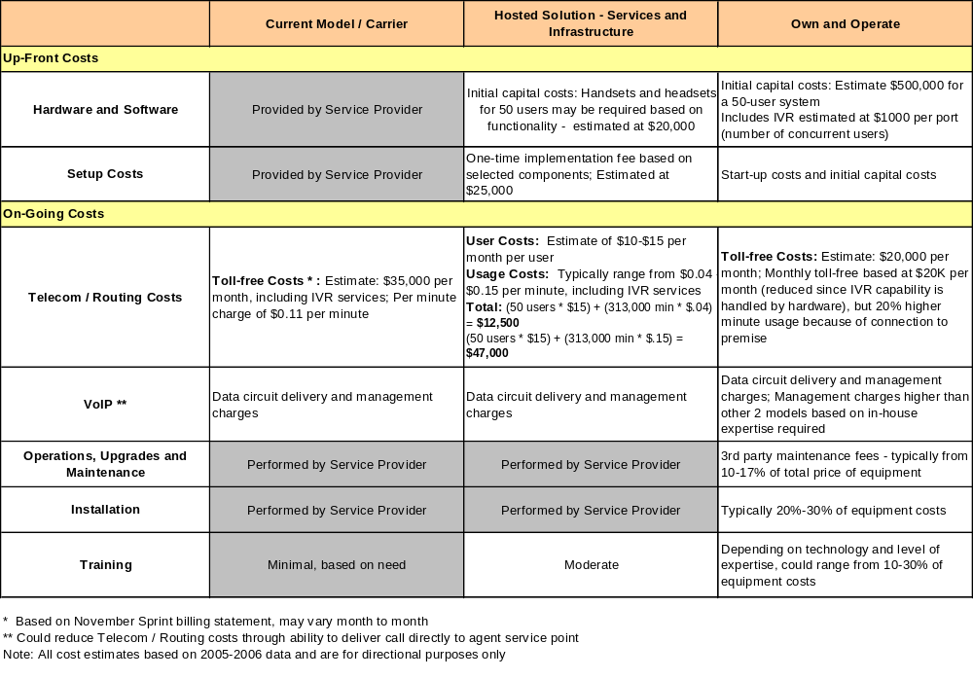
Call Routing Options -
Example: Relative Cost Comparison

Slide 36
Business Model Comparison
 | Carrier Model | Hosted Solution | Own & Operate
Technology strategy |  |  | 
Flexibility to respond to changing requirements |  |  | 
Expense budget |  |  | 
Capital budget |  |  | 
Network reliability and support |  |  | 
Multimedia channels available |  |  | 
Scalability (add or change centers) |  |  | 
Engineering support |  |  | 
Operations support |  |  | 
User support |  |  | 
Vendor management |  |  | 
Custom reporting |  |  | 
 - High Impact/Flexibility
 - Medium Impact/Flexibility
 - Low/limited Impact/Flexibility

Slide 37
Next Steps
Determine organizational business needs
  Current and future demand and direction
  Expansion plans
  Internal support structure and resources
  Technology strategy or approach
  Budget needs – capital and expense
Explore provider/vendor options:
  Ability to meet organizational business requirements
  Minimum 2-3 providers for geographic coverage, competitive cost and servicing
  Accessibility to provider/vendor and commitment to account support
  Ease of implementation and on-going support
On-going internal management
  Services support
  Migration path for new technology introductions

Slide 38
Interview Findings

Slide 39
Interview Results
Due to the sensitive nature of the calls, real-time monitoring and side-by-side observations were not possible
  Visited 2 centers and met with the Center Directors, discussed their mission and processes plus observed call activities as appropriate.
  Conducted phone interviews of 8 Center Directors to discuss the structure of their center plus discussed their understanding of Lifeline and the NSPL network.
    Note: We recognize the findings of 10 site visits/phone interviews out of a total of 117 centers does not constitute a statistically valid sampling, however it was sufficient to identify trends and opportunities. The limited sampling was the result of legal restrictions.
    Topics discussed during phone interviews included:
Role of the Center to the caller (e.g., referrals only, “warm” support, blended)
Size and composite of staff
Types of calls /contacts handled
How referral information is available to the counselors
Overflow support
Their understanding of the role of Lifeline
What is working well and/or areas of opportunity between the crisis centers and Lifeline

Slide 40
Positive Observations
Question: What is working well in your relationship with Lifeline?
Findings: Pretty much everything!
  The staff is very professional and approachable
  Centers feel valued and engaged in the process, especially in the recent development of Lethality Standards.
  Communication is vastly improved over what they had experienced with the previous administrator
    Board meetings are very productive; there is a general feeling of excitement when they get together due to all the sharing that is done.
    Meetings and conference calls are very productive, well facilitated and valuable information is shared. All feel the conference calls provide a much needed forum for the sharing of information between centers and to create the feeling of community.
  Directors find it helpful to have ideas and support from the technology team

Slide 41
Key Learnings
Question: What level of support is provided to callers?
Learning:
  8 centers provide “blended” support, listening to the caller, providing emotional support, encouraging them to develop a plan for needed next steps plus providing referrals to appropriate agencies for long term support.
  2 centers provide referrals only and can either transfer the caller or provide them with the telephone number of a center that can provide “warm” or listening support
Question: Composite of Staff
Learning:
  5 centers are staffed exclusively by paid professionals
  5 centers are staffed by a combination of paid and volunteer staff (paid supervisory personnel and mostly volunteer phone counselors).
Question: Types of calls handled by the center
Learning: All centers support a wide array of mental health and behavioral problems affecting their community. Suicide prevention calls from the NSPL line is a small percentage of their overall call volume.

Slide 42
Opportunities
Question: Are alternate means of communication (e.g., e-mail, chat, Instant Messaging) supported by the centers?
Findings:
  Many of the centers receive e-mail from either people in crisis or friends/family seeking information, but it is not a mode of communication that is encouraged. Messages are answered and people are strongly encouraged to call the center for assistance or information.
  2 centers host a chat room for teens, but it is not actively promoted or utilized
  No center utilizes or supports instant messaging or PC to PC video
Opportunity:
  Even though none of the centers surveyed are actively engaged in any of the communication alternatives at this time, they are all interested in them and understand the need to interact with people in crisis through a variety of means. Concerns voiced by the Directors have to do with privacy and accurate assessment of the “caller’s” needs.
  As the national coordinator of Suicide Prevention Crisis Centers, the SAMHSA Administrator is in a unique position to facilitate the dialogue on this issue and develop national policies and standards.

Slide 43
Opportunities
Question: Does your center provide overflow support to another crisis center? Who is your back-up for overflow calls?
Findings:
Opportunity:
  A matrix should be developed and maintained on the Lifeline web-site, identifying the routing structure for all TALK calls, plus a contact name and telephone number for each center. Directors can then easily identify which centers they support and which centers support them.
Does your center accept overflow calls? | Who is your back-up center?
3 centers are sure they are a back-up center for other agencies and know which centers they support | 5 centers are not sure who takes their overflow calls
4 centers think they accept overflow calls for other centers but are unsure which centers they support | 3 centers think their primary back up is Girls and Boys Town
2 centers are not sure if they accept overflow calls | 1 center does not believe they have a back-up for overflow calls
1 center does not accept overflow calls | 1 unknown

Slide 44
Opportunities
Question: If your center does serve as back-up for another center, do you have access to their referral information?
Findings: There is no established process for the sharing of this critical information.
  One center (who thinks they support two crisis centers) has information from one center but not the other
  One center supports several centers and they have info for some centers but not for most
  No other centers have any information
    One center uses the internet to find an applicable referral
    Two centers provide the telephone number of the crisis center or 211 agency closest to the caller and advises them to call them directly for a referral
Opportunity: There are several ways this information could be shared throughout the team:
  Establish a referral section to the Lifeline website available to all crisis centers. Directors could develop a listing of the referral agencies (and telephone numbers) used most often by their center. It would be the responsibility of each center to keep their information up-to-date
  Several of the agencies we spoke with use a internet site as their referral source. This web site could be added to the Referral section of the Lifeline web-site
  When sharing call routing overflow information with the crisis centers, Directors should be encouraged to reach-out to their support center(s) and establish an on-going dialogue for problems they are encountering and information needed to serve their callers

Slide 45
Opportunity
Question: What is the role of Lifeline to the NSPL?
Findings: Directors provided a variety of answers to this question:
  Call Tracking:
    “Manage the network for SAMHSA and provide them with the statistics needed to maintain and support the lifeline.”
  Technical Support:
    “Provide technical support and consultation for all crisis centers on the network.”
    “…maintain the network and direct the calls to the appropriate centers to make sure the caller gets help as quickly as possible.”
  Establish Standards:
    “Benchmark applicable areas and set standards for the centers. Assist in staff development and develop a set of core minimums for evaluations and lethality.”
    “To maintain the suicide prevention hotline and coordinate service on a national level to insure service is consistent among all centers.”
    “Make sure Centers are doing what they are supposed to be doing.”
  Communication
    “Keep Centers informed on what is going on in the area of mental health as it relates to suicide”
Opportunity: As administrator of the SAMHSA NSPL, Lifeline needs to clearly define, document and share with all members of the crisis network their role and what services and support the members can and should look to them to provide.

Slide 46
Areas of Opportunity - Communication
Caller demographics and reason for call
  The Lifeline application asks applicants what type of information is captured on each call and if the center is willing to share that data with Lifeline for evaluative purposes. Our interviews indicated that though most centers do document and retain some demographics plus the reason why someone called the Suicide hotline this information is not being shared. Lifeline should accelerate their plans to collect and analyze this data to identify escalating behaviors or regional/national trends. Such analysis could result in centers making changes or additions to their training materials to better assist callers.
    Girls and Boys Town captures demographic and systematic information and, as national over-flow support center, is already in a unique position to identify national trends.
Lifeline web-site
  Use of the Lifeline web-site, as reported by the centers interviewed, is tepid with some seeing it only as a location to secure call statistics. As a key method of sharing information with the general public as well as the member centers, the centers should be more familiar with the information to be found there as well as the links provided.
    Lifeline should consider a walk-through of the web site for one of the monthly conference calls, to re-introduce the site to all members.
    In addition, this would be a appropriate forum for soliciting the type of information that members would like to see stored there.

Slide 47
Areas of Opportunity - Communication
Lifeline Blog
  Use of the Lifeline blog is very low, as reported by the directors we contacted.
  Those that have used the blog provided positive feed-back but most mentioned they are not sure how to use it.
    An overview of the blog should be considered as an agenda item for a monthly team call.
    Information to be addressed should include:
      How to input information on a blog
      Types of information to be found there
Resolution of issues of ownership of 800-SUICIDE routing and calls
  No center is clear on what is happening with the 800 SUICIDE number and they would all like to be provided with a project update.
  One center did an analysis of the types of calls coming in on the two crisis center lines (273-TALK and SUICIDE):
    SUICIDE line – more teens, more acute problems, serious needs
    TALK line – more informational, less serious concerns

Slide 48
Areas of Opportunity - Training
One of NSPL’s goals is to establish a consistent training program for the Crisis Centers.
  Centers with limited funding find it a challenge to secure new or updated training videos.
  As national administrator of the Suicide Hotline, Lifeline is in a position to act as facilitator of a “national lending library”.
    Centers could provide a listing of their training videos and when they are available to be loaned to another center. This information could be added to the Lifeline web-site.
    AND / OR
    Lifeline could purchase a series of training videos on all topics related to suicide, suicide prevention and suicide survivors and loan them to centers to assist in their training programs.

Slide 49
Opportunities for
National Discussion
National Discussions to be led by Lifeline
Alternate communication mediums
  AAS studies indicate that suicide is the 3rd cause of death among young Americans ages 15 to 24. Only accidents and homicides occur more frequently. As such, it is crucial that the communication styles of the young (chat, e-mail, IM) be mainstreamed into the crisis centers to insure every possible means of support is available to those in need.
  Topics for national discussion include education on various communication methods, technologies being used by the caller and what is needed in the crisis center to provide support and policies on processes and privacy.
211 centers
  As of November, 2006, 211 services are available to 193 million Americans in 41 states and Washington, D.C. or 65% of the national population. 17 states have complete 2-1-1 coverage.
  211 centers either provide information/support directly to the caller or share referrals to organizations for the following services:
  Suicide prevention is just one of a wide array of responsibilities for 211 centers and some centers indicted they are grappling with their identity as a crisis center in a 211 environment. Since 211 was approved for use by the FCC in 2000, it is just a matter of time until this service is available in all states.
Human Services Agencies | Food and Shelter Providers | Child Care Resources
Special Services for Seniors | Volunteer Opportunities | City and County Information

Slide 50
Opportunities for
National Discussion
Use of the national network for national emergencies
  As part of the national response to Hurricane Katrina, the Lifeline network was used as a vehicle to provide information and referrals to those in need of social services support. Though all centers recognized the need to the public suffering the storm’s aftermath and the value of using an established national network, concerns were voiced that such use confused the public on the type of service and support provide by the NSPL. Centers indicated they began to get calls for needs beyond that of suicide prevention
  All centers should be engaged in the discussion on the role of the Lifeline as part of the national disaster response plan
Not all centers have dedicated technical support and they look to the NSPL staff to provide assistance and expertise.
  One problem voiced by Crisis Centers is how to trace blocked calls coming to the centers from outside of the national network
    Although this issue per se is outside of the scope of the NSPL, it is one that affects all centers on the network. The national forum of the NSPL provides an opportunity where learning and sharing can take place to the betterment of all crisis centers

