Slide 1


INDY SAVES
You Can Build Wealth
Notes:
Introductions provide brief personal intro.
Hello. I am (NAME) and I am (JOB TITLE) at the (COMPANY) but today, I am here as a volunteer for Indy Saves, a new program I want to tell you more about. Indy Saves is a broad coalition whose purpose is to help individuals save and build wealth.
This program promotes savings and wealth-building for all Indianapolis-area residents.

Slide 2

The good news – we can save and build wealth
What is wealth?
Can YOU be wealthy?
Notes:
Think about your answers to these questions:
Can YOU be wealthy?
Are you ready to be motivated to save and build wealth?
Do you believe that wealth is attainable only by people who earn “big” incomes?
Or is it only for those who were born into a particular family?

Slide 3


Start with financial dreams
What are your financial dreams?
Do you dream about being wealthy?
Notes:
Do you ever dream about being wealthy?
Want are your financial dreams?
Would you like to have the money to fund your dreams?
If time permits, invite participants to share their dreams with the group.

Slide 4



Dreams can become goals
If they are:
Clear
Descriptive
Targeted
Precise
Building blocks
Notes:
Think about these questions:
How would your life be different if your were “rich”?
Or
How would your life be different if you had more wealth?
Or
How would your life be different if you had and additional $5,000, $10,000, or $50,000? What would you dowith the money? Do you have a long or short list? Do you have a difficult time coming up with anything specific?
There is a difference between a fiancnal DREAM and a financial GOAL. A dream is more vague than a goal. Can you think of some expamples?
Audience sharing if time permits
If we say we want “adequate financial security at retirement,” this is a dream. When we say “We need to have $50,000 of annual income in the year 2020 when we turn 65,” it becomes a financial goal.
Contributing $2,400 of my annual income to my retirement account by December 15, 2002” is a goal. Financial goals are the “building blocks” that can help you make your financial dreams come true.

Slide 5


“ SMART ” goals
S-Specific
M-Measurable
A-Agreed Upon
R-Realistic
T-Timed
Notes:
Optional section, if time permits.
Let’s take a look at the critical components of a goal that’s really going to be a building block to realizing your financial dreams, or a “SMART” goal:
There are several important criteria of SMART goals:
S – Specific. A goal must be specific with dollar amounts and resources to be used in accomplishing the goal.
M – Measurable. A measurable goal states weekly or monthly amount to be set aside.
A – Agreed Upon. Goals shared with other family members and agreed upon by the family members will be easier to achieve. It is important that you all work on the goals to ether and not against each other to achieve your goals.
R – Realistic. It is important to ask yourself if the goal is realistic and attainable. Do you have the resources available to achieve your goal?
T – Timed. A specific date or time line to complete your goals is important. It helps you not only accomplish your goals but checks to see if they are realistic.

Slide 6


“ SMART ” goals are easy
Pay off $1200 credit card by Dec. 2004
Save $2,400 in two years for emergency fund
Notes:
Smart goals are easy to achieve. Here are some examples:
Establish a $2000 emergency fund within the next two years
Pay off the $2,500 balance on my credit cards by December 2002
Have $40,000 in savings, stocks, and bonds by the time my daughter turns 18, to pay part of her college expenses.
End of optional section on smart goals.

Slide 7


The bad news – we’re living on the financial edge
3 out of 4 Americans face at least one major financial problem
Individuals saved 9.6% in the 70’s, 5.9% in the 90’s
1.37 million Bankruptcies
Household debt = $7 trillion+
Notes:
A national survey revealed that 2 out of 4 Americans faced at least one significant financial problem recently, such as being unable to save for future needs, delaying medical care, or having problems with a a collection agency (Chandler & Morin, 1996).
The individual savings rate has fallen from 9.6% in the 1970’s to 5.9% in the 1990’s. (Source: U.S. Department of Commerce, Bureau of Economic Analysis. National Income and Product Accounts of the United States, 2001.)
When a crisis or life-cycle event such as illness, unemployment, birth of a child, death of a spouse, or divorce occurs, those involved are not able to maintain financial stability. This scenario repeats itself throughout the country.
National consumer debt currently exceeds seven trillion dollars (Source: Newsweek, August 27, 2001 , “Maxed Out”, page 34) and bankruptcy cases reached 1.37 million in 1998(Administrative Office of the U.S. Courts, 1998).

Slide 8


Where can you find money to save?
Ask yourself:
    Do I need this?
    Is it even good for me?
    What happens if I do not have it?
    Is there a better way to use this money?
Notes:
There is a clear need for Americans to improve their financial security through increased savings and reduced household debt.
Everyone has the ability to save and build wealth.
Almost everyone can find expenditures to cut to find money to save.
If you were asked to save an extra $100 per month out of your current income, you might think that would be impossible. However, for most of you, it is possible. It is a matter of finding expenditures that you can reduce or eliminate.
Use examples and ask audience to think of examples. Refer to handout “How to Save Dollars When You Don’t Have a Dime to Spare”. Review handout as time permits.

Slide 9
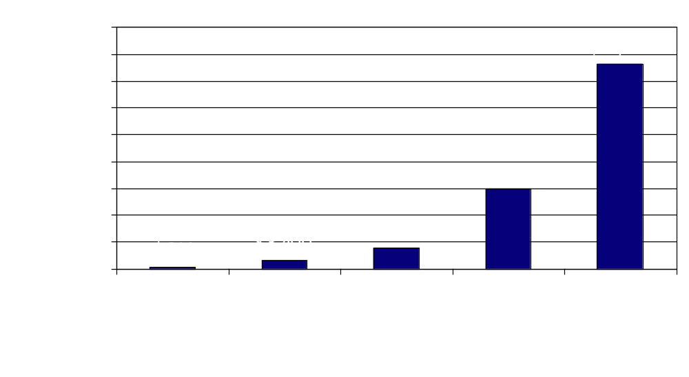
The Miracle of Compound Interest
31% of total ($24,000) is principal
69% of total ($52,301) is interest on principal and interest on interest
Notes:
Small savings grow rapidly because of the miracle of compounding interest.
Use examples.
Establish a specific behavior pattern for savings out of every paycheck to achieve that goal.
Save $25, $50 a month though your bank or credit union for an emergency fund. (3 to 6 months worth of living expenses). Once your emergency fund is fully funded, save the extra towards an IRA.

Slide 10



Wealth-building strategies
Set specific goals such as:
  Drive a car that is paid for
  Buy furniture, don’t finance it
  Save $25, $50 a month through bank
Notes:
Here are three strategies for saving money and building wealth
Saving on your own – Set a specific goal such as:
Drive a car that is paid for
Buy furniture, don’t finance it
Take a vacation on cash instead of credit

Slide 11


Wealth-building strategies
Save through employer’s retirement plan
  401(k), 403(b), or 457(b) plans
Contribute to your Roth IRA
Saving in your home
  Buy a home that you can afford
  Build equity, rather than paying rent
Notes:
If your are offered any type of retirement program or benefits at work, then you should consider taking advantage of that opportunity. Examples might be 403(b), 401(k) or 457(b)
Housing is usually a good investment. It is likely that your home’s value will increase during your lifetime. Don’t just automatically buy what your realtor tells you you can afford, as they may try to “upsell” you.

Slide 12

3 GOLDEN RULES for SAVING
Develop a simple savings plan
Set up automatic deductions
Spend less than you earn and save the difference
Notes:
The 3 Golden Rules of Saving and building wealth are:
Spend less thatn you earn; save the difference.
Develop a concrete savings plan that can be as simple as putting away $25.00 each month for a specific purpose.
Set up automatic deductions from payroll or checking account. The theory is that you won’t miss what you don’t see.

Slide 13
Indy Saver Benefits
No-fee savings and investment accounts
Free one-on-one coaching session(s)
Seminars taught by experts
Referrals as needed
Wealth-building clubs
American Saver newsletter 4 times a year
Participation in drawings for Savings Bonds and other financial products
Notes:
IndySaves can help you save and build wealth by helping you develop a simple but effective plan to meet and important savings goal, and by providing IndySavers with benefits such as follows
No-fee savings and investment accounts offered by participating Indianapolis-area financial institutions by showing your membership card.
Free one-on-one coaching session(s) with a Wealth Building Coach.
Seminars taught by experts on such topic as investing or retirement planning.
Referrals to debt counselors, housing counselors, or certified financial planners as needed.
Wealth-building clubs in which participants where information and experiences.
The American Saver newsletter mailed to you 4 times a year.
Participation in semi-annual prize drawings for Savings Bonds, Certificates of Deposits (CDs), and other financial products.

Slide 14

Save and Build Wealth
How does INDY SAVES work ?
What does it take to become an INDY SAVER ?
  Agreement Form
  Activate your Plan
  Wealth Building Coach will call
Notes:
You, the IndySaver make all final decisions and retain control of your money.
If you want to learn more about Indy Saves membership and free services, stick around.
Tear off the back panel of the IndySaves “Build Wealth, Not Debt” brochure. Complete the information and return it as instructed.
If you are ready to choose a goal and sign up today, complete and sign the agreement form at the end of the brochure, return it, and you are an IndySaver. You will receive a welcome contact from a Wealth-Building Coach in a few days.
If you would like help completing the form, just fill out and sign the bottom portion and you will receive a call from a Wealth-Building Coach.

