Slide 1

Welcome to the State Data Center
National Meeting
September 10 – 12, 2003
U.S. Census Bureau
Francis Amasa Walker Conference Center
Federal Office Building 3
Suitland, MD
Topic of Discussion:
Census 2000 Special EEO File
Speaker:
Patricia A. Johnson
Chief, Industry, Occupation, and Statistical Information Branch
Housing and Household Economic Statistics Division

Slide 2
Purpose
To monitor employment practices and enforce civil right laws and regulations in the workplace and to assist employers in measuring their compliance to the laws
The Census 2000 Special EEO File will serve as the primary external benchmark for comparing the race, ethnicity, and sex composition of an organization’s internal workforce and analogous external labor market, within a specified geography and job category

Slide 3
1970 File
Special Tabulation sponsored by Organization Research Council (ORC) – File referred to as “ORC” Tapes
Cross-classification of 42 occupational groups by race, Hispanic origin and sex for the U.S., states, counties and SMSA’s
National Data Planning Corporation (NDPC) sponsored additional tabulations for 101 occupations by earnings
and industry: Added places and towns of 50,000 or more to geographic detail

Slide 4
1980 File
The Census Bureau decided to make it a standard data product. Three federal agencies consulted – Office of Federal Contract Compliance Programs (OFCCP), Equal Employment Opportunity Commission (EEOC), and Civil Rights Division of the Department of Justice (DOJ)
Consisted of two tabulations for persons in labor force – Cross classified 514 occupation categories by race, Hispanic origin, and sex for Experienced Civilian Labor Force – Educational attainment by age, race, Hispanic origin and sex
Both tabulations shown for the U.S., states, all counties, SMSA’s, and places and towns of 50,000 or more
Three additional tabulations developed for NPDC – education, industry, and earnings for detailed occupations

Slide 5
1990 File
Standard Product
Content identical to 1980 File, except 512 categories shown
Added place/county of work tabulation by detailed occupation

Slide 6
Census 2000
Special EEO File

Slide 7
Four Sponsoring Agencies
Equal Employment Opportunity Commission (EEOC)
Civil Rights Division, Department of Justice (DOJ)
Office of Personnel Management (OPM)
Office of Federal Contract Compliance Programs,
Department of Labor (DOL)

Slide 8
2000 Census Race and Ethnic Categories
Race and Ethnicity for Geographies Other than in Hawaii (12)
Race and Ethnicity for Hawaii (15)
White alone not Hispanic or Latino
White alone Hispanic or Latino
Black or African American alone not Hispanic or Latino
American Indian and Alaska Native alone not Hispanic or Latino
Asian alone not Hispanic or Latino
Native Hawaiian and Other Pacific Islander alone not Hispanic or Latino
Black or African American and White not Hispanic or Latino
American Indian and Alaska Native and White not Hispanic or Latino
American Indian and Alaska Native and Black or African American not Hispanic or Latino
Asian and White not Hispanic or Latino
Native Hawaiian and Other Pacific Islander and White not Hispanic or Latino
Asian and Native Hawaiian and Other Pacific Islander not Hispanic or Latino
Asian and Native Hawaiian and Other Pacific Islander and White not Hispanic or Latino
Balance of individuals reporting more than one race not Hispanic or Latino plus individuals reporting some other race not Hispanic or Latino
Other Hispanic or Latino
White alone not Hispanic or Latino
White alone Hispanic or Latino
Black or African American alone not Hispanic or Latino
American Indian and Alaska Native alone not Hispanic or Latino
Asian alone not Hispanic or Latino
Native Hawaiian and Other Pacific Islander alone not Hispanic or Latino
Black or African American and White not Hispanic or Latino
American Indian and Alaska Native and White not Hispanic or Latino
American Indian and Alaska Native and Black or African American not Hispanic or Latino
Asian and White not Hispanic or Latino
Balance of individuals reporting more than one race not Hispanic or Latino plus individuals reporting some other race not Hispanic or Latino
Other Hispanic or Latino

Slide 9
2000 Census Special EEO File Geography
Residence Geography – provides data for where people live.
Workplace Geography – provides data for where people work.
Worksite/Residence Flows – provides data on where people work and the counties from which they commute.
County Sets
- Developed specifically for the residence data sets
- Provides data for counties of 50,000 or more
- Counties 50,000 or less were merged with other counties
- Specific guidelines used to create and name areas

Slide 10
2000 Census Special EEO File Geography
MSA’s – The following metro areas are excluded from the residence data set
- Arizona: Flagstaff AZ-UT MSA
- Arkansas: Fort Smith AR-OK MSA
- Maryland: Baltimore MD PMSA
- New York: Newburgh NY-PA PMSA
- Wisconsin: La Crosse WI-MN MSA
- North Dakota: Grand Forks ND-MN MSA
- Pennsylvania: Pittsburg PA MSA

Slide 11
Disclosure Rules
All special tabulations are reviewed by the Census Bureau’s Disclosure Review Board (DRB)
Disclosure rules apply to all special tabulations
Rules required because the Census Bureau Must avoid disclosing information about individual respondents

Slide 12
Census 2000 EEO File Data Sets
File contains a total of 24 data sets
- 7 Show Residence Geography
- 12 Show Worksite/Residence Flows
- 5 Show Worksite Geography
*See attachment “B” for further detail

Slide 13
Data Dissemination Plans
  File delivered to sponsor by December 31, 2003
  Will release concurrently Census 2000 EEO Data Tool
*See attachment “D” for further detail

Slide 14
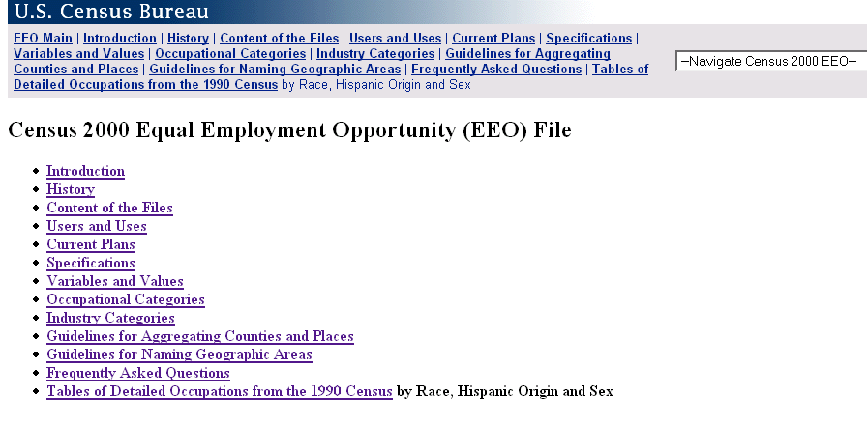
Please visit our website at http://www.census.gov/hhes/www/eeoindex.html for more information on the Census 2000 Equal Employment Opportunity File.
Census 2000 EEO File Website

