Slide 1
I
Have We Evaluated Addiction
Treatment Correctly?
Implications From a Chronic Care Perspective

Slide 2
Rehabilitation Model
“.. treatment benefits should be sustained following discharge for addiction treatment to be worth it …”
(McLellan,1998).

Slide 3
A Nice Simple Rehabilitation Model
Substance Abusing Patient
Meds,
Therapies,
Both
Treatment
NTOMS Sample of 250 Programs
Non- Substance Abusing Patient

Slide 4
Evaluate
Prior to Admission
Treatment
Re-Measure 6, 12, 24 mo Post Discharge

Slide 5
Based on This Model...
Treatment Has Not Met Public’s Expectations – There is No Cure
Intensive, Expensive, Complex Treatments Seldom Work Better Than Cheap, Fast, Simple Treatments
Very Difficult to Predict Outcomes or to Show “Matching” Effects

Slide 6
Evaluations ...
Made Sense For Inpatient/Residential Treatments – NOT for Outpatient
Have been Technically Challenging, Expensive and SLOW to do
Have not Informed Treatment Providers or Directed Individual Care

Slide 7
Some Facts About Contemporary Treatment

Slide 8
Treatment Compliance Is Low
  >90% of all treatment in US is Outpatient
  >50% of outpatients drop out of treatment within one month.
  >50% of court-ordered patients do not complete treatment

Slide 9
Relapse Rates Are High
About 60% use drugs within 6 mos. following treatment discharge
No difference between Brief and Intensive Treatments
No difference between Inpatient and Outpatient Treatments

Slide 10
So What Does This Say About Treatment?

Slide 11
How Are Other Illnesses Treated & Evaluated?

Slide 12
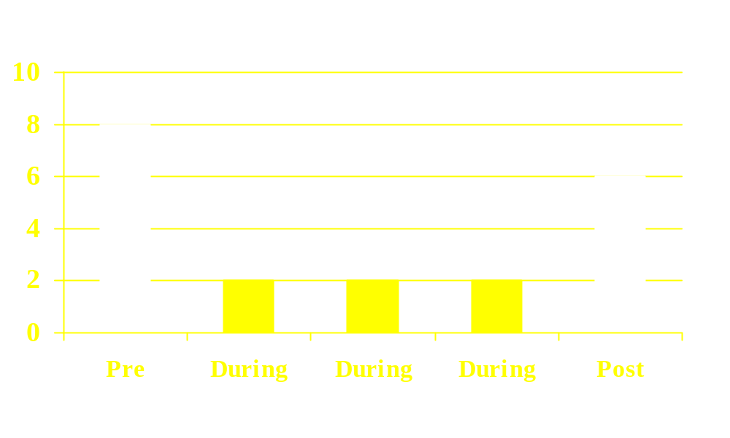
Outcome In Hypertension
Pre - During - Post
Treatment Research Institute

Slide 13
Outcome In Addiction
Pre - Post
Treatment Research Institute

Slide 14
In Chronic Illnesses….
1 – The effects of treatment do not last very long after care stops
2 – Patients who are out of treatment/contact are at elevated risk for relapse

Slide 15
So, For Treatment….
1 – One goal is to retain patients at an appropriate level of care and monitoring
2 – Another goal is to prepare patients to do well in the next level of care
3 - The effects of treatment are evaluated during treatment – not post-discharge

Slide 16
Consider….
If – in addiction treatment -effects are also significant but not long lasting after discharge…

Slide 17
Then….
Post Discharge Evaluations will NOT be able to differentiate conceptually or procedurally different treatments

Slide 18
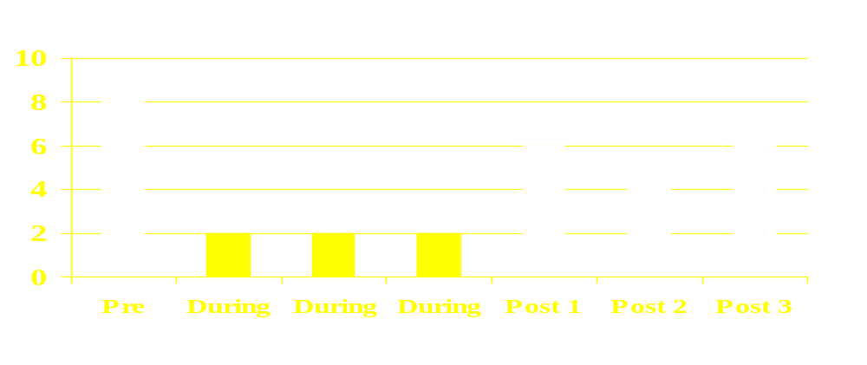
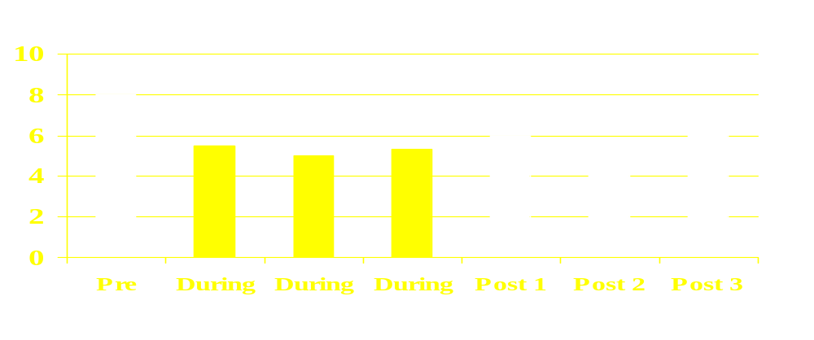
Comparing Rehabilitation Treatments
Treatment
Control

Slide 19
Examples…
1 – Inpatient vs Outpatient Studies
2 – Project MATCH
3 – Brief vs Long Interventions
4 – Different Types of Therapies

Slide 20
Consider also….
If treatment effects are significant but not long lasting after discharge…

Slide 21
Then….
Most Treatment Measures will NOT be significant in:
Matching Studies
Prediction of Outcome Studies

Slide 22

Comparing Rehabilitation Treatments

Slide 23
Examples…
1 – Project MATCH
2 – National Cocaine Collaborative
3 – Many ASAM Placement Studies

Slide 24
How an Evaluation Question/Perspective Shapes an Answer

Slide 25
Two Examples
Inpatient vs Outpatient Tx
Project Match
“Rehabilitation” and “Continuing Care”
Perspectives

Slide 26
Contrasting Rehabilitation and Continuing Care Models
Treatment and Research Assumptions
Implications
Specific Examples
  Inpatient VS Outpatient Detoxification
  Treatment Comparisons

Slide 27
A Nice Simple Model
Substance Abusing Patient
Treatment
NTOMS Sample of 250 Programs
Non- Substance Abusing Patient

Slide 28
ASSUMPTIONS
Some fixed amount or duration of treatment should resolve the problem
Clinical efforts put toward matching treatment and getting patients to complete treatment
Evaluation of effectiveness following completion
  Poor outcome means failure

Slide 29
A Continuing Care Model
Detox
Duration
Determined by
Performance
Criteria
Rehab
Duration
Determined by
Performance
Criteria
Continuing Care
Recovering Patient

Slide 30
ASSUMPTIONS
Patient will continue in treatment
There are agreed upon clinical targets at each stage of treatment
Achieving the clinical targets will prepare you for the next (reduced intensity) stage
There will be no discharge – just reduced intensity of care

Slide 31
Example I
Inpatient vs Outpatient Detoxification
Detoxification as Preparation for Rehabilitation
An Example of How the Question Shapes the Answer

Slide 32
OLD QUESTIONS
Is Inpatient Treatment more effective than Outpatient Treatment?
Inpatient vs Outpatient Detox
Inpatient vs Day Hospital Rehab
Residential vs Outpatient Rehab

Slide 33
Evaluate
Random Assignment
Inpatient
Detox
Outpatient
Detox
Evaluate @ 6 mo Post Discharge
From Hayashida et al. 1988, NEJM

Slide 34
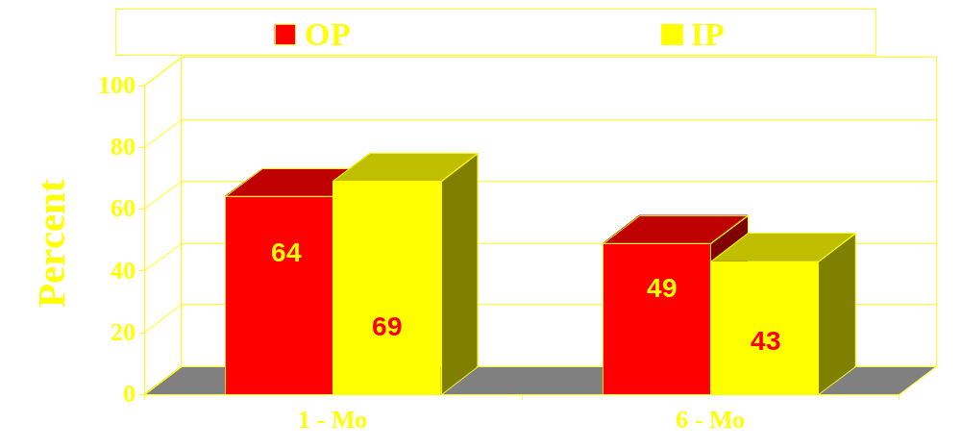
Alcohol Abstinence Rates
No Difference
No Difference
From Hayashida et al. 1988, NEJM

Slide 35
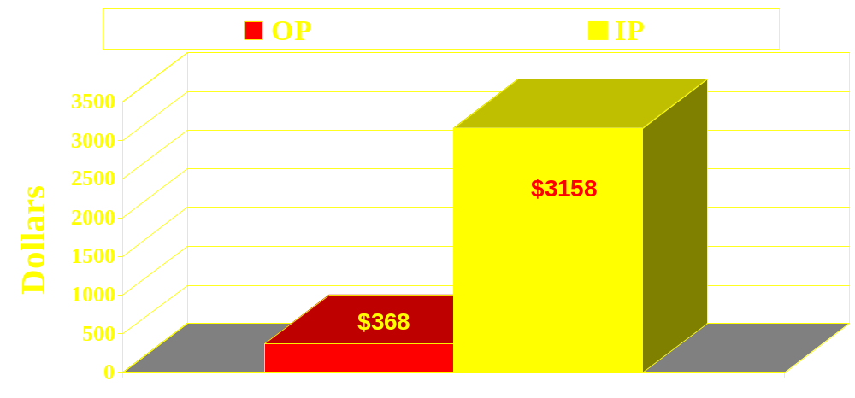
Costs Per Completion
Big Difference
From Hayashida et al. 1988, NEJM

Slide 36
NEW QUESTION
Does “Effective” Detoxification Lead to More Effective Outpatient Rehabilitation?
Inpt Stabilization Prior to Outpatient
VS
Direct Admission to Outpatient

Slide 37
Evaluate
Random Assignment
Inpatient
5 Day
Outpatient
60 Day
Outpatient
60 Day
Evaluate
During Rehab

Slide 38
Participants
All Male Veterans - N = 104
  Age - 48
  72% Black
  28% Employed
  17% Probation/Parole
  Prior Treatments - 5

Slide 39
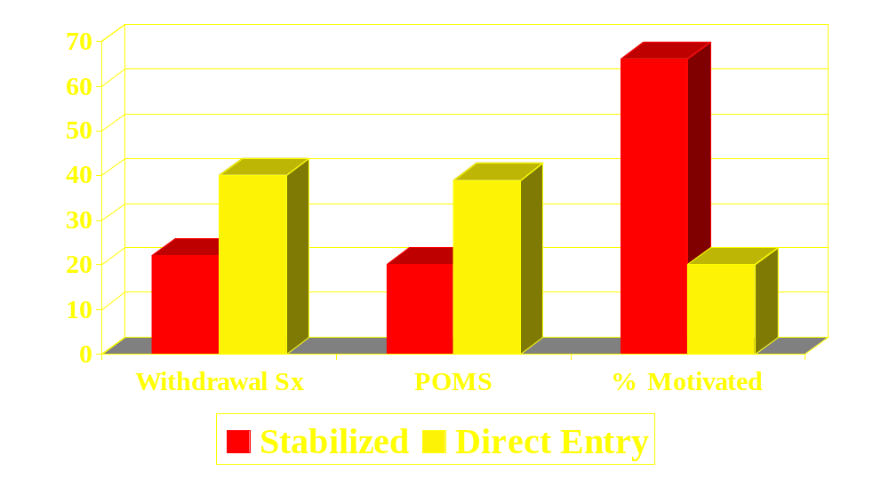
Stabilization @ Day 5
**
*
*

Slide 40
Drop Out – 2 Weeks
Direct Entry
26%
Pre-Stabilized
*8%

Slide 41
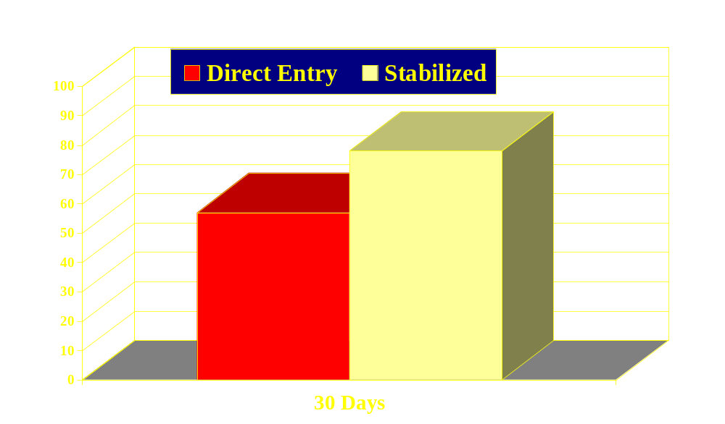
RETENTION for 30 Days
Percent
48%
78%

Slide 42
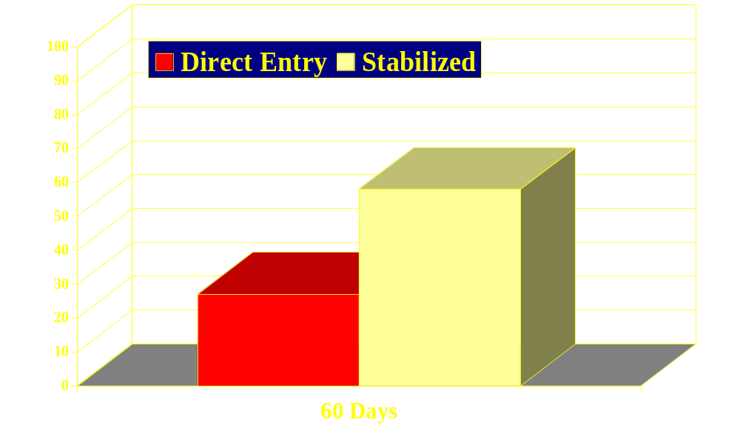
RETENTION for 60 Days
Percent
58%
27%

Slide 43
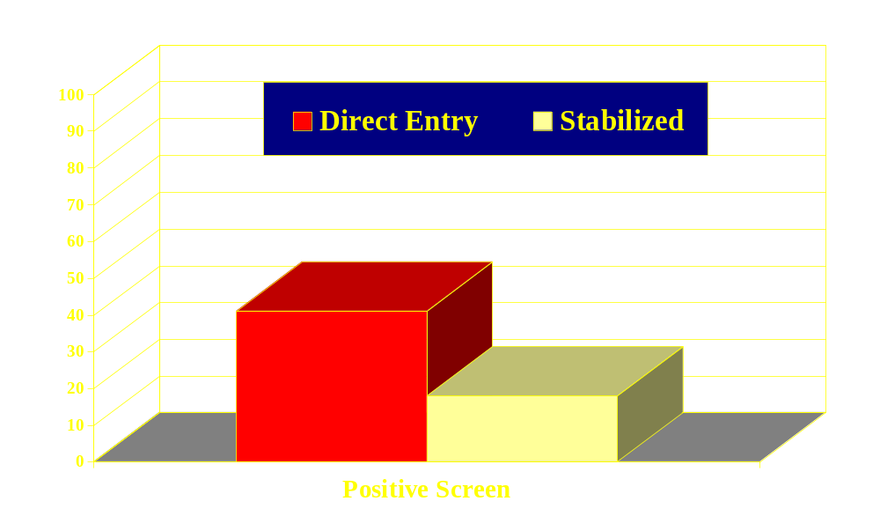
Positive Urinalysis @ 14 Days
Percent
41%
18%

Slide 44
Comparing Treatments
Example II
Testing Three Treatments in a Rehabilitation Model
Treatment Research Institute

Slide 45
Project MATCH
RCT - 3 Research-Derived Therapies
  $27 Million Dollar NIAAA Study
Different Mechanisms of Action
Fixed Interventions – All Patients
Goal – Achieve Lasting Abstinence Post Completion

Slide 46
MATCH Results
Significant but Equal Improvements
Equal Outcomes at all points
No Significant Matches Confirmed
Outpatient Arm Did Best

Slide 47
Project Match
Fixed Time - Fixed Content – Rehab Oriented
Treatment Type
Post Treatment Evaluations
6 12 18 24 30 39
MET
45%
38%
27%
CBT
12-Step

Slide 48
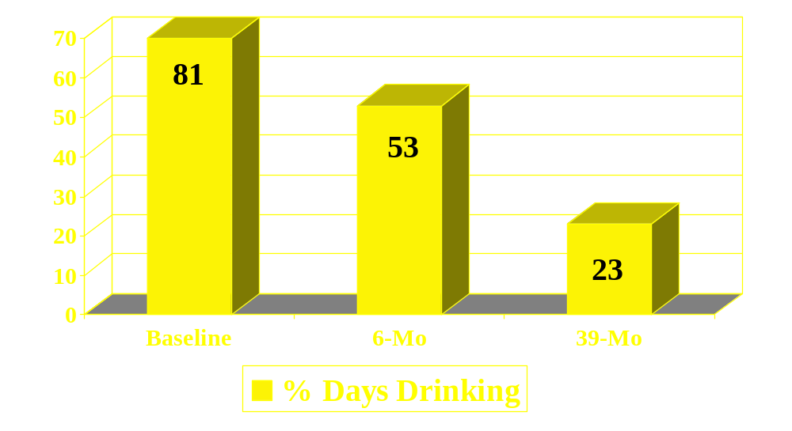
Improvement in Project MATCH

Slide 49
Again….
Maybe We Have the Wrong Model?

Slide 50
Comparing Treatments
Testing Three Treatments in a Continuing Care Model
Treatment Research Institute

Slide 51
ALLHAT
The Antihypertensive and Lipid-Lowering Treatment to Prevent Heart Attack
Treatment Research Institute

Slide 52
ALLHAT
Groups – Different Mechanisms of Action – Very Different Costs
  Diuretic - $0.10 / pill
  Calcium Channel Blocker - $1.50 /pill
  Ace Inhibitor - $4.00 /pill
Goal – Improvement on Pre-Specified Criterion DURING TREATMENT

Slide 53
ALLHAT
Pre-Specified Criteria – Adjustment Oriented
Start
27% Control
DURING Treatment Evaluations
Step 1 Step 2 Step 3
42%
55%
64%
Diuretic
CCB
ACE

Slide 54
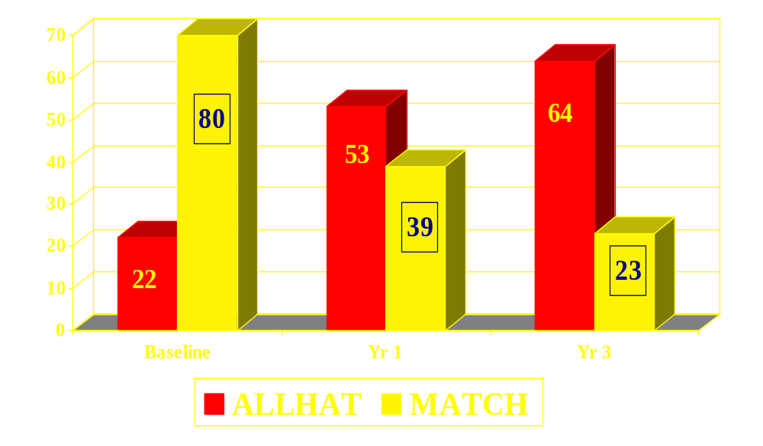
Improvement Comparison

Slide 55
Lessons from Chronic Illness:
  Medications relieve symptoms but…. behavioral change is necessary for sustained benefit

Slide 56
Lessons from Chronic Illness:
  2. Treatment effects usually don’t last very long after treatment stops.

Slide 57
Lessons from Chronic Illness:
  3. Patients who are not in some form of treatment or monitoring are at elevated risk for relapse.
  In addiction this could include monitoring or AA

Slide 58
What Continuing Care Does NOT Imply
Not every case of abuse or addiction needs Continuing Care
Some Patients Do Show Continuing Benefits From Acute Care
  Brief Interventions – Studies of Untreated Individuals
  Also Happens in Other Illnesses
  May Be Less Severe or May Engage in Different Lifestyle (e.g. AA)

Slide 59
What Continuing Care Does NOT Imply
A Continuing Care Strategy Does Not Imply Lack of Responsibility
  Just the Opposite
  Purpose is to Teach Self Management

Slide 60
What Continuing Care Does Imply
Need for Pre-Specified Treatment Goals
  Agreeable to the Patient
  Measurable
Need for Continuing Contact/Monitoring
  Tailored to the severity and needs of the patient
  Telephone and Internet Options
Need for Multiple Options
  Most First Efforts Will Fail – Hard to Predict
  Sensible Switching or Adding Time Frames

Slide 61
Lessons From Chronic Care
Multiple Acute Care Episodes IS NOT a Continuing Care Strategy
  Expensive and Wasteful
  Patient Education Necessary
  Align Patient and Provider Incentives to Promote Adherence/Compliance

Slide 62
Lessons From Chronic Care
Most Patients Do NOT Respond to Their First Treatment/Medication
  Need for more alternatives
  Improves retention

Slide 63
Patient Retention is Critical
  Make Treatment Attractive
  Offer Options/Alternatives
  Increase Monitoring/Management
Lessons From Chronic Care

Slide 64
Lessons From Chronic Care
Monitoring is Part of Health Care
  Telephone and IVR Useful
  Saves Physician Time, Reduces Number and Severity of Relapses
  Not Currently Reimbursed

Slide 65
Lessons From Chronic Care
Evaluations of Continuing Care Should Occur DURING Treatment
  Need for interim performance markers (retention, linkage, urines, pro-social behaviors, etc.)

Slide 66
Lessons From Addiction
Symptom Improvement Does Not Continue Without Behavioral Change
Social Support and Counseling Alone Can Improve Symptoms and Function
Poor, Psychiatrically Ill Patients CAN & DO Improve

Slide 67
“Recovery Monitoring” A Way To Evaluate Continuing Care Models
The Basic Assumptions
The Clinician as Evaluator
Specific Examples
  Inpatient VS Outpatient Detoxification
  Treatment Comparisons

Slide 68
The Criteria
The Same Traditional Outcomes
Reduce Substance Use
Improved Personal Health
Reductions of Public Health and Public Safety Problems
Operational Definition of Recovery

Slide 69
The Evaluation Points
Monthly
From the Start of Outpatient Care
Negotiated Treatment Plan
Care Team as Evaluation Team
Behavioral Criteria – NOT Time in Treatment or Process Fidelity

Slide 70
Clinical Considerations
Not Just More Standard Care
Attractive Alternatives
Pre-Specified, Behavioral Goals
New Ways of Monitoring

Slide 71
The Criteria
The Same Traditional Outcomes
Reduce Substance Use
Improved Personal Health
Reductions of Public Health and Public Safety Problems
Operational Definition of Recovery

Slide 72
The Evaluation Points
Monthly
From the Start of Outpatient Care
Negotiated Treatment Plan
Care Team as Evaluation Team
Behavioral Criteria – NOT Time in Treatment or Process Fidelity

Slide 73
An Ideal Model – No Discharge
Substance Abusing Patient
Hospital
Detox
Residential
Rehab
IOP
Rehab
Outpatient
Cont Care
AA -Tele
Monitoring
Tele
Monitoring
Regular “Performance” Eval

Slide 74
A More Typical Model
Detox- Only Admissions
Hospital
Detox
Residential
Rehab
IOP
Rehab
Outpatient
Cont Care
AA -Tele
Monitoring
Tele
Monitoring
42% of Philadelphia Episodes
@ $750 - $1500 each

Slide 75
Summary
The Continuing Care Model

Slide 76
Important Caveats
Not Every Case of Substance Abuse Needs a Continuing Care Strategy
  Not Clear When to Shift from Acute
  Also Not Clear in Other Illnesses
A Continuing Care Strategy Does Not Imply Lack of Responsibility
  Just the Opposite
  One Goal is Self-Management

Slide 77
Important Caveats
Some Patients Do Show Continuing Benefits From Acute Care
  Brief Interventions – Studies of Untreated Individuals
  Also Happens in Other Illnesses
  May Be Less Severe or May Engage in Different Lifestyle (e.g. AA)

Slide 78
Important Caveats
Some Studies Do Show Different Effects of Treatments, Therapies
  Many are in Methadone
  Very Few in Outpatient Settings

Slide 79
What Continuing Care Does NOT Imply
Not Every Case of Substance Abuse Needs a Continuing Care Strategy
  Not Clear When to Shift from Acute
  Also Not Clear in Other Illnesses
A Continuing Care Strategy Does Not Imply Lack of Responsibility
  Just the Opposite
  One Goal is Self Management

Slide 80
What Continuing Care Does Imply
Need for Pre-Specified Treatment Goals
  Agreeable to the Patient, Measurable
Need for Continuing Contact/Monitoring
  Tailored to the severity and needs of the patient
  Telephone and Internet Options
Need for Multiple Options
  Most First Efforts Will Fail – Hard to Predict
  Sensible Switching or Adding Time Frames

Slide 81
- The End -

