Slide 1
Food Card Access Project (FCAP): Improving Food Stamp Access in New York City
Presentation of Initial Findings to the USDA Food Stamp Outreach Coalition
By Rebecca Widom
Director of Research
Homelessness Outreach and Prevention Project
Urban Justice Center

Slide 2
Today’s Presentation
FCAP model
The Food Stamp Calculator
Early findings on client outcomes
Next steps for research
Role of project partners
Discussion with partners

Slide 3
FCAP model
Services based on “Food Force,” a broad citywide outreach program at the Community Food Resource Center (CFRC)
  Citywide media
  Eligibility pre-screening
Enhanced follow-up and facilitation services in target neighborhoods
  Community based outreach in five low income, largely immigrant neighborhoods
  Direct services provided by community based organizations in those neighborhoods
  Application assistance, appointment scheduling, follow-up, and advocacy
Synergy of collaboration, based in the United Way Community Impact Model
  Operations, training, research, and advocacy by citywide partners
  Improved local services and citywide impact
Notes:
United Way of New York City convened the partnership in January 2003.
Community Food Resource Center (CFRC) is the lead agency.
New York City Human Resources Administration (HRA) collaborates on data sharing and appointment scheduling.
FCAP and Food Force both use the same Food Stamp Calculator and receive client outcome data from the New York City Human Resources Administration.
Between June 26, 2003 and August 17, 2004, FCAP and Food Force pre-screened 21,994 clients as income eligible for food stamps.
Both programs were designed to reach immigrant communities and working families and have succeeded in that. Four out of ten of clients pre-screened as eligible reported earned income. Only about two out of ten New York State food stamp households have earned income. Similarly, FCAP and Food Force conduct pre-screenings in seven different languages and more than four in ten FCAP and Food Force clients speak primarily Spanish, Mandarin, or Cantonese.
---------------------------
Only about two out of ten New York State food stamp households have earned income. USDA, Characteristics of Food Stamp Households: Fiscal Year 2003, FSP-04-CHAR, by Karen Cunnyngham and Beth Brown. Project Officer, Kate Fink. Alexandria, VA: November, 2004. http://www.fns.usda.gov/oane/MENU/Published/FSP/FILES/Participation/2003Characteristics.pdf

Slide 4
The Food Stamp Calculator
Detailed questions
Extensive on-line help
Application facilitation
  Information on specific food stamps office based on zip code
  Ability to print completed application forms
  Follow-up reminders and client case notes
Pre-screenings in the field, not over the internet
  Data synchronized over the internet with one central server
Web-reports and full database for additional analysis
Notes:
The Calculator software was developed by Mission Research, Inc. with direction from CFRC and other project partners.

Slide 5
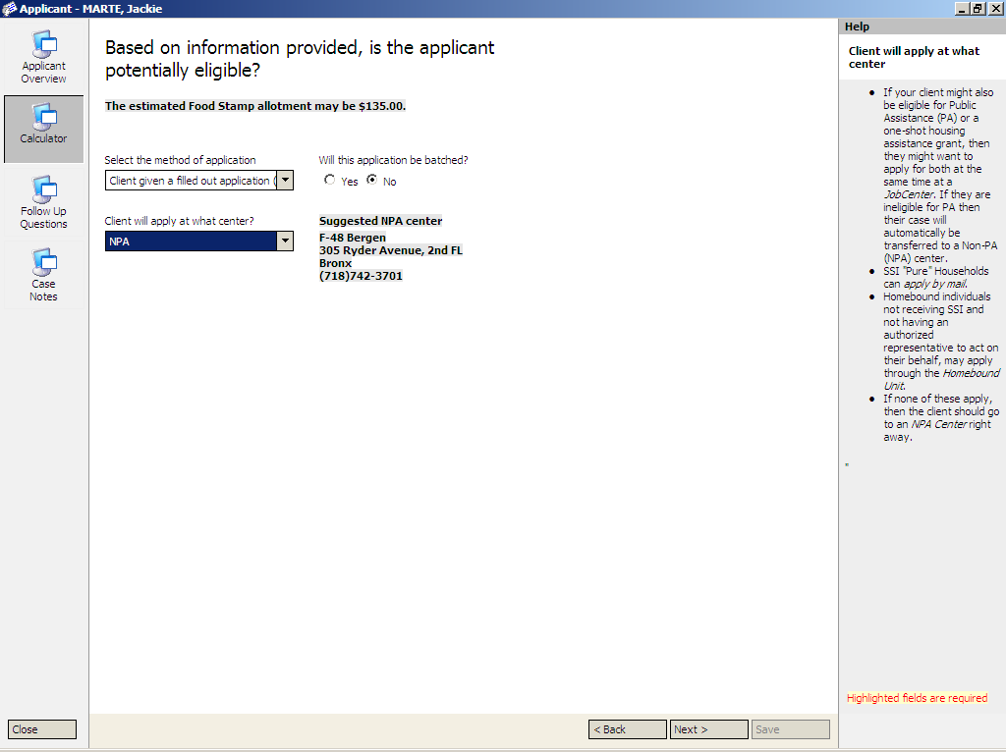

Slide 6
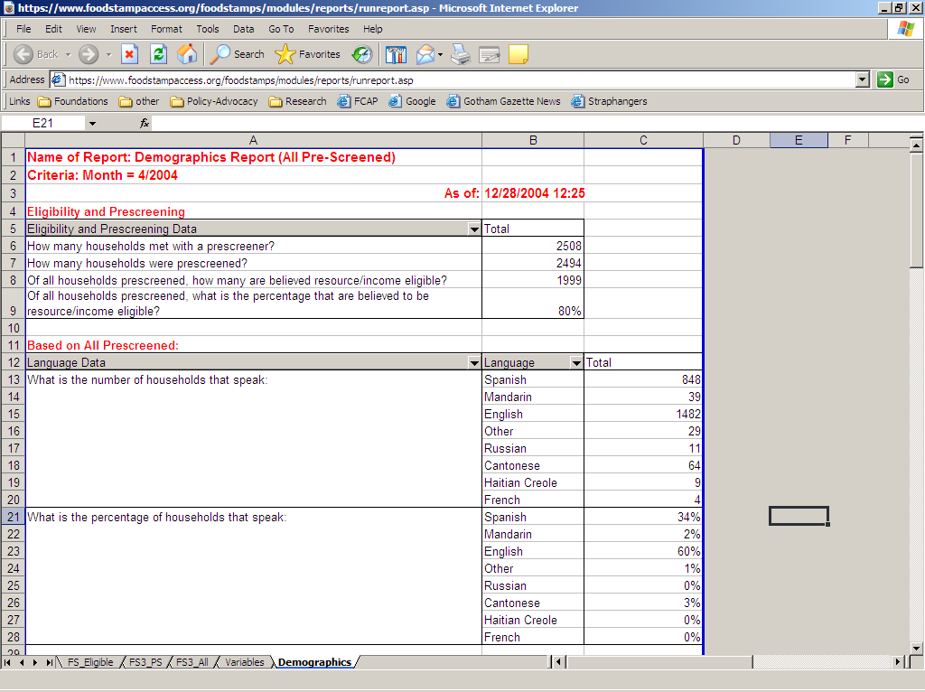

Slide 7
Early outcome findings:
Pre-screening is not enough.
Providing tailored information through eligibility pre-screenings increases enrollment, but it’s only part of the picture.
Most clients pre-screened as eligible do not enroll.
  Overall, only 42% of clients pre-screened as eligible for food stamps had enrolled four to five months after their pre-screening, leaving nearly two thirds without this vital support.
Notes:
In one month, FCAP and Food Force identified two thousand New Yorkers who could be eligible for food stamps. The Urban Justice Center has combined data from those pre-screenings, with HRA enrollment records from four to five months after the pre-screenings, and interviews with a random sample of clients. These data create a unique opportunity to describe the administrative hurdles clients face when trying to access food stamps and to make recommendations to remove these barriers. Findings presented here reflect early analysis for a report we plan to release this summer.
---------------------------
Tailored pre-screenings increase enrollment… Beth Osborne Daponte, Seth Sanders, and Lowell Taylor, “Why do low-income households not use Food Stamps? Evidence from an Experiment,” Journal of Human Resources, 34 (3): 612-628, 1999.

Slide 8
Early outcomes findings: Application assistance helps.
Services for FCAP clients pre-screened as eligible:
  referred 86% to a specific HRA office to apply.
  had follow-up contact with 53%.
  printed a completed application form for 59%.
  worked with HRA offices serving their neighborhoods to schedule appointments for 50%.
All of these services appear to help.
  Overall, although FCAP reached fewer clients, FCAP clients were significantly more likely to enroll than Food Force clients.
Notes:
Ms. Fox was supporting herself and her daughter on only $165 per month after rent and child care. An FCAP pre-screener estimated that Ms. Fox was eligible for an additional $259 per month in food stamps, filled out an application, and made an appointment for her with HRA. Spending five hours in an HRA office was not easy with her 18 month old daughter, but Ms. Fox ultimately received food stamps the day after her pre-screening.
Identifying which of the application assistance services made the biggest difference is difficult, because clients may choose services based on their overall interest in Food Stamps. Still, appointment scheduling looks promising, especially for households with earned income. Among households with earned income, 56% of those who had a specific appointment received food stamps, compared with only 29% of those without an appointment.

Slide 9
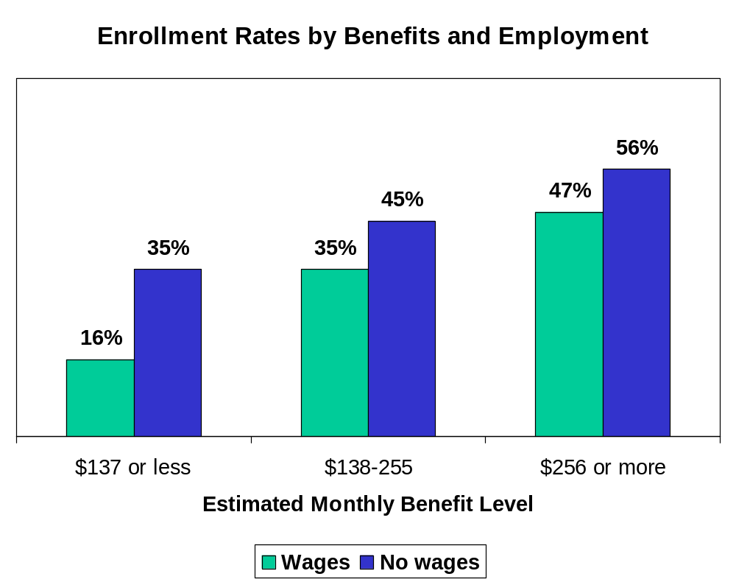
Early outcome findings:
Working clients are less likely to enroll.
Especially at lower benefit levels, clients with earned income are less likely to enroll.
Ms. Martinez:
  Works six days per week, for $1,299 per month.
  Food insecure: sometimes does not eat for an entire day.
  “It’s not that I decided not to apply, it’s that I didn’t have the time. My work didn’t allow it.”
Notes:
Potential clients weigh the costs and benefits of participating in the food stamps program. The benefits are pretty straightforward, and generally as people are eligible for more food stamps – working or not – they’re more likely to enroll. The fact that fewer working people are enrolled, even when you compare similar estimated benefits, suggests that the food stamp program involves additional costs or disincentives for working people like Ms. Martinez.
Ms. Martinez works 9am to 9pm six days per week, earning $1,299 per month to support herself and her teenaged son. She often chooses between paying for food and paying her phone bill, sometimes not eating for an entire day. $55 per month in Food Stamps could make a big difference for her. But Ms. Martinez is not receiving food stamps: “It’s not that I decided not to apply, it’s that I didn’t have the time. My work didn’t allow it.” Even if she were allowed to take a day off from work, Ms. Martinez would lose about $50 in earned income for that day to gain $55 in monthly benefits.
---------------------------
This graph is based on approximately 1,500 of the 2,000 clients pre-screened as eligible. Approximately 100 came for help checking their existing food stamps budget and are excluded from our analysis. An additional 400 did not give their social security number at the pre-screening, so we could not identify them in HRA’s database. Further information on checks against bias introduced by the social security number issue will be addressed in the report, but we don’t think that they’re significant.

Slide 10
Next Steps for Research
Our findings about outcomes for clients with earned income are consistent with many national studies, several funded by the USDA.
A recent USDA study found that many local offices have not implemented recommendations designed to improve food stamps access for working families.
Local outreach programs can and should track client outcomes in order to identify best practices tailored to the needs of the local community and encourage local offices to implement them.
Notes:
A recent USDA study found that the following local office practices were related to clients’ likelihood to complete the application process, once they knew that they could be eligible:
“Restricted office hours—Households with earnings were less likely to complete all application requirements in offices that were only open for interviews between the hours of 8 a.m. and 5 p.m. Monday through Friday.
Positive supervisor attitudes—’Pro-participation’ attitudes expressed by supervisors were positively associated with the likelihood that applicants completed the process.
Fingerprinting of applicants—In offices where applicants were fingerprinted or finger imaged prior to benefit receipt, households were less likely to complete the process.
Child-friendliness–Households with young children were less likely to fulfill all application requirements in offices that requested that children not be brought into the office.
Time limits for ABAWDs—ABAWDs in offices with time limits were less likely to complete the application process.”
Another place to start is ensuring that districts have effective systems in place to accept applications by mail, fax, or electronic means and minimizing or eliminating office visits by implementing the hardship waivers authorized by 7 C.F.R. § 273.2(e)(2).
---------------------------
Consistent findings… See, for example, the literature review in McKernan and Ratcliffe, Employment Factors Influencing Food Stamp Program Participation, Washington, DC: The Urban Institute, November 2003. USDA Economic Research Service, E-FAN-03-012.
Recent USDA study… Bartlett, Burstein, and Hamilton, Food Stamp Program Access Study: Final Report, Cambridge, MA: Abt Associates, November 2004. USDA Economic Research Service, E-FAN-03-013-3.
Local implementation of recommendations… Gabor, Hardison, Botsko and Bartlett, Food Stamp Program Access Study: Local Office Policies and Practices, Cambridge, MA: Abt Associates, December 2003. USDA Economic Research Service, E-FAN-03-013-1.

Slide 11
Role of Citywide Project Partners
United Way of NYC convenes and oversees the partnership and provides funding.
CFRC is the lead agency, designing the food stamp calculator, and providing training and quality assurance.
NYC Coalition Against Hunger provides outreach and develops sites for pre-screenings.
Seedco provides operations assistance and performance measurement and management.
Urban Justice Center trains on follow-up and advocacy, provides data assistance, and conducts research and advocacy.
NYC Human Resources Administration processes applications, provides appointment slots, and shares data on client outcomes.
Notes:
There are additional funding partners, including the New York State Office of Temporary and Disability Assistance.
The Public Advocate of New York City was also central to bringing together the partners and getting the project up and running.
Six community based organizations provide pre-screenings: Chinese-American Planning Council, Citizens Advice Bureau, Harlem Congregations for Community Improvement, NYC Central Labor Council, Ridgewood Bushwick Senior Citizens Council, and Sunnyside Community Services.
And hundreds of soup kitchens, churches, libraries, schools, grocery stores, WIC centers, and community organizations host our pre-screeners and serve our clients.

