Slide 1

Energy Showcases
Lead the Way to Green!
David Guthrie, P.E.
Energy Coordinator

Slide 2
Nine Energy Showcases
1995 National Conservation Training Center (NCTC), WV
1998 Prairie Learning Center, Neal Smith NWR, IA
1998 Visitor Center (VC), Wichita Mountains WR, OK
2001 Cusano Environmental Education Center, John
Heinz NWR at Tinicum, Philadelphia, PA
2003 Herbert H. Bateman Educational and Admin. Center,
Chincoteague NWR, VA
2004 Parker River NWR VC and Admin. HQ, MA
2005 Rhode Island NWR HQ and Kettle Pond VC, RI
2006 Missisquoi NWR HQ and VC Station, VT
2007 Tualatin River NWR Wildlife Center and HQ, OR
2008 ? Ottawa NWR VC, OH and Nulhegan Basin VCF, VT

Slide 3
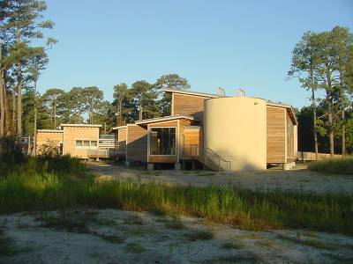
Sustainable Design
Reflect sensitivity to the site
Minimize energy and water use
Make efficient use of resources
Herbert H. Bateman
Education Center at Chincoteague NWR, VA – LEED Gold

Slide 4
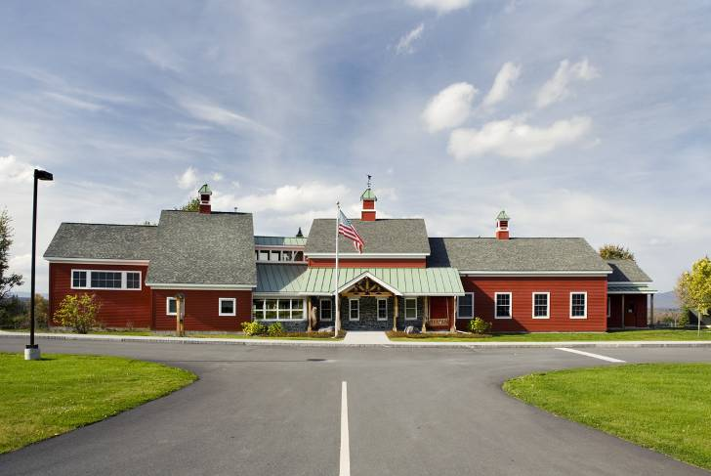
Biophilic Design
Nulhegan Basin VCF, VT
Photo courtesy of Kim Roseberry, Oak Point Associates
The building provides many connections, between occupants and the natural environment, through views, walkways and daylight. The occupant is sheltered but never far from nature. Visual and tactile experiences connect people with nature. Native vegetation, trees and planted areas increase the chance that a building occupant will see a native bird or butterfly. These experiences remind us of the interconnectedness of the resources of the world and they help us to be better stewards of our natural resources.

Slide 5
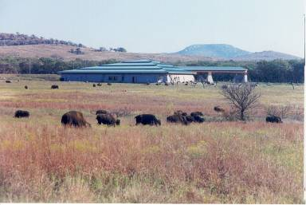
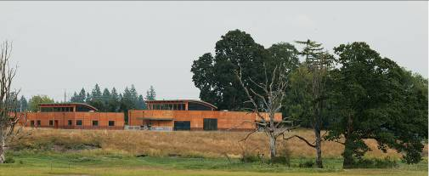
Sensitivity to the Site
Protect wildlife and minimize habitat disturbance
Brownfield redevelopment
“Dark Sky” principles
American Bison at the Wichita Mountains Visitor Center, OK -- the oldest managed wildlife preserve in the U.S.
Tualatin River NWR Wildlife Center, OR

Slide 6
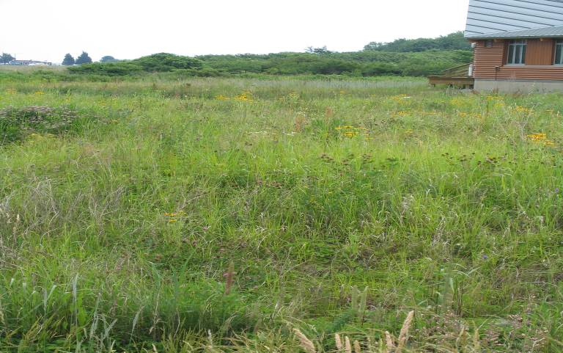
Habitat Restoration
Returning disturbed land to shallow wetlands, old field, upland woods, and coastal area habitats
Planting native species of trees, shrubs, and grasses
Utilizing soil excavated from storm runoff cleansing basins as loam throughout the site

Slide 7

Minimize Energy & Water Use
1st Tier
Passive solar energy design
Thermal Mass
Superinsulation: R19 walls/R38 ceiling
Daylighting
Energy-efficient lighting
Lowest LCC Energy Star®
HVAC systems
Renewable energy systems
2nd Tier
3rd Tier

Slide 8
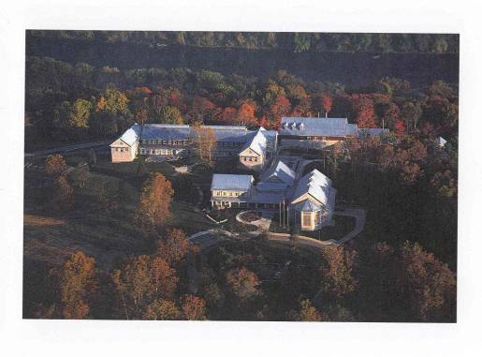
Passive Solar Energy
Buildings oriented on E-W Axis
Large S window areas
Brick floors behind windows for solar gain
Overhangs for summer shading, letting in winter sun
Landscaping for optimum summer shading and wind breaks
National Conservation Training Center, WV

Slide 9
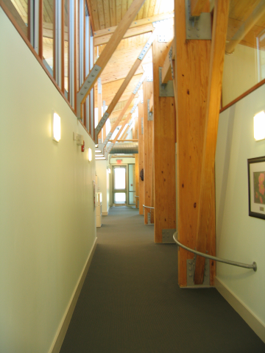
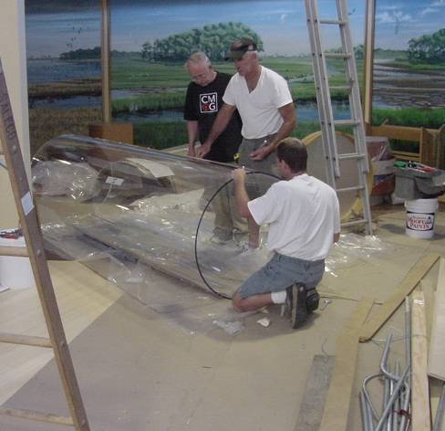
Daylighting:
Clerestories & Light Tubes
Parker River NWR VC, MA Herbert H. Bateman Ed. Center

Slide 10


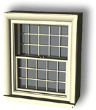
Energy Efficiency
Occupancy and daylight sensors, motion detectors
Energy-efficient lighting: “green tip” T-8 lamps (even T-5’s), electronic ballasts, CFL’s, LED exit lights; task lighting; Vending Misers on soda machines!
Timers for night set-back
Natural cross-ventilation
Low-E windows/glazing
Turn off the lights!

Slide 11

HVAC Systems
Specify lowest LCC System Available
Chill water off-peak
Centralized controls; EMCS
Variable speed motors
Seal leaks/Use OA/Switch fuels
Objective = Energy Star® building!

Slide 12
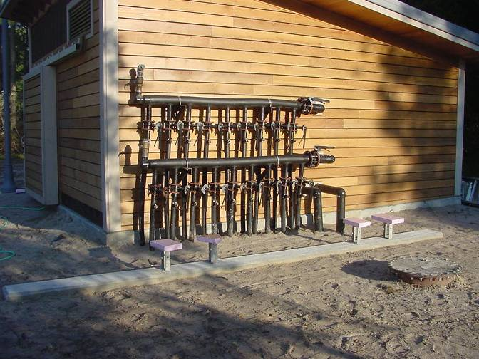
Geothermal Heat Pumps
23 geothermal heat pumps use a
total of 72, 250’ deep vertical wells
at the Herbert H. Bateman Ed. Center
7/9 of our Showcases use GHP technology

Slide 13
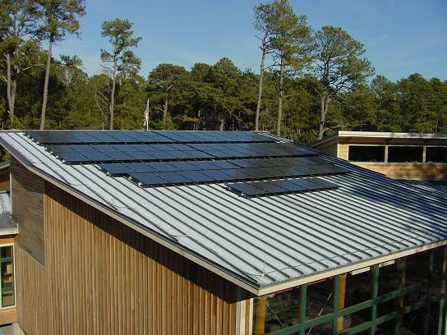
Active Solar Energy
15 kW solar
panels rest
on top of the
Auditorium at
the Herbert H.
Bateman Ed.
Center

Slide 14
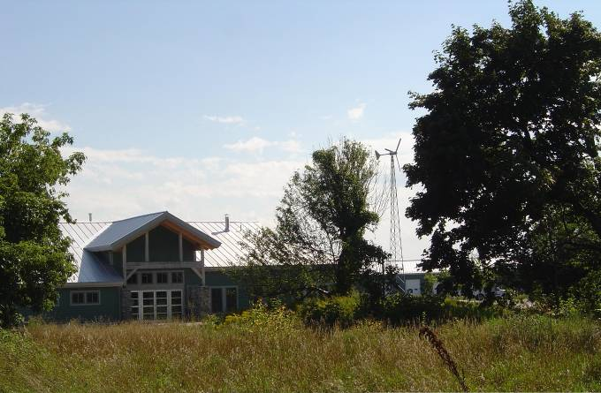
Max Renewables!
Missisquoi
NWR HQ
and VCS,
VT
♦Geothermal HVAC system ♦EPA-approved wood stove
for auxilliary heat
♦15 kW Solar PV array ♦10 kW Wind Turbine

Slide 15
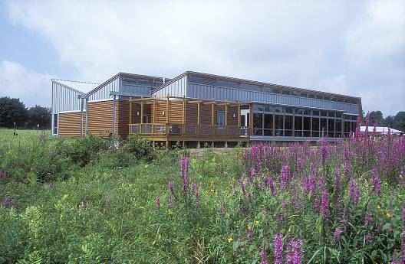
Water Conservation
Low-flow showers, faucets, low-flush toilets or waterless urinals
Roof runoff discharges onto grassy swales or into underground percolating chambers
Use pervious concrete pavement
Rainwater gardens
Xeriscaping
2,000,000 gallons was saved at one facility alone!

Slide 16
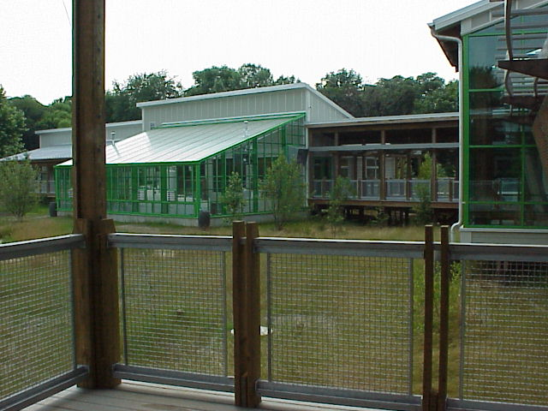
Marsh Machine
Marsh machine at the Cusano Environ-mental Education Center, John Heinz NWR at Tinicum, PA

Slide 17
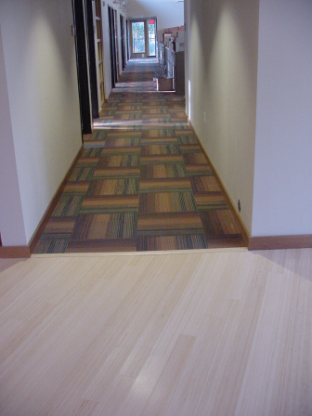
Make Efficient Use of Resources
Rapidly renewable materials for construction
Engineered wood
recycled carpet and bamboo flooring

Slide 18
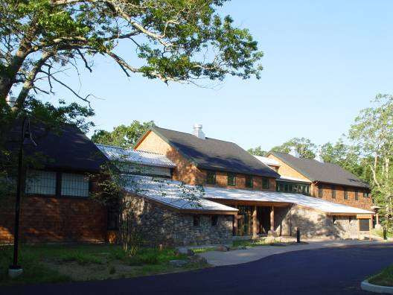
Green Tech!
Use beams left over from
logging operations
Decking made from
recycled plastic bottles
Fly ash in the cement
Reclaimed materials in siding -- no redwood/cedar!
Use Hardie Plank siding
Recovered materials in
the insulation
Resilient flooring made
from recycled tires
for high impact areas
Drywall and sheetrock
with high content of
recycled gypsum
Rhode Island NWR HQ and Kettle Pond VC, RI

Slide 19
Recycling
Recycled building materials with no or low-emissions
Use recycled wood; old barn timbers
Up to 100% of construction materials recycled, sometimes on-site
Non-hazardous preservative applied to exterior, pressure-treated wood
Use local materials to save fuel

Slide 20
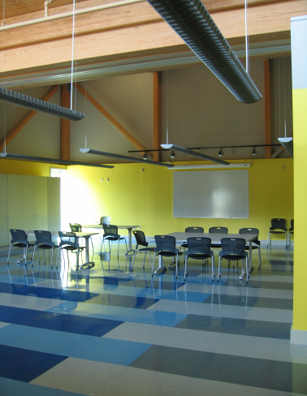
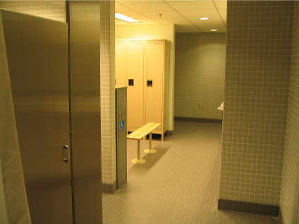
Recycling Examples
Sustainable Linoleum Flooring
Recycled Tiles

Slide 21
Indoor Air Quality
Interior finishes such as adhesives, laminates, paint systems have zero harmful VOC gases, ensuring the health of the applicator and building occupants.
Low-VOC carpets were specified.
Formaldehyde-free products used to prevent harmful off-gassing.

Slide 22
Outreach
Exhibits explaining the benefits of the facility’s sustainable features
Special interpretive exhibits that show good stewardship of the land
Hold seminars to explain the special architecture and low carbon footprint
Ask your “Friends” to help!

Slide 23
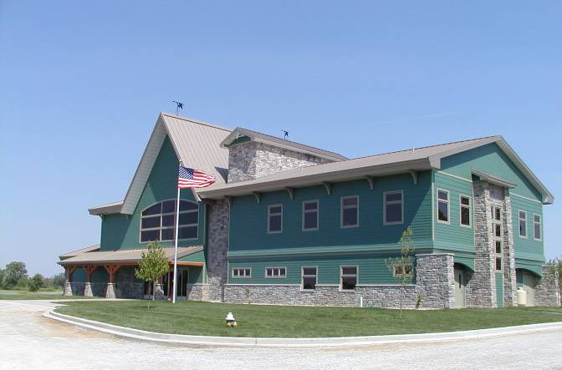
YOU can slow climate change by going Green!
Ottawa NWR Visitor Center, Oak Harbor, Ohio

