Slide 1

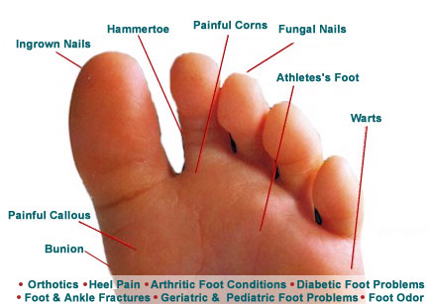
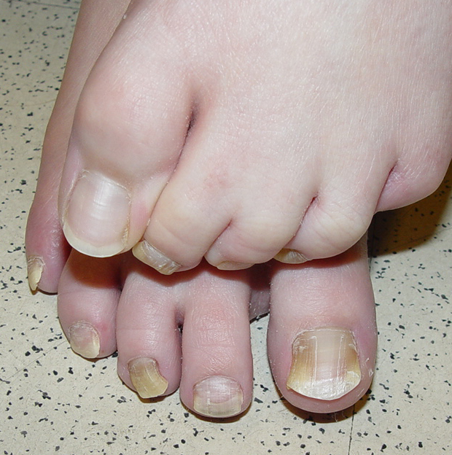
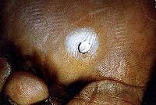
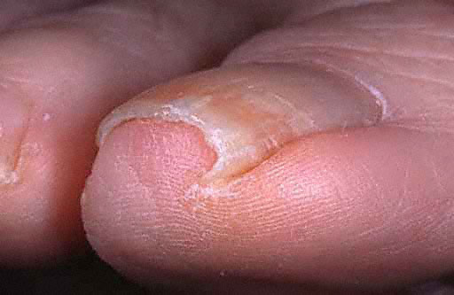
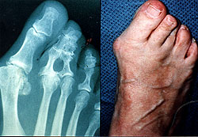
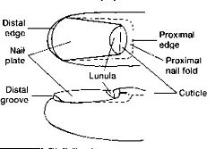
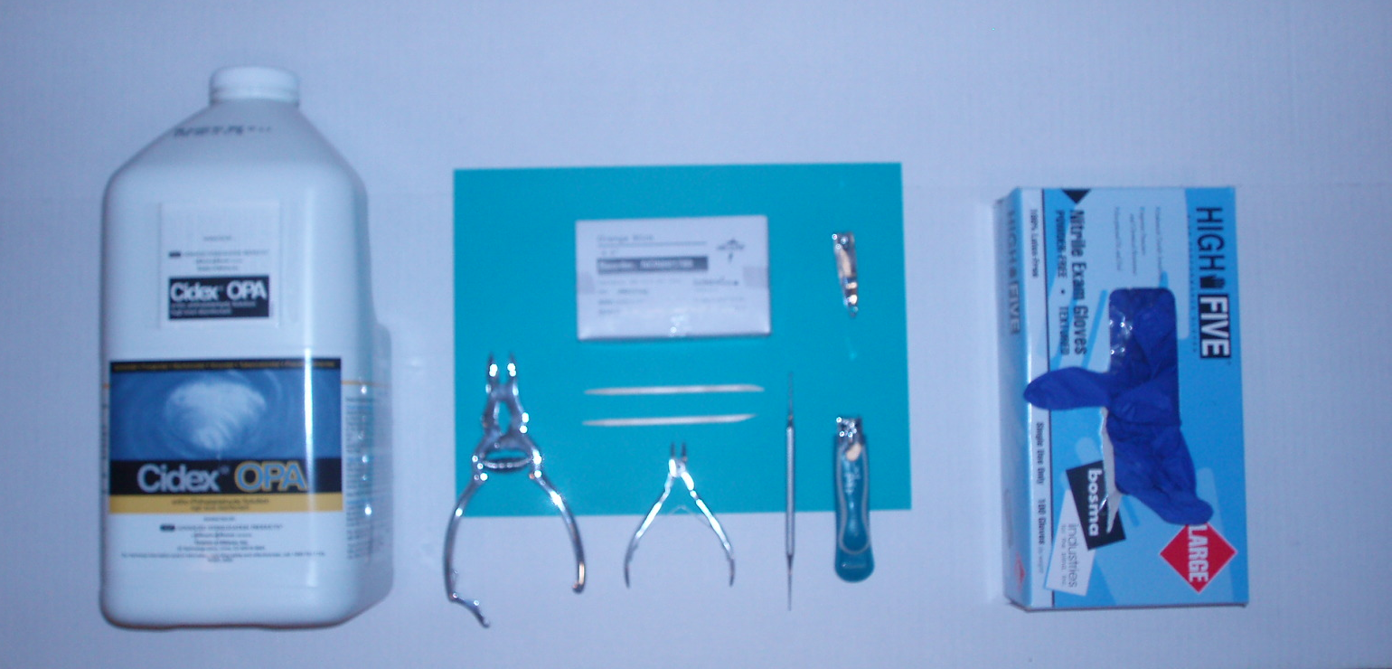
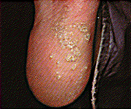
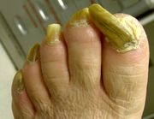
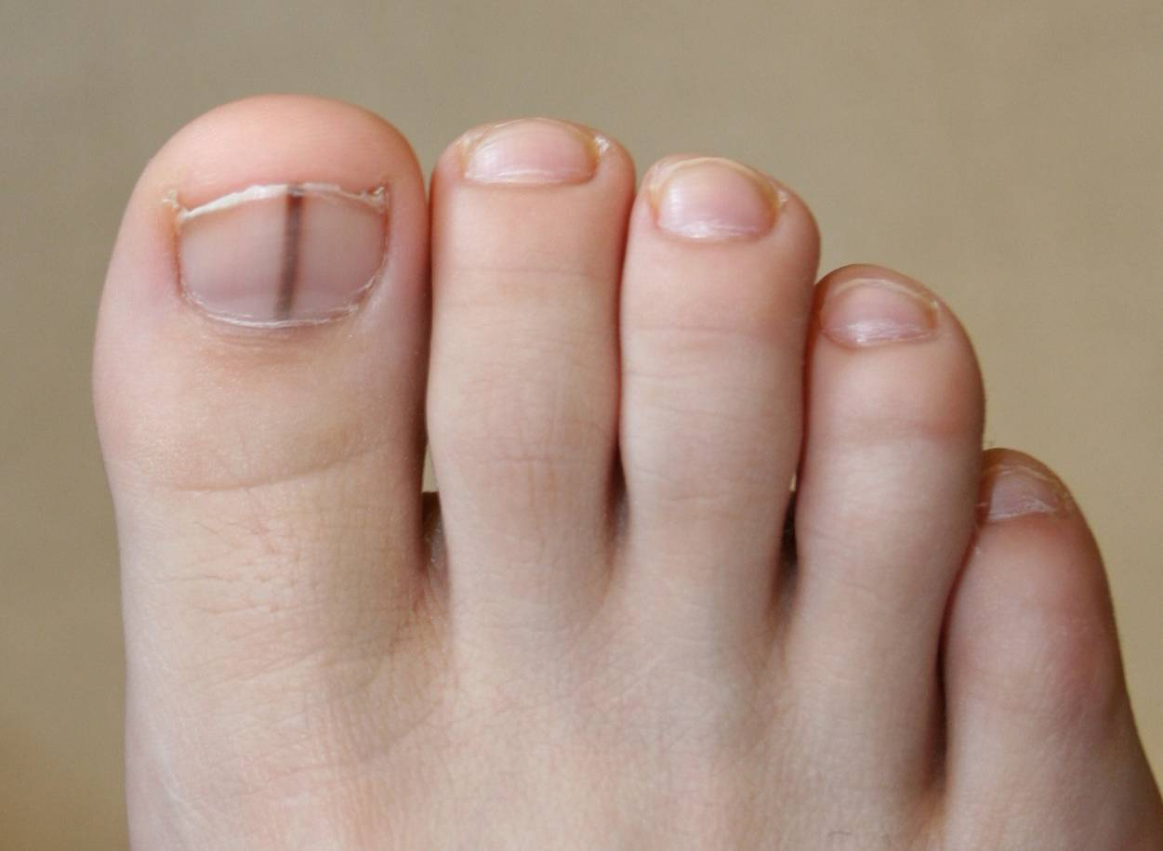
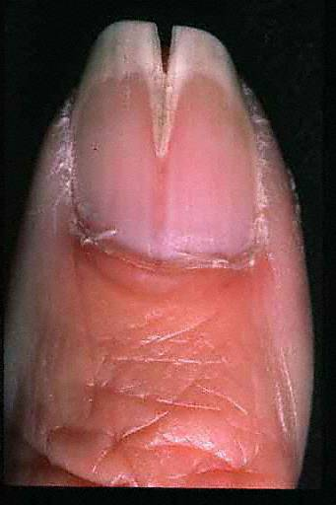
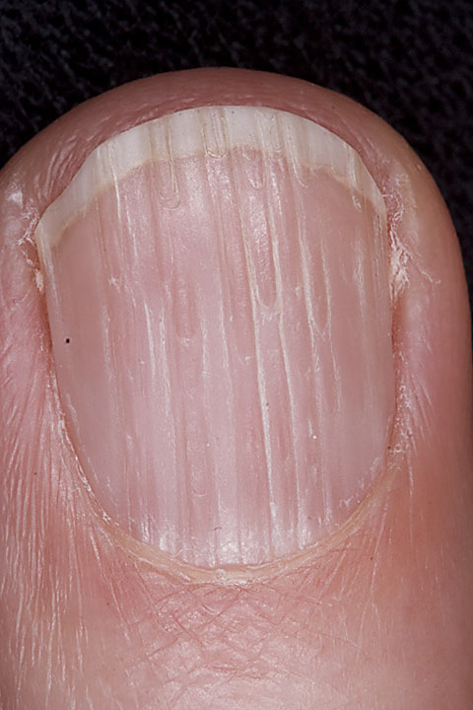
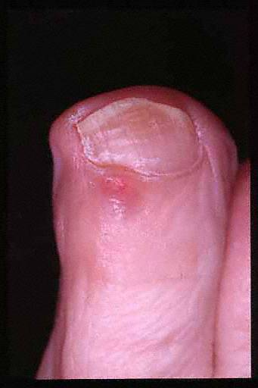
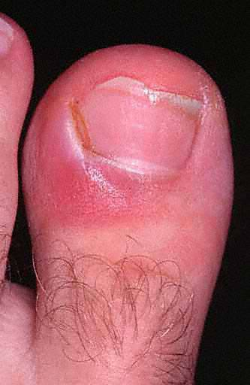
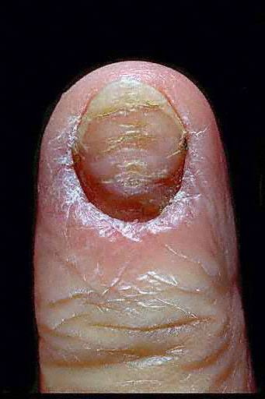
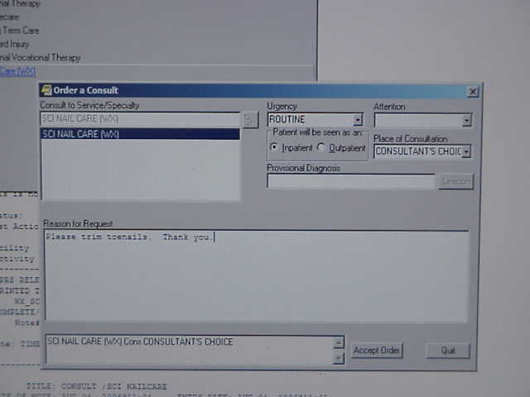
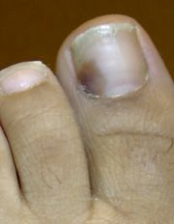
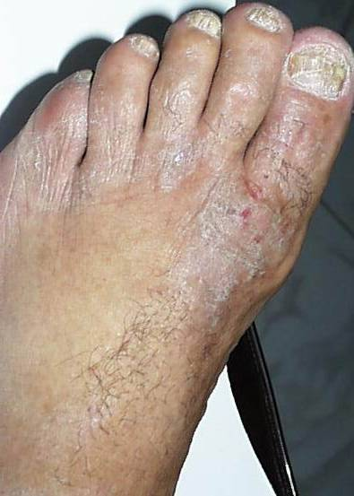
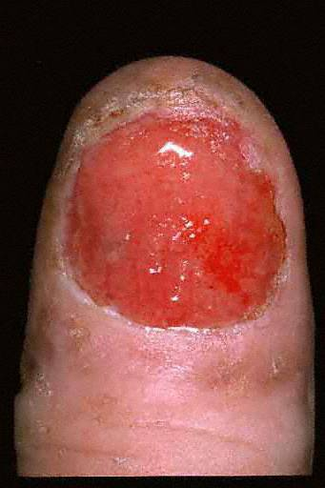
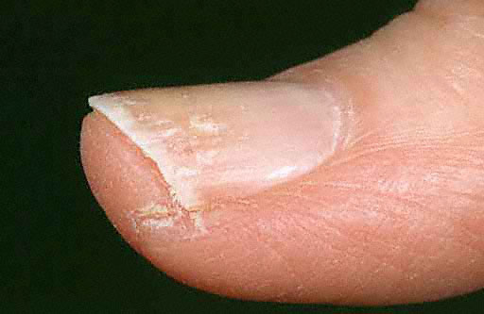
Developing an SCI Nail Care Program: How to Make It Happen
Kelly D. Skinner, MSN, CRRN, ANP, GNP, James T. Daniel, BSN, RN,
Nancy Brooks, BSN, RN, & Melody White, BSN, RN
VA Boston Healthcare System
Abstract
Education about Toenail Disorders
Competencies
Routine nail care is essential for spinal cord injured persons.
Spinal cord injured persons with hyperkeratotic
and elongated toenails are certainly at risk for complications since they have limited or no sensation
in their lower extremities.
But, who is going to provide this service regularly
to the spinal cord injured veterans? Podiatry services are limited at this facility related to increased workload and limited staffing. Therefore, it became apparent that the SCI Nail Care Program was needed in order
to meet the foot and nail care needs of the spinal cord injured patients.
This poster presentation illustrates the major steps involved in the implementation of this SCI Nail Care Program.
SCI Nail Care Competencies
METHOD OF VALIDATION:
(O) OBSERVATION (V)VERBAL (W) WRITTEN ASSESSMENT (D) DEMONSTRATION (PR) PEER REVIEW
COMPETENCIES MET NOT MET COMMENTS
Performs a clinical assessment of the spinal cord injured person.
Collects a health history.
Assesses medication history
2. Performs a physical assessment of the spinal cord injured patient:
Assesses patient for functional disabilities (e.g., gait, mobility, balance, visual, cognitive)
Assesses patient for health habits (e.g., smoking, exercise, hygiene, nutrition)
Assesses foot circulation by palpation (e.g., pulses, blanching, capillary refill)
Assesses foot circulation by Doppler
Assesses legs and feet for temperature
Assesses hair growth on legs and feet
Assesses foot skin integrity (e.g., fissures, ulcers, corns, calluses, dermatitis)
Assesses physical/musculoskeletal function of the foot (e.g., range of motion, deformities, strength)
Assesses toenails and cuticles
3. Performs skin care on the spinal cord injured patient:
  Performs hygiene to the feet and nails
  Identifies appropriate interventions for managing hyperkeratotic areas
  Implements off-loading
  Applies padding
  Identifies the need for compression therapy (e.g., to manage edema)
  Applies moisturizers to skin
  Performs cuticle care
  Identifies and make recommendations for skin conditions:
      Blisters Tinea pedis Trauma Other skin conditions
      Paronychia Plantar warts Maceration
      Identifies the need for use of therapeutic interventions (e.g., topical therapy) for skin conditions.
4. Performs nail care on the spinal cord injured patient:
  Defines free nail border (i.e, removes debris)
  Conducts debridement of toenails
  Performs cleaning and sterilization of equipment
  Uses personal protective equipment
  Maintains infection control for tinea pedis and candidiasis
  Identifies and makes recommendations for the following conditions:
      Onychomycosis Ingrowing/ingrown toenail
      Trauma Other conditions of the toenails
  Prescribes antifungal agents or antibiotics for infections (nurses with prescriptive authority)
5. Provides education when appropriate:
  Provides patient/caregiver education related to:
      foot care (e.g., hygiene, skin care, inspection, nail care) anatomy and physiology of the foot
      pathophysiology affecting the foot weight management
      age-specific changes of the foot prevention of specific problems
      proper footwear problems that should be reported
      plan for follow-up care
6. Identifies and initiates appropriate referrals (primary care provider, podiatry, orthopedics, dermatology, endocrinology, vascular surgery, general surgery,
physical therapy, OT, pedorthist/orthotist, home health, pain management, diabetes education, smoking cessation, case manager or social worker, wound care)
and consults with the spinal cord injured patient’s SCI MD/DO prior to initiating the appropriate consult.
7. Acts as a patient advocate regarding issues of foot care.
_________________________________________ DATE:___________________ / ______________________________________ DATE:______________
(Rating Official) (Employee Signature)
Onychomycosis Corn Bunion Onychocryptosis
Anatomy of the Nail
“Equipment Raiser
Plantar Warts Onychogrypsosis Melanonychia Median Nail
Dystrophy
Longitudinal Ridging Digital Mucous Cyst Acute Paronychia Chronic Paronychia
The Process
SCI Nail Care Electronic Note & Consult
Determining the Need and Interest
Administration and Labor Union Approval
Nail Care Training and Clinical Experience for
Selected Staff
Competencies
Equipment and Supplies
Electronic Consult & Note
Staff and Patient Education
Program Implementation
SCI Nail Care Note:
Medical History:
Allergies:
Medications:
O:
Nail tissue: veteran received routine and palliative nail care for elongated
and thickened nails. All nails were reduced/debrided without incident.
Callouses: [ ] none
[ ] locations:
Other issues:
A: [ ] onychomycosis
[ ]debridement of 1-5 digits
[ ]debridement of 6-10 digits
[ ] onychauxis
[ ] onychocryptosis
[ ] paronychia
[ ] wound
[ ] tinea pedis
[ ] cellulitis
[ ] hyperkeratosis-callous
[ ] other:
P: [ ] toenail care performed without incident [ ] lamb's wool
[ ] callous debridement without incident [ ] lachydrin as ordered
[ ] attending notified and consult placed [ ] absorbase emollient
[ ] lamisil as ordered [ ] x-ray as ordered
[ ] bacitracin as ordered [ ] carmol as ordered
[ ] povodine iodine swabbed in web spaces [ ] oral antibiotic as ordered
[ ] povodine iodine foot soak
FU plan:
[ ] PRN [ ] q 5 months [ ] other:
[ ] q 3 months [ ] q 6 months
[ ] q 4 months [ ] consult DPM clinic
Recommendations:
Subungual Hematoma Tinea Pedis Melanoma Hang Nail

