Slide 1
ENERGY STAR® Quantity Quotes
Ari Reeves, D&R International, Ltd.
Federal Environmental Symposium - East
June 3, 2008

Slide 2
Agenda
What is Quantity Quotes
Who uses it
Why is it valuable for Federal sector purchasers

Slide 3

ENERGY STAR Quantity Quotes
An online tool created with funding from the U.S. Department of Energy to connect large quantity buyers with suppliers of energy-efficient products

Slide 4
The Quantity Quotes Concept
Purchaser sends a request for quotes to suppliers through the Web site
Suppliers respond to the purchaser through the Web site
Purchaser follows up with suppliers and chooses one to negotiate a contract with
Notes:
First go to QuantityQuotes.net to register for free.
Once you’re registered, you can log in and submit a “purchase request” (a.k.a “request for bids” or “request for proposals”)

Slide 5
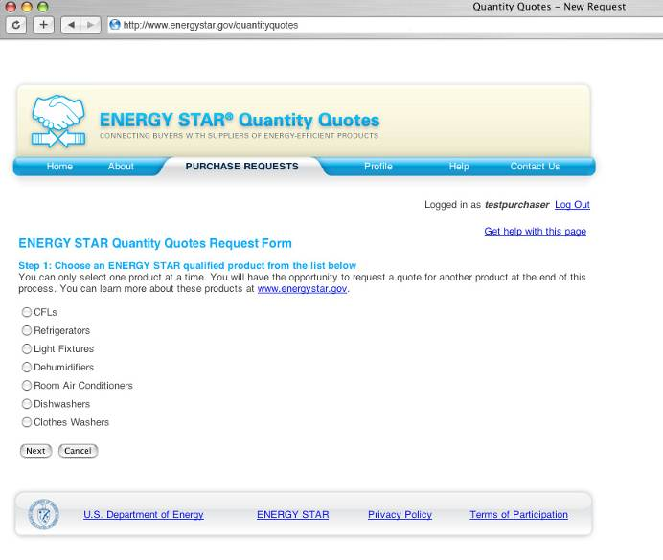

Choose a product.

Slide 6
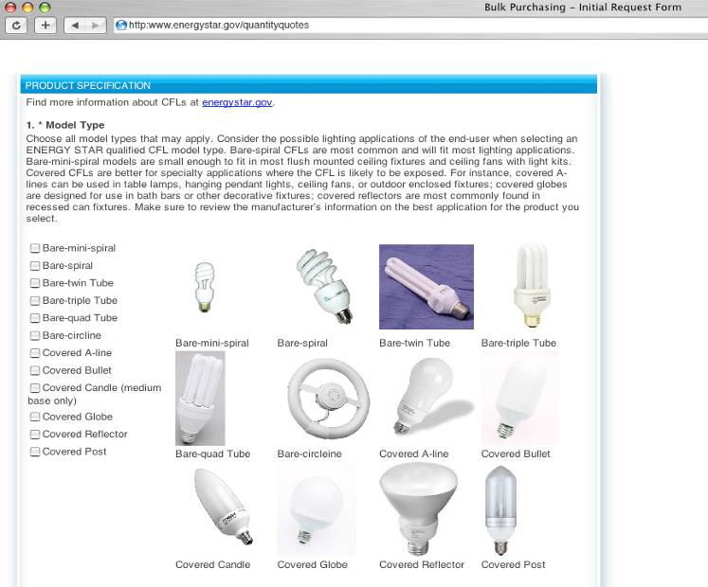
Enter all your specifications
so you get
the right product.

Slide 7
Almost 150 Participating Suppliers
Absocold Corporation
DePaul University
Fullerton Appliance
Commercial Lighting
Appliance World & Home Theater
All Lighting, Inc.
Duddys Electronics
Largents Inc.
Alpine Construction
Best Buy Gov LLC
Baker Bros. Appliance
Manhattan Lights Inc.
Gold Coast Ltd
Artline Wholesalers
Laketon TV
Sears Commercial
Feit Electric
TCP
Appliance Factory Outlet
Atlanta Light Bulbs, Inc.
Bulborama.com
Dobbs Appliances
Rutt’s Appliances
Bulb Star
Whirlpool Corporation
Bemis Appliance & TV
Efficient Lighting
Bay Lighting, LLC
Bulbs.com
Fasco Appliance
Jeannie Super Shop
Espen Technology Inc.
Broadview Appliance
Rigles Inc.
AM Conservation Group
Cascade Imports Lighting Corp.
Harbor Distribution
Buffalo Lite
Bartels Ace Hardware/
Homestead Appliance
Green Lighting Eco Products
Ecofuture, LLC
GOOD EARTH LIGHTING
Hamiltons Appliance & TV
GE
Myers Appliance
Metro Builders Supply
Kent Furniture & Appliance
OptoLight
Mitchell Appliance
Manual Joseph Appliance Center
Greenlite Lighting Corporation
AutoCell Electronics, Inc.
Energy Federation, Inc.
Jim & Dave’s Appliance
Frank’s Appliance Inc.
Michael’s Appliance Center
Light Bulb Inc.
EiKO Ltd.
Hutchins TV & Appliance, Inc.
Berman Industries
GEI Inc.
Ledup Enterprise Inc.
Maxlite
Turolight Inc.
Globe Electric Inc.
Nawara Bros. Appliance
Nova Lighting
Plass Appliance
Midwest Energy
Efficiency Alliance
GoodMart Lighting and Electrical Supply
Lamar’s Appliance & Furniture
Ruffalo Appliance
Sears Contract Sales
Southwest Appliance
Energy Savers Lights
Cummins’ Appliance
Rosa’s Home Store
Seattle Lighting
Maxim Lighting International
Melas Energy Engineering
Litetronics International Inc.
Mega Lite N’ Decors
Lux Electronic Products, Inc.
Marion Appliance Warehouse
House of Loule
Mrs. G TV & Appliance
Mary’s Appliance
Simon’s Kitchen Appliances
EBA Wholesale Corp.
TechniArt Inc.
NEPTUN Light, Inc.
The Competition, TV and Appliance
Global Consumer Products Inc.
Mac-Gray Co. Inc.
National Direct Lighting
North Coast Electric
ONE STEP LIGHTING
The Bicknell Corporation
The Retrofit Companies
Staber Industries, Inc.
Niagra Conservation Corporation
Hallock’s Appliance Express
Nutech Lighting Corp.
One Stop Appliances & Electronics
Pineapple Hospitality, Inc.
O W Houts & Sons, Inc.
Vann’s #01
Phillips Appliance
WHP Electronics
Ventura TV, Video
& Appl. Ctr.
Friedrich Air Conditioning Company
Quality Appliance Company
Satco Products, Inc.
Sonny’s Discount Appliances, Inc.
Randas Appliance and Electronics
West Coast Appliance
Household Furniture & Appliance
Powerhouse Appliance
Lane’s Appliance
CyberTech Lighting
Laninga Appliance
Sorenson’s Appliance & TV
Sterling Electronics,
Brooklyn NY
Sunrise Lighting, Inc.
Sea Gull Lighting Products, LLC.
U Lighting America
Notes:
Almost 150 individuals representing close to 130 companies have registered.

Slide 8
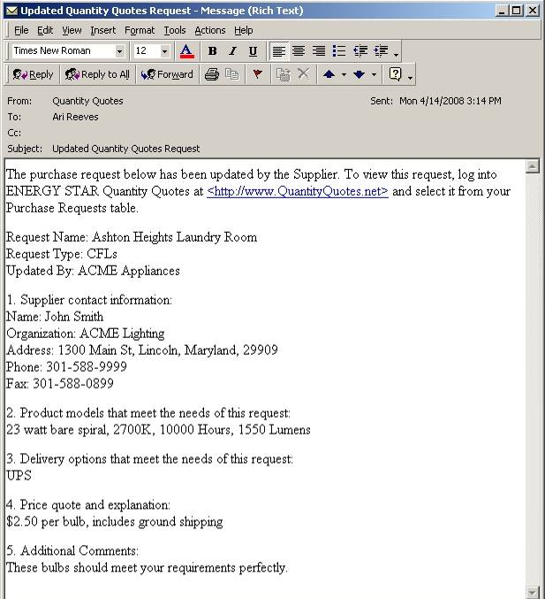
Get e-mail notifications
when suppliers respond.

Slide 9
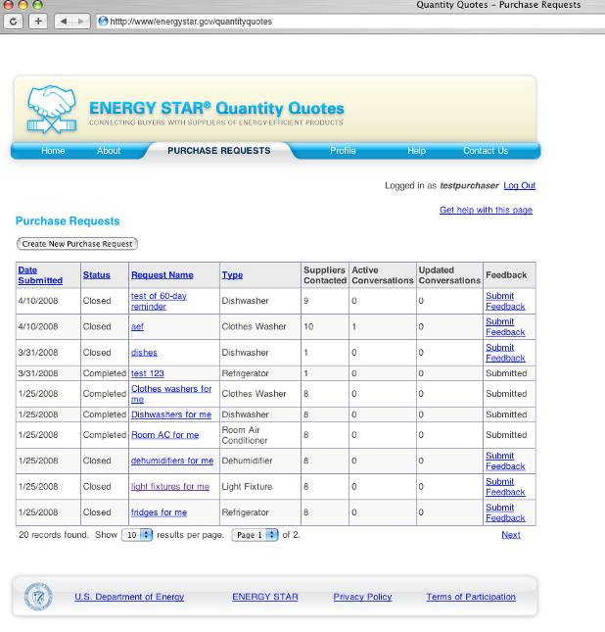
Manage all supplier responses in one place.

Slide 10
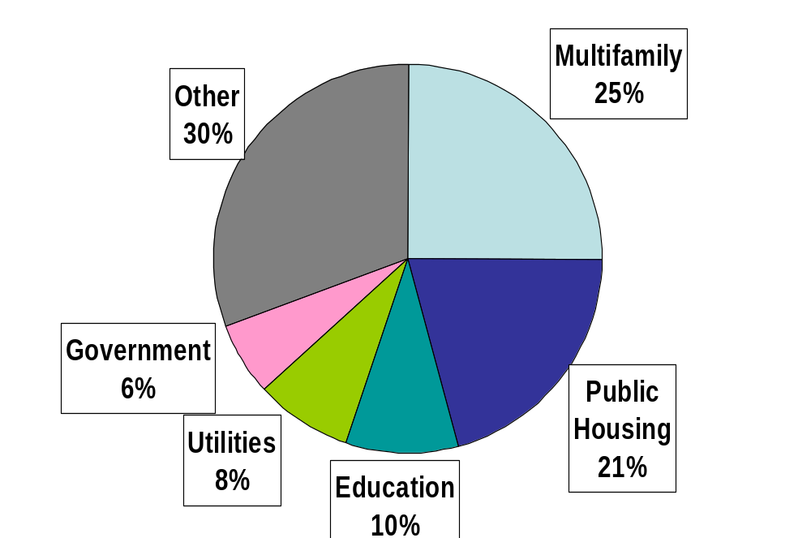
Purchase Requests by Sector
Notes:
“Other” includes banks, hotels, restaurants, individuals, and not-for-profit organizations.

Slide 11
Purchase Requests Submitted
Product | Purchase Requests | Products Requested
CFLs | 349 | 4,462,018
Refrigerators | 124 | 10,099
Room Air Conditioners | 28 | 31,576
Light Fixtures | 31 | 10,131
Clothes Washers | 24 | 2,282
Dishwashers | 23 | 2,550
Dehumidifiers | 4 | 78
Total | 583 | 4,518,734
Notes:
CFLs constitute 99% of products requested to date.

Slide 12










Federal Sector Purchasers
Public Housing Agencies
Military Housing Providers
Tribal Communities
Notes:
Over 250 Public Housing Agencies
Military Housing Providers
Tribal Communities
Smithsonian Institution
NOAA Fisheries Service
EPA
HUD
DOE
U.S. Senate
Treasury
Navy
National Park Service

Slide 13
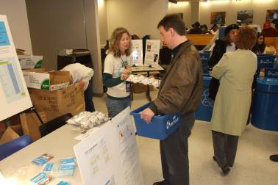
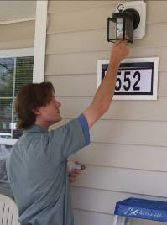


Project Types
)
Notes:
Employee giveaways (CFLs) [Photo shows an employee giveaway at NASA’s Glenn Research Center, Cleveland, Ohio.]
Replacements in offices, dormitories and elsewhere
As part of the ENERGY STAR Change A Light, Change the World Campaign
As part of ENERGY STAR OPERATION CHANGE OUT – The Military Challenge

Slide 14
Why Use Quantity Quotes
Consistent with Federal procurement requirements and policy per the Office of Federal Procurement Policy (Sept. 2007)
Easy-to-use tool fits into established procurement procedures
Save time: no need to search for ENERGY STAR suppliers
Save money: suppliers compete against one another for your business
Specify product requirements and have suppliers suggest models that meet the need
Notes:
Purchase requests receive 5.7 responses from suppliers, on average. More for CFLs and light fixtures, fewer for appliances.
DOD E-MALL and GSA e-Buy, both available only to federal government purchasers, also allow purchasers to specify product requirements and not exact models, but these sites appear to be designed for purchasers who already know exactly what model(s) they are looking for.
No software to download
QuantityQuotes.net ONLY includes ENERGY STAR qualified products – so if you are required to purchase labeled products, this is an excellent resource.

Slide 15
Contact
Ari Reeves
Project Manager, ENERGY STAR
D&R International, Ltd.
1300 Spring Street, Suite 500
Silver Spring, MD 20910
Phone: 301-588-9387
Fax: 301-628-4510
Email: areeves at drintl dot com
Web: www.drintl.com, www.energystar.gov/quantityquotes

