Slide 1
Operations’ Update
Fall and Holiday Periods
2002
Mailers Technical Advisory Committee Meeting August 7, 2002

Slide 2


Fall Mailing Season
Fall Period (mid August - Thanksgiving)
  4 Holidays:
  Labor Day Monday, Sept 2
  Columbus Monday, Oct 14
  Veteran’s Day Monday, Nov 11
  Thanksgiving Thursday, Nov 28
Holiday Period (Thanksgiving - January)
  3 Holidays:
  Christmas Wednesday, Dec. 25
  New Year’s Wednesday, Jan. 1
  Martin Luther King Monday, Jan. 20
Notes:
Most plants provide hours for mailers to enter their drop shipments during a scheduled holiday.
To be assured of getting a desired appointment slot for BMC or SCF entry, mailers are advised to schedule appointments in the Drop Shipment Appointment System (DSAS) as soon as possible.
Our mail mix has distinct characteristics in the Fall and Holiday Periods.
During the Fall Period, operations processes millions of catalogs (flats).
When we transition into Holiday period, the type of mail processed in December changes to increased parcel volumes, including perishable items, Christmas cards (handwritten, colored envelopes), and more Priority Mail and Express Mail.
When January arrives, we handle many financial documents, tax forms and W-2 statements, and more catalogs for white sales or clearance sales.

Slide 3
Fall Mailing Season
EXPECTATIONS
Mail Volume Plan At 2001 Level
Operations’ Plans
  Hire Fewer Casuals
  Close Annexes
  Encourage Mailers to Mail
Notes:
An uncertain economy is the number one factor that will influence the projected fall mailing season this year.
According to recent surveys, mailers identified other factors of slow growth:
-focus on customer retention, rather than on acquisition
-recent postal rate increase
Year-to-date, there are 6 billion fewer pieces in the mail stream that last year, and 3.5 billion pieces of that mail can be attributed to direct mail.
As a result of these forecasts, operations will hire fewer temporary postal employees. There are no plans to add more square footage for processing space. Since last year, several annexes have been closed.
Your business is important to us. Postal operations are poised to process your mailings efficiently and effectively.

Slide 4
Fall Mailing Season
PROCESSING CAPACITY
Increased Capacity to Process Flats
  185 AFSM 100s Added Since Last Fall
  532 AFSM 100s Operating Nationally
Upgraded Flat Sorting Machine 1000 (UFSM)
More Automated Sorting of Flats to Carrier Routes
Notes:
Added 185 AFSMs to the network.
Removed 630 mechanized FSMs to assist in improving productivity.
Deployed 79 automated feeders and OCRs for the FSM 1000.
Keying 33 million images a week at RECs.
9,308 5-digit zones and over 190,000 routes are sorted to carreir route level for approximately 1 billion an AP.

Slide 5
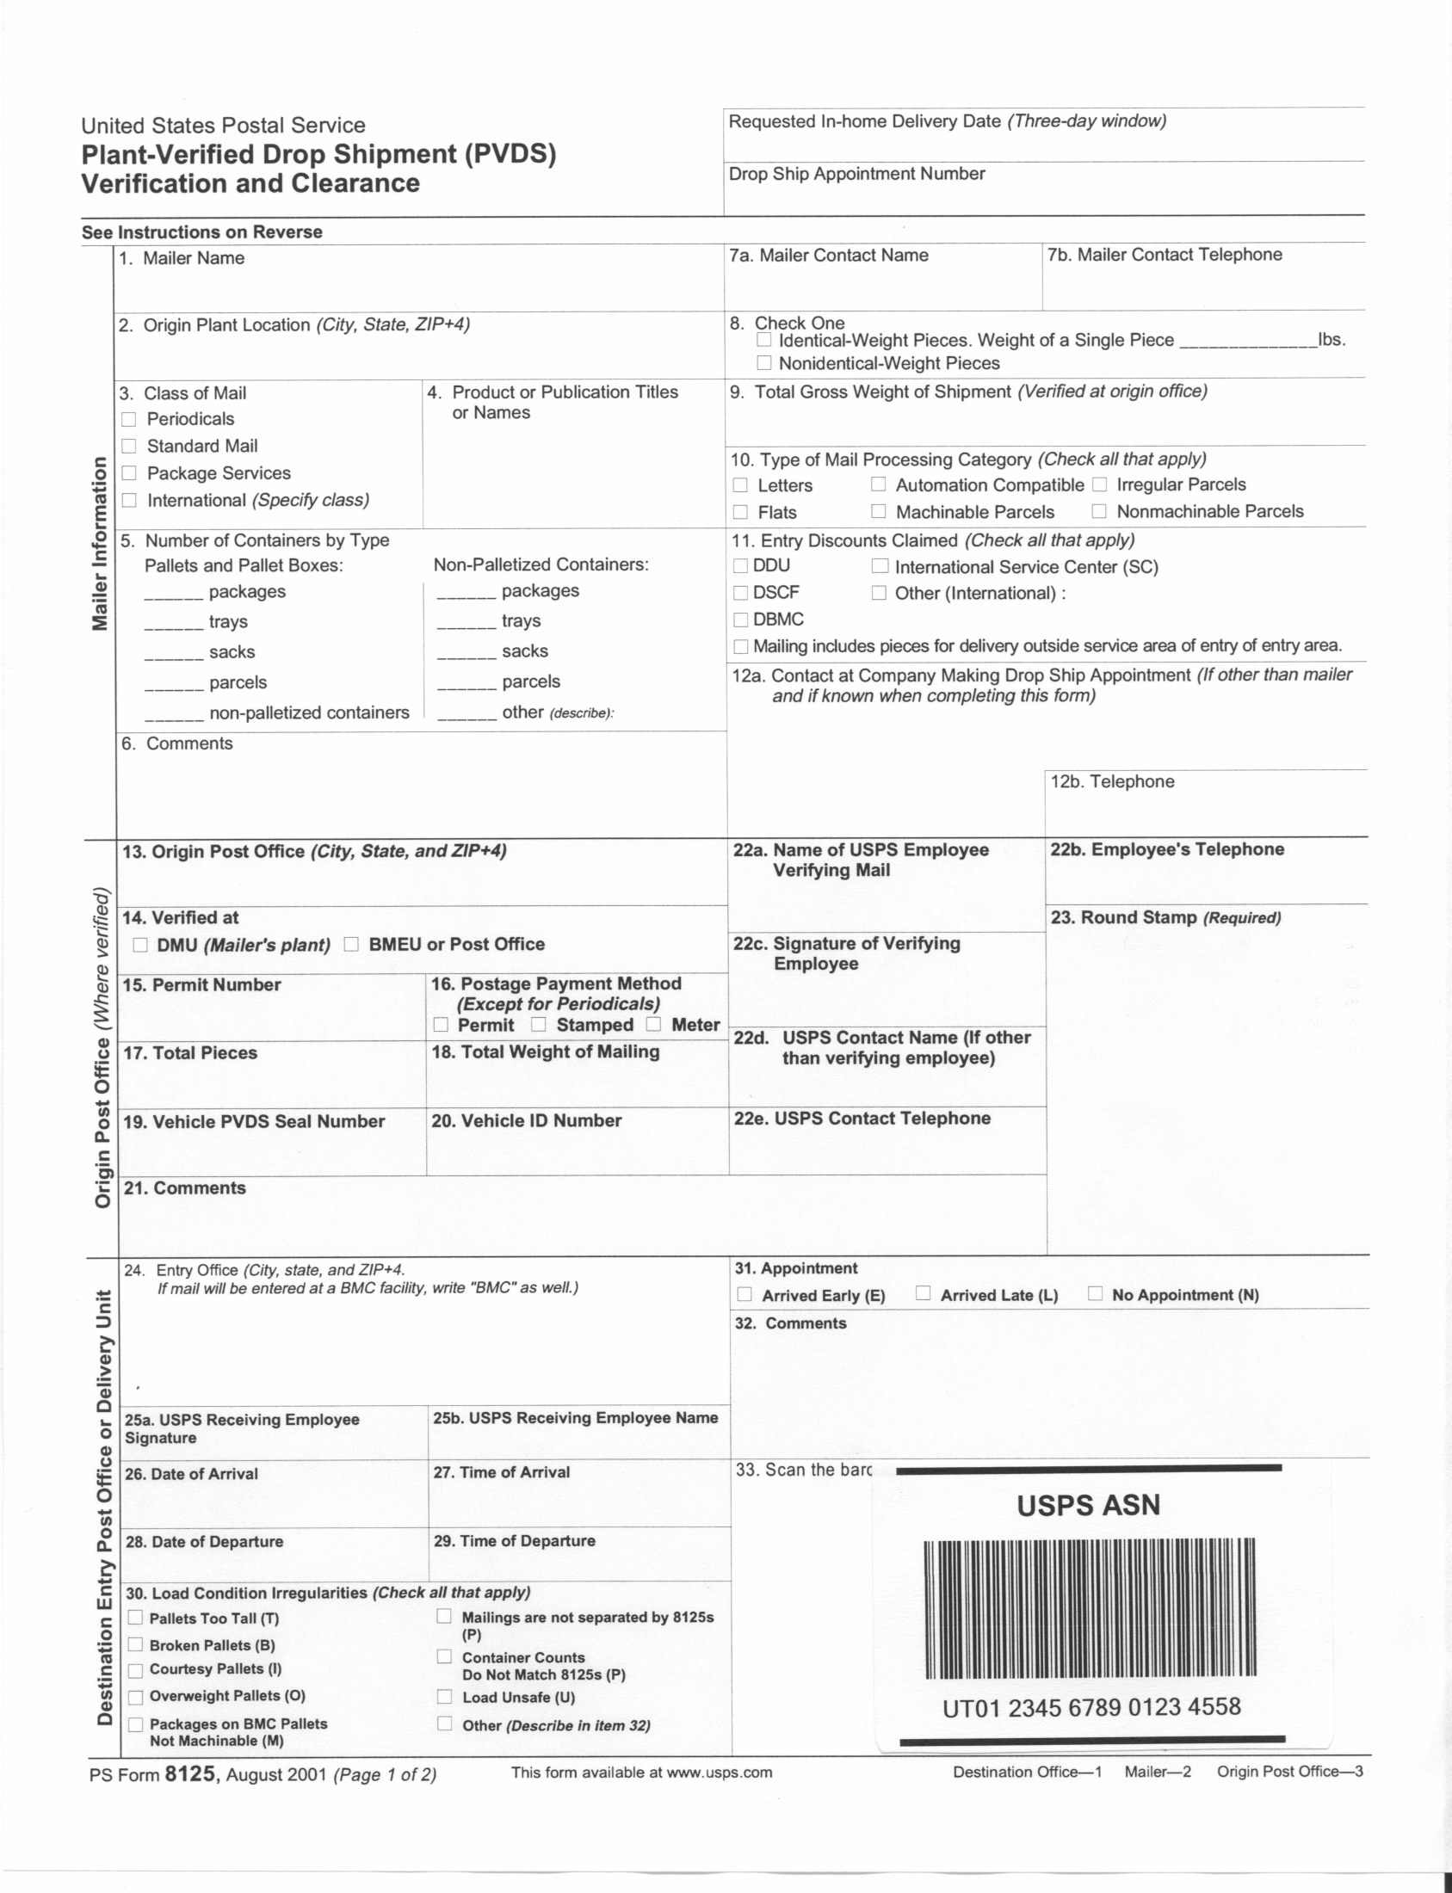

Fall Mailing Season
NEW FOR 2002
Entry
Barcode
Scan
Notes:
This will be the first Fall Mailing Season that postal employees capture electronic information about the induction of plant-verified drop shipments which may contain letters, flats, or parcels.
By scanning a barcoded Form 8125 at the destination entry office, we are able to provide electronic notification of WHEN and WHERE a shipment entered the Postal Service.
To scan an entry barcode, postal employees use a handheld scanner, like the ones letter carriers use to scan a Delivery Confirmation barcode from a parcel.

Slide 6
Fall Mailing Season
TRACKING SHIPMENTS
Programs Supported By Barcoded PS Form 8125
  Confirm - “USPS ASN” Barcode
  Parcel Select - “USPS SCAN” Barcode
Shared Reports Developed to Improve Service
Notes:
The “entry barcode” on Form 8125 supports two distinct programs
The Confirm Production System was launched October 1, 2001. We “start the clock” for a Confirm shipment by scanning a barcode on Form 8125. Mailers print “USPS ASN” above the barcode. Under the Confirm program, PLANET Codes will track the processing of individual letters or flats.
2. Parcel Select is supported by the Delivery Confirmation System and uses a different barcode, “USPS SCAN”. Parcel Select
Each of these programs have developed their own shared reports as a common tool for mailers and the Postal Service to use to improve service performance.
_____________________________________________________________________________
For Confirm, 5 shared reports are located on planetcodes.com:
Delivery Window
Entry Scan Performance
Mailer ASN Quality
Mailpiece Summary
Shipment Delivery
For Parcel Select service performance, new reports provide both the percent of pieces that meet standard and the percent of pieces delivery daily.

Slide 7
Fall Mailing Season
WHAT MAILERS CAN DO
Provide Readable Barcodes
  For Single Mailpieces - Letters, Flats, Parcels
  For Drop Shipments Using Form 8125
Use Drop Shipment Appointment System (DSAS) Responsibly
Notes:
Readable barcodes on letters, flats, and parcels ensure successful processing of mailpieces.
Readable barcodes on Form 8125 ensure successful capture of shipment data and provide the electronic linkage necessary to receive subsequent information on a particular mailpiece.
2. For all the appointments mailers make in DSAS, about 1 out of 5 are become categorized as “No Show”. Mailers need to cancel or reschedule appointments they will not be able to meet. This action will let other mailers take advantage of the vacant slot.

Slide 8
Fall Mailing Season
WHAT OPERATIONS WILL DO
Handle Volumes Efficiently
Meet In-Home Delivery Expectations
Capture Electronic Tracking Information
Continue to Work Together to Improve Service to Customers

