Slide 1
Topical Immunosuppressants (Calcineurin Inhibitors) -
Animal Toxicology
Barbara Hill, Ph.D.
Division of Dermatologic and Dental Drug Products
Pediatric Advisory Committee Meeting
February 15, 2005

Slide 2
Objective
Summarize the animal toxicology data available for two topical immunosuppressants (Calcineurin Inhibitors) that have been approved for the topical treatment of atopic dermatitis
Protopic (tacrolimus) ointment (12-8-00) and Elidel (pimecrolimus) cream (12-13-01)

Slide 3
Outline
Structures
General Toxicology
Genetic Toxicology Studies
Carcinogenicity Studies
9 Month Oral Monkey Toxicology Study
Summary

Slide 4
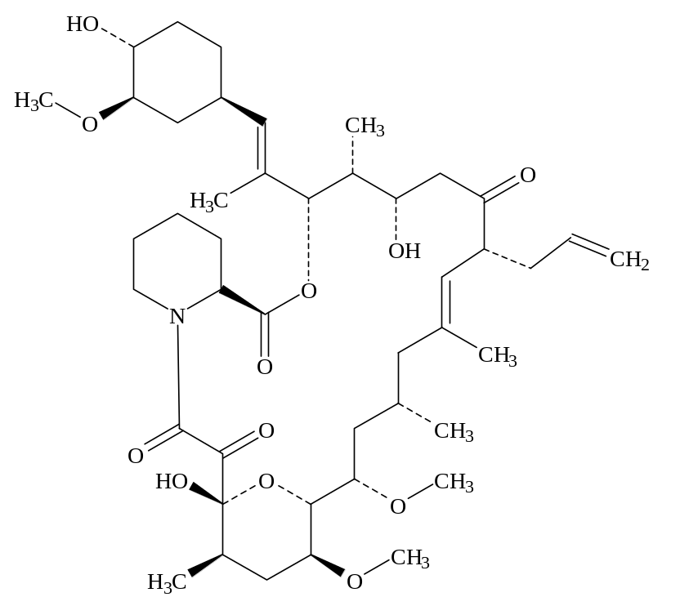
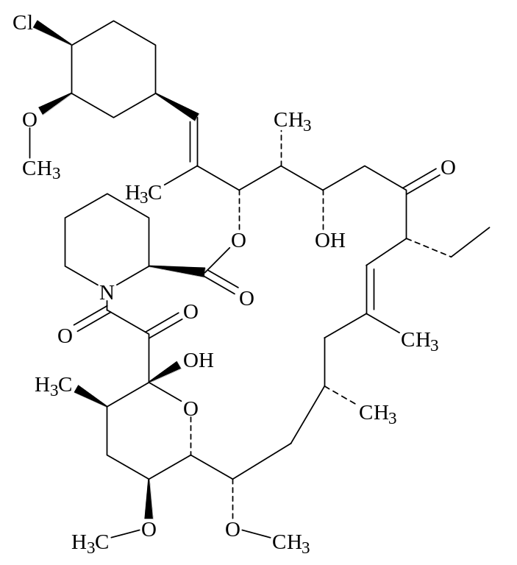
Structures
Tacrolimus
Pimecrolimus

Slide 5
General Toxicology
Potential immune target organs of toxicity identified in chronic rodent and nonrodent toxicology studies include thymus, lymph nodes and spleen
Nonclinical toxicology study results indicate both compounds are classic immunosuppressive agents

Slide 6
Genetic Toxicology
An appropriate battery of in vitro and in vivo genotoxicity tests were conducted for tacrolimus and pimecrolimus
Tacrolimus and pimecrolimus were non-genotoxic

Slide 7
Carcinogenicity Studies
Tacrolimus
Oral rat
Oral mouse
Dermal mouse (marketed formulation)
Pimecrolimus
Oral rat
Oral mouse
Dermal rat (marketed formulation)
Dermal mouse (ethanol - 13 week; special high dose studies)

Slide 8
Oral Carcinogenicity Studies - Lymphoma Signal
Drug | Species | Doseª | Factor^{b} | Result
Protopic | Rat | 3 | 9X | Negative^{c}
Protopic | Mouse | 5 | 3X | Negative^{c}
Elidel | Mouse | 48 | 258-340X | Lymphoma
Elidel | Mouse | 15 | 60-133X | NOEL^{d}
a – mg/kg/day
b – Multiple of human exposure based on maximum human AUC
c – Inadequate systemic exposure after oral administration
d – No Observed Effect Level

Slide 9
Dermal Carcinogenicity Studies - Lymphoma Signal
Drug | Species | Doseª | Factor^{b} | Result
Protopic^{c} | Mouse | 3.5 | 26X | Lymphoma
Protopic^{c} | Mouse | 1.1 | 10X | NOEL
Elidel^{c} | Rat | 10^{d} | 3.3X | Negative
Elidel^{e} | Mouse | 25 | 47X | Lymphoma
Elidel^{e} | Mouse | 10 | 17X | NOEL
Elidel^{e} | Mouse | 100 | 179-217X | Lymphoma^{f}
a – mg/kg/day
b – Multiple of human exposure based on maximum human AUC
c – Final market formulation; d – Highest possible dose
e – Dissolved in ethanol (13 week studies); f – After 8 weeks

Slide 10
Carcinogenicity Studies - Other Tumor Signal
Drug | Route | Species | Doseª | Factor^{b} | Result
Elidel | Oral | Rat (M&F) | 10 | 40X | BT^{c}
Elidel | Oral | Rat (M) | 5 | 32X | BT^{c}
Elidel | Oral | Rat (F) | 5 | 21X | NOEL
Elidel | Oral | Rat (M) | 1 | 1.1X | NOEL
Elidel^{d} | Dermal | Rat | 2e | 1.5X | FCAT^{f}
a – mg/kg/day
b – Multiple of human exposure based on maximum human AUC
c – Benign Thymoma; d – Final marketed formulation
e – Lowest dose tested; f – Follicular cell adenoma of the Thyroid

Slide 11
Lymphoma Mechanism
Results of the rodent carcinogenicity studies indicate that systemic immunosuppression leads to lymphoma formation
It is not clear if the mechanism of lymphoma formation is the same for rodents and humans

Slide 12
Oral monkey toxicology study
Oral doses of 0, 15, 45 and 120 mg/kg/day pimecrolimus administered for 39 weeks
High dose discontinued after 19 weeks due to mortality
Immunosuppressive related lymphoproliferative disorder (IRLD) noted in all dose groups
  IRLD frequently progresses to lymphoma

Slide 13
Oral monkey toxicology study
IRLD signal
Dose (mg/kg/day) | Incidence | Signal appearance (weeks)
0 | 0/8 | N/A
15 | 1/8 | 39
45 | 5/8 | 7ª – 39
120 | 7/9 | 14 – 18
a – one animal

Slide 14
Oral monkey toxicology study
IRLD was associated with lymphocryptovirus (Epstein Barr related virus)
IRLD exhibited a dose dependent expression
Opportunistic infections were noted in some animals in all dose groups
Three of the high dose monkeys with IRLD had concurrent leukemia

Slide 15
Oral monkey toxicology study
A NOEL for IRLD was not established in this study
Low dose is 31X MRHD based on AUC
Mechanism of lymphoma formation appears to be the same for monkeys and humans
It is unknown if the mechanism of leukemia formation is the same for monkeys and humans

Slide 16
Oral monkey toxicology study
Results from this study confirm that adequate systemic exposure to pimecrolimus could elicit lymphoma formation via a similar mechanism that has been established for tacrolimus in humans

Slide 17
Summary
Protopic (tacrolimus) ointment and Elidel (pimecrolimus) cream are topical immunosuppressants
Neither tacrolimus or pimecrolimus exhibited a genotoxic signal
Tumorigenicity exhibited by tacrolimus and pimecrolimus appears to be mediated by a non-genotoxic mechanism (i.e., immunosuppression)

Slide 18
Summary
A lymphoma signal was evident in a dermal mouse carcinogenicity study conducted with tacrolimus ointment
A lymphoma signal was evident in an oral mouse carcinogenicity study conducted with pimecrolimus
A lymphoma signal was evident in the 13 week dermal mouse study conducted with pimecrolimus dissolved in ethanol

Slide 19
Summary
Other tumor signals included:
  Benign thymoma noted in the oral rat carcinogenicity study conducted with pimecrolimus
  Follicular cell adenoma of the thyroid noted in the dermal rat carcinogenicity study conducted with pimecrolimus cream

Slide 20
Summary
IRLD was noted in a 9 month oral monkey toxicology study conducted with pimecrolimus
Biologic plausibility of lymphoma formation in local lymph nodes can not be ruled out at this time

