Slide 1

Development and Application of Computational Toxicology and Informatics Resources at the
FDA CDER Office of
Pharmaceutical Science
Advisory Committee for Pharmaceutical Science (ACPS)
Rockville, MD. October 19-20, 2004
The Informatics and Computational Safety Analysis Staff (ICSAS)
Joseph F. Contrera, Ph.D.*
Edwin J. Matthews, Ph.D.
Naomi L. Kruhlak, Ph.D.
R. Daniel Benz, Ph.D.

Slide 2
The Informatics and Computational Safety Analysis Staff (ICSAS)
Develops animal toxicology and clinical safety databases and data transformation algorithms
Transforms data, developing human expert rules for converting toxicological and clinical adverse effects data into a form suitable for computer modeling
Evaluates and promotes the use of quantitative structure activity relationship (QSAR) and data mining software
Leverages by working with the scientific community and software developers to create QSAR predictive toxicology software using mechanisms such as Material Transfer Agreements (MTAs) and Cooperative Research and Development Agreements (CRADAs)

Slide 3
FDA Critical Path Initiative
The Problem: “Not enough applied scientific work has been done to create new tools to get fundamentally better answers about how the safety and effectiveness of new products can be demonstrated, in faster time frames, with more certainty, and at lower costs.”
A Solution: “A new product development toolkit — containing powerful new scientific and technical methods such as animal or computer-based predictive models, biomarkers for safety and effectiveness, and new clinical evaluation techniques — is urgently needed to improve predictability and efficiency along the critical path from laboratory concept to commercial product.”

Slide 4
ICSAS and the Critical Path Initiative
Develop and supply new databases and predictive toxicology software tools to the pharmaceutical and chemical industry to improve the lead candidate screening process
Develop better means to identify and eliminate compounds with potentially significant adverse properties early in the discovery and development process, thereby reducing the regulatory review burden for the FDA, CDER and other regulatory agencies
Facilitate the review process by making better use of accumulated toxicological and human clinical knowledge.
Reduce testing (and use of animals) by eliminating non-critical and redundant laboratory studies
5. Encourage the development of complementary software systems that can predict toxicity and adverse human effects through collaboration with software developers and the scientific community

Slide 5
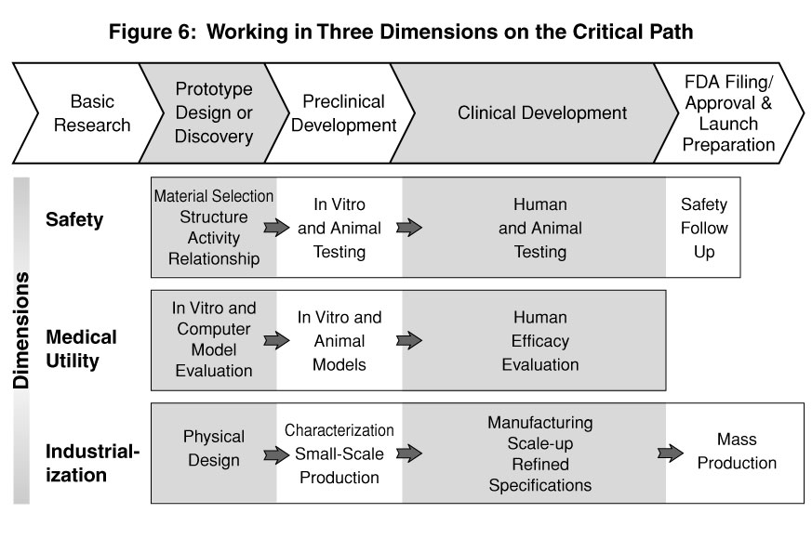

Slide 6
Currently Used Applications for ICSAS Computational Toxicology
“where toxicology data are limited or lacking”’
Lead Pharmaceutical Screening (Pharmaceutical Industry; National Institute on Drug Abuse, NIH - Drug Discovery Program for Medications Development for Addiction Treatment)
Evaluating Contaminants and Degradants in New Drug Products and Generic Drugs
Decision Support Information for Toxicology Issues Related to Drug Products in ONDC
Food Contact Substances (CFSAN/OFAS - FDAMA, 1997)
Environmental and Industrial Chemical Toxicity Screening (EPA)
Hypothesis generation, identifying data gaps; prioritizing research

Slide 7
The FDA Information Cycle
Submission
Review
Approval
Post-Approval
Proprietary
clinical and
toxicology data
Non-proprietary
clinical and
toxicology data
APPLICATIONS
Guidances
Decision Support
R & D
Computational
Toxicology
Proprietary
Databases
Non-proprietary
Databases

Slide 8
ICSAS Leveraging Initiatives for
Developing Informatic Resources
Objectives:
To construct endpoint specific, toxicity and adverse effect databases that are suitable for data mining and QSAR modeling
To hasten the Agency review process
To identify non-proprietary data that can be shared with industry and made publicly available through our CRADA partners
To investigate mechanisms of drug toxicity and develop human expert rules to explain the toxicities
Informatics (Database) CRADAs
MDL Information Systems / Reed Elsevier 2004 – 2008
Leadscope, Inc. (2005 – 2009)
LHASA Limited (2005 – 2009)

Slide 9
Chemical Structure-Linked
“Chemoinformatic” Knowledge Base
Chemical Structure
Similarity Searching
(MDL ISIS™/Host)
Clinical
Study
Summaries
Pharm/Tox
Study
Summaries
Chemical
Structure-Based
Substance Inventory
(“.mol”-file)
Clinical
Databases
Toxicology
Databases
Adverse
Event
Reporting
Systems
Computational
Predictive
Toxicology
e-Reviews;
Freedom of
Information
Files

Slide 10
Computational Predictive
Toxicology
Toxicologic Endpoints (e.g., Carcinogenicity, Mutagenicity)
Trans-formed
Toxicity
Data
Chemical
Structure
Data
Toxicity
Response
Predictions
SAR
Software
+
+
Dose Related Endpoints (e.g., MTD, MRDD, LD50)
Toxicity
Dose
Data
Chemical
Structure
Data
Toxicity
Dose
Predictions
SAR
Software
+
+

Slide 11
ICSAS Evaluated Predictive
Toxicology Software
Statistical Correlative In Silico Programs
MCASE(-ES) / MC4PC MultiCASE, Inc. CRADA*
MDL-QSAR MDL Information Systems, Inc. CRADA
ClassPharmer Bioreason, Inc. MTA
Leadscope Enterprise Leadscope, Inc. MTA
BioEpisteme Prous Science MTA
*CRADA = Cooperative Research and Development Agreement
MTA = Material Transfer Agreement
Human Expert Rule-Based In Silico Programs
DEREK for Windows LHASA, Limited MTA
ONCOLOGIC LogiChem, Inc. & EPA

Slide 12
ICSAS Animal Effects
Discovery System
In Vivo and In Vitro Toxicity Endpoints
Carcinogenicity in Rodents (male and female, rats and mice) M,Q
Teratogenicity in Mammals (rabbits, rats, mice) M,Q
Mutagenicity in Salmonella t. (TA100, TA1535, TA1537, TA98) M
Genetic Toxicity (chromosome aberrations)
Genetic Toxicity (mouse micronucleus; mouse lymphoma)
Reproductive Toxicity (male & female rats)
Behavioral Toxicity (rats)
Other Chemical Toxicity Endpoints
Acute Toxicity (rats, mice, rabbits)
90-Day Organ Toxicity (rats, mice, rabbits, dogs)

Slide 13
FDA / CDER/ ICSAS
Human Effects Discovery System
Organ System Adverse Endpoints
Hepatic Effects in Humans
Cardiac Effects in Humans
Renal / Bladder Effects in Humans
Immunological Effects in Humans
Dose Related Endpoints
Modeling the Maximum Recommended Daily Dose (MRDD)
Estimating the Safe Starting Dose in Phase I Clinical Trials
No-effect-level (NOEL) of Chemicals in Humans

Slide 14
Proprietary Data
Problems
  Industry and Agency archives contain critical positive control, toxic chemical data that are necessary for training QSAR models
  Identity of proprietary substances in Agency and Industry archives are confidential and legally protected

Slide 15
Technical Solutions for Sharing Data
Sharing study results linked to molecular attributes that do not disclose the name or molecular structure of proprietary compounds
Data linked to MDL-QSAR E-state descriptors or MULTICASE molecular fragments can supply useful molecular information that cannot be used to unambiguously reconstruct the molecular structure of a proprietary compound
MCASE / MC4PC and MDL-QSAR provide acceptable solutions

Slide 16
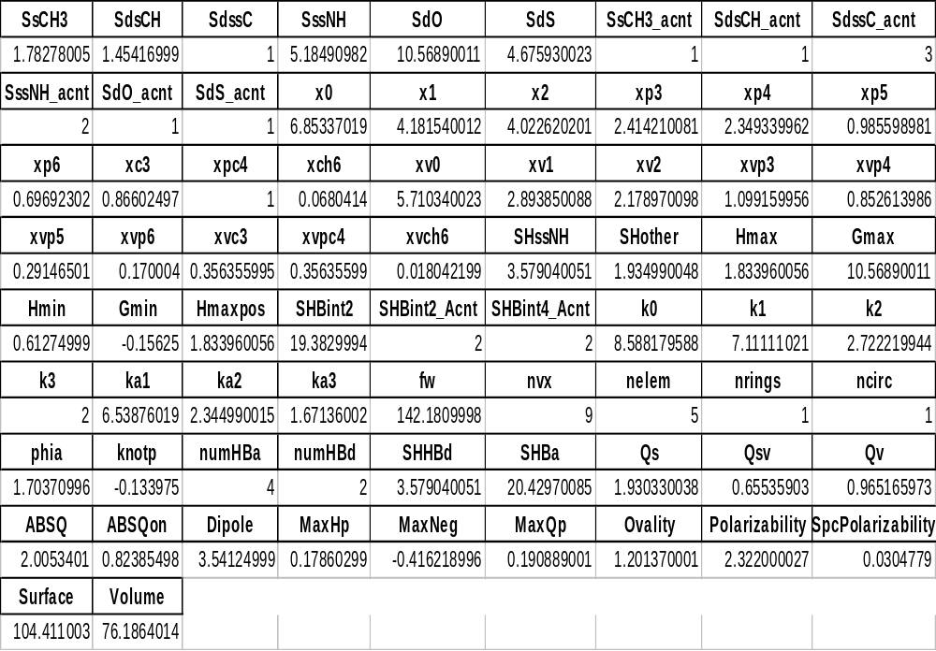
74 Methylthiouracil
MDL QSAR Descriptors
(S = E-state descriptors)
Kier, L.B. and L.H. Hall. Molecular Structure Description: The Electrotopological State, Academic Press

Slide 17
Selecting the Maximum Starting Dose in Clinical Trials
Present Method
Near Future
Multiple Dose Toxicity Studies
in Rodents and Non-rodents
Human MRDD
QSAR Model
Estimate Animal NOAEL
mg/kg/day
Predicted MRDD
mg/kg/day
Select Most Appropriate
Species Based on Species Sensitivity; ADME
Add Uncertainty-
Safety Factor(s)
Convert NOAEL to
Human Equivalent Dose (HED) (mg/kg/day)
Add Uncertainty-
Safety Factor(s)
Estimate Maximum Recommended
Starting Dose (MRSD)

Slide 18
Benefits of Using QSAR Modeling of the MRDD To Estimate the Safe Starting Dose in Phase I Clinical Trials
No animal test data are required (3Rs: Reduce, Refine, Replace)
No need for interspecies uncertainty factors
Increased accuracy, sensitivity and specificity over animal models (identifies chemical adverse effects not detected in animal studies)
Batch processing
(prioritization of large test chemical data sets)
Reduced cost

Slide 19
Future Application?
Two year rat and mouse carcinogenicity studies are the most costly and controversial non-clinical regulatory testing requirement. The results can have a major impact on the approvability and marketing of a drug product.
Is carcinogenicity testing necessary for all new drugs?
Can computational methods eventually replace carcinogenicity studies for compounds that are highly represented in the carcinogenicity database?
With increased experience and confidence with predictive software, it may be possible to reduce or eliminate carcinogenicity testing for compounds that have molecular structures that are highly represented in the carcinogenicity database.
This would reduce unnecessary testing and free resources for testing compounds that are truly new molecular entities and are poorly represented in the carcinogenicity database.

Slide 20
Challenges for the Regulatory Acceptance
of In Silico Testing
Accurate, validated in silico software
Standardization
Experience, training
Databases: data sharing with adequate protection of proprietary information
Regulatory scientists and managers willing to consider and use new approaches
Need for an objective appraisal of the limitations of current testing methods

Slide 21
Pharma 2005: An Industrial Revolution in R&D - PricewaterhouseCoopers
Now
Transition
Future
Primary Science:
Labs/Patients
Experimental Science:
e-R&D / Computers
Primary
Science
Primary
Science
Science
Secondary
Science
Secondary
Science
Secondary Science:
e-R&D / Computers
Confirmatory Science:
Labs/Patients

Slide 22
References
ICSAS website: www.fda.gov/cder/offices/ops_io/default.htm
Contrera, J. F., L. H. Hall, L. B. Kier, P. MacLaughlin, (2005) QSAR Modeling of Carcinogenic Risk Using Discriminant Analysis and Topological Molecular Descriptors, Regulatory Toxicology and Pharmacology, In press.
Contrera, J. F., E. J. Matthews and R. D. Benz, (2003). Predicting the Carcinogenic Potential of Pharmaceuticals in Rodents Using Molecular Structural Similarity and E-State Indices. Regulatory Toxicology and Pharmacology, 38(3):243-259.

Slide 23
References
Contrera, J. F., E. J. Matthews, N. L. Kruhlak and R.D.Benz, (2004). Estimating Maximum Recommended Daily Dose (MRDD) and No Effect Level (NOEL) Based on QSAR Modeling of Human Data. Regulatory Toxicology and Pharmacology, In press.
Matthews, E. J., N. L. Kruhlak, R. D. Benz, and J. F. Contrera (2004). Assessment of the Health Effects of Chemicals in Humans: I. QSAR Estimation of the Maximum Recommended Therapeutic Dose (MRTD) and No Effect Level (NOEL) of Organic Chemicals Based on Clinical Trial Data. Current Drug Discovery Technologies, 1:61-76.
Matthews, E. J. and Contrera, J. F. (1998). A new highly specific method predicting the carcinogenic potential of pharmaceuticals in rodents using enhanced MCASE QSAR-ES software. Regulatory Toxicology and Pharmacology 28:242 – 264.

