Slide 1
Perspective on Pharm/Tox Assessment for Cell and Gene Therapy Products
Ying Huang, Ph.D.
Pharmacologist
Center for Biologics Evaluation and Research
FDA

Slide 2
Presentation Outline
Regulatory expectations
OCTGT regulated CT and GT products
Preclinical evaluation
Potential safety concerns for CT and GT products
  Pharm/Tox study designs
  The use of animal species/models
Preclinical data in the IND
Communication with the FDA

Slide 3
Safety is Always Primary
FDA Regulatory & Scientific Input
ICH documents
FDA guidance/PTCs/21 CFR
Clinical Trials
IND Submission For
Early Phase Clinical Trial
Biologics License Application
(BLA)
Basic Research
POC Studies
Biodistribution
Toxicology
Product License Granted
PreIND discussion with FDA
Discovery Phase / Safety Assessment

Slide 4
How Are Animal Studies Integrated into the Proposed Clinical Plan?
21 CFR, part 312.23(a)(8)
Pharmacologic & Toxicologic Studies
  “…adequate information about the pharmacological & toxicological studies…on the basis of which the sponsor has concluded that it is reasonably safe to conduct the proposed clinical investigations. The kind, duration, & scope of animal and other tests required varies with the duration & nature of the proposed clinical investigations.”

Slide 5
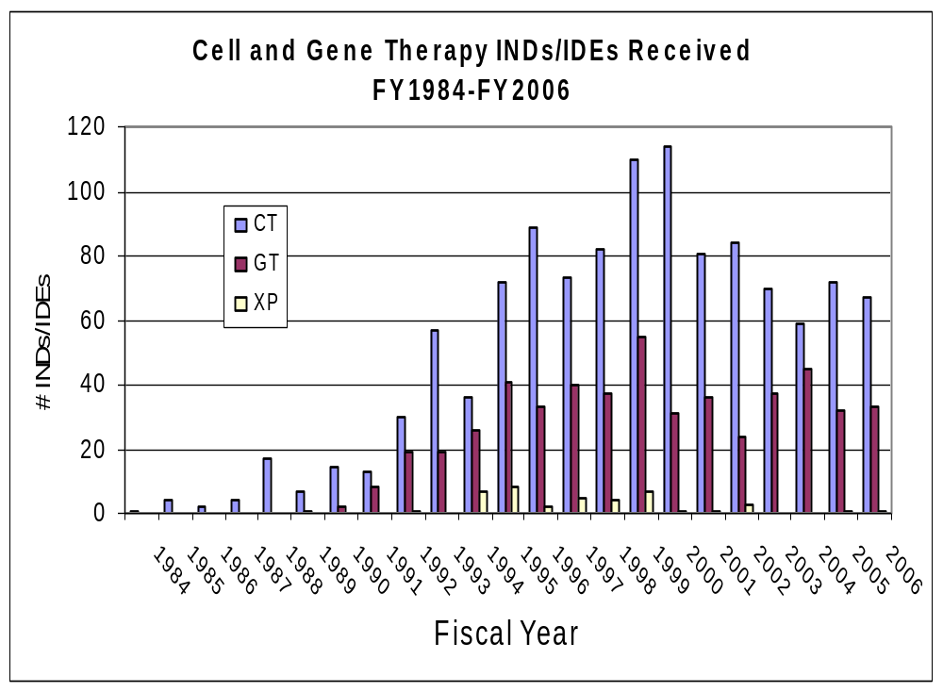
CT and GT IND/IDE Submissions in CBER
CT = cell therapy, GT = gene therapy, XP = xenotransplantation

Slide 6
OCTGT-Regulated Products
Somatic cell therapies
Gene Therapies
Viral therapies, e.g. oncolytic viruses
Immunotherapies, e.g. tumor vaccines
Xenotransplantation
Tissue engineering*
OCTGT Product + device*
* in conjunction with CDRH
Notes:
16
9
9

Slide 7
Product Examples
Cell Therapy Products
  Progenitor cells, e.g. stem cells derived from various types of human tissues, embryos, and hematopoietic stem cells…
  Differentiated cells, e.g. islet cells, cartilage cells, dendritic cells, T lymphocytes…
Gene Therapy Products
  Many types of replication deficient viral vectors
  Plasmid DNA vectors
  Various types of transgenes delivered by those vectors
Notes:
16
9
9

Slide 8
Product Examples (cont.)
Oncolytic Vectors
  Replication competent or attenuated viruses for the treatment of various type of cancers via viral lysis of tumor cells
Therapeutic Vaccines
  Tumor vaccines for cancer immunotherapy
  Vaccines for the treatment of nononcology diseases such as Alzheimer’s disease

Slide 9
Types of Vectors for GT
Plasmid DNA:
  Naked DNA
  Lipid-DNA complex
  Ligand-DNA complex
Others, e.g. bacteria-based gene transfer

Slide 10
Types of Vectors for GT (cont.)
Replication Deficient Viral Vectors
  Retroviruses
  Adenoviruses
  Adeno-associated viruses
  Vaccinia/fowlpox viruses
  Herpes simplex viruses
  Lentivirus
  Other newer vectors on the horizon ….

Slide 11
Routes of Gene Transfer
Ex vivo (transduction of cells in vitro)
  Transduced somatic cells
  Transduced hematopoietic cells
In situ (local delivery)
  Direct administration into specific tissues (e.g. intratumoral injection, s/c injection, etc.)
In vivo (systemic delivery)
  Intravenous administration, etc…

Slide 12
Regulatory expectations
OCTGT regulated CT and GT products
Preclinical evaluation
  Potential safety concerns for CT and GT products
  Pharm/Tox study designs
  The use of animal species/models
Preclinical data in the IND
Communication with the FDA

Slide 13
Preclinical Expectations for
Early Phase Clinical Trials
Scientific basis for conducting clinical trial
  Feasibility/establishment of rationale
  “Proof-of-concept” [POC]
    Establish pharmacologically effective dose(s)
    Optimize ROA/dosing regimen
    Rationale for species/model selection for further tests

Slide 14
Preclinical Expectations (cont.)
Recommend initial safe dose & dose escalation scheme in humans
  Potential target tissue(s) of toxicity/activity
  Parameters to monitor clinically
  Eligible patient population

Slide 15
Preclinical Evaluation – CT/GT
Agents vs. “Traditional” Biologics
Similar general requirements for safety
  Pharmacologic profiles
  Proof-of-Concept (POC)
  Dose-response relationship
  Toxicology profile

Slide 16
Preclinical Evaluation – CT & GT Agents
BUT… the approach by which safety data are obtained will differ
  Gene Therapy…………Cell Therapy
Biodistribution of
vector
Kinetics of gene
expression
Migration potential
Differentiation
Phenotype expressed
Anatomical/functional integration into host physiology
Post-transplant survival

Slide 17
Preclinical Evaluation –
CT & GT Agents (cont.)
  Gene Therapy.…………...Cell Therapy
  Long-term toxicity
Carcinogenicity/
insertional mutagenesis:
Tumorigenicity/
proliferative potential:
Depends on the product
Consider the ROA
Include appropriate study duration

Slide 18
Preclinical Evaluation –
CT & GT Agents (cont.)
  Gene Therapy.…………… Cell Therapy
  Long-term toxicity
Reproductive Toxicity
Consider a tiered approach
  Based on the BD data of the vector
  Determine the need to address the risk of germline transfer, then
  Determine the need to conduct reproductive and developmental toxicology studies
ICH S5(R2) guideline should be consulted for the overall design of these studies

Slide 19
Potential Safety Concerns for
CT Products
Risk analysis based on CT products
  Cell survival status following delivery
  Cell migration/trafficking to non-target site(s)
  Cell differentiation to undesired cell types
  Immunogenicity to xenogeneic/allogeneic cells
  Uncontrolled cell proliferation or tumorigenicity
  Host response (physiologic, anatomic, the use of immunosuppressants, etc.)

Slide 20
Potential Safety Concerns for
GT Products
Risk analysis based on GT products:
  Phenotype/activation state of target cell(s)
  Type of vector, mode of introduction
  Vector biodistribution to non-target cells
  Level and/or persistence of vector genome
  Level of viral replication in non-target tissues
  Inappropriate immune activation
  Potential for insertional mutagenesis and/or oncogenicity

Slide 21
Potential Safety Concerns for
GT Products (cont.)
Transgene related concerns
Expression of endogenous or recombinant enzymes, receptors, ligands, hormones, growth factors, oligonucleotides (anti-sense, siRNA, etc…)
  Local vs. systemic activities
  Acute or chronic effects
  Immunogenicity
  Autoimmunity

Slide 22
Pharm/Tox Studies
Pharmacology/POC studies
  Relevance of animal species/models
  Dose levels/regimen at which the desired biological activity can be observed via the proposed ROA
Toxicology (T) studies in a healthy animal that is biologically relevant for safety assessment
Hybrid pharmacology-toxicology study design
  POC + T – Obtain toxicology endpoints in an animal model of disease

Slide 23
Toxicology Study Design
Appropriate controls
Mimic clinical scenario as closely as possible
  Product, formulation, ROA, dose regimen, etc.
Reasonable group size to provide adequate interpretation of the data
The number of animals will vary depending on the species, disease model, delivery system, product class, etc.

Slide 24
Toxicology Study Design (cont.)
Sufficient duration, depending on the biology of the test product, to allow for appearance of any toxicities…and the potential for resolution of toxicities
  Use several time points to evaluate early, middle and late findings following dosing
  Include the time point at which the toxicities are expected to be reversed/resolved

Slide 25
Toxicology Study Design (cont.)
Selection of dose levels
  Include multiple dose levels in order to determine No-Observed-Adverse-Effect-Level (NOAEL)
  NOAEL will help to determine a safe starting dose level and dose escalation scheme in the clinical trial
  Need repeat dose toxicology study to support safety of a repeat dosing regimen in the clinical trial

Slide 26
Toxicology Study Design (cont.)
Standard Toxicology Endpoints
  Mortality
  Clinical observations, body weights, appetite
  Hematology and coagulation
  Serum chemistry
  Immune effects (humoral or cellular immune responses)
  Gross pathology (scheduled and unscheduled deaths)
  Microscopic pathology
    Scheduled and unscheduled deaths
    Examine both target and non-target tissues
  Specific immunohistochemistry staining

Slide 27
Pharm/Tox Study Design for
CT Products
The guiding principles for POC and safety studies remain the same for CT and GT products
Specific safety endpoints include cell survival, undesired cell differentiation and proliferation, immunogenicity to xenogeneic/allogeneic cells, host tissue/organ response…
Safety endpoints may vary
  Depending on the product
  Considering the ROA
Appropriate study duration may also vary

Slide 28
Pharm/Tox Study Design for
CT Products (cont.)
‘Hybrid’ studies may be conducted to provide rationale and safety data
Cell trafficking data may be needed depending on the product and ROA
The advisory committee recommendations (e.g. BRMAC* for cardiac CT) are also an important source of information for guiding safety assessment
        *Now called CTGTAC

Slide 29
Vector Biodistribution (BD) Studies for GT Products
Use of a relevant species, e.g. the same species as used in the toxicology study
Usually the maximum feasible dose and/or NOAEL dose levels used in toxicology study
Administered via the clinical ROA, i.e. used in toxicology study
Biodistribution profile in both target and non-target tissues, including the blood
Guidance for Industry: Gene Therapy Clinical Trials – Observing Subjects for Delayed Adverse Events

Slide 30
Vector BD Studies for GT Products – Specific Considerations
Novel GT products: the BD data need to be completed prior to initiation of clinical trials to assess vector persistence & kinetic profile
GT products similar to those previously used in humans:
  Safety database in humans
  BD data in animals by cross-reference to other INDs
  Conduct of BD study in parallel with early phase clinical trials
BD data using the clinical material are needed for license application and labeling

Slide 31
CT & GT Dose Extrapolation
The objective is to recommend a starting clinical dose level and dose escalation scheme that are safe and biologically plausible
Dose extrapolation between animals and humans based on:
  POC data – minimally active dose level
  Safety data from animal studies (e.g. toxicology, vector BD, cell migration) - NOAEL
Calculation of clinical dose levels based on
  Fixed dose level (e.g., absolute dose)
  Body weight
  Organ mass (volume/weight)

Slide 32
Preclinical Safety Evaluation –
Other Issues – Devices
Is this device approved/cleared for the intended use?
If not - has an IDE/MF been submitted to CDRH?
  Yes - Need to include a letter of cross reference in your IND
  No - Need to consult with CDRH as to what data are required for submission
Perform preclinical safety evaluation studies using the intended clinical device, if possible

Slide 33
Selection of Appropriate Animal Species
The use of NHPs is not required
The use of multiple species (e.g. a rodent and a non-rodent) is not required
…..BUT…..
Scientific justification must be provided for the selection of the animal species/model

Slide 34
Selection of Animal Species/Model
Use of relevant species/model
  Traditional
    Normal animals; rodent & non-rodent
  Non-traditional
    Spontaneous disease
    “Non-spontaneous” disease (induced, challenge)
    Genetically modified animals (e.g. “humanized” or transgenic animals)

Slide 35
Selection of Animal Species/Model (cont.)
Use of large animal models may be needed for preclinical assessment of CT/GT products
  Depends on the product
  Depends on the ROA
  Depends on the delivery system

Slide 36
Preclinical Summary
Pharm/Tox studies for CT & GT should be:
  Rational, problem-solving in study design
  Assessments based on the best available technology, methods to date
  Conclusions are data-driven
  Scientifically designed & judicious use of animals
Should allow for early initiation of clinical trials
Should allow uninterrupted clinical development

Slide 37
Preclinical Summary (cont.)
Some limitations of preclinical studies for CT and GT products
  Information on mechanism of action is often limited
  Biologically relevant animal species or model(s) of disease are not always available
  Limited information is available to support the validity of extrapolation from animal to human
No one species will be representative or predictive for all humans, including humans

Slide 38
Regulatory expectations
OCTGT regulated CT and GT products
Preclinical evaluation
Potential safety concerns for CT and GT products
  Pharm/Tox study designs
  The use of animal species/models
Pharm/Tox data in the IND
Communication with the FDA

Slide 39
Sources of Preclinical
Pharmacology Data
Pharmacology data in support of a clinical trial can come from:
  Well-controlled studies conducted in-house
  Published data in peer-reviewed journals
  Cross-reference to similar products in previously submitted MF/INDs

Slide 40
Sources of Toxicology Data
Toxicology data in support of a clinical trial can come from:
  GLP-compliant toxicology studies
  Well-controlled studies conducted in-house
  Published data in peer-reviewed journals
  Cross-reference to similar products in previously submitted MF/INDs

Slide 41
Perils of Using Published Animal or Human Studies as Sole Support for Initiation of Clinical Trials
Often they were not designed to answer a toxicologic question, and therefore, adequate toxicology endpoints may not have been incorporated into the design
Published reports often do not provide sufficient information for independent review
Products were not comparable/substantially similar

Slide 42
Submit Complete Study Reports
Not just summarized statements
Detailed description of the study performed
  Test system (i.e. animal species/model)
  Test articles/ROA/delivery system
  Study methodology - dose levels; dose schedule; dose procedure; test parameters, etc…
Complete data sets for all parameters evaluated
  Submit individual animal data for all parameters evaluated
  Submit summarized and tabulated results

Slide 43
Regulatory expectations
OCTGT regulated CT and GT products
Preclinical evaluation
  Potential safety concerns for CT and GT products
  Pharm/Tox study designs
  The use of animal species/models
Pharm/Tox data in the IND
Communication with the FDA

Slide 44
Early Communication
Pre-preIND interactions
  Non-binding, informal scientific discussions between Pharm/Tox in OCTGT/CBER and sponsor
Pre-IND meetings
  Submit a pre-IND package to include:
    Product development/characterization – Chemistry, Manufacturing and Controls (CMC)
    Summary of preclinical information – Pharmacology, Toxicology study protocol/plan
    Proposed clinical protocol outline
  Schedule a pre-IND teleconference

Slide 45
Selected Guidance Documents
Guidance for Industry: Providing Clinical Evidence of Effectiveness for Human Drug and Biological products www.fda.gov/cder/guidance/1397fnl.pdf
Guidance for Industry: Guidance for Human Somatice Cell Therapy and Gene Therapy (1998) www.fda.gov/cber/gdlns/somgene.pdf
The ICH S6 document: Preclinical Safety Evaluation of Biotechnology Derived Pharmaceuticals www.fda.gov/cder/guidance/1859fnl.pdf
Guidance for Industry: Gene Therapy Clinical Trials – Observing Subjects for Delayed Adverse Events www.fda.gov/cber/gdlns/gtclin.pdf

Slide 46
The Pharm/Tox Branch (PTB) at OCTGT/DCEPT
Mercedes Serabian, M.S. DABT, Branch Chief; Initial contact for
pre-preIND interactions
A total of 7 reviewers including the BC: Interdisciplinary scientists - biologist, chemist, pharmacologist, toxicologist, and ORISE Fellow
(301) 827-5102 [phone]; (301) 827-9796 [fax]

Slide 47
CME Questions
For the development of a replication-deficient adenoviral vector expressing the extracellular domain of the HER2 gene as a tumor vaccine for immunotherapy to treat cancer patients,
  What preclinical studies or endpoints might be useful in supporting the clinical proof of concept?
  What types of preclinical studies are needed to support safety of the proposed clinical trial?
  Please propose your scheme for scaling from animal to human safe doses.

