Slide 1


Methadone Mortality – A Reassessment
Decedents in Rural Virginia
Martha J Wunsch MD FASAM
Kent Nakamoto PhD

Slide 2
Year | Drug Deaths | Opioid Related Deaths* | Oxycodone | Methadone | Fentanyl | Hydrocodone | MSO4
1997 | 67 | ? | 1 | 4 | 0 | 6 | 12
1998 | 69 | 8 | 3 | 6 | 0 | 12 | 7
1999 | 84 | 25 | 18 | 12 | 0 | 8 | 11
2000 | 101 | 36 | 19 | 22 | 1 | 10 | 17
2001 | 164 | 95 | 41 | 49 | 9 | 34 | 13
2002 | 185 | 101 | 26 | 62 | 12 | 42 | 21
2003 | 223 | 157 | 44 | 88 | 21 | 47 | 15
2004 | 243 | ? | 37 | 69 | 22 | 47 | 36
2005 | 210 | ? | 36 | 70 | 14 | 47 | 31
*Opioids as a direct or contributing cause of death
Notes:
WE GOTTA PROBLEM!
Polysubstance deaths
Lack of “traditional street drugs” such as heroin and cocaine
Prescription drugs identified: opiates, benzodiazepines, antidepressants
Not just methadone—Hydrocodone, Oxycodone
Scene investigations: Drug trafficking, diversion, prescription fraud

Slide 3
“Opioid Mortality in Southwestern Virginia”
M Wunsch MD,
W Massello MD, G Behonick PhD,
K Nakamoto PhD
*National Institute of Drug Abuse RO3 DA019047-01A1
Notes:
Multidisciplinary: ME, Toxicologist, Addiction Medicine specialists

Slide 4
Overall Goal
Characterize individuals who die from prescription drugs in a rural area of Virginia
Who is dying?
From what drugs?
Is this “traditional” drug abuse?

Slide 5
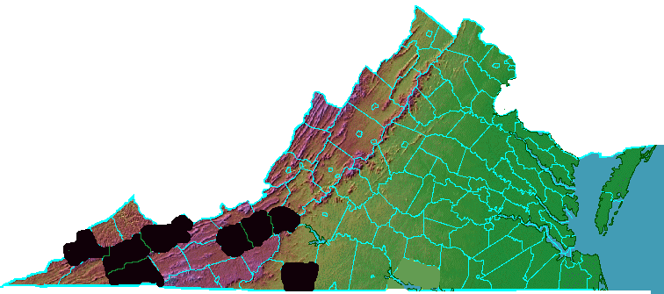
Geographic Area
Opioid Deaths in Rural Virginia
Roanoke/ Roanoke County + Salem
Montgomery
County
Tazewell County
Russell County
Wise + Norton
Washington County + Bristol
Pulaski County + Radford
Henry County
+ Martinsville
Notes:
Highlights of this region 7 HOURS FROM DC….got to NYC
34 counties, almost entirely rural—only one city with pop. 100,000. Total population of region 1.5 million.
Remote and mountainous--Appalachia
Serious economic decline—traditional industries textiles and forest products almost all lost to offshoring. Mining recent resurgence but unemployment in the region is still more than double that in Northern VA.

Slide 6
Methods
893 “Drug Death” OCME Files 1997-2003
  Autopsy Results
  Death Certificates
  Death Scene Investigations
  Police Reports
  Toxicology Reports
  Physician Notes
  Hospital Records ( ER, Inpatient, Psych)
Notes:
Data Base SPSS designed for this study allows importation for stat evaluation

Slide 7

Drug Deaths….Opioid Deaths
300
250
200
# Deaths
150
Drug Deaths
Opioid Deaths
100
50
0
1998
1999
2000
2001
2002
2003
2004
2005
Year
Notes:
Increase due to opioid deaths (parallel lines)
Serious Problem: Death Rate depending on age group 6 to 10 times national average.

Slide 8
Opioids Identified on Toxicology
Age | Under 20 | 20-34 | 35-54 | 55 or Over
N | 23 | 140 | 293 | 20
Heroin | 1 | 7 | 13 | 0 | p>.10
Methadone | 18 | 83 | 142 | 7 | p<.01
Oxycodone or Schedule II¹ | 4 | 71 | 145 | 10 | p<.05
Hydrocodone or Codeine² | 7 | 56 | 133 | 9 | p>.10
Schedule IV or other³ | 4 | 30 | 81 | 8 | p>.10
¹Fentanyl, Hydromorphone, Morphine, Oxymorphone ²Schedule II or III depending on preparation ³Propoxyphene, Tramadol (not scheduled)
Notes:
MOST prevalent drug involved in these deaths was methadone
Additionallly, oxycodone, hydrocodone frequently encountered in these cases.

Slide 9
Case Definition: Methadone Deaths
893 Drug Deaths (1997-2003)
  643 NO methadone identified by toxicology
    6 Classified as “methadone as COD”
  250 methadone identified by toxicology
    243 Classified as methadone as direct or contributing COD
243 cases where methadone was a direct or contributing cause of death AND toxicology was positive

Slide 10
243 Methadone Cases
Gender
  75.2% Male ; 24.8% Female
Race
  98% White ; 1.2% African American; .4 % Asian
Marital Status
  36.8% married;12% cohabitating
  14% divorced
  28.8% single
Education: 34% <High School; 46% HS grads
Notes:
Gender all DD: 58% Male; 42% Female (p<.001)
Race: more AA in DD: 92% White; 7.5% African American, .5% Native American(p<.01)
Marital Status: All DD more divorced, mtd more cohabitating (p <.01)
Education n.s.
34% < High School
46% HS graduate
14% Trade/Associates degree
2 % College or more education
4% unknown

Slide 11
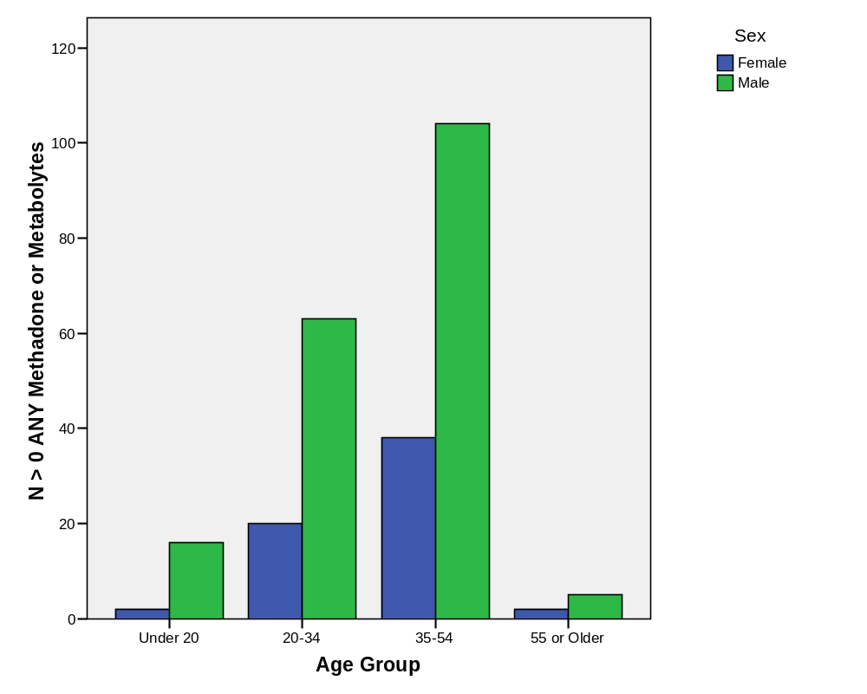
Age Distribution of Cases
Notes:
The Centers for Disease Control identified 11 states in which undetermined and unintended poisoning deaths increased by an average of 145% between 1990-2001.6 While the number of heroin poisonings increased by 12.4% from 1999 to 2002, the number of opioid analgesic poisonings in the US increased by 91.2%.
The 2003 New Dawn Report reported increased opioid-related drug misuse deaths in Maine, New Hampshire, Vermont, Maryland, Utah, and New Mexico involving predominantly the prescription medications oxycodone, hydrocodone, and methadone. 5 CDC New Mexico, Vermont, Utah, Maine, New Hampshire 35-54 y/o, Maryland younger

Slide 12
Manner of Death
Methadone Cases
Type of Death | Male | Female
Accident | 88.8%* | 80.6%*
Suicide | 8%* | 19.4%*
Unknown | 1.6% | 0
p<.001
Notes:
TOTAL SAMPLE
Females suicide 42.5, accident 52.6
Males suicide 23.3, accident 73.5

Slide 13
Prescriptions in Decedent Name
A decedent was noted to have a prescription for a medication if a bottle in their name was found at death scene, noted as prescribed in a medical record, or listed in death scene pharmacy log
Any Opioid Prescription?
  45.2% of cases had a Rx for an Opioid
Any Methadone Rx?
  23.6% of cases had a Rx for methadone
Notes:
OF THOSE WITH OPIOID RX HALF HAD ONE FOR METHADONE
Non methadone deaths: 1% had a rx for mtd
Prescription Present: Three indicators were used to identify that the decedents had been prescribed an opioid medications: 1) Presence at the death scene of a labeled prescription bottle in the name of the decedent from field medical examiner reports 2) Record from an attending physician or hospital note indicating the decedent was prescribed an opioid medication 3) Death investigation pharmacy logs indicating an opioid prescription in the name of the decedent.

Slide 14
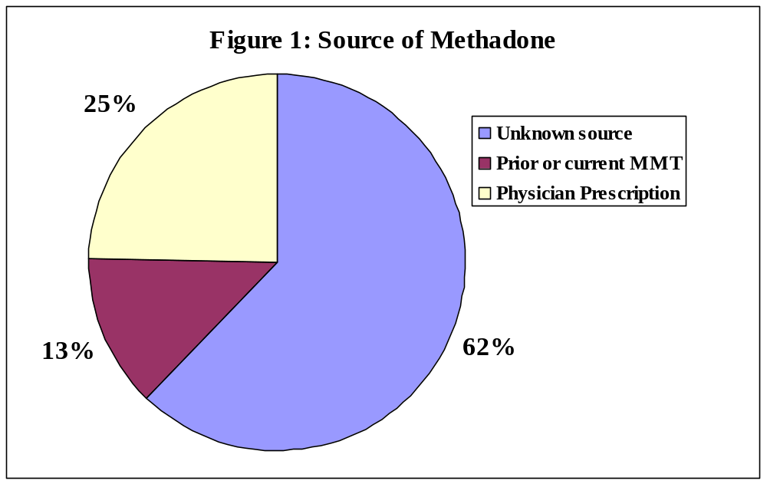
Source of methadone in 68 cases (2004)
Notes:
Verifies what we found—1/4 with rx from doc
AND because 13% had been in MMT….
WE are probably underestimating the # decedents who are prescribed methadone for medical problem—mmt or pain.

Slide 15
Medical Diagnosis
Chronic Pain 40%
  55 % have an antidepressant on toxicology
  55 % have a benzodiazepine on toxicology
Anxiety Disorder 19%
  50% have an antidepressant on toxicology
  46% have a benzodiazepine on toxicology
Depression 40%
  60% have an antidepressant on toxicology
  56% have a benzodiazepine on toxicology
Notes:
Scene Investigator
ME note on autopsy
Note in medical chart
BZD higher

Slide 16
Toxicology Results
Opioids
  68% had only methadone present
  24% had methadone AND another opioid present
  8% had methadone AND 2 or more opioids present

Slide 17
Implications
Traditional View (NSDUH) This is an epidemic of young people using prescription drugs non-medically to “get high”
Western Virginia (and probably other rural areas):
  Highest accidental mortality among adults 35-54.
  Many hold a prescription for methadone or opioid.
  Medical history consistent with prescription.
Perhaps these deaths are due to misuse of prescribed opioids including methadone.
A different problem calling for different strategies.
Notes:
Educating providers and patients

