Slide 1
TOXNET
Toxicology and Environmental Health Information on the Web
http://toxnet.nlm.nih.gov
New England Region, NN/LM
July 2007
The NN/LM NER is funded by the National Library of Medicine under a contract (#N01-LM-1-3518) with the University of Massachusetts Medical School in Worcester.

Slide 2
What is TOXNET?
System of databases
Information about toxicology, environmental health, hazardous chemicals, and toxic releases
Developed by the Specialized Information Services division (SIS) of the National Library of Medicine (NLM)

Slide 3
Where is TOXNET?
http://toxnet.nlm.nih.gov
TOXNET is freely available on the web. No subscription, no passwords, no registration, no spam, no pop-up ads.

Slide 4
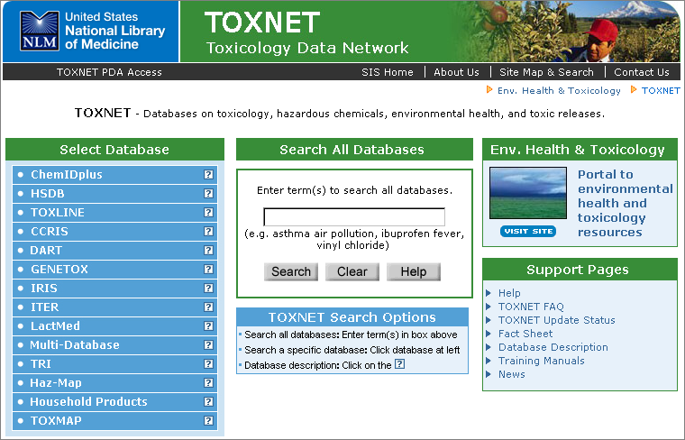
TOXNET home page:

Slide 5
Related Resources
TOXNET Resources
Data Files | Literature Files | Chemical Dictionary | Toxic Releases | Mapping | Consumer Health
HSDB | TOXLINE | ChemIDplus | TRI | TOXMAP | Haz-Map
CCRIS | DART |  |  |  | Household Products
GENE-TOX
IRIS
ITER
Lact-Med

Slide 6
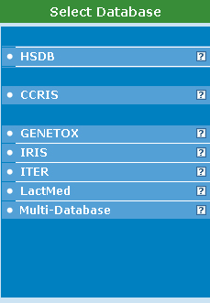
TOXNET Data Files
There are 6 of them
Click the ?
for additional information about each database

Slide 7
Hazardous Substances Data Bank
(HSDB)
  Data compiled by NLM
  1 record per chemical
  5,000 + records
  Human and animal toxicity
  Safety and handling
  Human health effects
  Emergency medical treatment
  Much more

Slide 8
Integrated Risk Information System
(IRIS)
  EPA data
  550 + chemical records
  Risk assessment as a function of toxicity and exposure
  Contains consensus scientific positions and quantitative values on cancer and non-cancer effects that may result from lifetime oral or inhalation exposure to specific chemical substances in the environment

Slide 9
International Toxicity Estimates for Risk Assessment (ITER)
  From Toxicology Excellence for Risk Assessment (TERA)
  650 + chemical records
  Contains data in support of human health risk assessment
  Provides comparisons of international risk assessment information in a side-by-side format and explains differences in risk values derived by different organizations.

Slide 10
Genetic Toxicology / Mutagenicity
(GENE-TOX)
  EPA data
  3,214 chemical records
  Mutagenicity Studies
  Data structure: assay type, assay code, results, panel report, reference
  Note: Has not been updated since January, 2000.

Slide 11
Chemical Carcinogenesis Research Information System (CCRIS)
  NCI data
  9,000 + chemical records
  Carcinogenicity studies
  Tumor inhibition studies
  Tumor promotion studies
  Mutagenicity studies

Slide 12
LactMed
  Database of drugs and chemicals to which breastfeeding moms may be exposed
  Levels in breast milk & infant blood
  Statements from the American Academy of Pediatrics re: a drug’s compatibility with breastfeeding
  Therapeutic alternatives
  Peer reviewed
  Over 550 records

Slide 13
TOXNET Data Files
Content differs from one data file to another
But format, layout of results, features, and navigation are similar
Learn the mechanics of one; know the mechanics of all

Slide 14
Searching the Data Files
Search by:
  Chemical name
  CAS Registry Number
Text word searching allowed
  Truncation (*) – end of word
  AND, OR, NOT (must be in caps)
  Nested searching OK
  Phrase searching OK

Slide 15
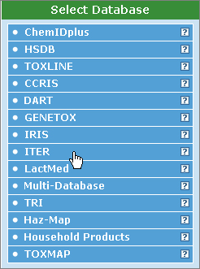
Data files can be search individually
Select the database to be searched:
Point the cursor at desired database
Click

Slide 16
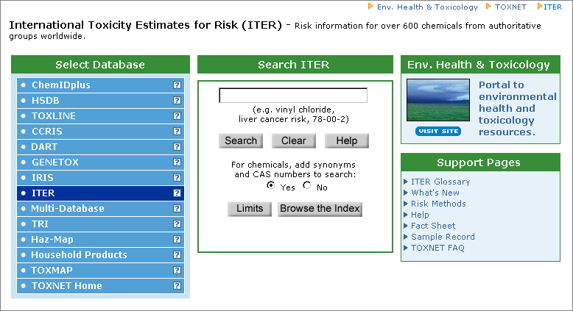
Search will be conducted only in the chosen database
Notes:
Now, TOXNET shows that only the chosen database will be searched. As with searching ALL of TOXNET, simply enter search terms here and click “Search.” This will bring you to the same search results pages seen before.

Slide 17
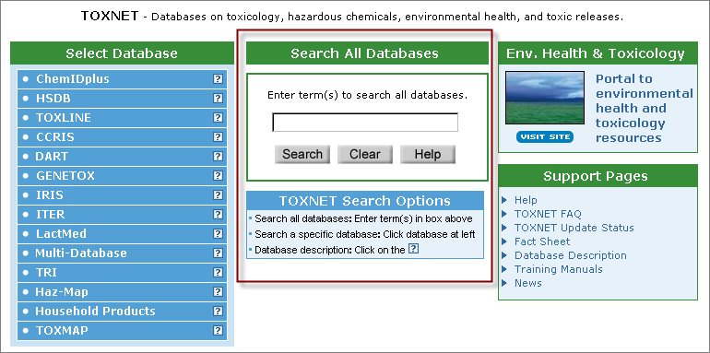
Or, search all TOXNET databases for information:
Notes:
This is the default search page in TOXNET. It automatically searches across all the TOXNET databases with a single click.

Slide 18
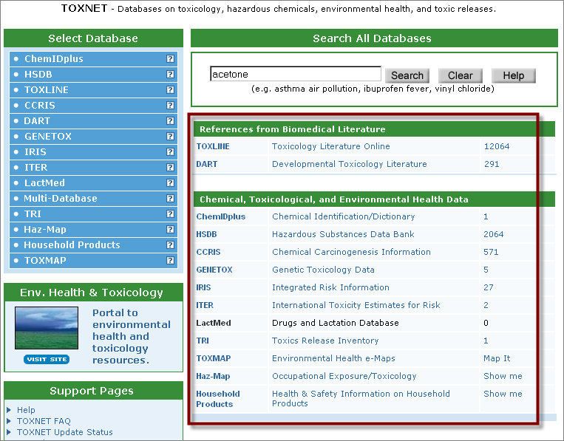
Results are hyperlinked. Click a link to see results from that database:
Notes:
All databases in TOXNET have been searched for information about acetone. The number of hits from each database are listed and hyperlinked. Click on the link to access results from a specific database.
NOTE: The number of records found from a "Search All Databases" query may differ slightly from the results retrieved from searching the individual databases because a general query is used here, while a more focused search is used in the individual databases.
Click on the hyperlink 2064 to see the results from HSDB.
(Search was done 6/19/2007)

Slide 19
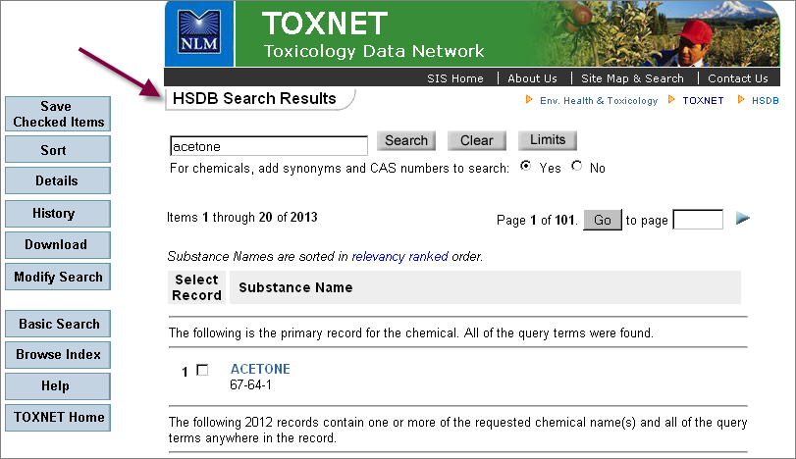
Notes:
Clicking on that hyperlink brings us here. This is the opening page of search results in TOXNET. Notice that under the SIS banner at the top, it clearly notes that these search results are from HSDB only. The blue boxes on the left hand side of the frame provide functionality and options. Notice, too, that the search box appears here with the search term, acetone, in it and there are three buttons adjacent to it: search, clear, and limits. It is possible to modify the search from this page. It is also possible to do a totally different search from here. Note the message: “Substance Names are sorted in relevancy ranked order.” Also note that the first record shown is the PRIMARY RECORD for this chemical. Underneath the chemical name is the CAS Registry Number for this substance. Let’s look at the primary record in HSDB, one of the TOXNET data files, by clicking on the blue word “acetone” in result #1.

Slide 20

Results in the Data Files
Note this message in the results in the Data Files:

Slide 21
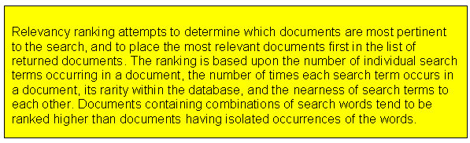
Relevancy Ranking
This is true of the relevancy ranking that occurs with all the Data files and the Special Results in the literature files.

Slide 22
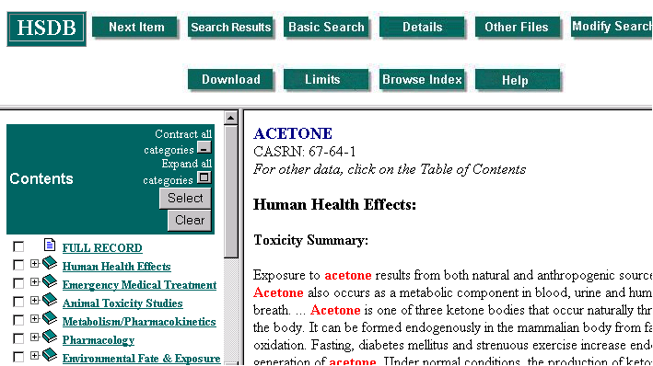
Notes:
Navigation and function buttons along the top of the page. The table of contents for this page is on the left. The text for this particular section, Human Health Effects, is displayed in the frame on the right. Note that the search terms are red in the text section – to make it easier to spot them. Let’s start with the table of contents.

Slide 23
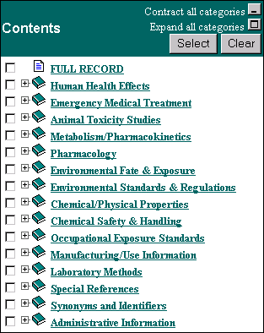
HSDB Contents
Each of these content areas is like a book: click on the + sign to see the chapters
Or, open or close all the books at once using the options in the upper right
Notes:
This is the default display for the content in HSDB. The + sign is the visual clue that each one of these items has additional content. Think of this in one of two ways: (1) Each of these content areas is like a book – click on the + sign to see the chapters; (2) Just as the MeSH tree has a broader to narrower arrangement, so does this content listing, with narrower content appearing under each broad category. Or, all the “books” can be opened at once using the box in the upper right hand corner of this frame that says “Expand all categories.”

Slide 24
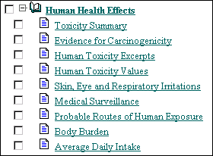
“Chapters” for Human Health Effects
The “+” sign has now morphed into a “–” sign indicating the book has been opened.
Use these links to jump from one content area to another
Notes:
Here are the “chapters” for the book “Human Health Effects.” Each one of the content books can be “opened” in this way. The content listing is also a navigational help. To move directly to a section, click on the hyperlinked content area and that text will appear in the right hand frame. For example, to get to the section on Body Burden, simply click on the hyperlink and →

Slide 25
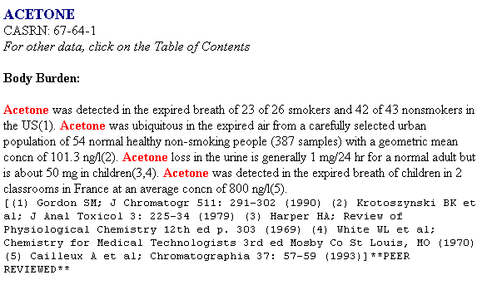
Body Burden section in HSDB
Notes:
This is what you’ll see in the text section on the right hand side of the frame – the Body Burden section. The original search terms are still in red (we’re still working off the same search). Notice that in HSDB, the guts of the database are short excerpts followed by bibliographic citations ( in case the searcher wants to read the original document this information came from) and a note at the end indicating the status of this information. In this particular entry, the status note is ** PEER REVIEWED ** This means that the data given has undergone peer review by the Scientific Review Panel or other high level review group. Other status tags in HSDB are: QC Review (meaning the data has been quality controlled but not yet reviewed by the Scientific Review Panel) and Unreviewed (which means pretty much just what it says) – the item has not yet been reviewed.

Slide 26
HSDB specific information
While all the data files in TOXNET share similarities, content differs.
HSDB is one of the most heavily used of the data files and has some unique content and attributes

Slide 27
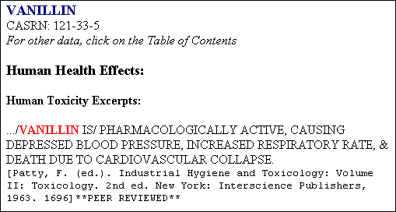
Records in HSDB consist of excerpts from books and reports along with the citation information for locating the complete document.
Records are also tagged: PEER REVIEWED, QC REVIEWED or Unreviewed.
Notes:
In this particular entry, the status note is ** PEER REVIEWED ** This means that the data given has undergone peer review by the Scientific Review Panel or other high level review group. Other status tags in HSDB are: QC Review (meaning the data has been quality controlled but not yet reviewed by the Scientific Review Panel) and Unreviewed (which means pretty much just what it says) – the item has not yet been reviewed.

Slide 28
Review Tags in HSDB
PEER REVIEWED: This item has been peer reviewed by the Scientific Review Panel
QC REVIEW: This item has undergone quality control review but has not yet been reviewed by the Scientific Review Panel
Unreviewed: Means what it says

Slide 29
Content areas of interest in HSDB
Human Health Effects
Emergency Medical Treatment
Antidotes
Physical & chemical properties
Interactions
Environmental fate & exposure
Manufacturers
Uses: therapeutic, business, etc.

Slide 30
Data Files
Remember, in the data files:
  Results look similar
  Navigate in the same manner
  Content varies from file to file
Notes:
Now, remember that the Data files are similar in layout of results, navigation, and features. Let’s take a look at some of those other Data Files.

Slide 31
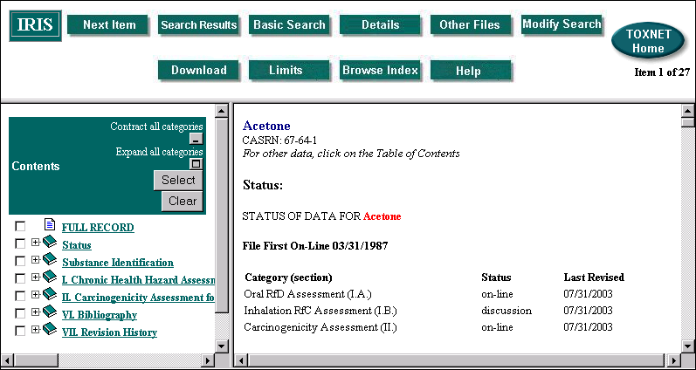
Notes:
Results from the IRIS database: Note the similarities (and differences) to the HSDB results. Similarites: page layout; search terms in red. Differences: the Contents section and the text in the right hand frame.

Slide 32
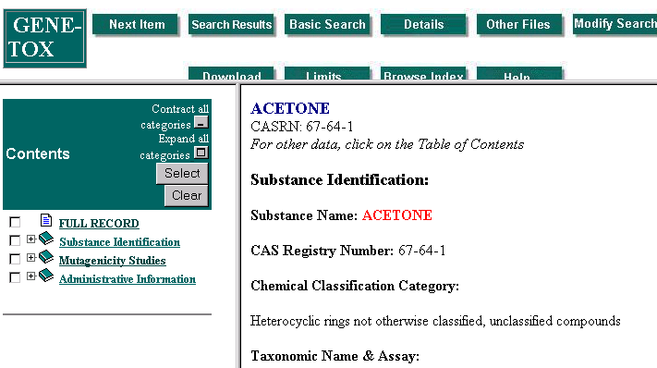
Notes:
GENE-TOX results: Again, this is another of the DATA files. Note similarities (and differences) to the HSDB and IRIS results.

Slide 33
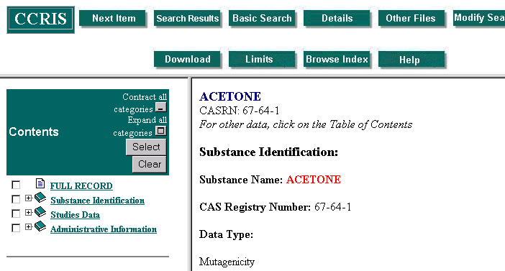
Notes:
CCRIS: again, another DATA file.

Slide 34

Navigation in the Data files
Indicates the Data file in use
Return to the TOXNET home page using this button

Slide 35



Navigational Buttons:
Move through results in order
Return to the initial list of search results
Return to the initial search screen
Alter the current search

Slide 36

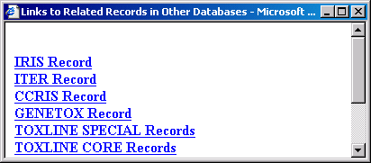
Other Files
Allows searchers to jump directly to other Data Files that contain information on this substance
Clicking on the Other Files button will bring up a menu of other TOXNET files that contain information on this substance.
Click on a database name to access the record for this substance in that database.
Notes:
So, for the acetone search….Each of the databases listed in the menu here contain records about acetone. Click on a database name and see the results for acetone in, say, IRIS, or TOXLINE Core records.

Slide 37

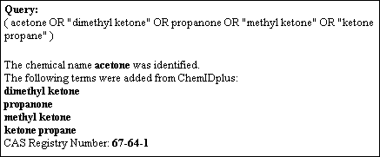
Details of Search
Use this button to see the terms and synonyms used in the search
Here are the Details for the acetone search:
Notes:
The default in TOXNET is to allow the system to add synonyms to the search. It is recommended that this feature be used for effective searching. However, it is easy to turn the feature off – simply look under any search box for a phrase that says: For chemicals, add CAS numbers and synonyms to the search. Yes / NO.” For a good example of many synonyms being added, search Tylenol and then look at the Details of Search. If the searcher really just wants references to the brand name, Tylenol, then turn off this feature and then run the search.

Slide 38
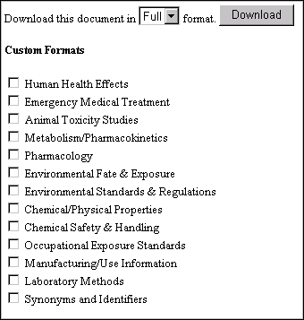
Download data
Allows all or parts of a record to be downloaded as a text file
Click the Download button and a menu pops up. Select the desired sections and then click the gray Download button. Selected sections will appear in the browser window in text only format.
Notes:
This download menu is from an HSDB search, so the HSDB content areas appear. Use a different Data file and different content areas will appear in the Download dialog box. One thing that may sometimes be confusing about downloading records in TOXNET is that, in some browsers, the downloaded [text] record will appear in the computer window directly behind the download dialog box. The dialog box must be closed in order to see the record in text format. One of the nice features of this download function, though, is that the downloaded record(s) include the date the search was done, the database used, and the details of the search (CAS registry numbers and synonyms). Once the information has been downloaded, it can be printed using the browser’s print feature or saved as a text file or whatever….When finished with the downloaded (text) record, you may have to use the browser’s back button to return to the search results in their original format. Or, depending on your browser, you may be able to just close (X out of) the window showing the downloaded file.

Slide 39

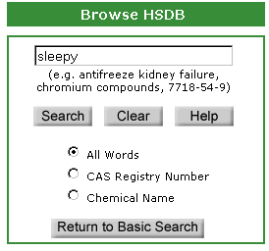
Browse Index
This button allows users to see the Index for the database. This is similar to using the Index in a book.
Clicking the Browse Index button returns the user to the initial search screen with this search box.
Search the HSDB index for the term “sleepy” to see how this works
Notes:
TOXNET files contain an index. This feature is nice for looking for chemical names if unsure of the spelling. It is also nice for looking up text words.

Slide 40
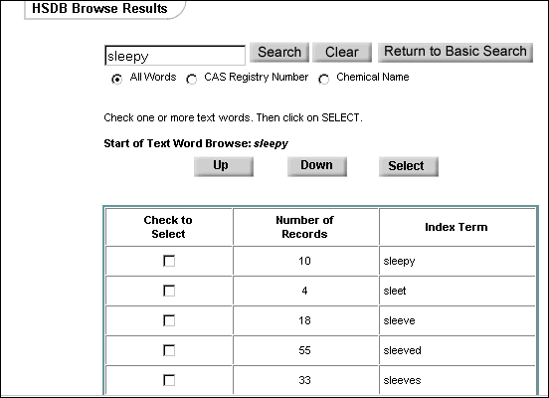
Notes:
To see all 10 records that contain the word “sleepy”, simply check the box next to the term and then click on “Select.” To move through the index, use the “Up” and “Down” boxes.

Slide 41

Limiting a Search
Use the Limits button to narrow or focus a search.
Limits can direct a database to search:
A single word term for an exact word match or as word variants;
For multi-word terms, as a phrase;
Or, it can direct the database to search for the term in a specified field only.
Each option presented in Limits may serve to narrow a search and reduce retrieval.

Slide 42
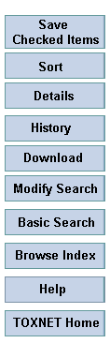
More on navigation…
These buttons perform the same functions as the green navigation buttons detailed before.
3 new options appear: Save Checked Items, Sort, and History

Slide 43
History
Keeps track of searches done
Click on the History button to access this feature
Expires after 1 hour of inactivity
Notes:
For PubMed users – this History feature is a bit different. This history really will expire after one hour of inactivity, rather than the 8 hours that PubMed allows.

Slide 44
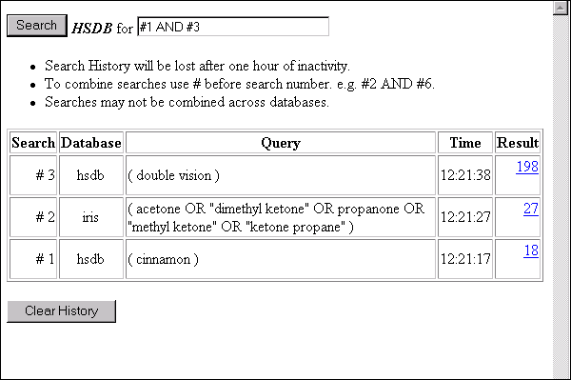
Using History
History keeps track of searches
Combine searches within a single database
Delete ALL history using the “Clear History” button
Notes:
Searches can be combined only within the same TOXNET database.
For example, if my search #1 is in HSDB and my search #2 is in IRIS and my search #3 is in HSDB, I cannot combine my #1 (HSDB) and #2 (IRIS) searches – because they are in different databases. I could, however, combine my search #1 (HSDB) and my search #3 (also HSDB) because those are in the same database. NOTE: to combine searches, the combining word MUST be in capital letters as in the example on the History page. (This is just like PubMed.)

Slide 45
Save checked items
This feature allows users to pick selected results from the list and save them.
If items are selected and saved:
  A box appears showing how many items have been saved and
  A new blue button appears saying “Display saved items”
Notes:
This feature is not as advanced as it could be. Searchers can’t page thru results, making selections and then “save” at the end. Selections must be saved on a per page basis. There is sometimes trouble retrieving the saved items, also. However, if this should happen, look in the History box – the selected items should appear there as a set by themselves.

Slide 46
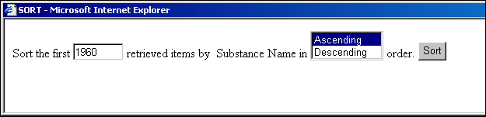
Sort
Clicking on the Sort button brings up this option box in the data files:
Notes:
In the Data files, the only Sort option is Substance Name in Ascending (A-Z) or Descending (Z-A) order. The searcher also gets to choose how many records to sort. (The Descending order is most clearly demonstrated by doing a search for acetone, looking in the HSDB results (1960on 7/26/04) and then sorting in Descending order.) NOTE that once the sorting is done, the records are NO LONGER in relevancy ranked order.

Slide 47
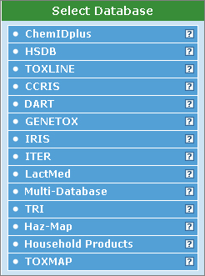
TOXNET Data Files
Can be searched simultaneously by using
“Multi-Databases”
Notes:
Or the DATA files may be searched together by using the “Multi-Databases” file. Choose this option by clicking on it….

Slide 48
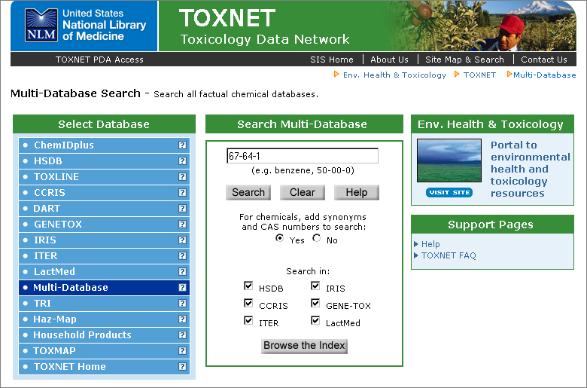
Notes:
Here is a Multi-Databases search using the CAS registry number for acetone. Note that the default here is to search ALL the data files together. However, selections may be made to search any combination of the data files the searcher may desire.

Slide 49
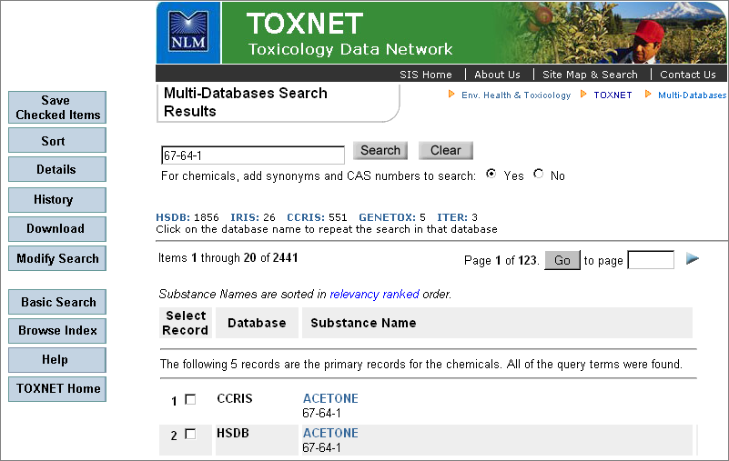
Notes:
Jump to results from a specific database by using the hyperlinked database names in the upper portion of the screen. Scroll down to review (1) the Primary records from each of the databases and then (2) the complete results from each database in relevancy ranked order.

Slide 50
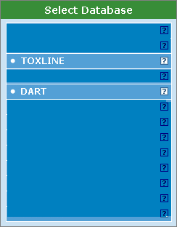
TOXNET’s 2 Literature Files
Notes:
TOXLINE and DART are the literature files in TOXNET. These are bibliographic files – much like what you’d find in PubMed, for example.

Slide 51
TOXLINE
Toxicology literature online
  (TOX + LINE)
The two parts of TOXLINE have been merged into a single unit for retrieval:
  TOXLINE Core → PubMed subset
  TOXLINE Special → in TOXNET
Over 3.5 million records
Notes:
Covers pharmacological, biochemical, physiological, environmental, and toxicological effects of chemicals/other agents on living systems. TOXLINE Core is the Toxicology Subset “tox[sb]” of MEDLINE on PubMed. TOXLINE Special complements the Core, but there is a lot of overlap between the two files. The Special collection does contain items that are not available in the Core

Slide 52
DART
Developmental and Reproductive Toxicology
The two parts of DART have been merged into a single unit for retrieval:
  DART Core → on PubMed
  DART Special → on TOXNET
100,000 + references to literature published since 1965
Notes:
DART Core is not a subset of MEDLINE on PubMed, but it is a preformulated search strategy

Slide 53
More on the Literature Files
Bibliographic records
MeSH term searching available
Keyword searching available
CAS registry numbers searchable
1965 to present
Automatic term mapping
Notes:
These are bibliographic files – meaning they contain citations to journal articles and abstracts (where available). There is no full text in the Special collections and limited full text available in the Core collections. These files may be searched using MeSH vocabulary, keywords, substance names, and CAS registry numbers. For the most part, this material is from 1965 to the present although there may be some older material found in the Core collections. The Core collections search PubMed and, as such, use Automatic term mapping. The search results from both the Core and the Special will be combined and presented in a single window.

Slide 54
2 for the Price of 1
Search the literature files and the results appear in one window
This is a change from the way results were displayed previously. In the past, results were returned in two separate windows.
Notes:
This change – from displaying results in 2 windows to displaying results in a single window – occurred in August, 2006.

Slide 55
TOXNET Literature Files
Content differs from one literature file to another
But format, layout of results, features, and navigation are similar
Learn the mechanics of one; know the mechanics of both

Slide 56
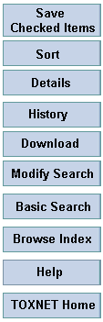
Navigation in the Literature Files
Same blue buttons as in the data files
All function in the same manner except……

Slide 57
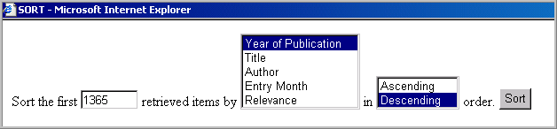
Sort in the Literature Files
There are more sort options in the literature files

Slide 58
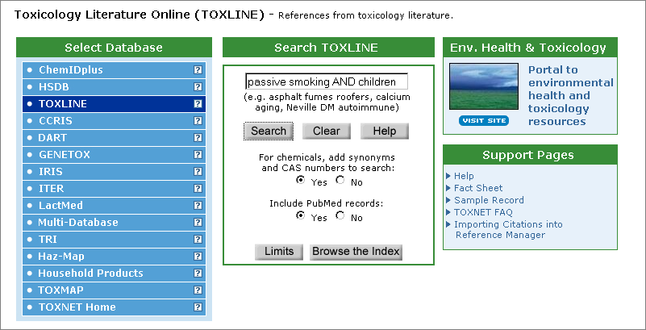
Using TOXLINE
Notes:
Search Toxline for passive smoking AND children done 6/19/2007

Slide 59
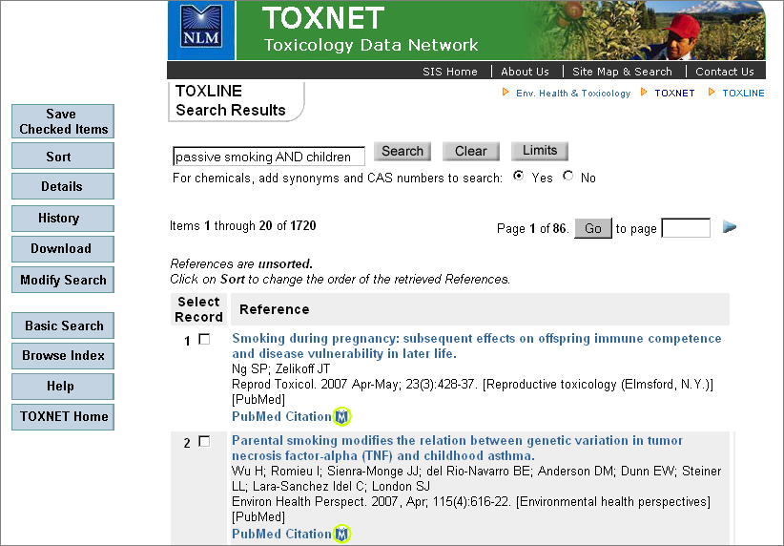
Notes:
These are the TOXLINE search results from a search done 6/19/2007.

Slide 60
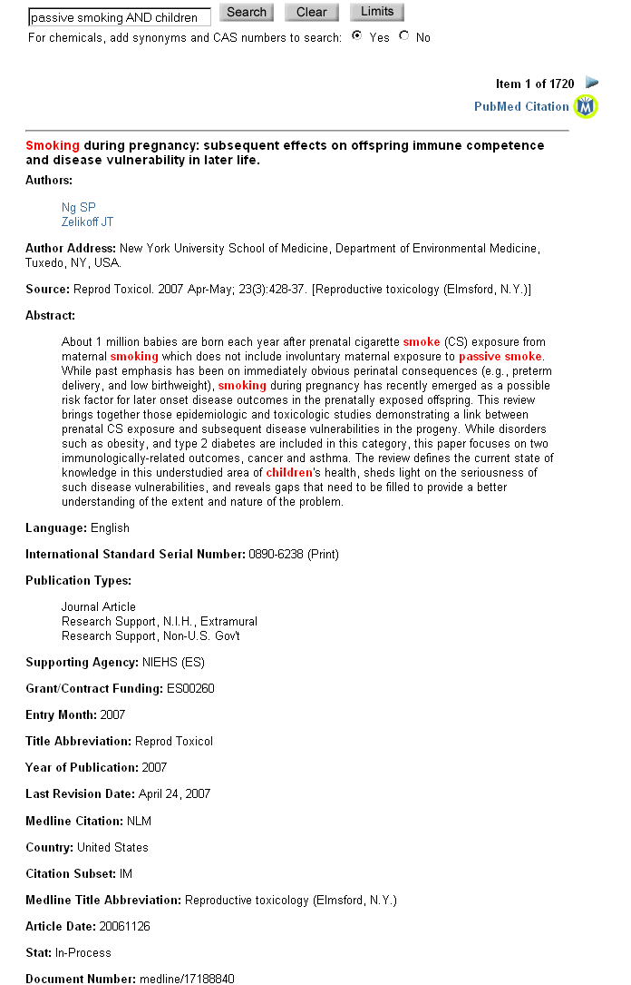
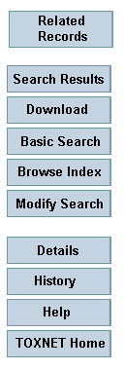
Terms in blue are hyperlinks. Click to retrieve more records with those terms.
Click here to access this record in PubMed
Search terms appear in red

Slide 61
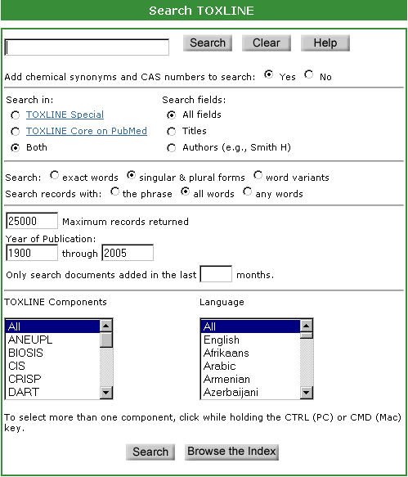
Limits

Slide 62
Literature Files
The DART files are searched with similar mechanics as the TOXLINE files
Navigation the same

Slide 63
TRI: Toxics Release Inventory
EPA information regarding the release of certain toxic chemicals
Reporting is mandated by law and does not cover all industries or all businesses
Release years 1987 – 2005 data available in TOXNET
Notes:
The same information found in TOXNET in the TRI file is available from the EPA website (http://www.epa.gov/tri/).
According to the EPA: “The Toxics Release Inventory (TRI) is a publicly available EPA database that contains information on toxic chemical releases and other waste management activities reported annually by certain covered industry groups as well as federal facilities. This inventory was established under the Emergency Planning and Community Right-to-Know Act of 1986 (EPCRA) and expanded by the Pollution Prevention Act of 1990.”
Users need to be aware of certain things when using this data: (1) not every industry/business needs to report; (2) the TRI data covers only certain chemicals – in 2001, there were 600 reportable chemicals; (3) facilities submit one report for each chemical, so a facility may have one or many records in the TRI database; and (4) the TRI data reflect releases and other waste management activities of chemcials, NOT whether (or to what degree) the public has been exposed to those chemicals.

Slide 64
TRI
Facility Identification
Substance Identification
Environmental release
Waste treatment (on & off site)
Source reduction and recycling

Slide 65
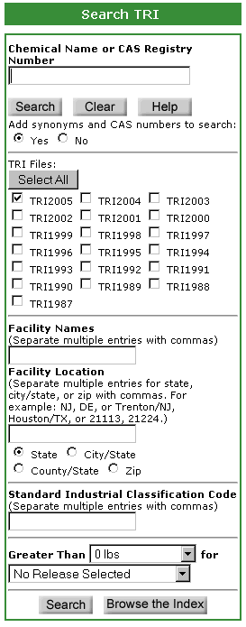
Searching TRI
Search by chemical name or CAS
Select a year or years
Search by facility name
Search by location
Search by SIC code
Specify release amount and type
Notes:
Must choose the year or years for the TRI files
Must choose EITHER a chemical name OR a facility name OR facility location OR SIC code

Slide 66
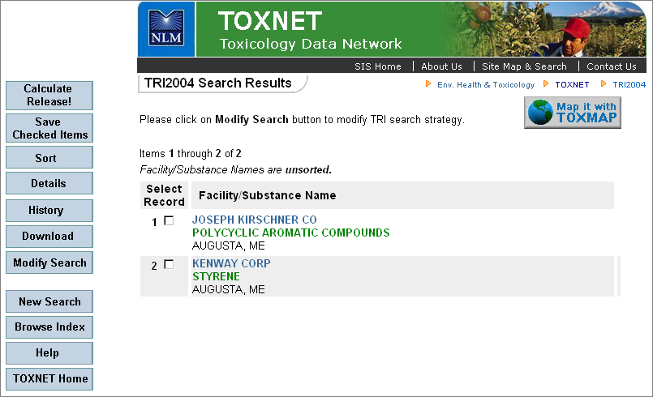
Searching for Augusta, ME
Notes:
Note the blue buttons on the left hand side of the search screen – all but one of these should be familiar from previous discussion. The Calculate Release! Button will be discussed shortly. Note that, in the results, the facility name is in blue and the compounds discussed in the record are in green – therefore, one company can have many entries in the results list (as shown here). Results can also be mapped using the “Map it with TOXMAP” button.

Slide 67
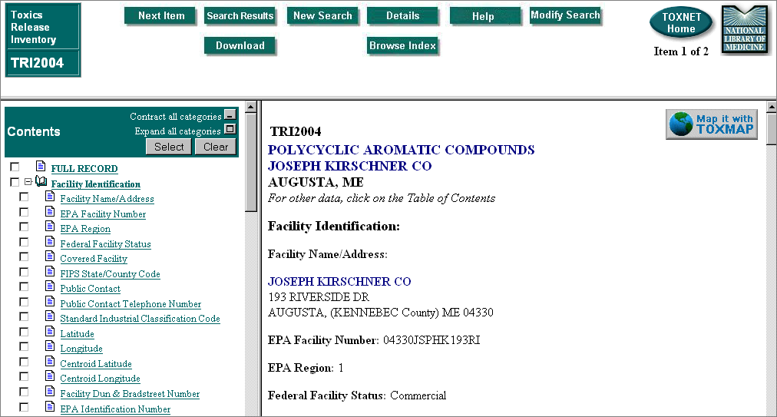
Notes:
This looks a bit like the data files: table of contents on the left, navigational buttons on top, and content in the right-hand frame. The sorts of information contained in a record can be seen by taking a look at the table of contents. Again, the Map it with TOXMAP button appears….

Slide 68
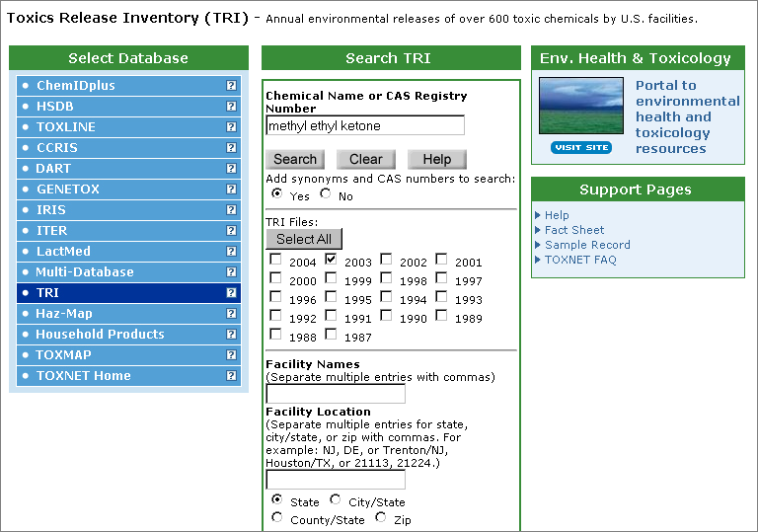
Search for methyl ethyl ketone
Notes:
Here’s my search. I could have used some shorthand and searched for MEK. I also could have chosen different reporting years.

Slide 69
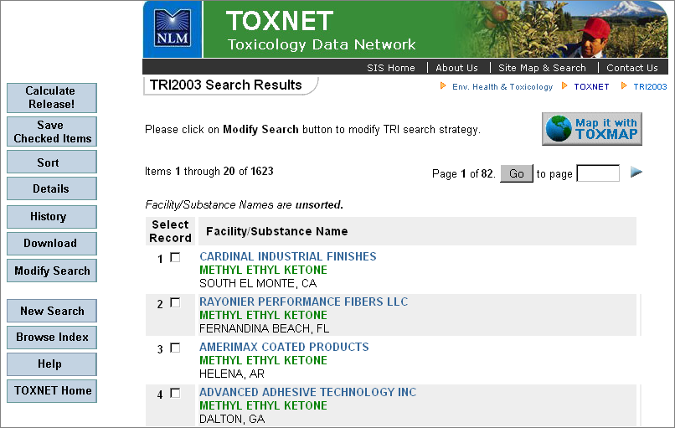
Notes:
The results screen looks like this. Now, click on the Calculate Release! Button….

Slide 70

Calculate Release! button
Use this for a tabular display of:
Total environmental
releases
+
Off-site waste transfers
For all retrieved records
Notes:
TRI will total up the damage, so to speak… So, if I want to know about the release of methyl ethyl ketone in, say 2001, I would do the following search in TRI:

Slide 71
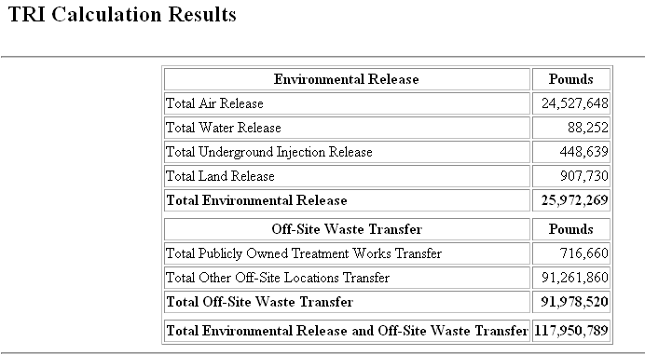
Calculate Release!
Notes:
And here is the total result for methyl ethyl ketone, reporting year 2003 (done on 1/25/2006)

Slide 72

Mapping results
This button provides mapping capabilities
Use it to see where the releases in question were located
Notes:
This is one of the newer functionalities of TOXNET’s TRI file. Click on the Map it button and a new web page opens up with a map. See the next slide for an example of this using the methyl ethyl ketone search.

Slide 73
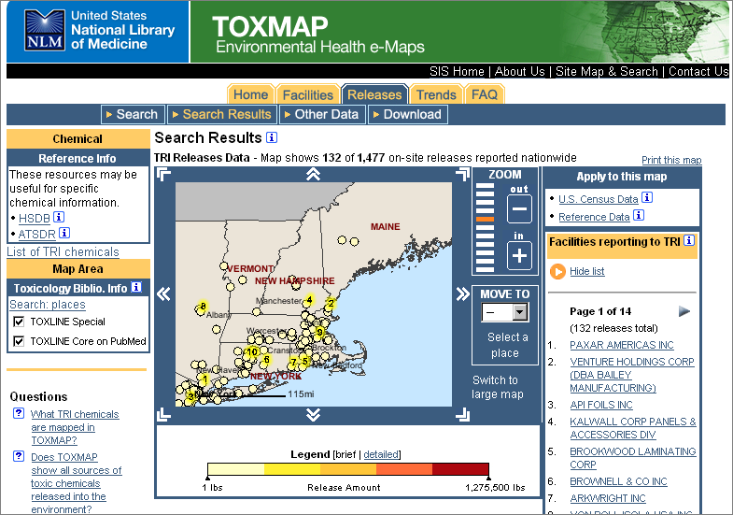
Notes:
This is just a brief example of the mapping functionality. There are tremendous capabilities here beyond what is shown. Additional layers can be added to the map (demographics from the 2000 census). The facilities listed on the right hand side link to brief displays about the release from that specific facility – and further links bring the searcher back to the TRI record. Note, too, that in the upper left hand box, the user can immediately search HSDB or ATSDR (Agency for Toxic Substances and Disease Registry) for information on methyl ethyl ketone. Explore this further on your own.

Slide 74
ChemIDplus
Chemical dictionary/directory file
Two versions: “Lite” & Advanced
379,000 + chemical records
257,000 + structural records
  In the Advanced file only
  Requires JAVA or CHIME software (free)
Direct link to other resources
Notes:
ChemIDplus is different from the other databases in TOXNET

Slide 75
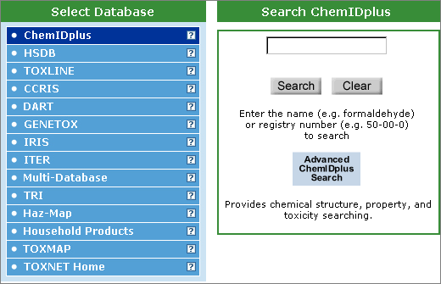
Searching ChemIDplus
Search by chemical name or CAS Registry Number
Click on “search” to retrieve results from the “Lite” version
Use the Advanced button to access the Advanced capabilities

Slide 76
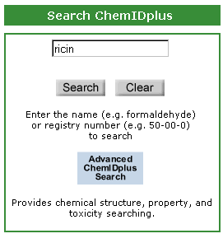
Looking for information on ricin
Notes:
Look at ChemIDplus “Lite” for information on ricin. Type ricin in the search box and click on Search…..

Slide 77
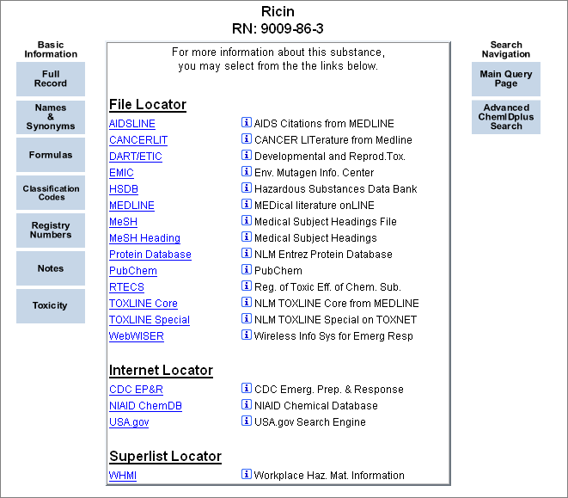
Notes:
File locators: These are NLM & non-NLM files that contain information on the substance searched. Click on the hyperlinked file name to access that information. Click on the blue “i” to retrieve information about the file itself. Note the navigational buttons on the right and the Basic Information on the left.

Slide 78
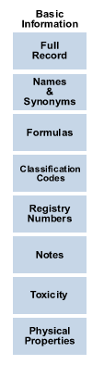
Click here for access to all the Basic Information on a single web page
Describe the general category assigned by a given source to a chemical based on toxicity, use and application, pharmacologic and/or therapeutic category, and status on certain chemical lists.
Names and synonyms associated with this substance
Gives a table of toxicity information by organism tested, test type, dose, effect, and source of the given information
A description of a compound’s use and utility, often from MeSH controlled vocabulary
Nice table of melting & boiling points, water solubility, vapor pressure, and more
Notes:
Formulas, not described on the slide, refer to the molecular formula for this substance. Registry numbers, also not described on this slide, refer to the CAS registry number. Each of these “Basic Information” elements will open a new window & display the requested information. Close the window to return to the results page. NOTE that the physical properties will also give the pKa dissociation constant, the log P (octanol-water), Henry’s Log Constant, Atmospheric OH Rate Constant

Slide 79
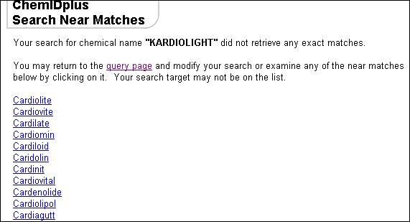
More on ChemIDplus searching
Misspellings?
List of near matches to assist
Select the appropriate term
Notes:
“Kardiolight” is a misspelling for a drug called Cardiolite – used in cardiac stress testing. The correct spelling appears on this list. Click it for access to information on this substance.

Slide 80
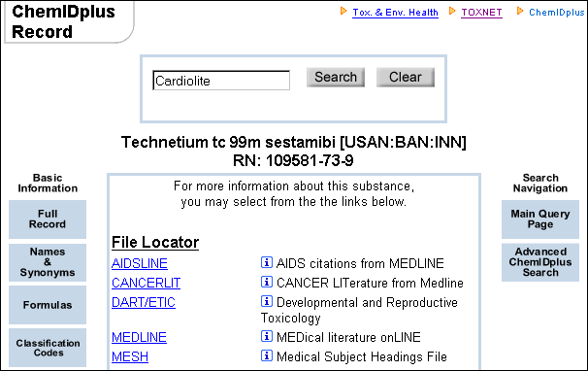
Initial results for Cardiolite
Notes:
Cardiolite is the trade name for Technetium tc 99m sestamibi (aka “sestamibi”)
A note about the [USAN:BAN:INN] notation:
USAN = US Accepted Name
BAN = British Accepted Name
INN = International Nonproprietary Nomenclature
May also see JAN in this notation. JAN = Japanese Accepted Name
And, RN, is, of course, the CAS Registry number associated with this substance. Let’s take a look at the Full Record….

Slide 81
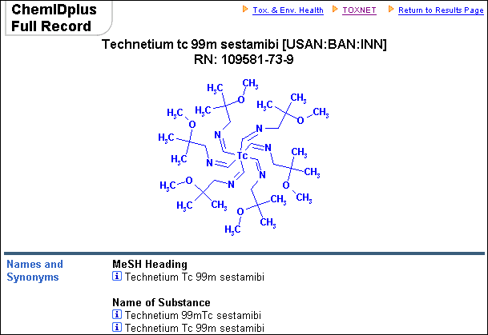
Molecular formula
Notes:
Clicking on Full Record will open another window on the computer and this is the beginning of that record. The “Lite” version of ChemIDplus has the molecular formula for the substance in it’s text-based format. In the Advanced Version, 3-D structures are available. Continue to scroll down for the additional information contained in the Full Record: Names & Synonyms, the Formula in it’s hyphenated form (C36-H66-N6-O6-Tc), Classification Codes, Registry Numbers, Notes, and Locators. Close the window to return to the results.

Slide 82
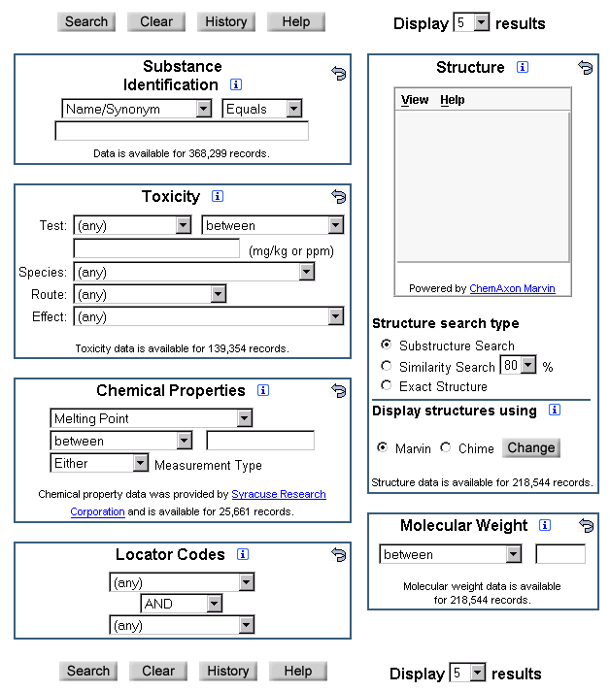
ChemIDplus Advanced
Notes:
This is the home page for ChemIDplus Advanced. On the right is a Structure Input Box. This can actually be used for drawing chemical / molecular structures to be used in searching this database. This class will not cover that particular. There is, however, a Help section for the Structure viewer that will give introductory information on how to use this feather. The rest of the page features several different search options.

Slide 83



Searching: One Option
Choose:
Set:
Type search terms
here
Notes:
ChemIDplus Advanced provides several searching options. Use this “Substance Identification” box to do text-based searches (for chemical names / synonyms) or enter the CAS number, the formula (in hyphenated notation) or choose a classification or locator code.

Slide 84




More Search Options
1
2
3
4
Notes:
Toxicity -- for numeric toxicity data such as LD50 (Lethal Dose 50);
2. Chemical Properties -- for numeric property data such as melting point, boiling point, vapor pressure, etc.
3. Locator Codes -- to qualify a search by one or more databases which contain pertinent data
4. Molecular Weight -- to range on the MW calculated from the structure

Slide 85

But wait, there’s more!
Draw structures
Search for substructures:
  Find the drawn structure embedded in other structures
Do similarity searching
Notes:
ChemIDplus allows a user to either draw their own structure for searching, or to pull in a structure that has already been retrieved. To transfer a structure, the transfer icon can be clicked to bring this to the search page for editing. Click the blue “i” for additional info and see the Help document, also.

Slide 86
Advantages of Advanced…
So, what can ChemIDplus Advanced do that the “Lite” version can’t do?
3-D structures
Structure-based searching
Similarity searching
More

Slide 87

Searching for DEET
Type
Click Search
Notes:
Leave the two menu-based options as they are: Name/Synonym and Equals. Type in DEET in the search box, then click the Search Button.

Slide 88

Results
Click on any blue box to retrieve information.
Or, click a link in the File Locator section to see the DEET information in that file.
Notes:
Clicking on any of the blue boxes will open up a new window displaying information. This method allows easy access to information about this substance.

Slide 89


3-D Structures: DEET
There are two ways to access the 3-D structures:
From the top of the initial results page, click
Or, click the blue Structure button
Notes:
Using the “Enlarge Structure” link at the top of the results page will open a new window showing the 2-D structure. Scroll down to the bottom of that window to find the check box “Display 3-D model” – once checked, the model will display.
Using the blue Structure box, the 3-D model will be displayed automatically below the 2-D model.

Slide 90

DEET molecular structure
Notes:
Once the model appears, the computer mouse can be used to rotate and move the model. Right-clicking on the mouse will also bring up a menu: the model’s appearance can be changed, it can be animated

Slide 91


Similarity searching: DEET
Use this box on the DEET results page
or
Use the Transfer Structure box to move the structure to the initial search page for ChemIDplus Advanced. Both similarity and substructure searches can be done there.
Notes:
The “Structure Similarity Search” box will automatically do the search. Transferring the substance to the initial search page allows some additional functionality – the user can set the percentage of similarity desired; and substructure searches can be done from there.

Slide 92

Results of similarity searching
The 1st result in the similarity list will be the substance searched: it is 100% similar to the query structure.
The following substances will be labeled as to how similar they are to the original:
Notes:
Click on the hyperlink to find additional information about this substance.

Slide 93

Added functionality
Transfer the structure to the query page
Do a similarity search for molecules 80% similar to this one
Enlarge this structure and provide access to the 3-D model

Slide 94
Additional Resources from SIS
Household Products Database
http://hpd.nlm.nih.gov/
Toxtown
http://toxtown.nlm.nih.gov/
Haz-Map
http://hazmap.nlm.nih.gov/
DIRLINE
http://dirline.nlm.nih.gov/

Slide 95
And still more resources
Wiser: Wireless Information System for Emergency Responders
http://wiser.nlm.nih.gov/
TOXMAP
http://toxmap.aquilent.com/toxmap/main/index.jsp

Slide 96
But wait! There’s more…
Chemical Warfare Agents
Biological Warfare Agents
Arsenic and Human Health
West Nile Virus: Pesticides used for mosquito control
Environmental Justice Links
Chemical Information Internet Links

Slide 97
Specialized Information Services
http://www.sis.nlm.nih.gov/index.html

