Slide 1
BFRs: Toxicology and Risk
Linda S. Birnbaum
Director, Experimental Toxicology Division
NHEERL
US EPA

Slide 2
Why BFRs?
Flame retardants save lives
>75 different BFRs
  40% of total Br usage
Worldwide demand ~200,000 metric tons/year
  ~1/2 in US
Global, transboundary problem
Persistence
Potential for bioaccumlation
Limited Data Base

Slide 3
Major classes of Concern
Br-Bisphenols (esp. TBBPA)
  Detected in air, sediment, sludge, biota
    Relatively short half-life, estrogenic, anti-thyroid
Br-Diphenyl Ethers (e.g., PBDE, OBDE, DBDE)
  Long range transport, PBT
    Anti-thyroid, liver toxicant, developmental neurotoxicant
Br-Cyclododecanes (e.g., HBCD)
  Long range transport, PBT
    Anti-thyroid, developmentally neurotoxic

Slide 4
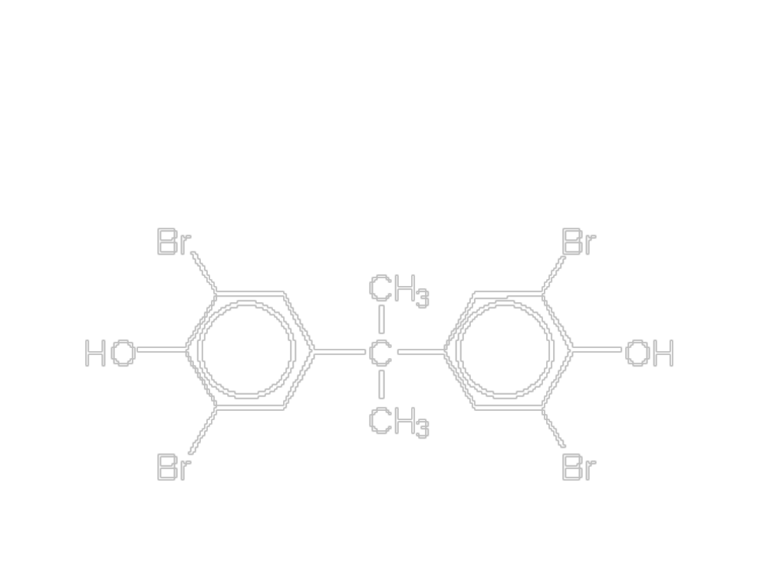
Tetrabromobisphenol A
(TBBPA)

Slide 5
TBBPA
(Tetrabromobisphenol A)
Acute tox data – oral LD₅₀: 5-10 g/kg
Low chronic toxicity
Not teratogenic or mutagenic
Limited data in biota
Dimethyl-TBBPA metabolite
eliminated in bile
Little retained in tissues

Slide 6
Health Effects of TBBPA
Immunotoxic
  Inhibits T cell activation : blocks CD25 (<3µM)
Hepatotoxic
  Toxic to primary hepatocytes: destroys mitochondria; membrane dysfunction (inhbits CYP2C9)
Neurotoxic
  Inhibits dopamine uptake
  Generates free radicals

Slide 7
Health Effects of TBBPA (con)
Endocrine Disruption
AhR Effects
  Not relevant for commercial product (contaminants?)
Thyroid
  TBBPA>T4 in relation to binding to transthyretin
  Blocks T3 binding to TR
  Perturbations observd in vivo
Estrogenic
  Inhibits sulfotransferase (decreases estrogen clearance)
  Mostly in vitro data

Slide 8
Agency Interest
Regulated under TSCA – OPPT
  PBDEs under VCCEP
Concern for Air (LRTRP), Clean water (sediment), Waste (sludge)
Major Regional Issues
  Region 9 Workshop; Region 5 Grants; GLNPO
Cross-Agency Workgroup
Agency “What We Know” Statement

Slide 9
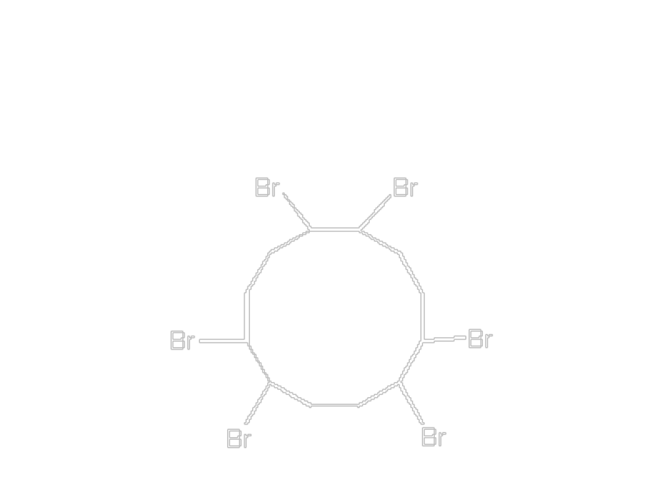
Hexabromocylododecane
(HBCD)

Slide 10
HBCD
(Hexabromocyclododecane)
Ecotox –
  Algae, daphnia, NOEC = 3 ug/L
  Fish, LC ₅₀>water solubility; PNEC=.03ug/L
General Toxicity
  High absorption; mild irritant and skin sensitizer; liver effects after repeated exposures (LOEL (rats) ~13 mg/kg/day)
    Need more info: repeated dose studies, repro tox

Slide 11
HBCD (con)
Neurotoxicity
  Developmental neurotoxicant
  Blocks dopamine uptake
Concern for Occupational Settings
Found in Human Breast Milk
Persistent, bioaccumulative, toxic, long range transport

Slide 12
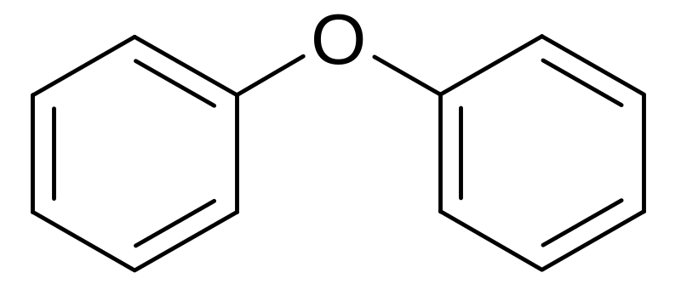
Polybrominated Diphenyl Ethers (PBDEs)
Br
Br

Slide 13
Composition of Commercial PBDE Mixtures
DBDE – 97% DBDE; 3% NBDE
OBDE - 6%HxBDE; 42%HpBDE; 36% OBDE; 13%NBDE; 2%DBDE – multiple congeners (unclear if any PeBDE)
PeBDE -Mainly PeBDE+TeBDE, some HxBDE

Slide 14
PBDEs (con)
Ecotoxicity
PeBDE>>OBDE>DBDE
  Highly toxic to invertebrates (Larval development, LOECs in low μg/l range)
DBDE/OBDE
  May be low risk to surface water organism and top predators
  Concern for waste water, sediment, and soil organisms
  Concerns for lower brominated congeners in OBDE, potential for debromination, and generation of PBDDs/PBDFs

Slide 15
Mammalian Toxicity of PBDEs in Adult Rodents
Hepatotoxic
Enzyme Induction
  UDP-glucuronyl transferase
  Cyotochrome P450
DBDE – hepatocarcinogen (high dose)

Slide 16
New Information on Deca
Deca CAN be Absorbed!
  >10% in appropo vehicle
Deca CAN be Metabolized!
  Reactive intermediates; debromination
Deca CAN be found in People!
  Milk and blood
Deca MAY be Developmentally Neurotoxic?
  Similar to BDE-47,99,and 153
Deca “may” be breaking down in fish
  Detection of BDE-181 and 190 in carp (Rice et al, 2002)

Slide 17
New Information On Penta
(SOT, 2003 and Dioxin2003)
Endocrine
Reproductive
Developmental Neurotoxicity

Slide 18
Endocrine Disrupting Effects
AhR Effects
  Relevance for commercial BFRs?
  combustion can produce PBDDs/PBDFs
Thyroid Homeostasis
  OH-PBDE metabolites bind to transthyretin
  Parent PBDEs - Effects on T4 seen in vivo
    induction of UDP-glucuronyl transferase
    Rats and mice; body burdens as low as 0.8 mg/kg
Estrogen Homeostasis (mostly in vitro)
  OH-PBDEs may be anti-estrogenic
  Sulfotransferase inhibition could be estrogenic

Slide 19
Developmental Reproductive Effects
DE71 (NHEERL) – pubertal exposures
  Delay in puberty
  Effects on male organs
BDE-99 (Switzerland; Germany) – in utero expo.
  Delay in Puberty
  Ovarian Toxicity
  Male Organ Effects and Decreased Sperm

Slide 20
Developmental Neurotoxicity
DE-71 – Rats (NHEERL)
  Perinatal Exposure
  Deficits in Sensory and Cognitive Function
BDE-99 - Mice (Sweden, Italy)
  Infantile Exposure (“Rapid Brain Growth”) - Permanent effects on learning
  Perinatal Exposure – Delay in sensory-motor development
BDE-99+PCB-52 – Mice (Sweden)
  Effects may be more than Additive

Slide 21
Pharmacokinetics of PBDEs
Absorption – DBDE is poorly absorbed
Distribution – lipid binding is important
  Fat: 47>99>>>209
  Liver: covalent binding from 99,209
Metabolism – hydroxylation, debromination, O-methylation
Excretion – feces is major route

Slide 22
Other Ongoing PBDE Research
Dose/Response (NHEERL, NIEHS, USDA, Sweden)
  Extrapolation issues
  Half-life
  Metabolism
Cell Signaling in vitro (NHEERL)
  Altered calcium associated with changes in learning and memory

Slide 23
Developmental Neurotoxicity of PBDEs
Both mice and rats
  Mice very sensitive (clear effects at 0.8 mg BDE-99/kg) in infantile period
Sensory and Cognitive Effects
Mechanism Unknown
  Depression in serum T4 as low as 0.8 mg/kg
PBDEs alter cell signaling in vitro
  Kodavanti and Derr-Yellin, 2002
    Altered calcium dependent release of arachidonic acid (associated with learning and memory)

Slide 24
Potential Health Risk of PBDEs
Comparison of Animal and Human Data
  Body Burden (allows cross-species comparison for PBTs)
Most Sensitive Effects to Date
  Developmental Neurotoxicity and Effects on Thyroid Hormones (<0.8mg/kg)
  Preliminary reports on Developmental Reproductive Toxicity at Even Lower Dose (0.06mg/kg)

Slide 25
Potential Health Risk of PBDEs (con.)
Top 5% of current human exposure in US - >400 ng/g lipid
  If humans are 25% lipid, then their “dose” is ~0.1 mg/kg
Significant dose causing DNT in mice at 0.8 mg/kg
Mouse tissue concentrations are only ~10X higher that total PBDE concentrations in human tissues

Slide 26
Potential Health Risk of PBDEs (con.)
Margin of exposure for PBDEs appears low
Additional concern: are PBDEs interacting with other PBTs?

