Slide 1
ICH S2 revision weakens safety standards, and undermines regulatory approaches to genotoxicity hazard identification
Rosalie Elespuru, PhD
FDA/Center for Devices & Radiological Health
(view as an expert genetic toxicologist)

Slide 2
Genetic Toxicology Credentials
A career as a genetic toxicologist, from thesis through post-doc to the present day
Elected President, The Environmental Mutagen Society (national society of genetic toxicologists)
Founder and Chair, FDA-wide GeneTox Network
Laboratory experience with genetic toxicology assays
Leadership in the application of new technologies: 3 inter-center Genomics projects funded by FDA Office of Science and Office of Women’s Health; founded, chaired and still participate in EMS New Technologies special interest group
Review experience in CDRH, CDER, CVM, CFSAN, and CBER
Recruited by CDER to help draft the original ICH S2A and B guideline on safety assessment of pharmaceuticals

Slide 3
Debate over the need for ICH S2 revisions
Rationale for the revision: Point/counterpoint
Point: One third of drugs in PDR have positive or equivocal carcinogenicity results.
Point: Many of the noncarcinogens have positive results in in vitro mammalian assays.
Counterpoint: This point is not relevant to the purpose of genotoxicity testing: hazard id. The attempt to make short term assays predict rodent carcinogenicity is inappropriate

Slide 4
Debate over the need for ICH S2 revisions
(continued)
Point: Drugs can induce tumors by a wide variety of mechanisms unrelated to DNA damage
Point: Some of these drugs have the occasional positive genetox response, probably unrelated to MOA
Counterpoint: We don’t understand the causes of human cancer. The attempt to undermine the connection between genetic damage and cancer risk is way outside the mainstream of scientific thinking.

Slide 5
Current ICH test battery
Bacterial mutagenesis assay
In vitro mammalian assay
  Mouse Lymphoma Assay (MLA) OR
  Chromosomal Aberration assay (CA)
Short term in vivo assay: rodent micronucleus or CA assay

Slide 6
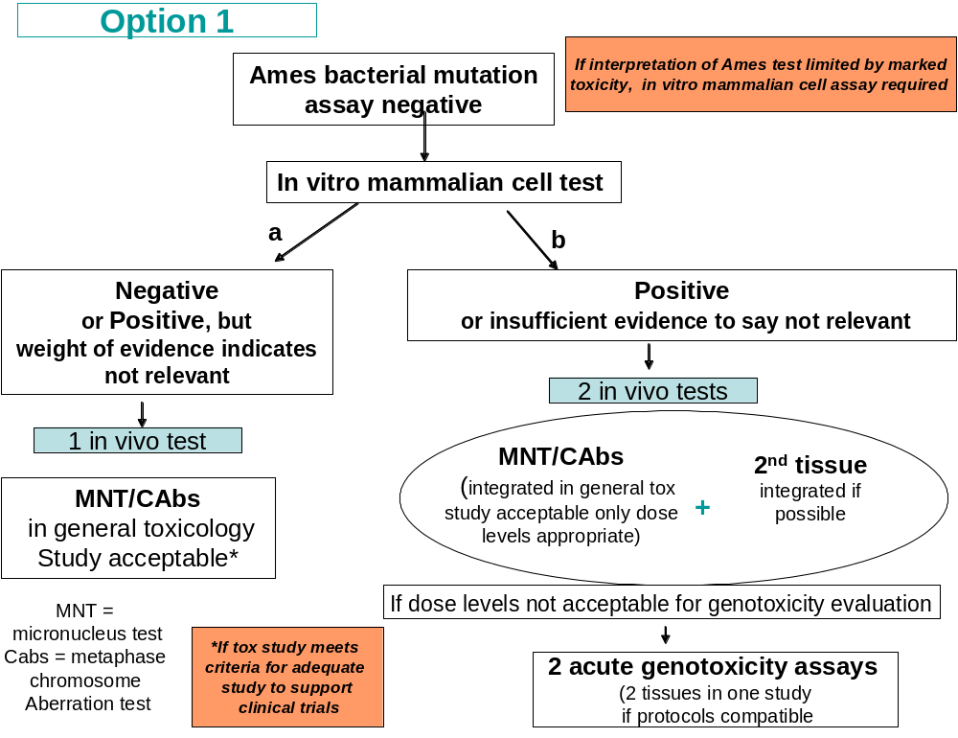
Proposed ICH test battery

Slide 7
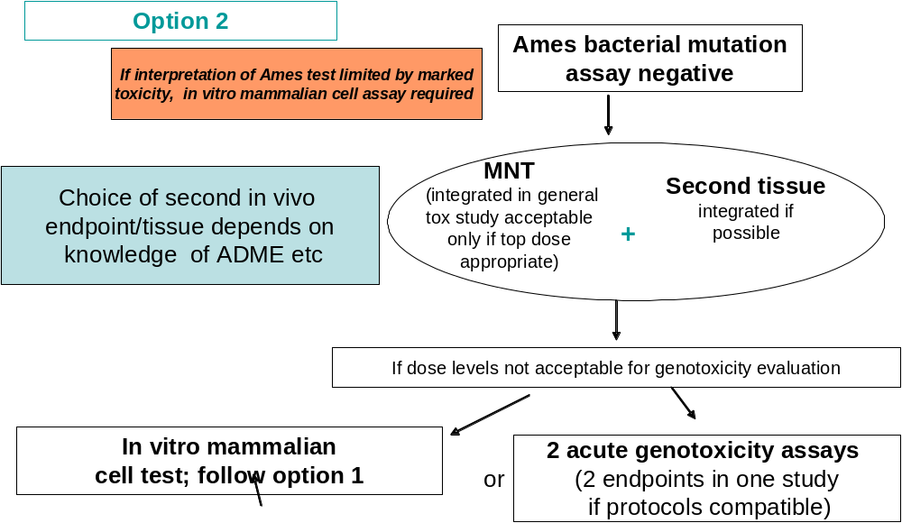
Proposed ICH test battery

Slide 8
Summary, ICH S2 document critique
New approaches to safety assessment are needed. However, improvement needs to be demonstrated before standards are changed. In this case, improvement has not been demonstrated.
The new guidance is likely to cause substantial problems for FDA, industry, and other regulated groups. Hence many regulatory genetic toxicologists oppose this draft revision.
It relies increasingly on animal tests and is likely to be untenable in the long run, due to efforts to minimize or eliminate animal testing

Slide 9
ICH guideline critique: Problems for FDA
The guidance will slow the FDA review process (complex, indistinct, and likely to cause debate within FDA and between FDA and industry)
The guidance weakens safety standards
The issues at which the guidance is directed are already being addressed successfully
The guidance will create disharmony among FDA centers and other regulatory agencies

Slide 10
Question 1
The perceived problem with the current battery, as articulated in the new guidance, is that there are too many irrelevant (false) in vitro mammalian cell assay positive results. Are there sufficient scientific data (preferably published) that support the proposed changes in the revised guidance? Does the new battery address this issue without missing genotoxicants? – Presentations from Drs. Bigger, Cimino, Dearfield, and Moore address this issue
Answer: No

Slide 11
Question 2
Most regulatory agencies use the same battery of genetic toxicology tests as described in the original ICH S2A and B Guidances. What is the rationale for having a different genetic toxicity battery to support safety determinations for pharmaceuticals, versus for other chemical substances? – Presentations from Drs. Bigger, Cimino, Dearfield, Levy, Elespuru and Moore address this issue.
Answer: Although each regulatory entity uses genotoxicity test data differently, the best tests are generally universally applicable.

Slide 12
Question 3
Is it reasonable, as part of ICH Guidance, to give sponsors an option of 2 test batteries? Are option 1 and option 2 test batteries equivalent? When would you use one and when would you use the other? – Presentations from Dr. Heflich, Levy, and Robison address this issue
Answer: Option 1 and Option 2 are not equivalent; the guidance does not address the appropriate use of each choice

Slide 13
Question 4
FDA has put in place new recommendations (“Guidance for Industry and Review Staff Recommended Approaches to Integration of Genetic Toxicology Study Results,” published in January 2006) concerning the interpretation of genotoxicity data (weight-of-evidence approach). Have standards and recommendations ….obviate[d] the need for changing the battery itself? Supporting data would be helpful. Dr. Robison addresses this.
Answer: Yes the WOE guidance and reviewer training on data interpretation appear to have had substantial impact on regulatory policy. We couldn’t find any evidence that in vitro positive genotoxicity results are slowing down the drug review process.

Slide 14
Question 5
Is the lowering of the maximum concentration in the in vitro mammalian assays by an order of magnitude scientifically justified? Drs. Bigger and Moore address this issue.
Answer: We will miss some genotoxins; however, there does not appear to be a lot of data addressing this issue.

Slide 15
Question 6
Do the changes in the ICH Guidance adequately address accuracy (which requires both sensitivity and specificity)? Dr. Levy addresses this issue
Answer: There is no data addressing the sensitivity issue. The reason for a test battery is to provide a broad screen for genotoxins. We don’t know whether the change in standards affecting the nature of the tests or the limits on doses tested affect the capability to detect known genotoxins.

Slide 16
Conclusions
The current ICH test battery is not perfect but is the best available
Suggested changes
  Are not scientifically justified
  Eliminate the most comprehensive tests for genotoxicity
  Weaken safety standards
  Eliminate the most important tests for hazard id
  Recommend non-validated animal tests in place of validated in vitro tests
  Are likely to slow the FDA review process because of added complexity and ambiguity
  Are likely to be untenable in Europe where the use of animals is being decreased

Slide 17
Conclusions
Many genetic toxicologists from regulatory agencies, industry and academia are working together to improve the genotoxicity testing paradigms in both US and international efforts (e.g. ILSI, WHO, IWGT, ICVAAM)
The draft ICH guideline as written undermines these efforts by foreclosing options to add value to in vitro mammalian tests, and by increasing emphasis on animal testing
The alterations in the new ICH guideline draft are significant departures expected to cause problems in US and international drug and other product review environments
We recommend continued participation in the ongoing international efforts and alterations in the ICH guideline only when justified by data and expected improvements

