Slide 1
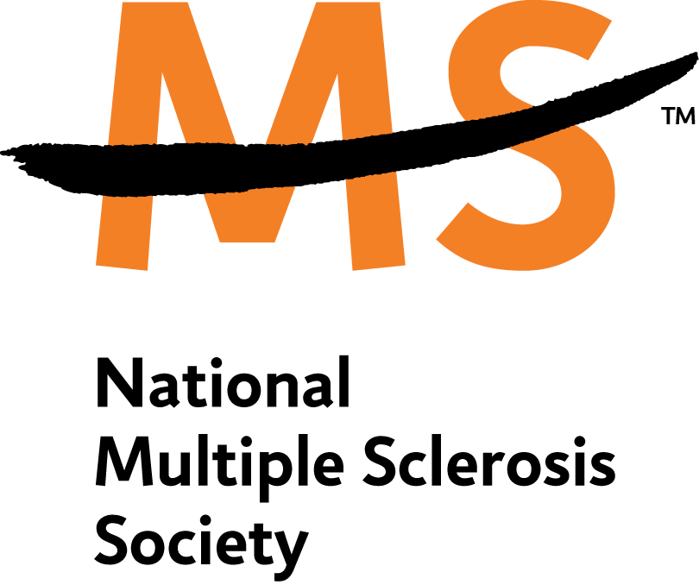
Living with Multiple Sclerosis
“life after diagnosis”
Jessica L. Potter
Community Development Coordinator
National Multiple Sclerosis Society – Maryland Chapter

Slide 2
What is Multiple Sclerosis?
Multiple Sclerosis interrupts the flow of information from the brain to the body and stops people from moving.
MS is thought to be an autoimmune disease. The body’s own defense system attacks myelin, the fatty substance that surrounds and protects the nerve fibers of the brain, optic nerves, and spinal cord (the central nervous system). The damaged myelin may form scar tissue (sclerosis). Often the nerve fiber is also damaged. When any part of the myelin sheath or nerve fiber is damaged or destroyed, nerve impulses traveling to and from the brain are distorted or interrupted.
Every hour in the United States someone is newly diagnosed with MS, an unpredictable disease of the Central Nervous System.

Slide 3
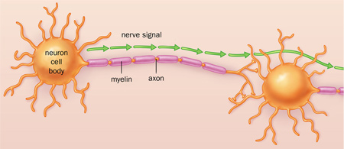
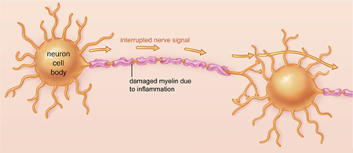
MS affects the nervous system. What does this mean?
Healthy Neuron
Neuron Damaged by Multiple Sclerosis

Slide 4
What are the symptoms of MS?
Symptoms range from numbness and tingling to blindness and paralysis.
The progress, severity and specific symptoms of MS in any one person cannot yet be predicted, but advances in research and treatment are moving us closer to a world free of MS.

Slide 5
At what age is Multiple Sclerosis typically diagnosed?
Most people with MS are diagnosed between the ages of 20 and 50 (prime of life), with more than twice as many women as men contracting the disease.
MS affects more than 400,000 people in the United States and 2.5 million worldwide.

Slide 6
Is MS easily diagnosed?
MS is not always easy to diagnose because symptoms may come and go. In addition, other diseases of the central nervous system have some of the same symptoms. No single neurological or laboratory test can confirm or rule out MS.
Medical imaging, particularly MRI (magnetic resonance imaging), helps to clarify diagnosis. A conclusive or definitive diagnosis requires evidence of multiple patches of scar tissue in different parts of the central nervous system and evidence of at least two separate attacks of the disease. A definitive diagnosis can take several months. Sometimes it takes years.

Slide 7
Are there different types of Multiple Sclerosis?
Relapsing Remitting Multiple Sclerosis – (RRMS) is the most common form of the disease. It is characterized by clearly defined acute attacks with full recovery or with residual deficit upon recovery. Periods between disease relapses are characterized by a lack of disease progression. Approximately 85% of people with MS begin with a relapsing remitting course.
Primary Progressive – (PPMS) characterized by progression of disability from onset, without plateaus or remissions or with occasional plateaus and temporary minor improvements. A person with PPMS, by definition, does not experience acute attacks. Of people with MS are diagnosed, only 10% have PPMS. In addition, the diagnostic criteria for PPMS are less secure than those for RRMS so that often the diagnosis is only made long after the onset of neurological symptoms and at a time when the person is already living with significant disability.
Secondary Progressive –(SPMS) begins with an initial relapsing-remitting disease course, followed by progression of disability (3a) that may include occasional relapses and minor remissions and plateaus (3b). Typically, secondary-progressive disease is characterized by: less recovery following attacks, persistently worsening functioning during and between attacks, and/or fewer and fewer attacks (or none at all) accompanied by progressive disability. According to some natural history studies, of the 85% who start with relapsing-remitting disease, more than 50% will develop SPMS within 10 years; 90% within 25 years. More recent natural history studies (perhaps because of the use of MRI to assist in the diagnosis) suggest a more benign outlook that these numbers suggest. Nevertheless, many patients with RRMS do develop SPMS ultimately.
Progressive Relapsing Remitting – (PRMS), which is the least common disease course, shows progression of disability from onset but with clear acute relapses, with or without full recovery. Approximately 5% of people with MS appear to have PRMS at diagnosis. Not infrequently a patient may be initially diagnosed as having PPMS and then will experience an acute attack, thereby establishing the diagnosis of PRMS.

Slide 8

Is there are cure for MS?
The answer is no—not yet. The cause and the cure of MS are the subject of intensive worldwide research. Over 300 research grants and fellowships are funded by the National MS Society each year. Knowledge about MS is expanding and many clinical trials are in progress.

Slide 9

What is a Disease Modifying Drug?
The Society’s Medical Advisory Board agrees that disease-modifying drugs are most effective when started early, before the disease has the opportunity to cause significant damage.
Most of these drugs are taken on a long-term basis, and they are the best defense currently available to slow down the natural course of MS. Even though the disease-modifying medications don’t make a person feel better, they can be looked upon as an investment in the future.

Slide 10
What do Disease Modifying Drugs do?
Reduce the frequency and severity of clinical attacks (also called relapses or exacerbations), which are defined as the sudden worsening of an MS symptom or symptoms, or the appearance of new symptoms, which lasts at least 24 hours and is separated from a previous exacerbation by at least one month.
Reduce the accumulation of lesions (damaged or active disease areas) within the brain and spinal cord as seen on MRI (magnetic resonance imaging).
Appear to slow down the accumulation of disabilities

Slide 11

The next step after diagnosis… which medicine do I choose?
Indication (FDA-approved Use)
Immunomodulating drugs:
Avonex® For the treatment of relapsing forms of MS, and for a single clinical episode if MRI features consistent with MS are also present.
Betaseron®For the treatment of relapsing forms of MS and secondary-progressive MS with relapses.
Copaxone® For the treatment of relapsing-remitting MS.
Rebif® For the treatment of relapsing forms of MS.
Tysabri®For the treatment of relapsing forms of MS as a monotherapy (meaning, not used in combination with any other immunomodulating therapy). Generally recommended for patients who have had inadequate response to, or are unable to tolerate, other MS therapies.
Immunosuppressant drug
Novantrone® For treatment of worsening relapsing-remitting MS and for progressive relapsing or secondary-progressive MS.

Slide 12
Do I have to quit working?
The Americans with Disabilities Act: Protection for People with Multiple Sclerosis
The Americans with Disabilities Act (ADA)—which became law in July 1990—is the first comprehensive legislation passed by any country in the world to prohibit discrimination on the basis of disability. The ADA guarantees full participation in American society for all people with disabilities just as the Civil Rights Act of 1964 guaranteed the rights of all people regardless of race, sex, national origin, or religion. And there are other federal, state, and local laws that also protect people who are disabled.
The ADA covers almost everyone with MS. It doesn't only apply to people who use wheelchairs. It covers every person with an impairment that substantially limits one or more major life activities. Even people with multiple sclerosis who have never had any disabling symptoms can be protected if they are perceived as disabled or they have records of such impairments.

Slide 13
Who is the National MS Society?
MS stops people from moving. The National MS Society exists to make sure it doesn’t. We do this through our home office and 50 – state network of chapters by funding more MS research, providing more services to people with MS, offering more professional education and furthering more advocacy efforts than any other MS organization in the world. The Society is dedicated to achieving a world free of MS. We are people who want to do something about MS, now. Join the movement at: nationalMSsociety.org.

Slide 14


How do I contact the National MS Society?
TELEPHONE:
(800)FIGHT-MS
or
(443)641-1200
INTERNET:
www.nationalmssociety.org

Slide 15
ARE YOU READY TO JOIN THE MOVEMENT?

