Slide 1

Advanced EVA:
Planning for Planetary Dust
Sandra Wagner
Advanced EVA Systems
March 29, 2005

Slide 2
Advanced EVA:
Planning for Planetary Dust
  Aim Dust Assessment
  Mars Human Precursor Measurements
  Technology Planning

Slide 3
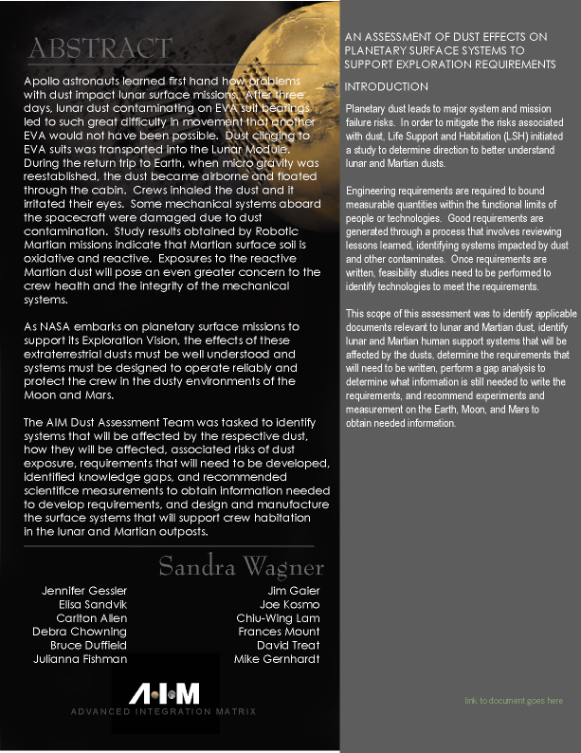
Advanced Integrated Matrix (AIM)
Dust Assessment
What Do We Need to Know About
Martian and Lunar Dust
to Write Human Support Systems Requirements?

Slide 4
AIM Dust Assessment
Define the Problem
System Affected
Subsystem Affected
Effects on System
Risks
  Hazards
  Habitability
  Toxicity
Requirements Needed
Knowledge Gaps
Recommendation
  Earth
  Moon
  Mars
Analyze the Problem
Frame the Question

Slide 5
AIM Interdivisional Dust Study
Affected Systems
Air Revitalization
  Water Recovery
  Solid Waste Processing
  Thermal Control
  Other ALS Systems
Advanced Food Systems
  Food Storage
  Food Processing
  Food Preparation.
Advanced EVA Systems
Airlock
Suit Assembly
Helmet
PLSS Power and communications
PLSS cooling
PLSS O2
PLSS Vent
Ancillary equipment
Structures
Tools and hardware
Rovers
Displays
Solar cells
Windows
Lights
Sensors
Cameras
Other Associated Systems
  GN&C
  Structures
  IVA
  Fire Detection and Suppression
  Environmental Monitoring
  Power
  Electrical and Electronics
  Communications

Slide 6
AIM Dust Study
Effects on System - Example
Subsystem/ Component
Effect due to Dust Exposure
Outer Garment
Dust accumulation/transfer to airlock-habitat; degradation of materials
Bearings
Seal degradation, leaks, higher spares/maintenance
Visor coatings
Scratches/severe abrasion; loss of coatings
Lighting
Reduced illumination due to dust coating illumination source

Slide 7
AIM Dust Study
Recommendations
Measure the Things that Can Only be Measured on Mars
Measure the Things that Can Only be Measured on the Moon
Perform Simulations and Studies on Earth to Test the Effects on Human Support Systems

Slide 8
AIM Dust Study
Overall Recommendations (Earth)
Develop a standard set of Lunar and Martian dust properties for future designers.
Develop and fully characterize new Lunar and Martian soil simulants.
Develop Lunar and Martian test chamber that closely approximates environment.
Develop Lunar and Martian dust test programs to demonstrate system reliability.
Obtain small quantities of actual lunar dust for critical test programs (i.e., toxicology).
Compile information on Apollo crew’s experience with the lunar dust.
Implement medical monitoring for astronauts exposed to Lunar and Martian dust.
Survey and mature innovative dust mitigation technologies.

Slide 9
AIM Dust Study
Toxicology Recommendations (Earth)
Determine diversity of the types of dust that could be present in the area of the outpost.
Effect of propellant byproducts on the surface of the dust.
Particle size and shape distribution of the dust fraction below 20 microns.
Perform toxicological studies using simulated Martian dusts (Hawaii volcanic ash) doped with appropriate oxidative chemicals.
Establish inhalation and ingestion standards for dust in oxygen and water recovered from in-situ resources.
Establish limits for larger dust particles for eye exposure.
Analyze epidemiology studies of human exposures to volcanic ashes
Review lessons learned on crew experience with the lunar dusts in the lunar command modules.

Slide 10
AIM Dust Study
Toxicology Recommendations (Moon)
Collect and analyze samples in regions where dust may be different than the samples collected in the Apollo surface missions.
  In-situ resource utilization on the polar regions that may
  contain water.
  Science missions that require low interference from earth
  radio sources such as observation using telescopes.
Fully characterize electrostatic levitation.
Determine magnetic properties of the dust.
Demonstrate airborne dust monitors and filters.

Slide 11
AIM Dust Study
Toxicology Recommendations (Mars)
Measure dust loading in the Martian atmosphere under a variety of environmental conditions.
Fully characterize the electrostatic properties of the Martian surface.
Return Martian dust samples to Earth for full analysis well before committing humans to a Mars mission.

Slide 12
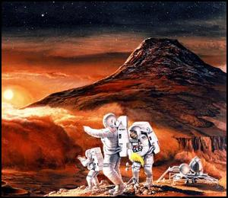


Mars Exploration Program Analysis Group (MEPAG)
Mars Human Precursor Science Steering Group (MHP SSG)
Measurement Team
Dust, Soil and Toxicology Focus Team

Slide 13
Team Dust
Strategy
Informal “Peer” Review of AIM Assessment
Prioritize Risks
Recommend Measurements for MHP missions
Prioritize Measurements

Slide 14
Team Dust
Risks
Risk 6A: If critical mechanical systems fail due to abrasion and adhesion of dust accumulated on systems, loss of science, injury or loss of crew may result.
Risk 6B: If critical electrical life-safety systems fail due to dust accumulation on systems, injury or loss of crew or loss of science will result.
Risk 6C: If critical life-safety systems fail due to corrosive effects of dust accumulated on systems, injury or loss of crew member may result.
Risk 7: If the crew inhales or ingests dust adverse health effects may result.

Slide 15
Team Dust
Investigations and Measurements
Investigation 1A.
Characterize the particulates that could be transported to mission surfaces through the air (including both natural aeolian dust and particulates that could be raised from the martian regolith by ground operations), and that could affect hardware’s engineering properties.
Analytic fidelity sufficient to establish credible engineering simulation labs and/or performance prediction/design codes on Earth is required.

Slide 16
Team Dust
Investigations and Measurements
Measurements
Complete analysis
  Shape and size distribution
  Mineralogy
  Electrical and thermal conductivity
  Triboelectric and photoemission properties
  Chemistry
Polarity and magnitude of charge
  individual dust particles suspended in atmosphere
  concentration of free atmospheric ions with positive and negative polarities.
The same measurements as in a) on a sample of air-borne dust collected during a major dust storm.
d. Subsets of the complete analysis described in a), and measured at different locations on Mars.

Slide 17
Team Dust
Investigations and Measurements
Investigation #2.
Determine the possible toxic effects of martian dust on humans.

Slide 18
Team Dust
Investigations and Measurements
Measurements:
For at least one site, assay for chemicals with known toxic effect on humans.
Fully characterize:
  soluble ion distributions
  reactions that occur upon humidification
  released volatiles
Analyze the shapes of martian dust grains
Determine if martian regolith elicits a biologic response in an animal species which is a surrogate for humans. *
* As authorized by the Institutional Animal Care and Use Committee

Slide 19
Team Dust
Risk Mapping
Risk
Exposure
Risk
Measurements
Measurement 1A.a
For System Reliability
Risk 6A
Measurement 1A.b
For Electrical Shock Reduction
Risk 6B
Measurement 1A.c
For More Confidence
in Measurements
Measurement 1A.d
Less value than 1A.a
Risk 6C
Measurement 2A
Risk 7
Measurement 2B
For Human
Exposure
Requirements
Measurement 2C
Measurement 2D

Slide 20
Advanced EVA
Dust Mitigation Scope
Minimize the amount of dust transferred into habitat as a result of EVA
Minimize the amount of dust entering EVA suits
Maximize EVA Systems Reliability
Maximize EVA Tool and Interfaces Reliability

Slide 21
Advanced EVA
Dust Mitigation Technology Planning
FY ‘05
FY ’06 - ??
Concept of Operations
New Technologies
Requirements Workshop
Mature Technologies
Technology Focus Group
Test Technologies
Technology Plans
Decision Gates
Testing Requirements
Drop Technology

Slide 22
Headed into
the Cosmos

