Slide 1
CEBS goals
A high quality public knowledgebase that aims to:
Create a reference toxicogenomic information system of studies on environmental chemicals and stressors and their effects (a public resource for the scientific community).
Develop relational and descriptive data compendia on toxicologically important genes, groups of genes, SNPs, mutants and their attributes across species that are relevant to human health and environmental disease.
Support hypothesis-driven and discovery research in environmental toxicology - and the research needs of risk assessment.
Create a vehicle for the evolution of “systems toxicology”.
Identify molecular pathways leading to disease
Improve ability to extrapolate from animal studies to probable human effects
Provide better understanding of gene-environment interactions in human disease

Slide 2
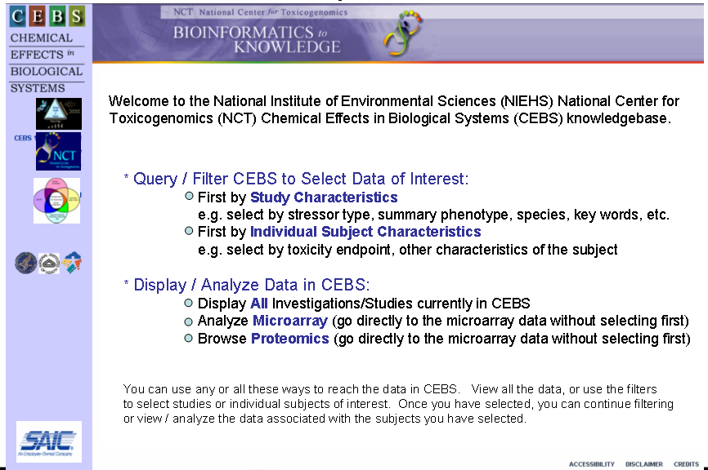
CEBS short-term plans: launch 4Q05
USING CEBS TODAY.......

Slide 3
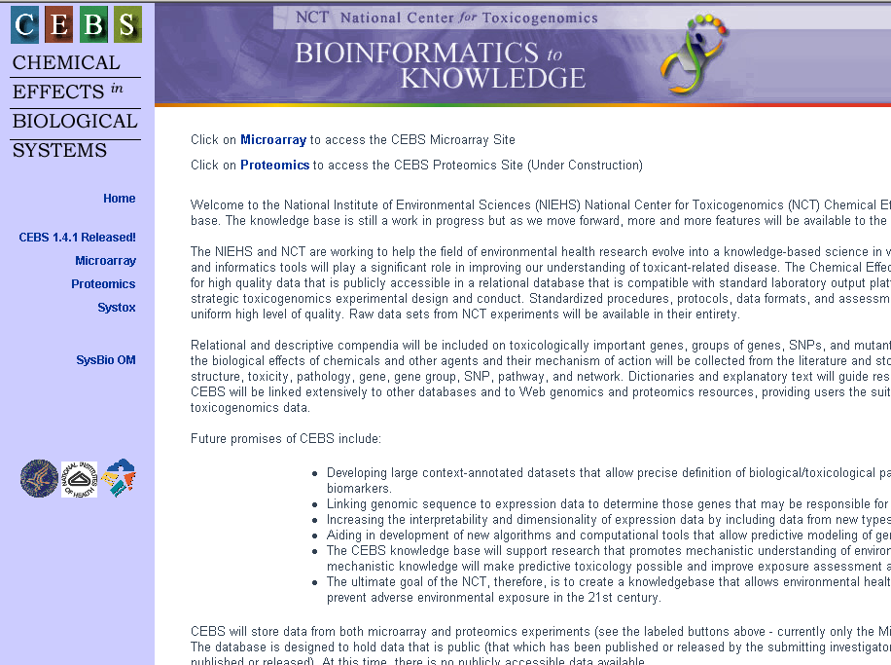
http://cebs.niehs.nih.gov/

Slide 4
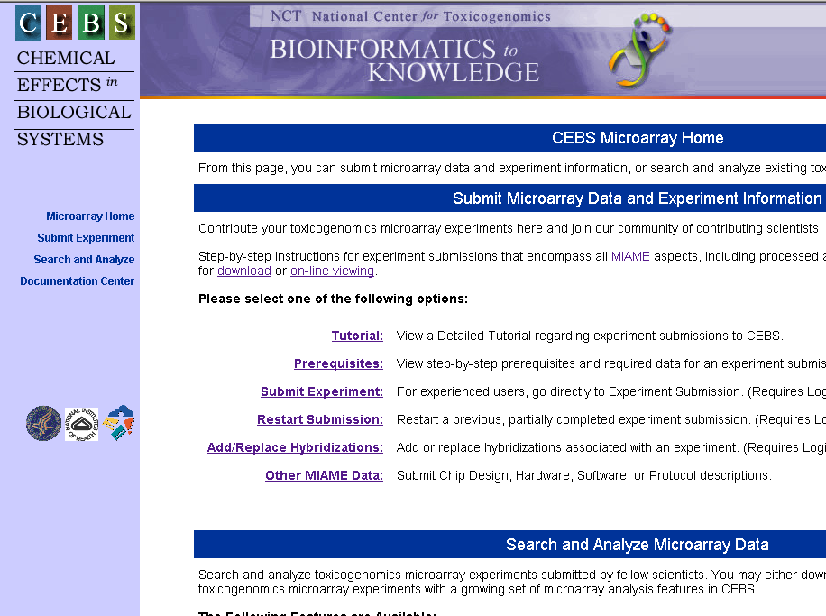

Slide 5
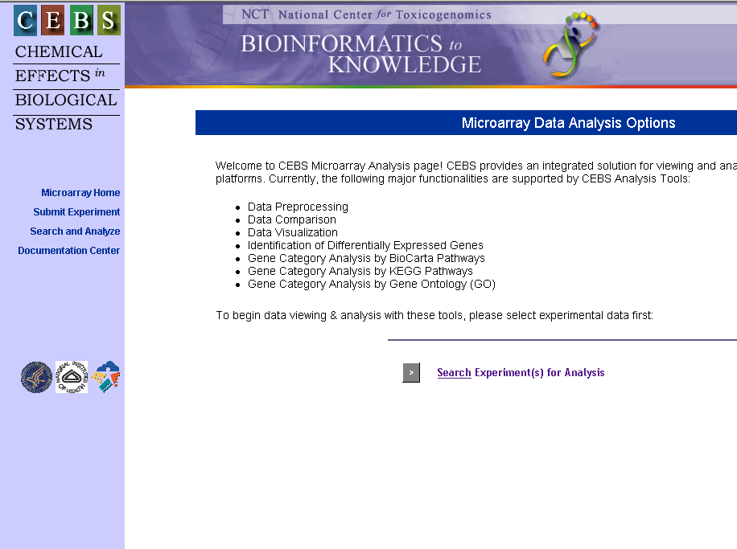

Slide 6
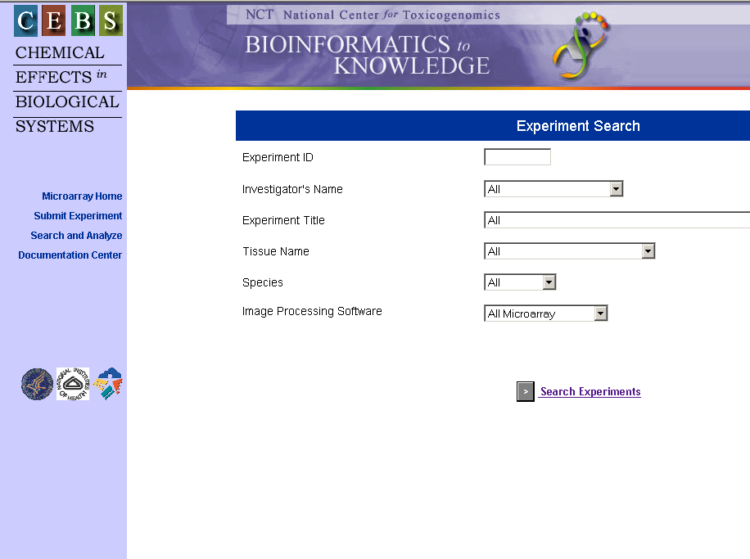

Slide 7
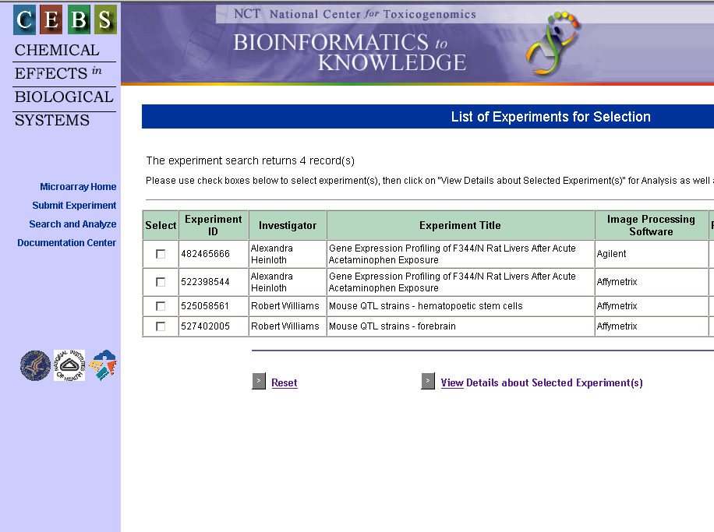
important!
To learn about the data

Slide 8
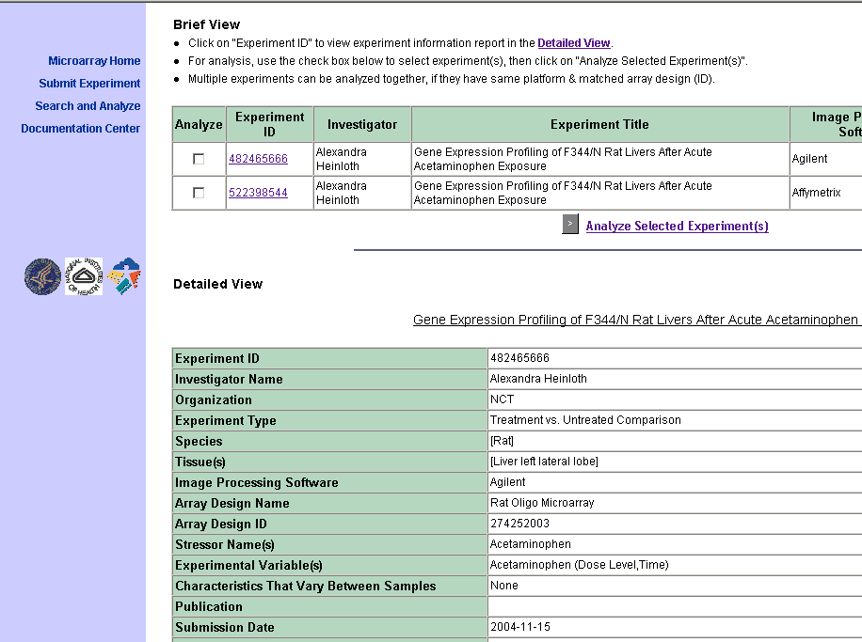
important!

Slide 9
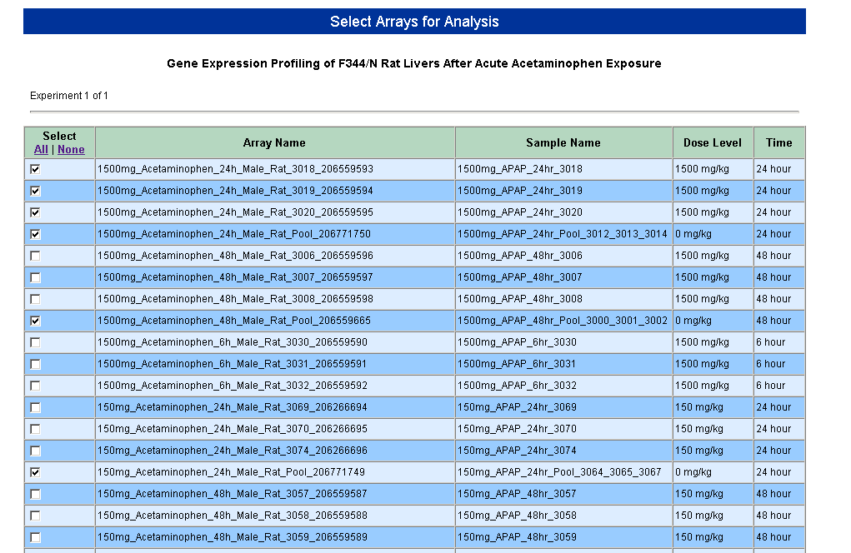
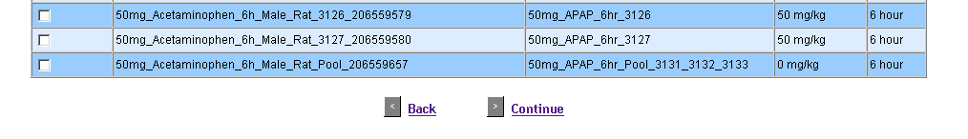
important!

Slide 10
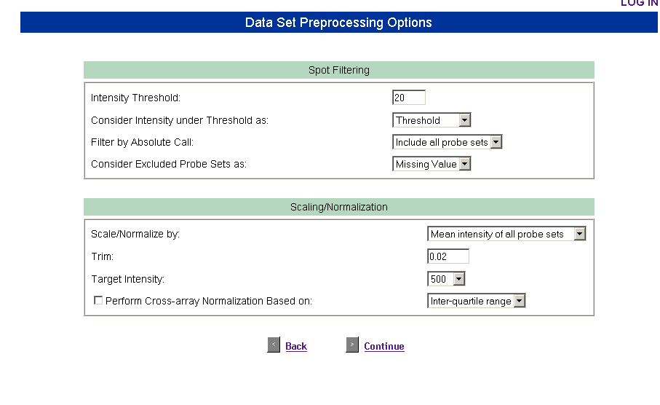
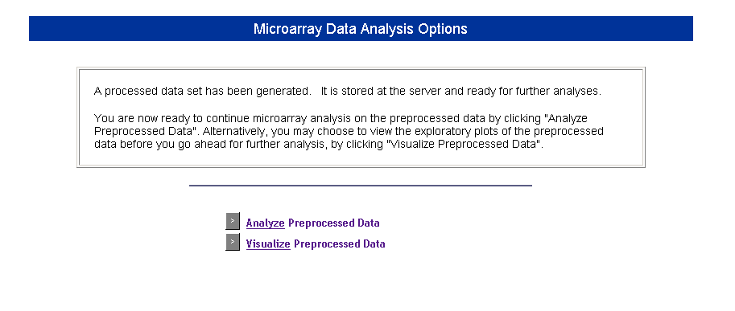

Slide 11
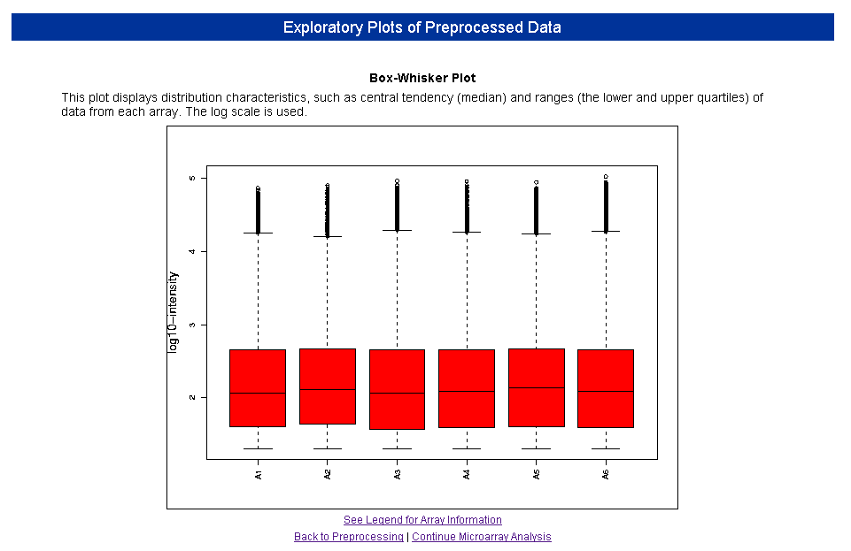
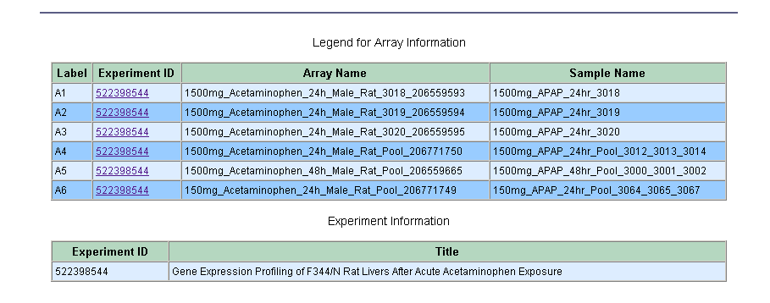
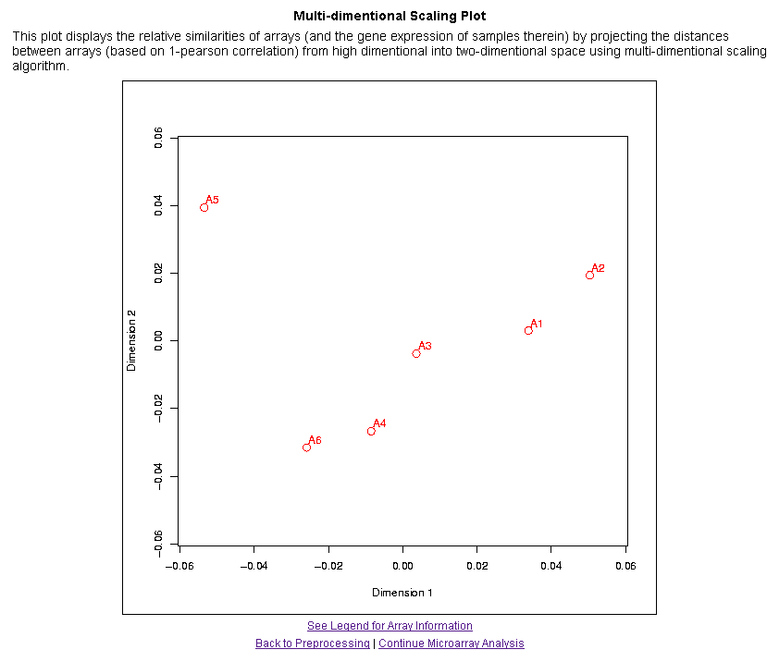
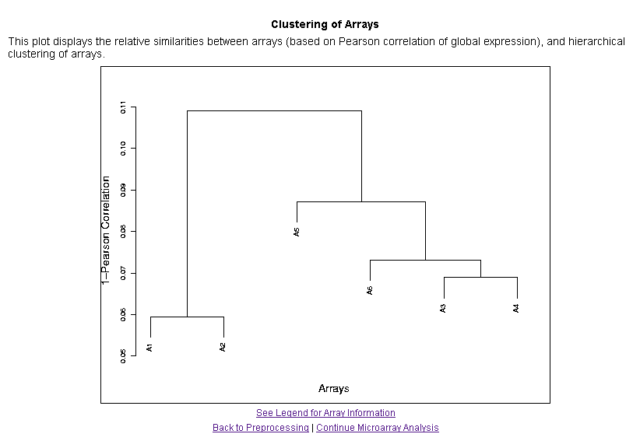

Slide 12
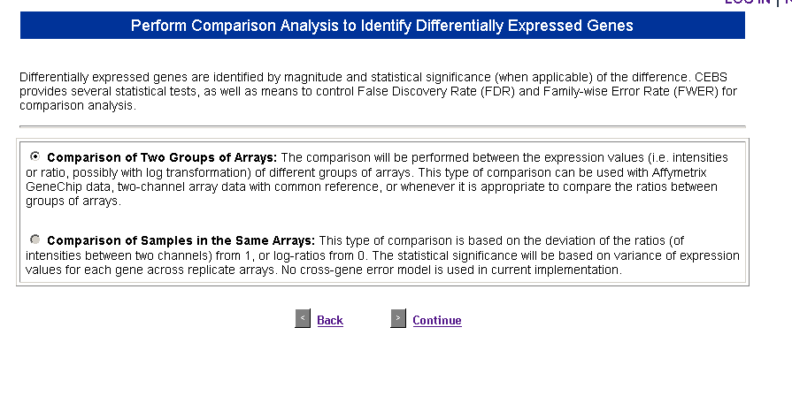

Slide 13
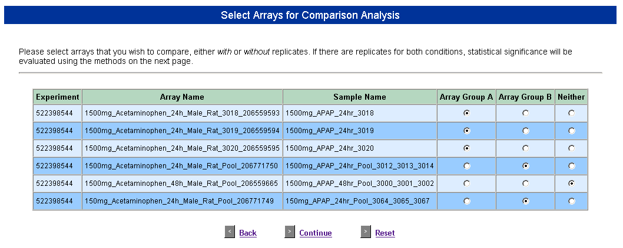

Slide 14
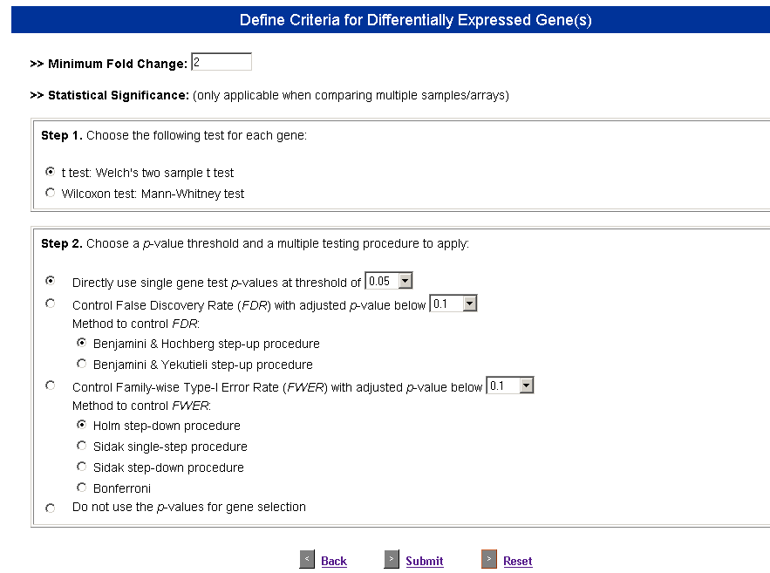

Slide 15
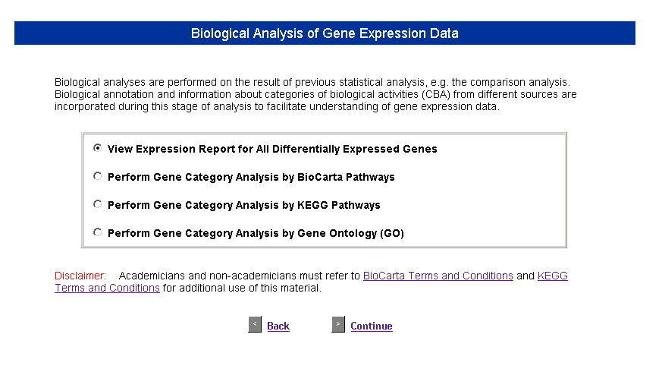

Slide 16
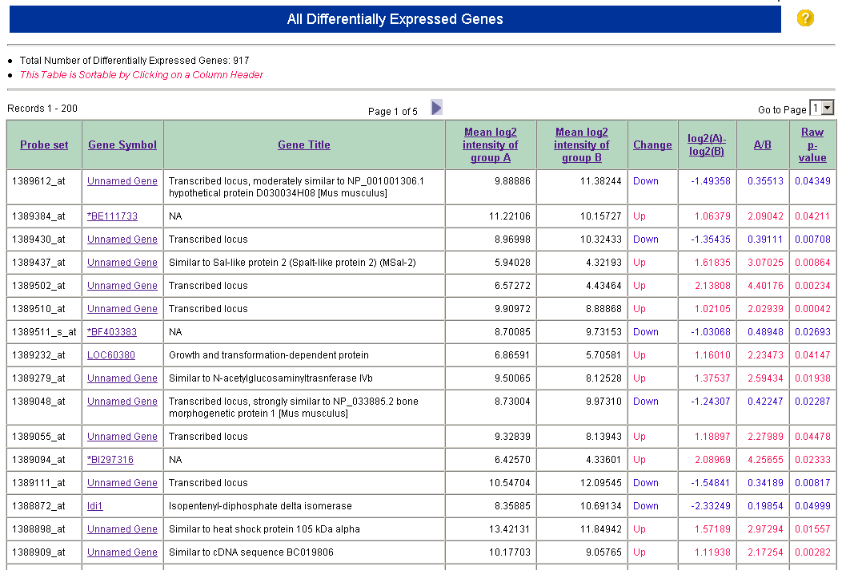
annotation (next page)

Slide 17
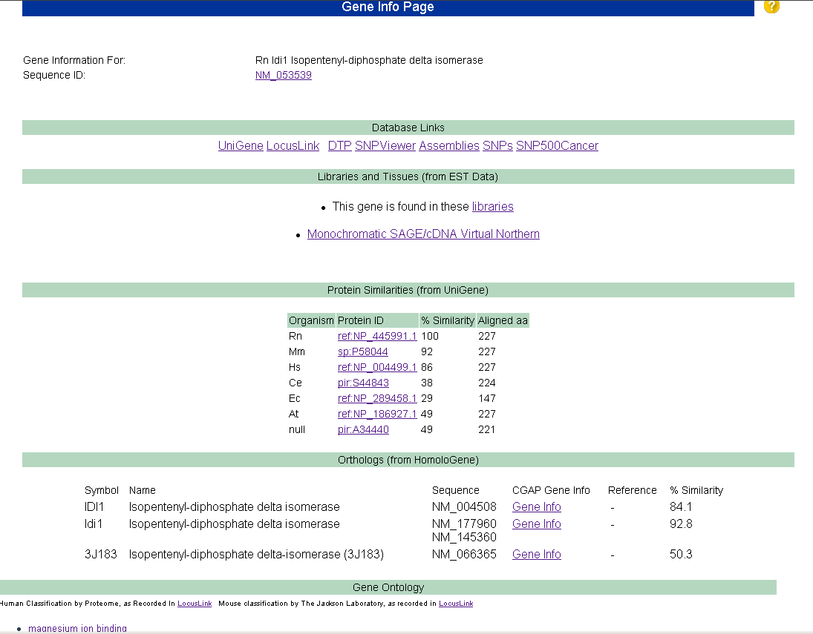

Slide 18
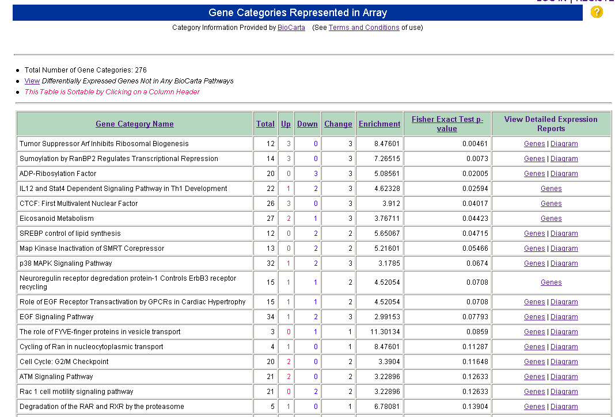
SORT
VIEW

Slide 19
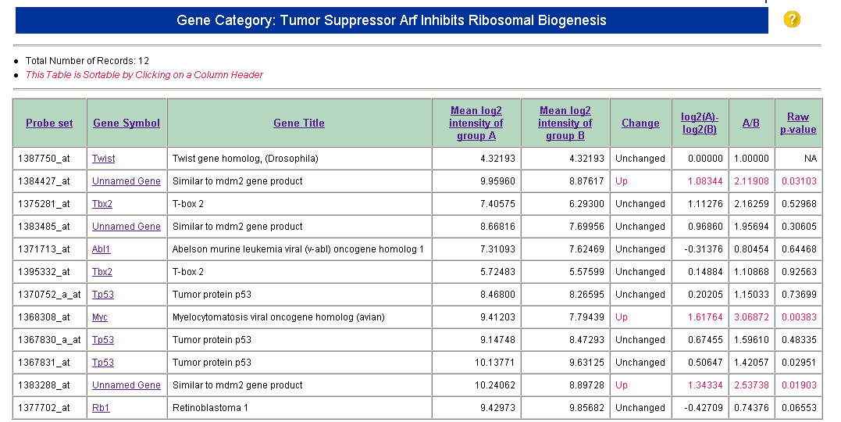
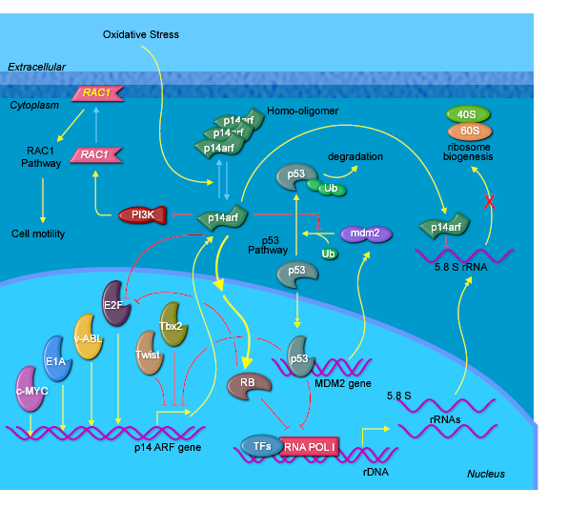

Slide 20
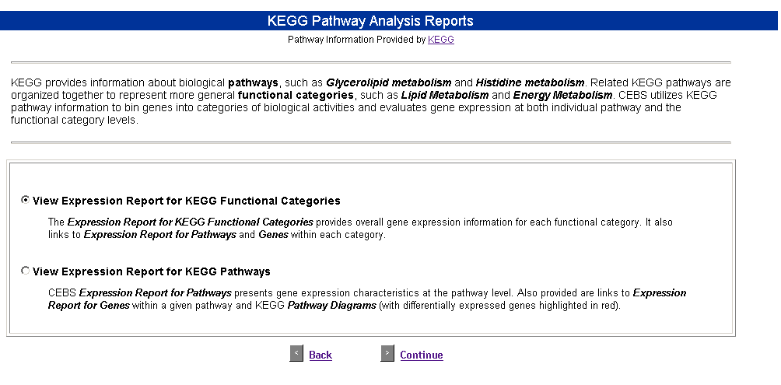

Slide 21
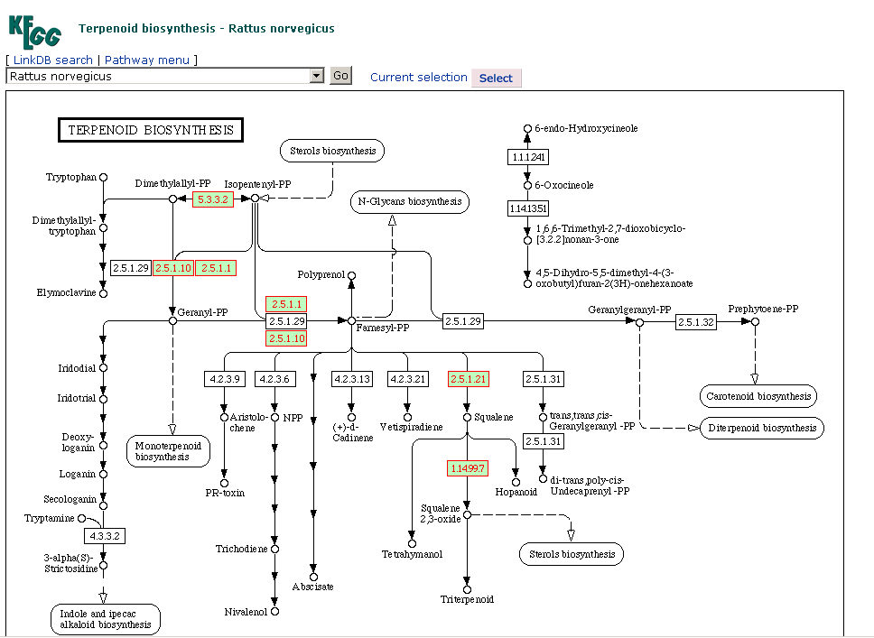
red outlines => changed transcripts

Slide 22
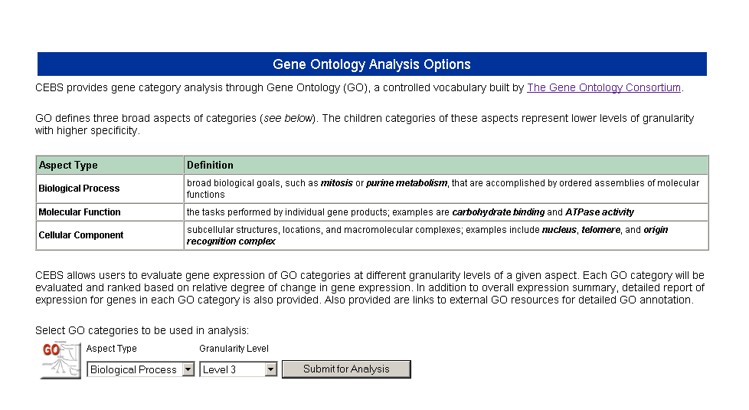

Slide 23
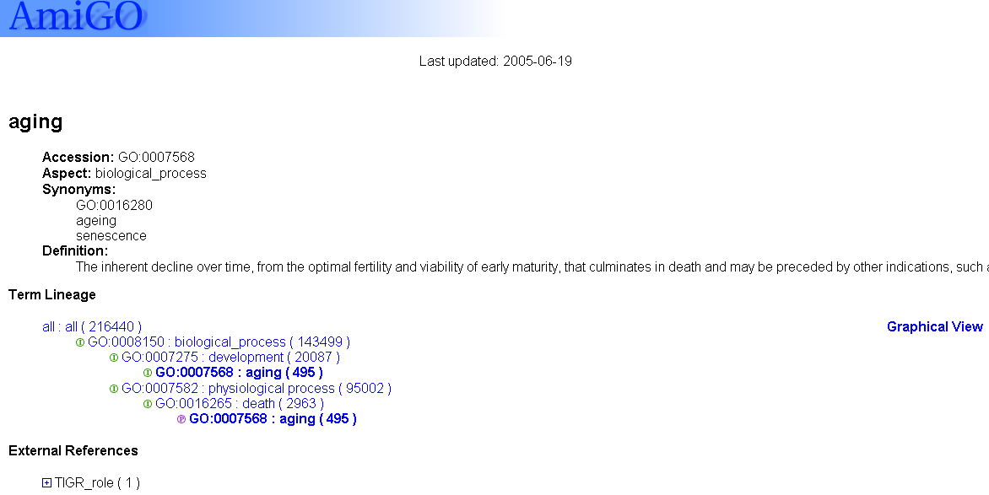
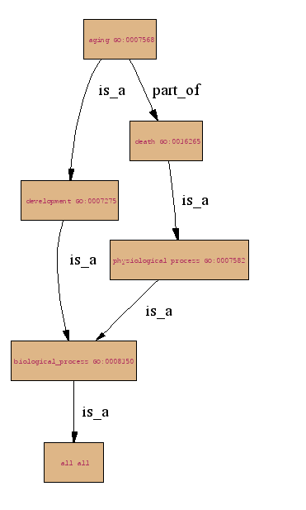

Slide 24
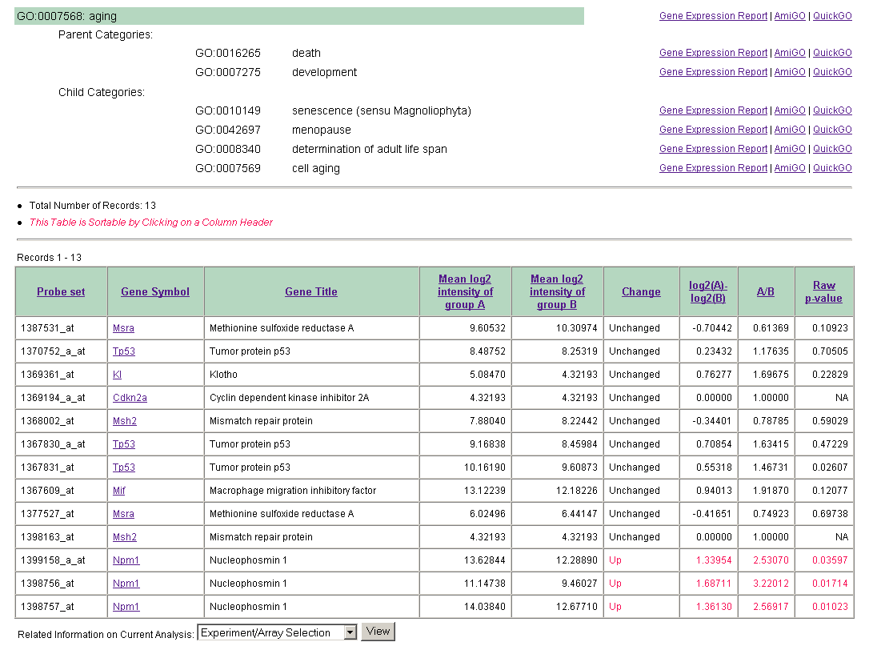

Slide 25
CEBS questions?
Interested in sharing your data in CEBS?
CEBS is designed to be used both as a public resource and as a public-private resource.
Users can create a private area in CEBS, upload their data and then
analyze their own data using CEBS tools, or select data already in CEBS on the same platform, and combine public and private data for analysis.
To set this up, please contact fostel@niehs.nih.gov
contact fostel@niehs.nih.gov

