Slide 1
The 2005 Cancer Guidelines and Early-Life Supplemental Guidance
Resha M. Putzrath, Ph.D., DABT
Health Science Coordinator
Risk Assessment Forum, EPA/ORD/NCEA
2005 Toxicology and
Risk Assessment Conference

Slide 2
Major Topics
Data before default options
Mode(s) of Action as a decision point
Weight of Evidence for human carcinogenicity
Dose-Response: Nonlinear as well as linear
Risk Characterization: More options to explain, e.g., more than one descriptor
Susceptible lifestages and populations with emphasis on early-life exposure

Slide 3

As toxicology and risk assessment advance, the guidelines have grown.
Guidelines for Carcinogen Risk Assessment
140
120
100
80
60
40
20
# of Pages
1986 1996 1999 2005
  Draft Draft Final

Slide 4
Cancer Guidelines 2005
Set forth recommended principles and procedures for assessing cancer risks.
Inform EPA decision makers and the public about these procedures.
Are meant to be dynamic and flexible.
Will be updated by additional supplemental guidance as experience and scientific understanding evolve.

Slide 5
Key Features of Cancer Guidelines
Analyze data before invoking default options.
Framework for mode of action
Weight-of-evidence narrative and descriptor replaces the previous alpha-numeric
Two-step dose-response process separates
  modeling the observed data, from
  extrapolation to lower doses.
Linear and nonlinear extrapolations are considered.
Differential risks to susceptible populations and lifestages are considered.

Slide 6
Supplemental Guidance for Early-Life Exposure 2005
Only apply if:
  Mutagenic mode of action for carcinogenesis, and
  Chemical-specific data are absent
Age-dependent adjustment factors (ADAFs) increase potency for exposure during certain periods of life
  Examples provided in Section 6 of Guidance
  Implementation memo on web site

Slide 7
When all else fails,
read the Guidelines and Guidance documents.
www.epa.gov/cancerguidelines

Slide 8
Cancer Guidelines: Important Definitions
Mode of Action: Key events and processes, starting with the interaction of an agent with a cell, through functional and anatomical changes, resulting in cancer or other health endpoints
Key Event: Empirically observable precursor step that is itself a necessary element of the mode of action or is a biologically based marker for such an element

Slide 9
Important Definitions (cont.)
Linear: Low-dose linear approximates a straight line at very low doses
Nonlinear: Refers to threshold models and some nonthreshold models, e.g., a quadratic model

Slide 10
What’s New, or May Seem New
Data before defaults
Mode of action (MOA) framework
Epidemiological data emphasized
Linear or nonlinear extrapolation - or both

Slide 11
What’s New (cont.)
Precursor data may be used
Risk characterization
  When MOA not established, present alternative models “with significant biological support”
  Margin of exposure (MOE) option

Slide 12
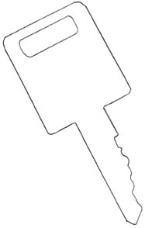
For decision-making and
for harmonizing
cancer and noncancer
risk assessment
Mode of Action
is the key

Slide 13
Use framework in Cancer Guidelines to establish MOA(s)
Use of MOA Framework
MOA sufficiently
supported in animals?
MOA can not be determined
Yes
Use linear extrapolation as a default.
MOA relevant to humans?
No
Yes
No further analysis of tumors.
Flag lifestage(s) or population(s) that could be susceptible (based on information about the specific MOA) for dose-response analysis.
Determine extrapolation based on information about specific MOA.
Nonlinear
Model using MOA or use RfD/RfC method as default. Adjustments for susceptible lifestages or populations are part of the process.
Linear, but nonmutagenic MOA
Linearity due to mutagenic MOA
Use the same linear extrapolation for all lifestages, unless have chemical-specific information on lifestages or populations.
Supplemental Guidance for Early-Life Exposures
Yes
Develop chemical-specific risk estimates incorporating lifestage susceptibility.
Were chemical-specific data available in MOA analysis to evaluate differences between adults and juveniles (more, less, or the same susceptibility)?
No
Early-life susceptibility assumed. Apply age-dependent adjustment factors (ADAFs) as appropriate to develop risk estimates.

Slide 14
Use of MOA Information
Assess the relevance of laboratory animal results to human environmental exposures
Provide insight into whether the dose-response curve is likely to be linear or nonlinear at low doses
Identify susceptible populations and lifestages
Quantify the relative sensitivity of laboratory animals and human populations

Slide 15
Mode of Action Framework
Summary description of the hypothesized mode of action.
Identification of key events.
Strength, consistency, specificity of association.
Dose-response concordance.
Temporal relationship.
Biological plausibility and coherence.
Consideration of the possibility of other MOAs

Slide 16
MOA Framework
Description of the hypothesized mode of action
Discussion of experimental support for the hypothesized mode of action
Consideration of the possibility of other modes of action
EPA’s framework is consistent with others, e.g., the International Programme on Chemical Safety and by the International Life Sciences Institute.

Slide 17
Conclusions about the MOA
Is the mode of action sufficiently supported in the test animals?
Is the mode of action relevant to humans?
Which populations or lifestages can be particularly susceptible to the mode or action?
  Question is both qualitative and quantitative
  Quantitative differences can be used in the dose-response assessment

Slide 18
Epidemiological Data
Data from humans preferred
Hill “criteria” for causation
  As discussed in Surgeon General’s report, for cases when only human data assessed
  Are guide, not checklist
“None of my nine viewpoints can bring indisputable evidence for or against the cause-and-effect hypothesis and none can be required as a sine qua non. What they can do, with greater or less strength, is to help us to make up our minds on the fundamental question — is there any other way of explaining the set of facts before us, is there any other answer equally, or more, likely than cause and effect?” Hill (1965)

Slide 19
Laboratory Animals
Conventional cancer bioassays generally can support modeling down to 1–10%
As a modeling convention, the lower bound associated with response levels of 1, 5, and 10% can be analyzed, presented, and considered
For making comparisons at doses within the observed range, the ED10 and LED10 are also reported and can be used
Where practicable, present upper and lower bounds on the central tendency

Slide 20
Statistical Significance
“A statistically significant response may or may not be biologically significant and vice versa. The selection of a significance level is a policy choice based on a trade-off between the risks of false positives and false negatives.”

Slide 21
Weight of Evidence
Narrative: a short summary (one to two pages) that explains an agent's human carcinogenic potential and the conditions that characterize its expression
Descriptors: provide some measure of clarity and consistency in an otherwise free-form narrative
  Are a matter of judgment and cannot be reduced to a formula
  Examples are illustrative, NOT a checklist

Slide 22
“Users of these cancer guidelines and of the risk assessments that result from the use of these cancer guidelines should consider the entire range of information included in the narrative rather than focusing simply on the descriptor.”

Slide 23
Weight-of-Evidence Descriptors
Carcinogenic to humans
Likely to be carcinogenic to humans
Suggestive evidence of carcinogenic potential
Inadequate information to assess carcinogenic potential
Not likely to be carcinogenic to humans

Slide 24
Weight of Evidence
Conditions of carcinogenicity:
  Route, magnitude, and duration of exposure
  Susceptible populations and lifestages
Summary of key evidence supporting these conclusions
Summary of key default options invoked
Summary of potential modes of action

Slide 25
Conflicting versus Differing Results
“[C]onflicting evidence, that is, some studies provide evidence of carcinogenicity but other studies of equal quality in the same sex and strain are negative. Differing results, that is, positive results in some studies and negative results in one or more different experimental systems, do not constitute conflicting evidence, as the term is used here.”

Slide 26
Multiple Descriptors
By route of exposure
By dose or exposure level
When multiple modes of action

Slide 27
Two-step approach to dose-response will encourage the use of more data.
Tumor incidence
STEP 1. Model the observed data down to a point of departure (POD)
xx %
?
POD
Dose (mg/kg-d)

Slide 28
Point of Departure (POD)
Starting point for subsequent extrapolations and analyses
Is the lowest point that is adequately supported by the data
“The POD for extrapolating the relationship to environmental exposure levels of interest, when the latter are outside the range of observed data, is generally the lower 95% confidence limit on the lowest dose level that can be supported for modeling by the data.”

Slide 29
POD (cont.)
SAB (1997) suggested that, "it may be appropriate to emphasize lower statistical bounds in screening analyses and in activities designed to develop an appropriate human exposure value, since such activities require accounting for various types of uncertainties and a lower bound on the central estimate is a scientifically-based approach accounting for the uncertainty in the true value of the ED10 [or central estimate].”

Slide 30
POD (cont.)
Cancer bioassays, 1–10%; epidemiologic studies, possibly below 1%
When good quality precursor data are available and are clearly tied to the mode of action of the compound of interest, models that include both tumors and their precursors may be advantageous for deriving a POD

Slide 31
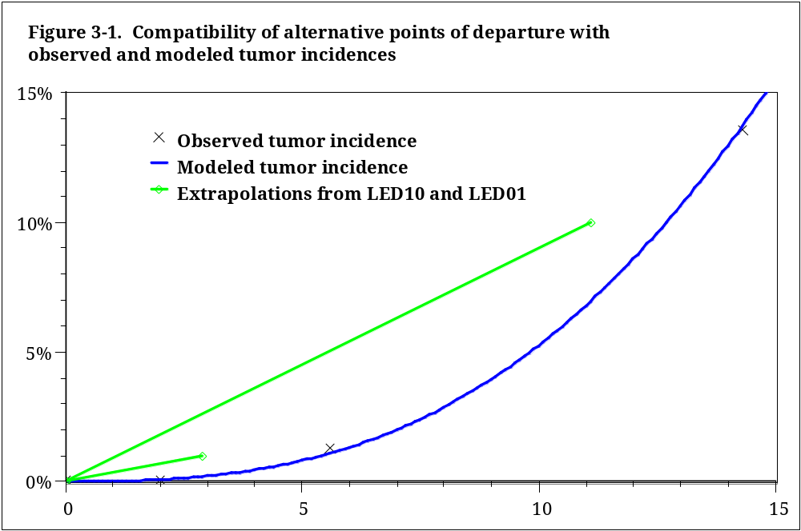

Slide 32
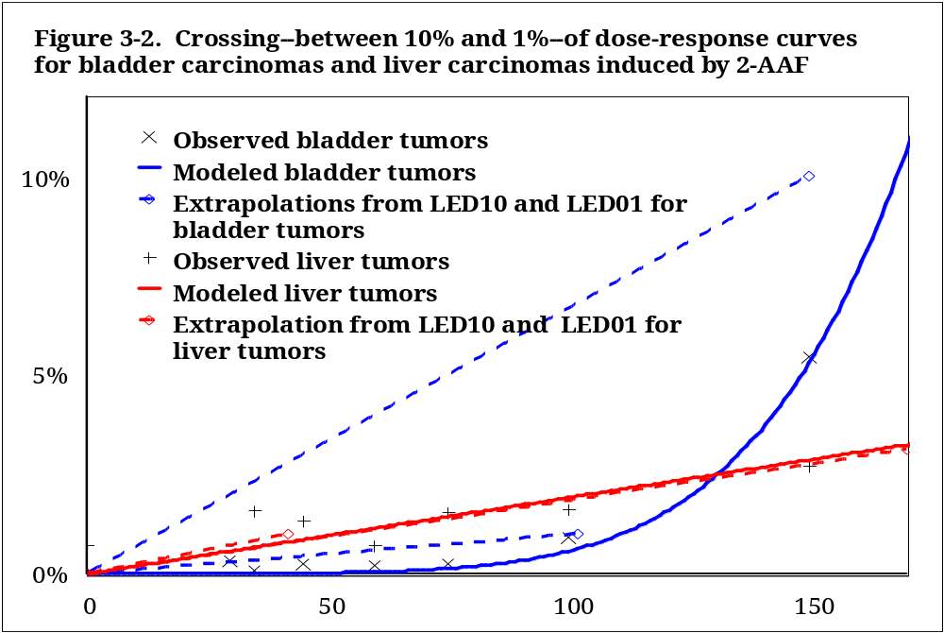

Slide 33
Linear Extrapolation from POD is Appropriate
When the agent has a mutagenic mode of action or acts through another mode of action expected to be linear at low doses,
or
When the data do not establish the mode of action, as default option

Slide 34
Nonlinear Extrapolation from POD is Appropriate
When there is no evidence of linearity, and
When there is sufficient information to support a mode of action that is nonlinear at low doses

Slide 35
Uncertainty
EPA uses a standard curve-fitting procedure for tumor incidence data
Use of different approach should provide an adequate justification and compare with the standard procedure
Application of models should be open and transparent

Slide 36
Uncertainty (cont.)
The risk characterization should therefore include,
where practicable,
  expected or central estimates of risk,
  as well as upper and lower bounds, e.g., confidence limits, based on the POD,
  if not a full characterization of uncertainty of the risk.
OMB Circular A-4 (2003) emphasizes, “Whenever it is possible to characterize quantitatively the probability distribution, some estimates of expected value ... must be provided in addition to ranges, variances, specified low-end and high-end percentile estimates, and other characteristics of the distribution.”

Slide 37
Uncertainty (cont.)
NRC (1994) saw the need to treat uncertainty in a predictable way that is “scientifically defensible, consistent with the agency's statutory mission, and responsive to the needs of decision-makers”
“Where alternative approaches with significant biological support are available for the same tumor response and no scientific consensus favors a single approach [i.e., no MOA], an assessment may present results based on more than one approach.” One procedure may be given greater weight or preference.

Slide 38
Evolution with Experience
Implementation memo on web site
Implementation working group
Mutagenic MOA working group
Examples will be posted on the web site

Slide 39
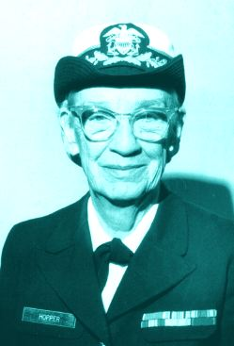
If you do something once, people will call it an accident.
If you do it twice, they call it a coincidence.
But do it a third time, and you’ve just proven a natural law.
Admiral Grace Murray Hopper
Inventor of the computer compiler,
and distributor of nanoseconds

Slide 40
More than One MOA
Both linear and nonlinear approaches may be used when there are multiple MOAs.
If there are multiple tumor sites, then the appropriate extrapolation is used at each site.
If there are multiple MOAs at a single tumor site, then both approaches can be used to decouple and consider the respective contributions of each MOA in different dose ranges.

Slide 41
More than One WOE
Different descriptors for different routes of exposure, exposure levels, or MOA
Narrative should describe the key decisions made and their significant biological support

Slide 42
Summary: Cancer Guidelines
Emphasis on mode of action (MOA)
Weight-of-evidence narrative and descriptors
Two-step approach to dose-response assessment
Choice of linear or nonlinear extrapolation

Slide 43
Take-home Lessons for Supplemental Guidance
Numerous definitions of mutagenic and genotoxic exist
Just because it is mutagenic, doesn’t mean it has a mutagenic MOA for carcinogenesis as described by the cancer guidelines and supplemental guidance
Weight-of-the-evidence approach given wide variety of data sets

Slide 44
Take-home Lessons (cont.)
Initial decision criteria
  Cancer potency factor available
  Weight of the evidence for mutagenic MOA; low-dose linearity
  No chemical-specific carcinogenicity data exist
  Apply age-dependent adjustment factors (ADAFs) if exposures are expected for the appropriate age groups

Slide 45
Take-home Lessons (cont.)
If carcinogenicity data exist for early-life exposures for a chemical, use the chemical-specific data
For all chemicals analyzed for the ADAFs in the supplemental guidance, chemical-specific data exist

Slide 46
Examples Consistent with 2005 Cancer Guidelines
Chloroform: nonlinear extrapolation based on MOA
http://www.epa.gov/iris/subst/0025.htm
Not relevant to humans
  α−2μ-globulin and kidney cancers: different kidney protein
  http://cfpub.epa.gov/ncea/raf/recordisplay.cfm?deid=54883
  2-butoxyethanol (EGBE): concentrations not sufficiently high for sufficient hemolysis
  Gift, 2005. Toxicol. Lett. 156:163-178

Slide 47
Also Consistent (cont.)
Linear and/or non-linear extrapolation: Thyroid follicular cell tumors
http://cfpub.epa.gov/ncea/raf/recordisplay.cfm?deid=13102
  Linear if mutagenic; nonlinear if not mutagenic; both demonstrates mutagenic and anti-thyroid effect
  Five criteria required, additional desirable, for anti-thyroid MOA

Slide 48
When All Else Fails, Read the Instructions
http://www.epa.gov/cancerguidelines
http://www.epa.gov/iris
Risk Assessment Forum
http://cfpub.epa.gov/ncea/raf/index.cfm
National Center for Environmental Assessment
http://cfpub.epa.gov/ncea/

