Slide 1
Loraine, Texas
June 9, 2002

Slide 2
Investigative Team
James LeBerte - Motor Carrier Operations
Mark Bagnard - Highway Factors
Robert Accetta - Scene Documentation
Burt Simon - Human Performance
Hank Hughes - Survival Factors
Ron Kaminski - Survival Factors
Dr. Mitch Garber - Toxicology
Joe Epperson - Metallurgy
Dave Rayburn - Vehicle Factors / IIC

Slide 3
Report Development
Debbie Curry - Editor
Ed Pacchetti - Safety Recommendations
Jennifer Bishop - Project Manager

Slide 4
Parties to the Investigation
Federal Motor Carrier Safety Administration
Texas Department of Transportation
Texas Department of Public Safety
Greyhound Lines, Inc.
Consolidated Safety Services

Slide 5
Safety Issue and Proposed Recommendations Recipient
Safety and management oversight of new entrant motor carriers
Federal Motor Carrier Safety Administration

Slide 6
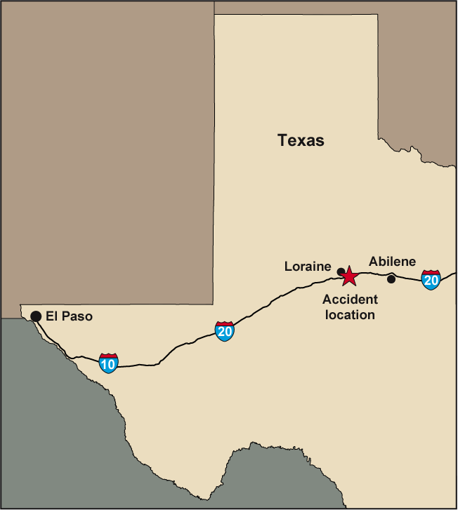

Slide 7
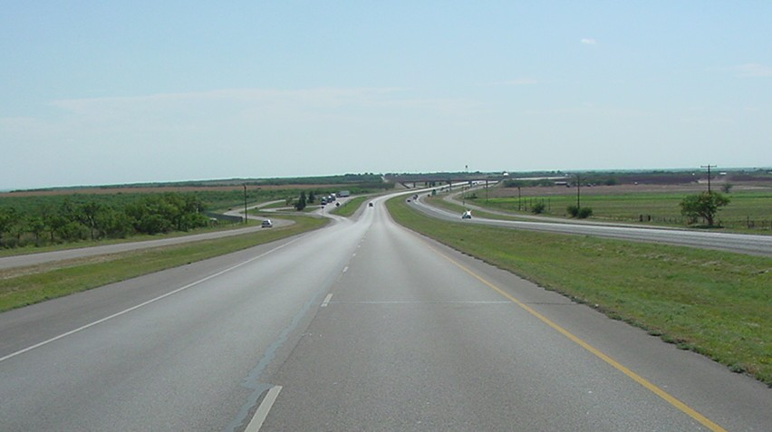


Slide 8
Vehicle Speeds
Tractor-semitrailer traveling about 15 to 18 mph
Greyhound bus traveling about 65 to 70 mph

Slide 9
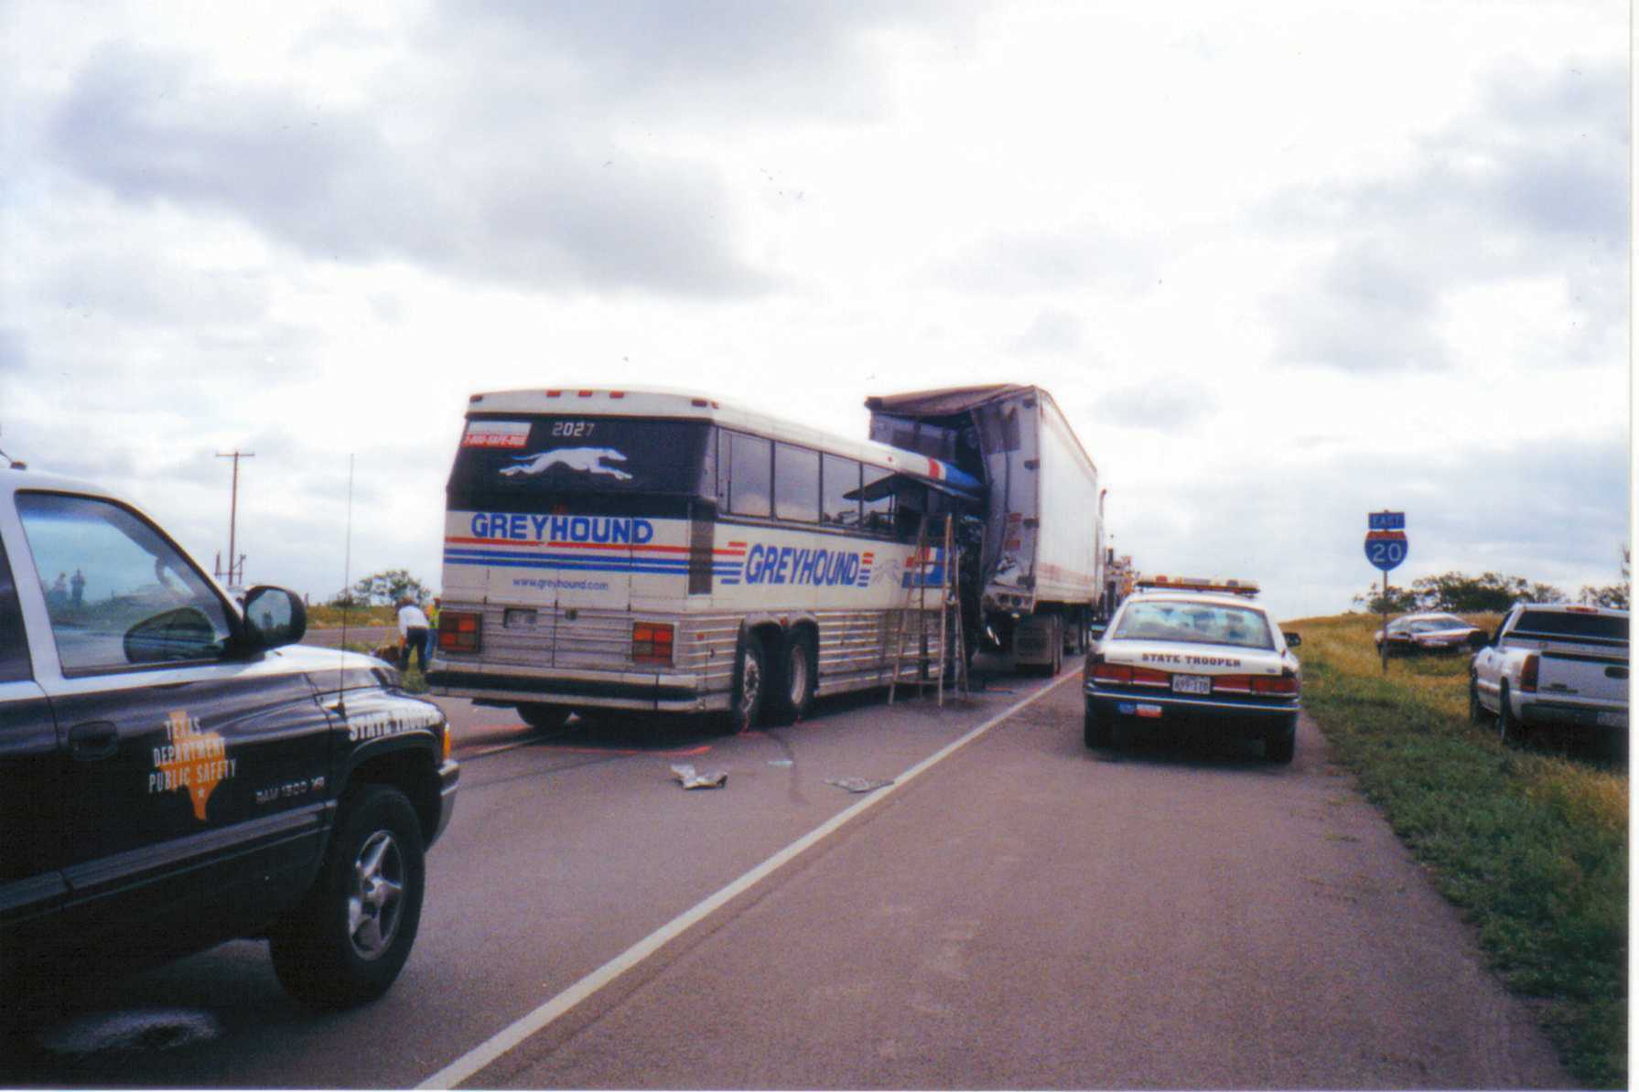

Slide 10
Lighting Conditions
Darkness
No artificial highway safety lighting
Only 2 percent of moon’s visible disc was illuminated
Greyhound bus was operating with low-beam headlights on

Slide 11
DelCar Semitrailer Lighting Inspection
Defective wiring
Burned-out fuse
Shorted taillights

Slide 12
Busdriver and Witness Statements
Busdriver stated semitrailer lights were not illuminated
Witnesses on bus stated they did not see lights on semitrailer
CB radio report of tractor-semitrailer operating without lights

Slide 13
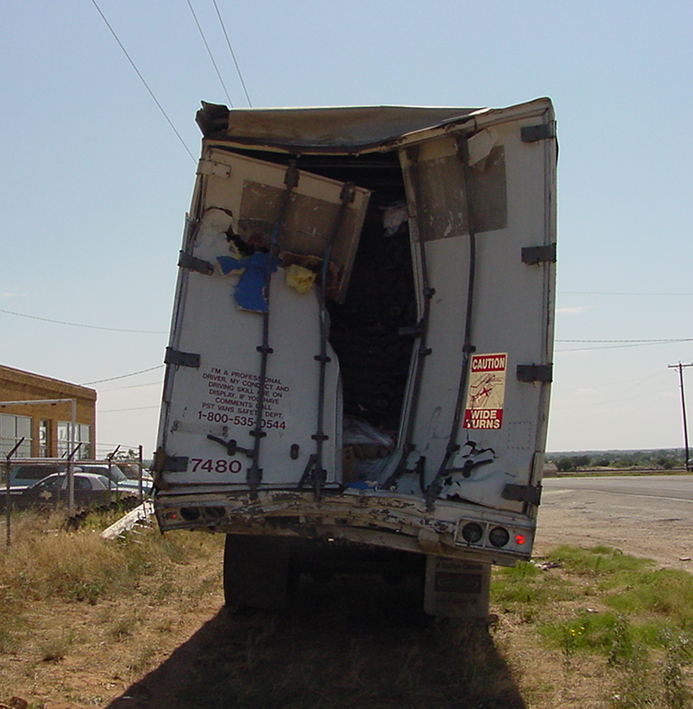

Slide 14
Accident
Absence of natural light
Absence of artificial lighting
Semitrailer’s inoperative lighting equipment
Lack of retroreflective sheeting
High closure rate

Slide 15
Truckdriver Toxicology Results
Benzoylecgonine found in blood and urine
Evaluation indicates cocaine likely used within a few hours prior to the accident
Driver impaired

Slide 16
Motor Carrier Safety

Slide 17
DelCar Trucking Company
August 17, 2000
  Registered with FMCSA
  2 tractors and 3 semitrailers
  4 drivers
At time of accident
  13 tractors and 25 semitrailers
  19 drivers

Slide 18
DelCar Owner Experience
Started as truckdriver in 1984
Became owner/operator in 1991
Felony drug conviction in 1999
Some knowledge of driving rules
Little knowledge of motor carrier operations safety regulations

Slide 19
DelCar Roadside Inspections
35% of vehicles with critical safety violations
National average 23%
17% of drivers with critical safety violations
National average 8%

Slide 20
DelCar Compliance Review
No drug and alcohol testing program
No driver qualification files
Using drivers without current medical certification
Hours-of-service violations
No vehicle inspection and maintenance records
Failure to require drivers to prepare vehicle inspection reports
Operating without insurance

Slide 21
DelCar Compliance Review Results
Unsatisfactory rating on June 18, 2002
60 days to improve rating or cease operation
Operating authority revoked on August 18, 2002

Slide 22
New Entrant Safety Data
Higher accident rates
Worse scores in driver and vehicle safety evaluation areas
More acute and critical violations
Worse compliance with FMCSRs
Less oversight by FMCSA

Slide 23
Safety Status Measurement System (SafeStat)
Used to evaluate a motor carrier’s safety performance and compliance with regulations
Safety evaluation areas
  Driver
  Vehicle
  Safety management
  Accident rate

Slide 24
SafeStat Score
Scores above 75 in one area are deficient
DelCar’s scores
  92.69 in driver safety evaluation area
  79.23 in vehicle safety evaluation area
  Not rated in accident rate and safety management safety evaluation areas
Sum of scores in all areas determines overall score

Slide 25
SafeStat for New Motor Carriers
40,000 motor carriers granted authority each year
New motor carriers not scored in all categories
New motor carrier scores not high enough to warrant compliance review

Slide 26
New Entrant Motor Carrier Regulations Prior to
January 1, 2003
Application process
  MCS-150
  OP-1
  $300 application fee
Authority granted with no further review

Slide 27
Current New Entrant Motor Carrier Regulations
FMCSA educational materials
Application process
  MCS-150
  OP-1
  $300 application fee
  MCS-150A
Safety review within 18 months

Slide 28
Current New Entrant Motor Carrier Application
Regulations
Knowledge of regulations
System in place to comply with regulations
No drug possession felonies
Safe operation
DelCar Applicant
No knowledge of regulations
No system to ensure compliance with regulations
Drug possession felony
No assurance of safe operation

Slide 29
Department of Defense
1992 prequalification program
Knowledge test (25% fail)
Prequalification inspection (40% fail)
Those that pass granted authority
All carriers that have failed had satisfactory ratings from FMCSA

Slide 30
New Entrant Motor Carrier Program
Prior to beginning operation
  Display knowledge and understanding of safety regulations
  Have safety management system in place
  Demonstrate ability to operate safely
Safety assurance

