Slide 1
Environmental Resource Management Systems for Nurseries, Greenhouses and Landscapes
North Carolina State University
ARS-McMinnville
Tennessee State University
University of Florida
ARS - Ft. Pierce
Clemson University

Slide 2
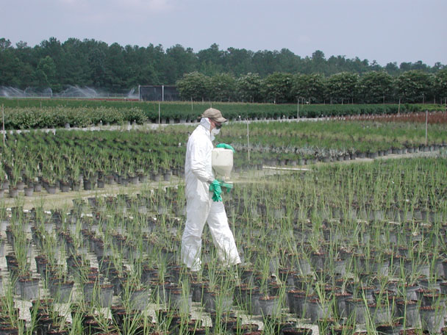
Environmental Challenges
excess nutrients, pesticide displacement and water movement from irrigation
soil-less substrates, plastic containers and non-permeable groundcovers,
alter and enhance the off-site movement of pesticides and nutrients.

Slide 3
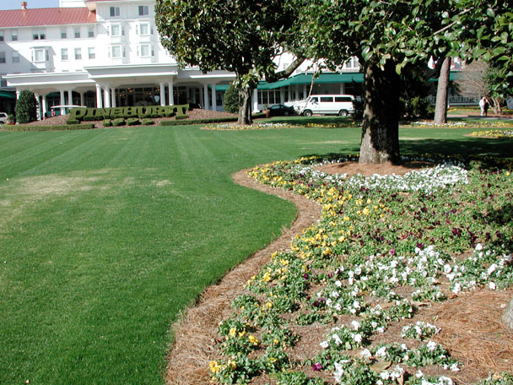
Environmental Challenges
Urban landscape contributes to increased nutrient and pesticides in surface and ground waters.

Slide 4
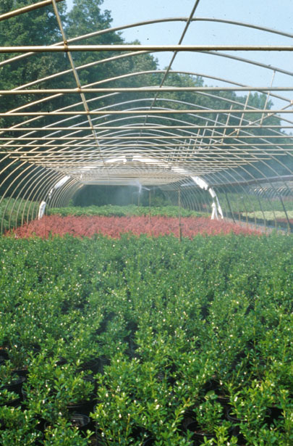
Objective 1 maximization of nutrient and water utilization efficiency
Ted Bilderback - Substrates - NCSU
Stuart Warren - Physiologist - NCSU
Donna Fare - Physiologist -ARS McMinnville
Chris Cantazara - Horticulturalist -TSU

Slide 5
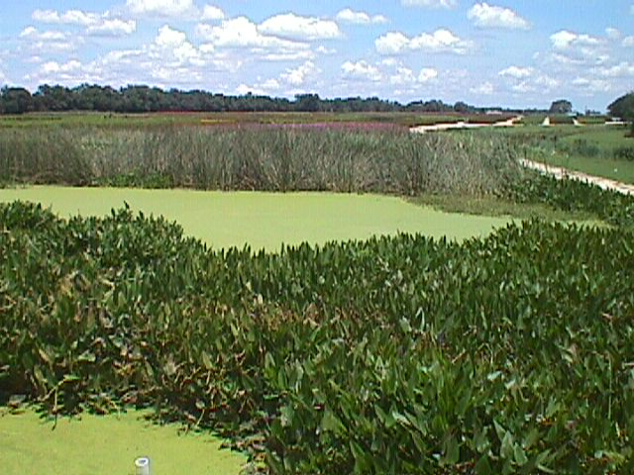
Objective 2 mitigation of nutrient and pesticide contaminants in off-site drainage
Chris Wilson - ENTOX - UF
Tom Yeager - HORT- UF
Joe Albano - Physiologist - ARS Ft Pierce FL
Ted Whitwell -Pesticides - CU
Steve Klaine - ENTOX - CU
Mickey Taylor - ENTOX - CU
Bob Polomski - HORT - CU

Slide 6
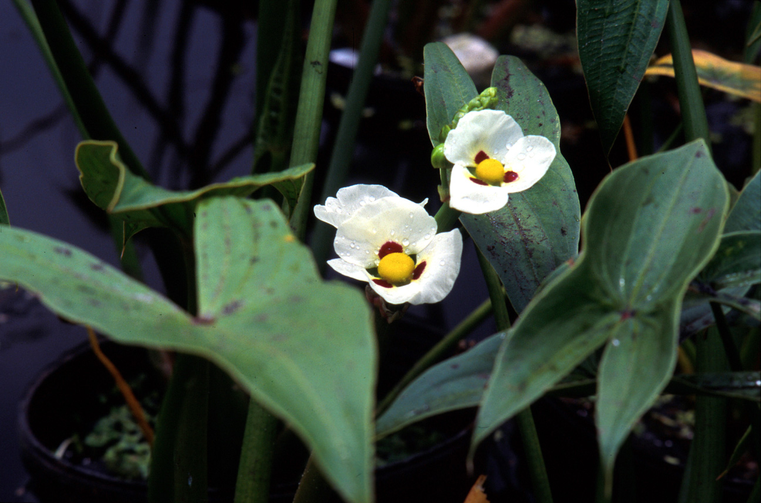
Objective 3 ornamentals to improve water quality in nurseries and urban landscape
Steve Klaine - Environmental Toxicology - CU
Mickey Taylor - Environmental Toxicology - CU
Bob Polomski - Horticulture - Landscape plants - CU
Ted Whitwell - Pesticides/Herbicides - CU

Slide 7
GOALS
Economical methods to improve exiting water quality.
Self-contained and self-remediating with respect to runoff water.
Increase production efficiency.
New markets for ornamental plants, and the development of a better selection of landscape plants.
Transfer technology for implementation of the strategies and methodologies developed in this research.

