Slide 1

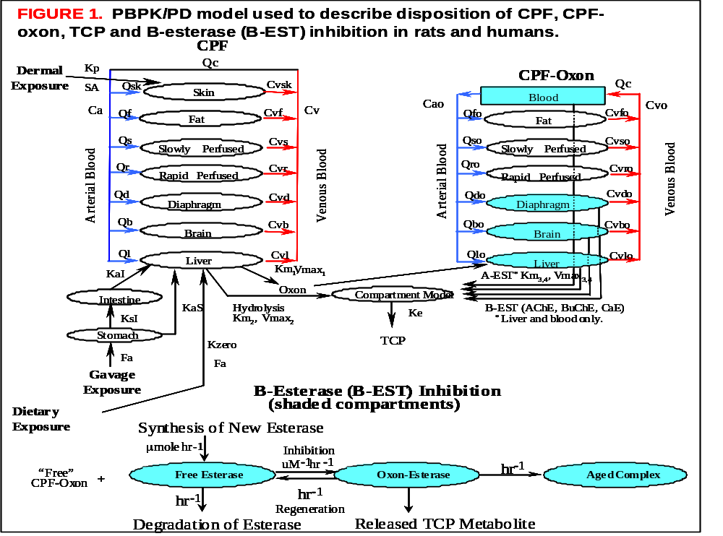
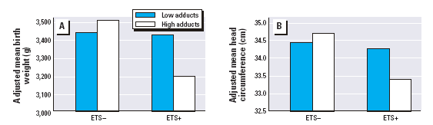
STAR Biomarkers Research
Basic Sciences, Validation, and Application
Kacee Deener and Nigel Fields, USEPA/ORD – National Center for Environmental Research
Introduction
Every day EPA makes public health decisions to manage and reduce environmental risks based on the available science. The Agency has also launched an effort to develop public health outcomes or “indicators” that can be used to assess the effectiveness and impact of risk-based regulatory decisions. In order to reduce the uncertainties in traditional risk assessment protocols and to advance the most relevant, reliable indicators, the National Center for Environmental Research (NCER), through its Science to Achieve Results (STAR) grant program, has developed a multi-year, multi-disciplinary biological markers research portfolio.
Why biomarkers are important
Provide quantitative information about exposure, early biologic effect and individual susceptibility
Fill in important gaps in the exposure-to-disease continuum
Increase our understanding of chemical transport and transformation in the body
Highlight interactions at the cellular and molecular levels that lead to toxic endpoints
Figure illustrating exposure-dose-effect continuum with opportunities for biomarker development at various points.
Exposure and Effect Biomarkers
Exposure
Internal
Dose
Biologically
Effective
Dose
Early
Biologic
Effect
Altered
Structure/
Function
Clinical
Disease
One of the goals of biomarkers research is the development and validation of tools that can be utilized in a real world setting. It is useful to envision biomarkers research as a three step process:
1) Basic Sciences ; 2) Validation; 3) Application
Through numerous Request for Applications representing a wide variety of subject areas, NCER has funded important work that represents all three research categories.
Susceptibility Markers
Adapted from National Research Council, Biologic Markers in Reproductive Toxicology. Washington: National Academy Press, 1989
STAR Basic Sciences Research
Identification of a genetic susceptibility factor in mice that will likely lead to identification of equivalent gene in humans - Miller, Wake Forest University
Investigation of a potential suite of biomarkers to predict future asthmatics who may have been exposed to tobacco smoke in utero or during early childhood - Klonoff-Cohen, University of California, San Diego
Investigation of effects of mixtures of bromoform, chloroform and PCE on perturbations of p53 expression and protein synthesis during different developmental stages – Reinisch, Marine Biological Lab
STAR Validation Research
Validation of meconium as a biomarker of cumulative prenatal exposure to pesticides - Whyatt, Columbia University
Validation of saliva as a biomarker of exposure to pesticides with simultaneous development and validation of a physiologically-based pharmacokinetic model - Timchalk, Battelle Pacific Northwest Division
Validation of meconium as a biomarker of fetal exposure to heavy metals and pesticides - Ostrea, Wayne State University
Evaluation of biomarkers of effect and susceptibility for studying cancer risk in pediatric populations
Validation of biomarkers of chromium exposure and effect in Chinese occupational population- Qu, New York University
PBPK model to evaluate age and gender dependent differences in detoxifying enzymes for biomarkers of susceptibility and effect- Olson, State University of New York at Buffalo
STAR Research Applies Biomarkers
Application of urinary biomarkers to assess exposure to organophosphate pesticides - Eskenazi, University of California, Berkeley
Application of various biomarkers to assess exposure, susceptibility and risk from several environmental toxicants - Perera, Columbia University
Application of biomarkers of susceptibility, exposure and effect in Azerbaijan and Chinese populations with high rates of neural tube defects – Donnelly, Texas A& M University
Potential application of STAR-funded biomarkers research to national-scale studies such as the National Children’s Study
Important Biomarker Issues
Biomarkers hold much promise for improving environmental health science and human health risk assessment. However, there are important issues that surround the development, validation, and application of these tools.
Treatment of values that fall below the analytical detection level
Continuity of databases to facilitate meta-analysis
Development of biorepositories for future research
Ethical issues – biomarker interpretation; communication to study participants; susceptibility markers and social stigma and employability
Intra- and inter-individual variability
Bar graph showing interaction effect of BAP-DNA and ETS on A) birth weight and B) head circumference Perera et al, 2004
Exposure Biomarkers of Exposure Outcomes
Assessment Effect/Susceptibility
PAH, PM_{2.5}, DEP
Pesticides
ETS
PAH-DNA Adducts
Pesticides
Cotinine, 4-ABP-Hb
Growth & Neurodevelopment
Allergens
Immune changes
(lymphocyte prolif.,
IgE, cytokines)
Persistent Wheeze / Asthma
Metals
Lead, mercury
Susceptibility Factors
Nutritional deficits
Genetic polymorphisms
Social stressors
Vitamins A,C,E
(Cancer Risk)
References
National Research Council, Biologic Markers in Reproductive Toxicology, National Academy Press, 1989.
Perera, Frederica P., Rauh, Virginia, Whyatt, Robin M., Tsai, Wei-Yann, Bernert, John T., Tu, Yi-Hsuan, Andrews, Howard, Ramirez, Judyth, Qu, Lirong, Tang, Deliang; Molecular Evidence of an Interaction Between Prenatal Environmental Exposures and Birth Outcomes in a Multiethnic Population, Environmental Health Perspectives April 2004 112(5):626-630.
Timchalk C, Nolan RJ, Mendrala AL, Dittenber DA, Brzak KA, Mattsson JL; A physiologically based pharmacokinetic and pharmacodynamic (PBPK/PD) model for the organophosphate insecticide chlorpyrifos in rats and humans, Toxicol Sci 2002 March 66(1):34-53.
Biomonitoring scheme for STAR-funded longitudinal cohort study at Columbia Center for Children’s Environmental Health, Perera et al, 2004
Basic Sciences Research
Validation
Application
Basic sciences research first identifies measurable properties that have potential to serve as biomarkers. Once exposed, a continuum of biological events occurs, beginning with exposure and ending with health effect. Events and parameters along the continuum can potentially be observed and quantified as biomarkers. Identification of biomarkers often begins with basic toxicology research, such as an animal study that investigates one or more of the stages along the exposure-dose-effect continuum or that aims to better understand disease susceptibility.
Important Considerations for Basic Sciences Research
What is the distribution of the marker in human populations?
If the marker was identified in an animal model, is there an equivalent marker in humans?
Do analytical methods exist for quantifying the marker?
Are there any technological considerations?
Validation of the biomarker is extremely important if it will be used in an epidemiological study or in a clinical setting. Without proper validation, the meaning of the biomarker is ambiguous and essentially useless. Validation characterizes the relationship between the marker and a stage or stages of the exposure-to-disease continuum. For example, validation of an exposure biomarker should establish the relationship between the marker and the environmental exposure in question, while a biomarker of effect should be clearly linked to a health endpoint.
Once developed and validated, the marker can then be applied in epidemiological studies to characterize exposure, dose, or early health effects. Historically, one of the weak points of epidemiological studies has been the struggle to adequately characterize exposure. Some methods traditionally used are retrospective questionnaires, environmental sampling (air, dust, etc.), and duplicate diet samples.
How biomarkers can improve environmental health science
Provide quantitative measures of exposure and dose
Identify the beginnings of the disease process, allowing for intervention strategies and/or early treatment
Identify populations who are at higher risk of disease, allowing for intervention strategies
Important Considerations for Validation Research
What is the positive predictive value of the marker?
What are the sensitivity and specificity of the marker?
What type of validation study is most appropriate for the marker (i.e., longitudinal cohort study, case-control study)?

