Slide 1

Metabolomics
NCI, Rockville MD
Technologies for Metabolic Profiling
Stephen C. Brown
Research Fellow, Chemistry
Esperion Therapeutics, a
division of Pfizer Global R&D
3621 S. State St.
Ann Arbor, MI 48108

Slide 2
Metabolomics: A Rosetta Stone bridging genomics, proteomics to drug discovery?
Metabolomics: The complete characterization of endogenous
metabolites in a biological system at a defined state
Genotype
DNA
Drug Target
MOA
mRNA
Phenotype
Biomarker
Proteins
Environment
Toxicology
Metabolites

Slide 3
Systems Biology and Biomarkers
NIH Roadmap ($70M/5 years)
  Understanding disease and interventions
    LIPID MAPS (RAW 264.7, E. Dennis UCSD)
  Surrogate markers for clinical endpoints
FDA Initiatives
  Concept Paper: “Drug-Diagnostic Co-Development” April 2005
MolPAGE (EU)
MGED-MIAME ()

Slide 4
Strategic Issues
Separations Required?
“Universal Detector”
Metabolism Models and Databases
Fluxes or Levels?
Accuracy and Precision Requirements?
Subset Analytes?
  Lipomics
  Glycomics
  Peptidomics
  RedOx actives

Slide 5
Technologies for Metabolic Profiling (Metabolomics, Metabonomics)
Bioanalytical Methods
  Mass Spectrometry Best sensitivity, quantitation variable
    FTMS (FT-ICR)
      Highest Mass Resolution
      Highest Mass Accuracy
    LC/MS/MS
    GC/MS/MS
  NMR Low sensitivity but very quantitative
    Solution NMR of biofluids (Metabonomics)
    Solid State NMR of tissues
  LC-Coulometric Electrochemical Array
  X-ray Fluorescence (metal cations)
Proteomic
  Multiplexed Luminex (e.g., RBM)
Notes:
Coulometric Electrochemical Array: PharmaGenomics (January, 2004), 46-52

Slide 6
Data Analyses and Modeling
Sampling Considerations
  Cell Compartments, Tissue Composition, Diurnal Variance
  Nutritional Status
  “Reactivity”, Preservatives
Data Analyses
  Unsupervised Multivariate (HCA, PCA)
  Supervised PLS “variable influence on projection”
  False Discovery Rates!! (Benjamini-Hochberg Adjustment)
Models
  Animals
  Systems Biology-Mathematical Models

Slide 7
Example 1
NMR-Metabonomics
Metabonomic Differentiation of Organ-Specific Toxicants

Slide 8
Toxicology Study Details
4 male Wistar rats/dose group
Two dose groups + control group
Urine samples collected daily before and after acute dose (5 time points)
Compounds:
  a-Napthylisothiocyanate (ANIT)
    Biliary liver toxin 10 & 100 mg/kg
  p-aminophenol (PAP)
    Proximal tubular kidney toxin 15 & 150 mg/kg

Slide 9
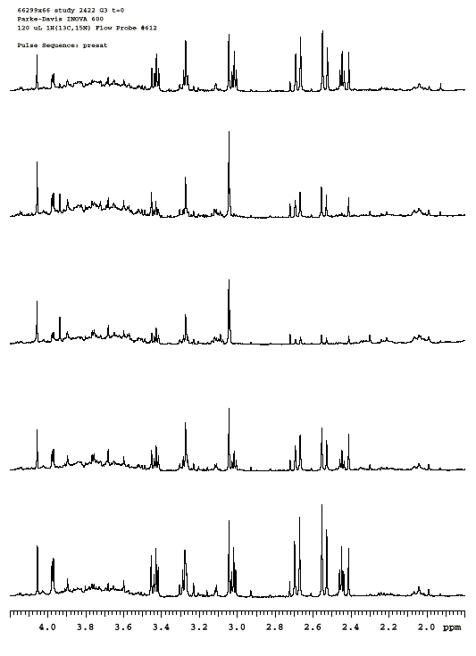
ANIT 100 mg/kg
day 4
day 3
creatine
day 2
TMAO
citrate
hippurate
day 1
creatinine
2-oxoglutarate
succinate
predose

Slide 10
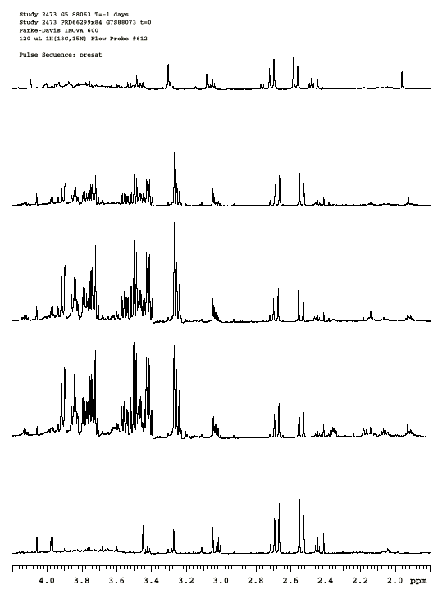
PAP 150 mg/kg
day 4
glucose
day 3
day 2
day 1
predose

Slide 11
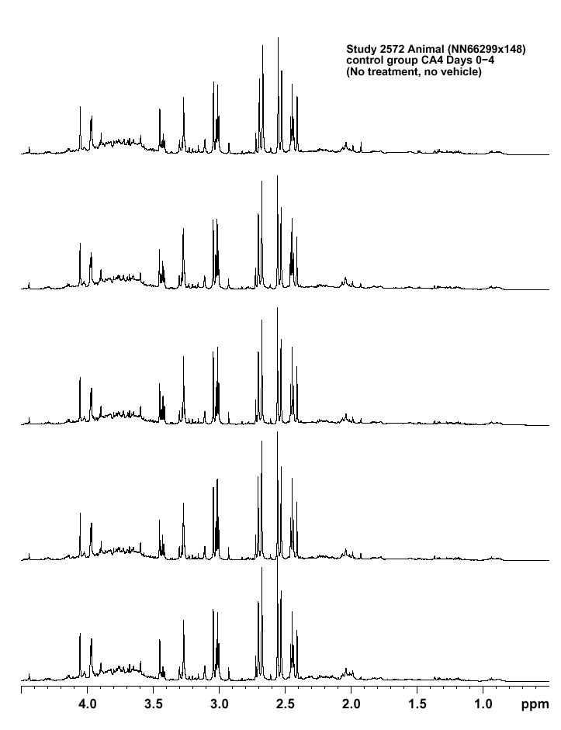
Control Rat
Day 5
Day 4
Day 3
Day 2
Day 1

Slide 12
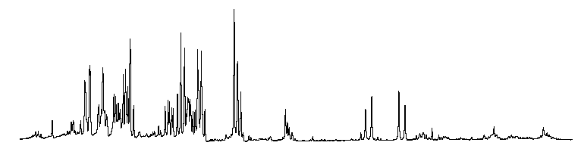
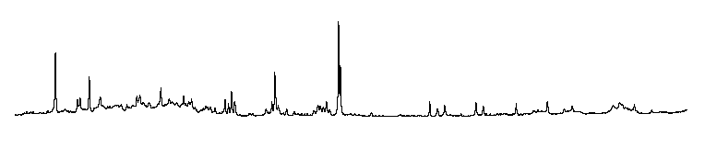
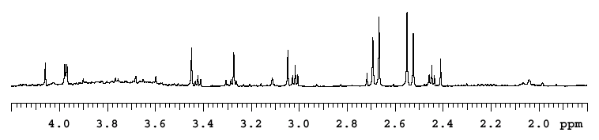
PAP
ANIT
Control

Slide 13
Pattern recognition techniques capture the systematic variation within the spectral variables and can be used to construct classification models
25
PC2
ANIT and PAP PC Models
20
15
Liver (ANIT)
10
5
0
Kidney (PAP)
-5
-10
Control
-15
-20
PC1
-25
-30
-20
-10
0
10

Slide 14
Example 1 Conclusions
Different stressors produce different metabolite profiles
Profiles are reproducible enough to build classification models
Lays groundwork for metabonomics-based toxicity screening paradigm

Slide 15
Example 2
FTMS-Metabolomics
Drug Mechanism of Action

Slide 16
Advantages of FTMS Metabolic Profiling
Ultra High Resolution: Resolve Complex Mixtures
Ultra High Mass Accuracy: Unambiguous Molecular Formula
Ultra high peak capacity: Less need for fractionation
Simple sample preparation
Global profiling: Simultaneous analysis by +/- ESI, APCI
Detailed profiling: Structural elucidation by MS^{n}

Slide 17
Image
Current
0.05
0.04
Time-Domain Transient
0.03
0.02
Differential Amplifier
0.01
0
-0.01
-0.02
-0.03
ω_{c}=qB₀/m
FT
-0.04
-0.05
0
100
200
300
400
500
600
700
800
Time (ms)
Frequency Spectrum
Mass Spectrum
m
z
=
A
ν
+
B
ν²
0
50
100
150
200
250
300
500
600
700
800
900
1000
1100
1200
1300
1400
Frequency (kHz)
m/z
Courtesy of Prof. Alan Marshall

Slide 18
2-Ethylhexyl phthalate (plasticizer)
279.1583
279.0594
279.0380
[Palmitate + Na]⁺
279.2288
279.1935
279.06
279.21
m/z

Slide 19
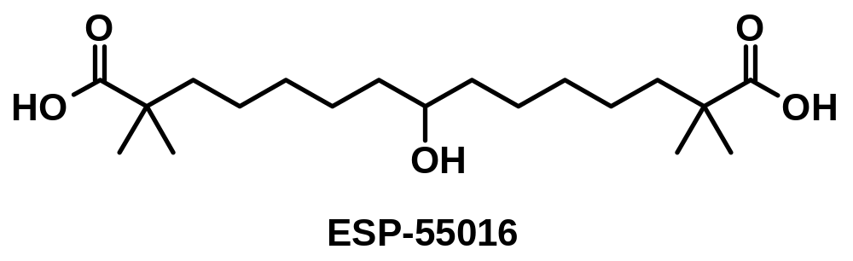
ESP 55016 vs. Vehicle in Rats
SD rats treated with 100 mg/kg (p.o. gavage)
Sacrificed 1.5 hr. post-dose
Livers Freeze-clamped
Liver tissue aliquot extracted (17:0)-CoA IS added
Extract passed through C18 Sep-Pak, eluted MeOH
Infused into FTMS, ESI⁻ mode
FTMS peaks normalized to (17:0)-CoA

Slide 20
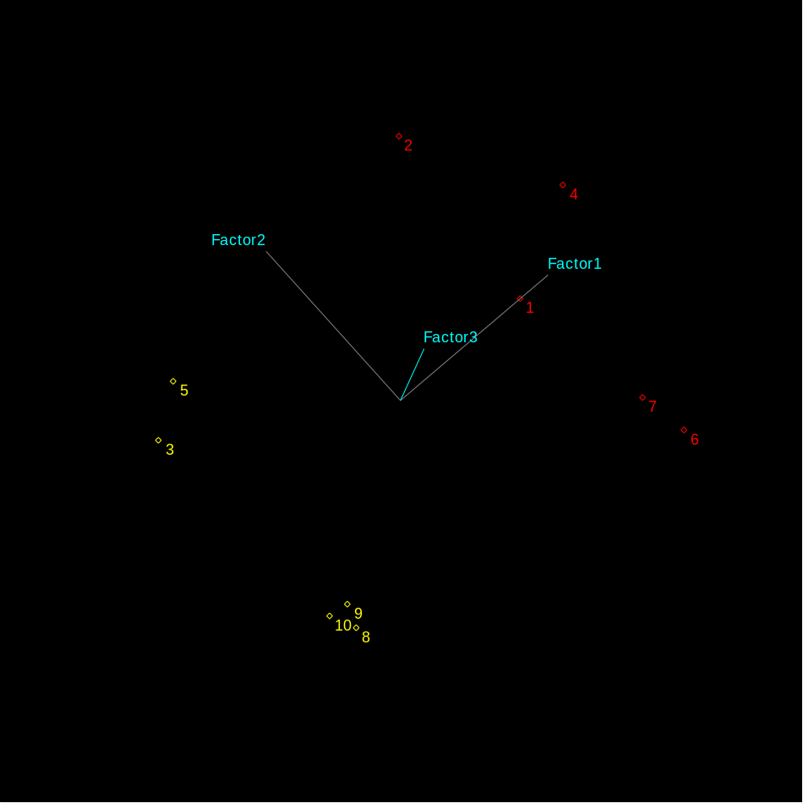
PCA Scores (71.4%,9.7%,8.2%)
Notes:
PCA
# of Included Samples: 10
# of Included X vars: 91
Preprocessing: Mean-center
Rotation: None
Maximum factors: 9
Optimal factors: 5
Validation: None
Prob. threshold: 0.9500
Calib Transfer: Not enabled
Transforms:
SNV
Algorithm date: 02/09/2004 15:29:13.0132

Slide 21
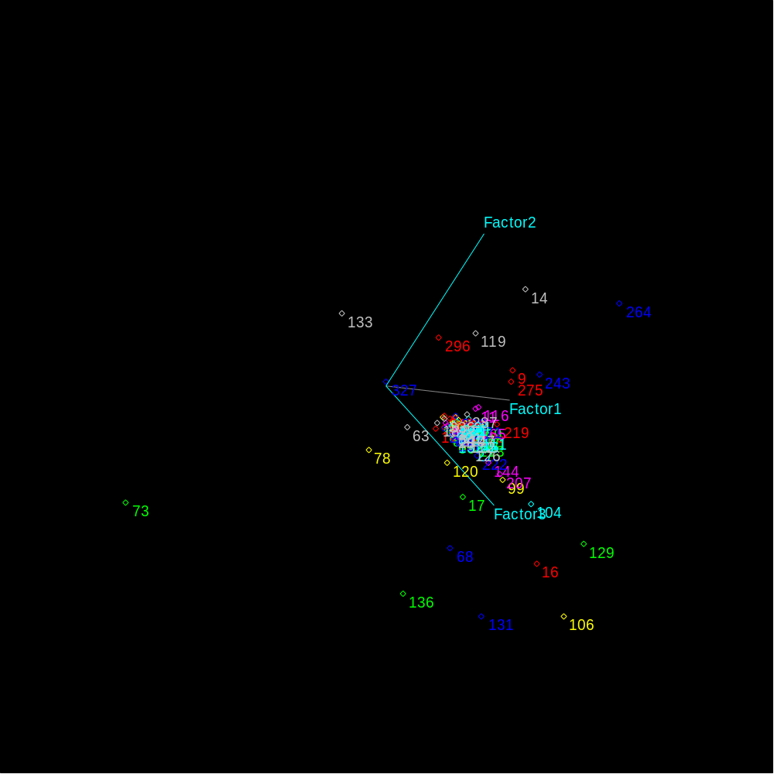
PCA Loadings
Notes:
9: 255.2322 palmitate
14: 281.2477 oleate
16: 283.2634 stearate
63: 391.2855 deoxycholate, chenodeoxycholate
68: 405.2646 dihydroxy-oxo-cholanoate
73: 407.2804 cholate
78: 408.2834 cholate 13C
104 : 462.2860 oxo-glycocholate
106: 464.3020 glycocholate
119: 498.2900 taurodeoxycholate, taurochenodeoxycholate
129: 512.2689 taurooxocholate
131: 513.27235 taurooxocholate 13C
133: 514.2848 taurocholate
136: 515.2879 taurocholate 13C
207: 715.5914
243: 885.5498
264: 1018.3528 (17:0)-CoA
275: 1040.3301 (17:0)-CoA Na
296: 1092.3492 ESP 41139
327: 1156.3818 cholyl-CoA

Slide 22
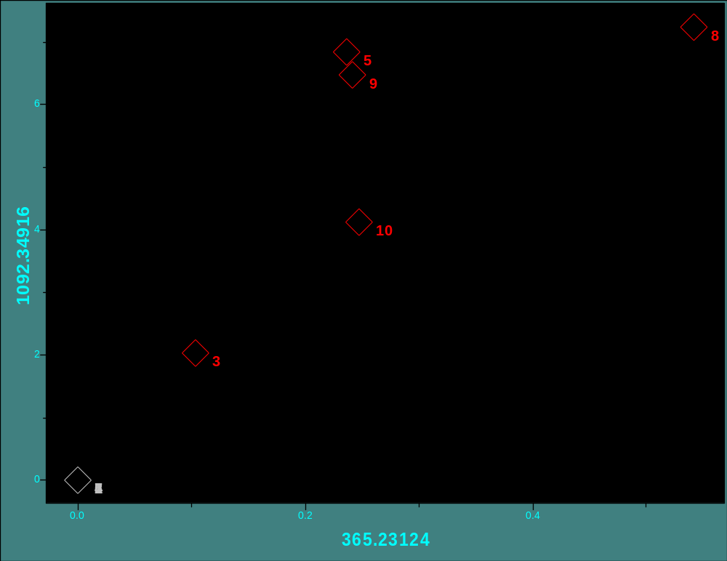
ESP55016 vs. CoA-ESP55016

Slide 23
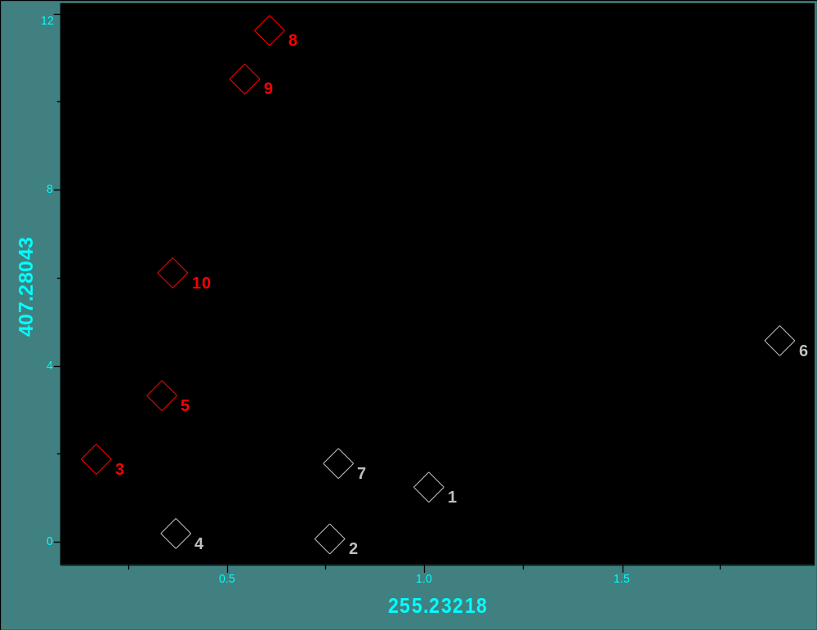
Cholate vs. Palmitate

Slide 24
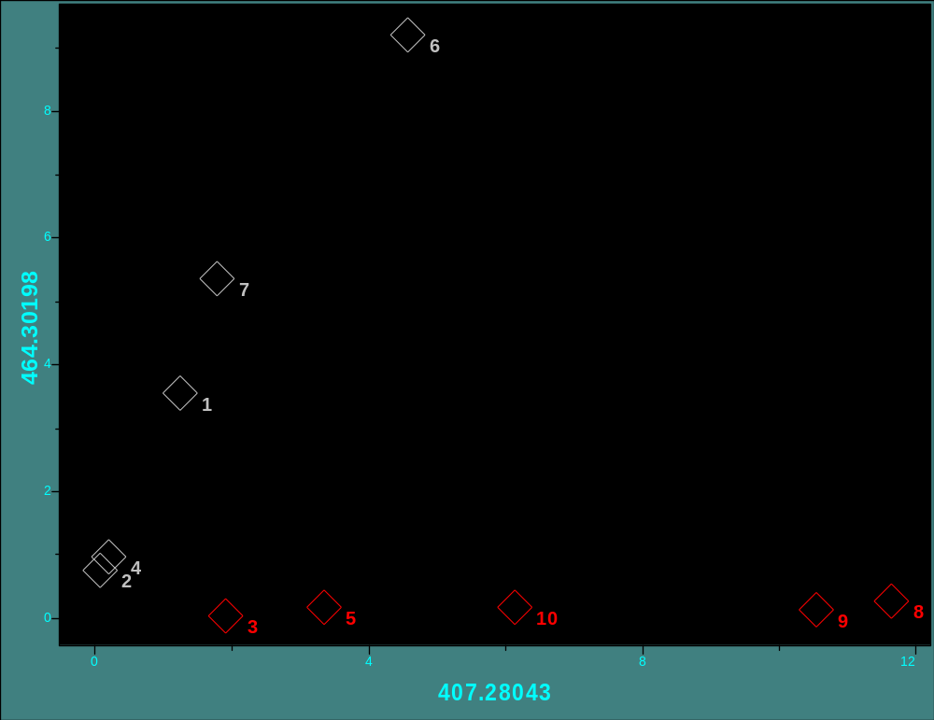
Glycocholate vs. Cholate

Slide 25
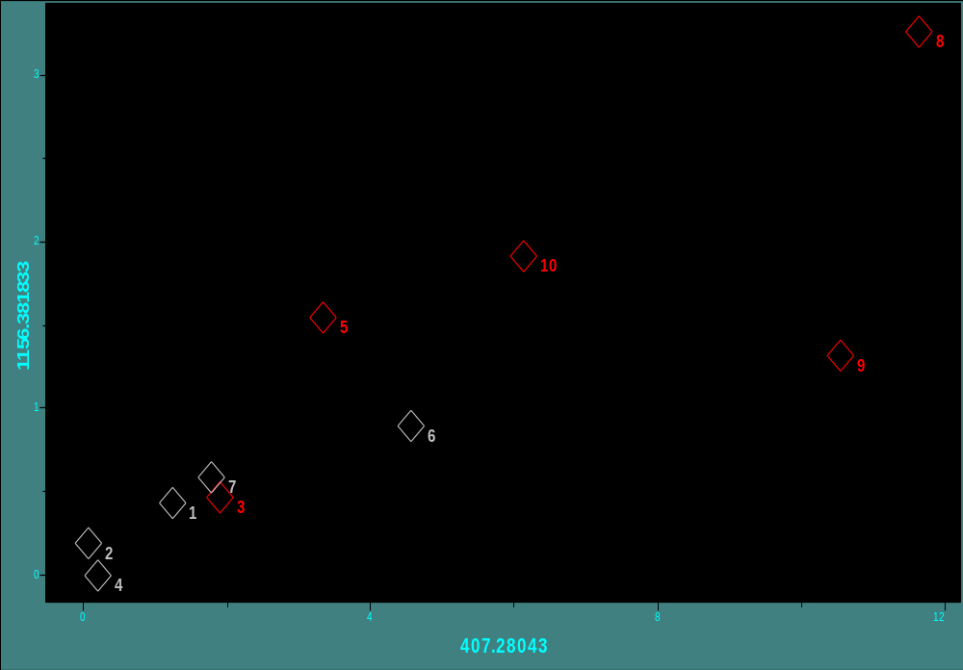
Cholyl-CoA vs. Cholate

Slide 26
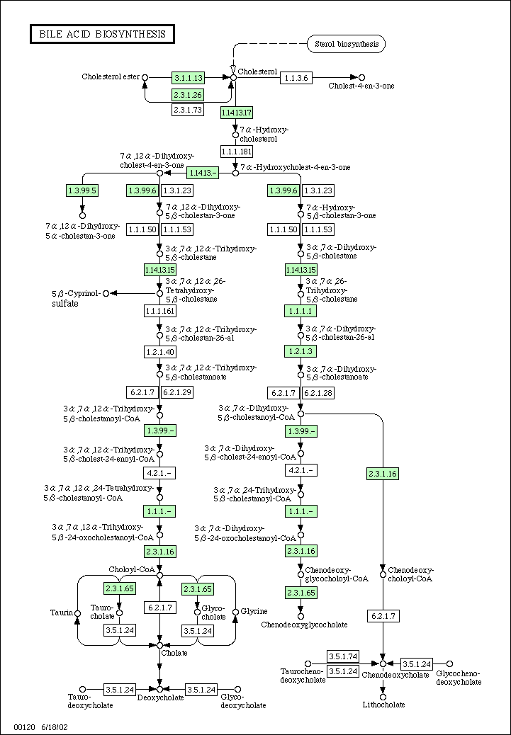

Slide 27
Example 2 Conclusions
In livers of ESP-55016 treated rats (100 mg/kg)
Free fatty acids are down-regulated, especially (16:0) and (18:1)
Bile Acids are up-regulated, but glycine conjugates have been suppressed.
Variance of both ESP-55016 and the CoA conjugate in livers is high.

Slide 28
Acknowledgements
Esperion Therapeutics, PGRD
  Stephen C. Brown
  Clay Cramer
  David Thibault
  Rose Ackermann
Ann Arbor , PGRD
  Michael Reily
  Don Robertson
  David Baker
  Dale Wells

Slide 29
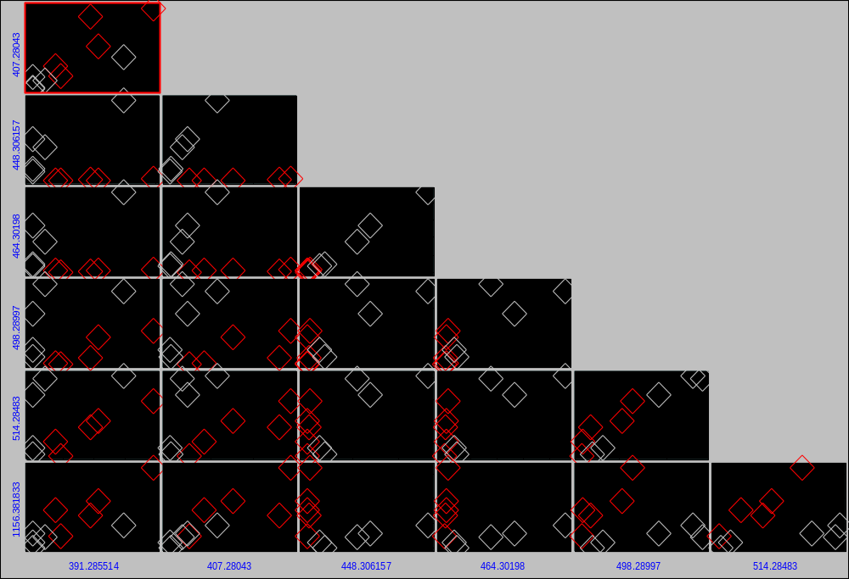
Pirouette 2D-plot comparisons
ESP-55016
Bile Acid Metabolism

Slide 30
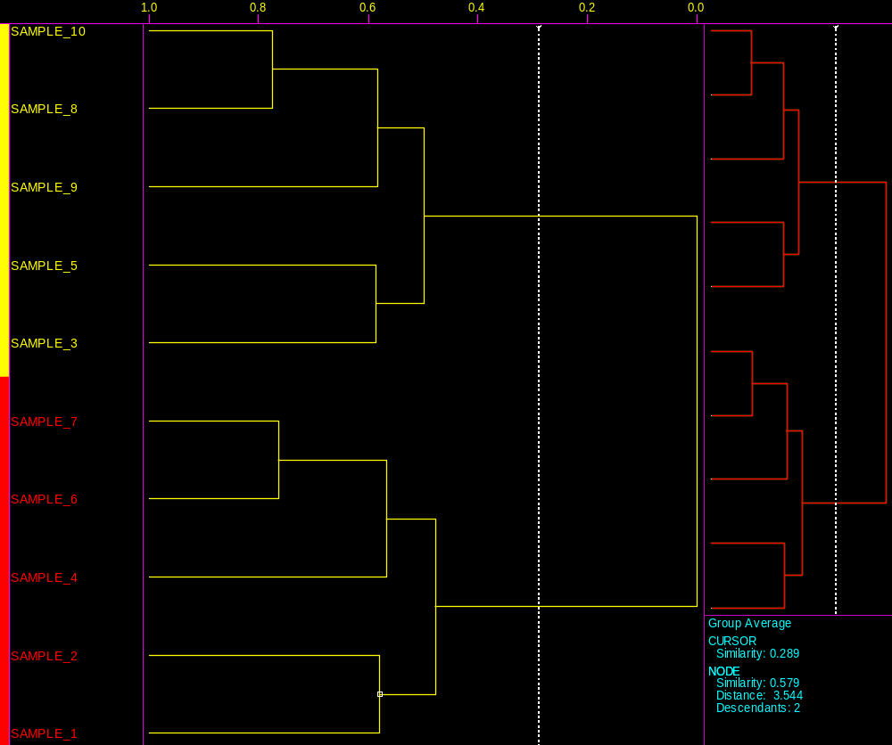
Hierarchical Clustering Analysis (HCA)
Notes:
HCA-8
Preprocessing: None
Distance: Euclidean
Linkage method: Group Average
Orientation: Sample
Transforms:
SNV
Algorithm date: 02/09/2004 14:57:25.0260

Slide 31
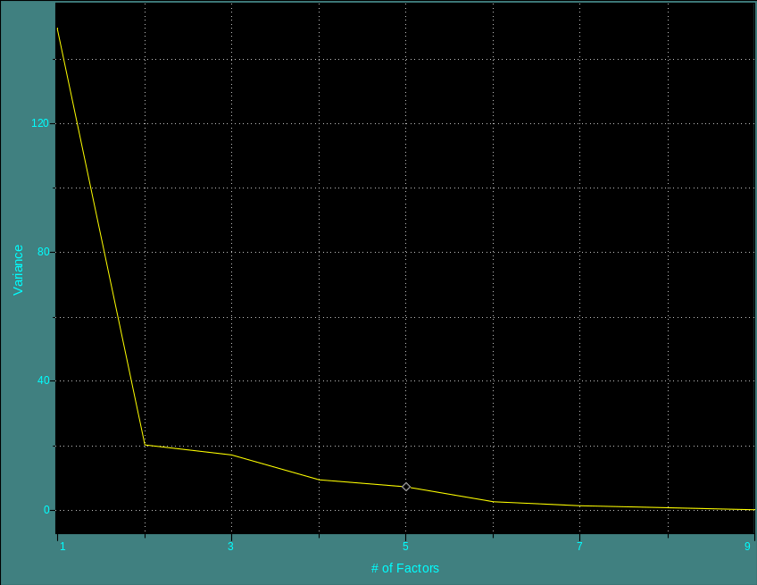
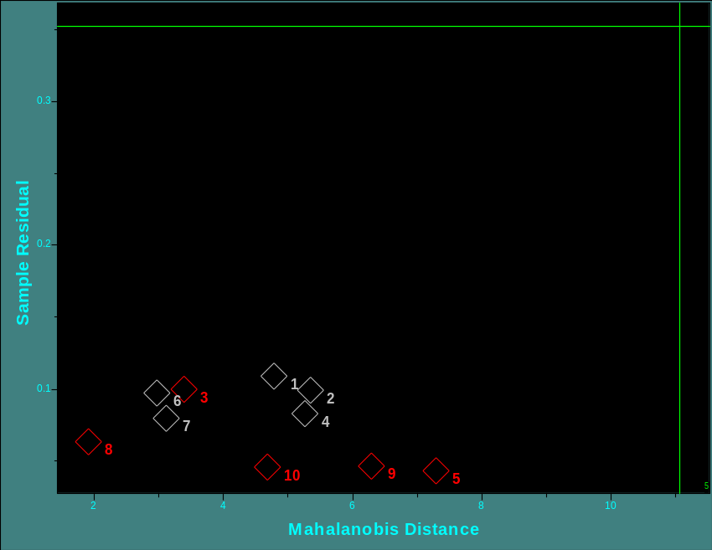
Principle Components Analysis (PCA) Convergence Measures
Convergence of Factors (5)
Outlier Diagnostics

Slide 32

Cholate vs. Stearate

Slide 33
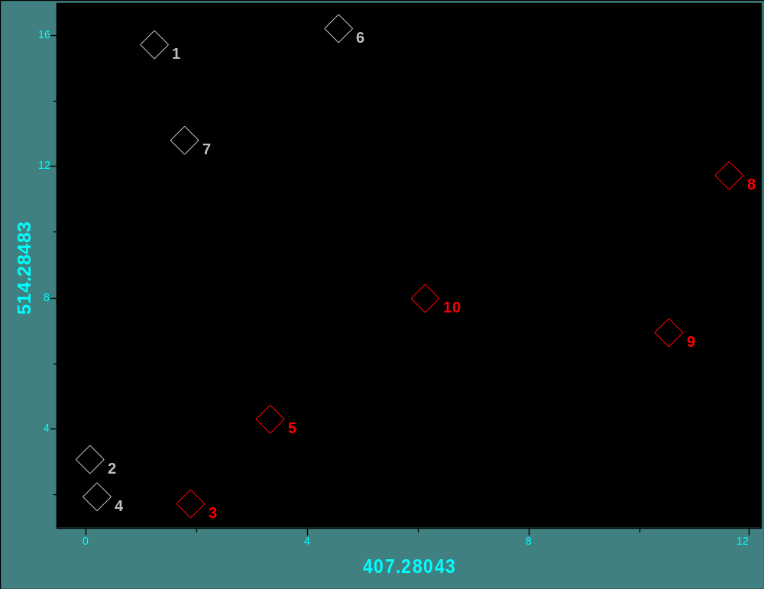
Taurocholate vs. Cholate

Slide 34
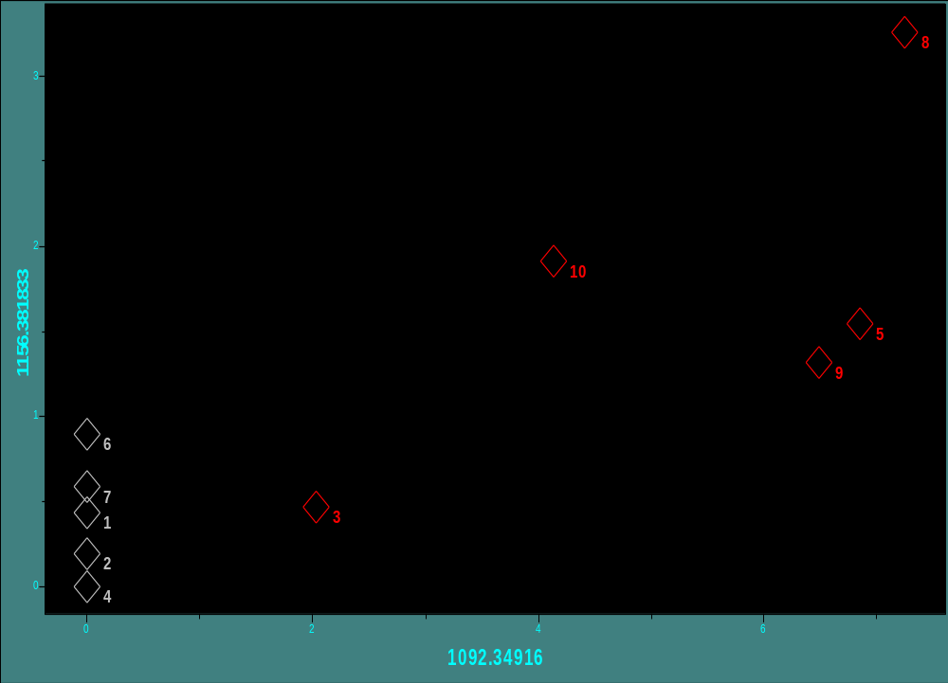
Cholyl-CoA vs. CoA-55016

