Slide 1

The Exploratory IND Guidance
“Phase 0” Trials in Oncologic Drug Development
September 5, 2007
David Jacobson-Kram, Ph.D. DABT
Office of New Drugs
Center for Drug Evaluation and Research
Food and Drug Administration

Slide 2

Challenges in Improving Efficiency of Drug Development
NME development = high risk and cost
  Extremely high failure rate before IND
  NME IND = NDA <20% of time
  Reported >50% failure rate in Phase 3
  Decreased NME NDAs despite increased INDs
  Cost per NME approved estimated at >$800M

Slide 3
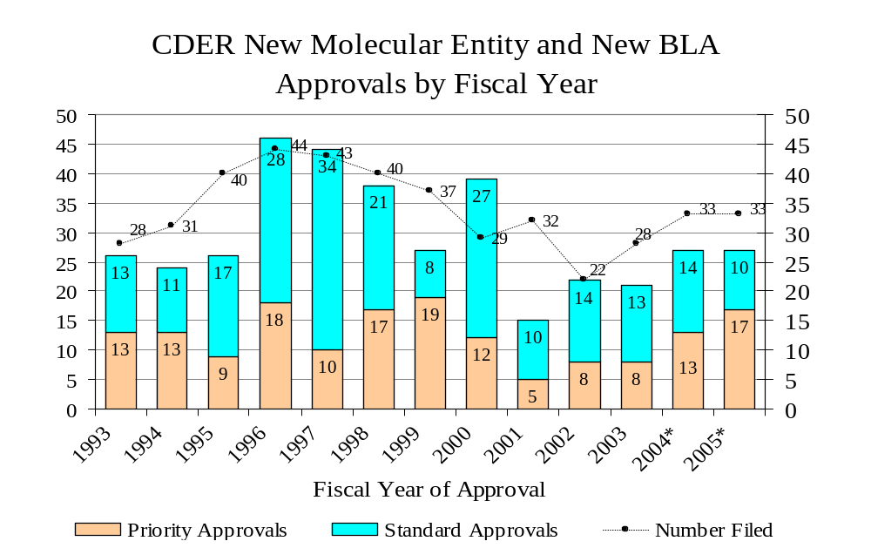
Number Approved
Number Filed
As of 31-Aug-06
*Includes the therapeutic biologic products transferred from CBER to CDER effective 10/1/2003.

Slide 4

Exploratory INDs: Guidance to Industry, Investigators and Reviewers
Draft guidance published April 2005, over 350 comments to the docket. Final published in January 2006.
“For the purposes of this guidance the phrase exploratory IND is intended to describe a clinical trial that occurs very early in phase 1, involves very limited human exposure (up to 7 days of dosing) and has no therapeutic intent.
Existing regulations allow flexibility of the amount of data that need to be submitted with an IND—depending on the goals of the investigation, the testing being proposed the expected risks.
Viewed as pavestone on the critical path.

Slide 5

Use of exploratory INDs (ExpINDs) in improving efficiency of drug development
ExpINDs allow sponsors to evaluate up to five chemical entities or formulations simultaneously.
When a lead compound has been selected, the ExpIND is closed and drug development proceeds along the traditional pathway.
ExpINDs provide opportunity to study PK and target interaction early in drug development.

Slide 6

Goals of expINDs
Gain an understanding of the relationship between a specific mechanism of action and the treatment of a disease.
Provide information on PK
Select the most promising lead product from a group of candidates designed to interact with a particular therapeutic target.
Explore a product’s biodistribution characteristics using various imaging technologies.

Slide 7


Types of studies: microdose
Microdose studies are designed to evaluate pharmacokinetics or imaging of specific targets and are designed not to induce pharmacological effects.
A microdose is defined as less than 1/100th of the dose calculated to yield a pharmacological effect and ≤100 micrograms.

Slide 8

Microdose studies
Potential risks to subjects very limited
Enabling study:
  Single mammalian species
  Clinical route of administration
  Single dose, 14-day observation
  Routine endpoints:
    Clinical observations
    Body weights
    Hematology and clinical chemistries
    Histopathology
Identification of minimally toxic dose or demonstration of large margin of safety (e.g. 100X)
Genetox not necessary.

Slide 9

Position Paper on Non-clinical Safety Studies to Support Clinical Trials with a Single Microdose
EMEA, June 2004
Enabling preclinical safety studies:
General toxicology studies using two routes of administration, IV plus clinical route
In vitro genotoxicity studies performed according to ICH guidance
EMEA requires more data: two routes of administration and genetox studies

Slide 10

Types of studies: Clinical Trials Designed to have Pharmacological Effects
Paradigm first proposed by PhRMA in May of 2004
Up to 5 compounds with a common biological target, not necessarily structurally related
Up to 7 repeated doses in clinic in healthy subjects or minimally ill patients
Goal is to achieve a pharmacological response but not an MTD
PhRMA collected a data base on 106 drugs tested in two species and in phase 1 clinical trial to support preclinical safety paradigm

Slide 11

Safety Requirements for Exploratory IND designed to produce pharmacological effects
14-day repeated dose tox study in rodent, full clinical and histopathology
Safety pharmacology (cv, cns, resp) as in ICH S7A
Bacterial mutation assay and micronucleus from 14-day study
Repeated dose study in second species (dog) at rat NOAEL. Administrations equivalent to number of dosing days in clinical trial

Slide 12
Clinical starting and stopping doses
Start dose would be 1/50 the rat NOAEL (mg/m²). If dog shows toxicity at rat NOAEL, compound not included in exploratory IND
Stopping dose would be whichever is lowest:
  Dose that induces pharmacological effect or target modulation
  ¼ of rat NOAEL
  Dose giving ½ of AUC in rat 14 day study or dog AUC if lower than rat

Slide 13
Evaluation of Pharma Dataset*
Would starting clinical trials at a dose equivalent on a body surface area basis to 1/50 the NOAEL dose in rodents be safe?
Conclusion: Based on evaluation of 106 compounds, all trials would have been conducted safely under the expIND paradigm
Would it be safe to stop trials on the basis of criteria detailed in the guidance (i.e. dose, exposure, clinical effects)?
Conclusion: Based on evaluation of 100 compounds, all trials would have been conducted safely under the expIND paradigm
*from PhRMA presentation Jan, 2004

Slide 14
expIND paradigm for a situation where both dose and AUC criteria met*
2 week rodent toxicity study
NOAEL dose 30 mg/kg ≡ 177 mg/m²
NOAEL AUC = 1970 ug.h/mL
Experimental Data
Nonrodent qualification
177 mg/m²
No findings
NR NOAEL Dose = 360 mg/m²
AUC = 3450 ug.h/mL
CNS, CV, respiratory, genotoxicity
No findings
FIH Parameters
Starting Dose (1/50 rodent NOAEL dose) = 3.5 mg/m²
Stop Dose (1/4 rodent NOAEL dose) = 44 mg/m²
Stop Exposure (1/2 rodent NOAEL AUC) = 985 ug.h/mL
Start dose = 31 mg/m²
Stop dose = 555 mg/m²
Stop exposure = 4660 ug.h/mL
Outcome
Trial stops at 44 mg/m² w/o effects. Further escalation only upon consultation with FDA.
*from PhRMA presentation January, 2004

Slide 15
expIND paradigm for a situation where nonrodent was more sensitive*
2 week rodent toxicity study
NOAEL dose 2000 mg/kg
≡ 11,800 mg/m²
NOAEL AUC = 40 ug.h/mL
Nonrodent qualification 11800 mg/m²
CNS, respiratory, hepatic and GI effects
Experimental Data
NR NOAEL Dose = 60 mg/m²
AUC = 1.2 ug.h/mL
CNS, CV, respiratory, genotoxicity
CV effects (QTc and HR)
FIH Parameters
Starting Dose (1/50 rodent NOAEL dose) = 236 mg/m²
Stop Dose (1/4 rodent NOAEL dose) = 2950 mg/m²
Stop Exposure (1/2 rodent NOAEL AUC) = 19.9 ug.h/mL
Start dose = 0.185 mg/m²
Stop dose = 31 mg/m²
Stop exposure = 0.61 ug.h/mL
Outcome
Toxicity in the NR at the rodent NOAEL dose either terminates the program or triggers additional studies leading in all likelihood to a conventional IND
*from PhRMA presentation January, 2004

Slide 16
The expIND will accelerate discovery and development of new pharmaceutical agents*
 | Conventional IND | expIND
API | 1 – 3 Kg | 10 - 300 g
Preclinical Resources | 9 – 12 studies 220 rodent and 38 NR 9 – 18 months | 5 – 6 studies 170 rodent and 6 NR 3 – 6 months
Benefits | Full toxicology profile Escalation to MTD in clinical trials Progression directly to Ph 2 | Predictable API requirement Faster progression to clinical trials Capability to evaluate candidates based on target activity Better development decisions made more quickly Early and less costly attrition
*PhRMA presentation January 2004

Slide 17
The expIND will accelerate discovery and development of new pharmaceutical agents*
 | Conventional IND | expIND
Disadvantages | Larger quantity of API Slower decisions Late and costly attrition | Potential delayed progression to Phase 2 MTD not established
*PhRMA presentation January 2004

Slide 18

Viability of PhRMA-proposed paradigm
OND has assembled results from recent submissions with 2 week or 4 week toxicology studies where the results of clinical studies are known.
The PhRMA paradigm succeeded in identifying safe starting and stopping doses but in many cases, dog or monkey had lower NOAELs.

Slide 19


Example from data base
Drug tested in rat and dog by 14-day IV infusion
Rat NOAEL 25 mg/kg; HED 4 mg/kg
Dog NOAEL 5 mg/kg; HED 2.7 mg/kg
Human start dose was 0.003 mg/kg (lower than 1/50th rat NOAEL.
Highest dose tested in humans 1 mg/kg (1/4 rat NOAEL)
Paradigm successful but drug would be eliminated because dog more sensitive

Slide 20
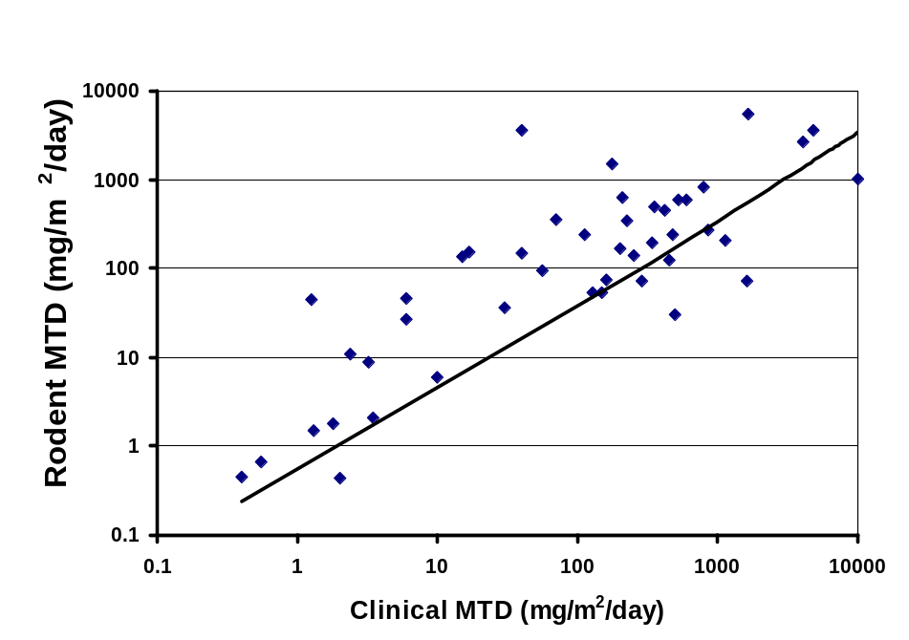
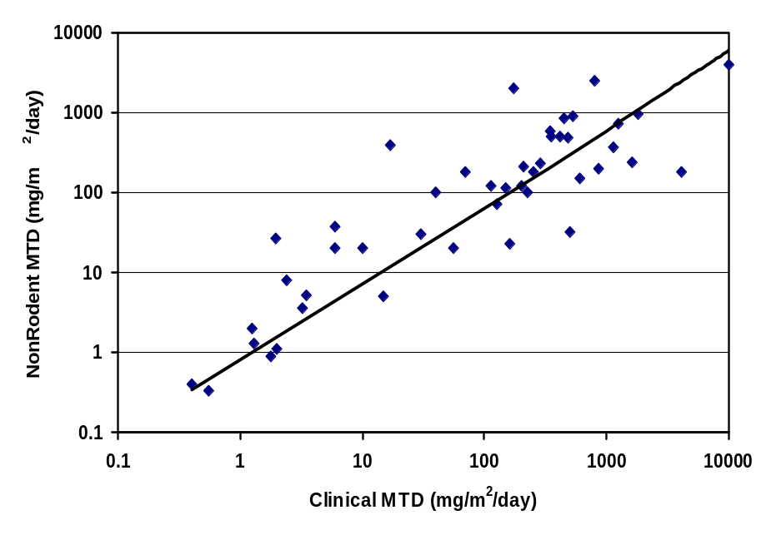
MTD- Rodent Human Correlation from : Smith and Tomaszewski, Preclinical and Clinical Toxicity Correlations for Cancer Drugs Developed by NCI. , 2002.
Rodent MTD (mg/m²/day)
Non-Rodent MTD (mg/m²/day)
Clinical MTD (mg/m²/day)

Slide 21
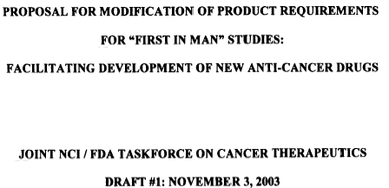
NCI vision of expIND

Slide 22
NCI vision for a new path for cancer drug development
Initial clinical experience not driven by toxicity
Pharmacological endpoints, e.g. plasma concentrations in humans
Pharmacodynamic endpoints in surrogate or tumor tissue
Shift in preclinical studies from toxicity to assessment of PK/PD relationships

Slide 23
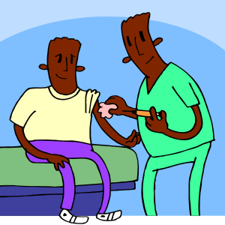
Facilitated IND as proposed by NCI
Used to select promising drugs for life threatening diseases
Clinical trial populations are terminally ill patients without therapeutic options
Up to 3 days of dosing in clinic

Slide 24

Success (or lack of) expINDs
Only a handful of expINDs have been received by the FDA. Those that have been received were not for purposes initially envisioned.

Slide 25
Why is this tool not being used?
New paradigm, established industry, slow to adopt.
Microdose studies may not be predictive of pharmacological dose studies.
Protracts the time line.
Design to kill drugs early that are likely to fail. No development team thinks their drug is a loser.

Slide 26
New paradigms being considered in maintenance of ICH M3R, “Timing of preclinical studies in relation to clinical trials”
Microdose: up to 5 doses each not to exceed 1/100th the NOAEL determined in the toxicology study or 1/100th the anticipated pharmacodynamically active dose or a total dose of 100 mcg which ever is lower.

Slide 27
New paradigms being considered in maintenance of ICH M3R, “Timing of preclinical studies in relation to clinical trials”
Microdose: up to 5 doses of 100mcg each not to exceed 1/100th the NOAEL determined in the toxicology study or 1/100th the anticipated pharmacodynamically active dose and with a washout of 6 half-lives between doses.

Slide 28
New paradigms being considered in maintenance of ICH M3R, “Timing of preclinical studies in relation to clinical trials”
Repeat dose exploratory studies up to 14 days in the therapeutic range but not to an MTD.
Supported by safety studies using large multiples of clinical exposure but not based on toxicity.

Slide 29

Bottom Line
CDER sees implementation of an exploratory IND guidance as an important part of FDA’s commitment to improving the “critical path” to new medical products.
The amount of preclinical safety data required for expINDs will generally be less or different than for conventional INDs.
Reduction in safety data requirements will be scaled to the goals, duration and scope of the proposed clinical trials.

Slide 30
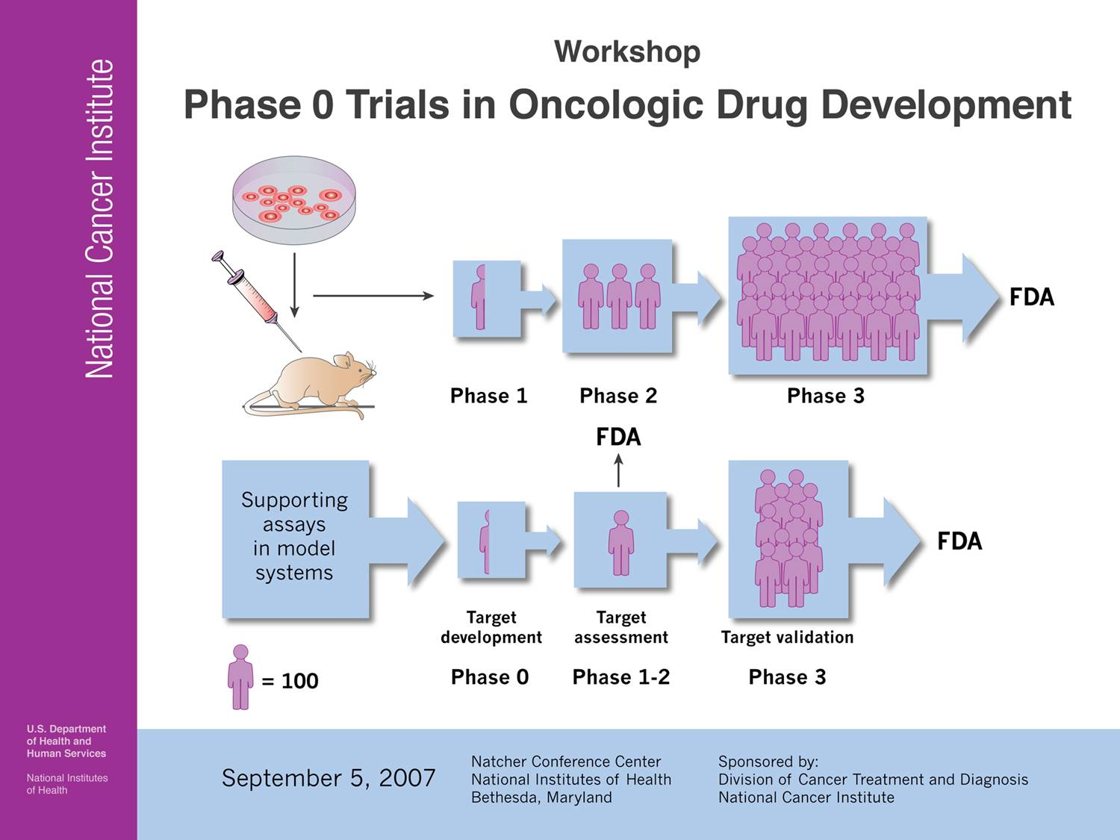



The Next Speaker is:
Dr. Joseph Tomaszewski

