Slide 1
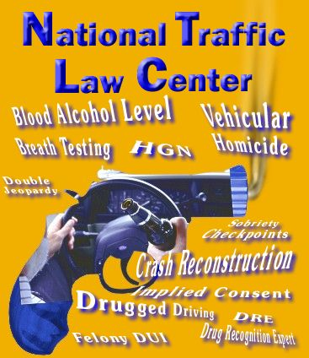


Presentation to the SES Working Group
March 2005
By: Stephen K. Talpins
Kimberly N. Overton

Slide 2
The Magnitude of the Nation’s
DUI Problem
Source: National Survey on Drug Use and Health (NSDUH) 2003 Survey
In the year prior to the survey,
  An estimated 32 million people drove under the influence of alcohol
  An estimated 19.5 million Americans aged 12 or older used illicit drugs
  An estimated 10.9 million people drove under the influence of drugs

Slide 3



Consequences
Over 44,000 people were killed in car crashes in 2003
Traffic crashes are the single greatest cause of death for every age group between two and 33 years of age in the U.S.
Alcohol related crashes alone claim about 17,000 lives and cost society over 100 billion dollars each year
Untold pain and suffering

Slide 4
Challenges
Poor communication between and among prosecutors, other law enforcement officers, toxicologists and victims
The youngest and most inexperienced assistants prosecute these cases
Some of the most experienced and highly paid defense attorneys (with incredible resources) defend many of them

Slide 5
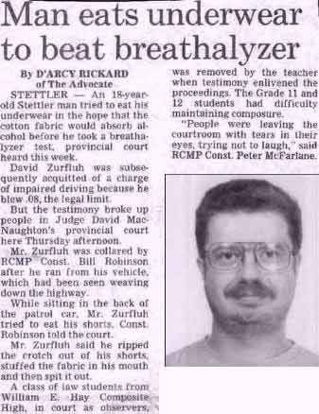
Challenges
People will try almost
ANYTHING
to beat a DUI charge

Slide 6
NTLC
The National Traffic Law Center (NTLC) is the national clearinghouse on impaired driving issues. The NTLC is a program of the American Prosecutors Research Institute (APRI), the non-profit research and technical assistance affiliate of the National District Attorney's Association. APRI created the NTLC in cooperation with the National Highway Traffic Safety Administration (NHTSA).
NTLC activities are funded by NHTSA and Anheuser-Busch

Slide 7
Mission
NTLC’s mission is to promote traffic safety and improve the quality of justice in traffic cases by creating, compiling and disseminating legal, technical and other information to prosecutors, law enforcement officers, judges, victims, other justice and traffic safety partners and the public.

Slide 8
National Association of Prosecutor Coordinators (NAPC)
Responsible for identifying, developing and implementing training and resource programs for prosecutors
45 member states
Lead on the Traffic Safety Resource Prosecutor (TSRP) program

Slide 9
TSRPs
TSRPs work closely with NTLC, NAPC and NHTSA
They become their state’s experts on DUI laws
They serve as liaisons between prosecutors and other law enforcement officer allied professionals
  Conduct cross-training programs with other law enforcement officers
  These relationships are especially valuable during crackdowns (high visibility enforcement)

Slide 10

NHTSA-NAPC Prosecutor Fellow
Serves as a liaison between NHTSA and NAPC
Works closely with NTLC and the TSRP’s

Slide 11
Methods

Slide 12
Information Highway
Traditional Flow
NHTSA
NTLC
Law Enforcement Community
Forensic Community
Prosecutors

Slide 13
Information Highway
Traditional Flow
NHTSA
NTLC
Law Enforcement Community
Forensic Community
Prosecutors

Slide 14
Information Highway
New and Improved!
NHTSA
NTLC
Law Enforcement Community
Forensic Community
NAPC
Forensic Community
Law Enforcement Community
TSRP’s
State Prosecutors

Slide 15

We work hard together because….
“The only place where success comes before work is a dictionary”
      Vidal Sassoon

Slide 16
NTLC Clearinghouse
(Available in hard copy; currently uploading for electronic distribution)
  Administrative license suspensions and revocations
  Blood tests
  Breath tests
  Crash reconstruction
  Deterrence
  Drug Evaluation and Classification (DEC) Program
  Effects of alcohol and other drugs
  Electronic Digital Recorders (EDRs)
  Field sobriety tests (including the Horizontal Gaze Nystagmus test)
  Global Positioning Satellite (GPS)
  Ignition interlock systems Implied consent
  Impoundment and forfeiture
  License plate confiscation
  Mobile videotaping
  Passive alcohol sensors
  Per se limits
  Sanctions
  Sentencing
  Sobriety checkpoints
  Vehicular homicide
  Youth programs
  Zero tolerance
*TSRPs and other allied professionals are some of the best sources for these materials

Slide 17
NTLC Brief Bank and Files
TSRPs and other prosecutors provide NTLC with relevant publications and transcripts
Evidence
Expert witnesses
  State witnesses
  Defense witnesses
Scientific research and studies
Predicate questions
Model legislation
Case law

Slide 18

Technical Assistance
Available to all of our traffic safety partners and allied professionals including: police officers, toxicologists, optometrists, and victims
NTLC: 949 requests in 2004 (up from 303 in 2003)
NAPC/TSRP: Not always tracked, but voluminous
Presented at multiple conferences
Providing PowerPoint trial templates
Participating in Nebraska’s upcoming DRE Daubert Hearing

Slide 19
Training
NTLC, NAPC and the TSRPs administer numerous training programs around the country
The trainings generally focus on prosecutors, but other law enforcement officers and toxicologists frequently participate
NTLC, NAPC and the TSRPs also encourage prosecutors to participate in other law enforcement officers’ and toxicologists’ training programs

Slide 20

Publications
Available to all of our traffic safety partners and the general public

Slide 21








NTLC Monographs
Alcohol Toxicology for Prosecutors
Drug Toxicology for Prosecutors
Crash Reconstruction Basics for Prosecutors
Admissibility of the Horizontal Gaze Nystagmus Evidence
Breath Testing for Prosecutors
The Drug Evaluation and Classification Program
Prior Convictions in Impaired Driving Prosecutions
Overcoming Impaired Driving Defenses
*TSRPs have written or peer reviewed many of them

Slide 22

Newsletters
NTLC and various TSRPs publish newsletters for prosecutors and other allied professionals
Recent topics include:
  NHTSA’s Prioritizing of Prosecutors: TSRP, What Does it Mean and How Can It Help You?
  Stop, Look and Listen: Prosecutors at the Crash Scene
  Event Data Recorders (EDR) – Recording Automotive Crash Event Data
  Crawford Made Simple
  Above and Beyond
  Selling the Obvious

Slide 23
E-Assistance: NTLC Web Site
Main Page
Link | Hits or Downloads
Home Page | 13,958
Legal Issues/Resources | 6,317
Brief Bank | 2,004
Publications
Link | Hits or Downloads
Alcohol Toxicology for Prosecutors | 28,391
Overcoming Impaired Driving Defenses | 23,217
Admissibility of HGN Evidence | 22,293
Crash Reconstruction Basics for Prosecutors | 20,520
Prior Convictions in Impaired Driving Prosecutions | 3,726
Drug Toxicology for Prosecutors | 2,686
HGN – The Science and the Law: A Resource Guide for Judges, Prosecutors and Law Enforcement | 14,851
Between the Lines Newsletter | 4,096

Slide 24

E-Assistance
The forum is an online multi-disciplinary forum for prosecutors and other law enforcement officers, toxicologists, traffic safety personnel, physicians, victims, community activists and others committed to eradicating impaired driving
The TSRPs regularly participate in this group (and have their own forum as well)
Features:
  Approaching 350 members
  On line discussions of relevant issues
  Monthly case law updates
  Selected unpublished opinions of national significance
  Selected scientific articles and research
  Calendar
  Contact List

Slide 25


NTLC Media and Promotions
December 18th: Don't Let Drunk or Impaired Drivers Kill Your Holiday!
August 7th: Training prosecutors to more effectively represent victims of crimes and their families
Exhibitions:
*Lifesavers Conference
*The Eleventh IACP DRE Conference on Drugs,
Alcohol, and Impaired Driving

Slide 26
NAPC/TSRP Media
NAPC assists local prosecutors and other law enforcement agencies by publicizing their efforts and creating sample media packets

Slide 27
Future Plans
Increase NTLC’s, NAPC’s and the TSRP’s visibility and continue fostering relationships with our non-prosecutor partners
We can’t help people who don’t know we exist
Improve the distribution of information (quantitatively and qualitatively)
Replace the monographs with a peer reviewed quarterly journal
Continue live training programs
Increase cross training with prosecutors and our allied professionals and victims

Slide 28
Future Plans
Continue collaborating With NAPC to Improve e-distribution methods
Increase NTLC forum memberships and NTLC and NAPC publications
Convert the NTLC Forum to a Web Page
Finish uploading the brief bank and resource files
CD based training and mentoring program
Web based training program

Slide 29
Future Plans
Design and deliver case preparation and testimony courses for law enforcement officers
Draft a white paper on getting more courts to accept HGN
Last, but not least……..
Create and administer a leadership institute for all traffic
safety partners

Slide 30
THANK YOU

