Slide 1
NIDA Research Training Director’s Meeting
November 3, 2006
Rockville, MD
Division of Pharmacotherapies and Medical Consequences of Drug Abuse
Jamie Biswas, Ph.D.
Chief, Medications Research Grants Branch

Slide 2
Medications Development for Substance Use Disorders (SUDs) in the DPMC
Identify unmet clinical needs
Identify medications to test (Preclinical screening; Clinical Phase I, II, or III) for SUDs
Prioritize trials
For contracts – Medications Development Workgroup review
For grants – make Programmatic decisions based on project, score, and available funding

Slide 3
Program Priorities for the Treatment of Substance Use Disorders
Stimulants
Cannabis abuse
Club drugs
Prescription opioids
New mechanisms for opioid abuse/addiction
New mechanisms for nicotine abuse/addiction

Slide 4
Addressing the Treatment Needs of Special Populations
Women and Gender Differences
Minorities
Pregnant women and their fetuses
Adolescents
Subjects with comorbid substance use disorders
Subjects with comorbid psychiatric disorders
Subjects within the Criminal Justice System

Slide 5
Funding Decisions Are Based On:
Unmet clinical needs
State of the art of the science and technology
Innovativeness (avoid redundancy)
Study Section recommendations, scores, and percentiles
Available funding

Slide 6
What kind of medications development research projects do we support?
Preclinical
- Medicinal chemistry (new chemical entities, immunotherapy)
- Behavioral animal models
- Predictive toxicology
- New pharmacokinetic assays
Clinical
- Test new medications (safety and efficacy)
- Vaccines and monoclonals
- New and more effective formulations

Slide 7
Medical/Health Consequences of Drug Abuse and Co-Occurring Infections
Medical/clinical consequences of legal and illegal drugs and co-occurring infections (HIV, HCV, STDs)
Clinical research that impacts the pathogenesis of HIV/AIDS
Factors that affect resistance and susceptibility to infection
Medical interventions for drug abuse, and HIV and associated clinical conditions
PK and pharmacodynamic interactions between drugs of abuse, medications to treat SUDs, and pharmacotherapies for HIV/AIDS and comorbid conditions
Factors in progression of infectious diseases in vulnerable and underserved patient populations of drug abusers

Slide 8
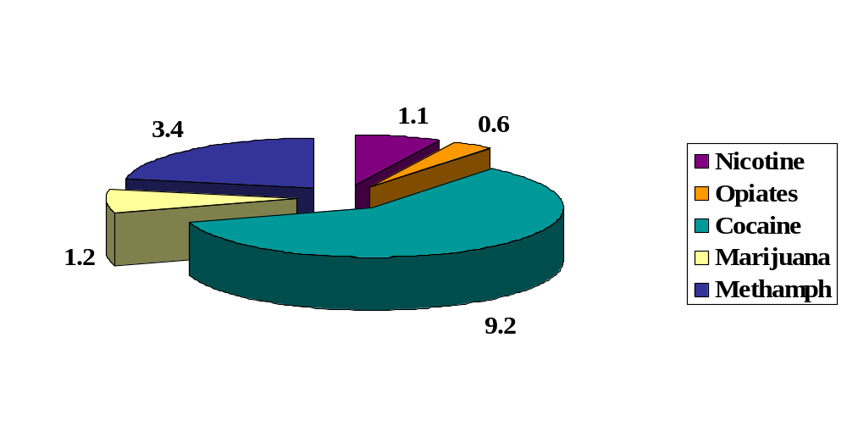
Distribution of Pre-clinical Grant Portfolio by Drug Treatment Target
(Millions of Dollars)

Slide 9
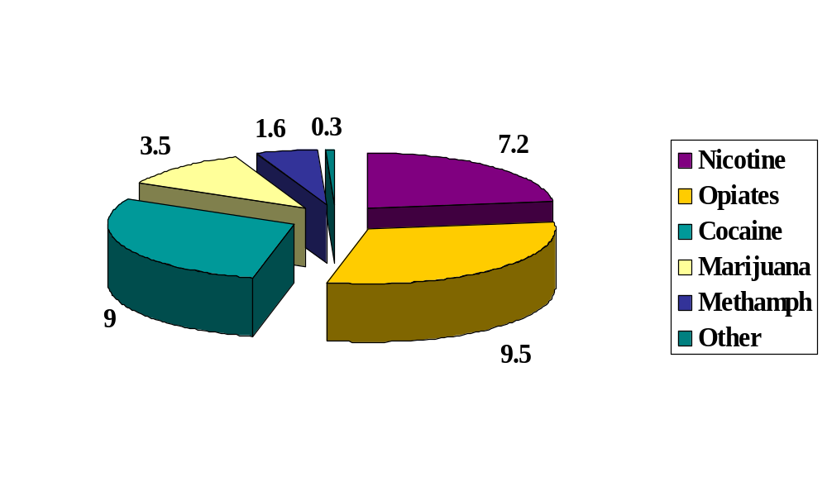
Distribution of Clinical Grant Portfolio by Drug Treatment Target
(millions of dollars)

Slide 10
Matching Training to Program Priorities – Drug Abuse Related Research Disciplines
Medicinal chemistry
Behavioral pharmacology
Pharmacokinetics
Medical toxicology
Translational research
Medical consequences of drug abuse
Imaging
Human lab studies
Conducting clinical trials
Data analysis and analysis methodologies

