Slide 1
NLM Online Update
May 22, 2006
David Gillikin
Head, MEDLARS Management Section
National Library of Medicine
National Institutes of Health
Department of Health & Human Services

Slide 2
Presentations
Dr. Stuart Nelson, MeSH
Joyce Backus, MedlinePlus
Maria Collins, DOCLINE
David Gillikin, Online Update
Questions

Slide 3


Slide 4
Milestones
170 yrs | Library of Surgeon General established, 1836
50 yrs | National Library of Medicine Act, Public Law 84-941, 1956
40 yrs | Specialized Information Services Division (SIS), NLM, 1966
35 yrs | MEDLINE, 1971
21 yrs | DOCLINE, 1985
10 yrs | PubMed, 1996 (available for free in 1997)

Slide 5
Milestones
Retirements
March 2006: Eve-Marie Lacroix, Chief of the Public Services Division
April 2006: Marj Cahn, Head of National Information Center on Health Services Research and Health Care Technology (NICHSR)
June 2006: Carolyn Tilley, Library Operations UMLS Coordinator, former Head of MEDLARS Management Section

Slide 6
Indexing
FY2005
  606,596 indexed citations added to MEDLINE
  Highest ever indexing rate
  45,312 gene indexing links created (compared to 33,444 in previous year)
FY2006
  301,396 citations indexed in first 6 months, greater than last year at this time
  More than 80% of MEDLINE citations now supplied electronically by publishers
Notes:
Fy2004: 567,000 indexed citations

Slide 7
Indexing
ClinicalTrials.gov numbers and Gene Expression Omnibus (GEO) numbers added to MEDLINE
New Web-based training program for MEDLINE indexing was introduced for the first time in the fall of 2005
Notes:
A web-based indexing training program has been used for the last two indexing classes held in 2005. We hope to eventually make it publically-available, as well as the MEDLINE Indexing Manual.

Slide 8
Indexing
Electronic Journal Indexing
  107 online-only journals indexed for MEDLINE, an increase from 90 a year ago
  140 additional journals, the online version is indexed instead of the print version, an increase from 95 a year ago
  Dual monitors, and revised workflow/journal distribution methods allowing for this change in journal format
Notes:
As of April 1, 107 online-only journals were being indexed for MEDLINE, and for 140 additional journals, the online version was being indexed instead of the print version. A year ago 90 online-only journals were indexed, and the online version of 95 journals. Dual-monitor equipment and revised workflow and journal distribution methods are being used to work productively with the change in journal format.

Slide 9
Indexing
Space Life Sciences data
  NASA ended the Interagency Agreement with NLM for Space Life Sciences data
  NLM is reviewing a list of NASA recommended journals to consider for indexing

Slide 10
Gateway
Access to 7 new collections
  NCBI Bookshelf
  Household Products Database
  Developmental and Reproductive Toxicology Database (DART)
  Chemical Carcinogenesis Research Information System (CCRIS)
  Genetic Toxicology Data Bank (GENE-TOX)
  Integrated Risk Information System (IRIS)
  International Toxicity Estimates for Risk (ITER)

Slide 11
OLDMEDLINE
Mapping OLDMEDLINE Keywords to current MeSH = major focus
  70% of citations mapped completely (over 1.2 million citations)
  22% in-process, with one or more keywords mapped
  8% with not mapping yet
No new citations currently being added due to budgetary constraints
Notes:
Current total of OLDMEDLINE citations is over 1,760,000

Slide 12
PubMed
PubMed – surpassed 16.3 million records this year
MEDLINE – over 13.8 million (85%)
  (expect to pass 14 million by July 2006)
In Process records – over 230,000 (1.4%)
OLDMEDLINE – over 1,760,000 (10.8%)
PubMed-only records – over 446,000 (2.8%)

Slide 13
PubMed
Usage continues to grow
  Searches by Unique IPs
    March 2005 : Nearly 7 million unique IPs
    March 2006: Nearly 9.8 million unique IPs
  Total number of searches
    March 2005: Over 68 million searches
    March 2006: Over 82 million searches
  Page views
    March 2005: Over 294 million page views
    March 2006: Over 377 million page views

Slide 14
PubMed Enhancements
Shared My NCBI Accounts
  Lets a library establish a URL that activates filters thought to be helpful to patrons.

Slide 15
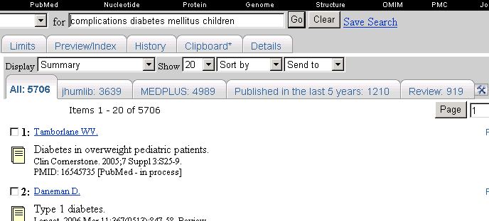
Shared Account Example

Slide 16
PubMed Enhancements
Search Links Added To Abstract & Citation Formats
  MeSH Terms
  Journal Title Abbreviations
  Grant ID
  Secondary Source ID
  Personal Name as Subject

Slide 17
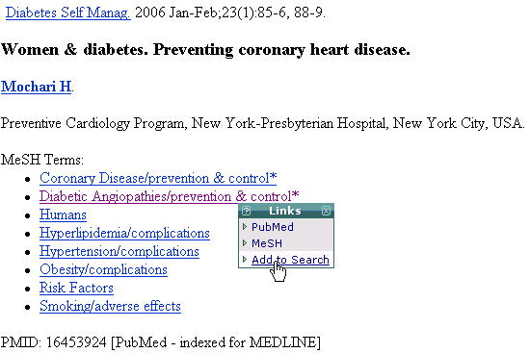

Slide 18
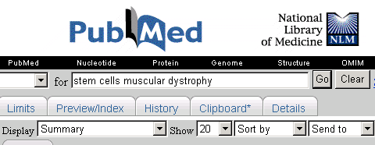
Clipboard Contents Indicator

Slide 19

Citations Added for PMC Manuscripts

Slide 20
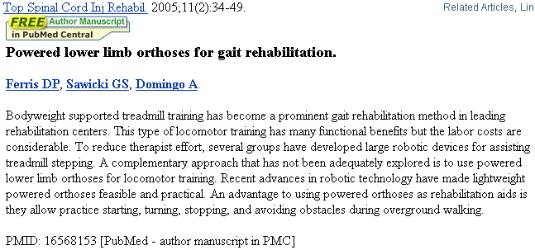
Display Showing Icon Link to PMC

Slide 21
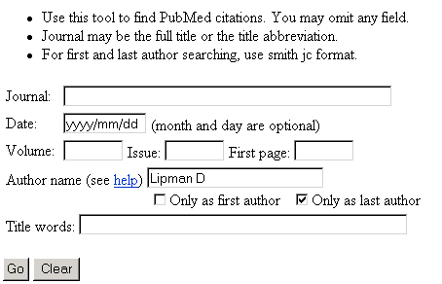
Last Author Search in Single Citation Matcher

Slide 22
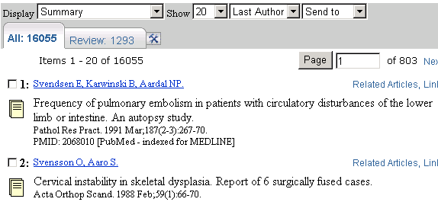
Sort Results by First or Last Author

Slide 23
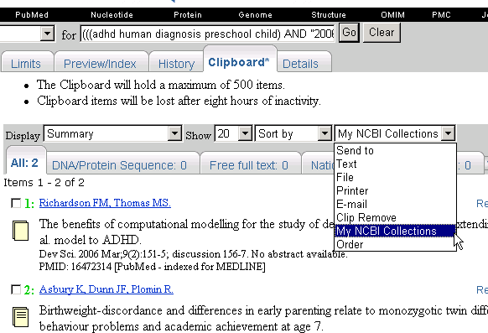
My NCBI Collections

Slide 24
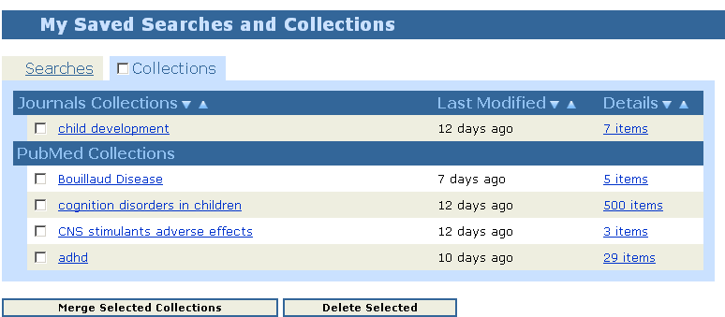
Collections in My NCBI

Slide 25
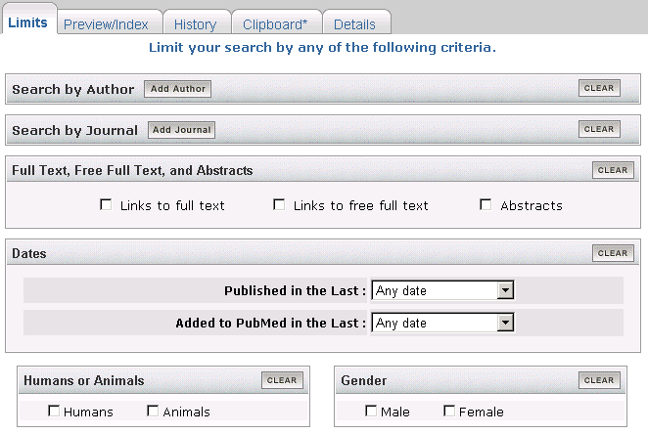
New Limits Design

Slide 26
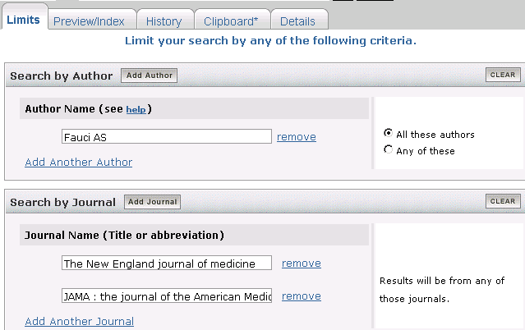
Limits
Author and Journal Searching

Slide 27
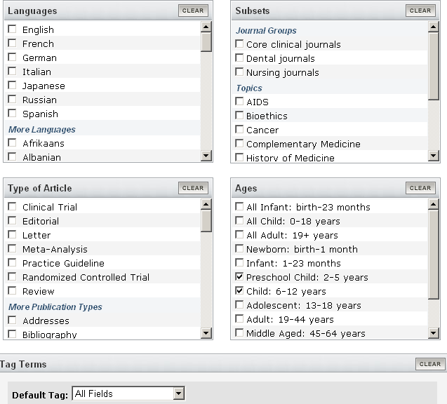
Limits – Multiple Selections Allowed

Slide 28
PubMed Enhancements
Order of Authors – personal and corporate author names to reflect order in article
Grant Numbers included:
  International Standard Randomised Controlled Trial Number (ISRCTN)
  Wellcome Trust Grant Numbers
Default displays for Entrez PubMed, Journals, MeSH, and NLM Catalog when retrieval = 1 record
Approximately 45,000 citations from 24 journals added to PubMed from the PubMed Central back file scanning project

Slide 29
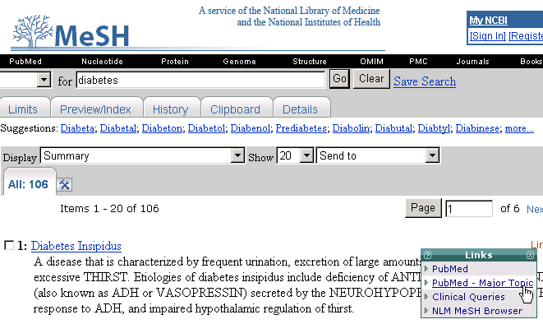
MeSH Database
Search by Major MeSH Heading

Slide 30
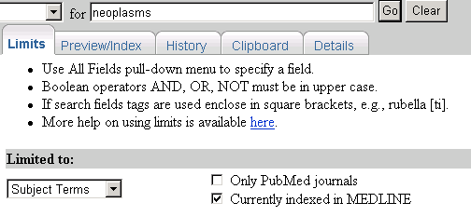
Journals Database
Limits

Slide 31
LinkOut
5,144 journals with LinkOut links
PubMed Citations:
    35.1% have full text links
    7.9% have free full text links
PubMed citations from 1999 on:
    80.8% have full text links
    16.3% have free full text links
Usage (over 20% increase from last year):
    24 million LinkOut hits/month
    1,000,000 LinkOut hits/work day
Notes:
Last year reported:
4,667 journals with LinkOut links
PubMed Citations:
30% have full text links
7% have free full text links
PubMed citations from 1999 on:
80% have full text links
15% have free full text links
Usage:
19.5 million LinkOut hits/month;
850,000 LinkOut hits/work day

Slide 32
LinkOut
LinkOut for Libraries program
  1485 Libraries participating as of May 15 (246 more than at this time last year)
  810 DOCLINE libraries show their serial holdings in LinkOut
  505 libraries from foreign countries
Submission Utility
  Undergoing a complete redesign
  Improve layout and add more functionalities
  Combines the management of LinkOut, Outside Tool and Document Delivery Service

Slide 33
PubMed Central
April 2006, the number of unique IPs searching PMC for a month topped 2 million for the first time
As of May 1:
  249 journals participating in PMC (184 last year)
  Covering over 675,000 articles (370,00 last year)
  Announcements of new PMC titles and coverage appear regularly in the NLM Technical Bulletin
Notes:
Reported last year:
March 2005, the number of unique IPs searching PMC for a month topped 1 million for the first time.
As of May 1:
184 journals participating in PMC
Covering over 370,000 articles

Slide 34
Training
Between January 2005 and April 2006 over 1211 users have taken our training courses throughout the country, covering PubMed, Gateway, ClinicalTrials.gov, TOXNET, UMLS
Basics of Medical Subject Headings (MeSH) – new instructional resource, accessed from NLM's PubMed Online Training page and the Distance Education page
Notes:
The classes include PubMed, Gate

Slide 35
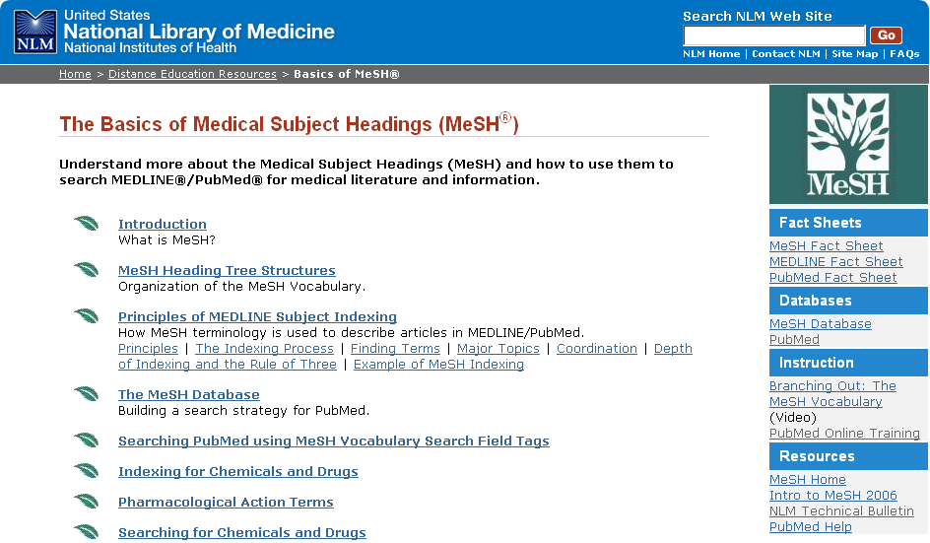

Slide 36
Training
PubMed Tutorial updated three times in the past year; the newest version made available in mid-May 2006
24 Quick Tours on topics including PubMed, Gateway, LinkOut and the NLM Catalog
Quick Tours received an NIH Plain Language Award in April 2006
Notes:
The classes include PubMed, Gate

Slide 37
NLM Technical Bulletin
New features:
  Search function, allowing searching of index text back to 1979 and the article text back to 1997
  Print This Issue, allows you to print an entire issue (closed issue)
  What Other Readers are Reading
  E-mail Notification of New Articles and Issue Closure (link to subscribe to the NLM-Announces mailing list)
  RSS Feed
  Skill Kit articles, covering search hints, system features, and data and indexing topics for NLM databases

Slide 38
Technical Services
January 2006, Voyager displays data in vernacular (non-Roman) characters
  Allows a user with the correct keyboard facilities to search records using vernacular characters
  Over 4,000 records in the database in Japanese and Chinese vernacular characters
2006 edition of the NLM Classification available online, April 2006
  Incorporate changes from April 2005 to March 2006
  Includes an online tutorial for searching the NLM Classification
Notes:
With the Voyager Unicode release in January, NLM began in-house cataloging using vernacular scripts. There are already over 4,000 records in the database in Japanese and Chinese vernacular characters, which came from previous cataloging contracts with OCLC. Vernacular data is supplied for all access points (authors, titles) and the edition and imprint. This allows a user with the correct keyboard facilities to search records using vernacular characters. Both the Romanized and vernacular data displays to all users. Soon, most in-house cataloging of Chinese, Korean, Arabic and Hebrew monographs and serials, as well as Slavic serials will be done with vernacular scripts.

Slide 39
Technical Services
New Authority Index Feature in the NLM Catalog
  An index of full author names, organizations, and conference names, as well as series titles, associated with the bibliographic records in the NLM Catalog
  Three new Quick Tours for searching author names, corporate/conference names, and series title

Slide 40
Data Distribution
Data distribution program continues to grow, with research areas in academics, biotech, and software development companies leading the way.
Over 350 MEDLINE licensees in FY2005, 14% growth.
118 Non-USA licensees, 26% growth

Slide 41
Unified Medical Language System (UMLS)
3 UMLS releases in 2005, 4 releases planned for 2006.
First 2006 release was in February, second release was in May
MetamorphoSys software continues to be enhanced, improving functionality and usability

Slide 42
DailyMed
New Web site:
http://dailymed.nlm.nih.gov/
Provides high quality information about marketed drugs
Includes FDA approved labels (package inserts)

Slide 43
Health Sciences Libraries
Information Rx Tool Kit
Information Rx Toolkit has been redesigned and reorganized for easier use
New Name:
  Health Sciences Libraries Information
  Rx Tool Kit
  http://nnlm.gov/hip/infoRx
Step-by-step guide to assist librarians with outreach activities

Slide 44
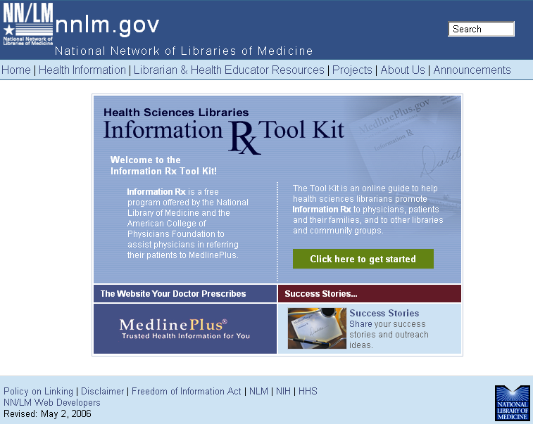
Health Sciences Libraries Information Rx Tool Kit

Slide 45
Specialized Information Services
(SIS)
TOXMAP 2.4 released
2004 Toxics Release Inventory released on TOXNET
Tox Town additions: “US-Mexico Border” and “Farm Scene”
WebWiser – WISER functionality via Internet, without downloading software or data to desktop.
Databases:
  Updates: Household Products Database, HazMap
  New: LactMed - covering Drugs and Lactation

Slide 46
Please stop by the NLM booth
and let us know what you think,
what you like, what you don’t like,
and what we can do better.
Thank you!

