Slide 1




Industry
Federal & State
Government
Research Translation Core
Seminars
International
~Chulabhorn Research Institute
~Japanese National Institute
of Health Sciences
~Korean Food & Drug
Administration
Industry
~Microbiology
~Environmental Engineering
Annual
Workshops
Meeting
Molecular
Biology
Academia
~Microbiology
~Environmental Engineering
~Classroom
Tools
Repository
Project 1: Characterization of the Pathways Linking Ah Receptor Activation with Altered B Cell Differentiation Using an Integrated Experimental and Computational Modeling Approach
Project 3: Non-Additive
Ah Receptor Ligand
Interactions
Project 2: Dissecting the
Signaling Network for Ah
Receptor-mediated B-cell
Toxicity
Project 4: Influence of Ah Receptor Ligands on Inflammatory Responses: Consequences for Tissue Injury and Gene Expression
Project 6: Molecular Insight
into Polyaromatic Toxicant
Degradation by Microbial
Communities
Project 5: A Proteomic
Analysis of the AHR signaling
Network
Center for Integrative
Toxicology
Water Quality Program
Environmental Science
Policy Program
Basic Science Faculty
Core C: Computational
Modeling of Mammalian
Biomolecular Responses Core
Project 7: Geochemical
Controls on the Adsorption, Bioavailability, and Long-term Environmental Fate of Dioxins, PCBs, and PAHs
Core A: Administrative Core
Core E: Environmental
Molecular Analysis Core
Core D: Biomedical
Informatics Core

Slide 2
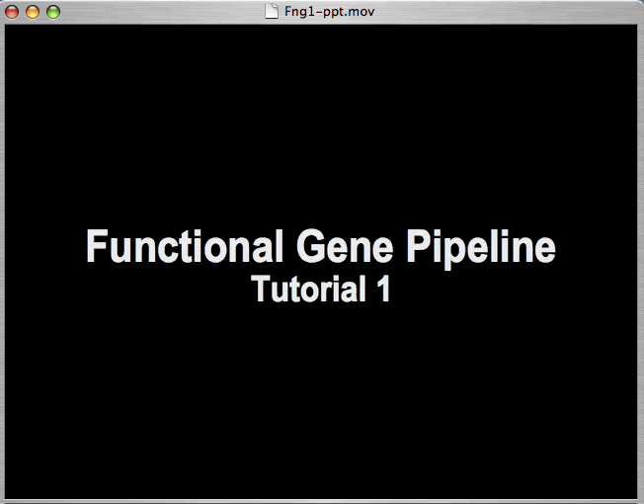


Slide 3
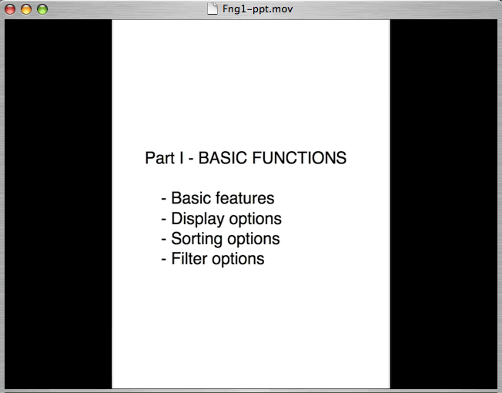

Slide 4
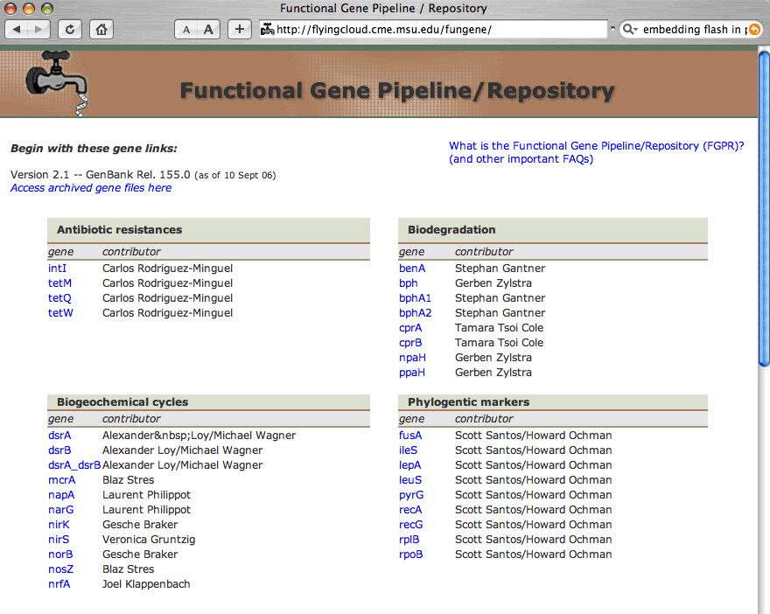

Slide 5
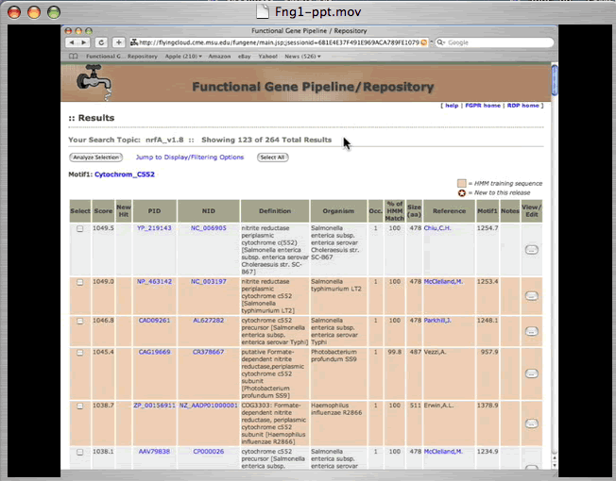

Slide 6
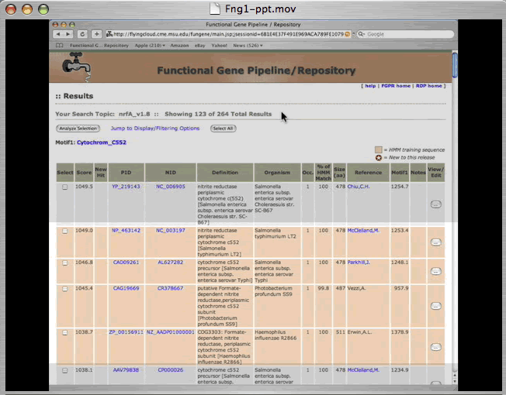

Slide 7
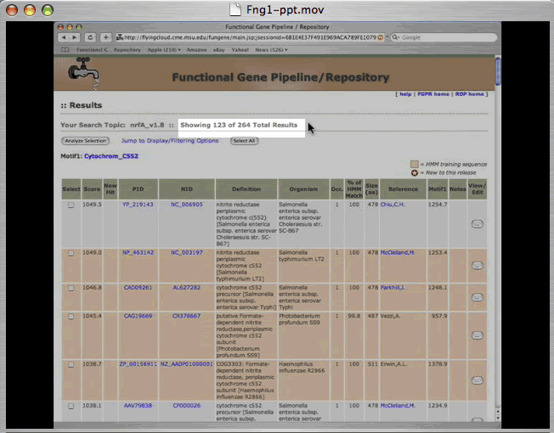

Slide 8
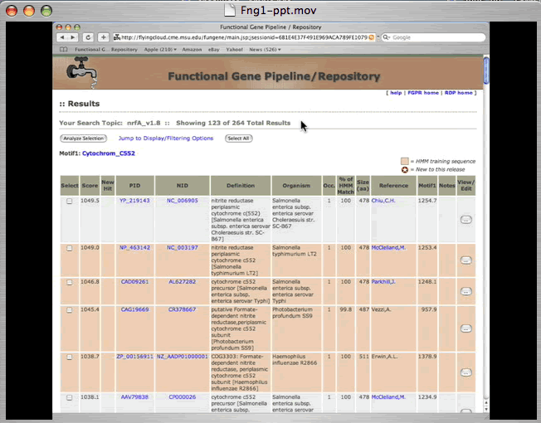

Slide 9
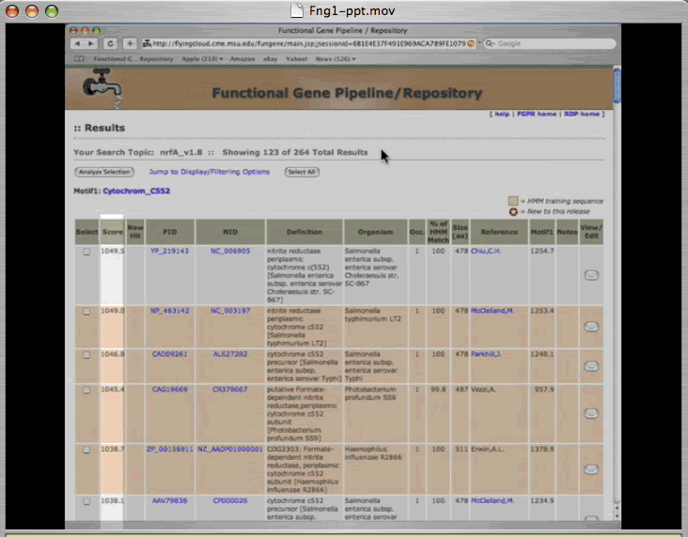

Slide 11
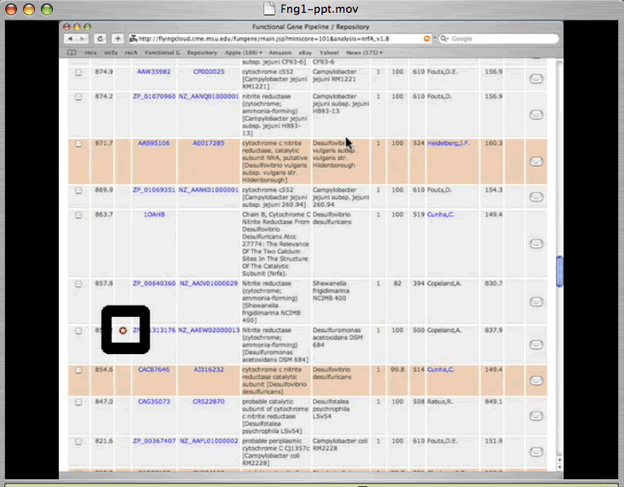

Slide 13
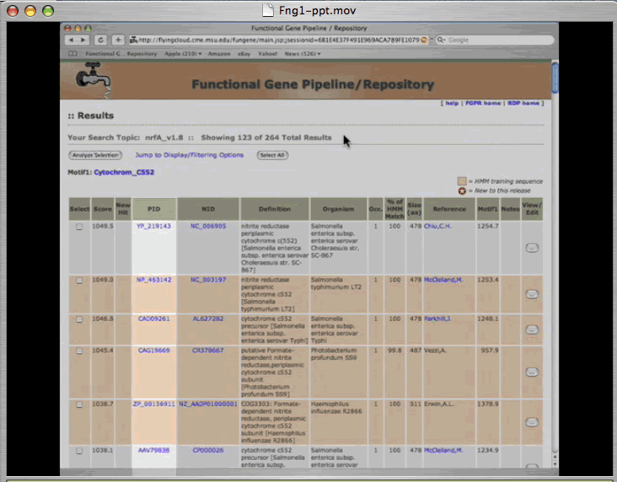

Slide 14
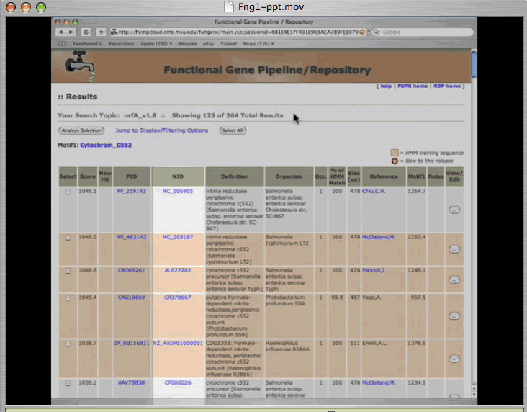

Slide 15
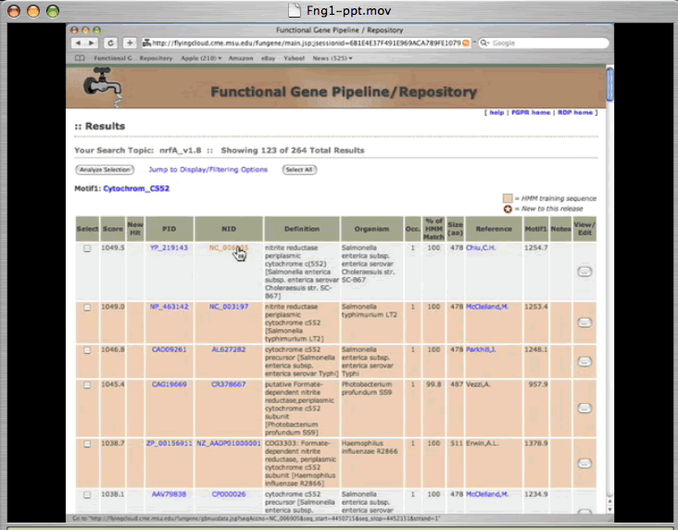

Slide 16
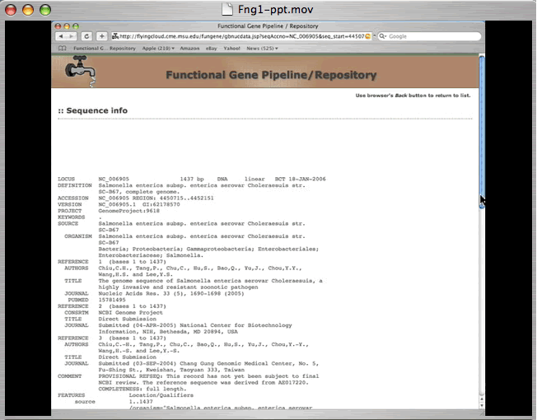

Slide 17
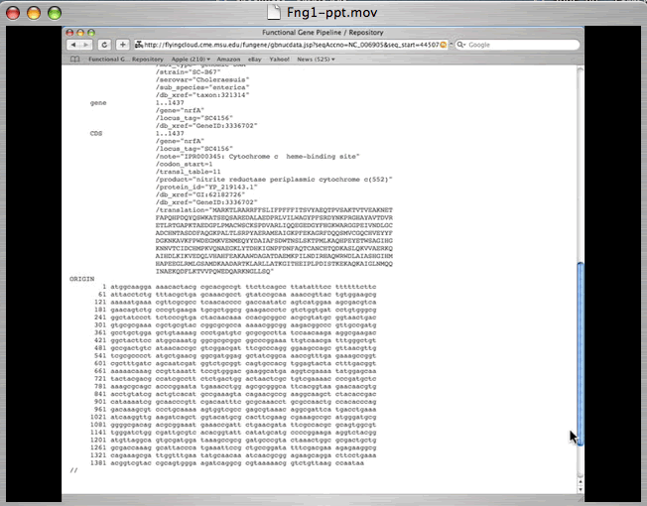

Slide 18


