Slide 1
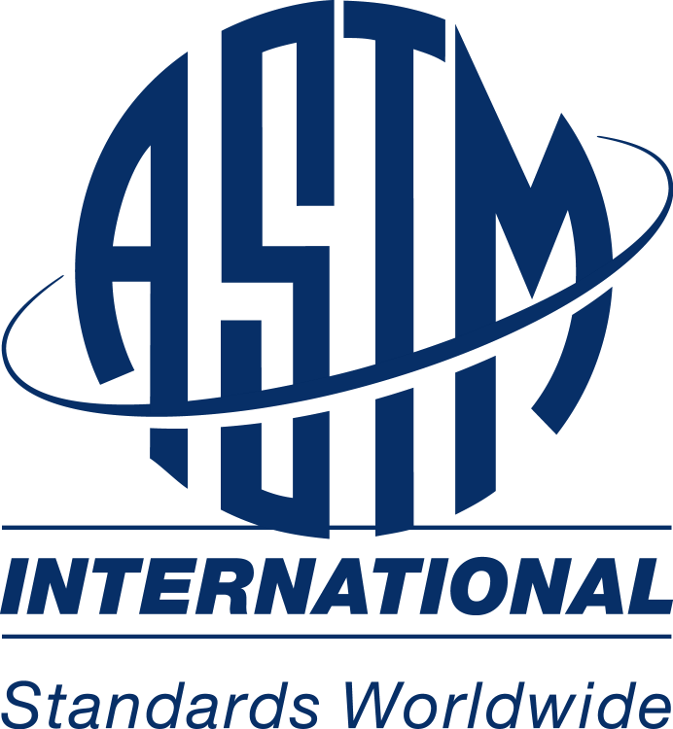
New Member Orientation

Slide 2
The ASTM Standards Development Process
Developing Voluntary, Full-Consensus Standards for Materials, Products, Systems & Services World-Wide.
ASTM Has Approximately 11,000 Standards Used Internationally.
ASTM Standards Always Reflect the Most Current Technology Because they are Living Documents that are Continually Revised.
Over 31,000 Members from Around the Globe Participate on ASTM Committees.
ASTM
www.astm.org

Slide 3
ASTM Staff Support Structure
ASTM Headquarters
ASTM has a 180 person staff to manage & support the standard development activities of the Technical Committees.
Each Committee has an ASTM Staff Manager & Editor. They ensure efficient committee operation & provide guidance & support in developing documents.
Staff Managers
130 Technical Committees
31,000 Members
ASTM
Managers & Editors help Technical Committees abide by ASTM procedure & regulation in the development of standards. They also assure that the documents are structured correctly.
ASTM
Committee
Regulations
Form
&
Style
Manual
www.astm.org

Slide 4
Technical Committee Organization
Technical Committees form to address specific industry subjects. They develop scopes to define their jurisdiction.
MAIN COMMITTEE
Subcommittees are established to address subsets of specialized subject matter under the scope of the Main Committee.
Subcommittee
.01
Subcommittee
.02
Subcommittee
.03
Subcommittees further organize their expertise into small Task Groups. This is the level at which documents are first developed and are subsequently revised.
Task Group
1
Task Group
2
ASTM
ASTM has approximately 130 Technical Committees, 2,000 Subcommittees, & thousands more Task Groups that produce 1,200 drafts, or revisions to drafts, annually.
www.astm.org

Slide 5
Technical Committee Operations
Bylaws
Officers
Ballots
Symposia
Funds

Slide 6
Classification & Balance
User
&
General Interest
Producer
ASTM
Technical Committees are balanced. There are no more Producer voters than User & General Interest Voters. This ensures the development of fair, consensus, technically sound documents. It protects the documents from bias.
ASTM
www.astm.org
The Committee on Technical Committee Operations (COTCO) maintains the Regulations & the activities of Technical Committees in accordance with them. This includes issues such as classification, balance, and bylaw revision.

Slide 7
Document Types
Classification
Guide
Practice
Specification
Terminology
Test Method

Slide 8
ASTM Balloting Process
3-
COMMITTEE ON STANDARDS
After Subcommittee approval, the Main Committee & entire Society vote on the draft. If approved, it is presented to the Committee on Standards for final review. If not, it returns to the Task Group for re-drafting, & balloting is repeated.
SOCIETY & MAIN COMMITTEE
2-
SUBCOMMITTEE
A completed draft is voted on by the Subcommittee. If approved, it moves to a Main Committee vote. If not, it returns to the Task Group for re-drafting.
The Committee on Standards (COS) is
a standing committee
of the Society. It
reviews the process by which each standard is developed or revised, to ensure ASTM procedure was administered.
TASK
GROUP
1-
ASTM
Documents are drafted, and continually revised, in the Task Group by a few members who specialize in the subject matter.
www.astm.org

Slide 9
Tools and Resources
Technical Committee Officer Handbook
Regulations Governing ASTM Technical Committees
Form and Style Manual
Long Range Planning Manual
Membership Information Packets
Committee Bylaws

Slide 10
More Tools…
Jurisdiction List
Guide to Preparing Revisions for Ballot
Guidelines for Writing Research Reports
Publicity Forms for Standardization News
Submittal Forms

Slide 11

Questions

