Slide 1

Intermountain Healthcare Clinical Genetics Institute
Marc S. Williams MD, Director
Grant M. Wood, Senior IT Strategist
AHIC PHC Workgroup
May 15, 2007
HL7 Clinical Genomics Update

Slide 2
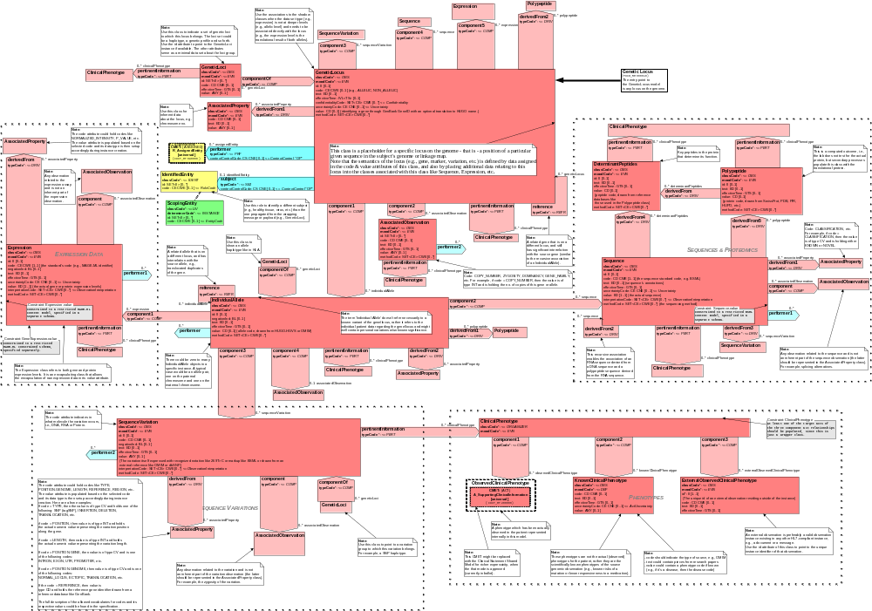
The GeneticLocus Model - Focal Areas:
Expression
Data
The Locus
and its Alleles
Sequence
and
Proteomics
Sequence
Variations
Clinical
Phenotypes

Slide 3
Core Genomic Models
Genome
Locus and non-locus data
Draft
Utility
Clinical Genomics
Query
GeneticLoci
A set of loci like haplotype, gene expression panel,
genetic testing battery, etc.
normative
normative
Rolling out the V3 Lab model:
GeneticLocus
Locus, alleles, sequence, sequence variation
Expression, proteomics
normative
Genetic Testing
Order
Draft
ClinicalPhenotype
Draft
Amnon Shabo, IBM Haifa Research Lab

Slide 4

HL7 Clinical Genomics
Genotype models are designed to store genomic data in the EHR for use by clinical decision support applications.
Need to finalize GeneticLoci and GeneticLocus models for normative balloting.
To complete our vocabulary effort, we have discussed the use of NCI terms/codes. The NCI is working on a controlled vocabulary.
Does the four modules cover all genetic testing use cases? (gap analysis report)
Need to pilot the models in both clinical research and clinical practice environments, as well as testing messaging between reference labs and healthcare providers.
Need implementation by early adopters and collaborative partners to test the exchange of clinical genomic and family history data.
We want to work with healthcare information technology users to ensure that HL7 standards meet real-world requirements.

Slide 5

Logical Observations Identifiers Names and Codes
LOINC was developed to provide a universal standard for identifying clinical information in electronic reports
The LOINC database provides a set of universal names and ID codes for identifying laboratory and clinical test results, including genetic tests
LOINC codes are intended to identify the test result or clinical observation
Codes work for both orders and observations
662 molecular/genetic codes created so far
LOINC code gets wrapped inside of a HL7 message

Slide 6
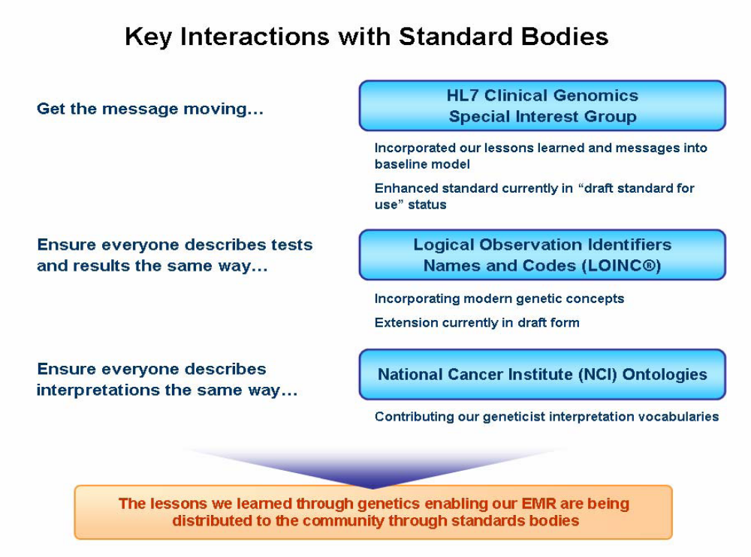
For More Information
From HPCGG RFI dated January 10, 2007 to DHHS AHIC PHC workgroup

Slide 7

HPCGG cite
Response to the
Department of Health and Human Services
Request for Information on
Improving Health and Accelerating Personalized Health Care through Health Information Technology and Genomic Information in Population- and Community-based Health Care Delivery Systems
Submitted by
The Harvard Medical School-Partners HealthCare
Center for Genetics and Genomics (HPCGG)
On
January 10, 2007
Document Version
1.0
Copyright 2007 – Harvard Medical School – Partners Healthcare Center for Genetics and Genomics – All rights Reserved
Cite for previous slide

Slide 8
For More Information
Personalized Healthcare RFI written by Harvard-Partners Center for Genetics and Genomics http://www.hpcgg.org/News/HPCGG_RFI_Response_1_0.pdf
For the Genetic Locus, Genetic Loci, and Family History model walkthroughs and XML Schemas, go to http://hl7.org/Special/committees/clingenomics/docs.cfm
Send any further questions to Amnon Shabo, Co-Chair HL7 Clinical Genomics Special Interest Group, IBM Research Lab in Haifa
E-mail: shabo@il.ibm.com
Find HL7 website at www.hl7.org
Contact me at via e-mail at grant.wood@intermountainmail.org

