Slide 1
SnapTrack, Inc.
FCC Location Roundtable
Walter Bell
Vice President of Engineering
June 28, 1999

Slide 2

SnapTrack’s Personal
Location Technology
Combine GPS receiving capability with a cell-based wireless network
  Air interface independent
Divide location determination task between client and server
Extract key information from the wireless network
  E.g., approximate location, carrier frequency
Software-based solution
  Use phone’s own DSP chip to rapidly process an information-rich snapshot of GPS data using fast convolution software

Slide 3


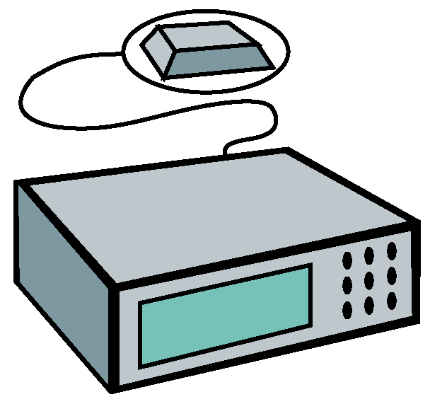
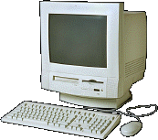
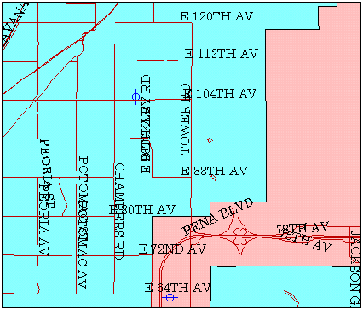
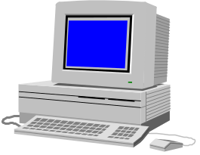
SnapTrack
Wireless-Aided GPS
Wireless
Network
GPS
GPS
Voice
&
Data
Data
Voice
&
Data
SnapTrack Wide
Area Reference Network
MAP
Client
Server
PSAP Operator

Slide 4
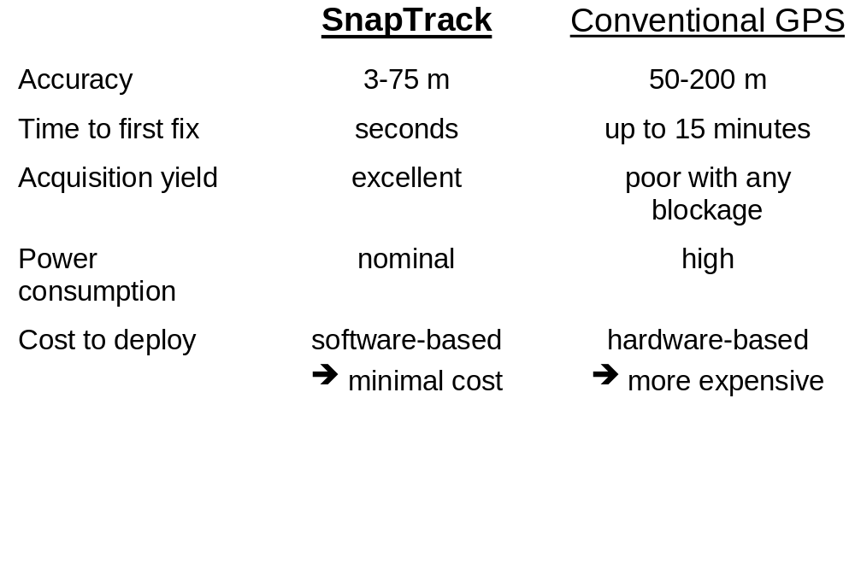
Performance v.
Conventional GPS

Slide 5
Comparison to
Terrestrial Triangulation
SnapTrack Wireless-Assisted GPS
Negligible network impact
  air interface independent
  server software can run on an existing platform
Can achieve accurate fix with only a single base station as long as cell phone can communicate
  first fix, cold start, 1-sigma accuracies generally range from 3-75 meters, depending on call environment
  average accuracy of ≈20 meters
Must use modified handsets
Terrestrial Triangulation
Extensive network impact
  modifications required to entire cellular network (new hardware and software at most if not all sites)
  new receiver sites must be built to increase accuracy and coverage
  accuracy dependent on cell configuration
  requires at least 3-4 receivers in appropriate geometric pattern to provide accurate fix (unavailable in many environments)
Severe multipath limitations
“Terrestrial triangulation systems are inevitably limited by multipath; wireless-assisted GPS is expected to achieve an order of magnitude better accuracy.” - Lucent Technologies, TR 45 filing

Slide 6
Test Groups
Goals
  Test and evaluate SnapTrack technology, serve as focus for standards activity
SnapTrack CDMA test group
  AirTouch, Ameritech, Bell Mobility, GTE, PrimeCo, Sprint PCS,
  U S WEST Wireless, Motorola, Samsung, LGIC, Hyundai, Denso, Fujitsu, Texas Instruments, VLSI
  Wireless-assisted GPS messages being standardized in TR 45.5
    Baseline text agreed, balloting scheduled for 8/99 completion
  Audited tests have been conducted on two separate CDMA networks in Tampa, Florida (USA)
    At 800 MHz (GTE Wireless) and 1900 MHz (Sprint PCS)
    Prototypes from multiple handset vendors tested
Recently launched SnapTrack GSM test group: 11 European and U.S. carriers

Slide 7
Major Field Tests
United States
  San Francisco Bay Area: analog (11/97)
  Denver: analog/CDMA end-to-end E9-1-1 trial (8/98)*
  Washington, D.C. : analog (11/98)
  Tampa (SnapTrack CDMA Test Group): CDMA (3/99)
  San Francisco (U.S. Marines Urban Warrior Exercise): GSM (4/99)
Japan
  Tokyo (NTT DoCoMo): PDC (12/97)
  Kyoto (Manufacturer): PHS (2/98)
Europe
  Finland (Manufacturer): GSM (1/99)
  Italy (Carrier): GSM (4/99)
* With Denver and Adams County PSAPs, SignalSoft, SCC, U S WEST Wireless

Slide 8
Tampa CDMA
Field Trial (1)
Structured field test to validate SnapTrack GPS performance when operating in a CDMA network
  Time and base station ID passed to GPS client in handset
  Network carrier frequency used to calibrate GPS oscillator
Prototype integration of SnapTrack GPS client with CDMA handset
  1st step in the GPS/handset commercialization process
  Substantial hardware and software integration
  Validated GPS performance within handset package
  Measured performance with miniature antennas and head blockage

Slide 9
Tampa CDMA
Field Trial (2)
SnapTrack server located on the wireless network
  Used existing circuit switched wireless data service to communicate with the GPS client in the handset
  Next field test will use standards based protocols for data connection, independent of the voice path
All tests were independent, single, cold start fixes
  Absolute worst case GPS scenario
  Multi-fix averaging (3 - 5 fixes) can be applied to improve yield and precision in difficult environments
Full range of environments: rural, urban, suburban, vehicles, indoor
  17 sites selected by wireless carriers to test operational limits

Slide 10
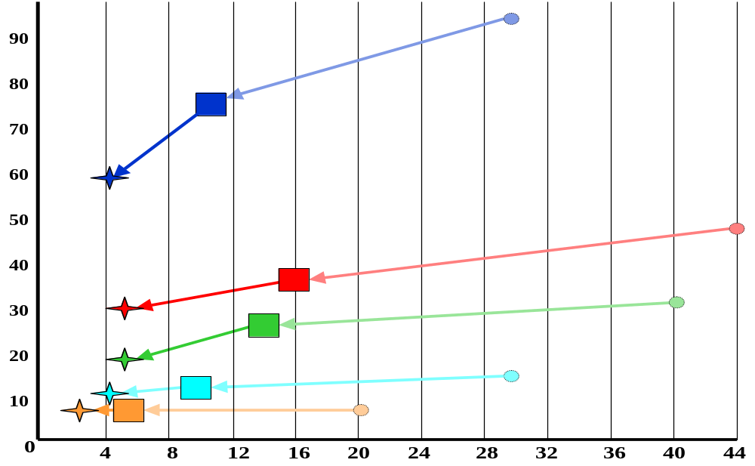
SnapTrack Technology
Evolution Curve
Urban Canyon
1998
TODAY
2000
Inside Shopping Mall
67% CEP Accuracy (meters)
Inside Residence
Inside Vehicle
Suburban Sidewalk
Time to Cold Start, Non-Tracking First Fix (seconds)
Note: 2000 performance comes from faster DSP and further GPS algorithm improvements

Slide 11
Impact on Handset Cost
SnapTrack’s software based handset solution minimizes incremental manufacturing cost
  Uses existing, standard processors already in handset
  Many opportunities for sharing the few RF hardware components required
Current estimates from semiconductor and handset manufactures are $7 - 10 incremental cost, including licensing fees, for first generation integrated implementations
  Costs will drop sharply as semiconductor densities and levels of integration increase
Use of standard processing elements will continually drive down cost, size and power consumption
  Moore’s law on transistor density (same cost and processing power trend seen in PCs)

Slide 12
Commercial Agreements
Motorola
  equity investment and commercial license agreement
Texas Instruments
  equity investment and commercial license agreement
NTT DoCoMo (Japan’s largest wireless carrier)
  commercial license agreement
Denso (SnapTrack-enabled PDA)
  commercial license agreement
NEC (Japan server distribution)
  commercial license agreement

