Slide 1
Update of RF Radiation Protection Standards
Bob Curtis
OSHA
Directorate of Technical Support

Slide 2
RF Standard Development
ANSI C95.1-1966 (OSHA Adopted)
ANSI 1982 (Frequency dependent)
ANSI/IEEE 1992 (Two-Tiered)
IEEE SCC-28 in process.

Slide 3
IEEE “Culture”
Engineers/Biologists - few IH’s
Dominated by Industry and DoD
Few Public Safety Regulators
Standards Based on Known Adverse Health Effects

Slide 4
Process for Standard Development
Literature Review
  Engineering
  Animal and Cellular (In Vitro, In Vivo)
  Epidemiology
  Mechanisms
Risk Assessment
Consensus

Slide 5
Problems
Review process going slow.
Risk Assessment proceeding.
Difficulty in getting consensus on basic concepts for a new standard.

Slide 6
Major Issues to Resolve
Selection of adverse effect level.
Basis for local SAR limit.
Acute vs Chronic exposures.
Time Averaging
Uncertainty Factor
One limit vs Public & Worker limits
Action Limit and RF Program
Notes:
Other issues:
Medical surveillance and emergency response.

Slide 7
Basis of Current RF Standards
Behavioral disruption threshold
Limit temperature increase to 1 degrees C
1-4 W/kg SAR
10-fold safety factor
Notes:
4 W/kg based on animal behavioral effects is the basis
Factor of 10 safety factor for whole body in humans (4/10 = .4 W/kg)
Localized maximums of 20 times the whole body average (.4 x 20 = 8 W/kg).
Uncontrolled environments limited to 20% of controlled (8 x .2 = 1.6 W/kg).

Slide 8
Proposed Thresholds
A - Adverse Effect
B - Effect Preliminary to a Known Adverse Effect
C - Effect, but Unknown Human Health Consequence
X - Known Non-Adverse Effect
Notes:
Per NIEHS (1999), “ELF-EMF exposure cannot be recognized as entirely safe because of weak scientific evidence that exposure may pose a leukemia hazard; the associations reported for childhood leukemia and adult chronic lymphocytic leukemia cannot be dismissed easily as random or negative findings.”

Slide 9
Exposures between B and C occur within known gaps in research, so “Precautionary Principle” or ALARA may be appropriate.
Precautionary Principle not justified below C level where most exposures occur.
Notes:
Concern for low-level exposures causing DNA changes.
Current standard based on heating causing behavior changes (animals reduced their activities and/or avoided the exposure areas.

Slide 10
Major Issues to Resolve
Selection of adverse effect level.
Basis for local SAR limit.
Acute vs Chronic exposures.
Time Averaging
Uncertainty Factor
One limit vs Public & Worker limits
Action Limit and RF Program
Notes:
Other issues:
Medical surveillance and emergency response.

Slide 11
UK Stewart Commission
Preliminary evidence that (phones) may cause, in some cases, subtle biological effects… (This) does not necessarily mean that health is affected.
Advocates the “Precautionary” approach until more information.
Specifically: Labeling of phones; Reduce children use.
Most points accepted by UK gov’t.

Slide 12
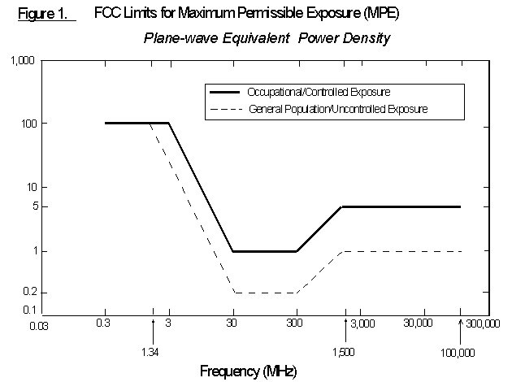

Slide 13
Comprehensive Standard vs. Exposure Limit
Combination of practices and exposure limits gives more guidance (e.g. ANSI Laser Stds.)
Exposure limit can be less restrictive.
E.g. Protection for all persons vs. exclusions for target populations.
For each exclusion, you need a program that checks the criteria.

Slide 14
Major Issues to Resolve
Selection of adverse effect level.
Basis for local SAR limit.
Acute vs Chronic exposures.
Time Averaging
Uncertainty Factor
One limit vs Public & Worker limits
Action Limit and RF Program
Notes:
Other issues:
Medical surveillance and emergency response.

Slide 15
Safety and Health Program
Core Elements
Management leadership and employee participation
Hazard identification and assessment
Hazard prevention and control
Information and training
Evaluation of program effectiveness

Slide 16
Right to Know
More lenient on threshold if people given choices.

Slide 17
Major Issues to Resolve
Selection of adverse effect level.
Basis for local SAR limit.
Acute vs Chronic exposures.
Time Averaging
Uncertainty Factor
One limit vs Public & Worker limits
Action Limit and RF Program
Notes:
Other issues:
Medical surveillance and emergency response.

Slide 18
Slow Progress on Needed Standards
RF Safety Program
RF Awareness (Signs)
Medical Surveillance and Response
Measurement Procedures for induced currents
Criteria for RF Protective Clothing
Spark Discharge
Cellular Phones

Slide 19
New Developments Confound Consensus Building
ICNIRP Standard being adopted more
Precautionary Principle being adopted by some countries and local governments.
Regulations regarding Mobile phones & Cellular Tower Sites

Slide 20
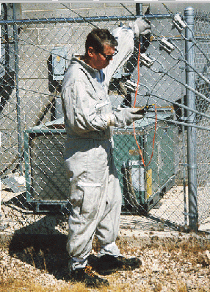

Slide 21
Predictions
Balloting next year on new limit.
Consensus will drive the standard to be similar to existing version.
US will continue to drift apart from other countries which will adopt precautionary principle.
The use of cell phones will continue to rise dramatically.
Other needed RF standards will proceed, but slow in development.

Slide 22
Proposal for ANSI
RF Program Standard
Class I areas: No signs needed.
Class II areas: Notice Signs are suggested
Class III areas: Caution Signs are required
Class IV areas: Warning Signs are required
Class V areas: Danger Signs are required

Slide 23
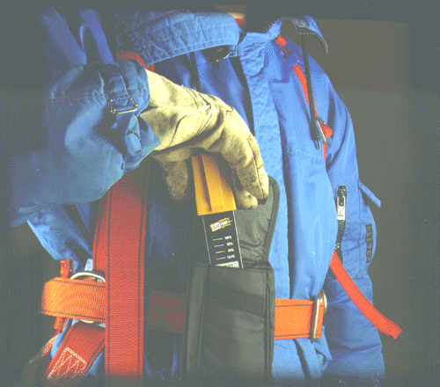

Slide 24
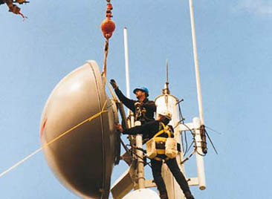
Exposure While Installing New Antenna

Slide 25
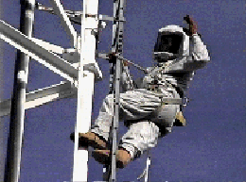

Slide 26
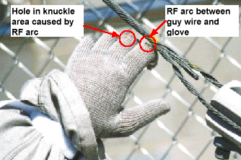

Slide 27
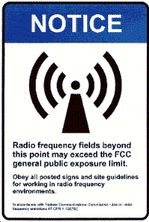
Perimeter
of FCC Uncontrolled Limits

Slide 28
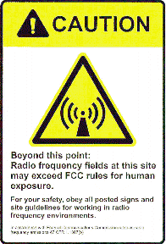
Perimeter of Controlled Limits indicating need for protective measures (e.g., time averaging)

Slide 29
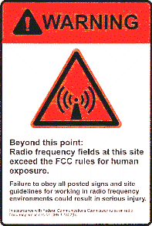
Time averaging is not feasible to prevent exposures > MPE’s

